Slide 1



Lesson 2 Plan
Remember!
You can travel through all the sections (enter or mouse click) or choose your section by clicking over it.
You should only “Try it” after exploring all lesson contents!
1. Rectangular Matrices
2. Square Matrices
3. Vector Matrices
Try it!
By EngiMath TEAM

Slide 2
Lesson 2
A Matrix is said to be RECTANGULAR if the number of rows is different from the number of columns.
1. Rectangular Matrices
2. Square Matrices
3. Vector Matrices
Try it!

Slide 3

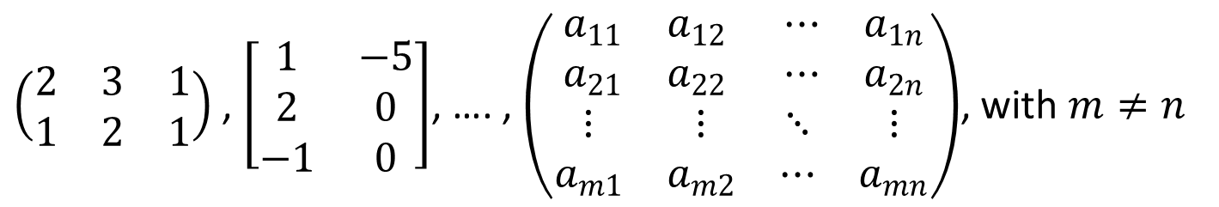
Lesson 2
A Matrix is said to be RECTANGULAR if the number of rows is different from the number of columns.
1. Rectangular Matrices
Generally, a matrix $A={\left[a_{ij}\right]}_{\begin{aligned}i=1,2,..,m \\ j=1,2,…,n\end{aligned}}$ is rectangular if $m≠n$.
2. Square Matrices
Examples…
3. Vector Matrices
$\left(\left.\begin{matrix}2 & 3 & 1 \\ 1 & 2 & 1\end{matrix}\right.\right)$ , $\left[\left.\begin{matrix}1 & −5 \\ 2 & 0 \\ −1 & 0\end{matrix}\right.\right]$, …. , $\left(\left.\begin{matrix}\left.\begin{matrix}a_{11} & a_{12} \\ a_{21} & a_{22}\end{matrix}\right. & \left.\begin{matrix}⋯ & a_{1n} \\ ⋯ & a_{2n}\end{matrix}\right. \\ \left.\begin{matrix}⋮ & ⋮ \\ a_{m1} & a_{m2}\end{matrix}\right. & \left.\begin{matrix}⋱ & ⋮ \\ ⋯ & a_{mn}\end{matrix}\right.\end{matrix}\right.\right)$, with $m≠n$
Try it!
2 x 3
3 x 2
$$m×n$$

Slide 4
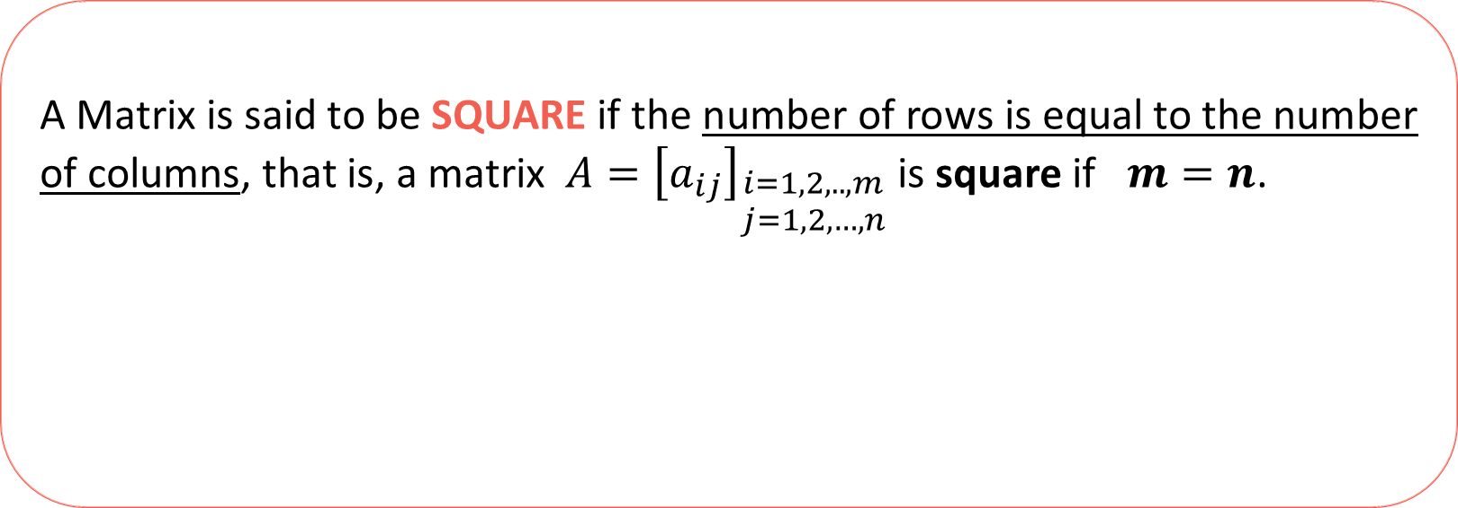
Lesson 2
A Matrix is said to be SQUARE if the number of rows is equal to the number of columns, that is, a matrix $A={\left[a_{ij}\right]}_{\begin{aligned}i=1,2,..,m \\ j=1,2,…,n\end{aligned}}$ is square if $m=n$.
1. Rectangular Matrices
2. Square Matrices
3. Vector Matrices
Try it!

Slide 5

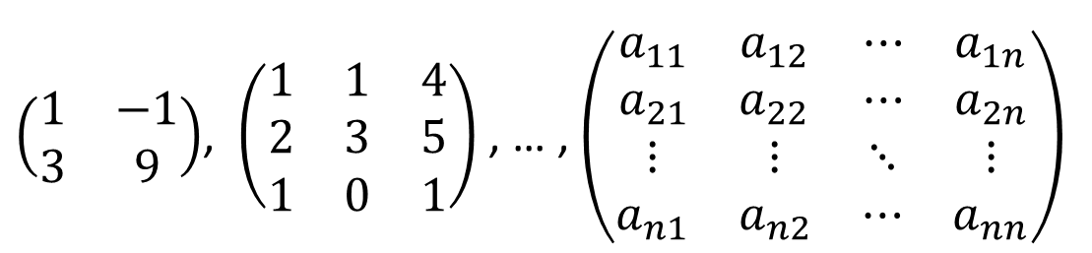
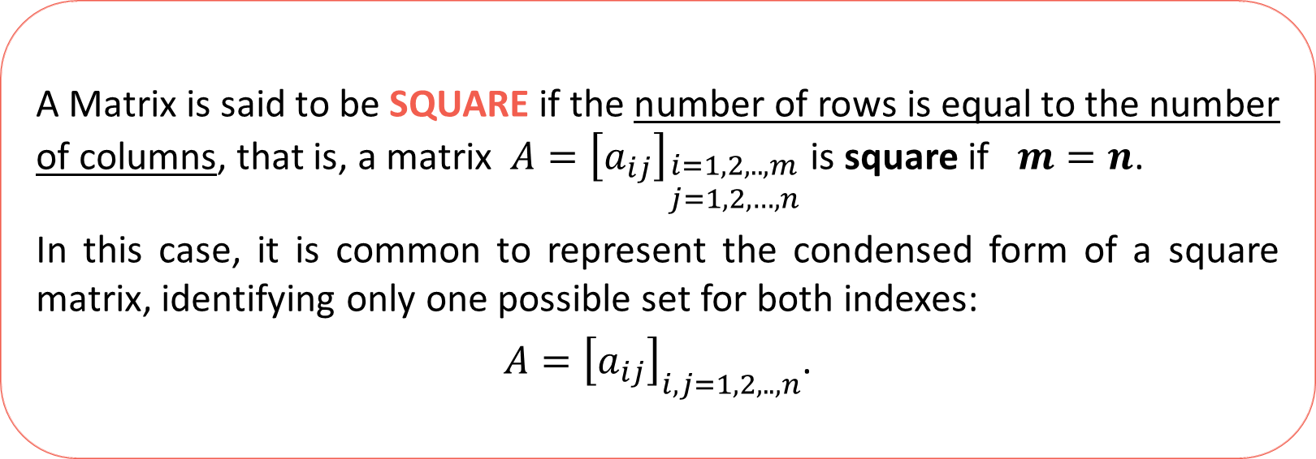
Lesson 2
A Matrix is said to be SQUARE if the number of rows is equal to the number of columns, that is, a matrix $A={\left[a_{ij}\right]}_{\begin{aligned}i=1,2,..,m \\ j=1,2,…,n\end{aligned}}$ is square if $m=n$.
In this case, it is common to represent the condensed form of a square matrix, identifying only one possible set for both indexes:
$A={\left[a_{ij}\right]}_{i,j=1,2,..,n}$.
1. Rectangular Matrices
2. Square Matrices
3. Vector Matrices
Examples…
$\left(\begin{matrix}1 & −1 \\ 3 & 9\end{matrix}\right)$, $\left(\left.\left.\begin{matrix}1 & 1 & 4 \\ 2 & 3 & 5 \\ 1 & 0 & 1\end{matrix}\right.\right.\right)$ , … , $\left(\left.\begin{matrix}\left.\begin{matrix}a_{11} & a_{12} \\ a_{21} & a_{22}\end{matrix}\right. & \left.\begin{matrix}⋯ & a_{1n} \\ ⋯ & a_{2n}\end{matrix}\right. \\ \left.\begin{matrix}⋮ & ⋮ \\ a_{n1} & a_{n2}\end{matrix}\right. & \left.\begin{matrix}⋱ & ⋮ \\ ⋯ & a_{nn}\end{matrix}\right.\end{matrix}\right.\right)$
Try it!
2 x 2
3 x 3
$$n×n$$

Slide 6
Lesson 2
A VECTOR Matrix has only one “line”.
1. Rectangular Matrices
2. Square Matrices
3. Vector Matrices
Try it!

Slide 7







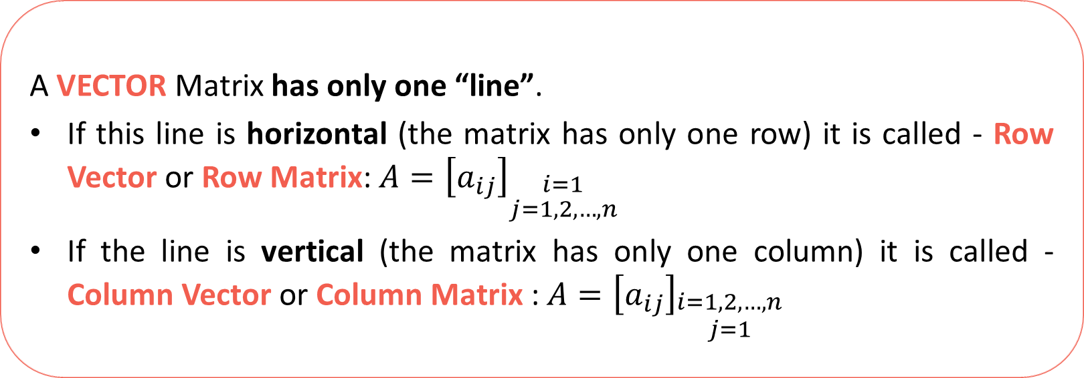

Lesson 2
A VECTOR Matrix has only one “line”.
If this line is horizontal (the matrix has only one row) it is called - Row Vector or Row Matrix: $A={\left[a_{ij}\right]}_{\begin{aligned}i=1 \\ j=1,2,…,n\end{aligned}}$
If the line is vertical (the matrix has only one column) it is called - Column Vector or Column Matrix : $A={\left[a_{ij}\right]}_{\begin{aligned}i=1,2,…,n \\ j=1\end{aligned}}$
1. Rectangular Matrices
2. Square Matrices
3. Vector Matrices
Examples…
Row Matrices
Column Matrices
$$\left(\begin{matrix}1 & −1 & 0\end{matrix}\right)$$
$$\left(\begin{matrix}6 & 1 & 3\end{matrix} \begin{matrix}−1 & 4 & 0\end{matrix}\right)$$
$$\left(\begin{matrix}x_{1} & x_{2} & x_{3}\end{matrix} \begin{matrix}⋯ & x_{n}\end{matrix}\right)$$
$\left(\left.\begin{aligned}1 \\ −1\end{aligned}\right.\right)$ $\left(\left.\begin{aligned}2 \\ \sqrt{3} \\ 7\end{aligned}\right.\right)$ $\left(\left.\begin{aligned}\left.\begin{aligned}x_{1} \\ x_{2}\end{aligned}\right. \\ \left.\begin{aligned}⋮ \\ x_{n}\end{aligned}\right.\end{aligned}\right.\right)$
$$1×3$$
Try it!
$$2×1$$
$$n×1$$
$$1×6$$
$$1×n$$
$$3×1$$

Slide 8

Lesson 2
1. Rectangular Matrices
Notice
A Vector Matrix (with more than one element)
is always a Rectangular Matrix
since the number of rows and columns are distinct.
2. Square Matrices
3. Vector Matrices
Examples…
Row Matrices
Column Matrices
$$\left(\begin{matrix}1 & −1 & 0\end{matrix}\right)$$
$$\left(\begin{matrix}6 & 1 & 3\end{matrix} \begin{matrix}−1 & 4 & 0\end{matrix}\right)$$
$$\left(\begin{matrix}x_{1} & x_{2} & x_{3}\end{matrix} \begin{matrix}⋯ & x_{n}\end{matrix}\right)$$
$\left(\left.\begin{aligned}1 \\ −1\end{aligned}\right.\right)$ $\left(\left.\begin{aligned}2 \\ \sqrt{3} \\ 7\end{aligned}\right.\right)$ $\left(\left.\begin{aligned}\left.\begin{aligned}x_{1} \\ x_{2}\end{aligned}\right. \\ \left.\begin{aligned}⋮ \\ x_{n}\end{aligned}\right.\end{aligned}\right.\right)$
$$1×3$$
Try it!
$$2×1$$
$$n×1$$
$$1×6$$
$$1×n$$
$$3×1$$

Slide 9

Lesson 2
1. Rectangular Matrices
2. Square Matrices
3. Vector Matrices
Try it!

Slide 10


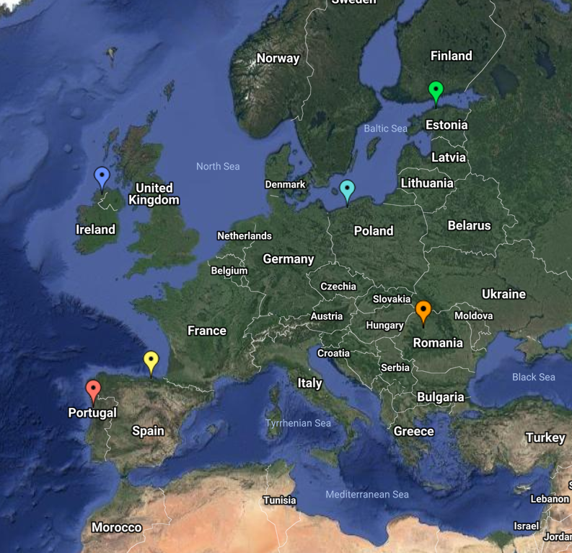
End of Lesson 2
Hope you enjoyed it!
1. Rectangular Matrices
2. Square Matrices
3. Vector Matrices
Try it!
By EngiMath TEAM

