Slide 1



Lesson 3 Plan
Remember!
You can travel through all the sections (enter or mouse click) or choose your section by clicking over it.
You should only “Try it” after exploring all lesson contents!
1. Square Matrices: …
2. Triangular Matrices
3. Diagonal Matrices
4. Identity Matrices
5. Scalar Matrices
6. Null Matrices
Try it!
By EngiMath TEAM

Slide 2


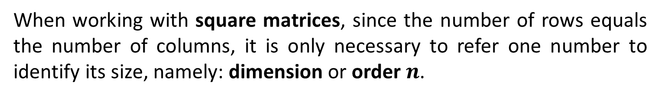
Lesson 3
SQUARE MATRICES – Some Special Elements
1. Square Matrices: …
When working with square matrices, since the number of rows equals the number of columns, it is only necessary to refer one number to identify its size, namely: dimension or order $n$.
2. Triangular Matrices
3. Diagonal Matrices
$$\left(\begin{matrix}a_{11} & a_{12} & … & a_{1n} \\ a_{21} & a_{22} & … & a_{2n} \\ ⋮ & ⋮ & ⋱ & ⋮ \\ a_{n1} & a_{n2} & … & a_{nn}\end{matrix}\right)$$
4. Identity Matrices
5. Scalar Matrices
6. Null Matrices
Try it!

Slide 3
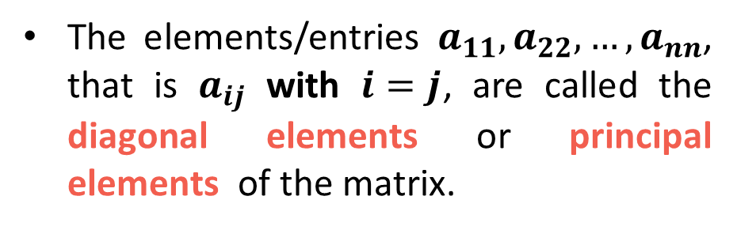
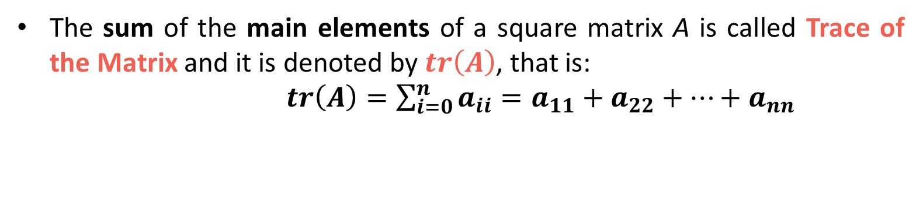
Lesson 3
SQUARE MATRICES – Some Special Elements
1. Square Matrices: …
When working with square matrices, since the number of rows equals the number of columns, it is only necessary to refer one number to identify its size, namely: dimension or order $n$.
2. Triangular Matrices
3. Diagonal Matrices
The elements/entries $a_{11},a_{22},…,a_{nn}$, that is $a_{ij}$ with $i=j$, are called the diagonal elements or principal elements of the matrix.
$$\left(\begin{matrix}a_{11} & a_{12} & … & a_{1n} \\ a_{21} & a_{22} & … & a_{2n} \\ ⋮ & ⋮ & ⋱ & ⋮ \\ a_{n1} & a_{n2} & … & a_{nn}\end{matrix}\right)$$
4. Identity Matrices
5. Scalar Matrices
This matrix diagonal is also called the principal or main of the matrix.
6. Null Matrices
The sum of the main elements of a square matrix A is called Trace of the Matrix and it is denoted by $tr\left(A\right)$, that is:
$tr\left(A\right)=\sum_{i=0}^{n}{a_{ii}}=a_{11}+a_{22}+⋯+a_{nn}$
Try it!

Slide 4
Lesson 3
SQUARE MATRICES – Some Special Elements
1. Square Matrices: …
When working with square matrices, since the number of rows equals the number of columns, it is only necessary to refer one number to identify its size, namely: dimension or order $n$.
2. Triangular Matrices
3. Diagonal Matrices
The elements/entries $a_{11},a_{22},…,a_{nn}$, that is $a_{ij}$ with $i=j$, are called the diagonal elements or principal elements of the matrix.
$$\left(\begin{matrix}a_{11} & a_{12} & … & a_{1n} \\ a_{21} & a_{22} & … & a_{2n} \\ ⋮ & ⋮ & ⋱ & ⋮ \\ a_{n1} & a_{n2} & … & a_{nn}\end{matrix}\right)$$
4. Identity Matrices
5. Scalar Matrices
This matrix diagonal is also called the principal or main of the matrix.
6. Null Matrices
The other diagonal – skew or secondary diagonal – is not frequently used or mentioned.
Its elements ($a_{ij})$ indexes verify the relation: $i+j=n+1$.
Try it!

Slide 5

Lesson 3
TRIANGULAR MATRICES
1. Square Matrices: …
Upper Triangular matrix is a square matrix where all the elements below the diagonal entries are zero.
2. Triangular Matrices
$$\left(\begin{matrix}a_{11} & a_{12} & … & a_{1n} \\ a_{21} & a_{22} & … & a_{2n} \\ ⋮ & ⋮ & ⋱ & ⋮ \\ a_{n1} & a_{n2} & … & a_{nn}\end{matrix}\right)$$
0
3. Diagonal Matrices
4. Identity Matrices
5. Scalar Matrices
6. Null Matrices
Try it!

Slide 6
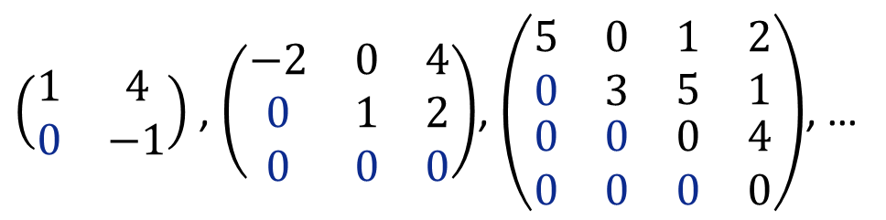
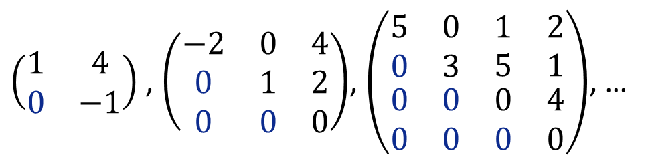
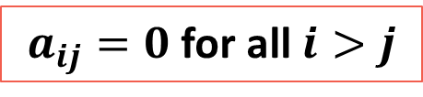
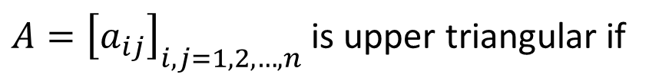
Lesson 3
TRIANGULAR MATRICES
1. Square Matrices: …
Upper Triangular matrix is a square matrix where all the elements below the diagonal entries are zero.
In this sense:
2. Triangular Matrices
$$\left(\begin{matrix}a_{11} & a_{12} & … & a_{1n} \\ a_{21} & a_{22} & … & a_{2n} \\ ⋮ & ⋮ & ⋱ & ⋮ \\ a_{n1} & a_{n2} & … & a_{nn}\end{matrix}\right)$$
$A={\left[a_{ij}\right]}_{i,j=1,2,…,n}$is upper triangular if
0
3. Diagonal Matrices
$a_{ij}=0$ for all $i>j$
4. Identity Matrices
5. Scalar Matrices
Examples
$\left(\begin{matrix}1 & 4 \\ 0 & −1\end{matrix}\right)$ , $\left(\left.\begin{matrix}−2 & 0 & 4 \\ 0 & 1 & 2 \\ 0 & 0 & 0\end{matrix}\right.\right)$, $\left(\left.\begin{matrix}\left.\begin{matrix}5 & 0 \\ 0 & 3\end{matrix}\right. & \left.\begin{matrix}1 & 2 \\ 5 & 1\end{matrix}\right. \\ \left.\begin{matrix}0 & 0 \\ 0 & 0\end{matrix}\right. & \left.\begin{matrix}0 & 4 \\ 0 & 0\end{matrix}\right.\end{matrix}\right.\right)$, …
6. Null Matrices
Try it!
Notice that there is no reference to the main or other entrances that may, also, be null (or not)!

Slide 7

Lesson 3
TRIANGULAR MATRICES
1. Square Matrices: …
Lower Triangular matrix is a square matrix where all the elements above the diagonal entries are zero.
2. Triangular Matrices
$$\left(\begin{matrix}a_{11} & a_{12} & … & a_{1n} \\ a_{21} & a_{22} & … & a_{2n} \\ ⋮ & ⋮ & ⋱ & ⋮ \\ a_{n1} & a_{n2} & … & a_{nn}\end{matrix}\right)$$
0
3. Diagonal Matrices
4. Identity Matrices
5. Scalar Matrices
6. Null Matrices
Try it!

Slide 8
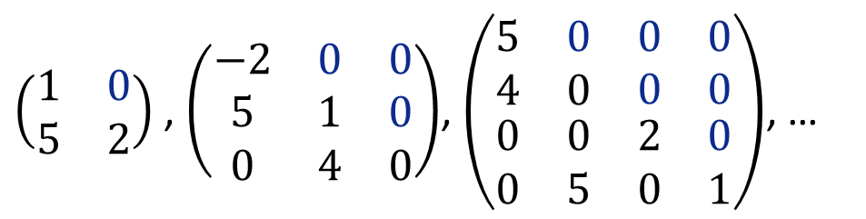

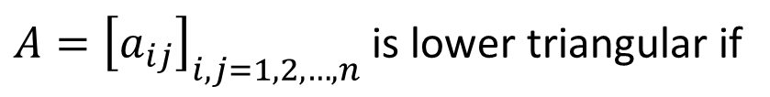
Lesson 3
TRIANGULAR MATRICES
1. Square Matrices: …
Lower Triangular matrix is a square matrix where all the elements above the diagonal entries are zero.
In this sense:
2. Triangular Matrices
$$\left(\begin{matrix}a_{11} & a_{12} & … & a_{1n} \\ a_{21} & a_{22} & … & a_{2n} \\ ⋮ & ⋮ & ⋱ & ⋮ \\ a_{n1} & a_{n2} & … & a_{nn}\end{matrix}\right)$$
0
$A={\left[a_{ij}\right]}_{i,j=1,2,…,n}$is lower triangular if
3. Diagonal Matrices
$a_{ij}=0$ for all $i<j$
4. Identity Matrices
5. Scalar Matrices
Examples
$\left(\begin{matrix}1 & 0 \\ 5 & 2\end{matrix}\right)$ , $\left(\left.\begin{matrix}−2 & 0 & 0 \\ 5 & 1 & 0 \\ 0 & 4 & 0\end{matrix}\right.\right)$, $\left(\left.\begin{matrix}\left.\begin{matrix}5 & 0 \\ 4 & 0\end{matrix}\right. & \left.\begin{matrix}0 & 0 \\ 0 & 0\end{matrix}\right. \\ \left.\begin{matrix}0 & 0 \\ 0 & 5\end{matrix}\right. & \left.\begin{matrix}2 & 0 \\ 0 & 1\end{matrix}\right.\end{matrix}\right.\right)$, …
6. Null Matrices
Try it!
Notice, once again, that there is no reference to the main or other entrances that may, also, be null (or not)!

Slide 9
Lesson 3
DIAGONAL MATRICES
1. Square Matrices: …
Diagonal matrix is a square matrix where all the non diagonal elements are zero.
2. Triangular Matrices
$$\left(\begin{matrix}a_{11} & a_{12} & … & a_{1n} \\ a_{21} & a_{22} & … & a_{2n} \\ ⋮ & ⋮ & ⋱ & ⋮ \\ a_{n1} & a_{n2} & … & a_{nn}\end{matrix}\right)$$
0
0
3. Diagonal Matrices
4. Identity Matrices
5. Scalar Matrices
6. Null Matrices
Try it!

Slide 10

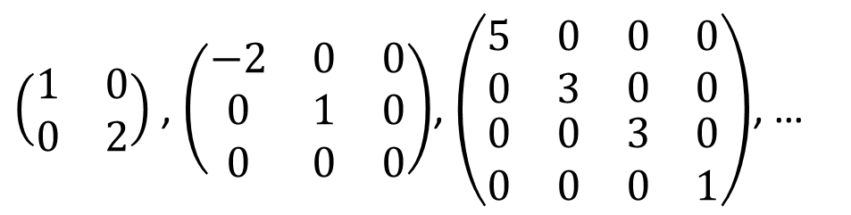
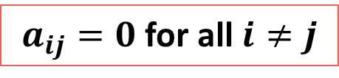
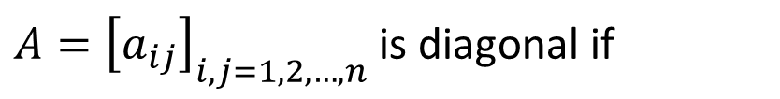
Lesson 3
DIAGONAL MATRICES
1. Square Matrices: …
Diagonal matrix is a square matrix where all the non diagonal elements are zero.
In this sense:
2. Triangular Matrices
$$\left(\begin{matrix}a_{11} & a_{12} & … & a_{1n} \\ a_{21} & a_{22} & … & a_{2n} \\ ⋮ & ⋮ & ⋱ & ⋮ \\ a_{n1} & a_{n2} & … & a_{nn}\end{matrix}\right)$$
0
$A={\left[a_{ij}\right]}_{i,j=1,2,…,n}$is diagonal if
0
3. Diagonal Matrices
$a_{ij}=0$ for all $i≠j$
4. Identity Matrices
5. Scalar Matrices
Examples
$\left(\begin{matrix}1 & 0 \\ 0 & 2\end{matrix}\right)$ , $\left(\left.\begin{matrix}−2 & 0 & 0 \\ 0 & 1 & 0 \\ 0 & 0 & 0\end{matrix}\right.\right)$, $\left(\left.\begin{matrix}\left.\begin{matrix}5 & 0 \\ 0 & 3\end{matrix}\right. & \left.\begin{matrix}0 & 0 \\ 0 & 0\end{matrix}\right. \\ \left.\begin{matrix}0 & 0 \\ 0 & 0\end{matrix}\right. & \left.\begin{matrix}3 & 0 \\ 0 & 1\end{matrix}\right.\end{matrix}\right.\right)$, …
6. Null Matrices
Try it!
Notice, once again, that there is no reference to the main entrances that may, also, be null (or not)!

Slide 11
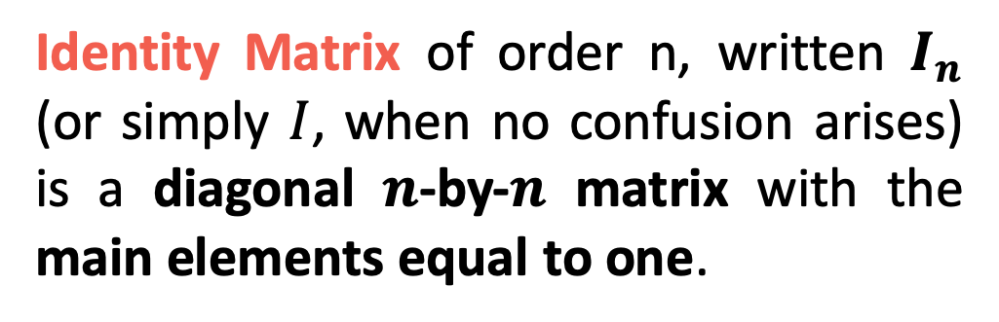
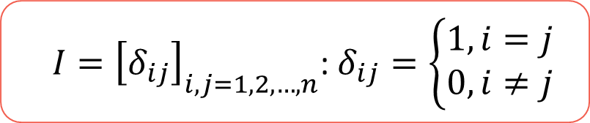
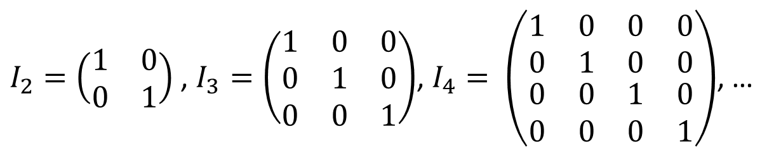
Lesson 3
Identity Matrix of order n, written $I_{n}$ (or simply $I$, when no confusion arises) is a diagonal $n$-by-$n$ matrix with the main elements equal to one.
1. Square Matrices: …
2. Triangular Matrices
3. Diagonal Matrices
4. Identity Matrices
Examples
$I_{2}=\left(\begin{matrix}1 & 0 \\ 0 & 1\end{matrix}\right)$ , $I_{3}=\left(\left.\begin{matrix}1 & 0 & 0 \\ 0 & 1 & 0 \\ 0 & 0 & 1\end{matrix}\right.\right)$, $I_{4}= \left(\left.\begin{matrix}\left.\begin{matrix}1 & 0 \\ 0 & 1\end{matrix}\right. & \left.\begin{matrix}0 & 0 \\ 0 & 0\end{matrix}\right. \\ \left.\begin{matrix}0 & 0 \\ 0 & 0\end{matrix}\right. & \left.\begin{matrix}1 & 0 \\ 0 & 1\end{matrix}\right.\end{matrix}\right.\right)$, …
5. Scalar Matrices
6. Null Matrices
Identity Matrix representation
$I={\left[δ_{ij}\right]}_{i,j=1,2,…,n}$: $δ_{ij}=\left\{\begin{matrix}1,i=j \\ 0,i≠j\end{matrix}\right.$
Try it!
The identity elements are represented by $δ_{ij}$ and these are usually recognized as Kronecker Symbols

Slide 12
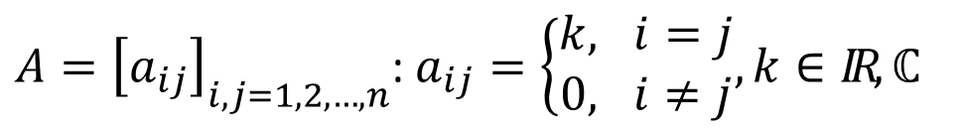

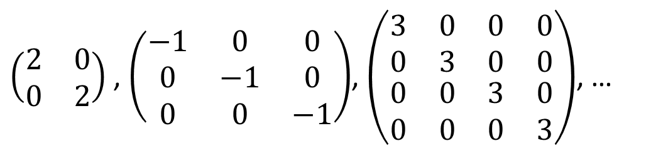
Lesson 3
1. Square Matrices: …
Scalar Matrix is a diagonal matrix where all the main elements are equal (real or complex constant).
$$\left(\left.\begin{matrix}\left.\begin{matrix}k & 0 \\ 0 & k\end{matrix}\right. & \left.\begin{matrix}⋯ & 0 \\ ⋯ & 0\end{matrix}\right. \\ \left.\begin{matrix}⋮ & ⋮ \\ 0 & 0\end{matrix}\right. & \left.\begin{matrix}⋱ & ⋮ \\ ⋯ & k\end{matrix}\right.\end{matrix}\right.\right)$$
2. Triangular Matrices
$A={\left[a_{ij}\right]}_{i,j=1,2,…,n}$: $a_{ij}=\left\{\begin{matrix}k, i=j \\ 0, i≠j\end{matrix}, k∈IR,ℂ\right.$
3. Diagonal Matrices
A scalar matrix can be written as $k.I$ !
(see multiplication of a matrix by a scalar in Lesson 5)
4. Identity Matrices
5. Scalar Matrices
6. Null Matrices
Examples
$\left(\begin{matrix}2 & 0 \\ 0 & 2\end{matrix}\right)$ , $\left(\left.\begin{matrix}−1 & 0 & 0 \\ 0 & −1 & 0 \\ 0 & 0 & −1\end{matrix}\right.\right)$, $\left(\left.\begin{matrix}\left.\begin{matrix}3 & 0 \\ 0 & 3\end{matrix}\right. & \left.\begin{matrix}0 & 0 \\ 0 & 0\end{matrix}\right. \\ \left.\begin{matrix}0 & 0 \\ 0 & 0\end{matrix}\right. & \left.\begin{matrix}3 & 0 \\ 0 & 3\end{matrix}\right.\end{matrix}\right.\right)$, …
Try it!

Slide 13
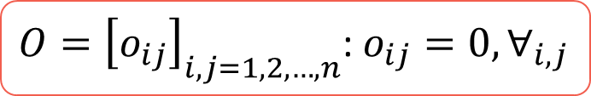
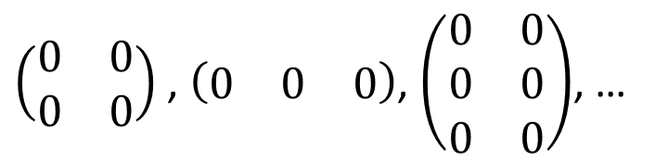

Lesson 3
1. Square Matrices: …
Zero Matrix is a matrix of any type or shape where all the entries are zero.
2. Triangular Matrices
3. Diagonal Matrices
Examples
4. Identity Matrices
$\left(\begin{matrix}0 & 0 \\ 0 & 0\end{matrix}\right)$ , $\left(\left.\begin{matrix}0 & 0 & 0\end{matrix}\right.\right)$, $\left(\begin{matrix}0 & 0 \\ 0 & 0 \\ 0 & 0\end{matrix}\right)$, …
5. Scalar Matrices
6. Zero Matrices
These matrices are commonly represented by a capital $O$, representing the matrices “zero”:
Try it!
$O={\left[o_{ij}\right]}_{i,j=1,2,…,n}$: $o_{ij}=0,∀_{i,j}$

Slide 14

Lesson 3
1. Square Matrices: …
IMPORTANT – before you Try it!
All presented definitions/designations are “not exclusive” in the sense that a single matrix may be “classified” in several ways!
2. Triangular Matrices
3. Diagonal Matrices
Example
All the elements below diagonal entries are zero
All the elements above diagonal entries are zero
4. Identity Matrices
Consider a zero square matrix of order 3:
All non diagonal elements are zero
This matrix is:
Diagonal matrix with equal main elements (k=0)
5. Scalar Matrices
Upper Triangular
$\left(\begin{matrix}0 & 0 & 0 \\ 0 & 0 & 0 \\ 0 & 0 & 0\end{matrix}\right)$
Lower Triangular
However, none of these four options is not enough to define it properly as “zero matrix” does!!
6. Null Matrices
Diagonal
Scalar
Try it!
(CLICK over each name to see why!)

Slide 15



Lesson 3
Pick up a peace of
paper and a pencil
before you start!
1. Square Matrices: …
2. Triangular Matrices
3. Diagonal Matrices
4. Identity Matrices
5. Scalar Matrices
6. Null Matrices
Try it!

Slide 16

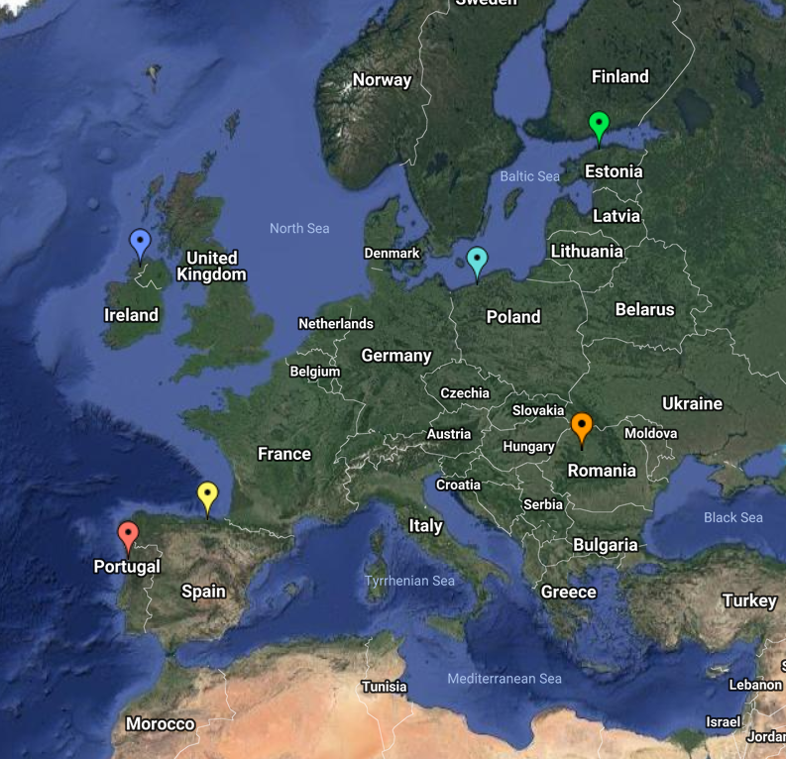

End of Lesson 3
Hope you enjoyed it!
1. Square Matrices: …
2. Triangular Matrices
3. Diagonal Matrices
4. Identity Matrices
5. Scalar Matrices
6. Null Matrices
By EngiMath TEAM
Try it!

