Slide 1



Lesson 4 Plan
Remember!
You can travel through all the sections (enter or mouse click) or choose your section by clicking over it.
You should only “Try it” after exploring all lesson contents!
1. Equal Matrices
2. Matrix Addiction and Subtraction
3. Properties of Matrix Addiction
Try it!
By EngiMath TEAM

Slide 2
Lesson 4
Two matrices are equal if and only if:
They both have exactly the same size – same number of rows and the same number of columns;
1. Equal Matrices
2. Matrix Addiction and Subtraction
3. Properties of Matrix Addiction
Try it!

Slide 3





Lesson 4
Two matrices are equal if and only if:
They both have exactly the same size – same number of rows and the same number of columns;
All their corresponding elements are equal - they have the same numbers (or expressions) in the same positions.
1. Equal Matrices
2. Matrix Addiction and Subtraction
Example
Given the following matrices $A$ and $B$ , is it possible that $A=B$ ?
(1) $A=\left(\begin{matrix}2 & −1 & 0 \\ 1 & 4 & 2\end{matrix}\right)$ and $B=$ $\left(\begin{matrix}2 & −1 \\ 1 & 4\end{matrix}\right)$
No! These matrices do not have the same size!
3. Properties of Matrix Addiction
(2) $A=\left(\begin{matrix}2 & −1 & 0 \\ 1 & 4 & 2\end{matrix}\right)$ and $B=$ $\left(\begin{matrix}2 & −1 & 0 \\ 1 & 3 & 2\end{matrix}\right)$
No! Not all elements are equal: $a_{22}≠b_{22}$
(3) $A=\left(\begin{matrix}2 & −1 & 0 \\ 1 & 4 & 2\end{matrix}\right)$ and $B=$ $\left(\begin{matrix}2 & −1 & x−1 \\ 1 & y+x & 2\end{matrix}\right)$
1 3
Yes! But only if: $x=$…… and $y=$……
Try it!
Mathematical Notation
$A={\left[a_{ij}\right]}_{\begin{aligned}i=1,2,..,m \\ j=1,2,…,n\end{aligned}}$ and $B={\left[b_{ij}\right]}_{\begin{aligned}i=1,2,..,m \\ j=1,2,…,n\end{aligned}}$ then $A=B⇔a_{ij}$= $b_{ij}$, $∀_{i,j}$

Slide 4
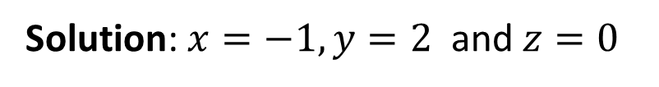

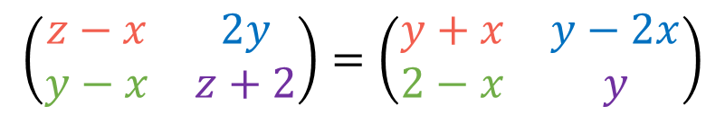

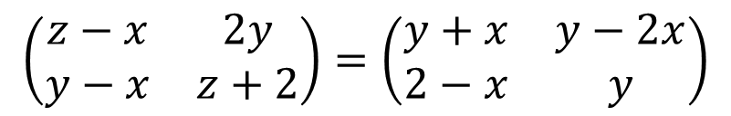
Lesson 4
Two matrices are equal if and only if:
They both have exactly the same size – same number of rows and the same number of columns;
All their corresponding elements are equal - they have the same numbers (or expressions) in the same positions.
1. Equal Matrices
2. Matrix Addiction and Subtraction
One more example
Find the values of 𝑥, 𝑦, 𝑧 which satisfy the matrix equality:
3. Properties of Matrix Addiction
$$⇔\left\{\begin{matrix}\begin{matrix}z−x=y+x \\ 2y=y−2x\end{matrix} \\ \begin{matrix}y−x=2−x \\ z+2=y\end{matrix}\end{matrix}\right.$$
$$⇔\left\{\begin{matrix}\begin{matrix}1=1 \\ x=−1\end{matrix} \\ \begin{matrix}y=2 \\ z=0\end{matrix}\end{matrix}\right.$$
$$\left(\begin{matrix}z−x & 2y \\ y−x & z+2\end{matrix}\right)=\left(\begin{matrix}y+x & y−2x \\ 2−x & y\end{matrix}\right)$$
$$\left(\begin{matrix}z−x & 2y \\ y−x & z+2\end{matrix}\right)=\left(\begin{matrix}y+x & y−2x \\ 2−x & y\end{matrix}\right)$$
Try it!
Solution: $x=−1, y=2$ and $z=0$
(Click over it to see proposed resolution)
Mathematical Notation
$A={\left[a_{ij}\right]}_{\begin{aligned}i=1,2,..,m \\ j=1,2,…,n\end{aligned}}$ and $B={\left[b_{ij}\right]}_{\begin{aligned}i=1,2,..,m \\ j=1,2,…,n\end{aligned}}$ then $A=B⇔a_{ij}$= $b_{ij}$, $∀_{i,j}$

Slide 5
Lesson 4
Matrix Addiction or Subtraction
is possible when, and only when, matrices have exactly the same size – same number of rows and the same number of columns.
1. Equal Matrices
2. Matrix Addiction and Subtraction
3. Properties of Matrix Addiction
Try it!

Slide 6
Lesson 4
Matrix Addiction or Subtraction
is possible when, and only when, matrices have exactly the same size – same number of rows and the same number of columns.
is done by adding or subtracting all corresponding elements - numbers (or expressions) in the same positions.
1. Equal Matrices
2. Matrix Addiction and Subtraction
3. Properties of Matrix Addiction
Try it!

Slide 7


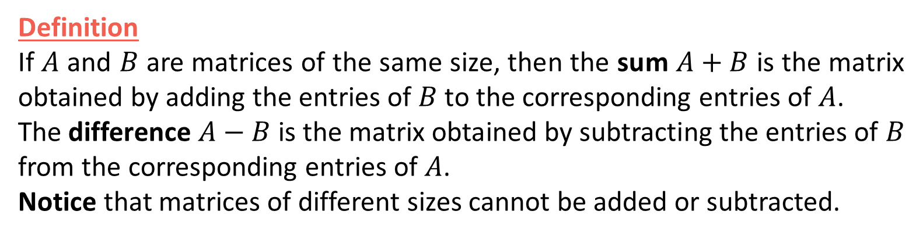

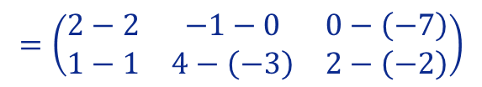



Lesson 4
Definition
If $A$ and $B$ are matrices of the same size, then the sum $A+B$ is the matrix obtained by adding the entries of $B$ to the corresponding entries of $A$.
The difference $A−B$ is the matrix obtained by subtracting the entries of $B$ from the corresponding entries of $A$.
Notice that matrices of different sizes cannot be added or subtracted.
Matrix Addiction or Subtraction
is possible when, and only when, matrices have exactly the same size – same number of rows and the same number of columns.
is done by adding or subtracting all corresponding elements - numbers (or expressions) in the same positions.
1. Equal Matrices
2. Matrix Addiction and Subtraction
Examples
(Click over it to see proposed resolution)
(1) $\left(\begin{matrix}3 & −1 \\ −2 & 4\end{matrix}\right)+\left(\begin{matrix}2 & 1 \\ −2 & 0\end{matrix}\right)$
$$=\left(\begin{matrix}5 & 0 \\ −4 & 4\end{matrix}\right)$$
$$=\left(\begin{matrix}3+2 & −1+1 \\ −2+\left(−2\right) & 4+0\end{matrix}\right)$$
3. Properties of Matrix Addiction
(2) $\left(\begin{matrix}2 & −1 & 0 \\ 1 & 4 & 2\end{matrix}\right)−\left(\begin{matrix}2 & 0 & −7 \\ 1 & −3 & −2\end{matrix}\right)$
$$=\left(\begin{matrix}0 & −1 & 7 \\ 0 & 7 & 4\end{matrix}\right)$$
$$=\left(\begin{matrix}2−2 & −1−0 & 0−\left(−7\right) \\ 1−1 & 4−\left(−3\right) & 2−\left(−2\right)\end{matrix}\right)$$
(3) $\left(\begin{matrix}2 & 0 \\ 1 & 4\end{matrix}\right)+\left(\begin{matrix}3 & −1 & 5 \\ 0 & 2 & 2\end{matrix}\right)$
Not possible/defined! Matrices do not have the same size!
Try it!
Mathematical Notation
$A={\left[a_{ij}\right]}_{\begin{aligned}i=1,2,..,m \\ j=1,2,…,n\end{aligned}}$ and $B={\left[b_{ij}\right]}_{\begin{aligned}i=1,2,..,m \\ j=1,2,…,n\end{aligned}}$ $⟹A±B=C={\left[c_{ij}\right]}_{\begin{aligned}i=1,2,..,m \\ j=1,2,…,n\end{aligned}}:c_{ij}$= ${a_{ij}±b}_{ij}$, $∀_{i,j}$

Slide 8




Lesson 4
Commutative Property
1. Equal Matrices
$$A+B=B+A$$
Associative Property
2. Matrix Addiction and Subtraction
$$A+\left(B+C\right)=\left(A+B\right)+C$$
3. Properties of Matrix Addiction
Existence of Additive Identity
$$A+O=O+A=A$$
Try it!
Existence of Additive Inverse
$$A+\left(−A\right)=\left(−A\right)+A=O$$

Slide 9

Lesson 4
Commutative Property
Example
1. Equal Matrices
$$A+B=B+A$$
$\left(\begin{matrix}3 & 2 \\ 2 & 4\end{matrix}\right)+\left(\begin{matrix}2 & 1 \\ 2 & 5\end{matrix}\right)=\left(\begin{matrix}5 & 3 \\ 4 & 9\end{matrix}\right)=$ $\left(\begin{matrix}2 & 1 \\ 2 & 5\end{matrix}\right)$ +$\left(\begin{matrix}3 & 2 \\ 2 & 4\end{matrix}\right)$
Associative Property
2. Matrix Addiction and Subtraction
$$A+\left(B+C\right)=\left(A+B\right)+C$$
3. Properties of Matrix Addiction
Existence of Additive Identity
$$A+O=O+A=A$$
Try it!
Existence of Additive Inverse
$$A+\left(−A\right)=\left(−A\right)+A=O$$

Slide 10

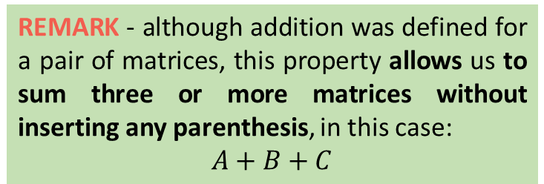






Lesson 4
Commutative Property
1. Equal Matrices
Example
$$A+B=B+A$$
$$A \left(B+C\right)$$
$\left(\begin{matrix}3 & 2 \\ 2 & 4\end{matrix}\right)+\left[\left(\begin{matrix}2 & 1 \\ 2 & 5\end{matrix}\right)+\left(\begin{matrix}0 & 4 \\ 6 & 2\end{matrix}\right)\right]=\left(\begin{matrix}3 & 2 \\ 2 & 4\end{matrix}\right)$+$\left(\begin{matrix}2 & 5 \\ 8 & 7\end{matrix}\right)$
Associative Property
$A+B+C$
$$=\left(\begin{matrix}5 & 7 \\ 10 & 11\end{matrix}\right)$$
2. Matrix Addiction and Subtraction
$$A+\left(B+C\right)=\left(A+B\right)+C$$
$\left[\left(\begin{matrix}3 & 2 \\ 2 & 4\end{matrix}\right)+\left(\begin{matrix}2 & 1 \\ 2 & 5\end{matrix}\right)\right]+\left(\begin{matrix}0 & 4 \\ 6 & 2\end{matrix}\right)=\left(\begin{matrix}5 & 3 \\ 4 & 9\end{matrix}\right)$+ $\left(\begin{matrix}0 & 4 \\ 6 & 2\end{matrix}\right)$
$$\left(A+B\right) C$$
REMARK - although addition was defined for a pair of matrices, this property allows us to sum three or more matrices without inserting any parenthesis, in this case:
$A+B+C$
3. Properties of Matrix Addiction
Existence of Additive Identity
$$A+O=O+A=A$$
Try it!
$$\left(\begin{matrix}3 & 2 \\ 2 & 4\end{matrix}\right)+\left(\begin{matrix}2 & 1 \\ 2 & 5\end{matrix}\right) +\left(\begin{matrix}0 & 4 \\ 6 & 2\end{matrix}\right)=\left(\begin{matrix}3+2+0 & 2+1+4 \\ 2+2+6 & 4+5+2\end{matrix}\right)$$
Existence of Additive Inverse
$$A+\left(−A\right)=\left(−A\right)+A=O$$

Slide 11
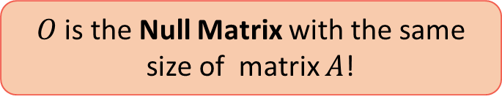
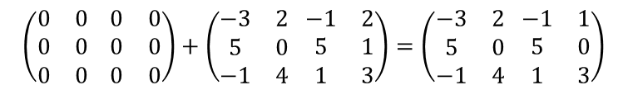


Lesson 4
Commutative Property
1. Equal Matrices
$$A+B=B+A$$
Examples
$$\left(\begin{matrix}3 & 2 \\ 2 & 4\end{matrix}\right)+\left(\begin{matrix}0 & 0 \\ 0 & 0\end{matrix}\right)=\left(\begin{matrix}3 & 2 \\ 2 & 4\end{matrix}\right)$$
Associative Property
2. Matrix Addiction and Subtraction
$$A O A$$
$$A+\left(B+C\right)=\left(A+B\right)+C$$
$$\left(\begin{matrix}0 & 0 \\ 0 & 0 \\ 0 & 0\end{matrix} \begin{matrix}0 & 0 \\ 0 & 0 \\ 0 & 0\end{matrix}\right)+\left(\begin{matrix}−3 & 2 \\ 5 & 0 \\ −1 & 4\end{matrix} \begin{matrix}−1 & 2 \\ 5 & 1 \\ 1 & 3\end{matrix}\right)=\left(\begin{matrix}−3 & 2 \\ 5 & 0 \\ −1 & 4\end{matrix} \begin{matrix}−1 & 1 \\ 5 & 0 \\ 1 & 3\end{matrix}\right)$$
$$O A A$$
3. Properties of Matrix Addiction
Existence of Additive Identity
$$A+O=O+A=A$$
$O$ is the Null Matrix with the same size of matrix $A$!
Try it!
Existence of Additive Inverse
$$A+\left(−A\right)=\left(−A\right)+A=O$$

Slide 12

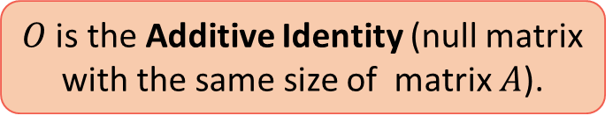
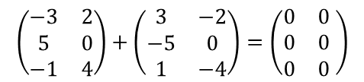


Lesson 4
Commutative Property
1. Equal Matrices
$$A+B=B+A$$
Examples
Associative Property
2. Matrix Addiction and Subtraction
$$\left(\begin{matrix}3 & −2 \\ 0 & 4\end{matrix}\right)+\left(\begin{matrix}−3 & 2 \\ 0 & −4\end{matrix}\right)=\left(\begin{matrix}0 & 0 \\ 0 & 0\end{matrix}\right)$$
$$A+\left(B+C\right)=\left(A+B\right)+C$$
$$A −A O$$
$$\left(\begin{matrix}−3 & 2 \\ 5 & 0 \\ −1 & 4\end{matrix}\right)+\left(\begin{matrix}3 & −2 \\ −5 & 0 \\ 1 & −4\end{matrix}\right)=\left(\begin{matrix}0 & 0 \\ 0 & 0 \\ 0 & 0\end{matrix} \right)$$
3. Properties of Matrix Addiction
Existence of Additive Identity
$$−A A O$$
$$A+O=O+A=A$$
$O$ is the Additive Identity (null matrix with the same size of matrix $A$).
Try it!
Existence of Additive Inverse
$$A+\left(−A\right)=\left(−A\right)+A=O$$
$−A$ is the matrix with elements ${−a}_{ij}$

Slide 13



Lesson 4
Just 4 questions before ending this lesson!...Better to pick a pen and paper!
1. Equal Matrices
2. Matrix Addiction and Subtraction
3. Properties of Matrix Addiction
Try it!

Slide 14


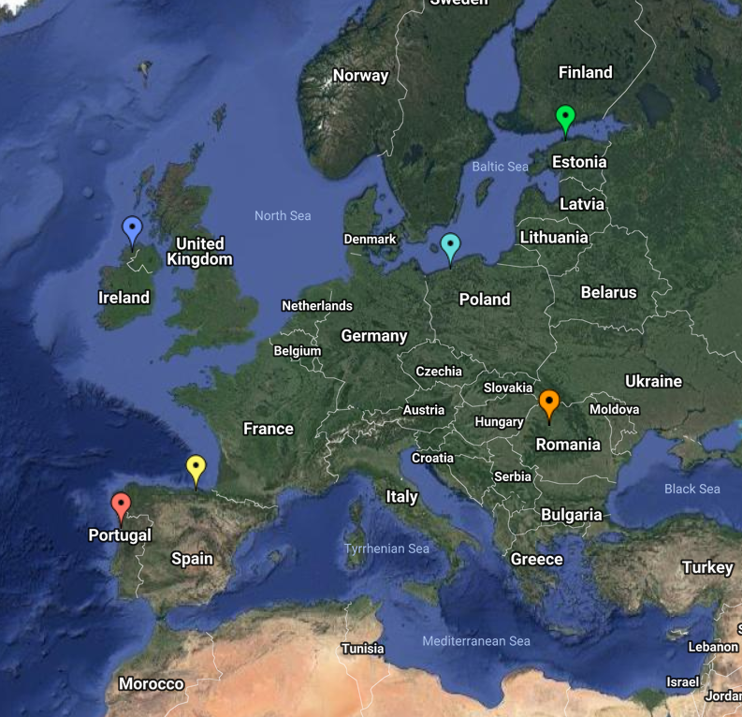
End of Lesson 4
Hope you enjoyed it!
1. Equal Matrices
2. Matrix Addiction and Subtraction
3. Properties of Matrix Addiction
Try it!
By EngiMath TEAM

