Slide 1



Lesson 5 Plan
Remember!
You can travel through all the sections (enter or mouse click) or choose your section by clicking over it.
You should only “Try it” after exploring all lesson contents!
1. Scalar Multiplication
of a Matrix
2. Properties of Scalar Multiplication
Try it!
By EngiMath TEAM

Slide 2
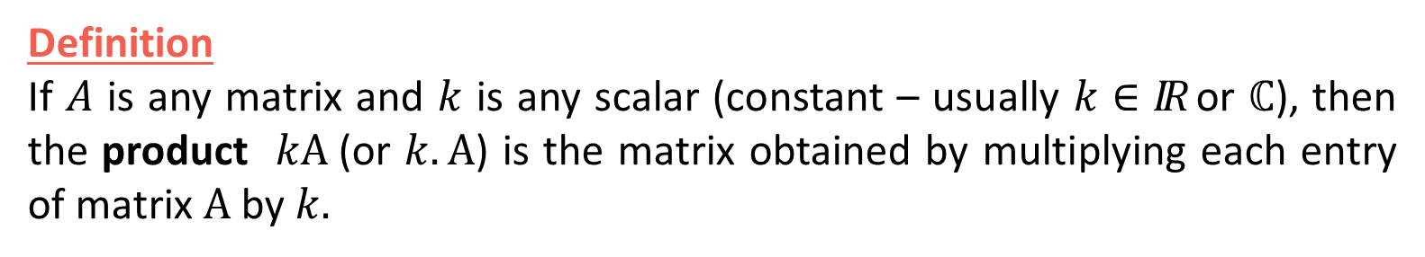
Lesson 5
Definition
If $A$ is any matrix and $k$ is any scalar (constant – usually $k∈IR$ or $ℂ$), then the product $kA$(or $k.A$) is the matrix obtained by multiplying each entry of matrix $A$ by $k.$
1. Scalar Multiplication
of a Matrix
2. Properties of Scalar Multiplication
Try it!

Slide 3

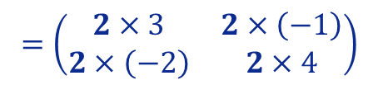

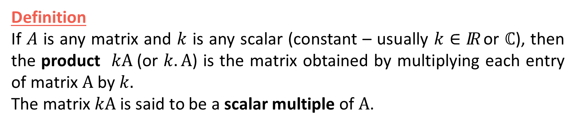




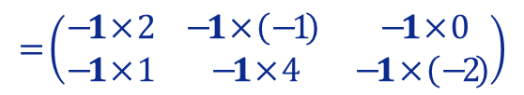

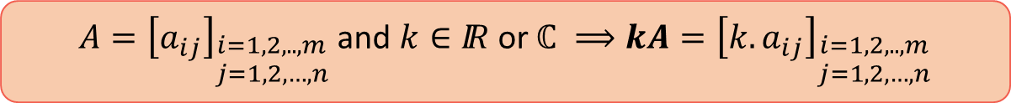

Lesson 5
Definition
If $A$ is any matrix and $k$ is any scalar (constant – usually $k∈IR$ or $ℂ$), then the product $kA$(or $k.A$) is the matrix obtained by multiplying each entry of matrix $A$ by $k.$
The matrix $kA$ is said to be a scalar multiple of $A$.
1. Scalar Multiplication
of a Matrix
2. Properties of Scalar Multiplication
Examples
(Click over it to see proposed resolution)
(1) $2\left(\begin{matrix}3 & −1 \\ −2 & 4\end{matrix}\right)$
$$=\left(\begin{matrix}6 & −2 \\ −4 & 8\end{matrix}\right)$$
$$=\left(\begin{matrix}2×3 & 2×\left(−1\right) \\ 2×\left(−2\right) & 2×4\end{matrix}\right)$$
(2) $\left(−1\right)\left(\begin{matrix}2 & −1 & 0 \\ 1 & 4 & −2\end{matrix}\right)$
$$=−\left(\begin{matrix}2 & −1 & 0 \\ 1 & 4 & −2\end{matrix}\right)$$
$$=\left(\begin{matrix}−2 & 1 & 0 \\ −1 & −4 & 2\end{matrix}\right)$$
$$=\left(\begin{matrix}−1×2 & −1×\left(−1\right) & −1×0 \\ −1×1 & −1×4 & −1×\left(−2\right)\end{matrix}\right)$$
Try it!
(3) $5\left(\begin{matrix}1 & 0 \\ 0 & 1\end{matrix}\right)$
$$=\left(\begin{matrix}5 & 0 \\ 0 & 5\end{matrix}\right)$$
$$=5I_{2}$$
Scalar Matrix (see Lesson 2)
Mathematical Notation
$A={\left[a_{ij}\right]}_{\begin{aligned}i=1,2,..,m \\ j=1,2,…,n\end{aligned}}$ and $k∈IR$ or $ℂ ⟹kA={\left[{k.a}_{ij}\right]}_{\begin{aligned}i=1,2,..,m \\ j=1,2,…,n\end{aligned}}$

Slide 4
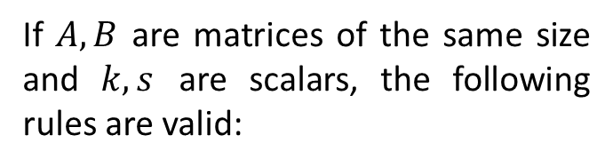
Lesson 5
Propositions
1. Scalar Multiplication
of a Matrix
If $A,B$ are matrices of the same size and $k,s$ are scalars, the following rules are valid:
2. Properties of Scalar Multiplication
Try it!

Slide 5
















Lesson 5
Propositions
1. Scalar Multiplication
of a Matrix
Example
If $A,B$ are matrices of the same size and $k,s$ are scalars, the following rules are valid:
$$2\left(A+B\right)$$
$$2\left(\begin{matrix}3 & 2 \\ 2 & 4\end{matrix}\right)+2\left(\begin{matrix}2 & 1 \\ 2 & 5\end{matrix}\right)$$
= $2\left[\left(\begin{matrix}3 & 2 \\ 2 & 4\end{matrix}\right)+\left(\begin{matrix}2 & 1 \\ 2 & 5\end{matrix}\right)\right]$
$$2A 2B$$
= $2\left(\begin{matrix}5 & 3 \\ 4 & 9\end{matrix}\right)$
= $\left(\begin{matrix}10 & 6 \\ 8 & 18\end{matrix}\right)$
$$k\left(A±B\right)=kA±kB$$
Distributive laws
2. Properties of Scalar Multiplication
$$\left(k±s\right)A=kA±sA$$
Example
$$−2A$$
$$3\left(\begin{matrix}3 & 2 \\ 2 & 4\end{matrix}\right)−5\left(\begin{matrix}3 & 2 \\ 2 & 4\end{matrix}\right)$$
= $\left(3−5\right)\left(\begin{matrix}3 & 2 \\ 2 & 4\end{matrix}\right)$
$$3A −5A$$
= $−2\left(\begin{matrix}3 & 2 \\ 2 & 4\end{matrix}\right)$
= $\left(\begin{matrix}−6 & −4 \\ −4 & −8\end{matrix}\right)$
Try it!
REMARK – In practice, when applying these propositions, keep in mind the reflexive property of equality: $A=B⇔B=A$.

Slide 6








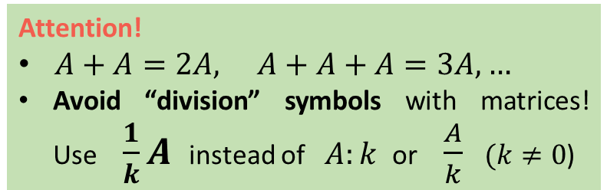





Lesson 5
Propositions
Example
1. Scalar Multiplication
of a Matrix
$$\left(2×3\right) A$$
If $A,B$ are matrices of the same size and $k,s$ are scalars, the following rules are valid:
= $6\left(\begin{matrix}3 & 2 \\ 2 & 4\end{matrix}\right)$
$$2\left[3\left(\begin{matrix}3 & 2 \\ 2 & 4\end{matrix}\right)\right]$$
= $\left(2×3\right)\left[\left(\begin{matrix}3 & 2 \\ 2 & 4\end{matrix}\right)\right]$
$$2\left(3A\right)$$
= $\left(\begin{matrix}18 & 12 \\ 12 & 24\end{matrix}\right)$
$$k\left(A±B\right)=kA±kB$$
Distributive laws
2. Properties of Scalar Multiplication
$$\left(k±s\right)A=kA±sA$$
Example
$$k\left(sA\right)=s\left(kA\right)=\left(k.s\right)A$$
$$0.\left(\begin{matrix}3 & 2 \\ 2 & 4\end{matrix} \begin{matrix}1 & 5 \\ 8 & 0\end{matrix}\right)=\left(\begin{matrix}0 & 0 \\ 0 & 0\end{matrix} \begin{matrix}0 & 0 \\ 0 & 0\end{matrix}\right)$$
$$1.A=A$$
$$0.A_{2×4} O_{2×4}$$
$$0.A=O$$
Try it!
0 - number zero
$O$- null matrix
Attention!
$A+A=2A, A+A+A=3A,…$
Avoid “division” symbols with matrices! Use $\frac{1}{k}A$instead of $A:k$ or $\frac{A}{k}$ $(k≠0$)
REMARK – In practice, when applying these propositions, keep in mind the reflexive property of equality: $A=B⇔B=A$.

Slide 7


Lesson 5
1. Scalar Multiplication
of a Matrix
3 questions to finish!...
2. Properties of Scalar Multiplication
Try it!

Slide 8

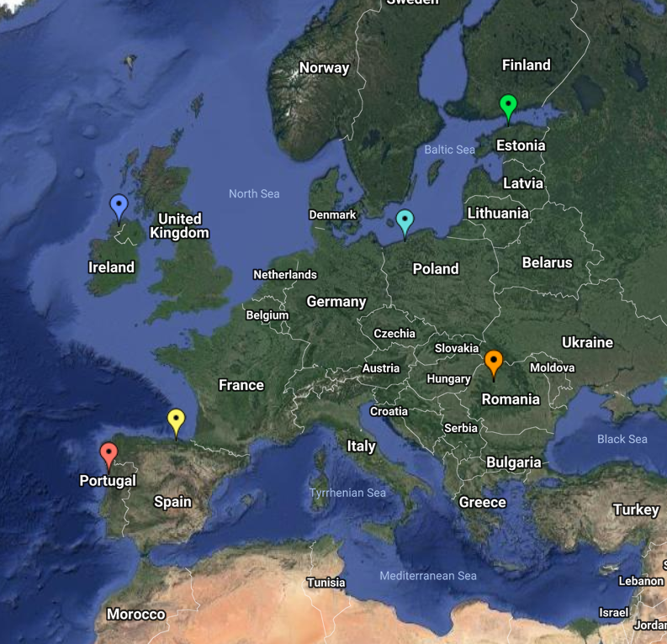

End of Lesson 5
Hope you enjoyed it!
1. Scalar Multiplication
of a Matrix
2. Properties of Scalar Multiplication
Try it!
By EngiMath TEAM

