Slide 1



Lesson 6 Plan
Remember!
You can travel through all the sections (enter or mouse click) or choose your section by clicking over it.
You should only “Try it” after exploring all lesson contents!
1. Warm up!
2. Matrix Multiplication
3. Properties of Matrix Multiplication
Try it!
By EngiMath TEAM

Slide 2

Lesson 6
Before introducing Matrix Multiplication lets analyse this more “basic” and introductory multiplication problem: ROW Matrix X COLUMN Matrix
1. Warm up!
2. Matrix Multiplication
3. Properties of Matrix Multiplication
Try it!

Slide 3
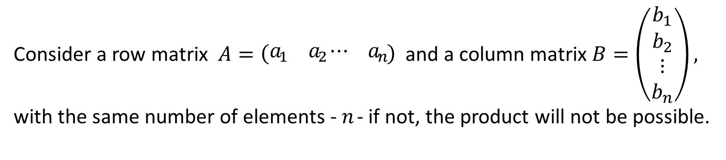













Lesson 6
Before introducing Matrix Multiplication lets analyse this more “basic” and introductory multiplication problem: ROW Matrix X COLUMN Matrix
1. Warm up!
Consider a row matrix $A=\left(\begin{matrix}a_{1} & a_{2}\end{matrix} \begin{matrix}⋯ & a_{n}\end{matrix}\right)$ and a column matrix $B=\left(\begin{matrix}\begin{matrix}b_{1} \\ b_{2}\end{matrix} \\ \begin{matrix}⋮ \\ b_{n}\end{matrix}\end{matrix}\right),$ with the same number of elements - $n$ - if not, the product will not be possible.
2. Matrix Multiplication
The product $AB$ will be a $1×1$ matrix (or a scalar) obtained by adding the products of the corresponding entries:
3. Properties of Matrix Multiplication
$$×$$
$$×$$
$$\left(\begin{matrix}a_{1} & a_{2}\end{matrix} \begin{matrix}⋯ & a_{n}\end{matrix}\right).\left(\begin{matrix}\begin{matrix}b_{1} \\ b_{2}\end{matrix} \\ \begin{matrix}⋮ \\ b_{n}\end{matrix}\end{matrix}\right)=$$
Try it!
$$a_{1}.b_{1}$$
$$+$$
$$a_{2}.b_{2}$$
$$+$$
$$⋯$$
$$+$$
$$a_{n}.b_{n}$$
$$×$$

Slide 4
Lesson 6
Before introducing Matrix Multiplication lets analyse this more “basic” and introductory multiplication problem: ROW Matrix X COLUMN Matrix
1. Warm up!
Consider a row matrix $A=\left(\begin{matrix}a_{1} & a_{2}\end{matrix} \begin{matrix}⋯ & a_{n}\end{matrix}\right)$ and a column matrix $B=\left(\begin{matrix}\begin{matrix}b_{1} \\ b_{2}\end{matrix} \\ \begin{matrix}⋮ \\ b_{n}\end{matrix}\end{matrix}\right),$ with the same number of elements - $n$ - if not, the product will not be possible.
2. Matrix Multiplication
The product $AB$ will be a $1×1$ matrix (or a scalar) obtained by adding the products of the corresponding entries:
3. Properties of Matrix Multiplication
$$\left(\begin{matrix}a_{1} & a_{2}\end{matrix} \begin{matrix}⋯ & a_{n}\end{matrix}\right).\left(\begin{matrix}\begin{matrix}b_{1} \\ b_{2}\end{matrix} \\ \begin{matrix}⋮ \\ b_{n}\end{matrix}\end{matrix}\right)=$$
Try it!
$$a_{1}.b_{1}$$
$$+$$
$$a_{2}.b_{2}$$
$$+$$
$$⋯$$
$$+$$
$$a_{n}.b_{n}$$
Notice – “moving from left to right” in matrix $A$ is simultaneous with “moving from top to bottom” in matrix $B$. This “product” is possible if the number of entries in this two matrices is equal!

Slide 5




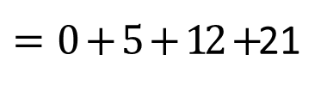
Lesson 6
Before introducing Matrix Multiplication lets analyse this more “basic” and introductory multiplication problem: ROW Matrix X COLUMN Matrix
1. Warm up!
Example
Try it on your own!!!!
(click to see the solution!)
$$\left(\begin{matrix}0 & 1\end{matrix} \begin{matrix}2 & 3\end{matrix}\right).\left(\begin{matrix}\begin{matrix}4 \\ 5\end{matrix} \\ \begin{matrix}6 \\ 7\end{matrix}\end{matrix}\right)$$
2. Matrix Multiplication
$$=0×4+1×5+2×6+3×7$$
$=0+5+12+$21
$$=38$$
3. Properties of Matrix Multiplication
$$\left(\begin{matrix}a_{1} & a_{2}\end{matrix} \begin{matrix}⋯ & a_{n}\end{matrix}\right).\left(\begin{matrix}\begin{matrix}b_{1} \\ b_{2}\end{matrix} \\ \begin{matrix}⋮ \\ b_{n}\end{matrix}\end{matrix}\right)=$$
Try it!
$$a_{1}.b_{1}$$
$$+$$
$$a_{2}.b_{2}$$
$$+$$
$$⋯$$
$$+$$
$$a_{n}.b_{n}$$
Notice – “moving from left to right” in matrix $A$ is simultaneous with “moving from top to bottom” in matrix $B$. This “product” is possible if the number of entries in this two matrices is equal!

Slide 6
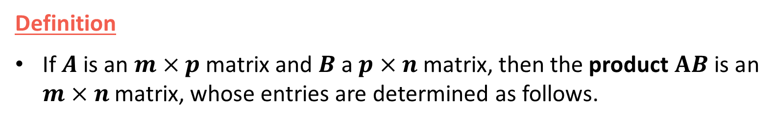
Lesson 6
Definition
If $A$ is an $m×p$matrix and $B$ a $p×n$matrix, then the product $AB$ is an $m×n$matrix, whose entries are determined as follows.
1. Warm up!
2. Matrix Multiplication
3. Properties of Matrix Multiplication
Try it!

Slide 7




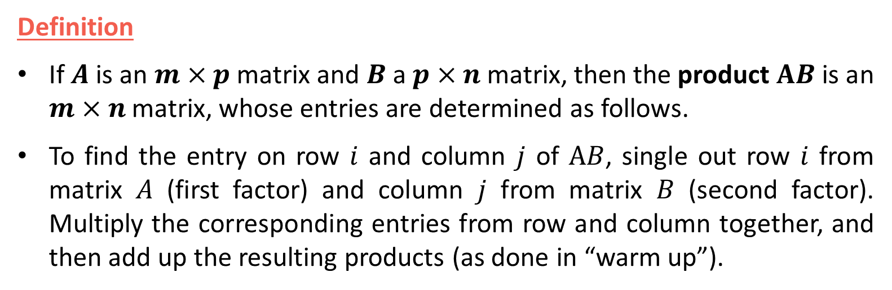

Lesson 6
Definition
If $A$ is an $m×p$matrix and $B$ a $p×n$matrix, then the product $AB$ is an $m×n$matrix, whose entries are determined as follows.
To find the entry on row $i$ and column $j$ of $AB$, single out row $i$ from matrix $A$ (first factor) and column $j$ from matrix $B$ (second factor). Multiply the corresponding entries from row and column together, and then add up the resulting products (as done in “warm up”).
1. Warm up!
2. Matrix Multiplication
3. Properties of Matrix Multiplication
If the number of columns of $A$ (number of elements of its rows) does not equal the number of rows of $B$ (number of elements of its columns), the matrix product $AB$ is not defined.
A simple way to verify if the product of two matrices is defined is to write side by side and in the respective product order the sizes of the matrices.
If the “inside” numbers are the same, the product is defined.
The outside numbers then give the size of the product matrix!
Try it!
$$A$$
$$B$$
$$AB$$
$m × p$ $p × n$
$$m × n$$
Inside
Outside

Slide 8


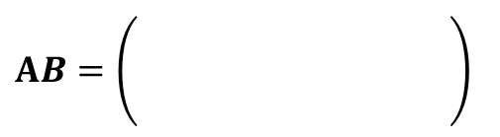





Lesson 6
Definition
If $A$ is an $m×p$matrix and $B$ a $p×n$matrix, then the product $AB$ is an $m×n$matrix, whose entries are determined as follows.
To find the entry on row $i$ and column $j$ of $AB$, single out row $i$ from matrix $A$ (first factor) and column $j$ from matrix $B$ (second factor). Multiply the corresponding entries from row and column together, and then add up the resulting products (as done in “warm up”).
1. Warm up!
2. Matrix Multiplication
3. Properties of Matrix Multiplication
Lets see how the definition “works”
Compute $AB$, if possible, given:
V
?
$$A=\left(\begin{matrix}1 & 2 & 3 \\ 0 & 4 & 2\end{matrix}\right)$$
$AB=\left(\begin{matrix} & \\ & \\ & \end{matrix} \right)$
$$2×3$$
$$3×4$$
$$2 × 4$$
Try it!
$$B=\left(\begin{matrix}1 \\ −1 \\ 2\end{matrix} \begin{matrix}3 \\ 0 \\ 1\end{matrix} \begin{matrix}7 \\ 2 \\ 0\end{matrix} \begin{matrix}5 \\ 4 \\ 3\end{matrix} \right)$$
$AB$ size

Slide 9
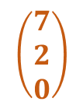


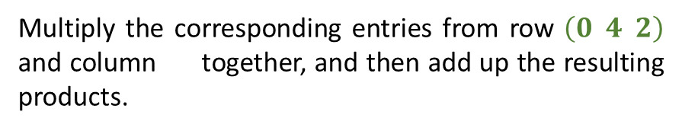


Lesson 6
Definition
If $A$ is an $m×p$matrix and $B$ a $p×n$matrix, then the product $AB$ is an $m×n$matrix, whose entries are determined as follows.
To find the entry on row $i$ and column $j$ of $AB$, single out row $i$ from matrix $A$ (first factor) and column $j$ from matrix $B$ (second factor). Multiply the corresponding entries from row and column together, and then add up the resulting products (as done in “warm up”).
1. Warm up!
2. Matrix Multiplication
3. Properties of Matrix Multiplication
Lets see how the definition “works”
Compute $AB$, if possible, given:
$$A=\left(\begin{matrix}1 & 2 & 3 \\ 0 & 4 & 2\end{matrix}\right)$$
To find the entry on row $2$
and column $3$ of $AB$
single out row $2$ from matrix $A$(first factor)
$AB=\left(\begin{matrix} & \\ & \\ & \end{matrix} \right)$
Try it!
and column $3$ from matrix $B$ (second factor)
$$B=\left(\begin{matrix}1 \\ −1 \\ 2\end{matrix} \begin{matrix}3 \\ 0 \\ 1\end{matrix} \begin{matrix}7 \\ 2 \\ 0\end{matrix} \begin{matrix}5 \\ 4 \\ 3\end{matrix} \right)$$
Multiply the corresponding entries from row $\left(0 4 2\right)$ and column together, and then add up the resulting products.

Slide 10




Lesson 6
Definition
If $A$ is an $m×p$matrix and $B$ a $p×n$matrix, then the product $AB$ is an $m×n$matrix, whose entries are determined as follows.
To find the entry on row $i$ and column $j$ of $AB$, single out row $i$ from matrix $A$ (first factor) and column $j$ from matrix $B$ (second factor). Multiply the corresponding entries from row and column together, and then add up the resulting products (as done in “warm up”).
1. Warm up!
2. Matrix Multiplication
3. Properties of Matrix Multiplication
Lets see how the definition “works”
Compute $AB$, if possible, given:
$$A=\left(\begin{matrix}1 & 2 & 3 \\ 0 & 4 & 2\end{matrix}\right)$$
$$\left(0 4 2\right)$$
$$=0×7+4×2+2×0=8$$
$AB=\left(\begin{matrix} & \\ & \\ & \end{matrix} \right)$
Try it!
$$8$$
$$B=\left(\begin{matrix}1 \\ −1 \\ 2\end{matrix} \begin{matrix}3 \\ 0 \\ 1\end{matrix} \begin{matrix}7 \\ 2 \\ 0\end{matrix} \begin{matrix}5 \\ 4 \\ 3\end{matrix} \right)$$
Multiply the corresponding entries from row $\left(0 4 2\right)$ and column together, and then add up the resulting products.

Slide 11

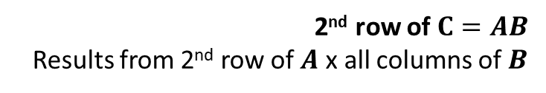




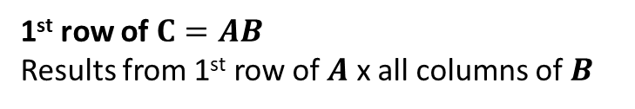











Lesson 6
There are several schemes that may ease the first contact with matrix multiplication procedure. It is important to remember:
Multiply rows (1st factor) by columns (2nd factor)
The result position, in the product matrix, depends directly on what row and column have been multiplied.
1. Warm up!
2. Matrix Multiplication
Example (continuation)
$$B$$
$$\left(\begin{matrix}1 \\ −1 \\ 2\end{matrix} \begin{matrix}3 \\ 0 \\ 1\end{matrix} \begin{matrix}7 \\ 2 \\ 0\end{matrix} \begin{matrix}5 \\ 4 \\ 3\end{matrix} \right)$$
$$\begin{matrix} & & \\ 0 & 4 & 2\end{matrix}$$
$$5$$
$$6$$
$$11$$
$$22$$
3. Properties of Matrix Multiplication
$$A$$
$$\left(\begin{matrix}1 & 2 & 3 \\ & & \end{matrix}\right)$$
$$0$$
$$2$$
$$8$$
14
1st row of $C=AB$
Results from 1st row of $A$ x all columns of $B$
$$C=AB$$
2nd row of $C=AB$
Results from 2nd row of $A$ x all columns of $B$
Try it!
$$c_{11}=1×1+2×\left(−1\right)+3×2=1−2+6=5$$
$$c_{21}=0×1+4×\left(−1\right)+2×2=−2+4=0$$
$$c_{12}=1×3+2×0+3×1=3+3=6$$
$$c_{22}=0×3+4×0+2×1=2$$
$$c_{13}=1×7+2×2+3×0=7+4=11$$
$$c_{23}=0×7+4×2+2×0=8$$
$$c_{14}=1×5+2×4+3×3=5+8+9=22$$
$$c_{24}=0×5+4×4+2×3=8+6=14$$

Slide 12


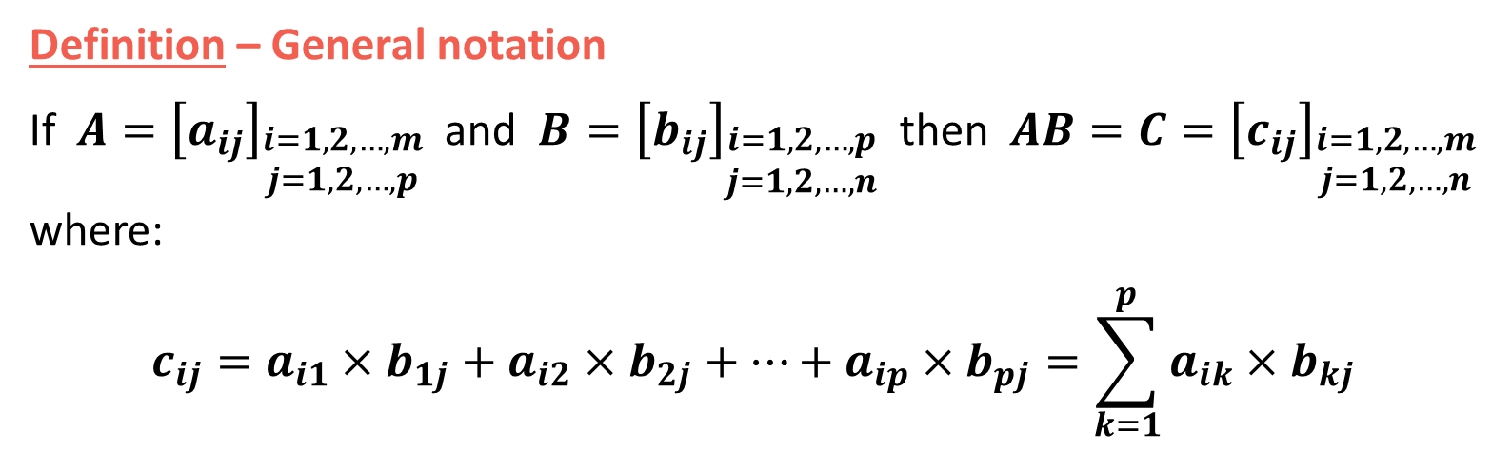
Lesson 6
Definition – General notation
If $A={\left[a_{ij}\right]}_{\begin{aligned}i=1,2,…,m \\ j=1,2,…,p\end{aligned}}$ and $B={\left[b_{ij}\right]}_{\begin{aligned}i=1,2,…,p \\ j=1,2,…,n\end{aligned}}$ then $AB=C={\left[c_{ij}\right]}_{\begin{aligned}i=1,2,…,m \\ j=1,2,…,n\end{aligned}}$ where:
$$c_{ij}=a_{i1}×b_{1j}+a_{i2}×b_{2j}+…+a_{ip}×b_{pj}=\sum_{k=1}^{p}{a_{ik}×b_{kj}}$$
1. Warm up!
2. Matrix Multiplication
3. Properties of Matrix Multiplication
$$\left(\begin{matrix}\begin{matrix}a_{11} \\ a_{21}\end{matrix} \\ \begin{matrix}⋮ \\ a_{i1}\end{matrix} \\ \begin{matrix}⋮ \\ a_{m1}\end{matrix}\end{matrix} \begin{matrix}\begin{matrix}a_{12} \\ a_{22}\end{matrix} \\ \begin{matrix}⋮ \\ a_{i2}\end{matrix} \\ \begin{matrix}⋮ \\ a_{m2}\end{matrix}\end{matrix} \begin{matrix}\begin{matrix}⋯ \\ ⋯\end{matrix} \\ \begin{matrix}⋮ \\ ⋯\end{matrix} \\ \begin{matrix}⋮ \\ ⋯\end{matrix}\end{matrix} \begin{matrix}\begin{matrix}a_{1p} \\ a_{2p}\end{matrix} \\ \begin{matrix}⋮ \\ a_{ip}\end{matrix} \\ \begin{matrix}⋮ \\ a_{mp}\end{matrix}\end{matrix}\right)×$$
$$\left(\begin{matrix}\begin{matrix}b_{11} \\ b_{21}\end{matrix} \\ \begin{matrix}⋮ \\ b_{p1}\end{matrix}\end{matrix} \begin{matrix} \begin{matrix}b_{12} \\ b_{22}\end{matrix} \\ \begin{matrix}⋮ \\ b_{p2}\end{matrix}\end{matrix} \begin{matrix}\begin{matrix}⋯ \\ ⋯\end{matrix} \\ \begin{matrix}⋮ \\ ⋯\end{matrix}\end{matrix} \begin{matrix}\begin{matrix}b_{1j} \\ b_{2j}\end{matrix} \\ \begin{matrix}⋮ \\ b_{pj}\end{matrix}\end{matrix} \begin{matrix}\begin{matrix}⋯ \\ ⋯\end{matrix} \\ \begin{matrix}⋮ \\ ⋯\end{matrix}\end{matrix} \begin{matrix}\begin{matrix}b_{1n} \\ b_{2n}\end{matrix} \\ \begin{matrix}⋮ \\ b_{pn}\end{matrix}\end{matrix}\right)$$
Try it!
Row i
Column j

Slide 13

Lesson 6
Associative Property
$$A\left(BC\right)=\left(AB\right)C$$
1. Warm up!
2. Matrix Multiplication
3. Properties of Matrix Multiplication
Try it!

Slide 14

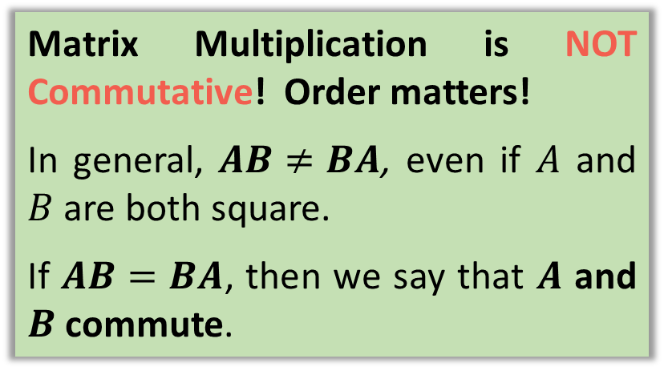



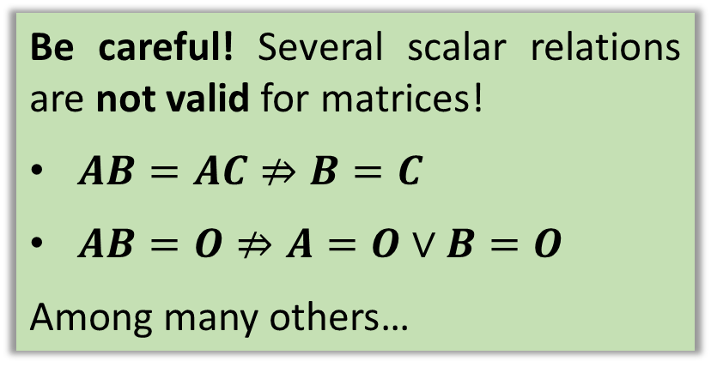
Lesson 6
Associative Property
IMPORTANT Remarks
$$A\left(BC\right)=\left(AB\right)C$$
1. Warm up!
Matrix Multiplication is NOT Commutative! Order matters!
In general, $AB≠BA$, even if $A$ and $B$ are both square.
If $AB=BA$, then we say that $A$ and $B$ commute.
Left distributive Property
$$A\left(B+C\right)=AB+AC$$
2. Matrix Multiplication
Right Distributive Property
$$\left(B+C\right)A=BA+CA$$
3. Properties of Matrix Multiplication
Associative Property of Scalar
Multiplication
Be careful! Several scalar relations are not valid for matrices!
$AB=AC⇏B=C$
$AB=O⇏A=O∨B=O$
Among many others…
$k\left(AB\right)=\left(kA\right)B=A$ $\left(kB\right)$
Try it!
Identity for Matrix Multiplication
$$I_{m}A=A=AI_{n}$$

Slide 15


Lesson 6
Perhaps you will need a pen and paper to answer these final questions!…
1. Warm up!
2. Matrix Multiplication
3. Properties of Matrix Multiplication
Try it!

Slide 16


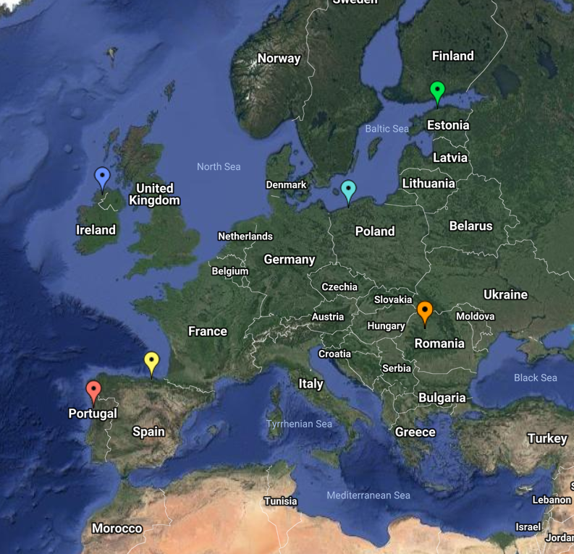
End of Lesson 6
Hope you enjoyed it!
1. Warm up!
2. Matrix Multiplication
3. Elements or Entries of a Matrix
Try it!
By EngiMath TEAM

