Slide 1



Lesson 7 Plan
Remember!
You can travel through all the sections (enter or mouse click) or choose your section by clicking over it.
You should only “Try it” after exploring all lesson contents!
1. Transpose of a Matrix
2. Properties of the Transpose
Try it!
By EngiMath TEAM

Slide 2
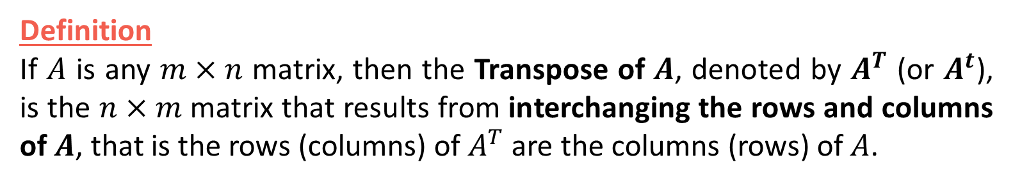
Lesson 7
Definition
If $A$ is any $m×n$ matrix, then the Transpose of $A$, denoted by $A^{T}$ (or $A^{t}$), is the $n×m$ matrix that results from interchanging the rows and columns of $A$, that is the rows (columns) of $A^{T}$ are the columns (rows) of $A$.
1. Transpose of a Matrix
2. Properties of the Transpose
Try it!

Slide 3










Lesson 7
Definition
If $A$ is any $m×n$ matrix, then the Transpose of $A$, denoted by $A^{T}$ (or $A^{t}$), is the $n×m$ matrix that results from interchanging the rows and columns of $A$, that is the rows (columns) of $A^{T}$ are the columns (rows) of $A$.
1. Transpose of a Matrix
2. Properties of the Transpose
Example
1st column
1st row
$$A^{T}=\left(\begin{matrix} & \\ \begin{matrix} \\ \end{matrix} & \begin{matrix} \\ \end{matrix} \\ & \end{matrix}\right)$$
$$2$$
$$−1$$
$$0$$
$$A=\left(\begin{matrix}2 & −1 & 0 \\ 3 & 5 & 7\end{matrix}\right)$$
$$3$$
$$5$$
$$7$$
2nd row
$$2×3$$
$$3×2$$
2nd column
Try it!
Mathematical Notation
$A={\left[a_{ij}\right]}_{\begin{aligned}i=1,2,..,m \\ j=1,2,…,n\end{aligned}}$ $⟹A^{T}={\left[{a^{′}}_{ij}\right]}_{\begin{aligned}i=1,2,..,n \\ j=1,2,…,m\end{aligned}}:{a^{′}}_{ij}=a_{ji}$

Slide 4


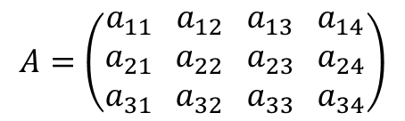




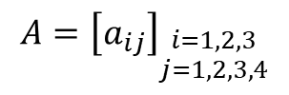


Lesson 7
Definition
If $A$ is any $m×n$ matrix, then the Transpose of $A$, denoted by $A^{T}$ (or $A^{t}$), is the $n×m$ matrix that results from interchanging the rows and columns of $A$, that is the rows (columns) of $A^{T}$ are the columns (rows) of $A$.
1. Transpose of a Matrix
2. Properties of the Transpose
How does this “work”?...
$$A=\left(\begin{matrix}a_{11} \\ a_{21} \\ a_{31}\end{matrix} \begin{matrix}a_{12} \\ a_{22} \\ a_{32}\end{matrix} \begin{matrix}a_{13} \\ a_{23} \\ a_{33}\end{matrix} \begin{matrix}a_{14} \\ a_{24} \\ a_{34}\end{matrix}\right)$$
$$A={\left[a_{ij}\right]}_{\begin{aligned}i=1,2,3 \\ j=1,2,3,4\end{aligned}}$$
interchanging the rows and columns
$$3×4$$
$$A^{T}=\left(\begin{matrix}\begin{matrix} \\ \end{matrix} \\ \begin{matrix} \\ \end{matrix}\end{matrix} \right)$$
$$\begin{matrix}\begin{matrix}a_{11} \\ a_{12}\end{matrix} \\ \begin{matrix}a_{13} \\ a_{14}\end{matrix}\end{matrix}$$
$$\begin{matrix}\begin{matrix}a_{21} \\ a_{22}\end{matrix} \\ \begin{matrix}a_{23} \\ a_{24}\end{matrix}\end{matrix}$$
$$\begin{matrix}\begin{matrix}a_{31} \\ a_{32}\end{matrix} \\ \begin{matrix}a_{33} \\ a_{34}\end{matrix}\end{matrix}$$
In $A^{T}$this entry is in
2nd row, 3rd column!
Relevant when working with generic matrices
Try it!
$$4×3$$
$${a^{′}}_{23}$$
Mathematical Notation
$A={\left[a_{ij}\right]}_{\begin{aligned}i=1,2,..,m \\ j=1,2,…,n\end{aligned}}$ $⟹A^{T}={\left[{a^{′}}_{ij}\right]}_{\begin{aligned}i=1,2,..,n \\ j=1,2,…,m\end{aligned}}:{a^{′}}_{ij}=a_{ji}$

Slide 5

Lesson 7
1. Transpose of a Matrix
Propositions
Apply it twice… get back where you started!...
If the sizes of the matrices are such that the stated operations can be performed, then:
2. Properties of the Transpose
$${(A^{T})}^{T}=A$$
Try it!

Slide 6




Lesson 7
1. Transpose of a Matrix
Propositions
Apply it twice… get back where you started!...
If the sizes of the matrices are such that the stated operations can be performed, then:
Adding and transpose the sum is the same as adding the respective transpose!
2. Properties of the Transpose
$${(A^{T})}^{T}=A$$
Transposing the product of a matrix by a scalar is the same multiplying the transpose!
$${\left(A±B\right)}^{T}=A^{T}±B^{T}$$
REMARK – The first three propositions are self-evident. However the fourth one isn´t… It may be generalized as:
The transpose of a product of any number of matrices is equal to the product of their transposes in the reverse order.
$${(kA)}^{T}={kA}^{T}$$
Try it!
$${\left(AB\right)}^{T}=B^{T}A^{T}$$
where $k$ is any scalar

Slide 7














Lesson 7
1. Transpose of a Matrix
${\left(AB\right)}^{T}≠A^{T}B^{T}$
Propositions
${\left(AB\right)}^{T} ≠ A^{T}B^{T}$
If the sizes of the matrices are such that the stated operations can be performed, then:
$$\left(p×n\right)$$
$${\left[ \right]}^{T}$$
$$\left(m×p\right)$$
$${\left[ \right]}^{T}$$
$$\left(m×p\right)$$
$${\left[ \right]}^{T}$$
$$\left(p×n\right)$$
$${\left[ \right]}^{T}$$
$$\left(m×n\right)$$
$$\left(p×m\right)$$
$$\left(n×p\right)$$
2. Properties of the Transpose
Impossible
$${(A^{T})}^{T}=A$$
$$\left(n×m\right)$$
Notice that even for square matrices the result is only the same if A and B commute.
$${\left(A±B\right)}^{T}=A^{T}±B^{T}$$
REMARK – The first three propositions are self-evident. However the fourth one isn´t… It may be generalized as:
The transpose of a product of any number of matrices is equal to the product of their transposes in the reverse order.
$${(kA)}^{T}={kA}^{T}$$
Try it!
$${\left(AB\right)}^{T}=B^{T}A^{T}$$
where $k$ is any scalar

Slide 8



Lesson 7
1. Transpose of a Matrix
Keeping up?...
…just 4 questions!…
Prepare… get set…and
GO!
2. Properties of the Transpose
Try it!

Slide 9


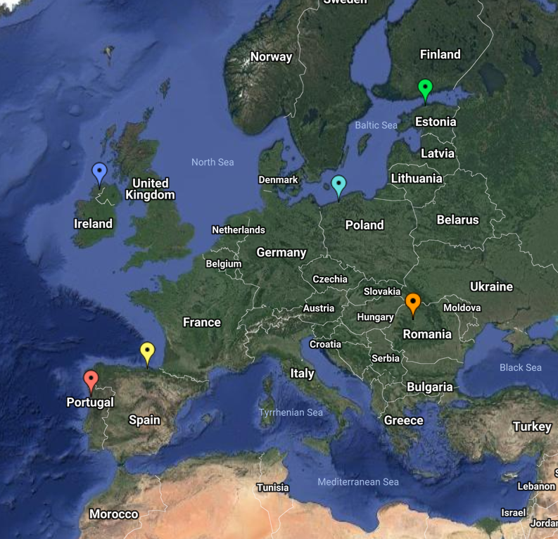
End of Lesson 7
Hope you enjoyed it!
1. Transpose of a Matrix
2. Properties of the Transpose
Try it!
By EngiMath TEAM

