Slide 1



Lesson 8 Plan
Remember!
You can travel through all the sections (enter or mouse click) or choose your section by clicking over it.
You should only “Try it” after exploring all lesson contents!
1. Partitioned Matrix
2. Block Addition and Scalar M.
3. Block Transpose
4. Block Multiplication
Try it!
By EngiMath TEAM

Slide 2
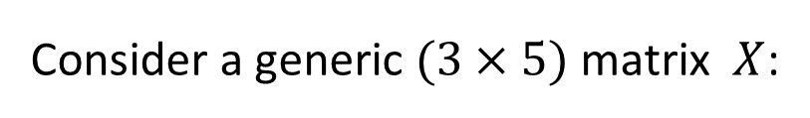
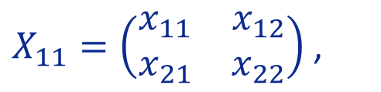
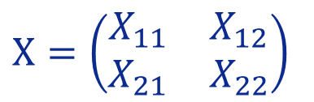
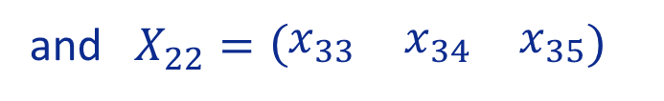


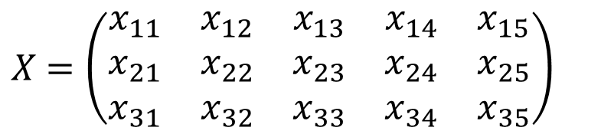
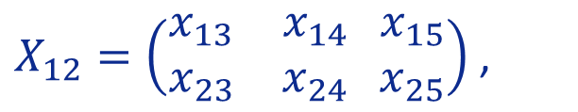
Lesson 8
A matrix can be subdivided or partitioned into smaller matrices – blocks (submatrices) – by inserting horizontal and vertical rules between selected rows and columns.
1. Partitioned Matrix
2. Block Addition and Scalar M.
For example:
$X$ $=\left(\begin{matrix}\begin{matrix}\begin{matrix}x_{11} \\ x_{21} \\ x_{31}\end{matrix} & \begin{matrix}x_{12} \\ x_{22} \\ x_{32}\end{matrix} & \begin{matrix}x_{13} \\ x_{23} \\ x_{33}\end{matrix}\end{matrix} & \begin{matrix}\begin{matrix}x_{14} \\ x_{24} \\ x_{34}\end{matrix} & \begin{matrix}x_{15} \\ x_{25} \\ x_{35}\end{matrix}\end{matrix}\end{matrix}\right)$
3. Block Transpose
Consider a generic $(3×5)$ matrix $X$:
$X$may be partitioned in “any way we want”!
4. Block Multiplication
$$X=\left(\begin{matrix}X_{11} & X_{12} \\ X_{21} & X_{22}\end{matrix}\right)$$
block matrix
This gives us the $(2×2)$ partitioned or block matrix:
where:
Try it!
$X_{11}=\left(\begin{matrix}x_{11} & x_{12} \\ x_{21} & x_{22}\end{matrix}\right)$ ,
$X_{12}=\left(\begin{matrix}x_{13} & x_{14} \\ x_{23} & x_{24}\end{matrix} \begin{matrix}x_{15} \\ x_{25}\end{matrix}\right)$ ,
$$X_{21}=\left(\begin{matrix}x_{31} & x_{32}\end{matrix}\right)$$
and $X_{22}=\left(\begin{matrix}x_{33} & x_{34} & x_{35}\end{matrix}\right)$

Slide 3



Lesson 8
A matrix can be subdivided or partitioned into smaller matrices – blocks (submatrices) – by inserting horizontal and vertical rules between selected rows and columns.
1. Partitioned Matrix
2. Block Addition and Scalar M.
For example:
$X$ $=\left(\begin{matrix}\begin{matrix}\begin{matrix}x_{11} \\ x_{21} \\ x_{31}\end{matrix} & \begin{matrix}x_{12} \\ x_{22} \\ x_{32}\end{matrix} & \begin{matrix}x_{13} \\ x_{23} \\ x_{33}\end{matrix}\end{matrix} & \begin{matrix}\begin{matrix}x_{14} \\ x_{24} \\ x_{34}\end{matrix} & \begin{matrix}x_{15} \\ x_{25} \\ x_{35}\end{matrix}\end{matrix}\end{matrix}\right)$
3. Block Transpose
Consider a generic $(3×5)$ matrix $X$:
Partition of $X$ into its rows:
4. Block Multiplication
$$X=\left(\begin{matrix}r_{1} \\ r_{2} \\ r_{3}\end{matrix}\right)$$
This gives us the $(3×1)$ block matrix:
Try it!
Partition of $X$ into into its columns:
This gives us the $(1×3)$ block matrix:
$$X=\left(c_{1} c_{2}{ c}_{3 } c_{4} c_{5}\right)$$

Slide 4


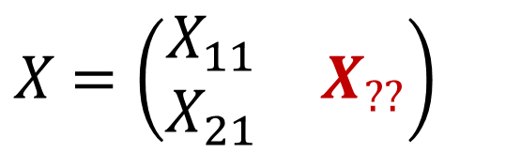
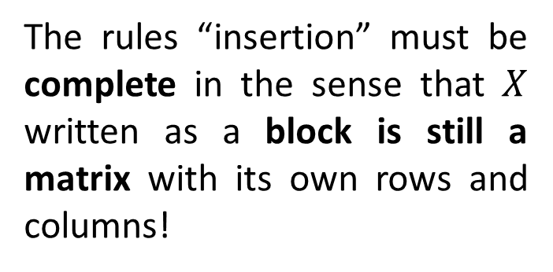
Lesson 8
A matrix can be subdivided or partitioned into smaller matrices – blocks (submatrices) – by inserting horizontal and vertical rules between selected rows and columns.
1. Partitioned Matrix
2. Block Addition and Scalar M.
$X$ $=\left(\begin{matrix}\begin{matrix}\begin{matrix}x_{11} \\ x_{21} \\ x_{31}\end{matrix} & \begin{matrix}x_{12} \\ x_{22} \\ x_{32}\end{matrix} & \begin{matrix}x_{13} \\ x_{23} \\ x_{33}\end{matrix}\end{matrix} & \begin{matrix}\begin{matrix}x_{14} \\ x_{24} \\ x_{34}\end{matrix} & \begin{matrix}x_{15} \\ x_{25} \\ x_{35}\end{matrix}\end{matrix}\end{matrix}\right)$
3. Block Transpose
4. Block Multiplication
Remark
The rules “insertion” must be complete in the sense that $X$ written as a block is still a matrix with its own rows and columns!
$X$ $=\left(\begin{matrix}\begin{matrix}X_{11} \\ X_{21}\end{matrix} & X_{??}\end{matrix}\right)$
Try it!

Slide 5
Lesson 8
A matrix can be subdivided or partitioned into smaller matrices – blocks (submatrices) – by inserting horizontal and vertical rules between selected rows and columns.
1. Partitioned Matrix
2. Block Addition and Scalar M.
Notation – Usually, when no confusion arises, the blocks are represented by the same capital letter as the matrix with the usual two subscripts that identify the blocks respective position.
3. Block Transpose
Take Home Messages
4. Block Multiplication
A partitioned matrix can the thought as a matrix whose entries are “smaller” matrices;
The main objective to use partitioned matrices is to simplify computations when the matrices are to large;
Try it!
Remember that often the context or the entries of the matrix will suggest a useful way to divide the matrix into blocks, for example, large blocks of zeros in a matrix or identity matrix blocks show useful ways to partition the matrix.

Slide 6

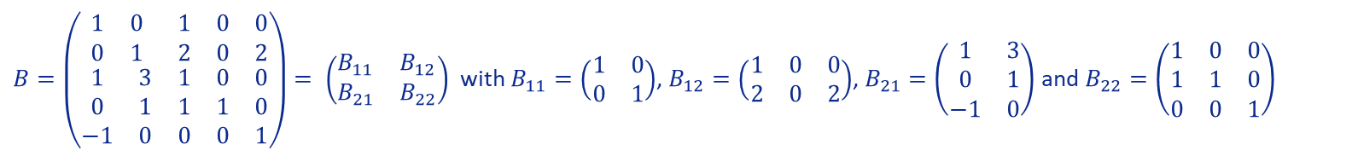


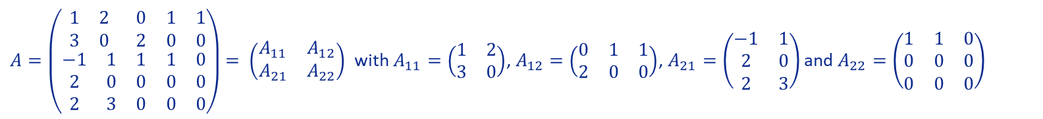

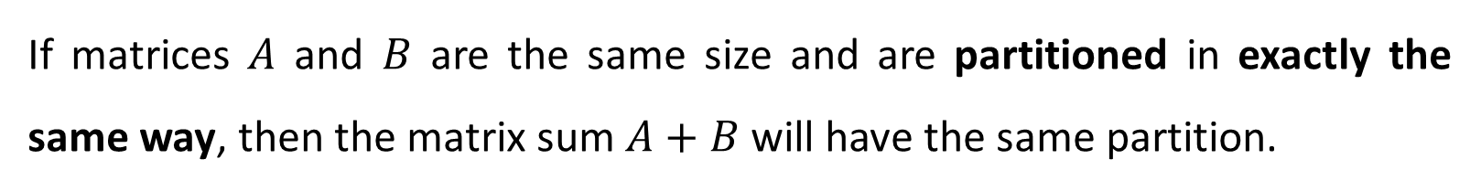

Lesson 8
If matrices $A$ and $B$ are the same size and are partitioned in exactly the same way, then the matrix sum $A+B$ will have the same partition.
1. Partitioned Matrix
2. Block Addition and Scalar M.
Each block of $A+B$ is the sum of the corresponding blocks of $A$ and $B$.
3. Block Transpose
$A=\left(\begin{matrix}\begin{matrix}1 & 2 \\ 3 & 0\end{matrix} & \begin{matrix}0 & 1 & 1 \\ 2 & 0 & 0\end{matrix} \\ \begin{matrix}−1 & 1 \\ 2 & 0 \\ 2 & 3\end{matrix} & \begin{matrix}1 & 1 & 0 \\ 0 & 0 & 0 \\ 0 & 0 & 0\end{matrix}\end{matrix}\right)$ $= \left(\begin{matrix}A_{11} & A_{12} \\ A_{21} & A_{22}\end{matrix}\right)$ with $A_{11}=\left(\begin{matrix}1 & 2 \\ 3 & 0\end{matrix}\right)$, $A_{12}=\left(\begin{matrix}0 & 1 & 1 \\ 2 & 0 & 0\end{matrix}\right)$, $A_{21}=\left(\begin{matrix}−1 & 1 \\ 2 & 0 \\ 2 & 3\end{matrix}\right)$ and $A_{22}=\left(\begin{matrix}1 & 1 & 0 \\ 0 & 0 & 0 \\ 0 & 0 & 0\end{matrix}\right)$
4. Block Multiplication
Example
$C=A+B$ $= \left(\begin{matrix}C_{11} & C_{12} \\ C_{21} & C_{22}\end{matrix}\right)$ with
$$C_{11}=\left(\begin{matrix}2 & 2 \\ 3 & 1\end{matrix}\right)$$
$$C_{12}=\left(\begin{matrix}1 & 1 & 1 \\ 4 & 0 & 2\end{matrix}\right)$$
$$C_{21}=\left(\begin{matrix}0 & 4 \\ 2 & 1 \\ 1 & 3\end{matrix}\right)$$
$$C_{22}=\left(\begin{matrix}2 & 1 & 0 \\ 1 & 1 & 0 \\ 0 & 0 & 1\end{matrix}\right)$$
$B=\left(\begin{matrix}\begin{matrix}1 & 0 \\ 0 & 1\end{matrix} & \begin{matrix}1 & 0 & 0 \\ 2 & 0 & 2\end{matrix} \\ \begin{matrix}1 & 3 \\ 0 & 1 \\ −1 & 0\end{matrix} & \begin{matrix}1 & 0 & 0 \\ 1 & 1 & 0 \\ 0 & 0 & 1\end{matrix}\end{matrix}\right)$ $= \left(\begin{matrix}B_{11} & B_{12} \\ B_{21} & B_{22}\end{matrix}\right)$ with $B_{11}=\left(\begin{matrix}1 & 0 \\ 0 & 1\end{matrix}\right)$, $B_{12}=\left(\begin{matrix}1 & 0 & 0 \\ 2 & 0 & 2\end{matrix}\right)$, $B_{21}=\left(\begin{matrix}1 & 3 \\ 0 & 1 \\ −1 & 0\end{matrix}\right)$ and $B_{22}=\left(\begin{matrix}1 & 0 & 0 \\ 1 & 1 & 0 \\ 0 & 0 & 1\end{matrix}\right)$
Try it!

Slide 7

Lesson 8
If matrices $A$ and $B$ are the same size and are partitioned in exactly the same way, then the matrix sum $A+B$ will have the same partition.
1. Partitioned Matrix
2. Block Addition and Scalar M.
Each block of $A+B$ is the sum of the corresponding blocks of $A$ and $B$.
3. Block Transpose
$A=\left(\begin{matrix}\begin{matrix}1 & 2 \\ 3 & 0\end{matrix} & \begin{matrix}0 & 1 & 1 \\ 2 & 0 & 0\end{matrix} \\ \begin{matrix}−1 & 1 \\ 2 & 0 \\ 2 & 3\end{matrix} & \begin{matrix}1 & 1 & 0 \\ 0 & 0 & 0 \\ 0 & 0 & 0\end{matrix}\end{matrix}\right)$ $= \left(\begin{matrix}A_{11} & A_{12} \\ A_{21} & A_{22}\end{matrix}\right)$ with $A_{11}=\left(\begin{matrix}1 & 2 \\ 3 & 0\end{matrix}\right)$, $A_{12}=\left(\begin{matrix}0 & 1 & 1 \\ 2 & 0 & 0\end{matrix}\right)$, $A_{21}=\left(\begin{matrix}−1 & 1 \\ 2 & 0 \\ 2 & 3\end{matrix}\right)$ and $A_{22}=\left(\begin{matrix}1 & 1 & 0 \\ 0 & 0 & 0 \\ 0 & 0 & 0\end{matrix}\right)$
4. Block Multiplication
$C=\left(\begin{matrix}\begin{matrix}2 & 2 \\ 3 & 1\end{matrix} & \begin{matrix}1 & 1 & 1 \\ 4 & 0 & 2\end{matrix} \\ \begin{matrix}0 & 4 \\ 2 & 1 \\ 1 & 3\end{matrix} & \begin{matrix}2 & 1 & 0 \\ 1 & 1 & 0 \\ 0 & 0 & 1\end{matrix}\end{matrix}\right)$
Example
$C=A+B$ $= \left(\begin{matrix}C_{11} & C_{12} \\ C_{21} & C_{22}\end{matrix}\right)$ with
$$C_{11}=\left(\begin{matrix}2 & 2 \\ 3 & 1\end{matrix}\right)$$
$$C_{12}=\left(\begin{matrix}1 & 1 & 1 \\ 4 & 0 & 2\end{matrix}\right)$$
$$C_{21}=\left(\begin{matrix}0 & 4 \\ 2 & 1 \\ 1 & 3\end{matrix}\right)$$
$$C_{22}=\left(\begin{matrix}2 & 1 & 0 \\ 1 & 1 & 0 \\ 0 & 0 & 1\end{matrix}\right)$$
$B=\left(\begin{matrix}\begin{matrix}1 & 0 \\ 0 & 1\end{matrix} & \begin{matrix}1 & 0 & 0 \\ 2 & 0 & 2\end{matrix} \\ \begin{matrix}1 & 3 \\ 0 & 1 \\ −1 & 0\end{matrix} & \begin{matrix}1 & 0 & 0 \\ 1 & 1 & 0 \\ 0 & 0 & 1\end{matrix}\end{matrix}\right)$ $= \left(\begin{matrix}B_{11} & B_{12} \\ B_{21} & B_{22}\end{matrix}\right)$ with $B_{11}=\left(\begin{matrix}1 & 0 \\ 0 & 1\end{matrix}\right)$, $B_{12}=\left(\begin{matrix}1 & 0 & 0 \\ 2 & 0 & 2\end{matrix}\right)$, $B_{21}=\left(\begin{matrix}1 & 3 \\ 0 & 1 \\ −1 & 0\end{matrix}\right)$ and $B_{22}=\left(\begin{matrix}1 & 0 & 0 \\ 1 & 1 & 0 \\ 0 & 0 & 1\end{matrix}\right)$
Try it!

Slide 8
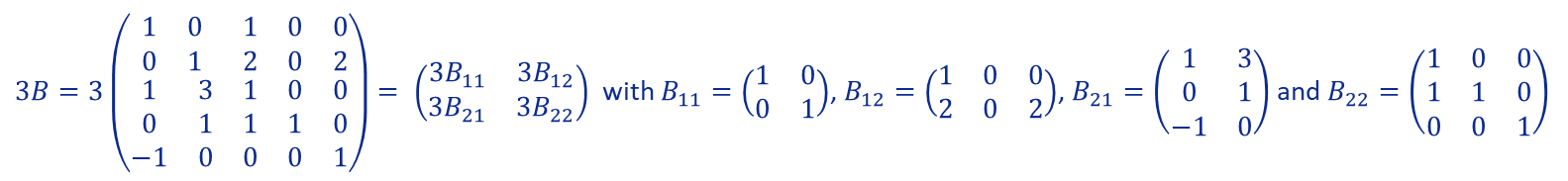
Lesson 8
If matrices $A$ and $B$ are the same size and are partitioned in exactly the same way, then the matrix sum $A+B$ will have the same partition.
1. Partitioned Matrix
2. Block Addition and Scalar M.
Each block of $A+B$ is the sum of the corresponding blocks of $A$ and $B$.
When working with partitioned matrices, the multiplication of a matrix by a scalar is also computed block-by-block.
3. Block Transpose
4. Block Multiplication
Example
Example
$3B=3\left(\begin{matrix}\begin{matrix}1 & 0 \\ 0 & 1\end{matrix} & \begin{matrix}1 & 0 & 0 \\ 2 & 0 & 2\end{matrix} \\ \begin{matrix}1 & 3 \\ 0 & 1 \\ −1 & 0\end{matrix} & \begin{matrix}1 & 0 & 0 \\ 1 & 1 & 0 \\ 0 & 0 & 1\end{matrix}\end{matrix}\right)$ $= \left(\begin{matrix}{3B}_{11} & {3B}_{12} \\ {3B}_{21} & 3B_{22}\end{matrix}\right)$ with $B_{11}=\left(\begin{matrix}1 & 0 \\ 0 & 1\end{matrix}\right)$, $B_{12}=\left(\begin{matrix}1 & 0 & 0 \\ 2 & 0 & 2\end{matrix}\right)$, $B_{21}=\left(\begin{matrix}1 & 3 \\ 0 & 1 \\ −1 & 0\end{matrix}\right)$ and $B_{22}=\left(\begin{matrix}1 & 0 & 0 \\ 1 & 1 & 0 \\ 0 & 0 & 1\end{matrix}\right)$
Try it!

Slide 9




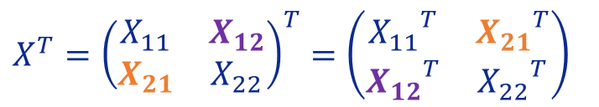



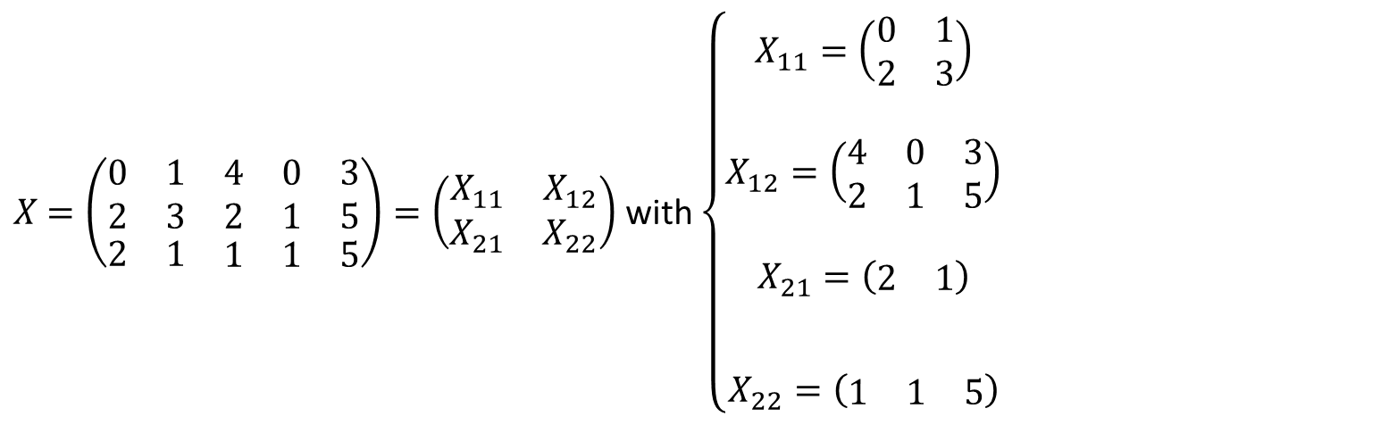

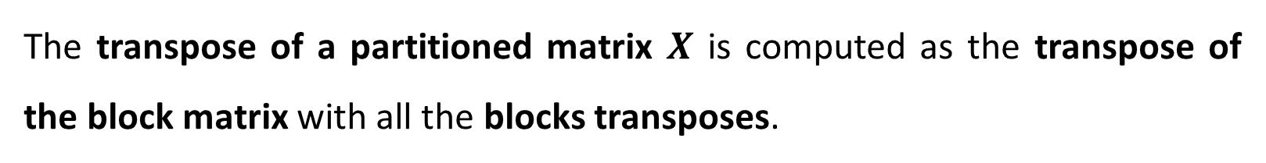

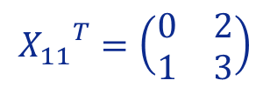
Lesson 8
The transpose of a partitioned matrix $X$ is computed as the transpose of the block matrix with all the blocks transposes.
1. Partitioned Matrix
2. Block Addition and Scalar M.
$X$ $=\left(\begin{matrix}\begin{matrix}0 & 1 \\ 2 & 3\end{matrix} & \begin{matrix}4 & 0 & 3 \\ 2 & 1 & 5\end{matrix} \\ \begin{matrix}2 & 1\end{matrix} & \begin{matrix}1 & 1 & 5\end{matrix}\end{matrix}\right)=\left(\begin{matrix}X_{11} & X_{12} \\ X_{21} & X_{22}\end{matrix}\right)$ with $\left\{\begin{matrix}\begin{matrix}\begin{aligned}X_{11}=\left(\begin{matrix}0 & 1 \\ 2 & 3\end{matrix}\right) \\ \end{aligned} \\ \begin{aligned}X_{12}=\left(\begin{matrix}4 & 0 & 3 \\ 2 & 1 & 5\end{matrix}\right) \\ \end{aligned}\end{matrix} \\ \begin{matrix}\begin{aligned}X_{21}=\left(\begin{matrix}2 & 1\end{matrix}\right) \\ {{}^{}}^{}\end{aligned} \\ X_{22}=\left(\begin{matrix}1 & 1 & 5\end{matrix}\right)\end{matrix}\end{matrix}\right.$
Example:
$${X_{11}}^{T}=\left(\begin{matrix}0 & 2 \\ 1 & 3\end{matrix}\right)$$
$${X_{12}}^{T}=\left(\begin{matrix}4 & 2 \\ 0 & 1 \\ 3 & 5\end{matrix}\right)$$
3. Block Transpose
$${X_{21}}^{T}=\left(\begin{matrix}2 \\ 1\end{matrix}\right)$$
$$X^{T}={\left(\begin{matrix}X_{11} & X_{12} \\ X_{21} & X_{22}\end{matrix}\right)}^{T}=\left(\begin{matrix}{X_{11}}^{T} & {X_{21}}^{T} \\ {X_{12}}^{T} & {X_{22}}^{T}\end{matrix}\right)$$
4. Block Multiplication
$${X_{22}}^{T}=\left(\begin{matrix}1 \\ 1 \\ 5\end{matrix}\right)$$
$X^{T}$ $=\left(\begin{matrix}\begin{matrix} & \\ & \end{matrix} & \begin{matrix} \\ \end{matrix} \\ \begin{matrix} & \\ & \\ & \end{matrix} & \begin{matrix} \\ \\ \end{matrix}\end{matrix}\right)$
$$\begin{matrix}0 & 2 \\ 1 & 3\end{matrix}$$
$$\begin{matrix}2 \\ 1\end{matrix}$$
Try it!
$$\begin{matrix}4 & 2 \\ 0 & 1 \\ 3 & 5\end{matrix}$$
$$\begin{matrix}1 \\ 1 \\ 5\end{matrix}$$

Slide 10


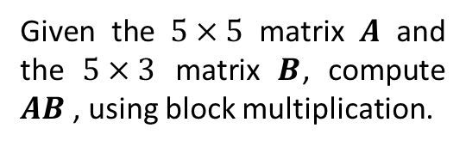


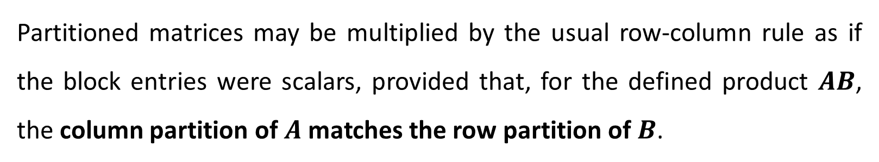
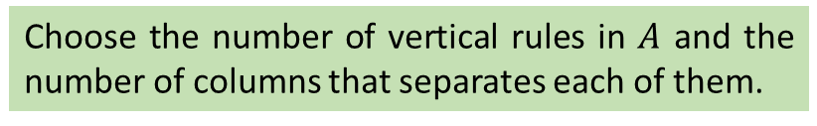
Lesson 8
Partitioned matrices may be multiplied by the usual row-column rule as if the block entries were scalars, provided that, for the defined product $AB$, the column partition of $A$ matches the row partition of $B$.
1. Partitioned Matrix
2. Block Addition and Scalar M.
Example
Given the $5×5$ matrix $A$ and the $5×3$ matrix $B$, compute $AB$ , using block multiplication.
BLOCK DIVISION
3. Block Transpose
Vertical division of $A$ and horizontal division $B$:
$$A=\left(\begin{matrix}\begin{matrix}1 & 2 \\ 3 & 0\end{matrix} & \begin{matrix}0 & 0 & 1 \\ 2 & 0 & 0\end{matrix} \\ \begin{matrix}−1 & 1 \\ 1 & 0 \\ 0 & 3\end{matrix} & \begin{matrix}1 & 0 & 0 \\ 0 & 1 & 0 \\ 0 & 0 & 1\end{matrix}\end{matrix}\right)$$
Choose the number of vertical rules in $A$ and the number of columns that separates each of them.
For example, just one vertical rule, dividing de 5 columns of $A$ in two sets of 2 + 3 columns.
4. Block Multiplication
$$B=\left(\begin{matrix}\begin{matrix}1 \\ 2\end{matrix} & \begin{matrix}3 & 0 \\ 0 & −1\end{matrix} \\ \begin{matrix}0 \\ 0 \\ 0\end{matrix} & \begin{matrix}−1 & 0 \\ 0 & 1 \\ 2 & 0\end{matrix}\end{matrix}\right)$$
Try it!

Slide 11

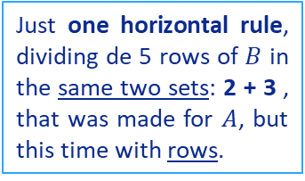
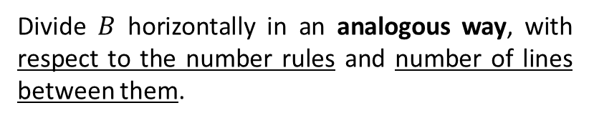
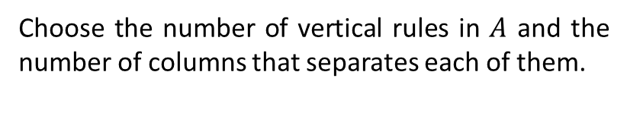
Lesson 8
Partitioned matrices may be multiplied by the usual row-column rule as if the block entries were scalars, provided that, for the defined product $AB$, the column partition of $A$ matches the row partition of $B$.
1. Partitioned Matrix
2. Block Addition and Scalar M.
Example
Given the $5×5$ matrix $A$ and the $5×3$ matrix $B$, compute $AB$ , using block multiplication.
BLOCK DIVISION
3. Block Transpose
Vertical division of $A$ and horizontal division $B$:
$$A=\left(\begin{matrix}\begin{matrix}1 & 2 \\ 3 & 0\end{matrix} & \begin{matrix}0 & 0 & 1 \\ 2 & 0 & 0\end{matrix} \\ \begin{matrix}−1 & 1 \\ 1 & 0 \\ 0 & 3\end{matrix} & \begin{matrix}1 & 0 & 0 \\ 0 & 1 & 0 \\ 0 & 0 & 1\end{matrix}\end{matrix}\right)$$
Choose the number of vertical rules in $A$ and the number of columns that separates each of them.
For example, just one vertical rule, dividing de 5 columns of $A$ in two sets of 2 + 3 columns.
4. Block Multiplication
Divide $B$ horizontally in an analogous way, with respect to the number rules and number of lines between them.
$$B=\left(\begin{matrix}\begin{matrix}1 \\ 2\end{matrix} & \begin{matrix}3 & 0 \\ 0 & −1\end{matrix} \\ \begin{matrix}0 \\ 0 \\ 0\end{matrix} & \begin{matrix}−1 & 0 \\ 0 & 1 \\ 2 & 0\end{matrix}\end{matrix}\right)$$
Just one horizontal rule, dividing de 5 rows of $B$ in the same two sets: 2 + 3 , that was made for $A$, but this time with rows.
Try it!

Slide 12

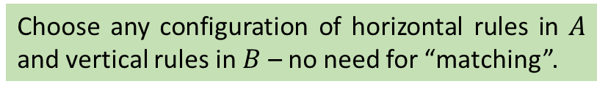
Lesson 8
Partitioned matrices may be multiplied by the usual row-column rule as if the block entries were scalars, provided that, for the defined product $AB$, the column partition of $A$ matches the row partition of $B$.
1. Partitioned Matrix
2. Block Addition and Scalar M.
Example
Given the $5×5$ matrix $A$ and the $5×3$ matrix $B$, compute $AB$ , using block multiplication.
BLOCK DIVISION
3. Block Transpose
Vertical division of $A$ and horizontal division $B$:
$$A=\left(\begin{matrix}\begin{matrix}1 & 2 \\ 3 & 0\end{matrix} & \begin{matrix}0 & 0 & 1 \\ 2 & 0 & 0\end{matrix} \\ \begin{matrix}−1 & 1 \\ 1 & 0 \\ 0 & 3\end{matrix} & \begin{matrix}1 & 0 & 0 \\ 0 & 1 & 0 \\ 0 & 0 & 1\end{matrix}\end{matrix}\right)$$
Choose the number of vertical rules in $A$ and the number of columns that separates each of them.
For example, just one horizontal, in order to “detach” the identity in the right bottom….
4. Block Multiplication
Divide $B$ horizontally in an analogous way, with respect to the number rules and number of lines between them.
$$B=\left(\begin{matrix}\begin{matrix}1 \\ 2\end{matrix} & \begin{matrix}3 & 0 \\ 0 & −1\end{matrix} \\ \begin{matrix}0 \\ 0 \\ 0\end{matrix} & \begin{matrix}−1 & 0 \\ 0 & 1 \\ 2 & 0\end{matrix}\end{matrix}\right)$$
For $B$, the choice is independent from the one made for $A$. For example, just one vertical, in order to “detach” the zero column in the left bottom….
Try it!
Horizontal division of $A$ and vertical division $B$:
Choose any configuration of horizontal rules in $A$ and vertical rules in $B$ – no need for “matching”.

Slide 13












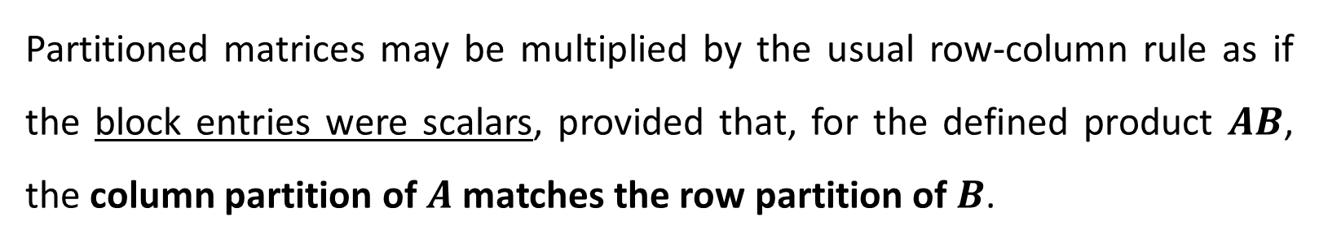



Lesson 8
Partitioned matrices may be multiplied by the usual row-column rule as if the block entries were scalars, provided that, for the defined product $AB$, the column partition of $A$ matches the row partition of $B$.
1. Partitioned Matrix
2. Block Addition and Scalar M.
Example
Given the $5×5$ matrix $A$ and the $5×3$ matrix $B$, compute $AB$ , using block multiplication.
$$A_{11}=\left(\begin{matrix}1 & 2 \\ 3 & 0\end{matrix}\right)$$
$$A_{12}=\left(\begin{matrix}0 & 0 & 1 \\ 2 & 0 & 0\end{matrix}\right)$$
$A_{21}=\left(\begin{matrix}−1 & 1 \\ 1 & 0 \\ 0 & 3\end{matrix}\right)$
$$A_{22}=I_{3}$$
3. Block Transpose
$$A=\left(\begin{matrix}\begin{matrix}1 & 2 \\ 3 & 0\end{matrix} & \begin{matrix}0 & 0 & 1 \\ 2 & 0 & 0\end{matrix} \\ \begin{matrix}−1 & 1 \\ 1 & 0 \\ 0 & 3\end{matrix} & \begin{matrix}1 & 0 & 0 \\ 0 & 1 & 0 \\ 0 & 0 & 1\end{matrix}\end{matrix}\right)$$
$\left(\begin{matrix}5 \\ 3\end{matrix}\right)$
$$\left(\begin{matrix}3 & −2 \\ 9 & 0\end{matrix}\right)+\left(\begin{matrix}2 & 0 \\ −2 & 0\end{matrix}\right)=\left(\begin{matrix}5 & −2 \\ 7 & 0\end{matrix}\right)$$
$$=\left(\begin{matrix}A_{11} & A_{12} \\ A_{21} & A_{22}\end{matrix}\right)$$
$$\left(\begin{matrix}0 \\ 0\end{matrix}\right)$$
$\left(\begin{matrix}1 & 2 \\ 3 & 0\end{matrix}\right)$ $\left(\begin{matrix}3 & 0 \\ 0 & −1\end{matrix}\right)$+ $\left(\begin{matrix}0 & 0 & 1 \\ 2 & 0 & 0\end{matrix}\right)$ $\left(\begin{matrix}−1 & 0 \\ 0 & 1 \\ 2 & 0\end{matrix}\right)$
4. Block Multiplication
$\left(\begin{matrix}1 & 2 \\ 3 & 0\end{matrix}\right) \left(\begin{matrix}1 \\ 2\end{matrix}\right)+$
Use properties!
$$AB=\left(\begin{matrix}A_{11} & A_{12} \\ A_{21} & A_{22}\end{matrix}\right)\left(\begin{matrix}B_{11} & B_{12} \\ B_{21} & B_{22}\end{matrix}\right)=\left(\begin{matrix}A_{11}B_{11}+A_{12}B_{21} & A_{11}B_{12}+A_{12}B_{22} \\ A_{21}B_{11}+A_{22}B_{21} & A_{21}B_{12}+A_{22}B_{22}\end{matrix}\right)$$
$$B_{11}=\left(\begin{matrix}1 \\ 2\end{matrix}\right)$$
$$B_{12}=\left(\begin{matrix}3 & 0 \\ 0 & −1\end{matrix}\right)$$
$B_{21}=O_{3×1}$
$B_{22}=\left(\begin{matrix}−1 & 0 \\ 0 & 1 \\ 2 & 0\end{matrix}\right)$
$$B=\left(\begin{matrix}\begin{matrix}1 \\ 2\end{matrix} & \begin{matrix}3 & 0 \\ 0 & −1\end{matrix} \\ \begin{matrix}0 \\ 0 \\ 0\end{matrix} & \begin{matrix}−1 & 0 \\ 0 & 1 \\ 2 & 0\end{matrix}\end{matrix}\right)$$
Try it!
$$=\left(\begin{matrix}B_{11} & B_{12} \\ B_{21} & B_{22}\end{matrix}\right)$$
$\left(\begin{matrix}−1 & 1 \\ 1 & 0 \\ 0 & 3\end{matrix}\right)$ $\left(\begin{matrix}1 \\ 2\end{matrix}\right)+$
$\left(\begin{matrix}−1 & 1 \\ 1 & 0 \\ 0 & 3\end{matrix}\right)\left(\begin{matrix}3 & 0 \\ 0 & −1\end{matrix}\right)+$
$$O_{3×1}$$
$$B_{22}$$
$$\left(\begin{matrix}1 \\ 1 \\ 6\end{matrix}\right)$$
$$\left(\begin{matrix}−3 & −1 \\ 3 & 0 \\ 0 & −3\end{matrix}\right)+\left(\begin{matrix}−1 & 0 \\ 0 & 1 \\ 2 & 0\end{matrix}\right)=\left(\begin{matrix}−4 & −1 \\ 3 & 1 \\ 2 & −3\end{matrix}\right)$$

Slide 14






Lesson 8
Partitioned matrices may be multiplied by the usual row-column rule as if the block entries were scalars, provided that, for the defined product $AB$, the column partition of $A$ matches the row partition of $B$.
1. Partitioned Matrix
2. Block Addition and Scalar M.
Example
Given the $5×5$ matrix $A$ and the $5×3$ matrix $B$, compute $AB$ , using block multiplication.
3. Block Transpose
$$A=\left(\begin{matrix}\begin{matrix}1 & 2 \\ 3 & 0\end{matrix} & \begin{matrix}0 & 0 & 1 \\ 2 & 0 & 0\end{matrix} \\ \begin{matrix}−1 & 1 \\ 1 & 0 \\ 0 & 3\end{matrix} & \begin{matrix}1 & 0 & 0 \\ 0 & 1 & 0 \\ 0 & 0 & 1\end{matrix}\end{matrix}\right)$$
$\left(\begin{matrix}5 \\ 3\end{matrix}\right)$
$$\left(\begin{matrix}3 & −2 \\ 9 & 0\end{matrix}\right)+\left(\begin{matrix}2 & 0 \\ −2 & 0\end{matrix}\right)=\left(\begin{matrix}5 & −2 \\ 7 & 0\end{matrix}\right)$$
$$=\left(\begin{matrix}A_{11} & A_{12} \\ A_{21} & A_{22}\end{matrix}\right)$$
$$\left(\begin{matrix}0 \\ 0\end{matrix}\right)$$
$\left(\begin{matrix}1 & 2 \\ 3 & 0\end{matrix}\right)$ $\left(\begin{matrix}3 & 0 \\ 0 & −1\end{matrix}\right)$+ $\left(\begin{matrix}0 & 0 & 1 \\ 2 & 0 & 0\end{matrix}\right)$ $\left(\begin{matrix}−1 & 0 \\ 0 & 1 \\ 2 & 0\end{matrix}\right)$
PRODUCT
4. Block Multiplication
$\left(\begin{matrix}1 & 2 \\ 3 & 0\end{matrix}\right) \left(\begin{matrix}1 \\ 2\end{matrix}\right)+$
$$AB=\left(\begin{matrix}\begin{matrix} \\ \end{matrix} & \begin{matrix} & \\ & \end{matrix} \\ \begin{matrix} \\ \\ \end{matrix} & \begin{matrix} & \\ & \\ & \end{matrix}\end{matrix}\right)$$
$$\begin{matrix}5 \\ 3\end{matrix}$$
$$\begin{matrix}5 & −2 \\ 7 & 0\end{matrix}$$
$$AB=\left(\begin{matrix}A_{11} & A_{12} \\ A_{21} & A_{22}\end{matrix}\right)\left(\begin{matrix}B_{11} & B_{12} \\ B_{21} & B_{22}\end{matrix}\right)=\left(\begin{matrix}A_{11}B_{11}+A_{12}B_{21} & A_{11}B_{12}+A_{12}B_{22} \\ A_{21}B_{11}+A_{22}B_{21} & A_{21}B_{12}+A_{22}B_{22}\end{matrix}\right)$$
$$B=\left(\begin{matrix}\begin{matrix}1 \\ 2\end{matrix} & \begin{matrix}3 & 0 \\ 0 & −1\end{matrix} \\ \begin{matrix}0 \\ 0 \\ 0\end{matrix} & \begin{matrix}−1 & 0 \\ 0 & 1 \\ 2 & 0\end{matrix}\end{matrix}\right)$$
$$\begin{matrix}1 \\ 1 \\ 6\end{matrix}$$
$$\begin{matrix}−4 & −1 \\ 3 & 1 \\ 2 & −3\end{matrix}$$
Try it!
$$=\left(\begin{matrix}B_{11} & B_{12} \\ B_{21} & B_{22}\end{matrix}\right)$$
$\left(\begin{matrix}−1 & 1 \\ 1 & 0 \\ 0 & 3\end{matrix}\right)$ $\left(\begin{matrix}1 \\ 2\end{matrix}\right)+$
$\left(\begin{matrix}−1 & 1 \\ 1 & 0 \\ 0 & 3\end{matrix}\right)\left(\begin{matrix}3 & 0 \\ 0 & −1\end{matrix}\right)+$
$$O_{3×1}$$
$$B_{22}$$
$$\left(\begin{matrix}1 \\ 1 \\ 6\end{matrix}\right)$$
$$\left(\begin{matrix}−3 & −1 \\ 3 & 0 \\ 0 & −3\end{matrix}\right)+\left(\begin{matrix}−1 & 0 \\ 0 & 1 \\ 2 & 0\end{matrix}\right)=\left(\begin{matrix}−4 & −1 \\ 3 & 1 \\ 2 & −3\end{matrix}\right)$$

Slide 15



Lesson 8
Better to have some paper and pen nearby before trying it!…
1. Partitioned Matrix
2. Block Addition and Scalar M.
3. Block Transpose
4. Block Multiplication
Try it!

Slide 16
Lesson 8
1. Partitioned Matrix
2. Block Addition and Scalar M.
3. Block Transpose
4. Block Multiplication
Try it!

Slide 17


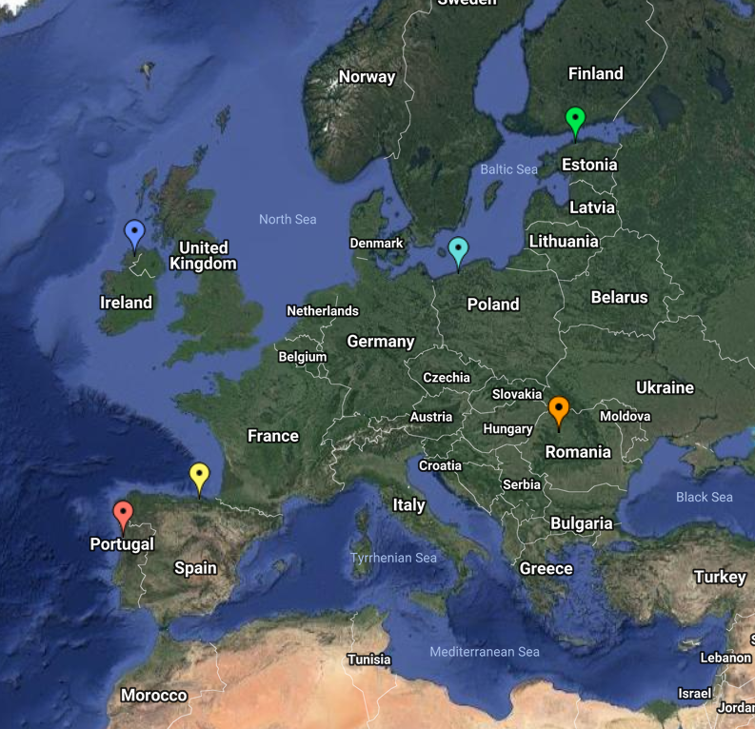
End of Lesson 8
Hope you enjoyed it!
1. Partitioned Matrix
2. Block Addition and Scalar M.
3. Block Transpose
4. Block Multiplication
Try it!
By EngiMath TEAM

