Slide 1



Lesson 8 Plan
Remember!
You can travel through all the sections (enter or mouse click) or choose your section by clicking over it.
You should only “Try it” after exploring all lesson contents!
1. Inverse of a Matrix
2. Properties of the Inverse
Try it!
By EngiMath TEAM

Slide 2

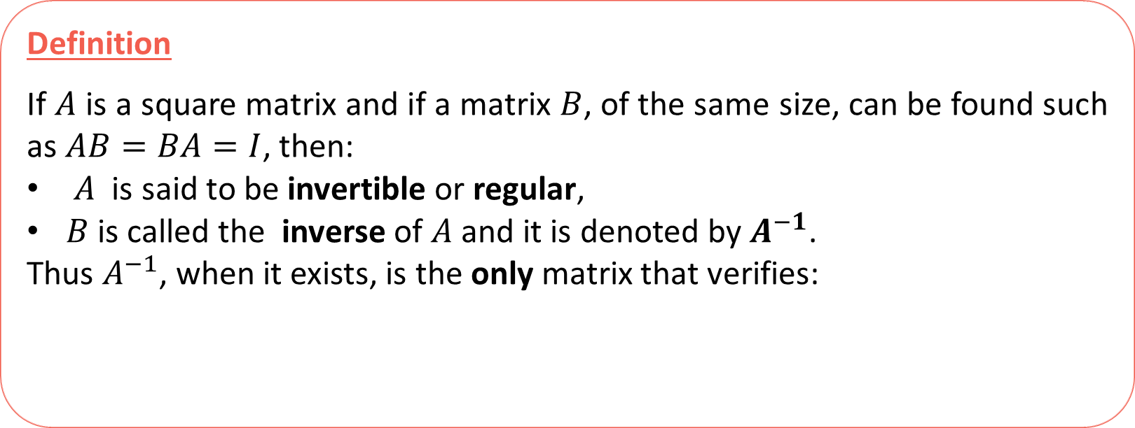
Lesson 8
Definition
If $A$ is a square matrix and if a matrix $B$, of the same size, can be found such as $AB=BA=I$, then:
$A$ is said to be invertible or regular,
$B$ is called the inverse of $A$ and it is denoted by $A^{−1}$.
Thus $A^{−1}$, when it exists, is the only matrix that verifies:
1. Inverse of a Matrix
2. Properties of the Inverse
$${AA}^{−1}=A^{−1}A=I$$
Try it!

Slide 3

Lesson 8
Definition
If $A$ is a square matrix and if a matrix $B$, of the same size, can be found such as $AB=BA=I$, then:
$A$ is said to be invertible or regular,
$B$ is called the inverse of $A$ and it is denoted by $A^{−1}$.
Thus $A^{−1}$, when it exists, is the only matrix that verifies:
1. Inverse of a Matrix
2. Properties of the Inverse
$${AA}^{−1}=A^{−1}A=I$$
$${⇔∄A}^{−1}$$
If no such matrix $B$ can be found, then $A$ is said to be singular
REMARKS
Try it!
The inverse of $A$ plays the same role in matrix arithmetic that the reciprocal $a^{−1}$ plays in the numerical relation $a^{−1}.a=a.a^{−1}=1$.
NO DIVISION in matrix arithmetic! .
The “corresponding” operation is the multiplication by the inverse.
NO FRACTION representation!
In $IR$ or $ℂ$: $a^{−1}=\frac{1}{a}$ . In matrix arithmetic , $\frac{1}{A}$ has no meaning – it is an ERROR representation!

Slide 4



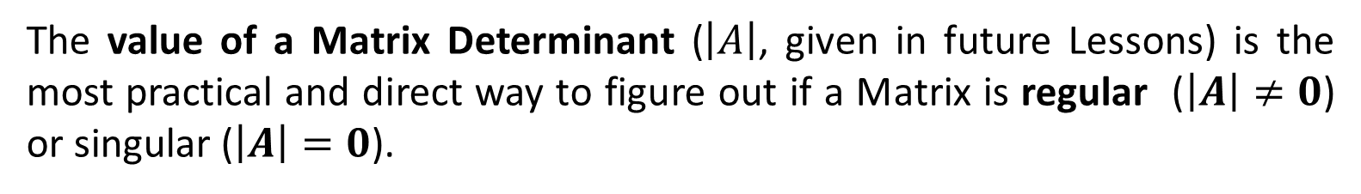
Lesson 8
${∃A}^{−1} ⇔$ $A$ is invertible or regular $⇔$ or
Resume
(practice)
$${AA}^{−1}=I$$
$$A^{−1}A=I$$
${∄A}^{−1} ⇔ A$ is singular or non invertible
1. Inverse of a Matrix
Important
Matrix inverse computation is one of the most “tricky” operations in matrix arithmetic.
2. Properties of the Inverse
In future lessons, several alternative ways will be worked, like – Using Elementary Operations – Through the Adjunct Matrix, etc.
The value of a Matrix Determinant ($\left|A\right|$, given in future Lessons) is the most practical and direct way to figure out if a Matrix is regular ($\left|A\right|≠0$) or singular ($\left|A\right|=0$).
Try it!
For now, we can only rely on the definition using one of the relations above. Notice that as the inverse is unique, we just need to test one these!...

Slide 5
Lesson 8
${∃A}^{−1} ⇔$ $A$ is invertible or regular $⇔$ or
Resume
(practice)
$${AA}^{−1}=I$$
$$A^{−1}A=I$$
${∄A}^{−1} ⇔ A$ is singular or non invertible
1. Inverse of a Matrix
Examples
Given $A=\left(\begin{matrix}1 & −1 \\ 3 & −2\end{matrix}\right)$, verify if $B=\left(\begin{matrix}−2 & 1 \\ −3 & 1\end{matrix}\right)$ or $C=\left(\begin{matrix}−2 & 1 \\ 3 & 1\end{matrix}\right)$ is the inverse of $A$.
2. Properties of the Inverse
Try it!

Slide 6

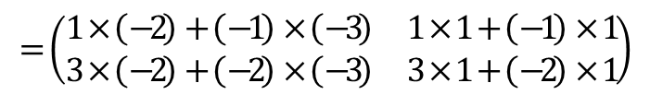

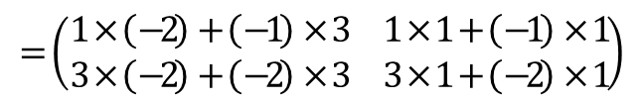


Lesson 8
${∃A}^{−1} ⇔$ $A$ is invertible or regular $⇔$ or
Resume
(practice)
$${AA}^{−1}=I$$
$$A^{−1}A=I$$
${∄A}^{−1} ⇔ A$ is singular or non invertible
1. Inverse of a Matrix
Examples
Given $A=\left(\begin{matrix}1 & −1 \\ 3 & −2\end{matrix}\right)$, verify if $B=\left(\begin{matrix}−2 & 1 \\ −3 & 1\end{matrix}\right)$ or $C=\left(\begin{matrix}−2 & 1 \\ 3 & 1\end{matrix}\right)$ is the inverse of $A$.
2. Properties of the Inverse
Since the question is to verify, just need to test if $AB=I$ and (or) $AC=I:$
$\left(\begin{matrix}1 & −1 \\ 3 & −2\end{matrix}\right)\left(\begin{matrix}−2 & 1 \\ −3 & 1\end{matrix}\right)=\left(\begin{matrix}1 & 0 \\ 0 & 1\end{matrix}\right)$
$\left(\begin{matrix}1 & −1 \\ 3 & −2\end{matrix}\right)\left(\begin{matrix}−2 & 1 \\ 3 & 1\end{matrix}\right)=\left(\begin{matrix}1 & 0 \\ 0 & 1\end{matrix}\right)$
$$=\left(\begin{matrix}1×\left(−2\right)+\left(−1\right)×\left(−3\right) & 1×1+\left(−1\right)×1 \\ 3×\left(−2\right)+\left(−2\right)×\left(−3\right) & 3×1+\left(−2\right)×1\end{matrix}\right)$$
$$=\left(\begin{matrix}1×\left(−2\right)+\left(−1\right)×3 & 1×1+\left(−1\right)×1 \\ 3×\left(−2\right)+\left(−2\right)×3 & 3×1+\left(−2\right)×1\end{matrix}\right)$$
Try it!
$=\left(\begin{matrix}−2+3 & 1−1 \\ −6+6 & 3−2\end{matrix}\right)$= $\left(\begin{matrix}1 & 0 \\ 0 & 1\end{matrix}\right)$
$=\left(\begin{matrix}−2−3 & 1−1 \\ −6−6 & 3−2\end{matrix}\right)$= $\left(\begin{matrix}−5 & 0 \\ −12 & 1\end{matrix}\right)$
Notice: The second part of the proposed solution is unnecessary since the inverse is unique! If ${B=A}^{−1}$then $C$ could never verify the relation $AC=I$!

Slide 7










Lesson 8
${∃A}^{−1} ⇔$ $A$ is invertible or regular $⇔$ or
Resume
(practice)
$${AA}^{−1}=I$$
$$A^{−1}A=I$$
${∄A}^{−1} ⇔ A$ is singular or non invertible
1. Inverse of a Matrix
Examples
Find the inverse of $A=\left(\begin{matrix}1 & −4 \\ 2 & −9\end{matrix}\right)$ and $B=\left(\begin{matrix}1 & −4 \\ 2 & −8\end{matrix}\right)$, if it exists.
2. Properties of the Inverse
$$\left(\begin{matrix}a & b \\ c & d\end{matrix}\right)$$
$A^{−1}$(if it exists) is a $2×2$ matrix – same size of $A$, whose elements are unknown:
(chose any distinct letters to represent all these 4 entries) and apply definition:
$$⇔\left\{\begin{matrix}\begin{matrix}a−4c=1 \\ 2a−9c=0\end{matrix} \\ \begin{matrix}b−4d=0 \\ 2b−9d=1\end{matrix}\end{matrix}\right.$$
$$⇔\left\{\begin{matrix}\begin{matrix}a−4c=1 \\ 2a−9c=0\end{matrix} \\ \begin{matrix}b−4d=0 \\ 2b−9d=1\end{matrix}\end{matrix}\right.$$
These are 2 independent systems of 2 variables, that can be solved with the “same steps” – using substitution for example.
$\left(\begin{matrix}1 & −4 \\ 2 & −9\end{matrix}\right)$ $\left(\begin{matrix}a & b \\ c & d\end{matrix}\right)$ $=\left(\begin{matrix}1 & 0 \\ 0 & 1\end{matrix}\right)$
$⇔\left(\begin{matrix}a−4c & b−4d \\ 2a−9c & 2b−9d\end{matrix}\right)$ $=\left(\begin{matrix}1 & 0 \\ 0 & 1\end{matrix}\right)$
Try it!
This is transformed in a system of linear equations with 4 variables.
$$⇔\left\{\begin{matrix}\begin{matrix}a=1+4c \\ 2\left(1+4c\right)−9c=0\end{matrix} \\ \begin{matrix}b=4d \\ 2\left(4d\right)−9d=1\end{matrix}\end{matrix}\right.$$
$$⇔\left\{\begin{matrix}\begin{matrix}2…0 \\ 2+8c−9c=0\end{matrix} \\ \begin{matrix}2…0 \\ 8d−9d=1\end{matrix}\end{matrix}\right.$$
$$⇔\left\{\begin{matrix}\begin{matrix}a=1+4×2 \\ c=2\end{matrix} \\ \begin{matrix}b=4×\left(−1\right) \\ d=−1\end{matrix}\end{matrix}\right.$$
$$⇔\left\{\begin{matrix}\begin{matrix}a=9 \\ c=2\end{matrix} \\ \begin{matrix}b=−4 \\ d=−1\end{matrix}\end{matrix}\right.$$
$$A^{−1}=\left(\begin{matrix}9 & −4 \\ 2 & 1\end{matrix}\right)$$

Slide 8










Lesson 8
${∃A}^{−1} ⇔$ $A$ is invertible or regular $⇔$ or
Resume
(practice)
$${AA}^{−1}=I$$
$$A^{−1}A=I$$
${∄A}^{−1} ⇔ A$ is singular or non invertible
1. Inverse of a Matrix
Examples
Find the inverse of $A=\left(\begin{matrix}1 & −4 \\ 2 & −9\end{matrix}\right)$ and $B=\left(\begin{matrix}1 & −4 \\ 2 & −8\end{matrix}\right)$, if it exists.
2. Properties of the Inverse
$$\left(\begin{matrix}a & b \\ c & d\end{matrix}\right)$$
Following the same steps for $B^{−1}$(if it exists), a $2×2$ matrix with unknown elements:
and applying the definition:
$$⇔\left\{\begin{matrix}\begin{matrix}a−4c=1 \\ 2a−8c=0\end{matrix} \\ \begin{matrix}b−4d=0 \\ 2b−8d=1\end{matrix}\end{matrix}\right.$$
$$⇔\left\{\begin{matrix}\begin{matrix}a−4c=1 \\ 2a−8c=0\end{matrix} \\ \begin{matrix}b−4d=0 \\ 2b−8d=1\end{matrix}\end{matrix}\right.$$
$\left(\begin{matrix}1 & −4 \\ 2 & −8\end{matrix}\right)$ $\left(\begin{matrix}a & b \\ c & d\end{matrix}\right)$ $=\left(\begin{matrix}1 & 0 \\ 0 & 1\end{matrix}\right)$
$⇔\left(\begin{matrix}a−4c & b−4d \\ 2a−8c & 2b−8d\end{matrix}\right)$ $=\left(\begin{matrix}1 & 0 \\ 0 & 1\end{matrix}\right)$
Try it!
$$⇔\left\{\begin{matrix}\begin{matrix}a=1+4c \\ 2\left(1+4c\right)−8c=0\end{matrix} \\ \begin{matrix}b=4d \\ 2\left(4d\right)−8d=1\end{matrix}\end{matrix}\right.$$
$$⇔\left\{\begin{matrix}\begin{matrix}2…0 \\ 2+8c−8c=0\end{matrix} \\ \begin{matrix}2…0 \\ 8d−8d=1\end{matrix}\end{matrix}\right.$$
$$⇔\left\{\begin{matrix}\begin{matrix}2…0 \\ 0=2\end{matrix} \\ \begin{matrix}2…0 \\ 0=−1\end{matrix}\end{matrix}\right.$$
The system is inconsistent!
So, $B$is a singular!
$${∄B}^{−1}$$

Slide 9






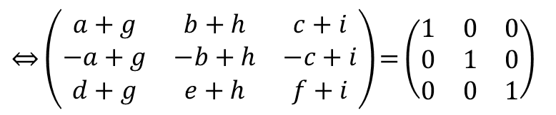
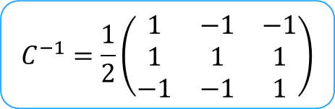
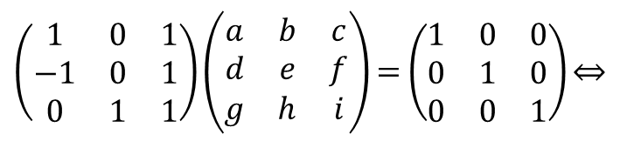


Lesson 8
${∃A}^{−1} ⇔$ $A$ is invertible or regular $⇔$ or
Resume
(practice)
$${AA}^{−1}=I$$
$$A^{−1}A=I$$
${∄A}^{−1} ⇔ A$ is singular or non invertible
1. Inverse of a Matrix
Examples
$$C^{−1}=\frac{1}{2}\left(\begin{matrix}1 & −1 & −1 \\ 1 & 1 & 1 \\ −1 & −1 & 1\end{matrix}\right)$$
Find the inverse of $C=\left(\begin{matrix}1 & 0 & 1 \\ −1 & 0 & 1 \\ 0 & 1 & 1\end{matrix}\right)$, if it exists.
2. Properties of the Inverse
This is just a small “sample of the workload” necessary to compute by definition, the inverses of square matrices of higher orders:
$\left(\begin{matrix}1 & 0 & 1 \\ −1 & 0 & 1 \\ 0 & 1 & 1\end{matrix}\right)$ $\left(\begin{matrix}a & b & c \\ d & e & f \\ g & h & i\end{matrix}\right)$ $=\left(\begin{matrix}1 & 0 & 0 \\ 0 & 1 & 0 \\ 0 & 0 & 1\end{matrix}\right)$ $⇔$
$$⇔\left\{\begin{matrix}\begin{matrix}a+g=1 \\ −a+g=0 \\ d+g=0\end{matrix} \\ \begin{matrix}\begin{matrix}b+h=0 \\ −b+h=1 \\ e+h=0\end{matrix} \\ \begin{matrix}c+i=0 \\ −c+i=1 \\ f+i=1\end{matrix}\end{matrix}\end{matrix}\right.$$
$$⇔\left\{\begin{matrix}\begin{matrix}a=1/2 \\ g=a \\ d=−g\end{matrix} \\ \begin{matrix}\begin{matrix}b=−h \\ h=1/2 \\ e=−h\end{matrix} \\ \begin{matrix}c=−i \\ i=1/2 \\ f=1/2\end{matrix}\end{matrix}\end{matrix}\right.$$
$$⇔\left\{\begin{matrix}\begin{matrix}a=1/2 \\ g=1/2 \\ d=−1/2\end{matrix} \\ \begin{matrix}\begin{matrix}b=−1/2 \\ h=1/2 \\ e=−1/2\end{matrix} \\ \begin{matrix}c=−1/2 \\ i=1/2 \\ f=1/2\end{matrix}\end{matrix}\end{matrix}\right.$$
Alternative ways!
(future Lessons)
However, this is one of the hardest operations to be done by hand for higher order matrices!
Try it!
Can you imagine the calculation of a 4x4 inverse matrix?...
$⇔\left(\begin{matrix}a+g & b+h & c+i \\ −a+g & −b+h & −c+i \\ d+g & e+h & f+i\end{matrix}\right)$ $=\left(\begin{matrix}1 & 0 & 0 \\ 0 & 1 & 0 \\ 0 & 0 & 1\end{matrix}\right)$

Slide 10
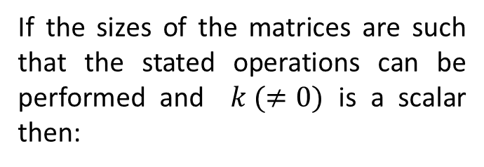

Lesson 8
Properties
1. Inverse of a Matrix
If the sizes of the matrices are such that the stated operations can be performed and $k (≠0)$ is a scalar then:
$${(A^{−1})}^{−1}=A$$
Inverting the inverse… gets you back to the start!
2. Properties of the Inverse
Try it!

Slide 11

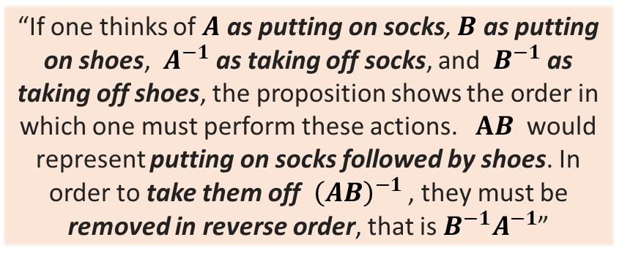



Lesson 8
“If one thinks of $A$ as putting on socks, $B$ as putting on shoes, $A^{−1}$as taking off socks, and $B^{−1}$as taking off shoes, the proposition shows the order in which one must perform these actions. $AB$ would represent putting on socks followed by shoes. In order to take them off ${\left(AB\right)}^{−1}$ , they must be removed in reverse order, that is $B^{−1}A^{−1}$”
Properties
1. Inverse of a Matrix
If the sizes of the matrices are such that the stated operations can be performed and $k (≠0)$ is a scalar then:
$${(A^{−1})}^{−1}=A$$
Inverting the inverse… gets you back to the start!
2. Properties of the Inverse
$${(kA)}^{−1}={\frac{1}{k}A}^{−1}$$
Inverting the product of a matrix by a scalar is the same as multiplying the inverse matrix by the inverse of the scalar! So, the scalar cannot be zero!
$${\left(AB\right)}^{−1}=B^{−1}A^{−1}$$
“socks and shoes rule” - similar to transpose of $AB$
Try it!
Click on the image
if you want to read about the “rule”
If $A$ and $B$ are invertible, what can we say about${(A+B) }^{−1}$?
$${(A+B) }^{−1}≠A^{−1}+B^{−1}$$
There are no guarantees about this inverse! Be CAREFULL!

Slide 12
Lesson 8
Propositions
1. Inverse of a Matrix
If the sizes of the matrices are such that the stated operations can be performed and $k (≠0)$ is a scalar then:
$${(A^{−1})}^{−1}=A$$
Inverting the inverse… gets you back to the start!
2. Properties of the Inverse
$${(kA)}^{−1}={\frac{1}{k}A}^{−1}$$
Inverting the product of a matrix by a scalar is the same as multiplying the inverse matrix by the inverse of the scalar! So, the scalar cannot be zero!
$${\left(AB\right)}^{−1}=B^{−1}A^{−1}$$
“socks and shoes rule” - similar to transpose of $AB$
Try it!
Click on the image
if you want to read about the “rule”
– The notion of an inverse matrix only applies to square matrices.
Take-Home Messages
– Not all square matrices are invertible.
– If $A$ is invertible, its inverse is unique, denoted by it $A^{−1}$ and
– $A^{−1}$ is one of the matrices that commutes with $A$: $A^{−1}.A=A.A^{−1}$

Slide 13



Lesson 8
Maybe a pen and paper will be needed to answer these final questions!…
1. Inverse of a Matrix
2. Properties of the Inverse
Try it!

Slide 14


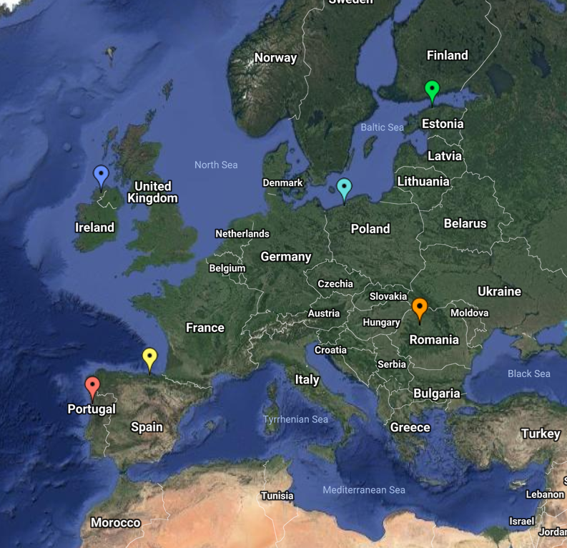
End of Lesson 8
Hope you enjoyed it!
1. Inverse of a Matrix
2. Properties of the Inverse
Try it!
By EngiMath TEAM

