Slide 1



Lesson 10 Plan
Remember!
You can travel through all the sections (enter or mouse click) or choose your section by clicking over it.
You should only “Try it” after exploring all lesson contents!
1. Power of Matrix
2. Other Matrix Propositions and Relations
Try it!
By EngiMath TEAM

Slide 2


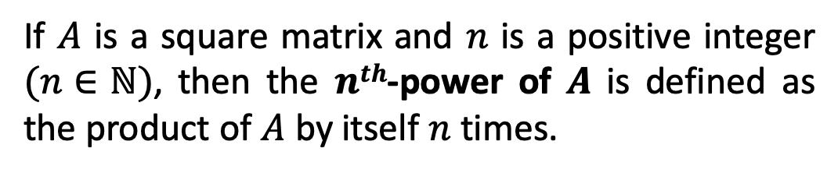
Lesson 10
Definition
1. Power of Matrix
If $A$ is a square matrix and $n$ is a positive integer $(n∈ℕ)$, then the $nth$-power of $A$ is defined as the product of $A$ by itself $n$ times.
$$A^{n}=A . A .⋯. A$$
$n$ factors
2. Other Matrix Propositions and Relations
Try it!

Slide 3


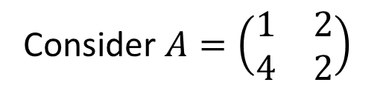
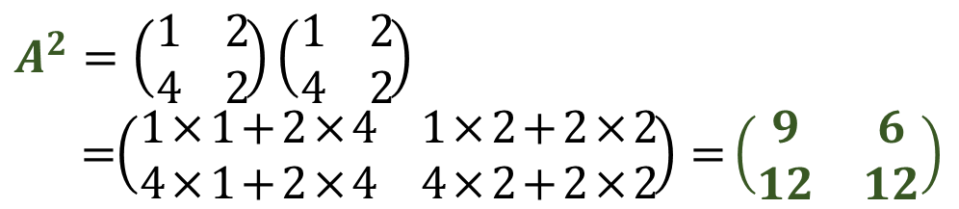



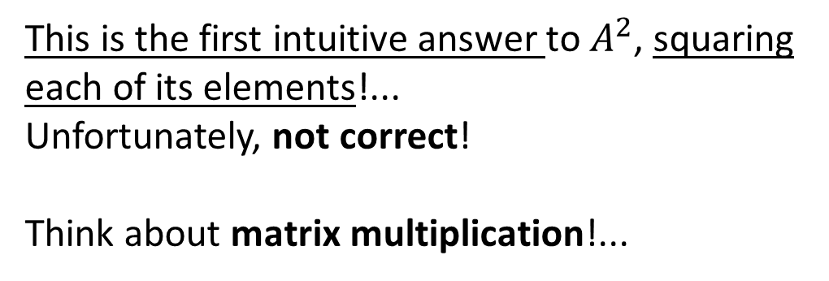

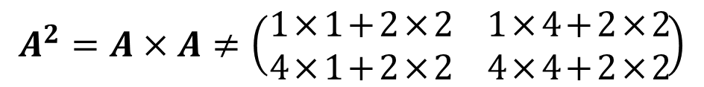
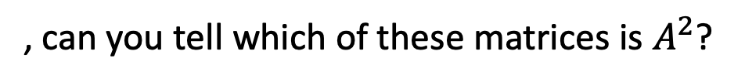
Lesson 10
Definition
1. Power of Matrix
If $A$ is a square matrix and $n$ is a positive integer $(n∈ℕ)$, then the $nth$-power of $A$ is defined as the product of $A$ by itself $n$ times.
$$A^{n}=A . A .⋯. A$$
$n$ factors
2. Other Matrix Propositions and Relations
Examples
Consider $A=\left(\begin{matrix}1 & 2 \\ 4 & 2\end{matrix}\right)$
, can you tell which of these matrices is $A^{2}$?
(Do some work before you “try your luck”! Pick by CLICK!)
$\left(\begin{matrix}1 & 4 \\ 16 & 4\end{matrix}\right)$
This is the first intuitive answer to $A^{2}$, squaring each of its elements!...
Unfortunately, not correct!
Think about matrix multiplication!...
UPS!... Matrix multiplication not correct!…
Maybe you got it wrong…. and multiplied rows by rows… review your work!
GOOD JOB! Through matrix multiplication!...
(lines 1st x columns 2nd)
Try it!
$\left(\begin{matrix}9 & 6 \\ 12 & 12\end{matrix}\right)$
$$A^{2}=A×A$$
$$A^{2} ≠\left(\begin{matrix}1^{2} & 2^{2} \\ 4^{2} & 2^{2}\end{matrix}\right)$$
$$A^{2}=\left(\begin{matrix}1 & 2 \\ 4 & 2\end{matrix}\right)\left(\begin{matrix}1 & 2 \\ 4 & 2\end{matrix}\right)$$
$=$ $\left(\begin{matrix}1×1+2×4 & 1×2+2×2 \\ 4×1+2×4 & 4×2+2×2\end{matrix}\right)=\left(\begin{matrix}9 & 6 \\ 12 & 12\end{matrix}\right)$
$$A^{2}=A×A≠\left(\begin{matrix}1×1+2×2 & 1×4+2×2 \\ 4×1+2×2 & 4×4+2×2\end{matrix}\right)$$
$\left(\begin{matrix}5 & 8 \\ 8 & 20\end{matrix}\right)$

Slide 4



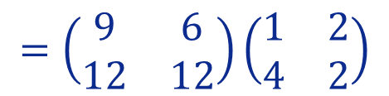

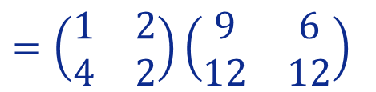



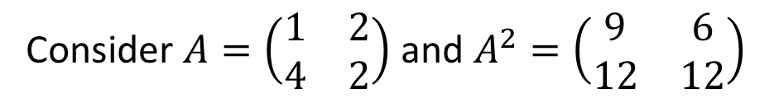

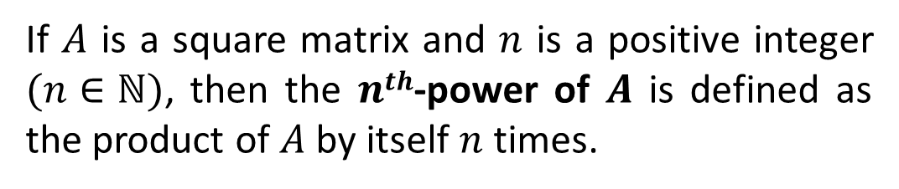

Lesson 10
Definition
1. Power of Matrix
If $A$ is a square matrix and $n$ is a positive integer $(n∈ℕ)$, then the $nth$-power of $A$ is defined as the product of $A$ by itself $n$ times.
$$A^{n}=A . A .⋯. A$$
$n$ factors
2. Other Matrix Propositions and Relations
Examples
Consider $A=\left(\begin{matrix}1 & 2 \\ 4 & 2\end{matrix}\right)$ and $A^{2}=\left(\begin{matrix}9 & 6 \\ 12 & 12\end{matrix}\right)$
. How to compute $A^{3}$? …
$$A^{3}=A×A×A$$
$=A×$ $A^{2}$
$=\left(\begin{matrix}1 & 2 \\ 4 & 2\end{matrix}\right)\left(\begin{matrix}9 & 6 \\ 12 & 12\end{matrix}\right)$
$$=\left(\begin{matrix}1×9+2×12 & 1×6+2×12 \\ 4×9+2×12 & 4×6+2×12\end{matrix}\right)$$
Try it!
associativity
Notice that associativity could be applied in another order:
$=\left(\begin{matrix}33 & 30 \\ 60 & 48\end{matrix}\right)$
But… the result is, obviously, the same!
associativity
$$=\left(\begin{matrix}9 & 6 \\ 12 & 12\end{matrix}\right)\left(\begin{matrix}1 & 2 \\ 4 & 2\end{matrix}\right)$$
$$A^{3}=A×A×A$$
$$=A^{2}×A$$
$$=\left(\begin{matrix}9×1+6×4 & 9×2+6×12 \\ 12×1+12×4 & 12×2+12×2\end{matrix}\right)$$

Slide 5

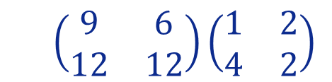
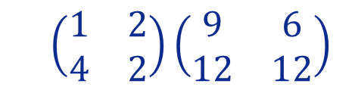
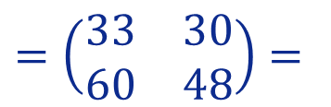
Lesson 10
Definition
1. Power of Matrix
If $A$ is a square matrix and $n$ is a positive integer $(n∈ℕ)$, then the $nth$-power of $A$ is defined as the product of $A$ by itself $n$ times.
$$A^{n}=A . A .⋯. A$$
$n$ factors
2. Other Matrix Propositions and Relations
Examples
Generalize and Remember
from this example:
Consider $A=\left(\begin{matrix}1 & 2 \\ 4 & 2\end{matrix}\right)$ and $A^{2}=\left(\begin{matrix}9 & 6 \\ 12 & 12\end{matrix}\right)$
. How to compute $A^{3}$? …
Any power of $A$ commutes with $A$! That is: $A^{n}A=AA^{n}$
$$A^{3}=A×A×A$$
$=A×$ $A^{2}$
$=\left(\begin{matrix}1 & 2 \\ 4 & 2\end{matrix}\right)\left(\begin{matrix}9 & 6 \\ 12 & 12\end{matrix}\right)$
$$=\left(\begin{matrix}1×9+2×12 & 1×6+2×12 \\ 4×9+2×12 & 4×6+2×12\end{matrix}\right)$$
Try it!
associativity
Notice that associativity could be applied in another order:
$=\left(\begin{matrix}33 & 30 \\ 60 & 48\end{matrix}\right)=$
But… the result is, obviously, the same!
associativity
$$=\left(\begin{matrix}9 & 6 \\ 12 & 12\end{matrix}\right)\left(\begin{matrix}1 & 2 \\ 4 & 2\end{matrix}\right)$$
$$A^{3}=A×A×A$$
$$=A^{2}×A$$
$$=\left(\begin{matrix}9×1+6×4 & 9×2+6×12 \\ 12×1+12×4 & 12×2+12×2\end{matrix}\right)$$

Slide 6
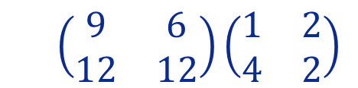
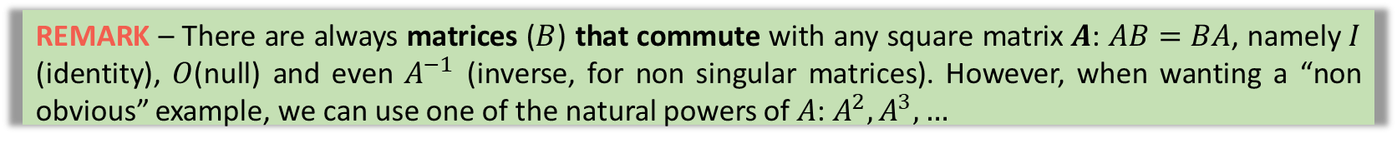
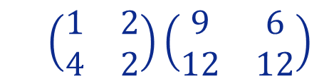
Lesson 10
Definition
1. Power of Matrix
If $A$ is a square matrix and $n$ is a positive integer $(n∈ℕ)$, then the $nth$-power of $A$ is defined as the product of $A$ by itself $n$ times.
$$A^{n}=A . A .⋯. A$$
$n$ factors
2. Other Matrix Propositions and Relations
Generalize and Remember
from this example:
Any power of $A$ commutes with $A$! That is: $A^{n}A=AA^{n}$
$=\left(\begin{matrix}1 & 2 \\ 4 & 2\end{matrix}\right)\left(\begin{matrix}9 & 6 \\ 12 & 12\end{matrix}\right)$
$$=\left(\begin{matrix}9 & 6 \\ 12 & 12\end{matrix}\right)\left(\begin{matrix}1 & 2 \\ 4 & 2\end{matrix}\right)$$
Try it!
$=\left(\begin{matrix}33 & 30 \\ 60 & 48\end{matrix}\right)=$
REMARK – There are always matrices ($B$) that commute with any square matrix $A$: $AB=BA$, namely $I$ (identity), $O$(null) and even $A^{−1}$ (inverse, for non singular matrices). However, when wanting a “non obvious” example, we can use one of the natural powers of $A$: $A^{2},A^{3}, …$

Slide 7

Lesson 10
Matrix arithmetic generates several “peculiar properties”.
Some of these are specific for matrices (as working with the transpose) and several others result essentially from lack of a commutative multiplication!
1. Power of Matrix
2. Other Matrix Propositions and Relations
Try it!

Slide 8
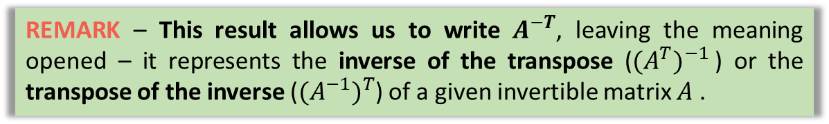
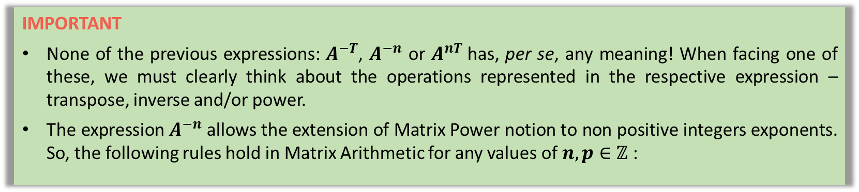

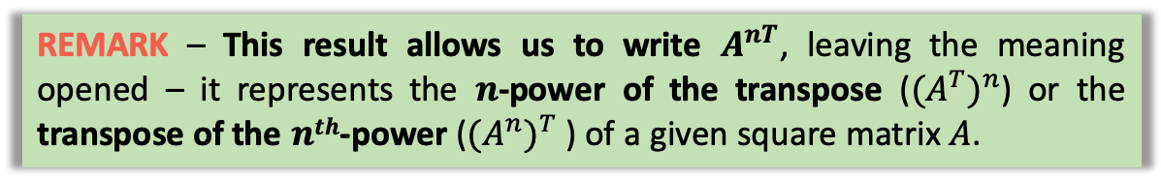

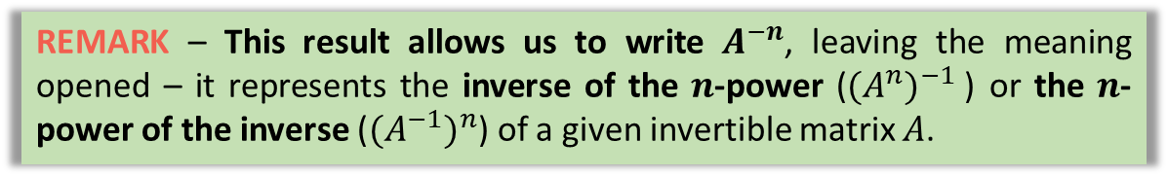

Lesson 10
Matrix arithmetic generates several “peculiar properties”.
Some of these are specific for matrices (as working with the transpose) and several others result essentially from lack of a commutative multiplication!
1. Power of Matrix
REMARK – This result allows us to write $A^{−T}$, leaving the meaning opened – it represents the inverse of the transpose (${(A^{T})}^{−1}$) or the transpose of the inverse (${(A^{−1})}^{T}$) of a given invertible matrix $A$ .
$${(A^{−1})}^{T}={(A^{T})}^{−1}$$
REMARK – This result allows us to write $A^{−n}$, leaving the meaning opened – it represents the inverse of the $n$-power (${(A^{n})}^{−1}$) or the $n$-power of the inverse (${(A^{−1})}^{n}$) of a given invertible matrix $A$.
2. Other Matrix Propositions and Relations
$${(A^{−1})}^{n}={(A^{n})}^{−1}$$
REMARK – This result allows us to write $A^{nT}$, leaving the meaning opened – it represents the $n$-power of the transpose (${(A^{T})}^{n}$) or the transpose of the $nth$-power (${(A^{n})}^{T}$) of a given square matrix $A$.
$${(A^{T})}^{n}={(A^{n})}^{T}$$
Try it!
IMPORTANT
None of the previous expressions: $A^{−T}$, $A^{−n}$ or $A^{nT}$has, per se, any meaning! When facing one of these, we must clearly think about the operations represented in the respective expression – transpose, inverse and/or power.
The expression $A^{−n}$ allows the extension of Matrix Power notion to non positive integers exponents. So, the following rules hold in Matrix Arithmetic for any values of $n,p∈ℤ$:

Slide 9




Lesson 10
Matrix arithmetic generates several “peculiar properties”.
Some of these are specific for matrices (as working with the transpose) and several others result essentially from lack of a commutative multiplication!
1. Power of Matrix
$${(A^{−1})}^{T}={(A^{T})}^{−1}$$
$${(A^{n})}^{p}=A^{n×p}$$
2. Other Matrix Propositions and Relations
$${(A^{−1})}^{n}={(A^{n})}^{−1}$$
$${A^{n}A}^{p}=A^{n+p}$$
$${(A^{T})}^{n}={(A^{n})}^{T}$$
$$A^{0}=I$$
Try it!
IMPORTANT
None of the previous expressions: $A^{−T}$, $A^{−n}$ or $A^{nT}$has, per se, any meaning! When facing one of these, we must clearly think about the operations represented in the respective expression – transpose, inverse and/or power.
The expression $A^{−n}$ allows the extension of Matrix Power notion to non positive integers exponents. So, the following rules hold in Matrix Arithmetic for any values of $n,p∈ℤ$:

Slide 10
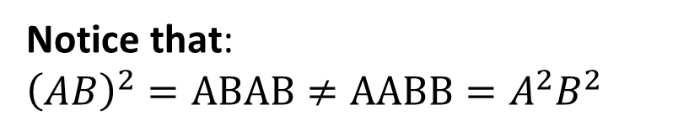

Lesson 10
Matrix Relations - TRUE or FALSE?...
1. Power of Matrix
For any two $(n×n)$ matrices $A$ and $B$ is it true that:…
$${\left(AB\right)}^{2}=A^{2}B^{2}$$
NO!
Notice that:
$${\left(AB\right)}^{2}=ABAB≠AABB=A^{2}B^{2}$$
2. Other Matrix Propositions and Relations
Matrix multiplication is not commutative
Try it!

Slide 11
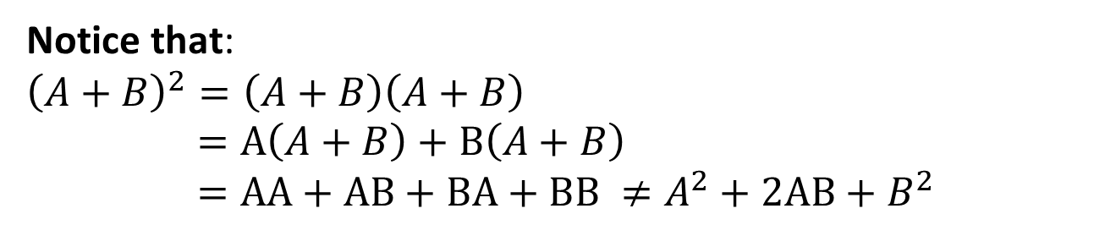


Lesson 10
Matrix Relations - TRUE or FALSE?...
1. Power of Matrix
For any two $(n×n)$ matrices $A$ and $B$ is it true that:…
$${\left(AB\right)}^{2}=A^{2}B^{2}$$
2. Other Matrix Propositions and Relations
$${\left(A+B\right)}^{2}=A^{2}{+2AB+B}^{2}$$
NO!
Notice that:
$${\left(A+B\right)}^{2}=\left(A+B\right)\left(A+B\right)$$
$=A\left(A+B\right)+B\left(A+B\right)$
$=AA+AB+BA+BB ≠A^{2}+2AB+B^{2}$
Try it!
Matrix multiplication is not commutative
Can not be added!!

Slide 12
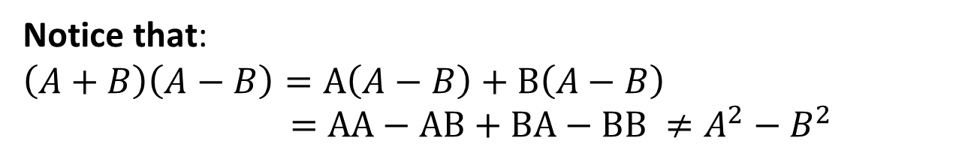


Lesson 10
Matrix Relations - TRUE or FALSE?...
1. Power of Matrix
For any two $(n×n)$ matrices $A$ and $B$ is it true that:…
$${\left(AB\right)}^{2}=A^{2}B^{2}$$
Take-Home Message
CAUTION with Matrix Multiplication!!!!
NOT COMMUTATIVE!
It is a common error fall into “the alphabetic order trap”, writing, for example, XY instead of YX!
2. Other Matrix Propositions and Relations
$${\left(A+B\right)}^{2}=A^{2}{+2AB+B}^{2}$$
$$\left(A−B\right)\left(A+B\right)=A^{2}{−B}^{2}$$
NO!
Try it!
Notice that:
$$\left(A+B\right)\left(A−B\right)=A\left(A−B\right)+B\left(A−B\right)$$
$=AA−AB+BA−BB ≠A^{2}−B^{2}$
Matrix multiplication is not commutative
Can not be added!!

Slide 13


Lesson 10
A pen and paper may be needed to answer these final questions!…
1. Power of Matrix
2. Other Matrix Propositions and Relations
Try it!

Slide 14


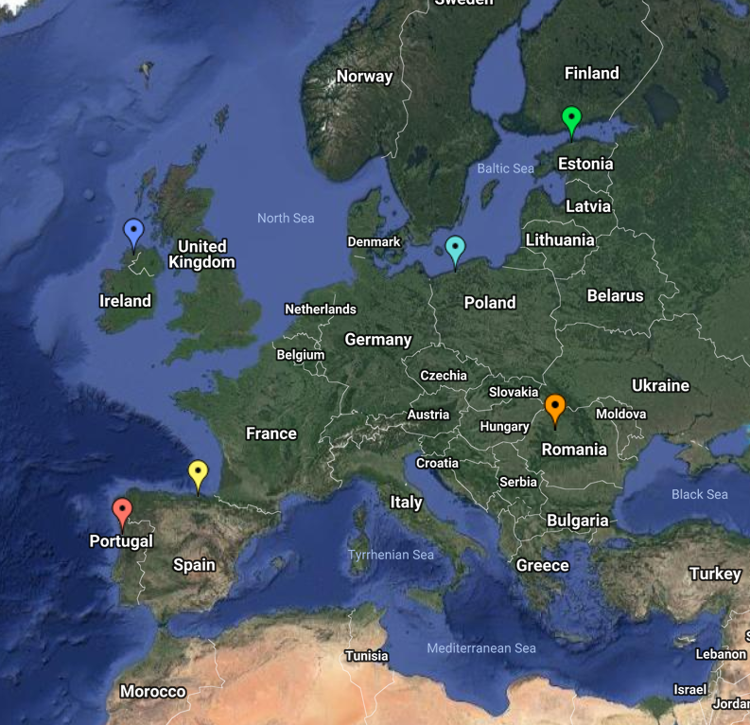
End of Lesson 10
Hope you enjoyed it!
1. Power of Matrix
2. Other Matrix Propositions and Relations
Try it!
By EngiMath TEAM

