Slide 1



Lesson 11 Plan
Remember!
You can travel through all the sections (enter or mouse click) or choose your section by clicking over it.
You should only “Try it” after exploring all lesson contents!
1. Idempotent
2. Nilpotent
3. Involutory
Matrix arithmetic, with all its distinctive characteristics, generates several peculiar properties that some matrices verify and, as so, have special and specific designations. Here we present some of these definitions!
4. Symmetric / Skew-symmetric
5. Orthogonal
6. Other Designations
Try it!
By EngiMath TEAM

Slide 2

Lesson 11
1. Idempotent
Idempotent
A matrix when multiplied by itself, yields
itself is Idempotent. It must be a square matrix
$$A^{2}=A$$
2. Nilpotent
3. Involutory
4. Symmetric / Skew-symmetric
5. Orthogonal
6. Other Designations
Try it!

Slide 3

Lesson 11
1. Idempotent
Nilpotent
A matrix when raised to some power p, yields
a zero matrix, is Nilpotent. It must be a square matrix
2. Nilpotent
$$A^{p}=O$$
3. Involutory
4. Symmetric / Skew-symmetric
5. Orthogonal
6. Other Designations
Try it!

Slide 4






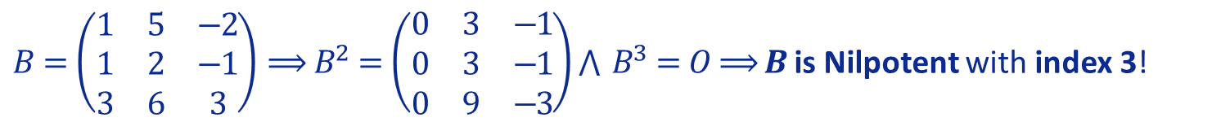
Lesson 11
1. Idempotent
2. Nilpotent
Nilpotent
for some positive integer $p.$
The smallest such $p$ is called the Index of $A$.
$$A^{p}=O$$
3. Involutory
:
Examples
4. Symmetric / Skew-symmetric
$A=\left(\begin{matrix}0 & 0 \\ 5 & 0\end{matrix}\right)⟹A^{2}=\left(\begin{matrix}0 & 0 \\ 0 & 0\end{matrix}\right)⟹$ $A$ is Nilpotent with index 2!
(since $A^{k}≠O$, for $0<k<2$)
5. Orthogonal
$B=\left(\begin{matrix}1 & 5 & −2 \\ 1 & 2 & −1 \\ 3 & 6 & 3\end{matrix}\right)⟹B^{2}=\left(\begin{matrix}0 & 3 & −1 \\ 0 & 3 & −1 \\ 0 & 9 & −3\end{matrix}\right)\bigwedge{ }B^{3}=O⟹$ $B$ is Nilpotent with index 3!
6. Other Designations
(since $B^{k}≠O$, for $0<k<3$)
Try it!
REMARK – Notice that, for any power greater than the index $(q>p$) the relation $A^{p}=O$ holds! The index is the least of these!

Slide 5

Lesson 11
1. Idempotent
2. Nilpotent
3. Involutory
Involutory
$$A^{2}=I$$
4. Symmetric / Skew-symmetric
5. Orthogonal
6. Other Designations
Try it!

Slide 6

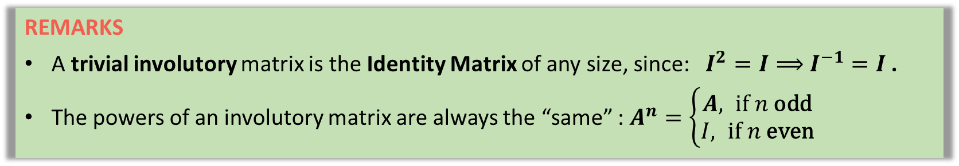


Lesson 11
REMARKS
A trivial involutory matrix is the Identity Matrix of any size, since: $I^{2}=I⟹$ $I^{−1}=I$ .
The powers of an involutory matrix are always the “same” : $A^{n}=\left\{\begin{aligned}A, \text{if} n \text{odd} \\ &I, \text{if} n \text{even}\end{aligned}\right.$
1. Idempotent
2. Nilpotent
Involutory
An involutory matrix is a matrix that is its own inverse:
3. Involutory
$$A^{2}=I$$
$$A^{−1}=A$$
4. Symmetric / Skew-symmetric
:
Examples
5. Orthogonal
$A=\left(\begin{matrix}2 & −3 \\ 1 & 3\end{matrix}\right)⟹A^{2}=\left(\begin{matrix}2 & −3 \\ 1 & 3\end{matrix}\right)\left(\begin{matrix}2 & −3 \\ 1 & 3\end{matrix}\right)=\left(\begin{matrix}1 & 0 \\ 0 & 1\end{matrix}\right)=I⟹$ $A$ is Involutory!!
$$A^{−1}=A$$
6. Other Designations
$B=\left(\begin{matrix}0 & 4 & 3 \\ 1 & −3 & −3 \\ −1 & 4 & 4\end{matrix}\right)⟹B^{2}=\left(\begin{matrix}0 & 4 & 3 \\ 1 & −3 & −3 \\ −1 & 4 & 4\end{matrix}\right)\left(\begin{matrix}0 & 4 & 3 \\ 1 & −3 & −3 \\ −1 & 4 & 4\end{matrix}\right)=I⟹$ $B$ is Involutory!
Try it!
$$B^{−1}=B$$

Slide 7


Lesson 11
1. Idempotent
2. Nilpotent
3. Involutory
Symmetric
4. Symmetric / Skew-symmetric
$$A^{T}=A$$
Skew - Symmetric
5. Orthogonal
$$A^{T}=−A$$
6. Other Designations
Try it!

Slide 8



Lesson 11
1. Idempotent
2. Nilpotent
3. Involutory
Symmetric
4. Symmetric / Skew-symmetric
$$A^{T}=A$$
Notice that: For both to hold, $A$ must be square!
Skew - Symmetric
5. Orthogonal
:
$$A^{T}=−A$$
$$A⇢\left(m×n\right)⇒A^{T}⇢\left(n×m\right)$$
6. Other Designations
$A^{T}=A$ or $A^{T}=−A$ only possible if $n=m$
So, $A$ must be square!
Try it!

Slide 9
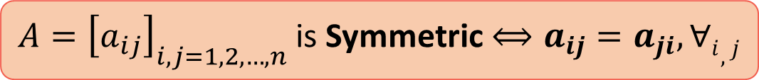
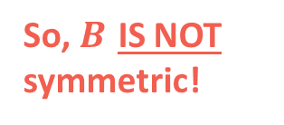

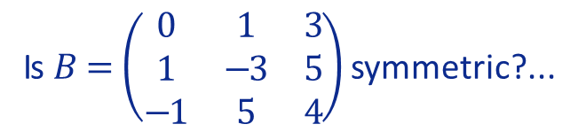
Lesson 11
:
Examples
$A=\left(\begin{matrix}2 & 1 \\ 1 & 3\end{matrix}\right)⟹A^{T}=\left(\begin{matrix}2 & 1 \\ 1 & 3\end{matrix}\right)⟹A=A^{T}⟹$ $A$ is Symmetric!
Try it on your own!!!!
(click here to see the solution!)
1. Idempotent
Is $B=\left(\begin{matrix}0 & 1 & 3 \\ 1 & −3 & 5 \\ −1 & 5 & 4\end{matrix}\right)$ symmetric?...
$$B^{T}=\left(\begin{matrix}0 & 1 & −1 \\ 1 & −3 & 5 \\ 3 & 5 & 4\end{matrix}\right)$$
DO NOT MATCH!
So, $B$ IS NOT symmetric!
2. Nilpotent
3. Involutory
Mathematical Notation
Symmetric
$A={\left[a_{ij}\right]}_{i,j=1,2,…,n}$ is Symmetric $⟺a_{ij}=a_{ji}, ∀i,j$
4. Symmetric / Skew-symmetric
$$A^{T}=A$$
5. Orthogonal
6. Other Designations
Try it!

Slide 10

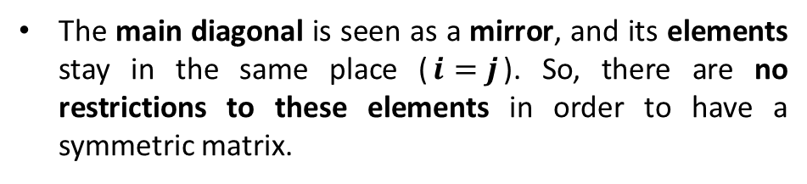


Lesson 11
:
:
Example
8
0
7
8
7
$$\left(\begin{matrix}0 & 7 & 8 \\ 7 & 4 & 5 \\ 8 & 5 & −1\end{matrix}\right)$$
1. Idempotent
Construct a (3 x 3 )
symmetric matrix!
4
5
5
2. Nilpotent
-1
3. Involutory
Mathematical Notation
Symmetric
$A={\left[a_{ij}\right]}_{i,j=1,2,…,n}$ is Symmetric $⟺a_{ij}=a_{ji}, ∀i,j$
4. Symmetric / Skew-symmetric
$$A^{T}=A$$
:
5. Orthogonal
Notice that, when transposing a square matrix:
The main diagonal is seen as a mirror, and its elements stay in the same place ($i=j$). So, there are no restrictions to these elements in order to have a symmetric matrix.
$$\left(\begin{matrix}a_{11} & a_{12} & … & a_{1n} \\ a_{21} & a_{22} & … & a_{2n} \\ ⋮ & ⋮ & ⋱ & ⋮ \\ a_{n1} & a_{n2} & … & a_{nn}\end{matrix}\right)$$
6. Other Designations
Try it!
The upper elements interchange with the lower ones – so these have to match, respectively, to verify the “mirror” effect of the main in a symmetric matrix.

Slide 11



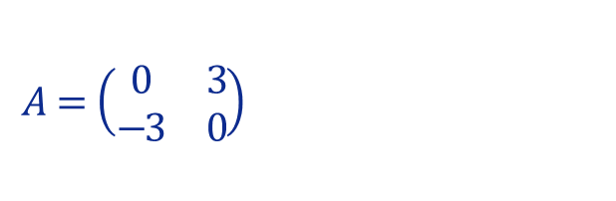
Lesson 11
1. Idempotent
2. Nilpotent
3. Involutory
Symmetric
4. Symmetric / Skew-symmetric
$$A^{T}=A$$
Skew - Symmetric
5. Orthogonal
$$A^{T}=−A$$
6. Other Designations
:
Example
$$A=\left(\begin{matrix}0 & 3 \\ −3 & 0\end{matrix}\right)⟹\left\{\begin{aligned}A^{T}=\left(\begin{matrix}0 & −3 \\ 3 & 0\end{matrix}\right) \\ −A=\left(\begin{matrix}0 & −3 \\ 3 & 0\end{matrix}\right)\end{aligned}\right.$$
$$⇒\left\{\begin{aligned}A^{T}=\left(\begin{matrix}0 & −3 \\ 3 & 0\end{matrix}\right) \\ −A=\left(\begin{matrix}0 & −3 \\ 3 & 0\end{matrix}\right)\end{aligned}\right.$$
Try it!
$⟹A^{T}=−A ⟹$ $A$ is Skew-Symmetric!
$$−A=\left(\begin{matrix}0 & −3 \\ 3 & 0\end{matrix}\right)$$

Slide 12
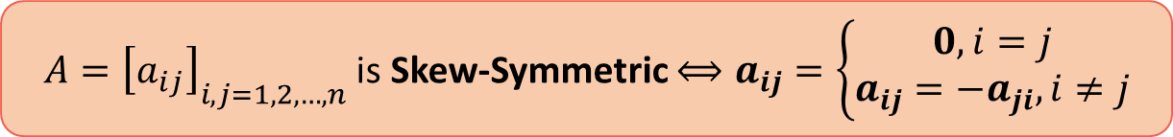
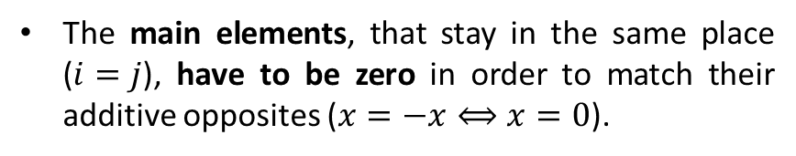

Lesson 11
Notice that, when transposing a square matrix and, simultaneously, matching with the additive opposite:
:
1. Idempotent
The main elements, that stay in the same place ($i=j$), have to be zero in order to match their additive opposites ($x=−x⟺x=0$).
0
$$\left(\begin{matrix}a_{11} & a_{12} & … & a_{1n} \\ a_{21} & a_{22} & … & a_{2n} \\ ⋮ & ⋮ & ⋱ & ⋮ \\ a_{n1} & a_{n2} & … & a_{nn}\end{matrix}\right)$$
0
2. Nilpotent
The upper elements that interchange with the lower ones have to be, respectively, additive opposites since these have to verify the “mirror” effect of the main with the corresponding numerical symmetric.
0
3. Involutory
4. Symmetric / Skew-symmetric
Mathematical Notation
Skew - Symmetric
$A={\left[a_{ij}\right]}_{i,j=1,2,…,n}$ is Skew-Symmetric $⟺a_{ij}=\left\{\begin{aligned}0,i=j \\ &a_{ij}=−a_{ji},i≠j\end{aligned}\right.$
5. Orthogonal
$$A^{T}=−A$$
6. Other Designations
:
Example
$$A=\left(\begin{matrix}0 & 3 \\ −3 & 0\end{matrix}\right)⟹\left\{\begin{aligned}A^{T}=\left(\begin{matrix}0 & −3 \\ 3 & 0\end{matrix}\right) \\ −A=\left(\begin{matrix}0 & −3 \\ 3 & 0\end{matrix}\right)\end{aligned}\right.$$
$$⇒\left\{\begin{aligned}A^{T}=\left(\begin{matrix}0 & −3 \\ 3 & 0\end{matrix}\right) \\ −A=\left(\begin{matrix}0 & −3 \\ 3 & 0\end{matrix}\right)\end{aligned}\right.$$
Try it!
$⟹A^{T}=−A ⟹$ $A$ is Skew-Symmetric!
$$−A=\left(\begin{matrix}0 & −3 \\ 3 & 0\end{matrix}\right)$$

Slide 13
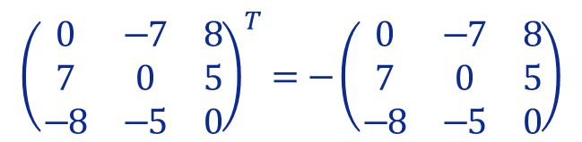

Lesson 11
Notice that, when transposing a square matrix and, simultaneously, matching with the additive opposite:
:
1. Idempotent
The main elements, that stay in the same place ($i=j$), have to be zero in order to match their additive opposites ($x=−x⟺x=0$).
0
$$\left(\begin{matrix}a_{11} & a_{12} & … & a_{1n} \\ a_{21} & a_{22} & … & a_{2n} \\ ⋮ & ⋮ & ⋱ & ⋮ \\ a_{n1} & a_{n2} & … & a_{nn}\end{matrix}\right)$$
0
2. Nilpotent
The upper elements that interchange with the lower ones have to be, respectively, additive opposites since these have to verify the “mirror” effect of the main with the corresponding numerical symmetric.
0
3. Involutory
4. Symmetric / Skew-symmetric
Mathematical Notation
Skew - Symmetric
$A={\left[a_{ij}\right]}_{i,j=1,2,…,n}$ is Skew-Symmetric $⟺a_{ij}=\left\{\begin{aligned}0,i=j \\ &a_{ij}=−a_{ji},i≠j\end{aligned}\right.$
5. Orthogonal
$$A^{T}=−A$$
6. Other Designations
:
:
Example
8
0
-7
-8
7
$${\left(\begin{matrix}0 & −7 & 8 \\ 7 & 0 & 5 \\ −8 & −5 & 0\end{matrix}\right)}^{T}=−\left(\begin{matrix}0 & −7 & 8 \\ 7 & 0 & 5 \\ −8 & −5 & 0\end{matrix}\right)$$
Try it!
Construct a (3 x 3 )
skew-symmetric matrix!
0
-5
5
0

Slide 14

Lesson 11
1. Idempotent
2. Nilpotent
3. Involutory
4. Symmetric / Skew-symmetric
5. Orthogonal
Orthogonal
$$A^{−1}=A^{T}$$
6. Other Designations
Try it!

Slide 15






Lesson 11
:
Examples
Which of the following matrices is orthogonal?
1. Idempotent
$$C=\frac{\sqrt{2}}{2}\left(\begin{matrix}1 & 1 \\ −1 & 1\end{matrix}\right)$$
$$D=\frac{1}{3}\left(\begin{matrix}2 & 1 & 2 \\ −2 & 2 & 1 \\ 1 & 2 & −2\end{matrix}\right)$$
$$A=\left(\begin{matrix}0 & 1 \\ 1 & 0\end{matrix}\right)$$
$$B=\left(\begin{matrix}1 & −1 \\ 0 & −1\end{matrix}\right)$$
2. Nilpotent
You can “CLICK” on each matrix to see the conclusion, but…
3. Involutory
4. Symmetric / Skew-symmetric
5. Orthogonal
Orthogonal
An orthogonal matrix transpose is its own inverse.
There are alternative, but equivalent, conditions as:
$$A^{−1}=A^{T}$$
6. Other Designations
$${\left(A^{−1}\right)}^{T}=A$$
or
$${A.A}^{T}=I$$
Try it!
REMARK – For practical purposes, when verifying the orthogonality of a matrix , use this relation!

Slide 16





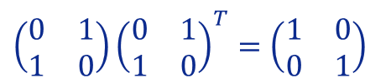
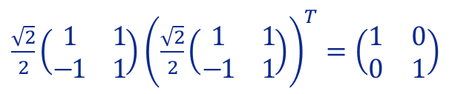








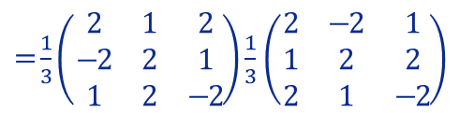



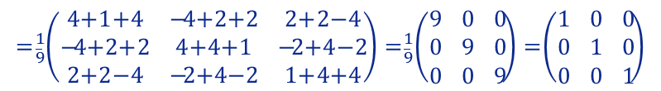
Lesson 11
:
:
Examples
Which of the following matrices is orthogonal?
1. Idempotent
$$C=\frac{\sqrt{2}}{2}\left(\begin{matrix}1 & 1 \\ −1 & 1\end{matrix}\right)$$
$$D=\frac{1}{3}\left(\begin{matrix}2 & 1 & 2 \\ −2 & 2 & 1 \\ 1 & 2 & −2\end{matrix}\right)$$
$$A=\left(\begin{matrix}0 & 1 \\ 1 & 0\end{matrix}\right)$$
$$B=\left(\begin{matrix}1 & −1 \\ 0 & −1\end{matrix}\right)$$
2. Nilpotent
You can “CLICK” on each matrix to see the conclusion, but…
Try to find the answers on your own using the given relation ${A.A}^{T}=I$
3. Involutory
$\left(\begin{matrix}0 & 1 \\ 1 & 0\end{matrix}\right){\left(\begin{matrix}0 & 1 \\ 1 & 0\end{matrix}\right)}^{T}=\left(\begin{matrix}1 & 0 \\ 0 & 1\end{matrix}\right)$
$\frac{\sqrt{2}}{2}\left(\begin{matrix}1 & 1 \\ −1 & 1\end{matrix}\right){\left(\frac{\sqrt{2}}{2}\left(\begin{matrix}1 & 1 \\ −1 & 1\end{matrix}\right)\right)}^{T}=\left(\begin{matrix}1 & 0 \\ 0 & 1\end{matrix}\right)$
4. Symmetric / Skew-symmetric
$=\left(\begin{matrix}0 & 1 \\ 1 & 0\end{matrix}\right)$ $\left(\begin{matrix}0 & 1 \\ 1 & 0\end{matrix}\right)$
$=\frac{2}{4}\left(\begin{matrix}1 & 1 \\ −1 & 1\end{matrix}\right)$ $\left(\begin{matrix}1 & −1 \\ 1 & 1\end{matrix}\right)$
$${C.C}^{T}=I$$
$${A.A}^{T}=I$$
5. Orthogonal
$$=\left(\begin{matrix}0+1 & 0×1+1×0 \\ 1×0+0×1 & 1+0\end{matrix}\right)=\left(\begin{matrix}1 & 0 \\ 0 & 1\end{matrix}\right)$$
$$=\frac{1}{2}\left(\begin{matrix}1+1 & −1+1 \\ −1+1 & 1+1\end{matrix}\right)=\frac{1}{2}\left(\begin{matrix}2 & 0 \\ 0 & 2\end{matrix}\right)=\left(\begin{matrix}1 & 0 \\ 0 & 1\end{matrix}\right)$$
$\left(\begin{matrix}1 & −1 \\ 0 & −1\end{matrix}\right){\left(\begin{matrix}1 & −1 \\ 0 & −1\end{matrix}\right)}^{T}=\left(\begin{matrix}1 & 0 \\ 0 & 1\end{matrix}\right)$
$$D.D^{T}=I$$
6. Other Designations
$=\frac{1}{3}\left(\begin{matrix}2 & 1 & 2 \\ −2 & 2 & 1 \\ 1 & 2 & −2\end{matrix}\right)$ $\frac{1}{3}$ $\left(\begin{matrix}2 & −2 & 1 \\ 1 & 2 & 2 \\ 2 & 1 & −2\end{matrix}\right)$
$${D.D}^{T}=I$$
$=\left(\begin{matrix}1 & −1 \\ 0 & −1\end{matrix}\right)$ $\left(\begin{matrix}1 & 0 \\ −1 & −1\end{matrix}\right)$
$${B.B}^{T}≠I$$
Try it!
$$=\frac{1}{9}\left(\begin{matrix}4+1+4 & −4+2+2 & 2+2−4 \\ −4+2+2 & 4+4+1 & −2+4−2 \\ 2+2−4 & −2+4−2 & 1+4+4\end{matrix}\right)=\frac{1}{9}\left(\begin{matrix}9 & 0 & 0 \\ 0 & 9 & 0 \\ 0 & 0 & 9\end{matrix}\right)=\left(\begin{matrix}1 & 0 & 0 \\ 0 & 1 & 0 \\ 0 & 0 & 1\end{matrix}\right)$$
$$=\left(\begin{matrix}1+1 & −1+1 \\ 0+1 & 0+1\end{matrix}\right)=\left(\begin{matrix}2 & 1 \\ 1 & 1\end{matrix}\right)≠\left(\begin{matrix}1 & 0 \\ 0 & 1\end{matrix}\right)$$

Slide 17
Lesson 11
There are several other specific designations!
The most common were presented in previous Lessons or in prior sections of this Lesson.
However, for example, when working with complex numbers we come across:
1. Idempotent
2. Nilpotent
3. Involutory
4. Symmetric / Skew-symmetric
5. Orthogonal
6. Other Designations
Try it!

Slide 18
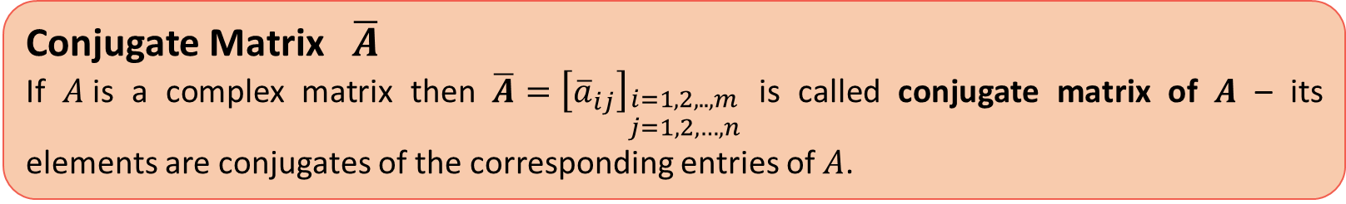
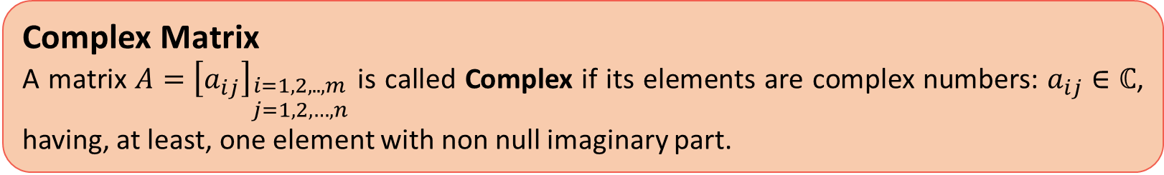


Lesson 11
There are several other specific designations!
The most common were presented in previous Lessons or in prior sections of this Lesson.
However, for example, when working with complex numbers we come across:
1. Idempotent
Complex Matrix
A matrix $A={\left[a_{ij}\right]}_{\begin{aligned}i=1,2,..,m \\ j=1,2,…,n\end{aligned}}$ is called Complex if its elements are complex numbers: $a_{ij}∈ℂ$, having, at least, one element with non null imaginary part.
2. Nilpotent
3. Involutory
4. Symmetric / Skew-symmetric
Conjugate Matrix $\overline{A}$
If $A$is a complex matrix then $\overline{A}={\left[{\overline{a}}_{ij}\right]}_{\begin{aligned}i=1,2,..,m \\ j=1,2,…,n\end{aligned}}$ is called conjugate matrix of $A$ – its elements are conjugates of the corresponding entries of $A$.
5. Orthogonal
6. Other Designations
Hermitian
Unitary
Try it!
$${\overline{A}}^{T}=A⟺\overline{A}=A^{T}$$
$$A^{−1}={\overline{A}}^{T}⟺A.{\overline{A}}^{T}=I$$

Slide 19



Lesson 11
Too many names to remember!...
But ok! Pen + Paper and…lets go!
1. Idempotent
2. Nilpotent
3. Involutory
4. Symmetric / Skew-symmetric
5. Orthogonal
6. Other Designations
Try it!

Slide 20


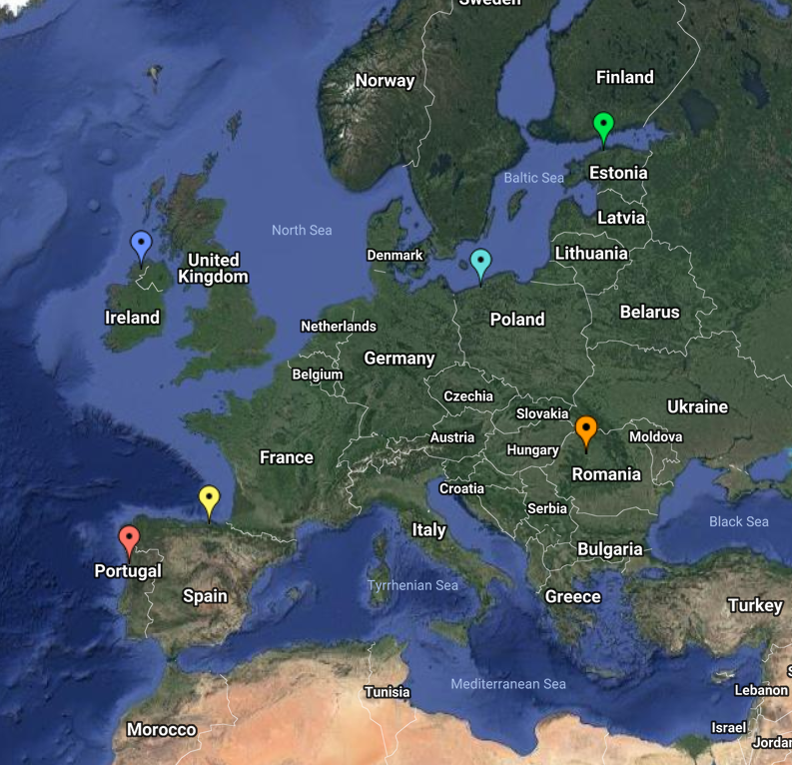
End of Lesson 11
Hope you enjoyed it!
1. Idempotent
2. Nilpotent
3. Involutory
4. Symmetric / Skew-symmetric
5. Orthogonal
6. Other Designations
By EngiMath TEAM
Try it!

