Slide 1



Lesson 12 Plan
Remember!
You can travel through all the sections (enter or mouse click) or choose your section by clicking over it.
You should only “Try it” after exploring all lesson contents!
1. Elementary Row Operations
2. Elementary Matrices
3. EROs by Matrix Multiplication
Try it!
By EngiMath TEAM

Slide 2

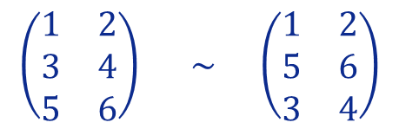
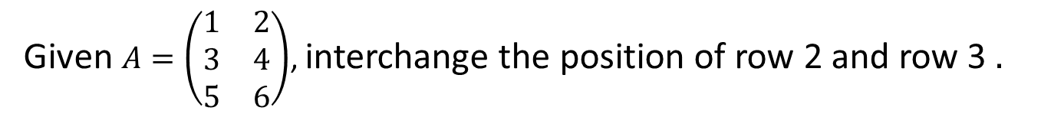
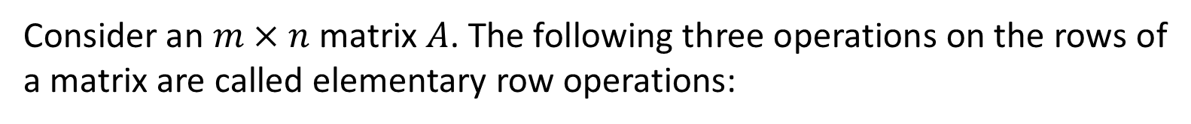
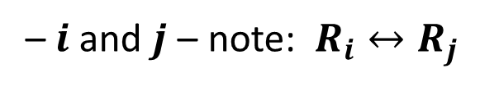
Lesson 12
Definition
1. Elementary Row Operations (EROs)
Consider an $m×n$matrix $A$. The following three operations on the rows of a matrix are called elementary row operations:
INTERCHANGE - Interchange two rows
– $i$ and $j$ – note: $R_{i}↔R_{j}$
2. Elementary Matrices
generalizing
Given $A=\left(\begin{matrix}\begin{matrix}1 & 2\end{matrix} \\ \begin{matrix}3 & 4\end{matrix} \\ \begin{matrix}5 & 6\end{matrix}\end{matrix}\right)$, interchange the position of row 2 and row 3 $.$
Example
3. EROs by Matrix Multiplication
Whenever an elementary operation is done over the rows (or columns) it is important to point it out so you won’t get lost!... See how…
Following this notation we have:
$$\left(\begin{matrix}\begin{matrix}1 & 2\end{matrix} \\ \begin{matrix}3 & 4\end{matrix} \\ \begin{matrix}5 & 6\end{matrix}\end{matrix}\right) \underset{ }{\sim}\left(\begin{matrix}\begin{matrix}1 & 2\end{matrix} \\ \begin{matrix}5 & 6\end{matrix} \\ \begin{matrix}3 & 4\end{matrix}\end{matrix}\right)$$
EASY!... Yes?...
$$R_{2}↔R_{3}$$
Try it!
Notice - Row operations may be applied to any matrix!...
Two matrices $A$ and $B$are said row equivalent if there is a sequence of row elementary operations that transforms one matrix into another, and we write: $A\sim B$

Slide 3




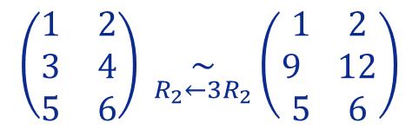
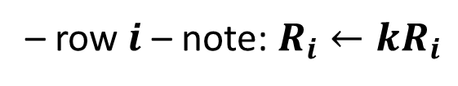

Lesson 12
Definition
1. Elementary Row Operations (EROs)
Consider an $m×n$matrix $A$. The following three operations on the rows of a matrix are called elementary row operations:
INTERCHANGE - Interchange two rows
– $i$ and $j$ – note: $R_{i}↔R_{j}$
2. Elementary Matrices
SCALING - Multiply a row by a non-zero scalar $k$
– row$i$ – note: $R_{i}←{kR}_{i}$
Given $A=\left(\begin{matrix}\begin{matrix}1 & 2\end{matrix} \\ \begin{matrix}3 & 4\end{matrix} \\ \begin{matrix}5 & 6\end{matrix}\end{matrix}\right)$, multiply row $2$ by $3$ $.$
3. EROs by Matrix Multiplication
Example
generalizing
Following the given notation we have:
“new” row
“old” row
Try it!
$$\left(\begin{matrix}\begin{matrix}1 & 2\end{matrix} \\ \begin{matrix}3 & 4\end{matrix} \\ \begin{matrix}5 & 6\end{matrix}\end{matrix}\right) \underset{R_{2}←3R_{2}}{\sim}\left(\begin{matrix}\begin{matrix}1 & 2\end{matrix} \\ \begin{matrix}9 & 12\end{matrix} \\ \begin{matrix}5 & 6\end{matrix}\end{matrix}\right)$$
$$R_{2} ← 3R_{2}$$
?

Slide 4

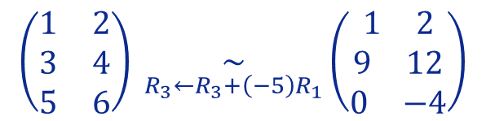

Lesson 12
Definition
1. Elementary Row Operations (EROs)
Consider an $m×n$matrix $A$. The following three operations on the rows of a matrix are called elementary row operations:
INTERCHANGE - Interchange two rows
– $i$ and $j$ – note: $R_{i}↔R_{j}$
2. Elementary Matrices
SCALING - Multiply a row by a non-zero scalar $k$
– row$i$ – note: $R_{i}←{kR}_{i}$
REPLACEMENT - Replace one row by the sum of itself and a multiple of another row
– add to row$i$ a multiple of row – note: $R_{i}←R_{i}+{kR}_{j}$
3. EROs by Matrix Multiplication
Given $A=\left(\begin{matrix}\begin{matrix}1 & 2\end{matrix} \\ \begin{matrix}3 & 4\end{matrix} \\ \begin{matrix}5 & 6\end{matrix}\end{matrix}\right)$, replace row $3$ by its sum with $\left(−5\right)$ times row 1$.$
Example
Representing the operation by:
$$R_{3}←R_{3}+\left(−5\right)R_{1}$$
Try it!
$$\left(\begin{matrix}\begin{matrix}1 & 2\end{matrix} \\ \begin{matrix}3 & 4\end{matrix} \\ \begin{matrix}5 & 6\end{matrix}\end{matrix}\right) \underset{R_{3}←R_{3}+\left(−5\right)R_{1}}{\sim}\left(\begin{matrix}\begin{matrix}1 & 2\end{matrix} \\ \begin{matrix}9 & 12\end{matrix} \\ \begin{matrix}0 & −4\end{matrix}\end{matrix}\right)$$
We have:

Slide 5


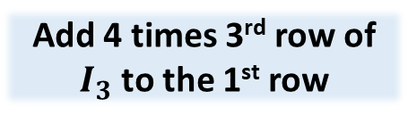




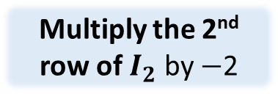
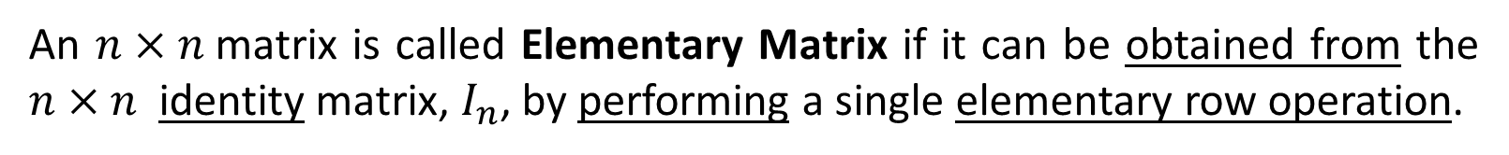

Lesson 12
Definition
1. Elementary Row Operations
An $n×n$matrix is called Elementary Matrix if it can be obtained from the $n×n$ identity matrix, $I_{n}$, by performing a single elementary row operation.
These are usually represented by the capital letter E. For example:
2. Elementary Matrices
Examples…
Listed below are three elementary matrices
$$\left(\begin{matrix}\begin{matrix}\begin{matrix}\begin{matrix}1 \\ 0\end{matrix} \\ \begin{matrix}0 \\ 0\end{matrix}\end{matrix} & \begin{matrix}\begin{matrix}0 \\ 0\end{matrix} \\ \begin{matrix}0 \\ 1\end{matrix}\end{matrix}\end{matrix} & \begin{matrix}\begin{matrix}\begin{matrix}0 \\ 0\end{matrix} \\ \begin{matrix}1 \\ 0\end{matrix}\end{matrix} & \begin{matrix}\begin{matrix}0 \\ 1\end{matrix} \\ \begin{matrix}0 \\ 0\end{matrix}\end{matrix}\end{matrix}\end{matrix}\right)$$
$$\left(\begin{matrix}1 & 0 & 4 \\ 0 & 1 & 0 \\ 0 & 0 & 1\end{matrix}\right)$$
3. EROs by Matrix Multiplication
$$E_{1}=$$
$$\left(\begin{matrix}1 & 0 \\ 0 & −2\end{matrix}\right)$$
$$E_{2}=$$
$$E_{3}=$$
Multiply the 2nd row of $I_{2}$ by $−$2
Interchange 2nd and 4th rows of $I_{4}$
Add 4 times 3rd row of $I_{3}$ to the 1st row
Try it!
Example 1
(click to see the operation)
Example 2
click to see the operation
Example 3
click to see the operation

Slide 6

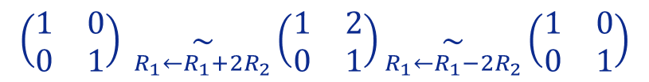



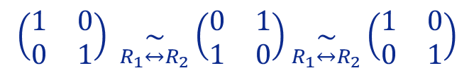




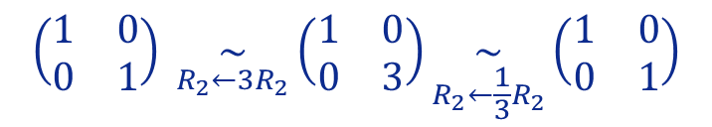
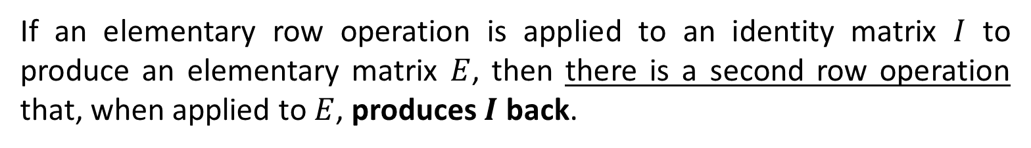

Lesson 12
If an elementary row operation is applied to an identity matrix $I$ to produce an elementary matrix $E$, then there is a second row operation that, when applied to $E$, produces $I$ back.
1. Elementary Row Operations
2. Elementary Matrices
Row operations on $I$ that Produces $E$
Row operations on $E$ that Produces $I$
Multiply row $i$ by $c≠0$
Multiply row $i$ by $1/c$
Interchange row $i$ and $j$
Interchange row $i$ and $j$
3. EROs by Matrix Multiplication
Add $c$ times row $i$ to row $j$
Add $−c$ times row $i$ to row $j$
Example
We will use $I_{2}$, to exemplify…
Try it!
$$\left(\begin{matrix}1 & 0 \\ 0 & 1\end{matrix}\right) \underset{R_{1}↔R_{2}}{\sim}\left(\begin{matrix}0 & 1 \\ 1 & 0\end{matrix}\right)\underset{R_{1}↔R_{2}}{\sim}\left(\begin{matrix}1 & 0 \\ 0 & 1\end{matrix}\right)$$
$$\left(\begin{matrix}1 & 0 \\ 0 & 1\end{matrix}\right) \underset{R_{2}←3R_{2}}{\sim}\left(\begin{matrix}1 & 0 \\ 0 & 3\end{matrix}\right)\underset{R_{2}←\frac{1}{3}R_{2}}{\sim}\left(\begin{matrix}1 & 0 \\ 0 & 1\end{matrix}\right)$$
$I$ $E I$
$$\left(\begin{matrix}1 & 0 \\ 0 & 1\end{matrix}\right) \underset{R_{1}←R_{1}+2R_{2}}{\sim}\left(\begin{matrix}1 & 2 \\ 0 & 1\end{matrix}\right)\underset{R_{1}←R_{1}−2R_{2}}{\sim}\left(\begin{matrix}1 & 0 \\ 0 & 1\end{matrix}\right)$$
$I$ $E I$
$I$ $E I$

Slide 7


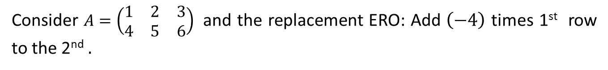
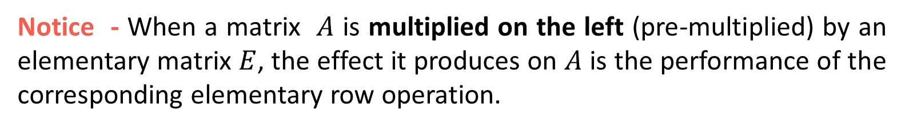

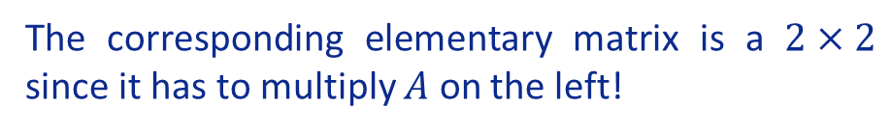

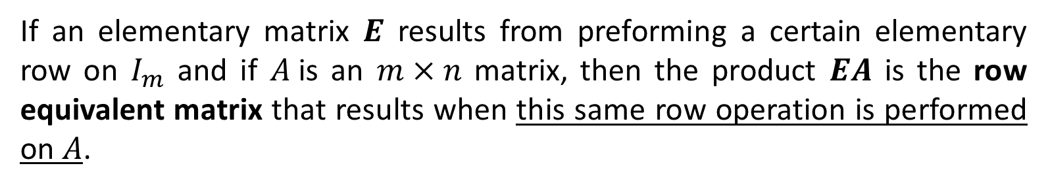


Lesson 12
If an elementary matrix $E$ results from preforming a certain elementary row on $I_{m}$ and if $A$is an $m×n$ matrix, then the product $EA$ is the row equivalent matrix that results when this same row operation is performed on $A$.
1. Elementary Row Operations
2. Elementary Matrices
Notice - When a matrix $A$ is multiplied on the left (pre-multiplied) by an elementary matrix $E$, the effect it produces on $A$ is the performance of the corresponding elementary row operation.
3. EROs by Matrix Multiplication
Example
Consider $A=\left(\begin{matrix}1 & 2 & 3 \\ 4 & 5 & 6\end{matrix}\right)$ and the replacement ERO: Add $\left(−4\right)$ times 1st row to the 2nd $.$
Just for final comparison we may apply the given ERO to $A$:
So, to test the given result we just have to compute $EA$:
$$\left(\begin{matrix}1 & 2 & 3 \\ 4 & 5 & 6\end{matrix}\right) \underset{R_{2}←R_{2}−4R_{1}}{\sim}\left(\begin{matrix}1 & 2 & 3 \\ 0 & −3 & −6\end{matrix}\right)$$
Try it!
The corresponding elementary matrix is a $2×2$ since it has to multiply $A$ on the left!
$$\left(\begin{matrix}1 & 0 \\ 0 & 1\end{matrix}\right) \underset{R_{2}←R_{2}−4R_{1}}{\sim}\left(\begin{matrix}1 & 0 \\ −4 & 1\end{matrix}\right)=E$$

Slide 8


Lesson 12
If an elementary matrix $E$ results from preforming a certain elementary row on $I_{m}$ and if $A$is an $m×n$ matrix, then the product $EA$ is the row equivalent matrix that results when this same row operation is performed on $A$.
1. Elementary Row Operations
2. Elementary Matrices
Notice - When a matrix $A$ is multiplied on the left (pre-multiplied) by an elementary matrix $E$, the effect it produces on $A$ is the performance of the corresponding elementary row operation.
3. EROs by Matrix Multiplication
Example
Consider $A=\left(\begin{matrix}1 & 2 & 3 \\ 4 & 5 & 6\end{matrix}\right)$ and the replacement ERO: Add $\left(−4\right)$ times 1st row to the 2nd $.$
Just for final comparison we may apply the given ERO to $A$:
So, to test the given result we just have to compute $EA$:
$$\left(\begin{matrix}1 & 2 & 3 \\ 4 & 5 & 6\end{matrix}\right) \underset{R_{2}←R_{2}−4R_{1}}{\sim}\left(\begin{matrix}1 & 2 & 3 \\ 0 & −3 & −6\end{matrix}\right)$$
Try it!
The corresponding elementary matrix is a $2×2$ since it has to multiply $A$ on the left!
$\left(\begin{matrix}1 & 0 \\ −4 & 1\end{matrix}\right)$ $\left(\begin{matrix}1 & 2 & 3 \\ 4 & 5 & 6\end{matrix}\right)$
$$=\left(\begin{matrix}1 & 2 & 3 \\ 0 & −3 & −6\end{matrix}\right)$$
$$\left(\begin{matrix}1 & 0 \\ 0 & 1\end{matrix}\right) \underset{R_{2}←R_{2}−4R_{1}}{\sim}\left(\begin{matrix}1 & 0 \\ −4 & 1\end{matrix}\right)=E$$

Slide 9



Lesson 12
Enjoy practice!...
1. Elementary Row Operations
2. Elementary Matrices
3. EROs by Matrix Multiplication
Try it!

Slide 10


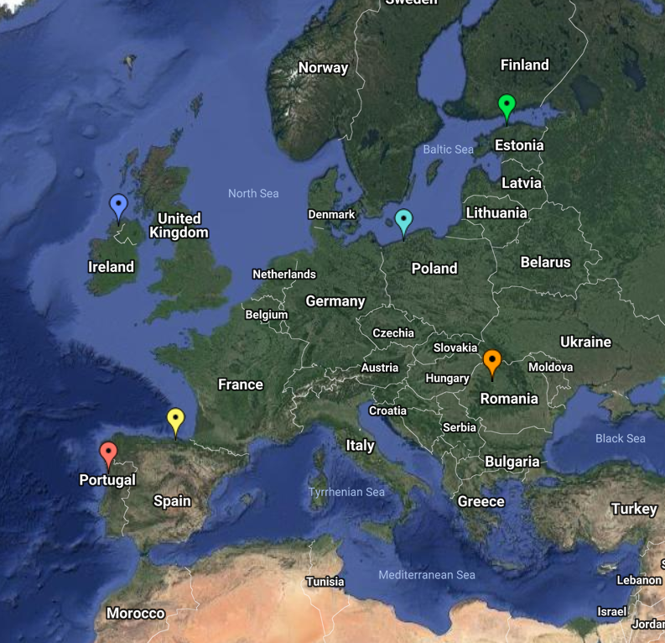
End of Lesson 12
Hope you enjoyed it!
1. Elementary Row Operations
2. Elementary Matrices
3. EROs by Matrix Multiplication
Try it!
By EngiMath TEAM

