Slide 1



Lesson 15 Plan
Remember!
You can travel through all the sections (enter or mouse click) or choose your section by clicking over it.
You should only “Try it” after exploring all lesson contents!
1. Notion of Determinant of a Matrix
2. Determinant of a 1x1 Matrix
3. Determinant of a 2x2 Matrix
4. Determinant of a 3x3 Matrix
Try it!
By EngiMath TEAM

Slide 2

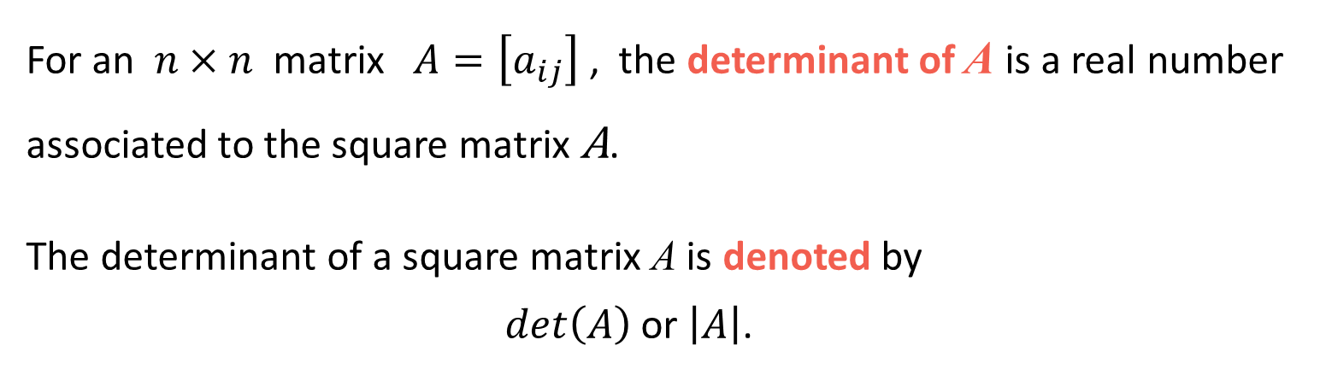
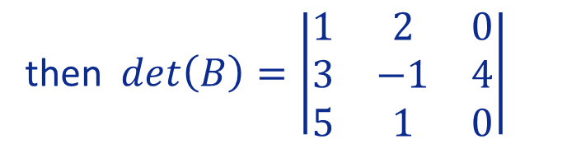
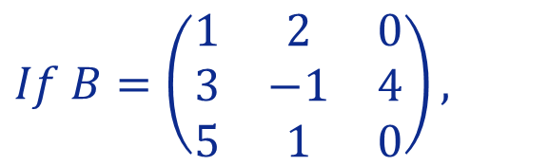

Lesson 15
For an $n×n$ matrix $A=\left[a_{ij}\right]$ , the determinant of A is a real number associated to the square matrix A.
The determinant of a square matrix A is denoted by
$det\left(A\right)$ or $\left|A\right|$.
1. Notion of Determinant of a Matrix
2. Determinant of a 1x1 Matrix
3. Determinant of a 2x2 Matrix
Examples
$$If B=\left(\begin{matrix}1 & 2 & 0 \\ 3 & −1 & 4 \\ 5 & 1 & 0\end{matrix}\right),$$
4. Determinant of a 3x3 Matrix
$If A=\left(\begin{matrix}1 & 2 \\ 3 & 4\end{matrix}\right)$,
1.
2.
Try it!
then $det\left(B\right)=\left|\begin{matrix}1 & 2 & 0 \\ 3 & −1 & 4 \\ 5 & 1 & 0\end{matrix}\right|$
then $\left|A\right|=\left|\begin{matrix}1 & 2 \\ 3 & 4\end{matrix}\right|$

Slide 3

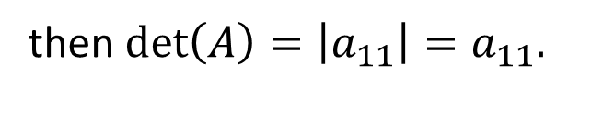





Lesson 15
$$, then \left|A\right|=a.$$
Determinant of a 1×1 Matrix
1. Notion of Determinant of a Matrix
Let $A=\left[a_{11}\right],$
2. Determinant of a 1x1 Matrix
then$det\left(A\right)=\left|a_{11}\right|=a_{11}.$
3. Determinant of a 2x2 Matrix
Examples
4. Determinant of a 3x3 Matrix
1.
2.
If $A=\left[4\right]$ ,
If$B=\left[−5\right],$
Try it!
then $det\left(A\right)=4$
then$\left|B\right|=−5$

Slide 4



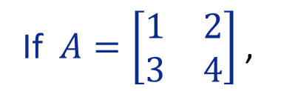

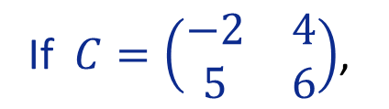







Lesson 15
Determinant of a 2×2 Matrix
1. Notion of Determinant of a Matrix
Let $A=\left[\begin{matrix}a_{11} & a_{12} \\ a_{21} & a_{22}\end{matrix}\right],$
2. Determinant of a 1x1 Matrix
then$det\left(A\right)=\left|\begin{matrix}a_{11} & a_{12} \\ a_{21} & a_{22}\end{matrix}\right|$
$$=a_{11}a_{22}$$
$$\text{−}$$
$$a_{21}a_{12}.$$
3. Determinant of a 2x2 Matrix
Examples
4. Determinant of a 3x3 Matrix
1.
If $A=\left[\begin{matrix}1 & 2 \\ 3 & 4\end{matrix}\right]$ ,
If $C=\left(\begin{matrix}−2 & 4 \\ 5 & 6\end{matrix}\right)$,
2.
Try it!
then $det\left(A\right)=$
$−$
$1×4$
$$3×2$$
then $\left|C\right|=−2×6−5×4$
$=−12−20=−32$
$=4−6=−2$

Slide 5









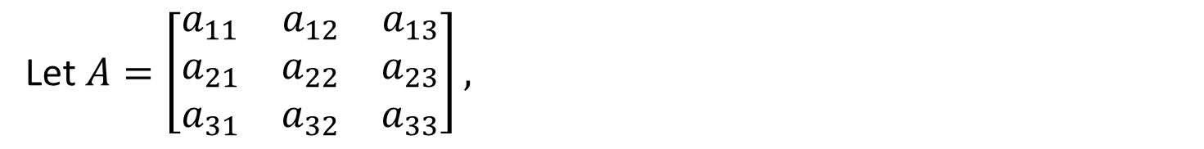

Lesson 15
Determinant of a 3×3 Matrix (Rule of Sarrus)
1. Notion of Determinant of a Matrix
Let $A=\left[\begin{matrix}a_{11} & a_{12} & a_{13} \\ a_{21} & a_{22} & a_{23} \\ a_{31} & a_{32} & a_{33}\end{matrix}\right],$
2. Determinant of a 1x1 Matrix
To compute the determinant of A, by using Sarrus’ Rule:
- copy the first and second row of A to form fourth and fifth rows
3. Determinant of a 2x2 Matrix
- then add the products of the diagonals going from top to bottom
- and subtract the products of the diagonals going from bottom to top
4. Determinant of a 3x3 Matrix
$$\left|A\right|=\left|\begin{matrix}a_{11} & a_{12} & a_{13} \\ a_{21} & a_{22} & a_{23} \\ a_{31} & a_{32} & a_{33}\end{matrix}\right|$$
$$=a_{11}a_{22}a_{33}$$
$$+$$
$$a_{21}a_{32}a_{13}$$
$$+$$
$$a_{31}a_{12}a_{23}$$
Try it!
$\begin{matrix}a_{11} & a_{12} & a_{13} \\ a_{21} & a_{22} & a_{23}\end{matrix}$
$$−a_{31}a_{22}a_{13}$$
$$−a_{11}a_{32}a_{23}$$
$$−a_{21}a_{12}a_{33}$$

Slide 6








Lesson 15
Determinant of a 3×3 Matrix (Rule of Sarrus)
1. Notion of Determinant of a Matrix
Example
Compute the determinant
2. Determinant of a 1x1 Matrix
$$\left|A\right|=\left|\begin{matrix}1 & 2 & 3 \\ −1 & 0 & 4 \\ −2 & 1 & 5\end{matrix}\right|$$
$$=1×0×5+$$
$$\left(−1\right)×1×3$$
$$+\left(−2\right)×2×4−$$
3. Determinant of a 2x2 Matrix
$$−\left(−2\right)×0×3$$
$$−1×1×4$$
$$−\left(−1\right)×2×5=$$
$\begin{matrix}1 & 2 & 3 \\ −1 & 0 & 4\end{matrix}$
$$=0−3−16−0−4+10=−13$$
4. Determinant of a 3x3 Matrix
Try it!

Slide 7








Lesson 15
Determinant of a 3×3 Matrix (Rule of Sarrus)
1. Notion of Determinant of a Matrix
Example
2. Determinant of a 1x1 Matrix
We can also compute the determinant of a 3x3 matrix by copy the first and second column of A to form fourth and fifth columns
3. Determinant of a 2x2 Matrix
$$\left|A\right|=\left|\begin{matrix}1 & 2 & 3 \\ −1 & 0 & 4 \\ −2 & 1 & 5\end{matrix}\right|$$
$$\begin{matrix}1 & 2 \\ −1 & 0 \\ −2 & 1\end{matrix}$$
- then add the products of the diagonals going from top to bottom
- and subtract the products of the diagonals going from bottom to top
4. Determinant of a 3x3 Matrix
$$=1×0×5+$$
$$2×4×\left(−2\right)$$
$$+3×\left(−1\right)×1$$
$$−\left(−2\right)×0×3−$$
$$−1×4×1$$
$$−5×\left(−1\right)×2=$$
Try it!
$$=0−3−16−0−4+10=−13$$

Slide 8



Lesson 15
Perhaps you will need a pen and paper to answer this final question!
1. Notion of Determinant of a Matrix
2. Determinant of a 1x1 Matrix
3. Determinant of a 2x2 Matrix
4. Determinant of a 3x3 Matrix
Try it!

Slide 9


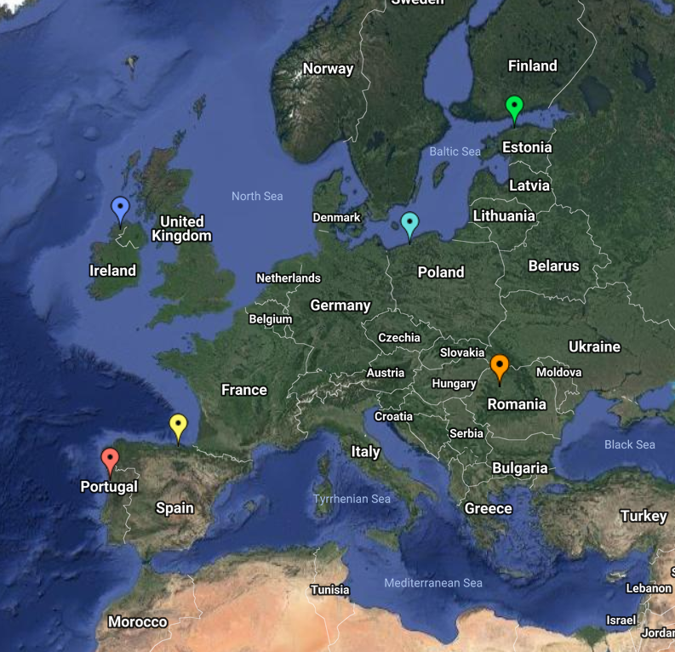
End of Lesson 15
Hope you enjoyed it!
1. Notion of Determinant of a Matrix
2. Determinant of a 1x1 Matrix
3.Diapositivo 4 Determinant of a 2x2 Matrix
4. Determinant of a 3x3 Matrix
Try it!
By EngiMath TEAM

