Slide 1



Lesson 16 Plan
Remember!
You can travel through all the sections (enter or mouse click) or choose your section by clicking over it.
You should only “Try it” after exploring all lesson contents!
1. Minor Entries of a Matrix
2. Cofactors Entries of a Matrix
Try it!
By EngiMath TEAM

Slide 2

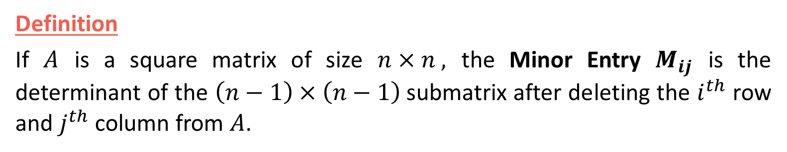





Lesson 16
Definition
If $A$ is a square matrix of size $n×n ,$ the Minor Entry $M_{ij}$ is the determinant of the $\left(n−1\right)×\left(n−1\right)$submatrix after deleting the $i^{th}$ row and $j^{th}$ column from $A$.
1. Minor Entries of a Matrix
Example
2. Cofactors Entries of a Matrix
Consider the following $3×3$ matrix:
$$A=\left(\begin{matrix}1 & 2 & 3 \\ 4 & 5 & 6 \\ 7 & 8 & 9\end{matrix}\right)$$
Try it!
The minor entry $M_{11}$ is the determinant of matrix after deleting the 1st row and the 1st column.
Therefore, $M_{11}=\left|\begin{matrix}5 & 6 \\ 8 & 9\end{matrix}\right|$
We can compute this determinant by the rule we used in Lesson 15.
$$=5×9−8×6$$
$$=−3$$

Slide 3





Lesson 16
1. Minor Entries of a Matrix
Example
We could calculate other minor entries.
For example, let's calculate $M_{23}$, that is the determinant of the submatrix after deleting the second row and third column of $A$
2. Cofactors Entries of a Matrix
$$A=\left(\begin{matrix}1 & 2 & 3 \\ 4 & 5 & 6 \\ 7 & 8 & 9\end{matrix}\right)$$
Therefore, $M_{23}=\left|\begin{matrix}1 & 2 \\ 7 & 8\end{matrix}\right|$
Try it!
Compute this determinant by the rule we used in Lesson 15, we will get
$$=1×8−7×2$$
$$=−6$$

Slide 4


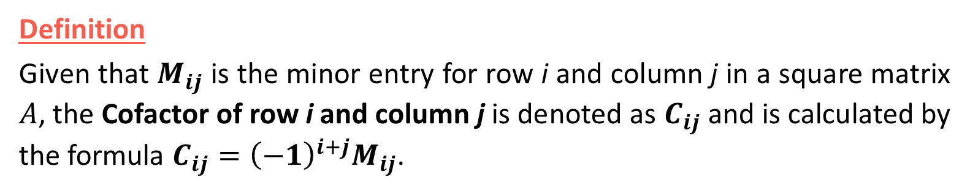
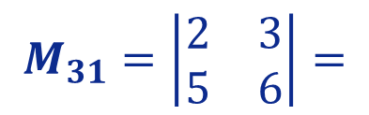



Lesson 16
Definition
Given that $M_{ij}$ is the minor entry for row i and column j in a square matrix $A$, the Cofactor of row i and column j is denoted as $C_{ij}$ and is calculated by the formula $C_{ij}={\left(−1\right)}^{i+j}M_{ij}$.
1. Minor Entries of a Matrix
Example
2. Cofactors Entries of a Matrix
Consider the following $3×3$ matrix:
$$A=\left(\begin{matrix}1 & 2 & 3 \\ 4 & 5 & 6 \\ 7 & 8 & 9\end{matrix}\right)$$
Let's try to find $C_{31}$ of matrix $A.$
Try it!
After deleting the 3rd row and the 1st column, we find $M_{31}$ by taking the determinant of this submatrix, that is
$$M_{31}=\left|\begin{matrix}2 & 3 \\ 5 & 6\end{matrix}\right|=$$
$$2×6$$
$$−5×3$$
$$=12−15=−3$$
Therefore, ${C_{31}={\left(−1\right)}^{3+1} M}_{31}={\left(−1\right)}^{4}×\left(−3\right)=−3$

Slide 5



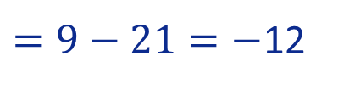





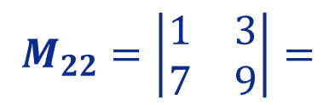
Lesson 16
Take-Home Message
Minors and Cofactors are EQUAL or SYMMETRIC!
Example
If $i+j$ is even then $C_{ij}=M_{ij}$
1. Minor Entries of a Matrix
If $i+j$ is odd then $C_{ij}=−M_{ij}$
We could evaluate other cofactors.
For example, let's calculate $C_{22}$of $A$.
$$A=\left(\begin{matrix}1 & 2 & 3 \\ 4 & 5 & 6 \\ 7 & 8 & 9\end{matrix}\right)$$
2. Cofactors Entries of a Matrix
First, let's try to find $M_{22}$ of matrix $A.$
So we will delete the 2nd row and 2nd column and find $M_{22}$ by taking the determinant of this submatrix, that is
Try it!
$$M_{22}=\left|\begin{matrix}1 & 3 \\ 7 & 9\end{matrix}\right|=$$
$$1×9$$
$$−7×3$$
$=9−21=−$12
Therefore, ${C_{22}={\left(−1\right)}^{2+2} M}_{22}={\left(−1\right)}^{4}×\left(−12\right)=−$12

Slide 6


Lesson 16
1. Minor Entries of a Matrix
Maybe you will need a pencil and paper to answer these final questions!…
2. Cofactors Entries of a Matrix
Try it!

Slide 7

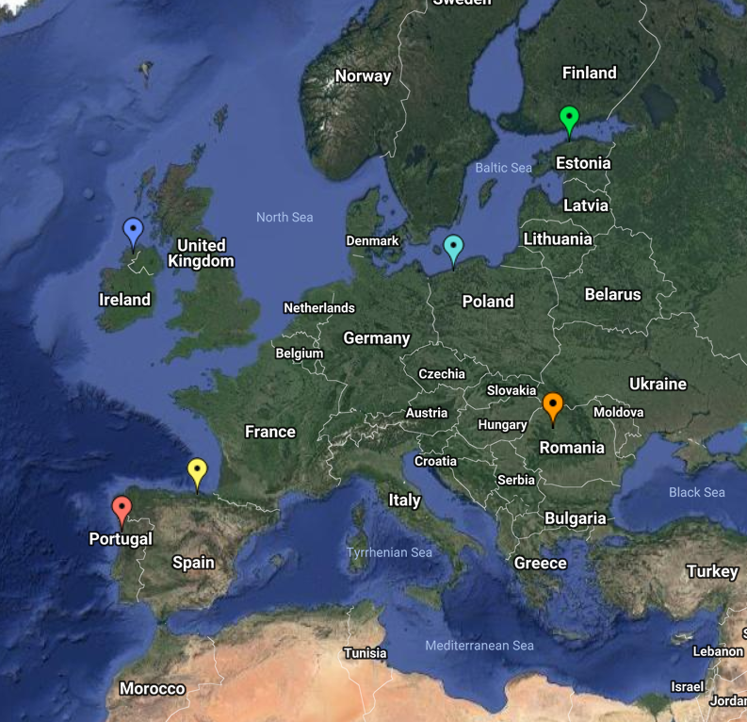
End of Lesson 16
Hope you enjoyed it!
1. Minor Entries of a Matrix
2. Cofactors Entries of a Matrix
Try it!
By EngiMath TEAM

