Slide 1



Lesson 17 Plan
Remember!
You can travel through all the sections (enter or mouse click) or choose your section by clicking over it.
You should only “Try it” after exploring all lesson contents!
1. Cofactor Expansion Along a Row
2. Cofactor Expansion Along a Column
3. Strategy for Cofactor Expansion
Try it!
By EngiMath TEAM

Slide 2
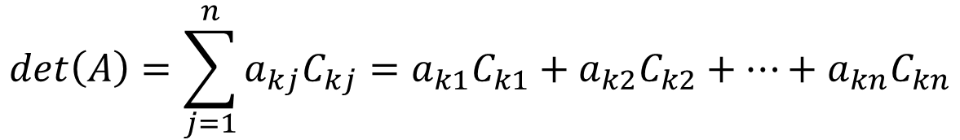
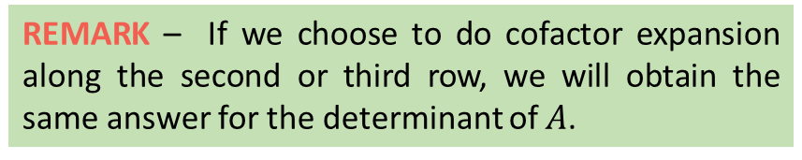






Lesson 17
Laplace’s Expansion
A determinant of a square matrix can be expanded in terms of any row or any column as we will see.
We can evaluate the determinant of a larger matrix by selecting any row, multiplying each element in that row by their corresponding cofactor, and summing the results, that is for any row k:
1. Cofactor Expansion Along a Row
$$det\left(A\right)=\sum_{j=1}^{n}{a_{kj}C_{kj}}=a_{k1}C_{k1}+a_{k2}C_{k2}+…+a_{kn}C_{kn}$$
2. Cofactor Expansion Along a Column
Example
$$A=\left(\begin{matrix}1 & 2 & 3 \\ −1 & 0 & 4 \\ −2 & 1 & 5\end{matrix}\right).$$
Suppose we have the following matrix
3. Strategy for Cofactor Expansion
Let's evaluating the determinant of 𝐴 by cofactor expansion along row 1.
So we will get the formula
REMARK – If we choose to do cofactor expansion along the second or third row, we will obtain the same answer for the determinant of $A$.
$$det\left(A\right)=a_{11}C_{11}+a_{12}C_{12}+a_{13}C_{13}$$
Try it!
$$det\left(A\right)=1×{\left(−1\right)}^{1+1}\left|\begin{matrix}0 & 4 \\ 1 & 5\end{matrix}\right|$$
$$+$$
$$2×{\left(−1\right)}^{1+2}\left|\begin{matrix}−1 & 4 \\ −2 & 5\end{matrix}\right|$$
$$+$$
$$3×{\left(−1\right)}^{1+3}\left|\begin{matrix}−1 & 0 \\ −2 & 1\end{matrix}\right|$$
$$det\left(A\right)=1×\left(0×5−1×4\right)−2×\left(−1×5−\left(−2\right)×4\right)+3×\left(−1×1−\left(−2\right)×0\right)$$
$$det\left(A\right)=1×\left(−4\right)−2×\left(3\right)+3×\left(−1\right)=−13$$

Slide 3




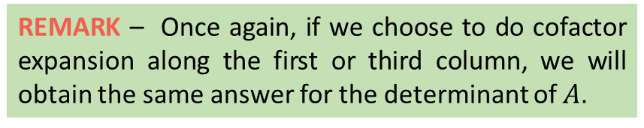
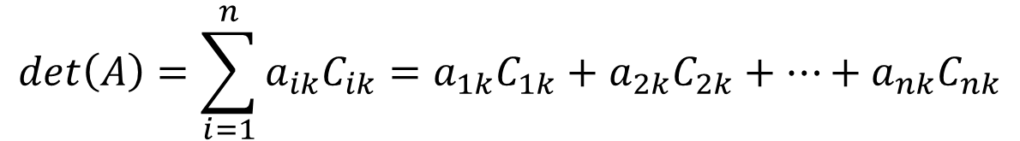

Lesson 17
We can also find the determinant of a square matrix by doing the exact same method for cofactor expansion along a row but instead use columns, that is for any column k:
1. Cofactor Expansion Along a Row
$$det\left(A\right)=\sum_{i=1}^{n}{a_{ik}C_{ik}}=a_{1k}C_{1k}+a_{2k}C_{2k}+…+a_{nk}C_{nk}$$
2. Cofactor Expansion Along a Column
Example
$$A=\left(\begin{matrix}1 & 2 & 3 \\ −1 & 0 & 4 \\ −2 & 1 & 5\end{matrix}\right).$$
Suppose we have the following matrix
3. Strategy for Cofactor Expansion
Let's evaluating the determinant of 𝐴 by cofactor expansion along column 2.
So we will get the formula
REMARK – Once again, if we choose to do cofactor expansion along the first or third column, we will obtain the same answer for the determinant of $A$.
$$det\left(A\right)=a_{12}C_{12}+a_{22}C_{22}+a_{32}C_{32}$$
Try it!
$$det\left(A\right)=2×{\left(−1\right)}^{1+2}\left|\begin{matrix}−1 & 4 \\ −2 & 5\end{matrix}\right|$$
$$+$$
$$0×{\left(−1\right)}^{2+2}\left|\begin{matrix}1 & 3 \\ −2 & 5\end{matrix}\right|$$
$$+$$
$$1×{\left(−1\right)}^{3+2}\left|\begin{matrix}1 & 3 \\ −1 & 4\end{matrix}\right|$$
$$det\left(A\right)=−2×\left(−1×5−\left(−2\right)×4\right)+0−1×\left(1×4−\left(−1\right)×3\right)$$
$$det\left(A\right)=−2×\left(3\right)+0−1×\left(7\right)=−13$$

Slide 4
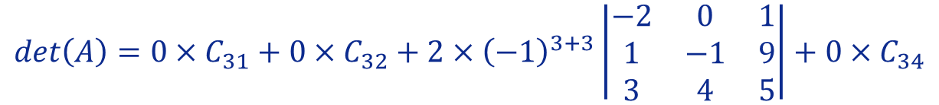
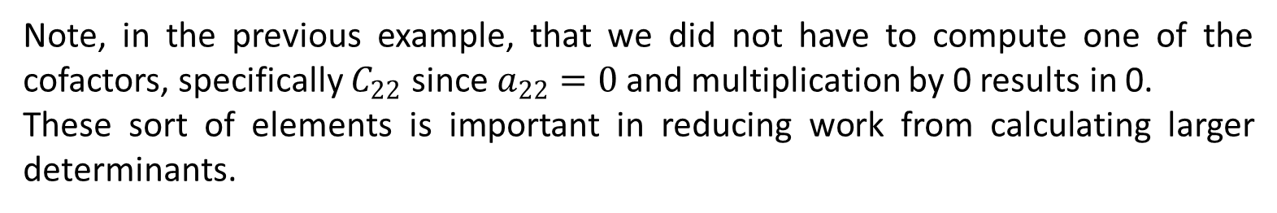

Lesson 17
Note, in the previous example, that we did not have to compute one of the cofactors, specifically $C_{22}$ since $a_{22}=0$ and multiplication by 0 results in 0.
These sort of elements is important in reducing work from calculating larger determinants.
1. Cofactor Expansion Along a Row
2. Cofactor Expansion Along a Column
Example
REMARK – Always check for rows/columns with a large amount of zeroes as cofactor expansion along them is often easier.
$$A=\left(\begin{matrix}−2 & 0 & \begin{matrix}6 & 1\end{matrix} \\ 1 & −1 & \begin{matrix}2 & 9\end{matrix} \\ \begin{matrix}0 \\ 3\end{matrix} & \begin{matrix}0 \\ 4\end{matrix} & \begin{matrix}\begin{matrix}2 \\ 3\end{matrix} & \begin{matrix}0 \\ 5\end{matrix}\end{matrix}\end{matrix}\right)$$
Considering the following matrix
3. Strategy for Cofactor Expansion
We notice right away that row 3 contains almost all zeroes. If we were to use cofactor expansion along the third row, we would greatly reduce the amount of work in terms of calculations as opposed to using cofactor expansion along let's say row 2.
So we will get the formula
Try it!
$$det\left(A\right)=a_{31}C_{31}+a_{32}C_{32}+a_{33}C_{33}+a_{34}C_{34}$$
$$det\left(A\right)=0×C_{31}+0×C_{32}+2×{\left(−1\right)}^{3+3}\left|\begin{matrix}−2 & 0 & 1 \\ 1 & −1 & 9 \\ 3 & 4 & 5\end{matrix}\right|+0×C_{34}$$
Applying the Rule of Sarrus,
$$det\left(A\right)=2×\left[\left(10+4+0\right)−\left(−3−72+0\right)\right]=89$$

Slide 5


Lesson 17
1. Cofactor Expansion Along a Row
2. Cofactor Expansion Along a Column
Maybe you will need a pen and paper to answer these final questions!…
3. Strategy for Cofactor Expansion
Try it!

Slide 6


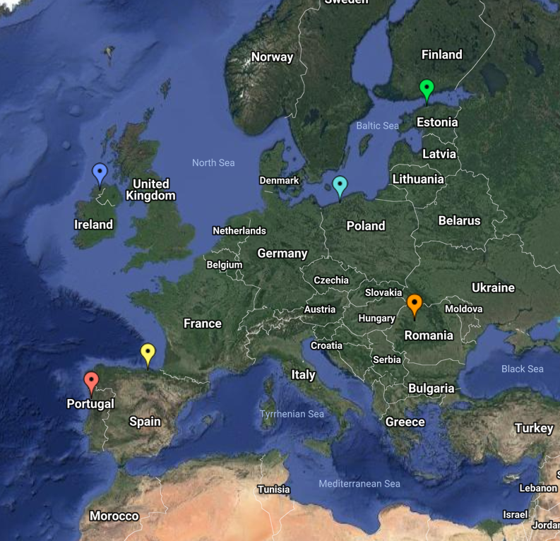
End of Lesson 17
Hope you enjoyed it!
1. Cofactor Expansion Along a Row
2. Cofactor Expansion Along a Column
3. Strategy for Cofactor Expansion
Try it!
By EngiMath TEAM

