Slide 1



Lesson 18 Plan
Remember!
You can travel through all the sections (enter or mouse click) or choose your section by clicking over it.
You should only “Try it” after exploring all lesson contents!
1. Switching Property
2. Scalar Multiple Property
3. Reflection Property
Try it!
By EngiMath TEAM

Slide 2

Lesson 18 Plan
Remember!
You can travel through all the sections (enter or mouse click) or choose your section by clicking over it.
You should only “Try it” after exploring all lesson contents!
1. Switching Property
2. Scalar Multiple Property
All Determinant Properties here presented have been “baptized” with a particular name only to facilitate its identification.
No need for name memorization!
3. Reflection Property
Try it!
By EngiMath TEAM

Slide 3


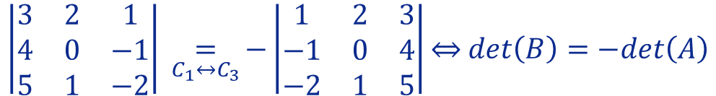


Lesson 18
Suppose that $A$ is a square matrix. If $B$ is the square matrix obtained from $A$ by interchanging the location of two rows (or two columns), then:
1. Switching Property
$$det\left(B\right)=−det\left(A\right)$$
2. Scalar Multiple Property
Example
$$A=\left(\begin{matrix}1 & 2 & 3 \\ −1 & 0 & 4 \\ −2 & 1 & 5\end{matrix}\right).$$
Suppose we have the following matrix
3. Reflection Property
Let matrix $B$ be obtained from matrix A interchanging column 1 with column 3.
So we will get
In practice, whenever an elementary operation is done over the rows or columns (see lesson 12) it is important to point it out!
$$B=\left(\begin{matrix}3 & 2 & 1 \\ 4 & 0 & −1 \\ 5 & 1 & −2\end{matrix}\right)$$
Try it!
Therefore,
$$\left|\begin{matrix}3 & 2 & 1 \\ 4 & 0 & −1 \\ 5 & 1 & −2\end{matrix}\right| \underset{C_{1}↔C_{3}}{=}{−}\left|\begin{matrix}1 & 2 & 3 \\ −1 & 0 & 4 \\ −2 & 1 & 5\end{matrix}\right|\overset{⇔}{ } det\left(B\right)=−det\left(A\right)$$

Slide 4
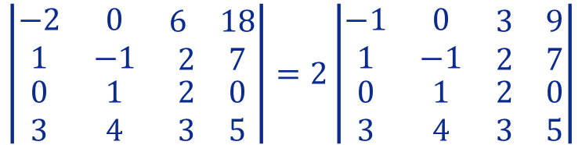


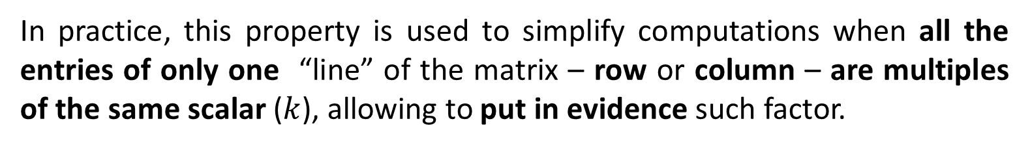

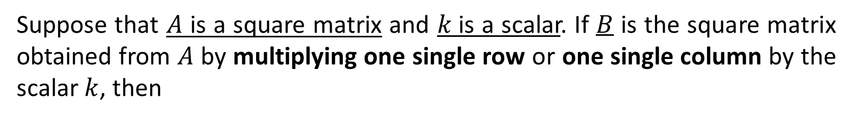
Lesson 18
Suppose that $A$ is a square matrix and $k$is a scalar. If $B$ is the square matrix obtained from $A$ by multiplying one single row or one single column by the scalar $k$, then
1. Switching Property
$$\det\left(B\right)=k.\det\left(A\right)$$
2. Scalar Multiple Property
In practice, this property is used to simplify computations when all the entries of only one “line” of the matrix – row or column – are multiples of the same scalar ($k$), allowing to put in evidence such factor.
3. Reflection Property
Examples
$$\left(\begin{matrix}−2 & 0 & \begin{matrix}6 & 18\end{matrix} \\ 1 & −1 & \begin{matrix}2 & 7\end{matrix} \\ \begin{matrix}0 \\ 3\end{matrix} & \begin{matrix}1 \\ 4\end{matrix} & \begin{matrix}\begin{matrix}2 \\ 3\end{matrix} & \begin{matrix}0 \\ 5\end{matrix}\end{matrix}\end{matrix}\right)$$
1. Considering the following matrix
Try it!
Notice that all the entries in row 1 are even numbers, so we can put number 2 in evidence, therefore we can write the determinant as
$$\left|\begin{matrix}−2 & 0 & \begin{matrix}6 & 18\end{matrix} \\ 1 & −1 & \begin{matrix}2 & 7\end{matrix} \\ \begin{matrix}0 \\ 3\end{matrix} & \begin{matrix}1 \\ 4\end{matrix} & \begin{matrix}\begin{matrix}2 \\ 3\end{matrix} & \begin{matrix}0 \\ 5\end{matrix}\end{matrix}\end{matrix}\right|=2\left|\begin{matrix}−1 & 0 & \begin{matrix}3 & 9\end{matrix} \\ 1 & −1 & \begin{matrix}2 & 7\end{matrix} \\ \begin{matrix}0 \\ 3\end{matrix} & \begin{matrix}1 \\ 4\end{matrix} & \begin{matrix}\begin{matrix}2 \\ 3\end{matrix} & \begin{matrix}0 \\ 5\end{matrix}\end{matrix}\end{matrix}\right|$$

Slide 5
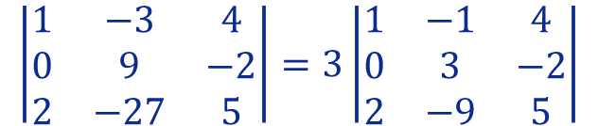

Lesson 18
Suppose that $A$ is a square matrix and $k$is a scalar. If $B$ is the square matrix obtained from $A$ by multiplying one single row or one single column by the scalar $k$, then
1. Switching Property
$$\det\left(B\right)=k.\det\left(A\right)$$
2. Scalar Multiple Property
In practice, this property is used to simplify computations when all the entries of only one “line” of the matrix – row or column – are multiples of the same scalar ($k$), allowing to put in evidence such factor.
3. Reflection Property
Examples
$$\left|\begin{matrix}1 & −3 & 4 \\ 0 & 9 & −2 \\ 2 & −27 & 5\end{matrix}\right|$$
2. Considering the following determinant
Try it!
Observe that all elements in column 2 are multiples of 3, so we can put number 3 in evidence and write
$$\left|\begin{matrix}1 & −3 & 4 \\ 0 & 9 & −2 \\ 2 & −27 & 5\end{matrix}\right|=3\left|\begin{matrix}1 & −1 & 4 \\ 0 & 3 & −2 \\ 2 & −9 & 5\end{matrix}\right|$$

Slide 6


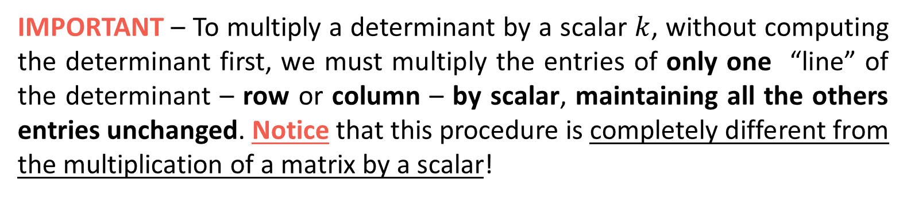
Lesson 18
Suppose that $A$ is a square matrix and $k$is a scalar. If $B$ is the square matrix obtained from $A$ by multiplying one single row or one single column by the scalar $k$, then
1. Switching Property
$$\det\left(B\right)=k.\det\left(A\right)$$
2. Scalar Multiple Property
IMPORTANT – To multiply a determinant by a scalar $k$, without computing the determinant first, we must multiply the entries of only one “line” of the determinant – row or column – by scalar, maintaining all the others entries unchanged. Notice that this procedure is completely different from the multiplication of a matrix by a scalar!
3. Reflection Property
Example
Given the determinant $\left|\begin{matrix}1 & 2 \\ 3 & 4\end{matrix}\right|$ we can easily determine its value:
Try it!
$$\left|\begin{matrix}1 & 2 \\ 3 & 4\end{matrix}\right|=1×4−2×3=4−6=−2$$
and if, for any reason, we want to triple its value we can just multiply it by 3!
$$3\left|\begin{matrix}1 & 2 \\ 3 & 4\end{matrix}\right|=3 \left(1×4−2×3\right)=3\left(4−6\right)=3\left(−2\right)=−6$$

Slide 7

Lesson 18
Suppose that $A$ is a square matrix and $k$is a scalar. If $B$ is the square matrix obtained from $A$ by multiplying one single row or one single column by the scalar $k$, then
1. Switching Property
$$\det\left(B\right)=k.\det\left(A\right)$$
2. Scalar Multiple Property
IMPORTANT – To multiply a determinant by a scalar $k$, without computing the determinant first, we must multiply the entries of only one “line” of the determinant – row or column – by scalar, maintaining all the others entries unchanged. Notice that this procedure is completely different from the multiplication of a matrix by a scalar!
3. Reflection Property
Example
The problem is if we want to triple the value of $\left|\begin{matrix}1 & 2 \\ 3 & 4\end{matrix}\right|$ without computing it!
Try it!
You probably would answer with matrix “intuition”, multiplying all entries:
$$3\left|\begin{matrix}1 & 2 \\ 3 & 4\end{matrix}\right|=\left|\begin{matrix}3 & 6 \\ 9 & 12\end{matrix}\right|=3×12−6×9=36−54=−18$$
We already know that the result is $\left(−6\right)$ not $\left(−18\right)$!

Slide 8



Lesson 18
Suppose that $A$ is a square matrix and $k$is a scalar. If $B$ is the square matrix obtained from $A$ by multiplying one single row or one single column by the scalar $k$, then
1. Switching Property
$$\det\left(B\right)=k.\det\left(A\right)$$
2. Scalar Multiple Property
IMPORTANT – To multiply a determinant by a scalar $k$, without computing the determinant first, we must multiply the entries of only one “line” of the determinant – row or column – by scalar, maintaining all the others entries unchanged. Notice that this procedure is completely different from the multiplication of a matrix by a scalar!
3. Reflection Property
Example
The problem is if we want to triple the value of $\left|\begin{matrix}1 & 2 \\ 3 & 4\end{matrix}\right|$ without computing it!
Try it!
For this determinant you have four options to solve the problem: multiply the
1st row or 2nd row
in all 4
Just one of these 4 options is needed to solve the problem! Pick one!
$$3\left|\begin{matrix}1 & 2 \\ 3 & 4\end{matrix}\right|=\left|\begin{matrix}3 & 6 \\ 3 & 4\end{matrix}\right|=\left|\begin{matrix}1 & 2 \\ 9 & 12\end{matrix}\right|=\left|\begin{matrix}3 & 2 \\ 9 & 4\end{matrix}\right|=\left|\begin{matrix}1 & 6 \\ 3 & 12\end{matrix}\right|$$
$$=12−18$$
$$=−6$$
1st column or 2nd column

Slide 9
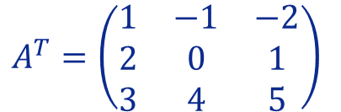
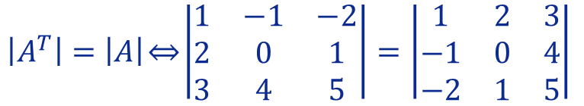


Lesson 18
Suppose that A is a square matrix. The value of the determinant of A remains unaltered by interchanging its rows and columns. Then
1. Switching Property
$$det\left(A^{T}\right)=det\left(A\right)$$
2. Scalar Multiple Property
Example
$$A=\left(\begin{matrix}1 & 2 & 3 \\ −1 & 0 & 4 \\ −2 & 1 & 5\end{matrix}\right).$$
Suppose we have the following matrix
3. Reflection Property
Let matrix $A^{T} (t$ranspose of A) be obtained by interchanging the columns and rows of A.
$$A^{T}=\left(\begin{matrix}1 & −1 & −2 \\ 2 & 0 & 1 \\ 3 & 4 & 5\end{matrix}\right)$$
Try it!
Therefore,
$${\left|A^{T}\right|=\left|A\right|\overset{⇔}{ }\left|\begin{matrix}1 & −1 & −2 \\ 2 & 0 & 1 \\ 3 & 4 & 5\end{matrix}\right|=\left|\begin{matrix}1 & 2 & 3 \\ −1 & 0 & 4 \\ −2 & 1 & 5\end{matrix}\right|}_{ }$$

Slide 10




Lesson 18
Pick up a peace of
paper and a pen
before you start!
1. Switching Property
2. Scalar Multiple Property
3. Reflection Property
Try it!

Slide 11

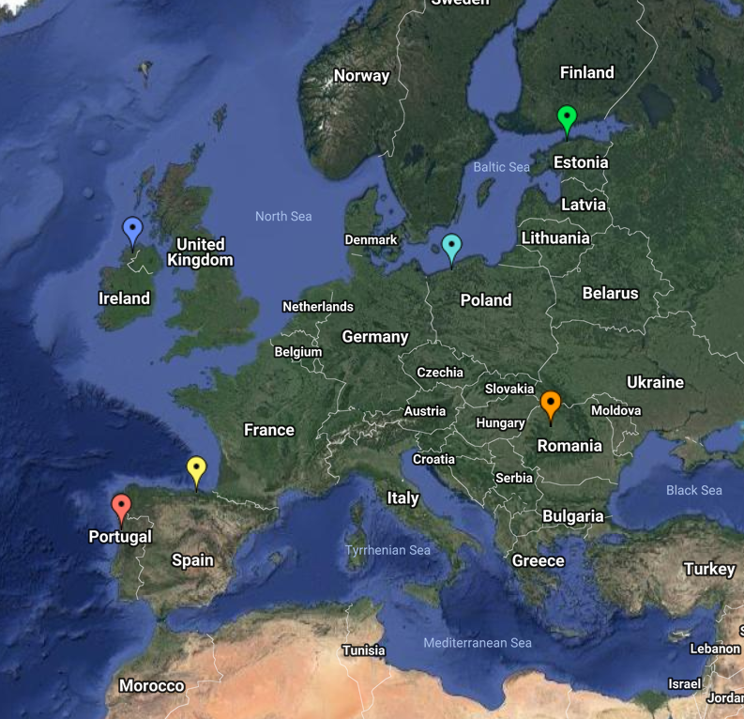
End of Lesson 18
Hope you enjoyed it!
1. Switching Property
2. Scalar Multiple Property
3. Reflection Property
Try it!
By EngiMath TEAM

