Slide 1



Lesson 19 Plan
Remember!
You can travel through all the sections (enter or mouse click) or choose your section by clicking over it.
You should only “Try it” after exploring all lesson contents!
1. All-zero “line” entries Property
2. Equal “parallel lines” Property
3.Proportional
“parallel lines” Property
Try it!
By EngiMath TEAM

Slide 2

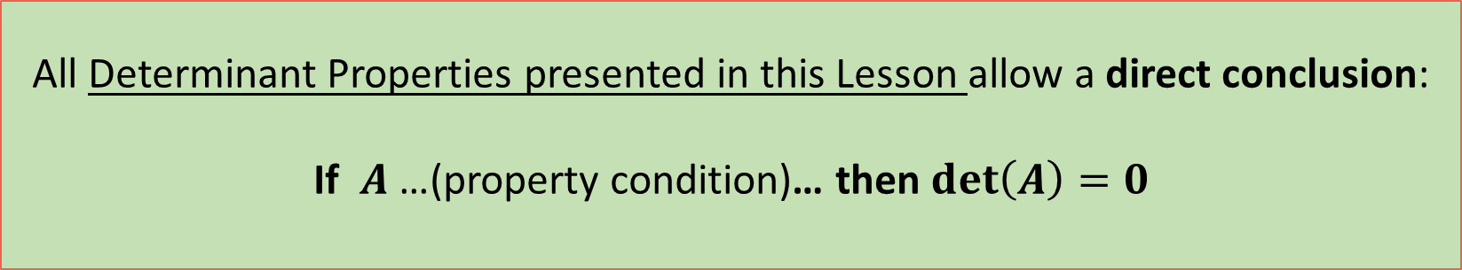
Lesson 19 Plan
Remember!
You can travel through all the sections (enter or mouse click) or choose your section by clicking over it.
You should only “Try it” after exploring all lesson contents!
1. All-zero “line” entries Property
All Determinant Properties here presented have been “baptized” with a particular name only to facilitate its identification.
No need for name memorization!
2. Equal “parallel lines” Property
All Determinant Properties presented in this Lesson allow a direct conclusion:
If $A$ …(property condition)… then $det\left(A\right)=0$
3.Proportional
“parallel lines” Property
Try it!
By EngiMath TEAM

Slide 3






Lesson 19
If $A$ is a square matrix with:
a “line” – row or column – where every entry is zero, then
1. All-zero “line” entries Property
$$\det\left(A\right)=0$$
2. Equal “parallel lines” Property
Example
$$A=\left(\begin{matrix}1 & 2 & 3 \\ 0 & 0 & 0 \\ −2 & 1 & 5\end{matrix}\right).$$
Suppose we have the following matrix
3.Proportional
“parallel lines” Property
Can you mentally try to evaluate $det\left(A\right)$ using Cofactor expansion to the 2nd row?…
Easy!... Yes?...
Try it!
$$det\left(A\right)=a_{21}C_{31}+a_{22}C_{32}+a_{23}C_{33}=$$
$$0×$$
$$0×$$
$$0×$$
$$= 0 + 0 + 0 =0$$

Slide 4
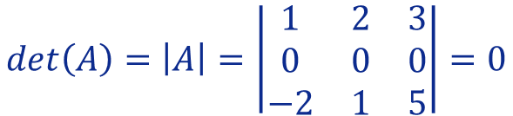


Lesson 19
If $A$ is a square matrix with:
a “line” – row or column – where every entry is zero, then
1. All-zero “line” entries Property
$$\det\left(A\right)=0$$
2. Equal “parallel lines” Property
Example
$$A=\left(\begin{matrix}1 & 2 & 3 \\ 0 & 0 & 0 \\ −2 & 1 & 5\end{matrix}\right).$$
Suppose we have the following matrix
3.Proportional
“parallel lines” Property
So, if we observe that all elements in ANY ROW or COLUMN are zero then we may conclude directly that its determinant is zero!
Since $A$ has the second row entries all equal zero, therefore
Try it!
We may justify this direct result by writing, for example:
$$det\left(A\right)=\left|A\right|=\left|\begin{matrix}1 & 2 & 3 \\ 0 & 0 & 0 \\ −2 & 1 & 5\end{matrix}\right|=0$$
, because $R_{2}=0$
“shortly” meaning: “$R$ow 2 has all entries equal to zero”!

Slide 5

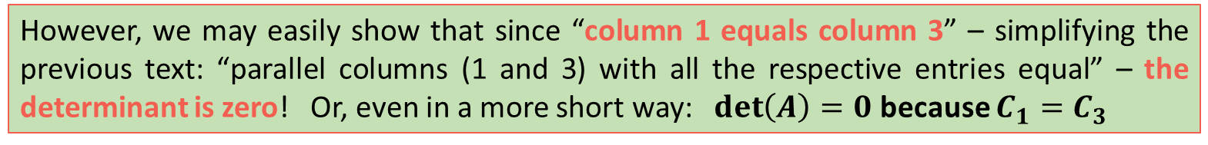

Lesson 19
If $A$ is a square matrix with:
two “parallel lines” – rows or columns – with all the respective entries equal, then
1. All-zero “line” entries Property
$$\det\left(A\right)=0$$
2. Equal “parallel lines” Property
Example
$$A=\left(\begin{matrix}1 & 2 & 1 \\ 3 & 0 & 3 \\ −2 & 1 & −2\end{matrix}\right).$$
Consider the following matrix
3.Proportional
“parallel lines” Property
Its determinant can always be evaluated by applying the practical procedures presented in previous lessons…
However, we may easily show that since “column 1 equals column 3” – simplifying the previous text: “parallel columns (1 and 3) with all the respective entries equal” – the determinant is zero! Or, even in a more short way: $\det\left(A\right)=0$ because $C_{1}=C_{3}$
Try it!
Let’s see how!

Slide 6




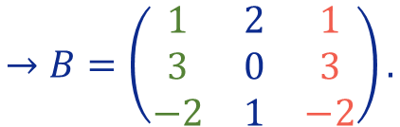

Lesson 19
If $A$ is a square matrix with:
two “parallel lines” – rows or columns – with all the respective entries equal, then
1. All-zero “line” entries Property
$$\det\left(A\right)=0$$
2. Equal “parallel lines” Property
Example
$$A=\left(\begin{matrix}1 & 2 & 1 \\ 3 & 0 & 3 \\ −2 & 1 & −2\end{matrix}\right).$$
$$→B=\left(\begin{matrix}1 & 2 & 1 \\ 3 & 0 & 3 \\ −2 & 1 & −2\end{matrix}\right).$$
$$A=\left(\begin{matrix}1 & 2 & 1 \\ 3 & 0 & 3 \\ −2 & 1 & −2\end{matrix}\right).$$
Consider the following matrix
3.Proportional
“parallel lines” Property
Since we do not know the value of the determinant, suppose that: $\det\left(A\right)=x, x∈IR$
Now, lets interchange column 1 with column 3…
Try it!
Using the “switching property” from previous Lesson, we have: $\det\left(B\right)=−x$
Nonetheless, since $A{=B}$ we must have:
$$\det\left(A\right)=\det\left(B\right)⇔x=−x⇔2x=0⇔x=0$$
$$\det\left(A\right)=0$$

Slide 7
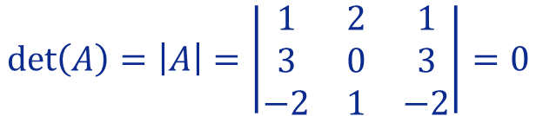
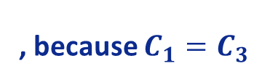
Lesson 19
If $A$ is a square matrix with:
two “parallel lines” – rows or columns – with all the respective entries equal, then
1. All-zero “line” entries Property
$$\det\left(A\right)=0$$
2. Equal “parallel lines” Property
Example
$$A=\left(\begin{matrix}1 & 2 & 1 \\ 3 & 0 & 3 \\ −2 & 1 & −2\end{matrix}\right).$$
Consider the following matrix
3.Proportional
“parallel lines” Property
So, if we observe that all elements in ANY two ROWS or ANY two COLUMNS are the same then we may conclude directly that its determinant is zero!
As $A$has two equal columns (first and third) then its determinant is zero!
Try it!
$$\det\left(A\right)=\left|A\right|=\left|\begin{matrix}1 & 2 & 1 \\ 3 & 0 & 3 \\ −2 & 1 & −2\end{matrix}\right|=0$$
, because $C_{1}=C_{3}$

Slide 8

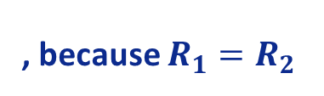

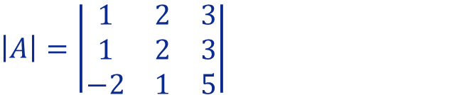
Lesson 19
If $A$ is a square matrix with:
two “parallel lines” – rows or columns – with all the respective entries equal, then
1. All-zero “line” entries Property
$$\det\left(A\right)=0$$
2. Equal “parallel lines” Property
Example
We can observe that the first and the second row of the determinant are equal, therefore:
3.Proportional
“parallel lines” Property
$$\left|A\right|=\left|\begin{matrix}1 & 2 & 3 \\ 1 & 2 & 3 \\ −2 & 1 & 5\end{matrix}\right|$$
, because $R_{1}=R_{2}$
$$=0$$
Try it!

Slide 9
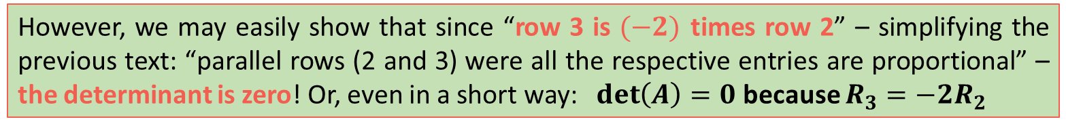
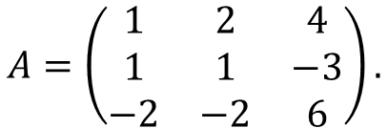

Lesson 19
If $A$ is a square matrix with:
two “parallel lines” – rows or columns – where all the respective entries are proportional, then
1. All-zero “line” entries Property
$$\det\left(A\right)=0$$
2. Equal “parallel lines” Property
Example
$$A=\left(\begin{matrix}1 & 2 & 4 \\ 1 & 1 & −3 \\ −2 & −2 & 6\end{matrix}\right).$$
Consider the following matrix
3.Proportional
“parallel lines” Property
Once again, its determinant can always be evaluated by applying the practical procedures presented in previous lessons…
However, we may easily show that since “row 3 is $(−2)$ times row 2” – simplifying the previous text: “parallel rows (2 and 3) were all the respective entries are proportional” – the determinant is zero! Or, even in a short way: $\det\left(A\right)=0$ because $R_{3}=−2R_{2}$
Try it!
Let’s see how!
It is easy using some given properties!...

Slide 10

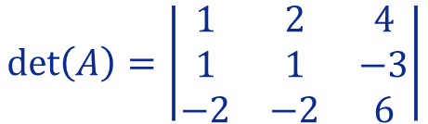
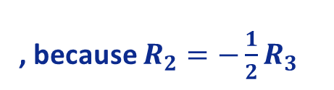



Lesson 19
If $A$ is a square matrix with:
two “parallel lines” – rows or columns – where all the respective entries are proportional, then
1. All-zero “line” entries Property
$$\det\left(A\right)=0$$
2. Equal “parallel lines” Property
Example
$$A=\left(\begin{matrix}1 & 2 & 4 \\ 1 & 1 & −3 \\ −2 & −2 & 6\end{matrix}\right).$$
Consider the following matrix
3.Proportional
“parallel lines” Property
We may justify directly this result by writing, for example:
$$\det\left(A\right)=\left|\begin{matrix}1 & 2 & 4 \\ 1 & 1 & −3 \\ −2 & −2 & 6\end{matrix}\right|$$
$$=−2\left|\begin{matrix}1 & 2 & 4 \\ 1 & 1 & −3 \\ 1 & 1 & −3\end{matrix}\right|$$
, because $R_{2}=−\frac{1}{2}R_{3}$
Try it!
$$=−2×0$$
$$=0$$
because
$R_{2}=R_{3}$
An alternative way to write the same proportionality relation between the rows!...
Scalar Multiple
Property

Slide 11

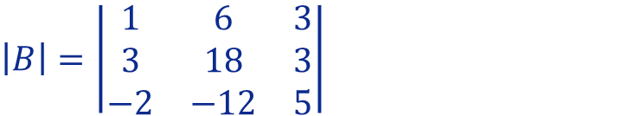
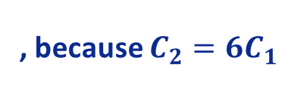

Lesson 19
If $A$ is a square matrix with:
two “parallel lines” – rows or columns – where all the respective entries are proportional, then
1. All-zero “line” entries Property
$$\det\left(A\right)=0$$
2. Equal “parallel lines” Property
Example
We can observe that the first and the second columns of the determinant are proportional, particularly that the second column is 6 times the first column therefore:
3.Proportional
“parallel lines” Property
$$\left|B\right|=\left|\begin{matrix}1 & 6 & 3 \\ 3 & 18 & 3 \\ −2 & −12 & 5\end{matrix}\right|$$
, because $C_{2}={6C}_{1}$
$$=0$$
Try it!

Slide 12

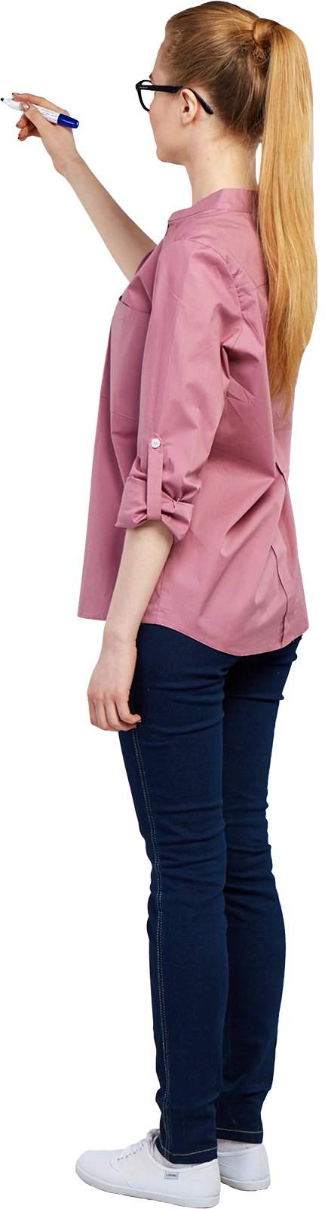
Lesson 19
1. All-zero “line” entries Property
I don´t think you need a notepad or a pencil to solve these questions!..
2. Equal “parallel lines” Property
3.Proportional
“parallel lines” Property
Try it!

Slide 13

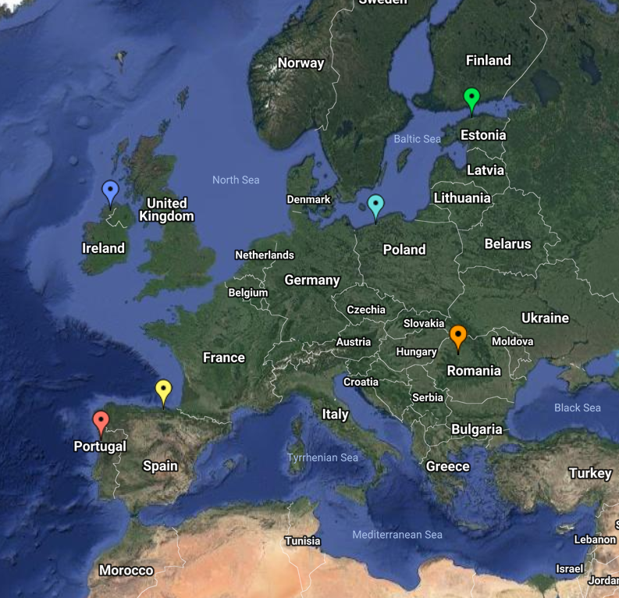
End of Lesson 19
Hope you enjoyed it!
1. All-zero “line” entries Property
2. Equal “parallel lines” Property
3.Proportional
“parallel lines” Property
Try it!
By EngiMath TEAM

