Slide 1



Lesson 20 Plan
Remember!
You can travel through all the sections (enter or mouse click) or choose your section by clicking over it.
You should only “Try it” after exploring all lesson contents!
1. Product of two Determinants Property
2. Sum Property
3. Invariance Property
Try it!
By EngiMath TEAM

Slide 2

Lesson 20 Plan
Remember!
You can travel through all the sections (enter or mouse click) or choose your section by clicking over it.
You should only “Try it” after exploring all lesson contents!
1. Product of two Determinants Property
All Determinant Properties here presented have been “baptized” with a particular name only to facilitate its identification.
No need for name memorization!
2. Sum Property
3. Invariance Property
Try it!
By EngiMath TEAM

Slide 3
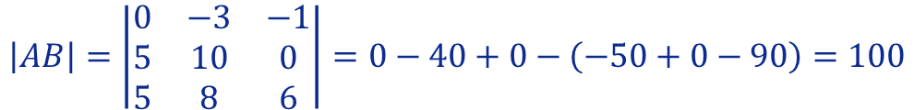
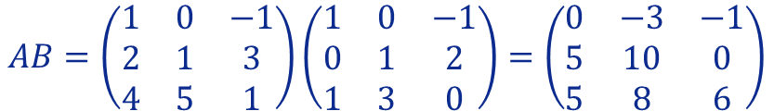


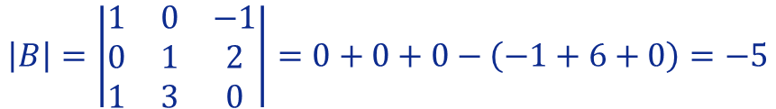
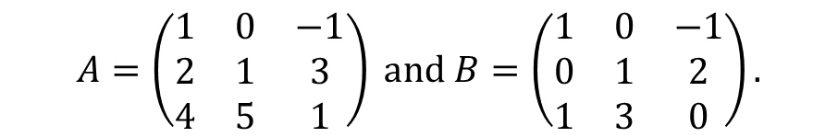

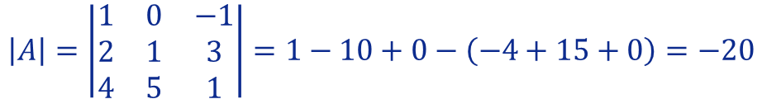
Lesson 20
Suppose that A and B are square matrices of the same order. Then
1. Product of two Determinants Property
$$det\left(AB\right)=det\left(A\right)det\left(B\right)$$
Example
$$A=\left(\begin{matrix}1 & 0 & −1 \\ 2 & 1 & 3 \\ 4 & 5 & 1\end{matrix}\right) and B=\left(\begin{matrix}1 & 0 & −1 \\ 0 & 1 & 2 \\ 1 & 3 & 0\end{matrix}\right).$$
2. Sum Property
Considering the following matrices
Let’s see that
$$\left|AB\right|=\left|A\right|\left|B\right|.$$
$$AB=\left(\begin{matrix}1 & 0 & −1 \\ 2 & 1 & 3 \\ 4 & 5 & 1\end{matrix}\right)\left(\begin{matrix}1 & 0 & −1 \\ 0 & 1 & 2 \\ 1 & 3 & 0\end{matrix}\right)=\left(\begin{matrix}0 & −3 & −1 \\ 5 & 10 & 0 \\ 5 & 8 & 6\end{matrix}\right)$$
3. Invariance Property
$$\left|AB\right|=\left|\begin{matrix}0 & −3 & −1 \\ 5 & 10 & 0 \\ 5 & 8 & 6\end{matrix}\right|=0−40+0−\left(−50+0−90\right)=100$$
By Using Sarrus’ Rule
(Lesson 15)
$$\left|A\right|=\left|\begin{matrix}1 & 0 & −1 \\ 2 & 1 & 3 \\ 4 & 5 & 1\end{matrix}\right|=1−10+0−\left(−4+15+0\right)=−20$$
Try it!
$$\left|B\right|=\left|\begin{matrix}1 & 0 & −1 \\ 0 & 1 & 2 \\ 1 & 3 & 0\end{matrix}\right|=0+0+0−\left(−1+6+0\right)=−5$$
So, $\left|A\right|\left|B\right|=−20×\left(−5\right)=100=\left|AB\right|$

Slide 4
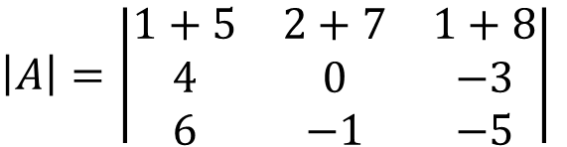
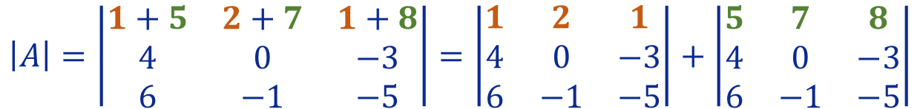
Lesson 20
If each element of a line (row or column) of a determinant is the sum of n terms, the determinant can be expressed as the sum of n determinants of the same order.
1. Product of two Determinants Property
2. Sum Property
Consider the following
Example
$\left|A\right|=\left|\begin{matrix}1+5 & 2+7 & 1+8 \\ 4 & 0 & −3 \\ 6 & −1 & −5\end{matrix}\right|$
Consider the following determinant
3. Invariance Property
Notice that each element of first row is the sum of two terms, thus $\left|A\right|$ can be expressed as the sum of two determinants of the third order.
Try it!
$$\left|A\right|=\left|\begin{matrix}1+5 & 2+7 & 1+8 \\ 4 & 0 & −3 \\ 6 & −1 & −5\end{matrix}\right|=\left|\begin{matrix}1 & 2 & 1 \\ 4 & 0 & −3 \\ 6 & −1 & −5\end{matrix}\right|+\left|\begin{matrix}5 & 7 & 8 \\ 4 & 0 & −3 \\ 6 & −1 & −5\end{matrix}\right|$$

Slide 5
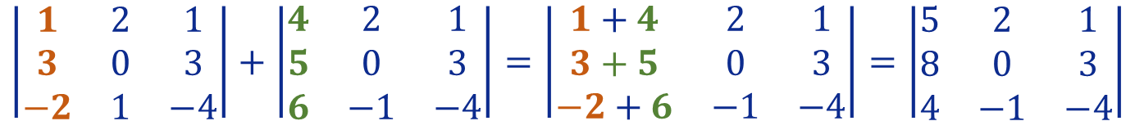
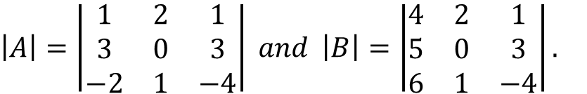
Lesson 20
The sum of determinants which are identical except for the elements of one pair of corresponding rows (columns) can be calculated as a single determinant by adding the corresponding rows (columns) elementwise, while leaving the other rows (columns) unchanged.
1. Product of two Determinants Property
2. Sum Property
Consider the following
Example
$\left|A\right|=\left|\begin{matrix}1 & 2 & 1 \\ 3 & 0 & 3 \\ −2 & 1 & −4\end{matrix}\right| and \left|B\right|=\left|\begin{matrix}4 & 2 & 1 \\ 5 & 0 & 3 \\ 6 & 1 & −4\end{matrix}\right|.$
Consider the following determinants
3. Invariance Property
Notice that determinants $\left|A\right|$ and $\left|B\right|$ are identical except for the elements of first column.
Thus, they can be calculated as a single determinant by adding the corresponding first column elementwise, while leaving the others columns unchanged.
Try it!
$$\left|\begin{matrix}1 & 2 & 1 \\ 3 & 0 & 3 \\ −2 & 1 & −4\end{matrix}\right|+\left|\begin{matrix}4 & 2 & 1 \\ 5 & 0 & 3 \\ 6 & −1 & −4\end{matrix}\right|=\left|\begin{matrix}1+4 & 2 & 1 \\ 3+5 & 0 & 3 \\ −2+6 & −1 & −4\end{matrix}\right|=\left|\begin{matrix}5 & 2 & 1 \\ 8 & 0 & 3 \\ 4 & −1 & −4\end{matrix}\right|$$

Slide 6

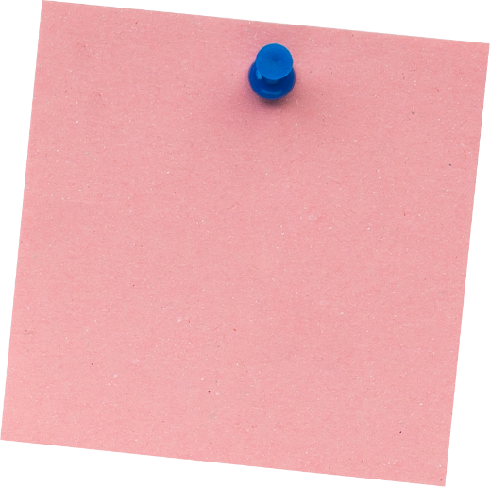



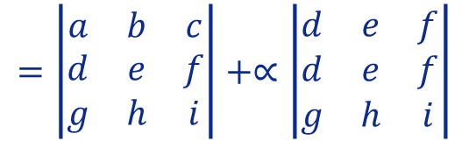
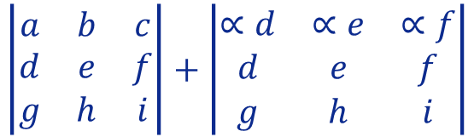
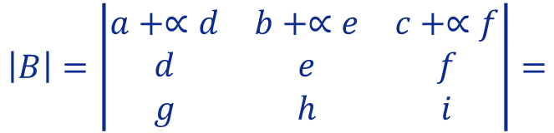



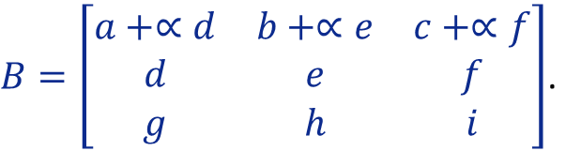

Lesson 20
Suppose that A is a square matrix. Let B be the square matrix obtained from A by multiplying a row (or column) by the scalar α and then adding it to another row (or column). Then
1. Product of two Determinants Property
$$det\left(B\right)=det\left(A\right)$$
Examples
$$A=\left[\begin{matrix}a & b & c \\ d & e & f \\ g & h & i\end{matrix}\right].$$
2. Sum Property
1. Consider the following matrix
Let B be the matrix obtained from A by multiplying the second row by the scalar $∝$ and then adding it to first row
3. Invariance Property
$B=\left[\begin{matrix}a+∝d & b+∝e & c+∝f \\ d & e & f \\ g & h & i\end{matrix}\right]$.
Let’s evaluate the determinant of matrix B
$$\left|B\right|=\left|\begin{matrix}a+∝d & b+∝e & c+∝f \\ d & e & f \\ g & h & i\end{matrix}\right|=$$
$$\left|\begin{matrix}a & b & c \\ d & e & f \\ g & h & i\end{matrix}\right|+\left|\begin{matrix}∝d & ∝e & ∝f \\ d & e & f \\ g & h & i\end{matrix}\right|$$
By Sum Property
Try it!
By Equal
“parallel lines” Property
By Scalar Multiple Property
$=\left|\begin{matrix}a & b & c \\ d & e & f \\ g & h & i\end{matrix}\right|+∝\left|\begin{matrix}d & e & f \\ d & e & f \\ g & h & i\end{matrix}\right|$
$=\left|\begin{matrix}a & b & c \\ d & e & f \\ g & h & i\end{matrix}\right|+∝×0=$
$\left|\begin{matrix}a & b & c \\ d & e & f \\ g & h & i\end{matrix}\right|+0=\left|A\right|$

Slide 7


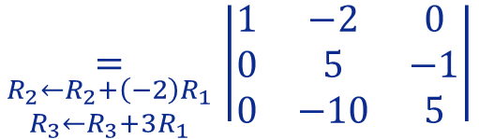



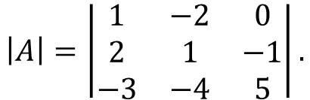

Lesson 20
Suppose that A is a square matrix. Let B be the square matrix obtained from A by multiplying a row (or column) by the scalar α and then adding it to another row (or column). Then
1. Product of two Determinants Property
$$det\left(B\right)=det\left(A\right)$$
Examples
$$\left|A\right|=\left|\begin{matrix}1 & −2 & 0 \\ 2 & 1 & −1 \\ −3 & −4 & 5\end{matrix}\right|.$$
2. Sum Property
2. Consider the following determinant
Applying this property we will try to simplify the computation of the determinant:
By cofactor expansion along
row 1
By Invariance
Property
3. Invariance Property
$$\left|A\right|=\left|\begin{matrix}1 & −2 & 0 \\ 2 & 1 & −1 \\ −3 & −4 & 5\end{matrix}\right|$$
$$\underset{\begin{aligned}R_{2}←R_{2}+\left(−2\right)R_{1} \\ R_{3}←R_{3}+3R_{1}\end{aligned}}{=}\left|\begin{matrix}1 & −2 & 0 \\ 0 & 5 & −1 \\ 0 & −10 & 5\end{matrix}\right|$$
$$=1×{\left(−1\right)}^{1+1} \left|\begin{matrix}5 & −1 \\ −10 & 5\end{matrix}\right|$$
Try it!
$$=25−\left(+10\right)$$
$$=15$$

Slide 8



Lesson 20
1. Product of two Determinants Property
I don´t think you will need a notepad or a pencil to solve these questions!..
2. Sum Property
3. Invariance Property
Try it!

Slide 9


End of Lesson 20
Hope you enjoyed it!
1. Product of two Determinants Property
2. Sum Property
3. Invariance Property
Try it!
By EngiMath TEAM

