Slide 1



Lesson 21 Plan
Remember!
You can travel through all the sections (enter or mouse click) or choose your section by clicking over it.
You should only “Try it” after exploring all lesson contents!
1. Triangle Property
2. Identity Property
3. Inverse Property
Try it!
By EngiMath TEAM

Slide 2

Lesson 21 Plan
Remember!
You can travel through all the sections (enter or mouse click) or choose your section by clicking over it.
You should only “Try it” after exploring all lesson contents!
1. Triangle Property
All Determinant Properties here presented have been “baptized” with a particular name only to facilitate its identification.
No need for name memorization!
2. Identity Property
3. Inverse Property
Try it!
By EngiMath TEAM

Slide 3



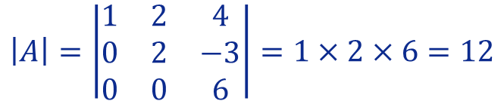

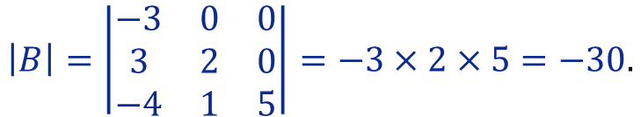
Lesson 21
If all the elements of a determinant above or below the main diagonal consist of zeros, then the determinant is equal to the product of diagonal elements.
1. Triangle Property
Examples
$$\left|A\right|=\left|\begin{matrix}1 & 2 & 4 \\ 0 & 2 & −3 \\ 0 & 0 & 6\end{matrix}\right|.$$
2. Identity Property
1. Consider the following determinant
Notice that all the elements below the main diagonal consist of zeros.
Then, the determinant is equal to the product of diagonal elements.
3. Inverse Property
$$\left|A\right|=\left|\begin{matrix}1 & 2 & 4 \\ 0 & 2 & −3 \\ 0 & 0 & 6\end{matrix}\right|=1×2×6=12$$
$$\left|B\right|=\left|\begin{matrix}−3 & 0 & 0 \\ 3 & 2 & 0 \\ −4 & 1 & 5\end{matrix}\right|.$$
2. Consider the following determinant
Try it!
Notice that all the elements above the main diagonal consist of zeros.
$$\left|B\right|=\left|\begin{matrix}−3 & 0 & 0 \\ 3 & 2 & 0 \\ −4 & 1 & 5\end{matrix}\right|=−3×2×5=−30.$$
Then, the determinant is equal to the product of diagonal elements.

Slide 4









Lesson 21
The determinant of the identity matrix is one.
$$\left|I_{n}\right|=\left|\begin{matrix}1 & 0 & \begin{matrix}0 & \begin{matrix}… & 0\end{matrix}\end{matrix} \\ 0 & 1 & \begin{matrix}0 & \begin{matrix}… & 0\end{matrix}\end{matrix} \\ \begin{matrix}0 \\ \begin{matrix}⋮ \\ 0\end{matrix}\end{matrix} & \begin{matrix}0 \\ \begin{matrix}⋮ \\ 0\end{matrix}\end{matrix} & \begin{matrix}\begin{matrix}1 \\ \begin{matrix}⋮ \\ 0\end{matrix}\end{matrix} & \begin{matrix}\begin{matrix}… & 0\end{matrix} \\ \begin{matrix}\begin{matrix}⋱ \\ …\end{matrix} & \begin{matrix}0 \\ 1\end{matrix}\end{matrix}\end{matrix}\end{matrix}\end{matrix}\right|=1$$
1. Triangle Property
2. Identity Property
Consider the following
Examples
1. Let’s compute the determinant of matrix $I_{2}=\left[\begin{matrix}1 & 0 \\ 0 & 1\end{matrix}\right]$.
So we need to compute the determinant of a $2×2$ matrix (Lesson 15), then
3. Inverse Property
$$\left|I_{2}\right|=\left|\begin{matrix}1 & 0 \\ 0 & 1\end{matrix}\right|$$
$$=1×1−0×0=1$$
Or, we may also use the triangle property to compute it…
2. Let’s compute the determinant of matrix $I_{3}=\left[\begin{matrix}1 & 0 & 0 \\ 0 & 1 & 0 \\ 0 & 0 & 1\end{matrix}\right]$.
Try it!
To compute this determinant, we can use the Sarrus’ Rule (Lesson 15) or use the triangle property, therefore we will get
$$\left|I_{3}\right|=\left|\begin{matrix}1 & 0 & 0 \\ 0 & 1 & 0 \\ 0 & 0 & 1\end{matrix}\right|=1$$

Slide 5

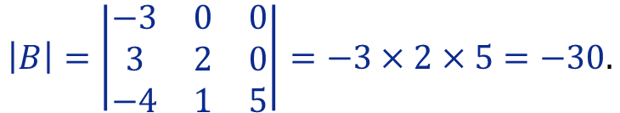



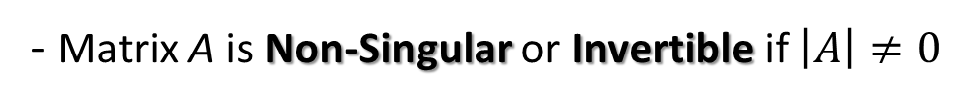


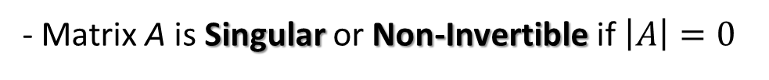
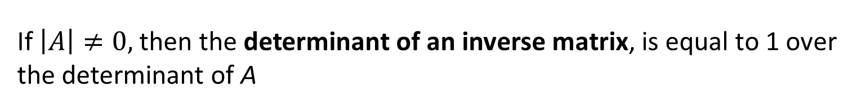

Lesson 21
If $\left|A\right|≠0,$ then the determinant of an inverse matrix, is equal to 1 over the determinant of A
$$\left|A^{−1}\right|=\frac{1}{\left|A\right|}$$
Note
1. Triangle Property
$$\left|I\right|=1$$
$\underset{⇔}{ }\left|A×A^{−1}\right|$=1
- Matrix A is Singular or Non-Invertible if $\left|A\right|=0$
$\underset{⇔}{ }\left|A\right|×\left|A^{−1}\right|$=1
2. Identity Property
$$\underset{⇔}{ }\left|A^{−1}\right|=\frac{1}{\left|A\right|}$$
- Matrix A is Non-Singular or Invertible if $\left|A\right|≠0$
Example
3. Inverse Property
$$\left|B\right|=\left|\begin{matrix}−3 & 0 & 0 \\ 3 & 2 & 0 \\ −4 & 1 & 5\end{matrix}\right|.$$
Consider the following determinant
Let’s find the determinant of $B^{−1}$.
As B is a triangular matrix, the determinant is equal to the product of diagonal elements.
Try it!
$$\left|B\right|=\left|\begin{matrix}−3 & 0 & 0 \\ 3 & 2 & 0 \\ −4 & 1 & 5\end{matrix}\right|=−3×2×5=−30.$$
Then, $\left|B^{−1}\right|=\frac{1}{\left|B\right|}=\frac{1}{−30}=−\frac{1}{30}$

Slide 6


Lesson 21
1. Triangle Property
Maybe you will need a paper and a pencil to solve these questions!..
2. Identity Property
3. Inverse Property
Try it!

Slide 7

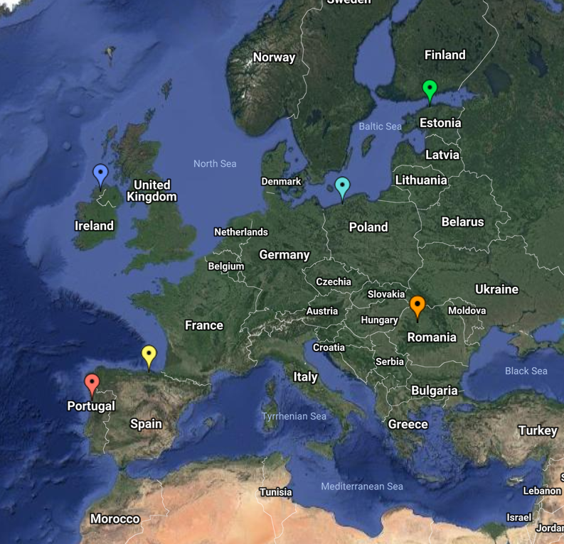
End of Lesson 21
Hope you enjoyed it!
1. Triangle Property
2. Identity Property
3. Inverse Property
Try it!
By EngiMath TEAM

