Slide 1



Lesson 22 Plan
Remember!
You can travel through all the sections (enter or mouse click) or choose your section by clicking over it.
You should only “Try it” after exploring all lesson contents!
1. Adjugate Matrix
2. Inverse of a Matrix
Try it!
By EngiMath TEAM

Slide 2



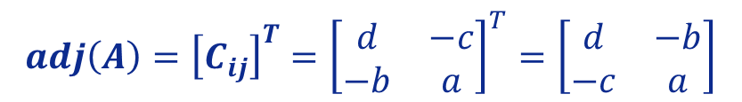
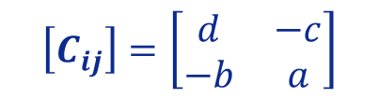
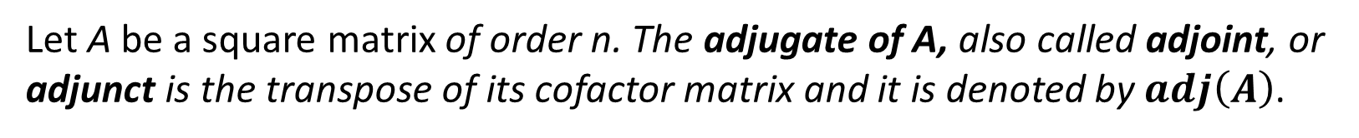
Lesson 22
Let A be a square matrix of order n. The adjugate of A, also called adjoint, or adjunct is the transpose of its cofactor matrix and it is denoted by $adj\left(A\right)$.
1. Adjugate Matrix
Examples
1. Consider the matrix
$$A=\left[\begin{matrix}a & b \\ c & d\end{matrix}\right].$$
2. Inverse of a Matrix
Let’s find the adjugate of A.
To find the adjugate of this matrix, first we will find the cofactor matrix of A.
$${C_{11}={\left(−1\right)}^{1+1} M}_{11}={\left(−1\right)}^{2}×\left|d\right|=d$$
$${C_{12}={\left(−1\right)}^{1+2} M}_{12}={\left(−1\right)}^{3}×\left|c\right|=−c$$
$${C_{21}={\left(−1\right)}^{2+1} M}_{21}={\left(−1\right)}^{3}×\left|b\right|=−b$$
$${C_{22}={\left(−1\right)}^{2+2} M}_{22}={\left(−1\right)}^{4}×\left|a\right|=a$$
Try it!
Then, the cofactor matrix of A is
$$\left[C_{ij}\right]=\left[\begin{matrix}d & −c \\ −b & a\end{matrix}\right]$$
Therefore,
$$adj\left(A\right)={\left[C_{ij}\right]}^{T}={\left[\begin{matrix}d & −c \\ −b & a\end{matrix}\right]}^{T}=\left[\begin{matrix}d & −b \\ −c & a\end{matrix}\right]$$

Slide 3






Lesson 22
Let A be a square matrix of order n. The adjugate of A, also called adjoint, or adjunct is the transpose of its cofactor matrix and it is denoted by $adj\left(A\right)$.
1. Adjugate Matrix
Examples
$$adj\left(A\right)=\left[\begin{matrix}d & −b \\ −c & a\end{matrix}\right]$$
1. Consider the matrix
$$A=\left[\begin{matrix}a & b \\ c & d\end{matrix}\right].$$
$$a$$
$$b$$
$$c$$
$$d$$
a $2×2$ matrix
you just need to:
2. Inverse of a Matrix
Let’s find the adjugate of A.
To find the adjugate of this matrix, first we will find the cofactor matrix of A.
$${C_{11}={\left(−1\right)}^{1+1} M}_{11}={\left(−1\right)}^{2}×\left|d\right|=d$$
$${C_{12}={\left(−1\right)}^{1+2} M}_{12}={\left(−1\right)}^{3}×\left|c\right|=−c$$
$${C_{21}={\left(−1\right)}^{2+1} M}_{21}={\left(−1\right)}^{3}×\left|b\right|=−b$$
$${C_{22}={\left(−1\right)}^{2+2} M}_{22}={\left(−1\right)}^{4}×\left|a\right|=a$$
Try it!
$$\left[C_{ij}\right]=\left[\begin{matrix}d & −c \\ −b & a\end{matrix}\right]$$
For all practical purposes, we can go over all these steps!...
Then, the cofactor matrix of A is
Therefore,
$$adj\left(A\right)={\left[C_{ij}\right]}^{T}={\left[\begin{matrix}d & −c \\ −b & a\end{matrix}\right]}^{T}=\left[\begin{matrix}d & −b \\ −c & a\end{matrix}\right]$$
Just remember that to …

Slide 4



Lesson 22
Let A be a square matrix of order n. The adjugate of A, also called adjoint, or adjunct is the transpose of its cofactor matrix and it is denoted by $adj\left(A\right)$.
1. Adjugate Matrix
Examples
Exchange the position of the main elements
$$adj\left(A\right)=\left[\begin{matrix}d & −b \\ −c & a\end{matrix}\right]$$
$$−b$$
1. Consider the matrix
$$A=\left[\begin{matrix}a & b \\ c & d\end{matrix}\right].$$
$$adj\left(\right)$$
$$a$$
$$b$$
$$−c$$
$$d$$
$$c$$
a $2×2$ matrix
you just need to:
Exchange the “sign” of the other elements
2. Inverse of a Matrix
Let’s find the adjugate of A.
To find the adjugate of this matrix, first we will find the cofactor matrix of A.
$${C_{11}={\left(−1\right)}^{1+1} M}_{11}={\left(−1\right)}^{2}×\left|d\right|=d$$
$${C_{12}={\left(−1\right)}^{1+2} M}_{12}={\left(−1\right)}^{3}×\left|c\right|=−c$$
$${C_{21}={\left(−1\right)}^{2+1} M}_{21}={\left(−1\right)}^{3}×\left|b\right|=−b$$
$${C_{22}={\left(−1\right)}^{2+2} M}_{22}={\left(−1\right)}^{4}×\left|a\right|=a$$
Try it!
$$\left[C_{ij}\right]=\left[\begin{matrix}d & −c \\ −b & a\end{matrix}\right]$$
For all practical purposes, we can go over all these steps!...
Then, the cofactor matrix of A is
Therefore,
$$adj\left(A\right)={\left[C_{ij}\right]}^{T}={\left[\begin{matrix}d & −c \\ −b & a\end{matrix}\right]}^{T}=\left[\begin{matrix}d & −b \\ −c & a\end{matrix}\right]$$
Just remember that to …

Slide 5


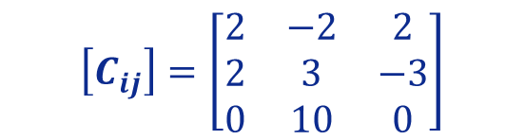
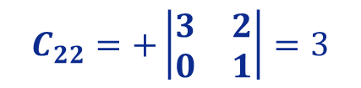




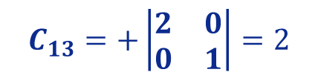
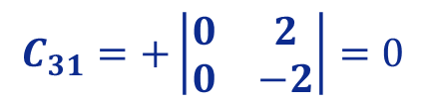
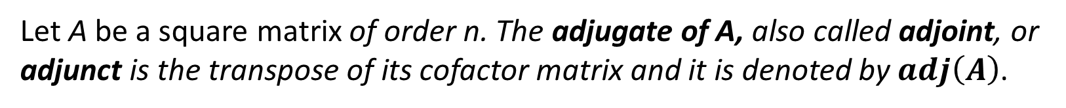
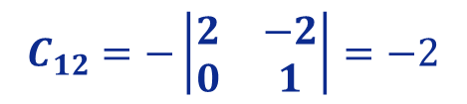
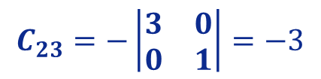

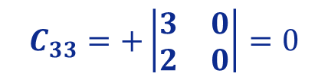
Lesson 22
Let A be a square matrix of order n. The adjugate of A, also called adjoint, or adjunct is the transpose of its cofactor matrix and it is denoted by $adj\left(A\right)$.
1. Adjugate Matrix
Examples
$$B=\left[\begin{matrix}3 & 0 & 2 \\ 2 & 0 & −2 \\ 0 & 1 & 1\end{matrix}\right].$$
2. Consider the matrix
Let’s find the adjugate of B.
2. Inverse of a Matrix
To find the adjugate of this matrix, first we will find the cofactor matrix of B.
$$C_{11}=+\left|\begin{matrix}0 & −2 \\ 1 & 1\end{matrix}\right|=2$$
$$C_{12}=−\left|\begin{matrix}2 & −2 \\ 0 & 1\end{matrix}\right|=−2$$
$$C_{13}=+\left|\begin{matrix}2 & 0 \\ 0 & 1\end{matrix}\right|=2$$
$$C_{21}=−\left|\begin{matrix}0 & 2 \\ 1 & 1\end{matrix}\right|=2$$
$$C_{22}=+\left|\begin{matrix}3 & 2 \\ 0 & 1\end{matrix}\right|=3$$
$$C_{23}=−\left|\begin{matrix}3 & 0 \\ 0 & 1\end{matrix}\right|=−3$$
$$C_{31}=+\left|\begin{matrix}0 & 2 \\ 0 & −2\end{matrix}\right|=0$$
$$C_{32}=−\left|\begin{matrix}3 & 2 \\ 2 & −2\end{matrix}\right|=10$$
$$C_{33}=+\left|\begin{matrix}3 & 0 \\ 2 & 0\end{matrix}\right|=0$$
Try it!
Then, the cofactor matrix of B is
Therefore,
$$\left[C_{ij}\right]=\left[\begin{matrix}2 & −2 & 2 \\ 2 & 3 & −3 \\ 0 & 10 & 0\end{matrix}\right]$$
$$adj\left(B\right)={\left[C_{ij}\right]}^{T}=\left[\begin{matrix}2 & 2 & 0 \\ −2 & 3 & 10 \\ 2 & −3 & 0\end{matrix}\right]$$

Slide 6

Lesson 22
Let A be a square matrix of order n. The adjugate of A, also called adjoint, or adjunct is the transpose of its cofactor matrix and it is denoted by $adj\left(A\right)$.
1. Adjugate Matrix
NOTE
Larger Matrices
2. Inverse of a Matrix
It is exactly the same steps for larger matrices (such as a 4×4, 5×5,…), but notice that there is a lot of calculations involved.
Try it!
For instance, in a 4×4 matrix we have to calculate 16 of 3×3 determinants. So in these cases, most of the times, we use computers to determine it…..

Slide 7




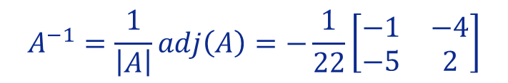


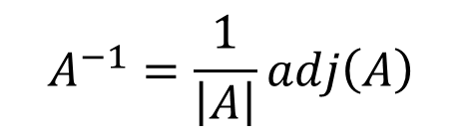

Lesson 22
If A is an invertible matrix, that is $\left|A\right|≠0,$ then its inverse can be obtained by the formula
1. Adjugate Matrix
$$A^{−1}=\frac{1}{\left|A\right|}adj\left(A\right)$$
Examples
1. Consider the matrix
$$A=\left[\begin{matrix}2 & 4 \\ 5 & −1\end{matrix}\right].$$
2. Inverse of a Matrix
Determine whether the matrix A is invertible and if so, then find the invertible matrix using the above formula.
Let’s find the determinant of A,
$$\left|A\right|=\left|\begin{matrix}2 & 4 \\ 5 & −1\end{matrix}\right|=−2−20=−22≠0.$$
Hence, A is invertible.
Try it!
Next, we will find the cofactor matrix of A,
$$\left[C_{ij}\right]=\left[\begin{matrix}d & −c \\ −b & a\end{matrix}\right]=\left[\begin{matrix}−1 & −5 \\ −4 & 2\end{matrix}\right]$$
Then, the adjoint matrix of A is: $adj\left(A\right)=\left[\begin{matrix}−1 & −4 \\ −5 & 2\end{matrix}\right]$
Using the formula, we will obtain
the inverse matrix as
$$A^{−1}=\frac{1}{\left|A\right|}adj\left(A\right)=−\frac{1}{22}\left[\begin{matrix}−1 & −4 \\ −5 & 2\end{matrix}\right]$$

Slide 8


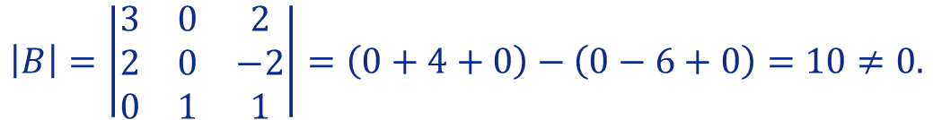

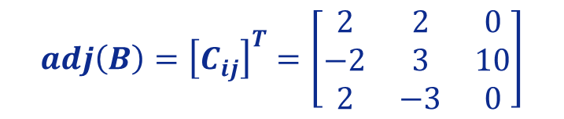
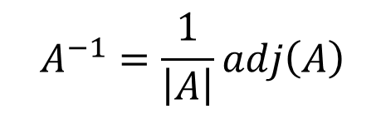

Lesson 22
If A is an invertible matrix, that is $\left|A\right|≠0,$ then its inverse can be obtained by the formula
1. Adjugate Matrix
$$A^{−1}=\frac{1}{\left|A\right|}adj\left(A\right)$$
Examples
$$B=\left[\begin{matrix}3 & 0 & 2 \\ 2 & 0 & −2 \\ 0 & 1 & 1\end{matrix}\right].$$
2. Consider the matrix
Determine whether the matrix B is
2. Inverse of a Matrix
invertible and if so, then find the invertible matrix using the above formula.
Let’s find the determinant of B, by using Sarrus’ Rule (Lesson 15)
$$\left|B\right|=\left|\begin{matrix}3 & 0 & 2 \\ 2 & 0 & −2 \\ 0 & 1 & 1\end{matrix}\right|=\left(0+4+0\right)−\left(0−6+0\right)=10≠0.$$
Hence, B is invertible.
Try it!
Next, we will find the adjoint matrix of B, (from exercise 2 of Adjugate Matrix)
$$adj\left(B\right)={\left[C_{ij}\right]}^{T}=\left[\begin{matrix}2 & 2 & 0 \\ −2 & 3 & 10 \\ 2 & −3 & 0\end{matrix}\right]$$
Using the formula, we will obtain the inverse matrix as
$$B^{−1}=\frac{1}{10}\left[\begin{matrix}2 & 2 & 0 \\ −2 & 3 & 10 \\ 2 & −3 & 0\end{matrix}\right]$$

Slide 9

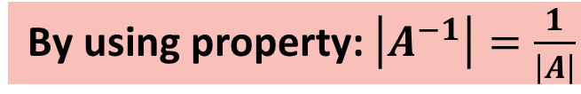
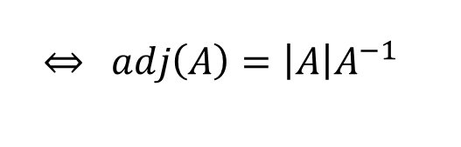

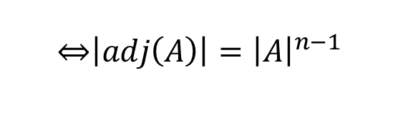
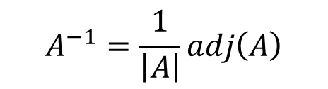
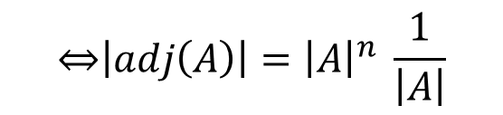
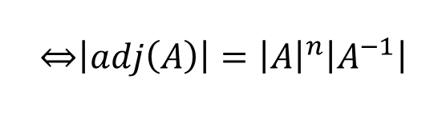
Lesson 22
If A is an invertible matrix, that is $\left|A\right|≠0,$ then its inverse can be obtained by the formula
1. Adjugate Matrix
$$A^{−1}=\frac{1}{\left|A\right|}adj\left(A\right)$$
Remark
Let A be a square matrix of order n, invertible, therefore
2. Inverse of a Matrix
$$A^{−1}=\frac{1}{\left|A\right|}adj\left(A\right)$$
$\underset{⇔}{ } adj\left(A\right)=\left|A\right|A^{−1}$
There are several “properties” of the adjugate that use this relation, for example, its determinant value obtained from the one of A:
$$\left|adj\left(A\right)\right|=\left|\left|A\right|A^{−1}\right|$$
Try it!
By using property: $\left|kA\right|=k^{n}\left|A\right|$
$$\underset{⇔}{ }\left|adj\left(A\right)\right|={\left|A\right|}^{n}\left|A^{−1}\right|$$
$$\underset{⇔}{ }\left|adj\left(A\right)\right|={\left|A\right|}^{n} \frac{1}{\left|A\right|}$$
By using property: $\left|A^{−1}\right|=\frac{1}{\left|A\right|}$
$$\underset{⇔}{ }\left|adj\left(A\right)\right|={\left|A\right|}^{n−1}$$

Slide 10


Lesson 22
1. Adjugate Matrix
Better to have a paper and a pencil nearby, before solving these questions!..
2. Inverse of a Matrix
Try it!

Slide 11


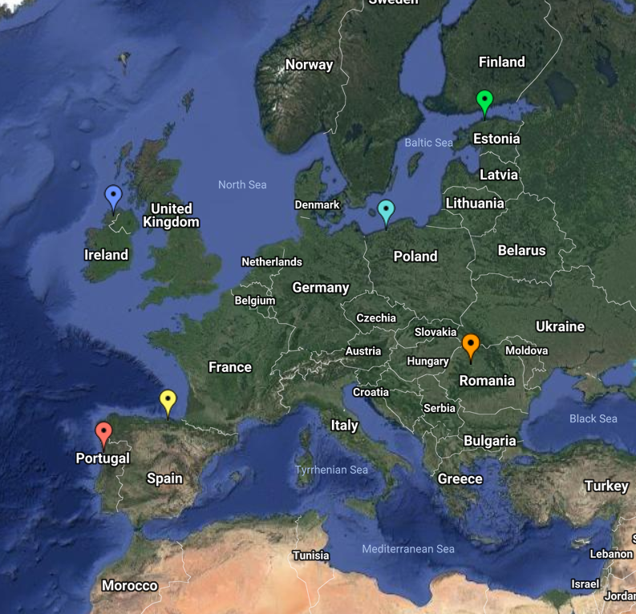
End of Lesson 22
Hope you enjoyed it!
1. Adjugate Matrix
2. Inverse of a Matrix
Try it!
By EngiMath TEAM

