Slide 1



Lesson 23 Plan
Remember!
You can travel through all the sections (enter or mouse click) or choose your section by clicking over it.
You should only “Try it” after exploring all lesson contents!
1. What is a Linear Equation?...
2. System of Linear Equations
3. Linear Systems and Matrices
4. Consistency and Number of Solutions
5. Homogeneous Linear Systems
Try it!
By EngiMath TEAM

Slide 2
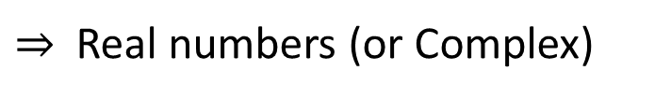
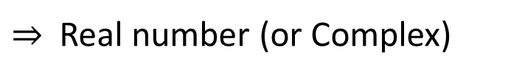
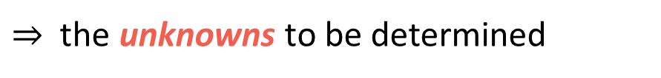
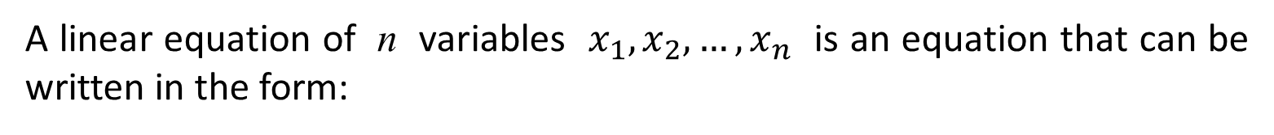
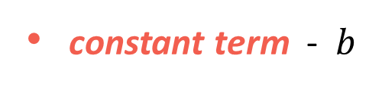
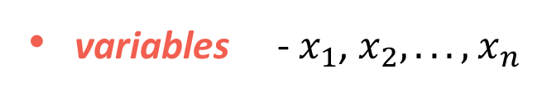
Lesson 23
What is a linear equation?...
1. What is a Linear Equation?...
A linear equation of n variables $x_{1},x_{2},…,x_{n}$ is an equation that can be written in the form:
2. System of Linear Equations
$$a_{1}⋅x_{1}+a_{2}⋅x_{2}+…+a_{n}⋅x_{n}=b$$
where we can identify:
3. Linear Systems and Matrices
coefficients - $a_{1},a_{2},…,a_{n}$
$⇒$ Real numbers (or Complex)
variables - $x_{1}$, $x_{2}, . . . ,$ $x_{n}$
$⇒$ the unknowns to be determined
4. Consistency and Number of Solutions
constant term - $b$
$⇒$ Real number (or Complex)
5. Homogeneous Linear Systems
Notice that
Linear equations have no products or roots of variables and no variables are involved in trigonometric, exponential or logarithmic functions.
Try it!
Variables appear only to its first power - the exponent of every unknown $x_{i}$is one ($x_{i}^{1}$).

Slide 3


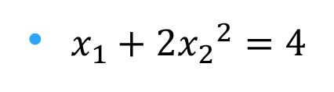
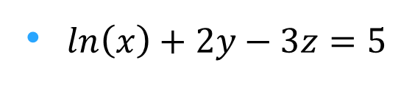
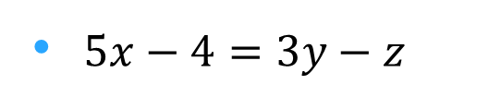

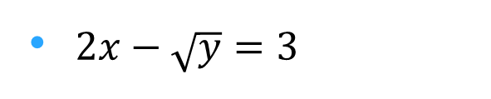
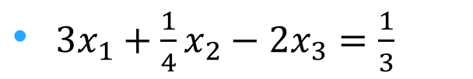
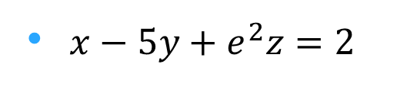
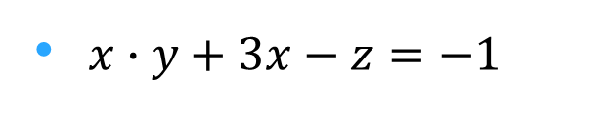
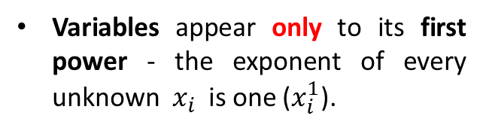
Lesson 23
Examples
1. What is a Linear Equation?...
${3x}_{1}+\frac{1}{4}x_{2}−2x_{3}=\frac{1}{3}$
?
LINEAR?...
2. System of Linear Equations
$5x−4=3y−z$
$2x−\sqrt{y}=3$
NOT LINEAR?...
3. Linear Systems and Matrices
$x∙y+3x−z=−1$
4. Consistency and Number of Solutions
Can you tell?...
$x_{1}+2{x_{2}}^{2}=4$
CHECK “list”
No products or roots of variables and no variables are involved in trigonometric, exponential or logarithmic functions.
5. Homogeneous Linear Systems
$2x−y=\sqrt{3}$
If you can, CLICK HERE
and
check your answers!
$ln\left(x\right)+2y−3z=5$
Try it!
Variables appear only to its first power - the exponent of every unknown $x_{i}$is one ($x_{i}^{1}$).
$x−5y+e^{2}z=2$

Slide 4

Lesson 23
Examples
1. What is a Linear Equation?...
${3x}_{1}+\frac{1}{4}x_{2}−2x_{3}=\frac{1}{3}$
LINEAR!...
?
2. System of Linear Equations
$5x−4=3y−z$
?
$2x−\sqrt{y}=3$
3. Linear Systems and Matrices
$x∙y+3x−z=−1$
4. Consistency and Number of Solutions
$x_{1}+2{x_{2}}^{2}=4$
CHECK “list”
No products or roots of variables and no variables are involved in trigonometric, exponential or logarithmic functions.
5. Homogeneous Linear Systems
$2x−y=\sqrt{3}$
$ln\left(x\right)+2y−3z=5$
Try it!
Variables appear only to its first power - the exponent of every unknown $x_{i}$is one ($x_{i}^{1}$).
$x−5y+e^{2}z=2$

Slide 5

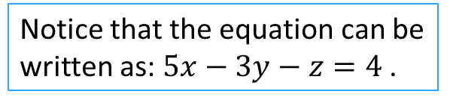
Lesson 23
Examples
1. What is a Linear Equation?...
${3x}_{1}+\frac{1}{4}x_{2}−2x_{3}=\frac{1}{3}$
LINEAR!...
?
2. System of Linear Equations
$5x−4=3y−z$
LINEAR!...
?
Notice that the equation can be written as: $5x−3y−z=4$ .
$2x−\sqrt{y}=3$
?
3. Linear Systems and Matrices
$x∙y+3x−z=−1$
4. Consistency and Number of Solutions
$x_{1}+2{x_{2}}^{2}=4$
CHECK “list”
No products or roots of variables and no variables are involved in trigonometric, exponential or logarithmic functions.
5. Homogeneous Linear Systems
$2x−y=\sqrt{3}$
$ln\left(x\right)+2y−3z=5$
Try it!
Variables appear only to its first power - the exponent of every unknown $x_{i}$is one ($x_{i}^{1}$).
$x−5y+e^{2}z=2$

Slide 6
Lesson 23
Examples
1. What is a Linear Equation?...
${3x}_{1}+\frac{1}{4}x_{2}−2x_{3}=\frac{1}{3}$
LINEAR!...
?
2. System of Linear Equations
$5x−4=3y−z$
LINEAR!...
?
$2x−\sqrt{y}=3$
NOT LINEAR!...
?
3. Linear Systems and Matrices
$x∙y+3x−z=−1$
4. Consistency and Number of Solutions
$x_{1}+2{x_{2}}^{2}=4$
CHECK “list”
No products or roots of variables and no variables are involved in trigonometric, exponential or logarithmic functions.
5. Homogeneous Linear Systems
$2x−y=\sqrt{3}$
$ln\left(x\right)+2y−3z=5$
Try it!
Variables appear only to its first power - the exponent of every unknown $x_{i}$is one ($x_{i}^{1}$).
$x−5y+e^{2}z=2$

Slide 7

Lesson 23
Examples
1. What is a Linear Equation?...
CHECK “list”
${3x}_{1}+\frac{1}{4}x_{2}−2x_{3}=\frac{1}{3}$
LINEAR!...
?
No products or roots of variables and no variables are involved in trigonometric, exponential or logarithmic functions.
2. System of Linear Equations
$5x−4=3y−z$
LINEAR!...
?
$2x−\sqrt{y}=3$
NOT LINEAR!...
?
3. Linear Systems and Matrices
Variables appear only to its first power - the exponent of every unknown $x_{i}$is one ($x_{i}^{1}$).
NOT LINEAR!...
$x∙y+3x−z=−1$
?
4. Consistency and Number of Solutions
$x_{1}+2{x_{2}}^{2}=4$
CHECK “list”
No products or roots of variables and no variables are involved in trigonometric, exponential or logarithmic functions.
5. Homogeneous Linear Systems
$2x−y=\sqrt{3}$
$ln\left(x\right)+2y−3z=5$
Try it!
Variables appear only to its first power - the exponent of every unknown $x_{i}$is one ($x_{i}^{1}$).
$x−5y+e^{2}z=2$

Slide 8

Lesson 23
Examples
1. What is a Linear Equation?...
CHECK “list”
${3x}_{1}+\frac{1}{4}x_{2}−2x_{3}=\frac{1}{3}$
LINEAR!...
?
No products or roots of variables and no variables are involved in trigonometric, exponential or logarithmic functions.
2. System of Linear Equations
$5x−4=3y−z$
LINEAR!...
?
$2x−\sqrt{y}=3$
NOT LINEAR!...
?
3. Linear Systems and Matrices
Variables appear only to its first power - the exponent of every unknown $x_{i}$is one ($x_{i}^{1}$).
NOT LINEAR!...
$x∙y+3x−z=−1$
?
4. Consistency and Number of Solutions
$x_{1}+2{x_{2}}^{2}=4$
NOT LINEAR!...
?
5. Homogeneous Linear Systems
$2x−y=\sqrt{3}$
Notice that an integer power greater than one represents a product!
However, the “power” item in the list is easy to check!
$ln\left(x\right)+2y−3z=5$
Try it!
$x−5y+e^{2}z=2$

Slide 9

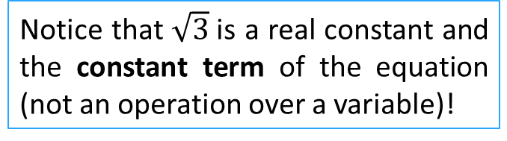
Lesson 23
Examples
1. What is a Linear Equation?...
CHECK “list”
${3x}_{1}+\frac{1}{4}x_{2}−2x_{3}=\frac{1}{3}$
LINEAR!...
?
No products or roots of variables and no variables are involved in trigonometric, exponential or logarithmic functions.
2. System of Linear Equations
$5x−4=3y−z$
LINEAR!...
?
$2x−\sqrt{y}=3$
NOT LINEAR!...
?
3. Linear Systems and Matrices
Variables appear only to its first power - the exponent of every unknown $x_{i}$is one ($x_{i}^{1}$).
NOT LINEAR!...
$x∙y+3x−z=−1$
?
4. Consistency and Number of Solutions
$x_{1}+2{x_{2}}^{2}=4$
NOT LINEAR!...
?
5. Homogeneous Linear Systems
$2x−y=\sqrt{3}$
LINEAR!...
?
$ln\left(x\right)+2y−3z=5$
Notice that $\sqrt{3}$is a real constant and the constant term of the equation (not an operation over a variable)!
Try it!
$x−5y+e^{2}z=2$

Slide 10
Lesson 23
Examples
1. What is a Linear Equation?...
CHECK “list”
${3x}_{1}+\frac{1}{4}x_{2}−2x_{3}=\frac{1}{3}$
LINEAR!...
?
No products or roots of variables and no variables are involved in trigonometric, exponential or logarithmic functions.
2. System of Linear Equations
$5x−4=3y−z$
LINEAR!...
?
$2x−\sqrt{y}=3$
NOT LINEAR!...
?
3. Linear Systems and Matrices
Variables appear only to its first power - the exponent of every unknown $x_{i}$is one ($x_{i}^{1}$).
NOT LINEAR!...
$x∙y+3x−z=−1$
?
4. Consistency and Number of Solutions
$x_{1}+2{x_{2}}^{2}=4$
NOT LINEAR!...
?
5. Homogeneous Linear Systems
$2x−y=\sqrt{3}$
LINEAR!...
?
$ln\left(x\right)+2y−3z=5$
NOT LINEAR!...
?
Try it!
$x−5y+e^{2}z=2$

Slide 11

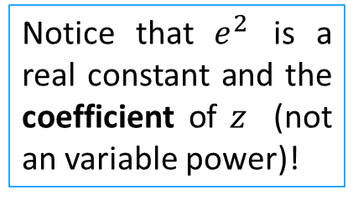
Lesson 23
Examples
1. What is a Linear Equation?...
CHECK “list”
${3x}_{1}+\frac{1}{4}x_{2}−2x_{3}=\frac{1}{3}$
LINEAR!...
?
No products or roots of variables and no variables are involved in trigonometric, exponential or logarithmic functions.
2. System of Linear Equations
$5x−4=3y−z$
LINEAR!...
?
$2x−\sqrt{y}=3$
NOT LINEAR!...
?
3. Linear Systems and Matrices
Variables appear only to its first power - the exponent of every unknown $x_{i}$is one ($x_{i}^{1}$).
NOT LINEAR!...
$x∙y+3x−z=−1$
?
4. Consistency and Number of Solutions
$x_{1}+2{x_{2}}^{2}=4$
NOT LINEAR!...
?
5. Homogeneous Linear Systems
$2x−y=\sqrt{3}$
LINEAR!...
?
Notice that $e^{2}$ is a real constant and the coefficient of $z$ (not an variable power)!
$ln\left(x\right)+2y−3z=5$
NOT LINEAR!...
?
Try it!
$x−5y+e^{2}z=2$
LINEAR!...
?

Slide 12
Lesson 23
Answers - Resume
Examples
Return to answer construction
1. What is a Linear Equation?...
${3x}_{1}+\frac{1}{4}x_{2}−2x_{3}=\frac{1}{3}$
LINEAR!...
?
2. System of Linear Equations
$5x−4=3y−z$
LINEAR!...
?
$2x−\sqrt{y}=3$
NOT LINEAR!...
?
3. Linear Systems and Matrices
NOT LINEAR!...
$x∙y+3x−z=−1$
?
4. Consistency and Number of Solutions
$x_{1}+2{x_{2}}^{2}=4$
NOT LINEAR!...
?
5. Homogeneous Linear Systems
$2x−y=\sqrt{3}$
LINEAR!...
?
$ln\left(x\right)+2y−3z=5$
NOT LINEAR!...
?
Try it!
$x−5y+e^{2}z=2$
LINEAR!...
?

Slide 13



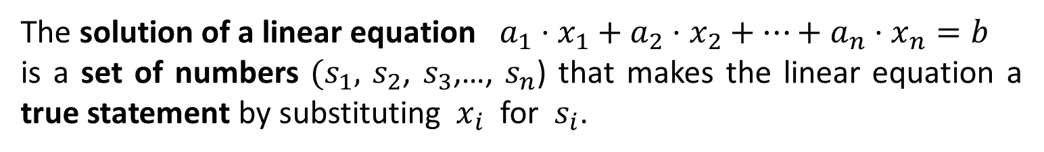

Lesson 23
Solution of a Linear Equation
1. What is a Linear Equation?...
The solution of a linear equation $a_{1}⋅x_{1}+a_{2}⋅x_{2}+…+a_{n}⋅x_{n}=b$
is a set of numbers $(s_{1},$ $s_{2}$, $s_{3}$,…, $s_{n}$) that makes the linear equation a true statement by substituting $x_{i}$ for $s_{i}$.
2. System of Linear Equations
3. Linear Systems and Matrices
Examples
Is $\left(2,−2\right)$ a solution for the linear equation $3x+2y=2$ ?
Replacing, in the given equation
$3__+2__=2$
4. Consistency and Number of Solutions
, the unknowns
by their corresponding values
, we get a TRUE proposition:
$3×2+2×\left(−2\right)=2$
and we may conclude that $\left(2,−2\right)$ is a solution of the given equation.
5. Homogeneous Linear Systems
Is $\left(1−π,π+1\right)$ a solution for the linear equation $x+y=0$ ?
, the unknowns
$__+__=0$
Try it!
Replacing, in the given equation
by their corresponding values
, we get a FALSE proposition:
$\left(1−π\right)+\left(1+π\right)=0$
and we may conclude that $\left(1−π,π+1\right)$ is a NOT solution of the given equation.

Slide 14

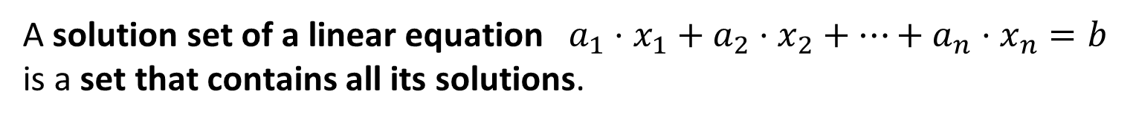
Lesson 23
Parametric Representation of a Solution Set of a Linear Equation
1. What is a Linear Equation?...
A solution set of a linear equation $a_{1}⋅x_{1}+a_{2}⋅x_{2}+…+a_{n}⋅x_{n}=b$
is a set that contains all its solutions.
2. System of Linear Equations
Remark - In our opinion, this concept can be more easily understood through small examples, since its generalization can be confusing and seems unnecessary at this point.
3. Linear Systems and Matrices
Examples
A linear equation, with more than one variable, has an Infinite number of Solutions
Solve the linear equation: $x+2y=1$
4. Consistency and Number of Solutions
Solution: $x=1−2y$
At this point, we have made some “choices”:
Free Variable – $y$ – it can assume any real value
5. Homogeneous Linear Systems
Not Free or Dependent Variable – $x$ – its value depends on the value of $y$.
By setting $y=k$ (a “third variable” – parameter), we can represent the solution set as:
Try it!
or

Slide 15

Lesson 23
Parametric Representation of a Solution Set of a Linear Equation
1. What is a Linear Equation?...
A solution set of a linear equation $a_{1}⋅x_{1}+a_{2}⋅x_{2}+…+a_{n}⋅x_{n}=b$
is a set that contains all its solutions.
2. System of Linear Equations
Notice that
this parametric set representation is not unique since it depends upon the choices for free and not free variables. All the solution sets have the same elements!
3. Linear Systems and Matrices
Examples
Solve the linear equation: $x+2y=1$
$$y=\frac{1−x}{2}⇒$$
4. Consistency and Number of Solutions
Solution: $x=1−2y$
or
At this point, we have made some “choices”:
Free Variable – $y$ – it can assume any real value
5. Homogeneous Linear Systems
Not Free or Dependent Variable – $x$ – its value depends on the value of $y$.
By setting $y=k$ (a “third variable” – parameter), we can represent the solution set as:
Try it!
or

Slide 16


Lesson 23
Parametric Representation of a Solution Set of a Linear Equation
1. What is a Linear Equation?...
A solution set of a linear equation $a_{1}⋅x_{1}+a_{2}⋅x_{2}+…+a_{n}⋅x_{n}=b$
is a set that contains all its solutions.
2. System of Linear Equations
Examples
A more “obvious” choice for a solution would be… (?)
3. Linear Systems and Matrices
Solve the linear equation: $3x−y+2z=6$
$$y=3x−2z+6$$
Solution: $x=2+\frac{y−2z}{3}$
4. Consistency and Number of Solutions
In this case the “choices” are:
Free Variables – $y$ and $z$ – it can assume any real value
Not Free or Dependent Variable – $x$ – its value depends on the values of $y$ and $z$ .
5. Homogeneous Linear Systems
By setting $y=k_{1}$ and $z=k_{2}$, we obtain the following parametric representation:
Try it!
or

Slide 17

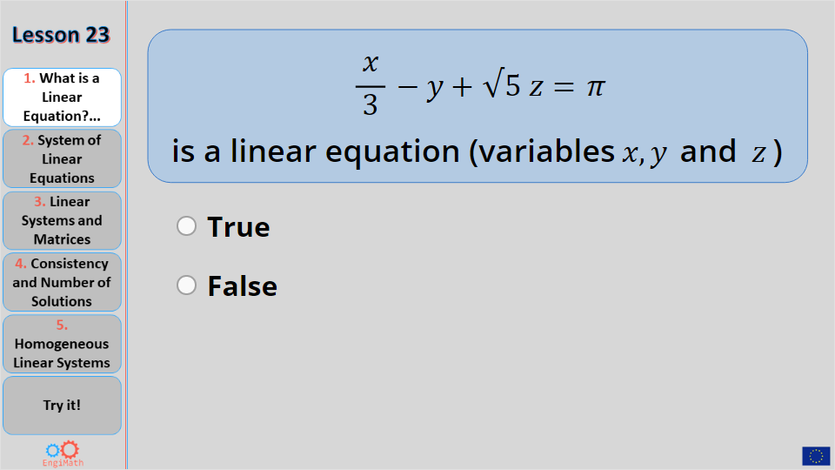
Lesson 23
Quiz
1. What is a Linear Equation?...
Click the Quiz button to edit this object
2. System of Linear Equations
3. Linear Systems and Matrices
4. Consistency and Number of Solutions
5. Homogeneous Linear Systems
Try it!

Slide 18
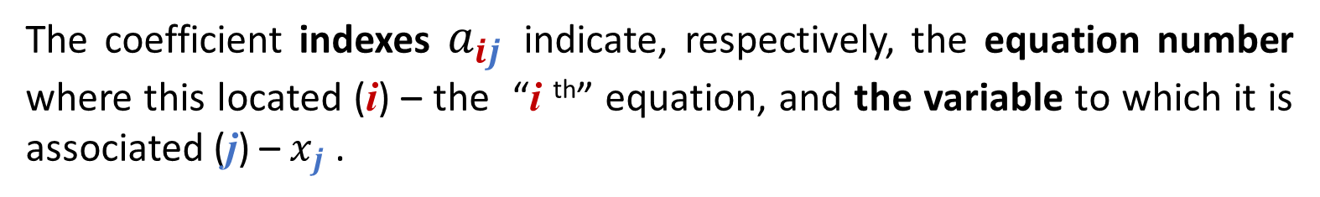

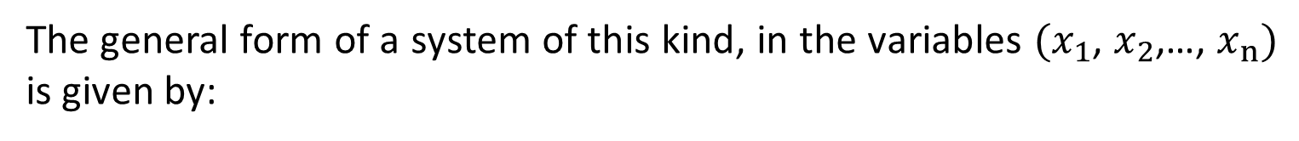
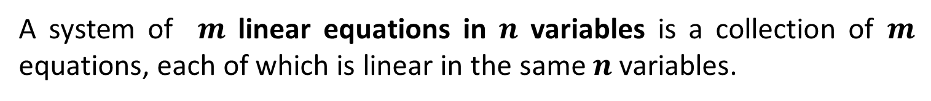
Lesson 23
System of linear equations
1. What is a Linear Equation?...
A system of $m$ linear equations in $n$ variables is a collection of $m$ equations, each of which is linear in the same $n$ variables.
2. System of Linear Equations
The general form of a system of this kind, in the variables ${(x}_{1}$, $x_{2}$,…, $x_{n})$ is given by:
$$\left\{\begin{matrix}a_{11}∙x_{1}+ \\ \begin{matrix}a_{21}∙x_{1}+ \\ ⋮\end{matrix} \\ a_{m1}∙x_{1}+\end{matrix}\begin{matrix}a_{12}∙x_{2}+… \\ \begin{matrix}a_{22}∙x_{2}+… \\ ⋱ \end{matrix} \\ a_{m2}∙x_{2}+… \end{matrix}\begin{matrix}{+a}_{1n}∙x_{n} \\ \begin{matrix}+a_{2n}∙x_{n} \\ \end{matrix} \\ { +a}_{mn}∙x_{n}\end{matrix}\begin{matrix}=b_{1} \\ \begin{matrix}{=b}_{2} \\ ⋮\end{matrix} \\ =b_{m}\end{matrix}\right.$$
3. Linear Systems and Matrices
4. Consistency and Number of Solutions
Notice that:
5. Homogeneous Linear Systems
The coefficient indexes $a_{ij}$ indicate, respectively, the equation number where this located (i) – the “i ^{th}” equation, and the variable to which it is associated (j) – $x_{j}$ .
Try it!

Slide 19
Lesson 23
System of linear equations
1. What is a Linear Equation?...
A system of $m$ linear equations in $n$ variables is a collection of $m$ equations, each of which is linear in the same $n$ variables.
2. System of Linear Equations
The general form of a system of this kind, in the variables ${(x}_{1}$, $x_{2}$,…, $x_{n})$ is given by:
$$\left\{\begin{matrix}a_{11}∙x_{1}+ \\ \begin{matrix}a_{21}∙x_{1}+ \\ ⋮\end{matrix} \\ a_{m1}∙x_{1}+\end{matrix}\begin{matrix}a_{12}∙x_{2}+… \\ \begin{matrix}a_{22}∙x_{2}+… \\ ⋱ \end{matrix} \\ a_{m2}∙x_{2}+… \end{matrix}\begin{matrix}{+a}_{1n}∙x_{n} \\ \begin{matrix}+a_{2n}∙x_{n} \\ \end{matrix} \\ { +a}_{mn}∙x_{n}\end{matrix}\begin{matrix}=b_{1} \\ \begin{matrix}{=b}_{2} \\ ⋮\end{matrix} \\ =b_{m}\end{matrix}\right.$$
3. Linear Systems and Matrices
4. Consistency and Number of Solutions
The number of equations may be
Greater,
Smaller or
Equal
to the number of variables
Notice that:
5. Homogeneous Linear Systems
Try it!

Slide 20
Lesson 23
System of linear equations
1. What is a Linear Equation?...
A system of $m$ linear equations in $n$ variables is a collection of $m$ equations, each of which is linear in the same $n$ variables.
2. System of Linear Equations
The general form of a system of this kind, in the variables ${(x}_{1}$, $x_{2}$,…, $x_{n})$ is given by:
$$\left\{\begin{matrix}a_{11}∙x_{1}+ \\ \begin{matrix}a_{21}∙x_{1}+ \\ ⋮\end{matrix} \\ a_{m1}∙x_{1}+\end{matrix}\begin{matrix}a_{12}∙x_{2}+… \\ \begin{matrix}a_{22}∙x_{2}+… \\ ⋱ \end{matrix} \\ a_{m2}∙x_{2}+… \end{matrix}\begin{matrix}{+a}_{1n}∙x_{n} \\ \begin{matrix}+a_{2n}∙x_{n} \\ \end{matrix} \\ { +a}_{mn}∙x_{n}\end{matrix}\begin{matrix}=b_{1} \\ \begin{matrix}{=b}_{2} \\ ⋮\end{matrix} \\ =b_{m}\end{matrix}\right.$$
3. Linear Systems and Matrices
4. Consistency and Number of Solutions
Notice that:
A system of linear equations may have:
Exactly one solution,
An infinite number of solutions or
No solution
5. Homogeneous Linear Systems
Try it!

Slide 21
Lesson 23
System of linear equations
1. What is a Linear Equation?...
A system of $m$ linear equations in $n$ variables is a collection of $m$ equations, each of which is linear in the same $n$ variables.
2. System of Linear Equations
The general form of a system of this kind, in the variables ${(x}_{1}$, $x_{2}$,…, $x_{n})$ is given by:
$$\left\{\begin{matrix}a_{11}∙x_{1}+ \\ \begin{matrix}a_{21}∙x_{1}+ \\ ⋮\end{matrix} \\ a_{m1}∙x_{1}+\end{matrix}\begin{matrix}a_{12}∙x_{2}+… \\ \begin{matrix}a_{22}∙x_{2}+… \\ ⋱ \end{matrix} \\ a_{m2}∙x_{2}+… \end{matrix}\begin{matrix}{+a}_{1n}∙x_{n} \\ \begin{matrix}+a_{2n}∙x_{n} \\ \end{matrix} \\ { +a}_{mn}∙x_{n}\end{matrix}\begin{matrix}=b_{1} \\ \begin{matrix}{=b}_{2} \\ ⋮\end{matrix} \\ =b_{m}\end{matrix}\right.$$
3. Linear Systems and Matrices
4. Consistency and Number of Solutions
A system of linear equations is said to be:
Consistent – if it has, at least, one solution
Inconsistent – if it does not have any solution
Notice that:
5. Homogeneous Linear Systems
Try it!

Slide 22




Lesson 23
Examples of linear equation systems
1. What is a Linear Equation?...
$$\left\{\begin{matrix}2x+y=−1 \\ x−y=2\end{matrix}\right.$$
$$\left\{\begin{matrix}3x+2y−z=2 \\ \begin{aligned}2x−y+z=0 \\ x−2y+3z=1\end{aligned}\end{matrix}\right.$$
$$\left\{\begin{matrix}3x+2y−z+t=2 \\ \begin{aligned}x−2y+z−t=0 \\ x−y+z+2t=1\end{aligned}\end{matrix}\right.$$
2. System of Linear Equations
2 variables (x, y)
2 equations
3. Linear Systems and Matrices
4 variables (x, y, z, t)
3 equations
3 variables (x, y, z)
3 equations
4. Consistency and Number of Solutions
$$\left\{\begin{matrix}2x1+x2=−1 \\ \begin{aligned}x1−x2=2 \\ −3x1+2x2=0\end{aligned}\end{matrix}\right.$$
Notice that
5. Homogeneous Linear Systems
Linear equation systems may have different number of variables and different number of equations, but the equations are always linear.
2 variables (x₁, x₂)
3 equations
Try it!

Slide 23
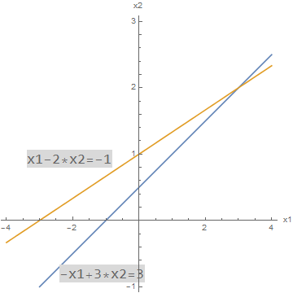
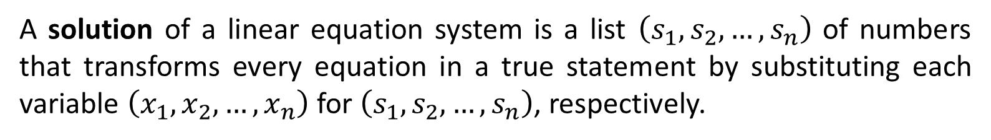
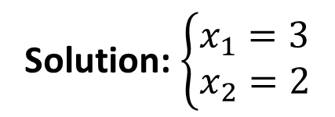
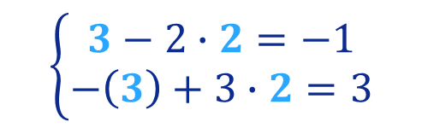
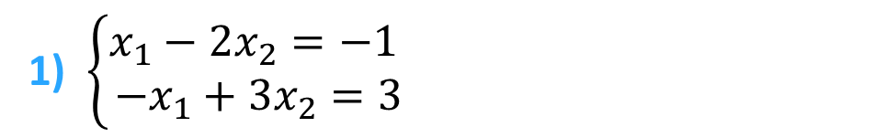
Lesson 23
Solution of a linear equation system
1. What is a Linear Equation?...
A solution of a linear equation system is a list $\left(s_{1},s_{2},…,s_{n}\right)$ of numbers that transforms every equation in a true statement by substituting each variable $\left(x_{1},x_{2},…,x_{n}\right)$ for $\left(s_{1},s_{2},…,s_{n}\right)$, respectively.
2. System of Linear Equations
3. Linear Systems and Matrices
Examples
Graphical representation
1) $\left\{\begin{matrix}x_{1}−{2x}_{2}=−1 \\ −x_{1}+3x_{2}=3\end{matrix}\right.$
4. Consistency and Number of Solutions
(3,2)
Solution: $\left\{\begin{matrix}x_{1}=3 \\ x_{2}=2\end{matrix}\right.$
$$\left\{\begin{matrix}3−2∙2=−1 \\ −\left(3\right)+3∙2=3\end{matrix}\right.$$
5. Homogeneous Linear Systems
Try it!
Exactly one solution

Slide 24
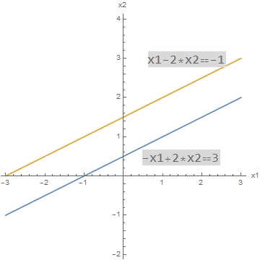
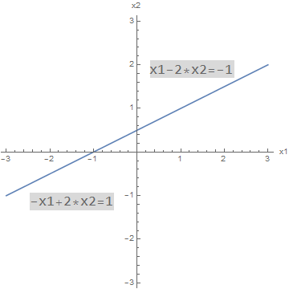
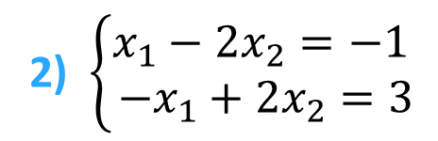
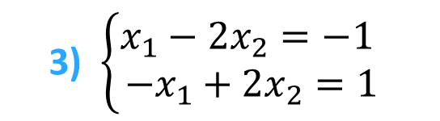
Lesson 23
Examples
1. What is a Linear Equation?...
2) $\left\{\begin{matrix}x_{1}−{2x}_{2}=−1 \\ −x_{1}+2x_{2}=3\end{matrix}\right.$
3) $\left\{\begin{matrix}x_{1}−{2x}_{2}=−1 \\ −x_{1}+2x_{2}=1\end{matrix}\right.$
2. System of Linear Equations
Graphical Representation
3. Linear Systems and Matrices
Parallel lines
Coincident lines
4. Consistency and Number of Solutions
Remember that:
5. Homogeneous Linear Systems
No intersection
Systems in ex 1) and 3) are called
Consistent – since these have, at least, one solution
Overlapping
Infinitely
many solutions
Try it!
No solution

Slide 25
Lesson 23
Examples
1. What is a Linear Equation?...
2) $\left\{\begin{matrix}x_{1}−{2x}_{2}=−1 \\ −x_{1}+2x_{2}=3\end{matrix}\right.$
3) $\left\{\begin{matrix}x_{1}−{2x}_{2}=−1 \\ −x_{1}+2x_{2}=1\end{matrix}\right.$
2. System of Linear Equations
Graphical Representation
3. Linear Systems and Matrices
Parallel lines
Coincident lines
4. Consistency and Number of Solutions
Remember that:
5. Homogeneous Linear Systems
No intersection
Systems like ex 2) are called
Inconsistent – it does not have any solution
Overlapping
Infinitely
many solutions
Try it!
No solution

Slide 26


Lesson 23
1. What is a Linear Equation?...
If not, see Lesson 6!...
Do you remember matrix operations?... In particular,
matrix multiplication?...
2. System of Linear Equations
3. Linear Systems and Matrices
4. Consistency and Number of Solutions
5. Homogeneous Linear Systems
Try it!

Slide 27

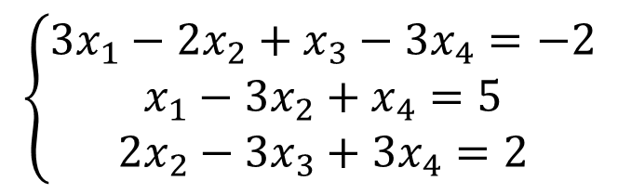
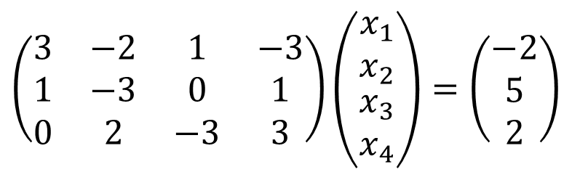
Lesson 23
Any Linear System can be written as a Matrix Equation
1. What is a Linear Equation?...
Because...
Consider, for example, the following linear system:
2. System of Linear Equations
$$\left\{\begin{matrix}3x_{1}−2x_{2}+x_{3}−3x_{4}=−2 \\ x_{1}−3x_{2}+x_{4}=5 \\ 2x_{2}−3x_{3}+3x_{4}=2\end{matrix}\right.$$
3. Linear Systems and Matrices
This System can be written as a Matrix Equation:
4. Consistency and Number of Solutions
$$\left(\begin{matrix}\begin{matrix}3 & −2 \\ 1 & −3 \\ 0 & 2\end{matrix} & \begin{matrix}1 & −3 \\ 0 & 1 \\ −3 & 3\end{matrix}\end{matrix}\right)\left(\begin{matrix}\begin{matrix}x_{1} \\ x_{2}\end{matrix} \\ \begin{matrix}x_{3} \\ x_{4}\end{matrix}\end{matrix}\right)=\left(\begin{matrix}−2 \\ 5 \\ 2\end{matrix}\right)$$
5. Homogeneous Linear Systems
Try it!

Slide 28
Lesson 23
Any Linear System can be written as a Matrix Equation
1. What is a Linear Equation?...
Consider, for example, the following linear system:
Remember
2. System of Linear Equations
$$\left\{\begin{matrix}3x_{1}−2x_{2}+x_{3}−3x_{4}=−2 \\ x_{1}−3x_{2}+x_{4}=5 \\ 2x_{2}−3x_{3}+3x_{4}=2\end{matrix}\right.$$
Matrix multiplication Lines of the 1st factor x columns of the 2nd
3. Linear Systems and Matrices
Matrix equality
Equality of elements, one by one
This System can be written as a Matrix Equation:
4. Consistency and Number of Solutions
$$\left(\begin{matrix}\begin{matrix}3 & −2 \\ 1 & −3 \\ 0 & 2\end{matrix} & \begin{matrix}1 & −3 \\ 0 & 1 \\ −3 & 3\end{matrix}\end{matrix}\right)\left(\begin{matrix}\begin{matrix}x_{1} \\ x_{2}\end{matrix} \\ \begin{matrix}x_{3} \\ x_{4}\end{matrix}\end{matrix}\right)=\left(\begin{matrix}−2 \\ 5 \\ 2\end{matrix}\right)$$
5. Homogeneous Linear Systems
Try it!

Slide 29
Lesson 23
Any Linear System can be written as a Matrix Equation
1. What is a Linear Equation?...
Consider, for example, the following linear system:
Notice that
If we represent these three Matrices by the capital letters A, X and B, respectively,
2. System of Linear Equations
$$\left\{\begin{matrix}3x_{1}−2x_{2}+x_{3}−3x_{4}=−2 \\ x_{1}−3x_{2}+x_{4}=5 \\ 2x_{2}−3x_{3}+3x_{4}=2\end{matrix}\right.$$
3. Linear Systems and Matrices
we get the relative “short writing” of the given system!..
This System can be written as a Matrix Equation:
4. Consistency and Number of Solutions
$$\left(\begin{matrix}\begin{matrix}3 & −2 \\ 1 & −3 \\ 0 & 2\end{matrix} & \begin{matrix}1 & −3 \\ 0 & 1 \\ −3 & 3\end{matrix}\end{matrix}\right)\left(\begin{matrix}\begin{matrix}x_{1} \\ x_{2}\end{matrix} \\ \begin{matrix}x_{3} \\ x_{4}\end{matrix}\end{matrix}\right)=\left(\begin{matrix}−2 \\ 5 \\ 2\end{matrix}\right)$$
A.X = B
5. Homogeneous Linear Systems
A
X
B
Try it!

Slide 30
Lesson 23
Any Linear System can be written as a Matrix Equation
1. What is a Linear Equation?...
Consider, for example, the following linear system:
2. System of Linear Equations
$$\left\{\begin{matrix}3x_{1}−2x_{2}+x_{3}−3x_{4}=−2 \\ x_{1}−3x_{2}+x_{4}=5 \\ 2x_{2}−3x_{3}+3x_{4}=2\end{matrix}\right.$$
A is the coefficient matrix of the system.
3. Linear Systems and Matrices
This System can be written as a Matrix Equation:
X is the vector matrix of the variables.
4. Consistency and Number of Solutions
$$\left(\begin{matrix}\begin{matrix}3 & −2 \\ 1 & −3 \\ 0 & 2\end{matrix} & \begin{matrix}1 & −3 \\ 0 & 1 \\ −3 & 3\end{matrix}\end{matrix}\right)\left(\begin{matrix}\begin{matrix}x_{1} \\ x_{2}\end{matrix} \\ \begin{matrix}x_{3} \\ x_{4}\end{matrix}\end{matrix}\right)=\left(\begin{matrix}−2 \\ 5 \\ 2\end{matrix}\right)$$
A.X = B
B is the vector matrix of the constant terms
5. Homogeneous Linear Systems
A
X
B
Try it!
These 3 matrices are sufficient to uniquely define a linear equations system and each having a specific designation!

Slide 31





Lesson 23
All the relevant information about a linear system can be compactly recorded in a single matrix called the Augmented Matrix of the system – A|B
Any Linear System can be written as a Matrix Equation
1. What is a Linear Equation?...
Consider, for example, the following linear system:
Remark
2. System of Linear Equations
$$\left\{\begin{matrix}3x_{1}−2x_{2}+x_{3}−3x_{4}=−2 \\ x_{1}−3x_{2}+x_{4}=5 \\ 2x_{2}−3x_{3}+3x_{4}=2\end{matrix}\right.$$
It is usual to place a vertical line to isolate this last column.
3. Linear Systems and Matrices
This is done so that constant terms are confused with those in coefficients’ columns.
To get this Augmented Matrix we must:
4. Consistency and Number of Solutions
Write the coefficient matrix of the system A
“add” matrix B (vector of the constant terms) on the right side of A
5. Homogeneous Linear Systems
$$\left(\begin{matrix}\begin{matrix}3 & −2 \\ 1 & −3 \\ 0 & 2\end{matrix} & \begin{matrix}1 & −3 \\ 0 & 1 \\ −3 & 3\end{matrix}\end{matrix}\right)$$
Try it!

Slide 32
Lesson 23
Generalizing, for a linear system of m equations with n variables
1. What is a Linear Equation?...
2. System of Linear Equations
3. Linear Systems and Matrices
We have:
The matrix notation of the linear system:
4. Consistency and Number of Solutions
5. Homogeneous Linear Systems
A.X = B
Try it!

Slide 33
Lesson 23
Generalizing, for a linear system of m equations with n variables
1. What is a Linear Equation?...
Notice that
The augmented matrix has always the same number of rows and one more column than the coefficient matrix.
2. System of Linear Equations
3. Linear Systems and Matrices
We have:
The coefficient matrix of the linear system:
The augmented matrix of the linear system:
4. Consistency and Number of Solutions
5. Homogeneous Linear Systems
Try it!

Slide 34


Lesson 23
Example
1. What is a Linear Equation?...
Write the matrix notation of the following system
2. System of Linear Equations
3. Linear Systems and Matrices
Try it on your own!!!!
(click here to see the solution!)
4. Consistency and Number of Solutions
5. Homogeneous Linear Systems
Try it!

Slide 35
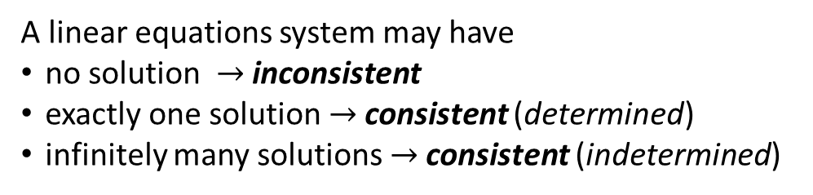
Lesson 23
Existence and Uniqueness of solutions in linear systems
1. What is a Linear Equation?...
When facing a system to be solved, if possible, how can we know if:
2. System of Linear Equations
Is the system consistent? That is, does at least one solution exist?
If a solution exists, is it the only one? That is, is the unique solution?
3. Linear Systems and Matrices
Remember that
A linear equations system may have
    no solution $→$inconsistent
    exactly one solution $→$consistent (determined)
    infinitely many solutions $→$consistent (indetermined)
4. Consistency and Number of Solutions
5. Homogeneous Linear Systems
One possible way to answer these is to check the rank of the coefficient matrix and the augmented matrix of the linear system.
check the rank
Try it!

Slide 36

Lesson 23
Existence and Uniqueness of solutions in linear systems
1. What is a Linear Equation?...
2. System of Linear Equations
3. Linear Systems and Matrices
See Lesson 13 if you do not remember how to determine the Rank of a Matrix!
4. Consistency and Number of Solutions
5. Homogeneous Linear Systems
One possible way to answer these is to check the rank of the coefficient matrix and the augmented matrix of the linear system.
check the rank
Try it!

Slide 37
Lesson 23
Existence and Uniqueness of solutions in linear systems
1. What is a Linear Equation?...
After checking the rank of the coefficient matrix and the augmented matrix of the linear system, we may conclude:
2. System of Linear Equations
If the rank of coefficient matrix is different from the rank of the augmented matrix, the system is inconsistent.
3. Linear Systems and Matrices
If the rank of coefficient matrix is equal to the rank of the augmented matrix, the system is consistent.
4. Consistency and Number of Solutions
In this case, we may also say that, if:
the (equal) ranks are also equal to the number of variables (unknowns) the system has a unique solution.
5. Homogeneous Linear Systems
the (equal) ranks are inferior to the number of variables (unknowns) the system has infinitely many solutions
One possible way to answer these is to check the rank of the coefficient matrix and the augmented matrix of the linear system.
check the rank
Try it!

Slide 38
Lesson 23
Analyzing a linear system
1. What is a Linear Equation?...
Find the
Rank for the coefficient
and augmented matrices
2. System of Linear Equations
Consistency of the linear system:
(Matrix Rank analysis)
Set p = Rank of Coefficient matrix
and q = Rank of Augmented matrix
Consistent system
Only one solution
3. Linear Systems and Matrices
Yes
4. Consistency and Number of Solutions
p = q ?
Consistent System
How many solutions?
n = Number of unknowns
p = q = n ?
Yes
5. Homogeneous Linear Systems
No
No
Try it!
Inconsistent system
Consistent system
Infinite solutions

Slide 39
Lesson 23
Examples
Study the consistency of the following linear systems
Coefficient matrix
Augmented matrix
1. What is a Linear Equation?...
2. System of Linear Equations
Rank calculation of Coefficient matrix
3. Linear Systems and Matrices
Rank (A) = 2
4. Consistency and Number of Solutions
Rank calculation of Augmented matrix
5. Homogeneous Linear Systems
Rank (A│B) = 2
Try it!
Rank(A) = Rank(A│B)
= Number of variables = 2
CONSISTENT SYSTEM
with ONLY ONE SOLUTION

Slide 40
Lesson 23
Examples
Study the consistency of the following linear systems
Coefficient matrix
Augmented matrix
1. What is a Linear Equation?...
2. System of Linear Equations
Rank calculation of Coefficient matrix
3. Linear Systems and Matrices
Rank (A) = 2
4. Consistency and Number of Solutions
Rank (A│B) = 3
Rank calculation of Augmented matrix
5. Homogeneous Linear Systems
Try it!
Rank(A) ≠ Rank(A│B)
INCONSISTENT SYSTEM
with NO SOLUTION

Slide 41








Lesson 23
Examples
Study the consistency of the following linear systems
Coefficient matrix
Augmented matrix
1. What is a Linear Equation?...
$$\left\{\begin{matrix}\begin{matrix}x+y+2z=1 \\ x+2y+z=1\end{matrix} \\ \begin{matrix}2x+y+z=1 \\ 2x+3y+3z=2\end{matrix}\end{matrix}\right.$$
$$A=\left(\begin{matrix}1 & 1 & 2 \\ 1 & 2 & 1 \\ 2 & 1 & 1 \\ 2 & 3 & 3\end{matrix}\right)$$
$$A|B=\left(\begin{matrix}\begin{matrix}1 & 1 \\ 1 & 2 \\ 2 & 1 \\ 2 & 3\end{matrix} & \begin{matrix}2 & 1 \\ 1 & 1 \\ 1 & 1 \\ 3 & 2\end{matrix}\end{matrix}\right)$$
2. System of Linear Equations
Rank calculation of Coefficient and Augmented matrix
3. Linear Systems and Matrices
$$\left(\begin{matrix}\begin{matrix}1 & 1 \\ 1 & 2 \\ 2 & 1 \\ 2 & 3\end{matrix} & \begin{matrix}2 & 1 \\ 1 & 1 \\ 1 & 1 \\ 3 & 2\end{matrix}\end{matrix}\right)$$
~ $\left(\begin{matrix}\begin{matrix}1 & 1 \\ 0 & 1 \\ 0 & −1 \\ 0 & 1\end{matrix} & \begin{matrix}2 & 1 \\ −1 & 0 \\ −3 & −1 \\ −1 & 0\end{matrix}\end{matrix}\right)$
~ $\left(\begin{matrix}\begin{matrix}1 & 1 \\ 0 & 1 \\ 0 & 0 \\ 0 & 0\end{matrix} & \begin{matrix}2 & 1 \\ −1 & 0 \\ −4 & −1 \\ 0 & 0\end{matrix}\end{matrix}\right)$
$$\begin{matrix}R2←R2−R1 \\ R3←R3−2R1 \\ R4←R4−2R1\end{matrix}$$
$$\begin{matrix} \\ R3←R3+R2 \\ R4←R4−R2\end{matrix}$$
4. Consistency and Number of Solutions
5. Homogeneous Linear Systems
Notice that
The rank computation for both matrices – Coefficient and Augmented, can be made simultaneously!
Rank (A) = 3
Rank (A│B) = 3
Try it!
Rank(A) = Rank(A│B)
= Number of variables = 3
CONSISTENT SYSTEM
with ONLY ONE SOLUTION

Slide 42








Lesson 23
Examples
Study the consistency of the following linear systems
Coefficient matrix
Augmented matrix
1. What is a Linear Equation?...
$$\left\{\begin{matrix}\begin{matrix}x+2y+z=1 \\ 2x+y+3z=−4\end{matrix} \\ \begin{matrix}x−y+2z=−5 \\ 4x+2y+6z=−8\end{matrix}\end{matrix}\right.$$
$$A=\left(\begin{matrix}1 & 2 & 1 \\ 2 & 1 & 3 \\ 1 & −1 & 2 \\ 4 & 2 & 6\end{matrix}\right)$$
$$A|B=\left(\begin{matrix}\begin{matrix}1 & 2 \\ 2 & 1 \\ 1 & −1 \\ 4 & 2\end{matrix} & \begin{matrix}1 & 1 \\ 3 & −4 \\ 2 & −5 \\ 6 & −8\end{matrix}\end{matrix}\right)$$
2. System of Linear Equations
Rank calculation of Coefficient and Augmented matrix
3. Linear Systems and Matrices
$$\left(\begin{matrix}\begin{matrix}1 & 2 \\ 2 & 1 \\ 1 & −1 \\ 4 & 2\end{matrix} & \begin{matrix}1 & 1 \\ 3 & −4 \\ 2 & −5 \\ 6 & −8\end{matrix}\end{matrix}\right)$$
~ $\left(\begin{matrix}\begin{matrix}1 & 2 \\ 0 & −3 \\ 0 & −3 \\ 0 & −6\end{matrix} & \begin{matrix}1 & 1 \\ 1 & −6 \\ 1 & −6 \\ 2 & −12\end{matrix}\end{matrix}\right)$
~ $\left(\begin{matrix}\begin{matrix}1 & 2 \\ 0 & −3 \\ 0 & 0 \\ 0 & 0\end{matrix} & \begin{matrix}1 & 1 \\ 1 & −6 \\ 0 & 0 \\ 0 & 0\end{matrix}\end{matrix}\right)$
$$\begin{matrix}R2←R2−2R1 \\ R3←R3−R1 \\ R4←R4−4R1\end{matrix}$$
$$\begin{matrix} \\ R3←R3−R2 \\ R4←R4−2R2\end{matrix}$$
4. Consistency and Number of Solutions
5. Homogeneous Linear Systems
Rank (A) = 2
Rank (A│B) = 2
Try it!
Rank(A) = Rank(A│B) = 2
< Number of variables = 3
CONSISTENT SYSTEM
with INFINITELY MANY SOLUTIONS

Slide 43



Lesson 23
Homogeneous System of Linear Equations
1. What is a Linear Equation?...
A system of $m$ linear equations in $n$ variables:
$$\left\{\begin{matrix}a_{11}∙x_{1}+ \\ \begin{matrix}a_{21}∙x_{1}+ \\ ⋮\end{matrix} \\ a_{m1}∙x_{1}+\end{matrix}\begin{matrix}a_{12}∙x_{2}+… \\ \begin{matrix}a_{22}∙x_{2}+… \\ ⋱ \end{matrix} \\ a_{m2}∙x_{2}+… \end{matrix}\begin{matrix}{+a}_{1n}∙x_{n} \\ \begin{matrix}+a_{2n}∙x_{n} \\ \end{matrix} \\ { +a}_{mn}∙x_{n}\end{matrix}\begin{matrix}=b_{1} \\ \begin{matrix}{=b}_{2} \\ ⋮\end{matrix} \\ =b_{m}\end{matrix}\right.$$
2. System of Linear Equations
3. Linear Systems and Matrices
is called Homogeneous if all its $m$ independent terms ${(b}_{1}$, $b_{2}$,…, $b_{m})$ are null, namely:
4. Consistency and Number of Solutions
$$\left\{\begin{matrix}a_{11}∙x_{1}+ \\ \begin{matrix}a_{21}∙x_{1}+ \\ ⋮\end{matrix} \\ a_{m1}∙x_{1}+\end{matrix}\begin{matrix}a_{12}∙x_{2}+… \\ \begin{matrix}a_{22}∙x_{2}+… \\ ⋱ \end{matrix} \\ a_{m2}∙x_{2}+… \end{matrix}\begin{matrix}{+a}_{1n}∙x_{n} \\ \begin{matrix}+a_{2n}∙x_{n} \\ \end{matrix} \\ { +a}_{mn}∙x_{n}\end{matrix}\begin{matrix}=0 \\ \begin{matrix}=0 \\ ⋮\end{matrix} \\ =0\end{matrix}\right.$$
5. Homogeneous Linear Systems
Try it!
and can be written, in matrix notation, as:

Slide 44

Lesson 23
Homogeneous System of Linear Equations
1. What is a Linear Equation?...
These linear systems have an unique property:
They are always consistent!
2. System of Linear Equations
since they always admit, at least, the solution:
3. Linear Systems and Matrices
$$\left(x_{1},x_{2},…,x_{n}\right)=\left(0,0,…,0\right)$$
This solution is frequently called the Trivial Solution.
4. Consistency and Number of Solutions
$$\left\{\begin{matrix}a_{11}∙x_{1}+ \\ \begin{matrix}a_{21}∙x_{1}+ \\ ⋮\end{matrix} \\ a_{m1}∙x_{1}+\end{matrix}\begin{matrix}a_{12}∙x_{2}+… \\ \begin{matrix}a_{22}∙x_{2}+… \\ ⋱ \end{matrix} \\ a_{m2}∙x_{2}+… \end{matrix}\begin{matrix}{+a}_{1n}∙x_{n} \\ \begin{matrix}+a_{2n}∙x_{n} \\ \end{matrix} \\ { +a}_{mn}∙x_{n}\end{matrix}\begin{matrix}=0 \\ \begin{matrix}=0 \\ ⋮\end{matrix} \\ =0\end{matrix}\right.$$
5. Homogeneous Linear Systems
Try it!
and can be written, in matrix notation, as:

Slide 45
Lesson 23
Homogeneous System of Linear Equations
1. What is a Linear Equation?...
These linear systems have an unique property:
They are always consistent!
2. System of Linear Equations
since they always admit, at least, the solution:
3. Linear Systems and Matrices
$$\left(x_{1},x_{2},…,x_{n}\right)=\left(0,0,…,0\right)$$
This solution is frequently called the Trivial Solution.
4. Consistency and Number of Solutions
Remember that – for Homogeneous Linear Systems:
5. Homogeneous Linear Systems
The rank of Coefficient and Augmented Matrices is always the same – the difference between the two will always be a column of zeros, which does not change the rank!
Try it!
If the system is consistent with only one solution, then this solution is the trivial or null.
If the system admits a nontrivial solution, then it admits infinitely many others since it has to be consistent with infinite solutions (as it also admits the trivial one).

Slide 46



Lesson 23
Let’s go!!!!
1. What is a Linear Equation?...
2. System of Linear Equations
3. Linear Systems and Matrices
4. Consistency and Number of Solutions
5. Homogeneous Linear Systems
Try it!

Slide 47

Lesson 23
Quiz
1. What is a Linear Equation?...
Click the Quiz button to edit this object
2. System of Linear Equations
3. Linear Systems and Matrices
4. Consistency and Number of Solutions
5. Homogeneous Linear Systems
Try it!

Slide 48


Lesson 23
Hope you enjoyed it!
1. What is a Linear Equation?...
2. System of Linear Equations
3. Linear Systems and Matrices
4. Consistency and Number of Solutions
5. Homogeneous Linear Systems
By EngiMath TEAM
Try it!

