Slide 1



Lesson 24 Plan
Remember!
You can travel through all the sections (enter or mouse click) or choose your section by clicking over it.
You should only “Try it” after exploring all lesson contents!
1. Linear Systems solving by the Inverse Matrix
2. Examples
3. Application
Try it!
By EngiMath TEAM

Slide 2


Lesson 24
As seen in Lesson 23, any linear system of m equations with n variables
1. Linear Systems solving by the Inverse Matrix
2. Examples
can be written as a Matrix Equation:
3. Application
A.X = B
coefficient matrix
vector matrix
of the variables
vector matrix
of the constant terms
where
,
and
Try it!

Slide 3
Lesson 24
If the number of equations is equal to the number of unknowns, m = n
1. Linear Systems solving by the Inverse Matrix
2. Examples
the Coefficient Matrix of this system is a Square Matrix
3. Application
A.X = B
coefficient matrix
vector matrix
of the variables
vector matrix
of the constant terms
where
,
and
Try it!

Slide 4
Lesson 24
If the number of equations is equal to the number of unknowns, m = n
1. Linear Systems solving by the Inverse Matrix
Remember that
INVERSE MATRIX
LESSON 9!...
Only square matrices may have an INVERSE MATRIX and not all of them have…
2. Examples
the Coefficient Matrix of this system is a Square Matrix
3. Application
A.X = B
where
,
and
Try it!

Slide 5



Lesson 24
If the number of equations is equal to the number of unknowns, m = n
1. Linear Systems solving by the Inverse Matrix
Remember that
INVERSE MATRIX
LESSON 9!...
Only square matrices may have an INVERSE MATRIX and not all of them have…
2. Examples
3. Application
${∃A}^{−1} ⇔$ $A$ is invertible or regular $⇔$ or
Resume
(practice)
$${AA}^{−1}=I$$
$$A^{−1}A=I$$
${∄A}^{−1} ⇔ A$ is singular or non invertible
Try it!

Slide 6
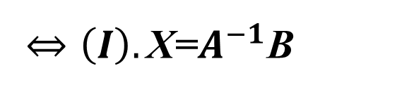
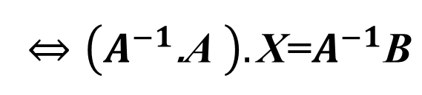
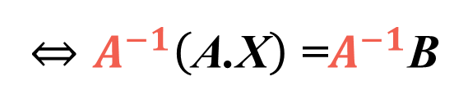
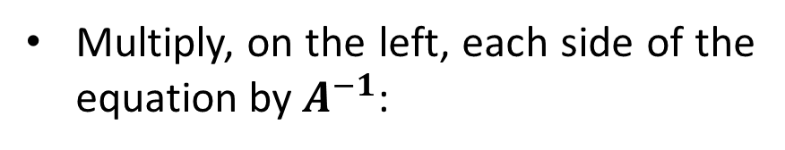
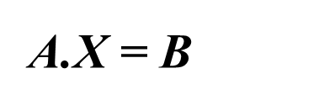
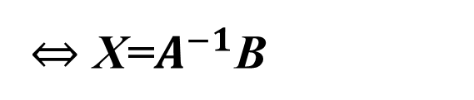
Lesson 24
Thus, if the A.X = B represents a linear system where A is a regular square matrix, we may solve the matrix equation as follows:
1. Linear Systems solving by the Inverse Matrix
$$\text{A}\text{.}\text{X}\text{ = }\text{B}$$
Multiply, on the left, each side of the equation by $A^{−1}$:
2. Examples
$$⇔A^{−1}\left(\text{A}\text{.}\text{X}\right)\text{ =}A^{−1}\text{B}$$
Use the associative property:
$$⇔\left(A^{−1}\text{.}\text{A} \right).\text{X}\text{=}A^{−1}\text{B}$$
3. Application
Inverse definition:
$$⇔\left(I\right).\text{X}\text{=}A^{−1}\text{B}$$
Identity in matrix multiplication:
$$⇔\text{X}\text{=}A^{−1}\text{B}$$
Try it!
Remember that
Matrix multiplication is not commutative, so each side of the equation must be multiplied on the left (or right) to maintain the equation equivalence.

Slide 7

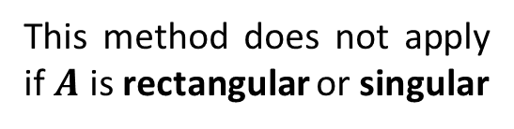
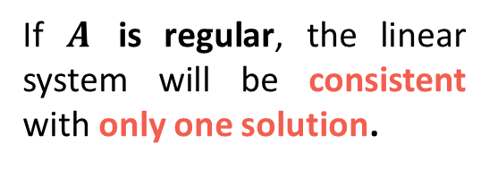
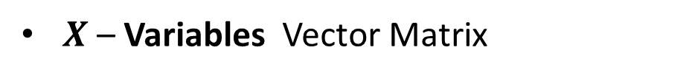
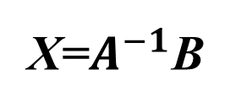
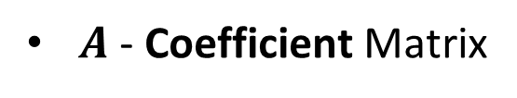
Lesson 24
METHOD - Linear Systems solving by the Inverse Matrix
1. Linear Systems solving by the Inverse Matrix
Given a linear system of equations, determine matrices $A$, $X$and $B$
Notice that
$A$- Coefficient Matrix
2. Examples
This method does not apply if $A$ is rectangular or singular
$X$– Variables Vector Matrix
If $A$ is regular, the linear system will be consistent with only one solution.
$B$– Constant Terms Vector Matrix
3. Application
or write the matrix notation of the system
Compute matrix $A^{−1}$, the inverse of $A$, if possible.
Try it!
Multiply matrix $A^{−1}$ by $B$, to find the system solution $\text{X}$.
$$\text{X}\text{=}A^{−1}\text{B}$$

Slide 8


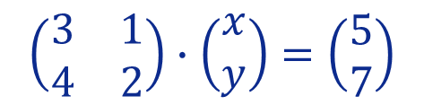





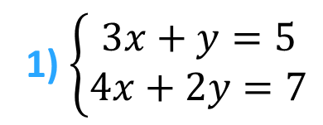
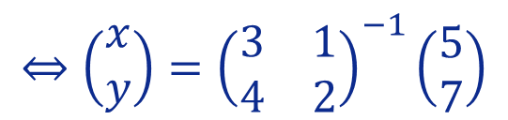
Lesson 24
Example
Solve following linear systems using the Inverse Method
1. Linear Systems solving by the Inverse Matrix
1) $\left\{\begin{matrix}3x+y=5 \\ 4x+2y=7\end{matrix}\right.$
$$⇔\left(\begin{matrix}x \\ y\end{matrix}\right)={\left(\begin{matrix}3 & 1 \\ 4 & 2\end{matrix}\right)}^{−1}\left(\begin{matrix}5 \\ 7\end{matrix}\right)$$
$$\left(\begin{matrix}3 & 1 \\ 4 & 2\end{matrix}\right)∙\left(\begin{matrix}x \\ y\end{matrix}\right)=\left(\begin{matrix}5 \\ 7\end{matrix}\right)$$
Matrix
Equation
$$A$$
$$X$$
$$B$$
objective
2. Examples
$$A=\left(\begin{matrix}3 & 1 \\ 4 & 2\end{matrix}\right)$$
In previous Lessons you have seen 3 ways to compute this matrix!...
Do you remember?
HOW?
3. Application
Try it!
2. Compute $A^{−1}$
Inverse Method (3 steps)
1. Matrix Notation

Slide 9


Lesson 24
Example
Solve following linear systems using the Inverse Method
1. Linear Systems solving by the Inverse Matrix
1) $\left\{\begin{matrix}3x+y=5 \\ 4x+2y=7\end{matrix}\right.$
$$⇔\left(\begin{matrix}x \\ y\end{matrix}\right)={\left(\begin{matrix}3 & 1 \\ 4 & 2\end{matrix}\right)}^{−1}\left(\begin{matrix}5 \\ 7\end{matrix}\right)$$
$$\left(\begin{matrix}3 & 1 \\ 4 & 2\end{matrix}\right)∙\left(\begin{matrix}x \\ y\end{matrix}\right)=\left(\begin{matrix}5 \\ 7\end{matrix}\right)$$
Matrix
Equation
$$A$$
$$X$$
$$B$$
objective
2. Examples
$$A=\left(\begin{matrix}3 & 1 \\ 4 & 2\end{matrix}\right)$$
In previous Lessons you have seen 3 ways to compute this matrix!...
Let´s work this example using the last one
– the Adjugate –
3. Application
Remember
Inverse Computation by:
Definition – Lesson 9
EROs – Lesson 14
Adjugate – Lesson 22
Try it!
2. Compute $A^{−1}$
Inverse Method (3 steps)
1. Matrix Notation

Slide 10
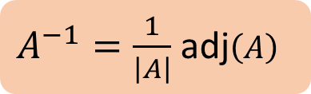
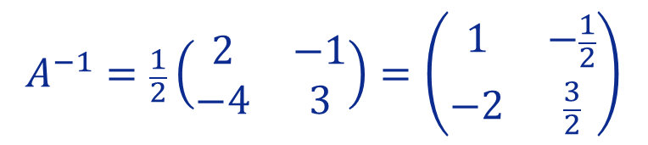
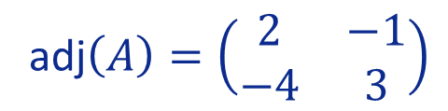




Lesson 24
Example
Solve following linear systems using the Inverse Method
1. Linear Systems solving by the Inverse Matrix
1) $\left\{\begin{matrix}3x+y=5 \\ 4x+2y=7\end{matrix}\right.$
$$⇔\left(\begin{matrix}x \\ y\end{matrix}\right)={\left(\begin{matrix}3 & 1 \\ 4 & 2\end{matrix}\right)}^{−1}\left(\begin{matrix}5 \\ 7\end{matrix}\right)$$
$$\left(\begin{matrix}3 & 1 \\ 4 & 2\end{matrix}\right)∙\left(\begin{matrix}x \\ y\end{matrix}\right)=\left(\begin{matrix}5 \\ 7\end{matrix}\right)$$
Matrix
Equation
$$A$$
$$X$$
$$B$$
objective
2. Examples
$$A=\left(\begin{matrix}3 & 1 \\ 4 & 2\end{matrix}\right)$$
adj$\left(A\right)=\left(\begin{matrix}2 & −1 \\ −4 & 3\end{matrix}\right)$
$$\left|A\right|=2×3−\left(−4\right)×\left(−1\right)$$
Let’s work this example using the last one
– the Adjugate –
$$=6−4=2$$
3. Application
$$A^{−1}=\frac{1}{2}\left(\begin{matrix}2 & −1 \\ −4 & 3\end{matrix}\right)=\left(\begin{matrix}1 & −\frac{1}{2} \\ −2 & \frac{3}{2}\end{matrix}\right)$$
Remember that
$$A=\left(\begin{matrix}a & b \\ c & d\end{matrix}\right)⇒\left|A\right|=ad−bc$$
$A^{−1}=\frac{1}{\left|A\right|}$ adj$\left(A\right)$
Try it!
$$A=\left(\begin{matrix}a & b \\ c & d\end{matrix}\right)⇒\text{adj}\left(A\right)=\left(\begin{matrix}d & −b \\ −c & a\end{matrix}\right)$$
2. Compute $A^{−1}$
Inverse Method (3 steps)
1. Matrix Notation

Slide 11



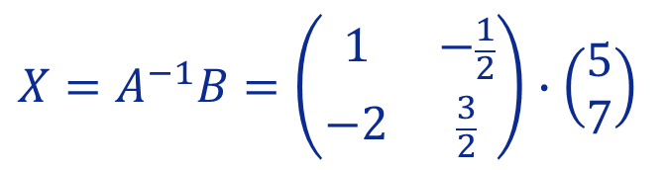




Lesson 24
Example
Solve following linear systems using the Inverse Method
1. Linear Systems solving by the Inverse Matrix
1) $\left\{\begin{matrix}3x+y=5 \\ 4x+2y=7\end{matrix}\right.$
$$⇔\left(\begin{matrix}x \\ y\end{matrix}\right)={\left(\begin{matrix}3 & 1 \\ 4 & 2\end{matrix}\right)}^{−1}\left(\begin{matrix}5 \\ 7\end{matrix}\right)$$
$$\left(\begin{matrix}3 & 1 \\ 4 & 2\end{matrix}\right)∙\left(\begin{matrix}x \\ y\end{matrix}\right)=\left(\begin{matrix}5 \\ 7\end{matrix}\right)$$
Matrix
Equation
$$A$$
$$X$$
$$B$$
objective
2. Examples
$$A=\left(\begin{matrix}3 & 1 \\ 4 & 2\end{matrix}\right)$$
adj$\left(A\right)=\left(\begin{matrix}2 & −1 \\ −4 & 3\end{matrix}\right)$
$$\left|A\right|=2×3−\left(−4\right)×\left(−1\right)$$
$$=6−4=2$$
3. Application
$$A^{−1}=\frac{1}{2}\left(\begin{matrix}2 & −1 \\ −4 & 3\end{matrix}\right)=\left(\begin{matrix}1 & −\frac{1}{2} \\ −2 & \frac{3}{2}\end{matrix}\right)$$
$A^{−1}=\frac{1}{\left|A\right|}$ adj$\left(A\right)$
$$X=A^{−1}B=\left(\begin{matrix}1 & −\frac{1}{2} \\ −2 & \frac{3}{2}\end{matrix}\right)∙\left(\begin{matrix}5 \\ 7\end{matrix}\right)$$
$⇒ \left\{\begin{matrix}x=\frac{3}{2} \\ y=\frac{1}{2}\end{matrix}\right.$
$$=\left(\begin{matrix}1×5−\frac{1}{2}×7 \\ −2×5+\frac{3}{2}×7\end{matrix}\right)$$
$$=\left(\begin{matrix}\frac{3}{2} \\ \frac{1}{2}\end{matrix}\right)$$
Try it!
2. Compute $A^{−1}$
Inverse Method (3 steps)
1. Matrix Notation
3. Multiply $A^{−1}.B$

Slide 12
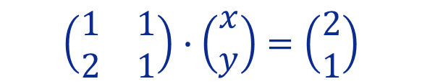

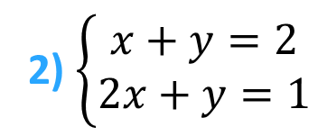


Lesson 24
Example
Solve following linear systems using the Inverse Method
1. Linear Systems solving by the Inverse Matrix
$$A$$
$$X$$
$$B$$
2) $\left\{\begin{matrix}x+y=2 \\ 2x+y=1\end{matrix}\right.$
$$\left(\begin{matrix}1 & 1 \\ 2 & 1\end{matrix}\right)∙\left(\begin{matrix}x \\ y\end{matrix}\right)=\left(\begin{matrix}2 \\ 1\end{matrix}\right)$$
2. Examples
3. Application
Try it!
2. Compute $A^{−1}$
Inverse Method (3 steps)
1. Matrix Notation
3. Multiply $A^{−1}.B$

Slide 13

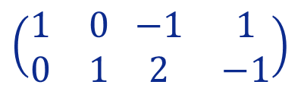
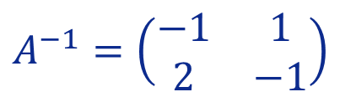
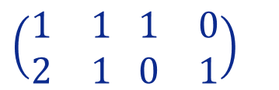
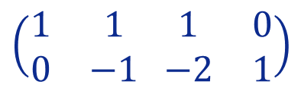





Lesson 24
Example
Solve following linear systems using the Inverse Method
1. Linear Systems solving by the Inverse Matrix
$$A$$
$$X$$
$$B$$
2) $\left\{\begin{matrix}x+y=2 \\ 2x+y=1\end{matrix}\right.$
$$\left(\begin{matrix}1 & 1 \\ 2 & 1\end{matrix}\right)∙\left(\begin{matrix}x \\ y\end{matrix}\right)=\left(\begin{matrix}2 \\ 1\end{matrix}\right)$$
$$\left(\begin{matrix}1 & 1 \\ 2 & 1\end{matrix} \begin{matrix}1 & 0 \\ 0 & 1\end{matrix}\right)$$
$$\underset{R_{2}←R_{2}−2R_{1}}{\sim}{}$$
$$\left(\begin{matrix}1 & 1 \\ 0 & −1\end{matrix} \begin{matrix}1 & 0 \\ −2 & 1\end{matrix}\right)$$
2. Examples
Let’s do it using EROs!...
(Lesson 14)
“Elementary Row Operations”
$$A$$
$$I$$
$$\underset{\begin{aligned}R_{1}←R_{1}+R_{2} \\ R_{2}←−R_{2}\end{aligned}}{\sim}$$
$$\left(\begin{matrix}1 & 0 \\ 0 & 1\end{matrix} \begin{matrix}−1 & 1 \\ 2 & −1\end{matrix}\right)$$
$$A^{−1}=\left(\begin{matrix}−1 & 1 \\ 2 & −1\end{matrix}\right)$$
3. Application
$$I$$
$$A^{−1}$$
Try it!
2. Compute $A^{−1}$
Inverse Method (3 steps)
1. Matrix Notation
3. Multiply $A^{−1}.B$

Slide 14
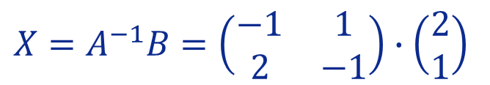


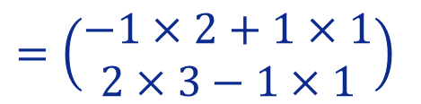
Lesson 24
Example
Solve following linear systems using the Inverse Method
1. Linear Systems solving by the Inverse Matrix
$$A$$
$$X$$
$$B$$
2) $\left\{\begin{matrix}x+y=2 \\ 2x+y=1\end{matrix}\right.$
$$\left(\begin{matrix}1 & 1 \\ 2 & 1\end{matrix}\right)∙\left(\begin{matrix}x \\ y\end{matrix}\right)=\left(\begin{matrix}2 \\ 1\end{matrix}\right)$$
$$\left(\begin{matrix}1 & 1 \\ 2 & 1\end{matrix} \begin{matrix}1 & 0 \\ 0 & 1\end{matrix}\right)$$
$$\underset{R_{2}←R_{2}−2R_{1}}{\sim}{}$$
$$\left(\begin{matrix}1 & 1 \\ 0 & −1\end{matrix} \begin{matrix}1 & 0 \\ −2 & 1\end{matrix}\right)$$
2. Examples
$$A$$
$$I$$
$$\underset{\begin{aligned}R_{1}←R_{1}+R_{2} \\ R_{2}←−R_{2}\end{aligned}}{\sim}$$
$$\left(\begin{matrix}1 & 0 \\ 0 & 1\end{matrix} \begin{matrix}−1 & 1 \\ 2 & −1\end{matrix}\right)$$
$$A^{−1}=\left(\begin{matrix}−1 & 1 \\ 2 & −1\end{matrix}\right)$$
3. Application
$$I$$
$$A^{−1}$$
$$X=A^{−1}B=\left(\begin{matrix}−1 & 1 \\ 2 & −1\end{matrix}\right)∙\left(\begin{matrix}2 \\ 1\end{matrix}\right)$$
$$=\left(\begin{matrix}−1×2+1×1 \\ 2×3−1×1\end{matrix}\right)$$
$$=\left(\begin{matrix}−1 \\ 3\end{matrix}\right)$$
$⇒ \left\{\begin{matrix}x=−1 \\ y=3\end{matrix}\right.$
Try it!
2. Compute $A^{−1}$
Inverse Method (3 steps)
1. Matrix Notation
3. Multiply $A^{−1}.B$

Slide 15


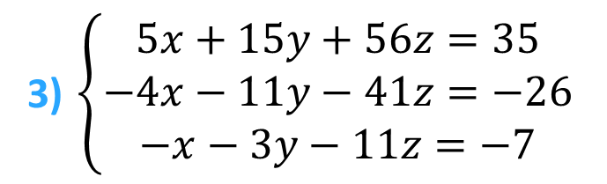
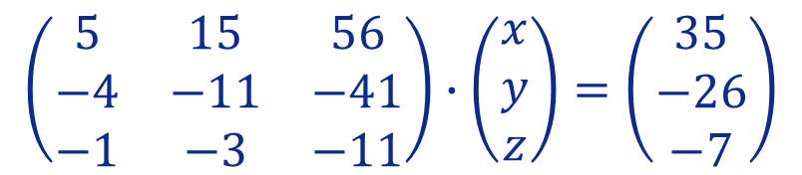


Lesson 24
Example
Solve following linear systems using the Inverse Method
1. Linear Systems solving by the Inverse Matrix
$$A$$
$$X$$
$$B$$
3) $\left\{\begin{matrix}5x+15y+56z=35 \\ −4x−11y−41z=−26 \\ −x−3y−11z=−7\end{matrix}\right.$
$$\left(\begin{matrix}5 & 15 & 56 \\ −4 & −11 & −41 \\ −1 & −3 & −11\end{matrix}\right)∙\left(\begin{matrix}x \\ y \\ z\end{matrix}\right)=\left(\begin{matrix}35 \\ −26 \\ −7\end{matrix}\right)$$
2. Examples
Choose your option to…
ADJUGATE
click here to see it!
EROs
click here to see it!
3. Application
Try it!
2. Compute $A^{−1}$
Inverse Method (3 steps)
1. Matrix Notation
3. Multiply $A^{−1}.B$

Slide 16

Lesson 24
Example
Solve following linear systems using the Inverse Method
1. Linear Systems solving by the Inverse Matrix
$$A$$
$$X$$
$$B$$
3) $\left\{\begin{matrix}5x+15y+56z=35 \\ −4x−11y−41z=−26 \\ −x−3y−11z=−7\end{matrix}\right.$
$$\left(\begin{matrix}5 & 15 & 56 \\ −4 & −11 & −41 \\ −1 & −3 & −11\end{matrix}\right)∙\left(\begin{matrix}x \\ y \\ z\end{matrix}\right)=\left(\begin{matrix}35 \\ −26 \\ −7\end{matrix}\right)$$
2. Examples
Choose your option to…
ADJUGATE
click here to see it!
EROs
click here to see it!
3. Application
Try it!
2. Compute $A^{−1}$
Inverse Method (3 steps)
1. Matrix Notation
3. Multiply $A^{−1}.B$

Slide 17
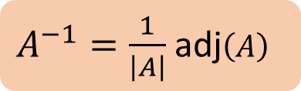
Lesson 24
Example
Solve following linear systems using the Inverse Method
1. Linear Systems solving by the Inverse Matrix
3) $\left\{\begin{matrix}5x+15y+56z=35 \\ −4x−11y−41z=−26 \\ −x−3y−11z=−7\end{matrix}\right.$
$$\left(\begin{matrix}5 & 15 & 56 \\ −4 & −11 & −41 \\ −1 & −3 & −11\end{matrix}\right)∙\left(\begin{matrix}x \\ y \\ z\end{matrix}\right)=\left(\begin{matrix}35 \\ −26 \\ −7\end{matrix}\right)$$
2. Examples
$A^{−1}=\frac{1}{\left|A\right|}$ adj$\left(A\right)$
Laplace to the 1st column
Sarrus Rule
3. Application
Try it!
EROs
click here to see it!
2. Compute $A^{−1}$
Inverse Method (3 steps)
1. Matrix Notation
3. Multiply $A^{−1}.B$

Slide 18






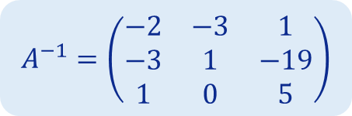

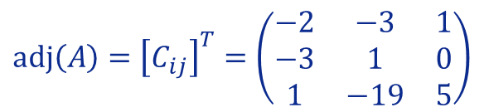




Lesson 24
Example
Solve following linear systems using the Inverse Method
1. Linear Systems solving by the Inverse Matrix
3) $\left\{\begin{matrix}5x+15y+56z=35 \\ −4x−11y−41z=−26 \\ −x−3y−11z=−7\end{matrix}\right.$
$$\left(\begin{matrix}5 & 15 & 56 \\ −4 & −11 & −41 \\ −1 & −3 & −11\end{matrix}\right)∙\left(\begin{matrix}x \\ y \\ z\end{matrix}\right)=\left(\begin{matrix}35 \\ −26 \\ −7\end{matrix}\right)$$
$$A^{−1}=\left(\begin{matrix}−2 & −3 & 1 \\ −3 & 1 & −19 \\ 1 & 0 & 5\end{matrix}\right)$$
2. Examples
To find the adjugate of this matrix, first we will find the cofactor matrix of A.
$A^{−1}=\frac{1}{\left|A\right|}$ adj$\left(A\right)$
$$C_{12}=−\left|\begin{matrix}−4 & −41 \\ −1 & −11\end{matrix}\right|=−3$$
$$C_{13}=+\left|\begin{matrix}−4 & −11 \\ −1 & −3\end{matrix}\right|=1$$
$$C_{11}=+\left|\begin{matrix}−11 & −41 \\ −3 & −11\end{matrix}\right|=−2$$
$$C_{21}=−\left|\begin{matrix}15 & 56 \\ −3 & −11\end{matrix}\right|=−3$$
$$C_{22}=+\left|\begin{matrix}5 & 56 \\ −1 & −11\end{matrix}\right|=1$$
$$C_{23}=−\left|\begin{matrix}5 & 15 \\ −1 & −3\end{matrix}\right|=0$$
3. Application
$$C_{31}=+\left|\begin{matrix}15 & 56 \\ −11 & −41\end{matrix}\right|=1$$
$$C_{32}=−\left|\begin{matrix}5 & 56 \\ −4 & −41\end{matrix}\right|=−19$$
$C_{33}=+\left|\begin{matrix}5 & 15 \\ −4 & −11\end{matrix}\right|=$5
Then, as the adjugate is the transpose of the cofactor matrix, we get
$$adj\left(A\right)={\left[C_{ij}\right]}^{T}=\left(\begin{matrix}−2 & −3 & 1 \\ −3 & 1 & 0 \\ 1 & −19 & 5\end{matrix}\right)$$
($A^{−1}=\frac{1}{\left|A\right|}$ adj$\left(A\right)$∧ $\left|A\right|=1$)
Try it!
, since
, thus:
EROs
click here to see it!
2. Compute $A^{−1}$
Inverse Method (3 steps)
1. Matrix Notation
3. Multiply $A^{−1}.B$

Slide 19


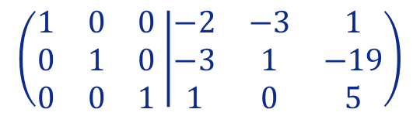


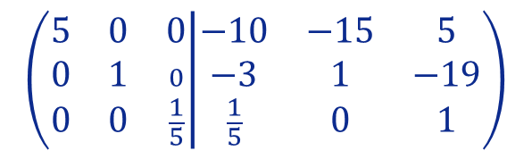

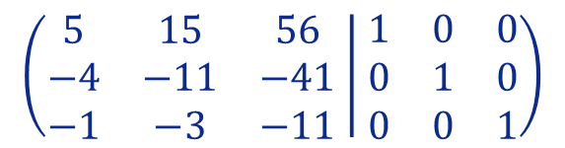

Lesson 24
Example
Solve following linear systems using the Inverse Method
1. Linear Systems solving by the Inverse Matrix
3) $\left\{\begin{matrix}5x+15y+56z=35 \\ −4x−11y−41z=−26 \\ −x−3y−11z=−7\end{matrix}\right.$
$$\left(\begin{matrix}5 & 15 & 56 \\ −4 & −11 & −41 \\ −1 & −3 & −11\end{matrix}\right)∙\left(\begin{matrix}x \\ y \\ z\end{matrix}\right)=\left(\begin{matrix}35 \\ −26 \\ −7\end{matrix}\right)$$
$$A^{−1}=\left(\begin{matrix}−2 & −3 & 1 \\ −3 & 1 & −19 \\ 1 & 0 & 5\end{matrix}\right)$$
2. Examples
$$\left(\begin{matrix}5 & 15 & 56 \\ 0 & 1 & \frac{19}{5} \\ 0 & 0 & \frac{1}{5}\end{matrix} | \begin{matrix}1 & 0 & 0 \\ \frac{4}{5} & 1 & 0 \\ \frac{1}{5} & 0 & 1\end{matrix}\right)$$
$$\left(\begin{matrix}5 & 0 & −1 \\ 0 & 1 & \frac{19}{5} \\ 0 & 0 & \frac{1}{5}\end{matrix} | \begin{matrix}12 & −15 & 0 \\ \frac{4}{5} & 1 & 0 \\ \frac{1}{5} & 0 & 1\end{matrix}\right)$$
$$\left(\begin{matrix}5 & 15 & 56 \\ −4 & −11 & −41 \\ −1 & −3 & −11\end{matrix} | \begin{matrix}1 & 0 & 0 \\ 0 & 1 & 0 \\ 0 & 0 & 1\end{matrix}\right)$$
~
~
$$\begin{matrix} \\ \begin{aligned} \\ \\ \\ R1←R1−15R2 \\ \end{aligned}\end{matrix}$$
$$\begin{matrix} \\ \begin{aligned} \\ \\ R2←R2+\frac{4}{5}R1 \\ R3←R3−\frac{−1}{5}R1\end{aligned}\end{matrix}$$
3. Application
$$\left(\begin{matrix}5 & 0 & 0 \\ 0 & 1 & 0 \\ 0 & 0 & \frac{1}{5}\end{matrix} | \begin{matrix}−10 & −15 & 5 \\ −3 & 1 & −19 \\ \frac{1}{5} & 0 & 1\end{matrix}\right)$$
$$\left(\begin{matrix}1 & 0 & 0 \\ 0 & 1 & 0 \\ 0 & 0 & 1\end{matrix} | \begin{matrix}−2 & −3 & 1 \\ −3 & 1 & −19 \\ 1 & 0 & 5\end{matrix}\right)$$
~
~
$$\begin{matrix} \\ \begin{aligned} \\ \begin{matrix}R1←\frac{1}{5}R1 \\ R3←5R3\end{matrix} \\ \\ \\ \end{aligned}\end{matrix}$$
Try it!
$$\begin{matrix} \\ \begin{aligned} \\ \begin{matrix}R1←R1+5R3 \\ R2←R2−19R3\end{matrix} \\ \\ \\ \end{aligned}\end{matrix}$$
ADJUGATE
click here to see it!
2. Compute $A^{−1}$
Inverse Method (3 steps)
1. Matrix Notation
3. Multiply $A^{−1}.B$

Slide 20
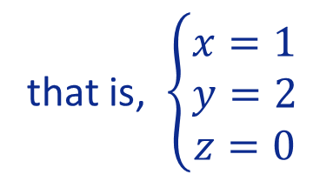

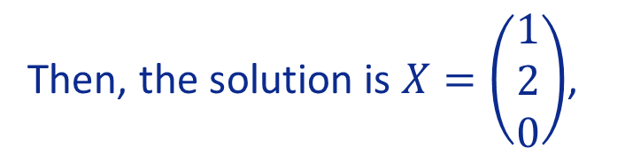

Lesson 24
Example
Solve following linear systems using the Inverse Method
1. Linear Systems solving by the Inverse Matrix
3) $\left\{\begin{matrix}5x+15y+56z=35 \\ −4x−11y−41z=−26 \\ −x−3y−11z=−7\end{matrix}\right.$
$$A^{−1}=\left(\begin{matrix}−2 & −3 & 1 \\ −3 & 1 & −19 \\ 1 & 0 & 5\end{matrix}\right)$$
2. Examples
As $X=A^{−1}∙B$, we have:
$${X=A}^{−1}∙B=\left(\begin{matrix}−2 & −3 & 1 \\ −3 & 1 & −19 \\ 1 & 0 & 5\end{matrix}\right)∙\left(\begin{matrix}35 \\ −26 \\ −7\end{matrix}\right)=\left(\begin{matrix}−2∙35−3∙(−26)+1∙(−7) \\ −3∙35+1∙(−26)−19∙(−7) \\ 1∙35+0∙(−26)+5∙(−7)\end{matrix}\right)=\left(\begin{matrix}1 \\ 2 \\ 0\end{matrix}\right)$$
3. Application
Then, the solution is $X=\left(\begin{matrix}1 \\ 2 \\ 0\end{matrix}\right)$,
that is, $\left\{\begin{matrix}x=1 \\ y=2 \\ z=0\end{matrix}\right.$
Return to CHOOSE YOUR OPTION for computing A⁻¹
click here to return!
Try it!
2. Compute $A^{−1}$
Inverse Method (3 steps)
1. Matrix Notation
3. Multiply $A^{−1}.B$

Slide 21
Lesson 24
Why and When the Inverse Matrix is used for solving Linear Systems?
1. Linear Systems solving by the Inverse Matrix
This is not an “easy” method to use since it involves one of the most time-consuming and tedious operations with matrices – the inversion.
However, there are specific problems for which the most recommended method of resolution is this.
2. Examples
3. Application
For example, suppose you must solve several systems with the same Coefficient Matrix but with distinct constant terms.
Try it!
In this case, this method – Inverse Matrix – should be applied since the solution of each system is reduced to a matrix multiplication, once you have determined the inverse of the system matrix!

Slide 22

Lesson 24
Example
1. Linear Systems solving by the Inverse Matrix
A factory produces two types of products: X and Y. Each model X requires 4 hours of cutting and 2 hours of polishing, each model Y requires 2 hours of cutting and 5 hours of polishing. Knowing that, the cutters and polishers work an average of 32 and 40 hours respectively, determine the number of products of each type that can be produced weekly.
2. Examples
$$\left\{\begin{matrix}4x+2y=32 \\ 2x+5y=40\end{matrix}\right.$$
System representation:
3. Application
Try it!

Slide 23
Lesson 24
Example
1. Linear Systems solving by the Inverse Matrix
A factory produces two types of products: X and Y. Each model X requires 4 hours of cutting and 2 hours of polishing, each model Y requires 2 hours of cutting and 5 hours of polishing. Knowing that, the cutters and polishers work an average of 32 and 40 hours respectively, determine the number of products of each type that can be produced weekly.
2. Examples
$$\left\{\begin{matrix}4x+2y=32 \\ 2x+5y=40\end{matrix}\right.$$
System representation:
3. Application
Try it!

Slide 24








Lesson 24
Example
1. Linear Systems solving by the Inverse Matrix
A factory produces two types of products: X and Y. Each model X requires 4 hours of cutting and 2 hours of polishing, each model Y requires 2 hours of cutting and 5 hours of polishing. Knowing that, the cutters and polishers work an average of 32 and 40 hours respectively, determine the number of products of each type that can be produced weekly.
2. Examples
$$\left|A\right|=20−4=16$$
$$\left\{\begin{matrix}4x+2y=32 \\ 2x+5y=40\end{matrix}\right.$$
$$A=\left(\begin{matrix}4 & 2 \\ 2 & 5\end{matrix}\right)$$
System representation:
adj$\left(A\right)=\left(\begin{matrix}5 & −2 \\ −2 & 4\end{matrix}\right)$
$$A^{−1}=\frac{1}{16}\left(\begin{matrix}5 & −2 \\ −2 & 4\end{matrix}\right)$$
$\left(\begin{matrix}x \\ y\end{matrix}\right)=\frac{1}{16}\left(\begin{matrix}5 & −2 \\ −2 & 4\end{matrix}\right)$ $\left(\begin{matrix}32 \\ 40\end{matrix}\right)$
$$=\frac{1}{16}\left(\begin{matrix}80 \\ 96\end{matrix}\right)=\left(\begin{matrix}5 \\ 6\end{matrix}\right)$$
3. Application
Answer: 5 from X and 6 from Y
In a certain week, one of the polishers broke and it just works 24 hours. How many products of each type were produced that week? Suppose it maintains 32 hours of cutter.
Try it!
$\left(\begin{matrix}x \\ y\end{matrix}\right)=\frac{1}{16}\left(\begin{matrix}5 & −2 \\ −2 & 4\end{matrix}\right)$ $\left(\begin{matrix}32 \\ 24\end{matrix}\right)$
$$=\frac{1}{16}\left(\begin{matrix}112 \\ 32\end{matrix}\right)=\left(\begin{matrix}7 \\ 2\end{matrix}\right)$$
Notice that
The coefficient matrix is the same!... Just simple matrix product to solve more systems in this condition!
Answer: 7 from X and 2 from Y

Slide 25



Let’s do it!…
It is small…just 3 questions!
Lesson 24
1. Linear Systems solving by the Inverse Matrix
2. Examples
3. Application
Try it!

Slide 26


Lesson 24
Quiz
1. Linear Systems solving by the Inverse Matrix
Click the Quiz button to edit this object
2. Examples
3. Application
Try it!

Slide 27


Lesson 24
Hope you enjoyed it!
1. Linear Systems solving by the Inverse Matrix
2. Examples
3. Application
Try it!
By EngiMath TEAM

