Slide 1



Lesson 26 Plan
Remember!
You can travel through all the sections (enter or mouse click) or choose your section by clicking over it.
You should only “Try it” after exploring all lesson contents!
1. Warm up!
2. Gauss Method
3. Gauss-Jordan Method
4. Consistent Systems with Infinite Solutions
Try it!
By EngiMath TEAM

Slide 2
Lesson 26
In previous Lessons (24 and 25) we have seen different methods for solving Systems of Linear Equations that rely on one hard condition to be met:
1. Warm up!
The existence of the System Inverse Matrix
2. Gauss Method
In this Lesson we will see how Elementary Row Operations may be used to solve any Linear System, with no imposed restrictions on its use.
3. Gauss-Jordan Method
Here we will present and go through two Methods:
4. Consistent Systems with Infinite Solutions
Gauss Elimination Method and Gauss - Jordan Elimination Method
These Methods only use elementary operations performed on the rows of the System Augmented Matrix!
Try it!

Slide 3
Lesson 26
HOW DO THESE WORK?...
1. Warm up!
in a very “simplistic” way:
Write the
System Augmented Matrix
The existence of the System Inverse Matrix
2. Gauss Method
In this Lesson we will see how Elementary Row Operations may be used to solve any Linear System, with no imposed restrictions on its use.
3. Gauss-Jordan Method
Here we will present and go through two Methods:
4. Consistent Systems with Infinite Solutions
Gauss Elimination Method and Gauss - Jordan Elimination Method
These Methods only use elementary operations performed on the rows of the System Augmented Matrix!
Try it!

Slide 4
Lesson 26
HOW DO THESE WORK?...
1. Warm up!
in a very “simplistic” way:
Write the
System Augmented Matrix
2. Gauss Method
Compute the
Row Echelon Form of the Augmented Matrix
Compute the
Reduced Row Echelon Form of the Augmented Matrix
3. Gauss-Jordan Method
4. Consistent Systems with Infinite Solutions
Gauss Elimination Method and Gauss - Jordan Elimination Method
Upper Triangular Matrix
Return to system equations
Compute system solution through backward substitution
Identity Matrix
Return to system equations
Direct solution result
Try it!

Slide 5


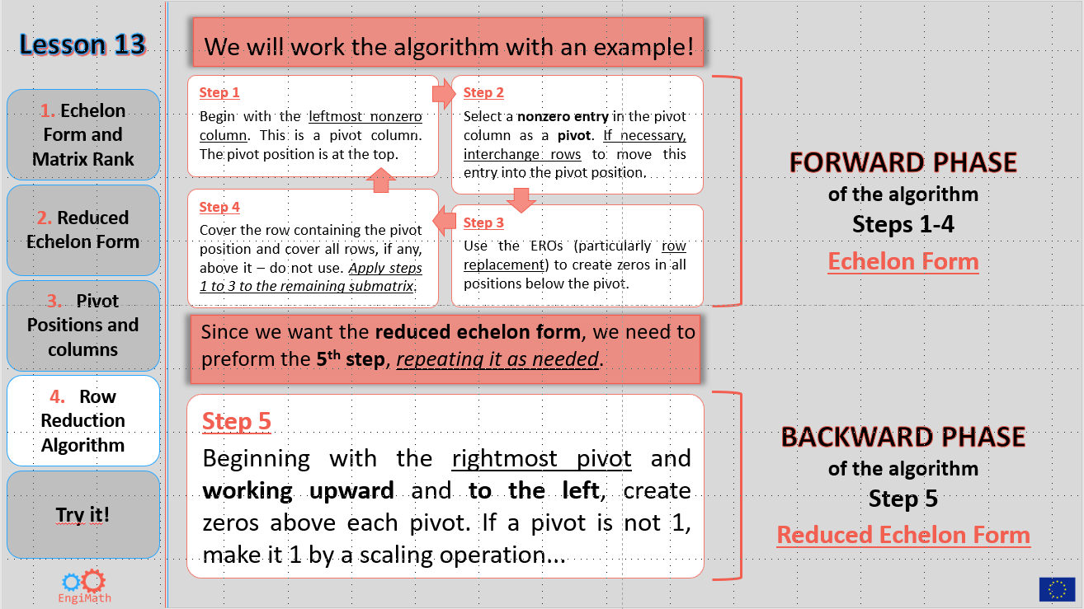
Lesson 26
1. Warm up!
Compute the
Reduced Row Echelon Form of the Augmented Matrix
Compute the
Row Echelon Form of the Augmented Matrix
2. Gauss Method
Do you
remember?…
Lesson 13
Check it out!…
3. Gauss-Jordan Method
4. Consistent Systems with Infinite Solutions
Section 4
Row Reduction Algorithm
Try it!

Slide 6
Lesson 26
GAUSS METHOD
Centred in 4 principal “steps”:
1. Warm up!
1. Write the Augmented Matrix of the System
2. Use elementary row operations to construct a row equivalent matrix in Row Echelon form
2. Gauss Method
3. Write the system of equations corresponding to the matrix in row echelon form
3. Gauss-Jordan Method
4. Use backward substitution to find the System Solution
Augmented matrix
Example 1.
4. Consistent Systems with Infinite Solutions
2.
1.
Try it!
3.
4.

Slide 7
Lesson 26
GAUSS METHOD
Centred in 4 principal “steps”:
1. Warm up!
1. Write the Augmented Matrix of the System
2. Use elementary row operations to construct a row equivalent matrix in Row Echelon form
2. Gauss Method
3. Write the system of equations corresponding to the matrix in row echelon form
3. Gauss-Jordan Method
4. Use backward substitution to find the System Solution
Augmented matrix
Example 1.
4. Consistent Systems with Infinite Solutions
2.
1.
Try it!
Notice that:
Right after step 2, the system consistency can and should be analised!
3.
4.
In this case, we have:
Rank (A) = 2
= Rank (A|B)
= Number of variables

Slide 8
Lesson 26
GAUSS METHOD
Centred in 4 principal “steps”:
1. Warm up!
1. Write the Augmented Matrix of the System
2. Use elementary row operations to construct a row equivalent matrix in Row Echelon form
2. Gauss Method
3. Write the system of equations corresponding to the matrix in row echelon form
3. Gauss-Jordan Method
4. Use backward substitution to find the System Solution
Augmented matrix
Example 1
4. Consistent Systems with Infinite Solutions
2.
1.
Try it!
Notice that:
Right after step 2, the system consistency can and should be analised!
3.
4.
In this case, we have:
Rank (A) = 2
= Rank (A|B)
= Number of variables
Then, follow to steps 3 and 4!...
Consistent System - Unique Solution

Slide 9




Lesson 26
Use Gauss elimination Method to solve the system:
Example 2.
1. Warm up!
$$\left\{\begin{matrix}x_{1}+10x_{3}=5 \\ {3x}_{1}+x_{2}−4x_{3}=−1 \\ {4x}_{1}+x_{2}+6x_{3}=1\end{matrix}\right.$$
2. Gauss Method
Please notice all the “background concepts” you need, to keep up with Gauss Method!...
3. Gauss-Jordan Method
Remember
EROs – Lesson 12
Row Echelon Forms – Lesson 13
System Consistency – Lesson 23
Augmented
Matrix
4. Consistent Systems with Infinite Solutions
Try it!
1. Augmented Matrix
2. Row Echelon
3. System $↺$
4. Backward
Gauss Method (4 steps)

Slide 10
Lesson 26
Use Gauss elimination Method to solve the system:
Example 2.
1. Warm up!
$$\left\{\begin{matrix}x_{1}+10x_{3}=5 \\ {3x}_{1}+x_{2}−4x_{3}=−1 \\ {4x}_{1}+x_{2}+6x_{3}=1\end{matrix}\right.$$
Here, we can analyse the system consistency and just follow to the next method steps if it is consistent!...
2. Gauss Method
3. Gauss-Jordan Method
Augmented
Matrix
Since: Rank(A) = 2 ≠ Rank(A│B) = 3
Row Echelon
form
4. Consistent Systems with Infinite Solutions
Inconsistent system: There is no solution
Let’s see!..
So, we have solved the given system without using further method steps!
Try it!
But… what happens if we proceed with the method steps without this analysis?...
1. Augmented Matrix
2. Row Echelon
3. System $↺$
4. Backward
Gauss Method (4 steps)

Slide 11

Lesson 26
Use Gauss elimination Method to solve the system:
Example 2.
1. Warm up!
$$\left\{\begin{matrix}x_{1}+10x_{3}=5 \\ {3x}_{1}+x_{2}−4x_{3}=−1 \\ {4x}_{1}+x_{2}+6x_{3}=1\end{matrix}\right.$$
2. Gauss Method
3. Gauss-Jordan Method
Augmented
Matrix
Row Echelon
form
4. Consistent Systems with Infinite Solutions
Equivalent system
$$\left\{\begin{matrix}x_{1}{+10x}_{3}=5 \\ x_{2}{−34x}_{3}=−16 \\ 0=−3\end{matrix}\right.$$
Let’s see!..
Try it!
But… what happens if we proceed with the method steps without this analysis?...
1. Augmented Matrix
2. Row Echelon
3. System $↺$
4. Backward
Gauss Method (4 steps)

Slide 12


Lesson 26
Use Gauss elimination Method to solve the system:
Example 2.
1. Warm up!
$$\left\{\begin{matrix}x_{1}+10x_{3}=5 \\ {3x}_{1}+x_{2}−4x_{3}=−1 \\ {4x}_{1}+x_{2}+6x_{3}=1\end{matrix}\right.$$
Just a curiosity
This system Graphic Solution
shows that there is not a point of intersection for the three planes!
No Solution
2. Gauss Method
3. Gauss-Jordan Method
Augmented
Matrix
Row Echelon
form
4. Consistent Systems with Infinite Solutions
Equivalent system
“IMPOSSIBLE”
Inconsistent system: There is no solution
$$\left\{\begin{matrix}x_{1}{+10x}_{3}=5 \\ x_{2}{−34x}_{3}=−16 \\ 0=−3\end{matrix}\right.$$
Try it!
We get the same result!... So…
$$0=−3$$
The “previous” rank analysis is “optional”!
1. Augmented Matrix
2. Row Echelon
3. System $↺$
4. Backward
Gauss Method (4 steps)

Slide 13
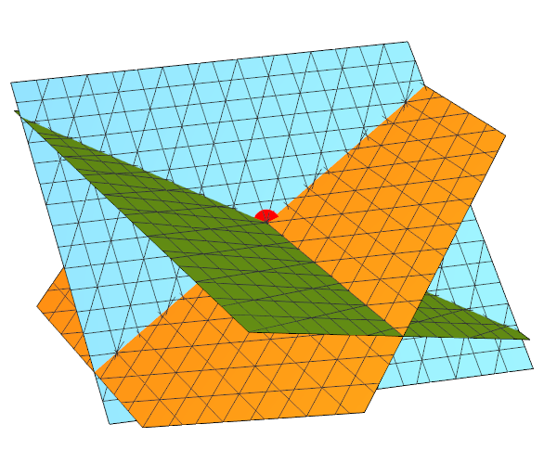







Lesson 26
Use Gauss elimination Method to solve the system:
Example 3.
1. Warm up!
$$\left\{\begin{matrix}x_{1}+2x_{2}+3x_{3}=14 \\ {2x}_{1}+3x_{2}+4x_{3}=20 \\ {3x}_{1}+4x_{2}+6x_{3}=29\end{matrix}\right.$$
Just a curiosity
System Graphic Solution
(x₁, x₂, x₃) = (1, 2, 3)
Intersection point of three planes
Rank(A) = Rank(A│B)
???...
= 3
2. Gauss Method
3. Gauss-Jordan Method
Augmented
Matrix
Row echelon form
4. Consistent Systems with Infinite Solutions
Equivalent system
$$\left\{\begin{matrix}x_{1}{+2x}_{2}{+3x}_{3}=14 \\ {−x}_{2}{−2x}_{3}=−8 \\ { x}_{3}=3\end{matrix}\right.$$
$$⇔\left\{\begin{matrix}x_{1}{+2x}_{2}{+3 x}_{3}=14 \\ {−x}_{2}{−2 x}_{3}=−8 \\ { x}_{3}=3\end{matrix}\right.$$
$$⇔\left\{\begin{matrix}x_{1}{+2 x}_{2}=5 \\ x_{2}=2 \\ x_{3}=3\end{matrix}\right.$$
$$⇔\left\{\begin{matrix}x_{1}=1 \\ x_{2}=2 \\ x_{3}=3\end{matrix}\right.$$
Try it!
1. Augmented Matrix
2. Row Echelon
3. System $↺$
4. Backward
Gauss Method (4 steps)

Slide 14


Lesson 26
Use Gauss elimination Method
to solve the system:
Example 4.
1. Warm up!
This one is for you !
$$\left\{\begin{matrix}x+z=2 \\ \begin{aligned}x−2y=0 \\ x−2y−z=1\end{aligned}\end{matrix}\right.$$
Please try it on your own…
2. Gauss Method
Click on me to see it,
step by step!
3. Gauss-Jordan Method
4. Consistent Systems with Infinite Solutions
Try it!
Solution:
To skip it, just press enter or next!

Slide 15
Lesson 26
Use Gauss elimination Method
to solve the system:
Example 4.
1. Warm up!
$$\left\{\begin{matrix}x+z=2 \\ \begin{aligned}x−2y=0 \\ x−2y−z=1\end{aligned}\end{matrix}\right.$$
Step 1.
Write the
augmented matrix
2. Gauss Method
3. Gauss-Jordan Method
4. Consistent Systems with Infinite Solutions
Try it!
Solution:
Skip it!

Slide 16
Lesson 26
Use Gauss elimination Method
to solve the system:
Example 4.
1. Warm up!
Step 2.
Compute the row
echelon form of the
augmented matrix
$$\left\{\begin{matrix}x+z=2 \\ \begin{aligned}x−2y=0 \\ x−2y−z=1\end{aligned}\end{matrix}\right.$$
2. Gauss Method
3. Gauss-Jordan Method
4. Consistent Systems with Infinite Solutions
Rank(A) = Rank(A│B)
Try it!
Solution:
Skip it!

Slide 17
Lesson 26
Use Gauss elimination Method
to solve the system:
Example 4.
1. Warm up!
Step 3.
Write the
Equivalent System
$$\left\{\begin{matrix}x+z=2 \\ \begin{aligned}x−2y=0 \\ x−2y−z=1\end{aligned}\end{matrix}\right.$$
2. Gauss Method
3. Gauss-Jordan Method
4. Consistent Systems with Infinite Solutions
Try it!
Solution:
Skip it!

Slide 18
Lesson 26
Use Gauss elimination Method
to solve the system:
Example 4.
1. Warm up!
Step 4.
Get the system
solution trough
backward
substitution!
$$\left\{\begin{matrix}x+z=2 \\ \begin{aligned}x−2y=0 \\ x−2y−z=1\end{aligned}\end{matrix}\right.$$
2. Gauss Method
3. Gauss-Jordan Method
4. Consistent Systems with Infinite Solutions
Try it!
Solution:
Skip it!

Slide 19
Lesson 26
GAUSS-JORDAN METHOD
Centred in 3 principal “steps”:
1. Warm up!
1. Write the Augmented Matrix of the System
2. Use elementary row operations to construct a row equivalent matrix in Reduced Row Echelon form
2. Gauss Method
3. Write the system of equations corresponding to the matrix in reduced row echelon form and see the system solution!
3. Gauss-Jordan Method
Example 1.
Augmented matrix
2.
4. Consistent Systems with Infinite Solutions
1.
Try it!
3.

Slide 20
Lesson 26
GAUSS-JORDAN METHOD
Centred in 3 principal “steps”:
1. Warm up!
1. Write the Augmented Matrix of the System
2. Use elementary row operations to construct a row equivalent matrix in Reduced Row Echelon form
2. Gauss Method
3. Write the system of equations corresponding to the matrix in reduced row echelon form and see the system solution!
3. Gauss-Jordan Method
Notice that:
Step 2 in Gauss-Jordan Method can be “divided” in two distinct sub steps:
4. Consistent Systems with Infinite Solutions
2.1 Forward Phase of the algorithm (Lesson 13) to get the row echelon form (Step 2 in Gauss Method)
2.2 Backward Phase of the same algorithm (using EROs over the row echelon form) to get the reduced row echelon form
Try it!
The system consistency can also be analysed right after 2.1 (row echelon form), as in Gauss Method (see next example). If inconsistent the process ends with no solution!

Slide 21

Lesson 26
GAUSS-JORDAN METHOD
Centred in 3 principal “steps”:
1. Warm up!
1. Write the Augmented Matrix of the System
2. Use elementary row operations to construct a row equivalent matrix in Reduced Row Echelon form
2. Gauss Method
3. Write the system of equations corresponding to the matrix in reduced row echelon form and see the system solution!
3. Gauss-Jordan Method
Example 2.
Use Gauss-Jordan elimination Method to solve the system:
Augmented Matrix
4. Consistent Systems with Infinite Solutions
$$\left\{\begin{matrix}x_{1}−x_{2}+3x_{3}=2 \\ {2x}_{1}+x_{2}−x_{3}=0 \\ x_{1}+2x_{2}−4x_{3}=1\end{matrix}\right.$$
Try it!
Since: Rank(A) = 2 ≠ Rank(A│B) = 3
Inconsistent system: There is no solution
The system consistency can also be analysed right after 2.1 (row echelon form), as in Gauss Method (see next example). If inconsistent the process ends with no solution!

Slide 22



Lesson 26
Use Gauss-Jordan elimination Method to solve the system:
Example 3.
1. Warm up!
$$\left\{\begin{matrix}2y+z=4 \\ x−2y−3z=1 \\ −x+y+2z=−3\end{matrix}\right.$$
Before writing the augmented matrix, we can rewrite the system (even just “mentally”), interchanging some equations, in order to get a non null first pivot element in the matrix.
$$\left\{\begin{matrix}x−2y−3z=1 \\ −x+y+2z=−3 \\ 2y+z=4\end{matrix}\right.$$
2. Gauss Method
This can also be done by interchanging rows in the matrix or directly when writing the augmented matrix to avoid more EROs!...
3. Gauss-Jordan Method
Augmented
Matrix
4. Consistent Systems with Infinite Solutions
Try it!
3. System $↺$Solution
Gauss-Jordan Method (3 steps)
1. Augmented Matrix
2. Reduced Row Echelon

Slide 23

Lesson 26
Use Gauss-Jordan elimination Method to solve the system:
Example 3.
1. Warm up!
$$\left\{\begin{matrix}2y+z=4 \\ x−2y−3z=1 \\ −x+y+2z=−3\end{matrix}\right.$$
2. Gauss Method
3. Gauss-Jordan Method
Augmented
Matrix
4. Consistent Systems with Infinite Solutions
$$⟶ \left\{\begin{matrix}x=5 \\ y=2 \\ z=0\end{matrix}\right.$$
Try it!
3. System $↺$Solution
Gauss-Jordan Method (3 steps)
1. Augmented Matrix
2. Reduced Row Echelon

Slide 24
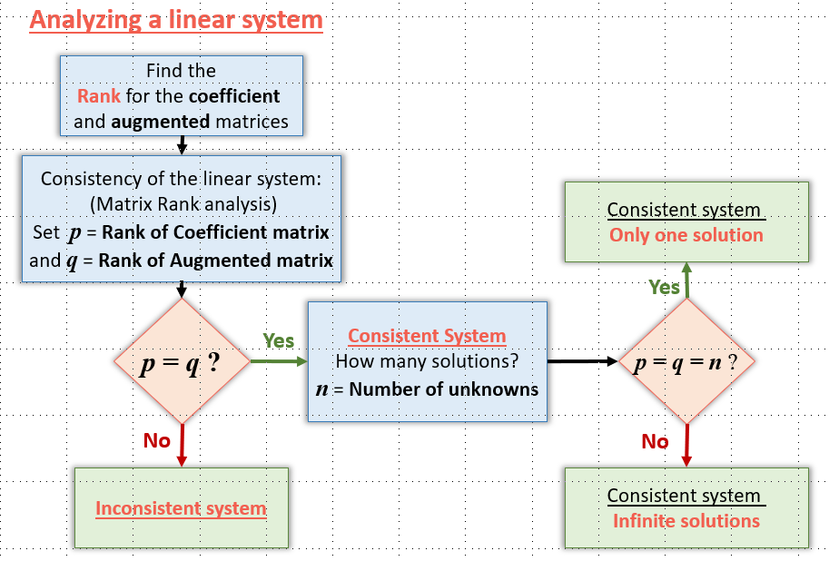



Lesson 26
Solving Consistent Systems with Infinite Solutions
through Gauss and Gauss-Jordan Methods
1. Warm up!
So far we just have seen how to solve, through Gauss and Gauss-Jordan Methods, two of the three “types” of linear equations’ systems.
2. Gauss Method
Recall section 4 in
Lesson 23?...
3. Gauss-Jordan Method
Rank(A) = Rank(A│B) = Number of variables
4. Consistent Systems with Infinite Solutions
Try it!
Rank(A) ≠ Rank(A│B)
???

Slide 25



Lesson 26
Solving Consistent Systems with Infinite Solutions
through Gauss and Gauss-Jordan Methods
1. Warm up!
Here is the case where, at Step 2 in both Gauss Methods, we see that:
2. Gauss Method
Rank(A) = Rank(A│B) < Number of variables
so, the system is:
Please see the following general procedure!...
3. Gauss-Jordan Method
Consistent with Infinitely many solutions
4. Consistent Systems with Infinite Solutions
Now, the question is:
How do we get/write/represent the set of all the “infinitely many” solutions?...
Try it!

Slide 26
Lesson 26
Solving Consistent Systems with Infinite Solutions
through Gauss and Gauss-Jordan Methods
1. Warm up!
For Gauss and Gauss-Jordan Methods – after Step 2:
1. Establish as principal variables the variables whose coefficients are the successive pivots on the "diagonal" of the row echelon form or the reduced row echelon form, respectively;
2. Gauss Method
2. Establish as non principal variables (free), the remaining ones.
When returning to the equations’ system (step 3), place, on the second hand of each equation, all the non principal variable terms (do not forget to change the respective signs) and define one equation line for each one of these free variables, setting their domain.
Please see the following general procedure!...
3. Gauss-Jordan Method
Remember, we only get specific solutions for the principal variables, the others are free!...
4. Consistent Systems with Infinite Solutions
Try it!

Slide 27
Lesson 26
Solving Consistent Systems with Infinite Solutions:
through Gauss and Gauss-Jordan Methods
1. Warm up!
For Gauss and Gauss-Jordan Methods – after Step 2:
1. Establish as principal variables the variables whose coefficients are the successive pivots on the "diagonal" of the row echelon form or the reduced row echelon form, respectively;
2. Gauss Method
2. Establish as non principal variables (free), the remaining ones.
When returning to the equations’ system (step 3), place, on the second hand of each equation, all the non principal variable terms (do not forget to change the respective signs) and define one equation line for each one of these free variables, setting their domain.
3. Gauss-Jordan Method
Remember, we only get specific solutions for the principal variables, the others are free!...
4. Consistent Systems with Infinite Solutions
Example 1.
Try it!
2.
1.
Row echelon and
Reduced row echelon
Gauss and
Gauss-Jordan Methods
Rank(A) = Rank(A│B) = 1
< Number of variables = 2

Slide 28
Lesson 26
Solving Consistent Systems with Infinite Solutions:
through Gauss and Gauss-Jordan Methods
1. Warm up!
For Gauss and Gauss-Jordan Methods – after Step 2:
1. Establish as principal variables the variables whose coefficients are the successive pivots on the "diagonal" of the row echelon form or the reduced row echelon form, respectively;
2. Gauss Method
2. Establish as non principal variables (free), the remaining ones.
When returning to the equations’ system (step 3), place, on the second hand of each equation, all the non principal variable terms (do not forget to change the respective signs) and define one equation line for each one of these free variables, setting their domain.
3. Gauss-Jordan Method
Remember, we only get specific solutions for the principal variables, the others are free!...
4. Consistent Systems with Infinite Solutions
x
Principal Variable
Example 1.
y
Free Variable
Try it!
2.
1.
3.
Gauss and
Gauss-Jordan Methods
As seen is Lesson 23, solution set may be written using a parameter.
Solution:

Slide 29

Lesson 26
Use Gauss elimination Method to solve the system:
Example 2.
1. Warm up!
$$\left\{\begin{matrix}x−y+2z−3t+2w=0 \\ y−z−w=0 \\ \begin{aligned}x+z−2t+w=0 \\ 2x−y+3z−5t+3w=0\end{aligned}\end{matrix}\right.$$
Homogeneous system (null constant terms) $→$ consistent!
Notice that since the number of equations (4) is less than the number of variables (5) it will have infinite solutions!
2. Gauss Method
Rank(A) = Rank(A│B) < Number of variables
3. Gauss-Jordan Method
Principal
Variables
Free
Variables
4. Consistent Systems with Infinite Solutions
x
z
y
w
t
Try it!
Rank(A) = Rank(A│B) = 3
1. Augmented Matrix
2. Row Echelon
3. System $↺$
4. Backward
Gauss Method (4 steps)

Slide 30






Lesson 26
Use Gauss elimination Method to solve the system:
Example 2.
1. Warm up!
$$\left\{\begin{matrix}x−y+2z−3t+2w=0 \\ y−z−w=0 \\ \begin{aligned}x+z−2t+w=0 \\ 2x−y+3z−5t+3w=0\end{aligned}\end{matrix}\right.$$
Homogeneous system (null constant terms) $→$ consistent!
Notice that since the number of equations (4) is less than the number of variables (5) it will have infinite solutions!
2. Gauss Method
Rank(A) = Rank(A│B) < Number of variables
3. Gauss-Jordan Method
Principal
Variables
Free
Variables
$$x−y−3t=−2z−2w$$
4. Consistent Systems with Infinite Solutions
$$\left\{\begin{matrix}\begin{matrix}0… \\ 0…\end{matrix} \\ 0… \\ \begin{matrix}0… \\ 0…\end{matrix}\end{matrix}\right.$$
x
z
$$y=z+w$$
y
w
$$t=0$$
t
$$z∈ℝ$$
Try it!
$$w∈ℝ$$
Rank(A) = Rank(A│B) = 3
1. Augmented Matrix
2. Row Echelon
3. System $↺$
4. Backward
Gauss Method (4 steps)

Slide 31












Lesson 26
Use Gauss elimination Method to solve the system:
Example 2.
1. Warm up!
$$\left\{\begin{matrix}x−y+2z−3t+2w=0 \\ y−z−w=0 \\ \begin{aligned}x+z−2t+w=0 \\ 2x−y+3z−5t+3w=0\end{aligned}\end{matrix}\right.$$
Homogeneous system (null constant terms) $→$ consistent!
Notice that since the number of equations (4) is less than the number of variables (5) it will have infinite solutions!
2. Gauss Method
Rank(A) = Rank(A│B) < Number of variables
3. Gauss-Jordan Method
Principal
Variables
Free
Variables
$$x−y−3t=−2z−2w$$
$$x=−z−w$$
$$x−\left(z+w\right)−3×0=−2z−2w$$
4. Consistent Systems with Infinite Solutions
$$\left\{\begin{matrix}\begin{matrix}0… \\ 0…\end{matrix} \\ 0… \\ \begin{matrix}0… \\ 0…\end{matrix}\end{matrix}\right.$$
$$\left\{\begin{matrix}\begin{matrix}0… \\ 0…\end{matrix} \\ 0… \\ \begin{matrix}0… \\ 0…\end{matrix}\end{matrix}\right.$$
$$⇔\left\{\begin{matrix}\begin{matrix}0… \\ 0…\end{matrix} \\ 0… \\ \begin{matrix}0… \\ 0…\end{matrix}\end{matrix}\right.$$
x
z
$$y=z+w$$
$$y=z+w$$
$$y=z+w$$
y
$$t=0$$
$$t=0$$
$$t=0$$
w
t
$$z∈ℝ$$
$$z∈ℝ$$
$$z∈ℝ$$
Try it!
$$w∈ℝ$$
$$w∈ℝ$$
$$w∈ℝ$$
Rank(A) = Rank(A│B) = 3
1. Augmented Matrix
2. Row Echelon
3. System $↺$
4. Backward
Gauss Method (4 steps)

Slide 32
Lesson 26
Use Gauss elimination Method to solve the system:
Example 2.
1. Warm up!
$$\left\{\begin{matrix}x−y+2z−3t+2w=0 \\ y−z−w=0 \\ \begin{aligned}x+z−2t+w=0 \\ 2x−y+3z−5t+3w=0\end{aligned}\end{matrix}\right.$$
Homogeneous system (null constant terms) $→$ consistent!
Notice that since the number of equations (4) is less than the number of variables (5) it will have infinite solutions!
2. Gauss Method
Rank(A) = Rank(A│B) < Number of variables
3. Gauss-Jordan Method
$$x=−z−w$$
$$⇔\left\{\begin{matrix}\begin{matrix}0… \\ 0…\end{matrix} \\ 0… \\ \begin{matrix}0… \\ 0…\end{matrix}\end{matrix}\right.$$
$$x−\left(z+w\right)−3×0=−2z−2w$$
4. Consistent Systems with Infinite Solutions
$$\left\{\begin{matrix}\begin{matrix}0… \\ 0…\end{matrix} \\ 0… \\ \begin{matrix}0… \\ 0…\end{matrix}\end{matrix}\right.$$
$$y=z+w$$
$$y=z+w$$
$$t=0$$
$$t=0$$
$$z∈ℝ$$
$$z∈ℝ$$
Try it!
$$w∈ℝ$$
$$w∈ℝ$$
Rank(A) = Rank(A│B) = 3
Solution:
1. Augmented Matrix
2. Row Echelon
3. System $↺$
4. Backward
Gauss Method (4 steps)

Slide 33



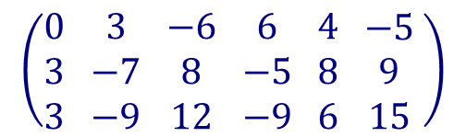
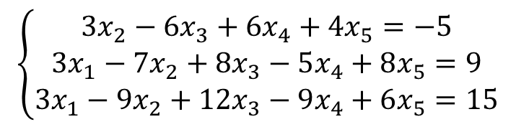

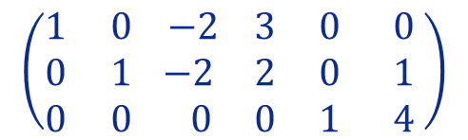
Lesson 26
Use Gauss-Jordan elimination Method to solve the system:
Example 3.
1. Warm up!
$$\left\{\begin{matrix}{3x}_{2}−6x_{3}+6x_{4}+4x_{5}=−5 \\ {3x}_{1}−7x_{2}+8x_{3}−5x_{4}+8x_{5}=9 \\ {3x}_{1}−9x_{2}+12x_{3}−9x_{4}+6x_{5}=15\end{matrix}\right.$$
$$\left({\begin{aligned}0 \\ 3 \\ 3\end{aligned} \begin{aligned}3 \\ −7 \\ −9\end{aligned} \begin{aligned}−6 \\ 8 \\ 12\end{aligned} \begin{aligned}6 \\ −5 \\ −9\end{aligned} \begin{aligned}4 \\ 8 \\ 6\end{aligned} \begin{aligned}−5 \\ 9 \\ 15\end{aligned}}^{ }\right)$$
2. Gauss Method
$$\left({\begin{aligned}1 \\ 0 \\ 0\end{aligned} \begin{aligned}0 \\ 1 \\ 0\end{aligned} \begin{aligned} −2 \\ −2 \\ 0\end{aligned} \begin{aligned}3 \\ 2 \\ 0\end{aligned} \begin{aligned}0 \\ 0 \\ 1\end{aligned} \begin{aligned} 0 \\ 1 \\ 4\end{aligned}}^{ }\right)$$
$R_{1}↔R_{3}$
$R_{2}←R_{2}−$ $R_{1}$
$R_{3}←R_{3}−\frac{3}{2}R_{2}$
$R_{2}←R_{2}−2R_{3}$
$R_{1}←R_{1}−6R_{3}$
$R_{1}←{\frac{1}{3}R}_{1}$
$R_{2}←\frac{1}{2}R_{2}$
$R_{1}←R_{1}+3R_{2}$
If you sequentially apply this “list” of EROs to the given augmented system matrix…
3. Gauss-Jordan Method
… you will get its Reduced Row Echelon form! Try it!...
4. Consistent Systems with Infinite Solutions
Try it!
3. System $↺$Solution
Gauss-Jordan Method (3 steps)
1. Augmented Matrix
2. Reduced Row Echelon

Slide 34



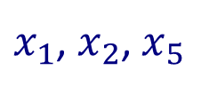






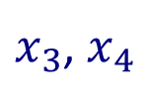






Lesson 26
Use Gauss-Jordan elimination Method to solve the system:
Example 3.
1. Warm up!
$$\left\{\begin{matrix}{3x}_{2}−6x_{3}+6x_{4}+4x_{5}=−5 \\ {3x}_{1}−7x_{2}+8x_{3}−5x_{4}+8x_{5}=9 \\ {3x}_{1}−9x_{2}+12x_{3}−9x_{4}+6x_{5}=15\end{matrix}\right.$$
$$\left({\begin{aligned}0 \\ 3 \\ 3\end{aligned} \begin{aligned}3 \\ −7 \\ −9\end{aligned} \begin{aligned}−6 \\ 8 \\ 12\end{aligned} \begin{aligned}6 \\ −5 \\ −9\end{aligned} \begin{aligned}4 \\ 8 \\ 6\end{aligned} \begin{aligned}−5 \\ 9 \\ 15\end{aligned}}^{ }\right)$$
2. Gauss Method
$x_{1}$, $x_{2}$, $x_{5}$
$$\left({\begin{aligned}1 \\ 0 \\ 0\end{aligned} \begin{aligned}0 \\ 1 \\ 0\end{aligned} \begin{aligned} −2 \\ −2 \\ 0\end{aligned} \begin{aligned}3 \\ 2 \\ 0\end{aligned} \begin{aligned}0 \\ 0 \\ 1\end{aligned} \begin{aligned} 0 \\ 1 \\ 4\end{aligned}}^{ }\right)$$
Principal Variables:
$x_{3}$, $x_{4}$
Free Variables:
$$x_{1}$$
$$x_{2}$$
$$x_{3}$$
$$x_{4}$$
$$x_{5}$$
3. Gauss-Jordan Method
$$\left\{\begin{matrix}\begin{matrix}0… \\ 0…\end{matrix} \\ 0… \\ \begin{matrix}0… \\ 0…\end{matrix}\end{matrix}\right.$$
$$\left\{\begin{matrix}\begin{matrix}0… \\ 0…\end{matrix} \\ 0… \\ \begin{matrix}0… \\ 0…\end{matrix}\end{matrix}\right.$$
$$x_{1}=$$
$${2x}_{3}−{3x}_{4}$$
3 Principal
$$x_{2}=$$
$${1+2x}_{3}−{2x}_{4}$$
4. Consistent Systems with Infinite Solutions
Rewriting the system equations:
$$x_{5}=$$
$$4$$
5 variables – 5 “lines”
2 Free
$$x_{3}∈ℝ$$
Try it!
$$x_{4}∈ℝ$$
Solution:
$${\left(x_{1},x_{2},x_{3},x_{4},x_{5}\right)=\left(2k−3p,1+2k−2p,k,p,4\right),k,p∈ℝ}_{}$$
3. System $↺$Solution
Gauss-Jordan Method (3 steps)
1. Augmented Matrix
2. Reduced Row Echelon

Slide 35



Lesson 26
Let’s try it!
1. Warm up!
2. Gauss Method
3. Gauss-Jordan Method
4. Consistent Systems with Infinite Solutions
Try it!

Slide 36

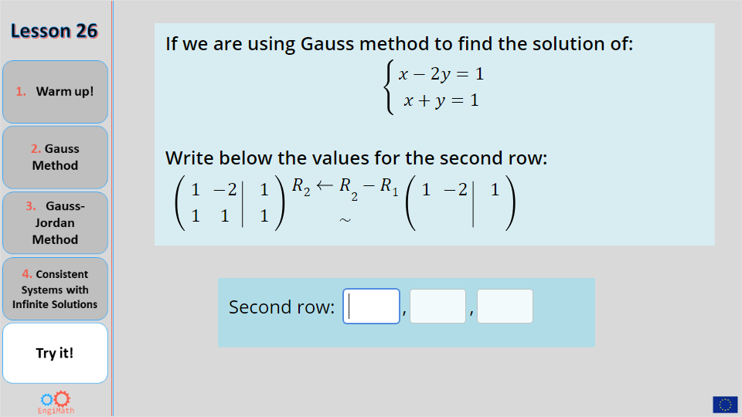
Lesson 26
Quiz
1. Warm up!
Click the Quiz button to edit this object
2. Gauss Method
3. Gauss-Jordan Method
4. Consistent Systems with Infinite Solutions
Try it!

Slide 37



Lesson 26
Hope you enjoyed it!
1. Warm up!
2. Gauss Method
3. Gauss-Jordan Method
4. Consistent Systems with Infinite Solutions
Try it!
By EngiMath TEAM

