Slide 1

  Exponential Function
  Introduction

Slide 2

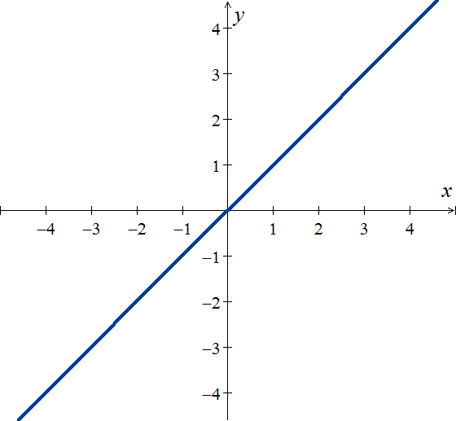
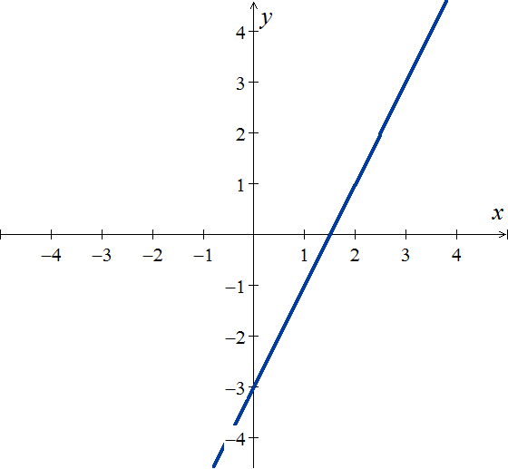
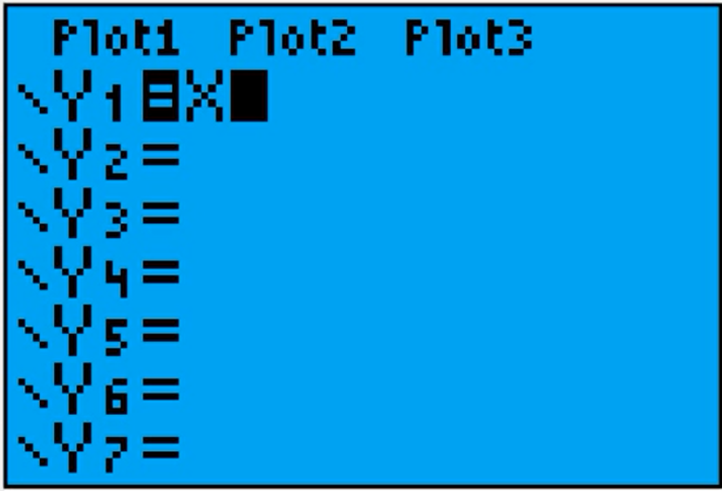
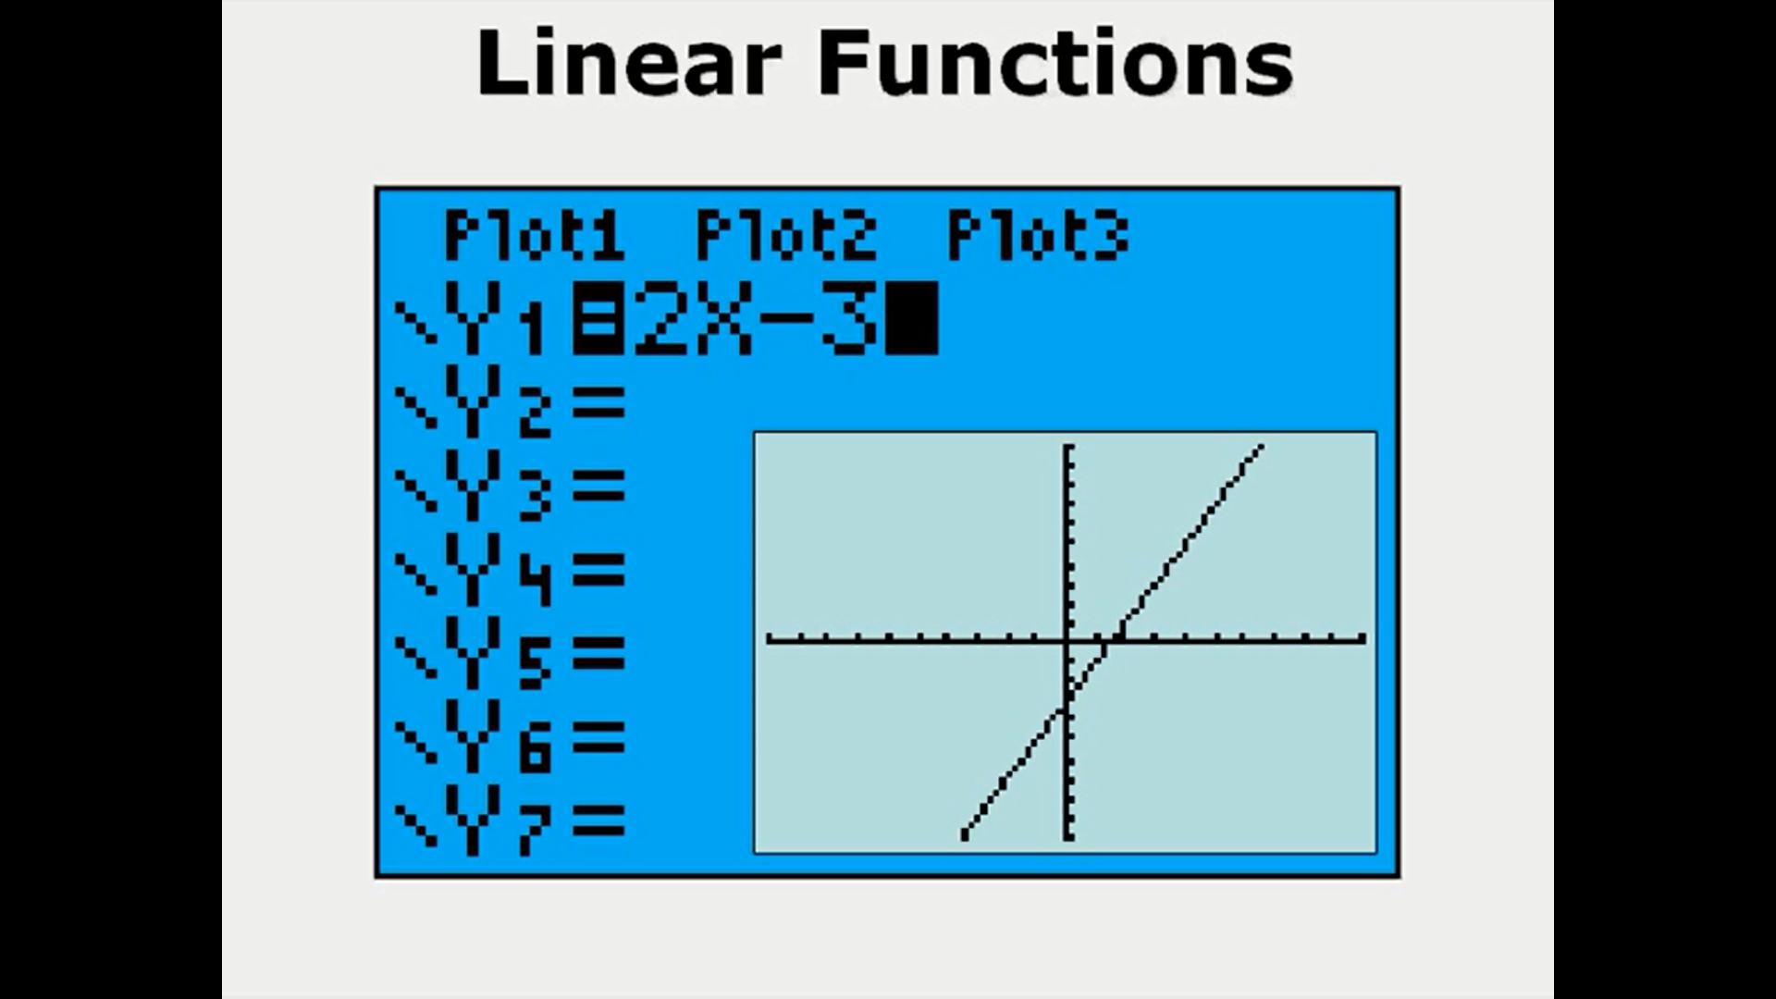
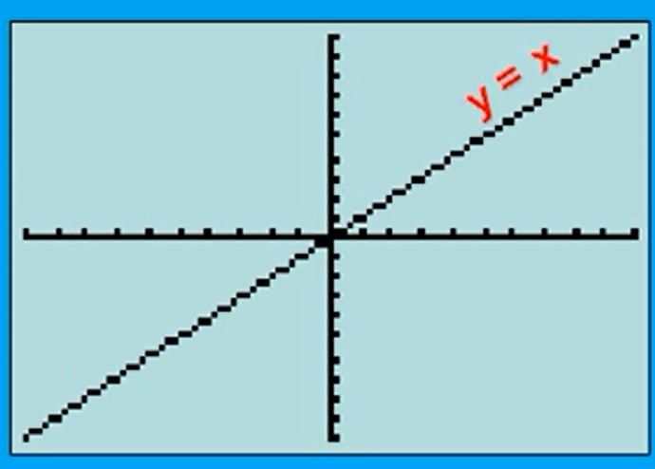
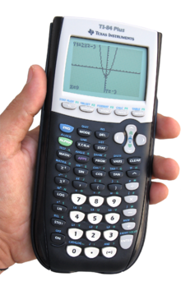
Definition – part 1
Comparing some functions
Linear/Affine
Quadratic
Exponential

Slide 3
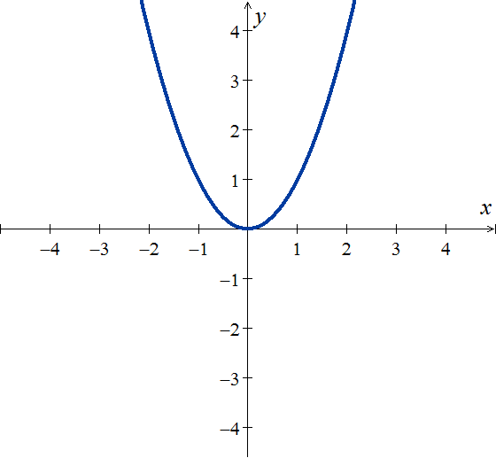
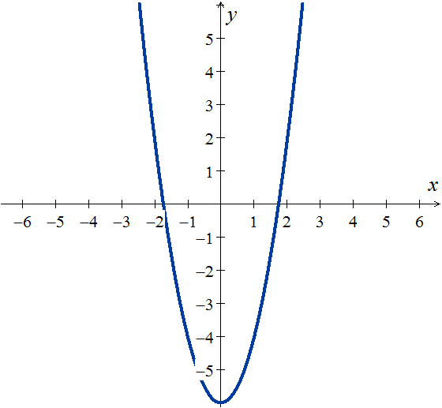
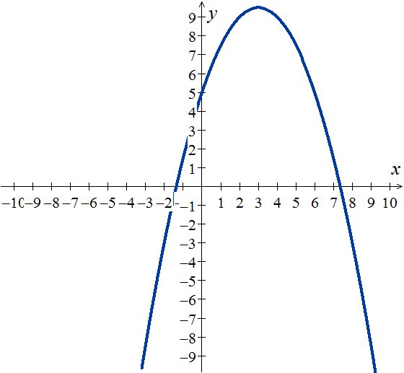
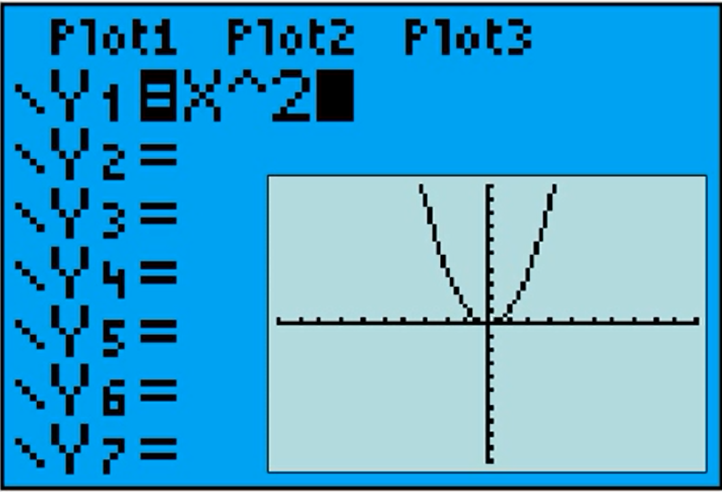
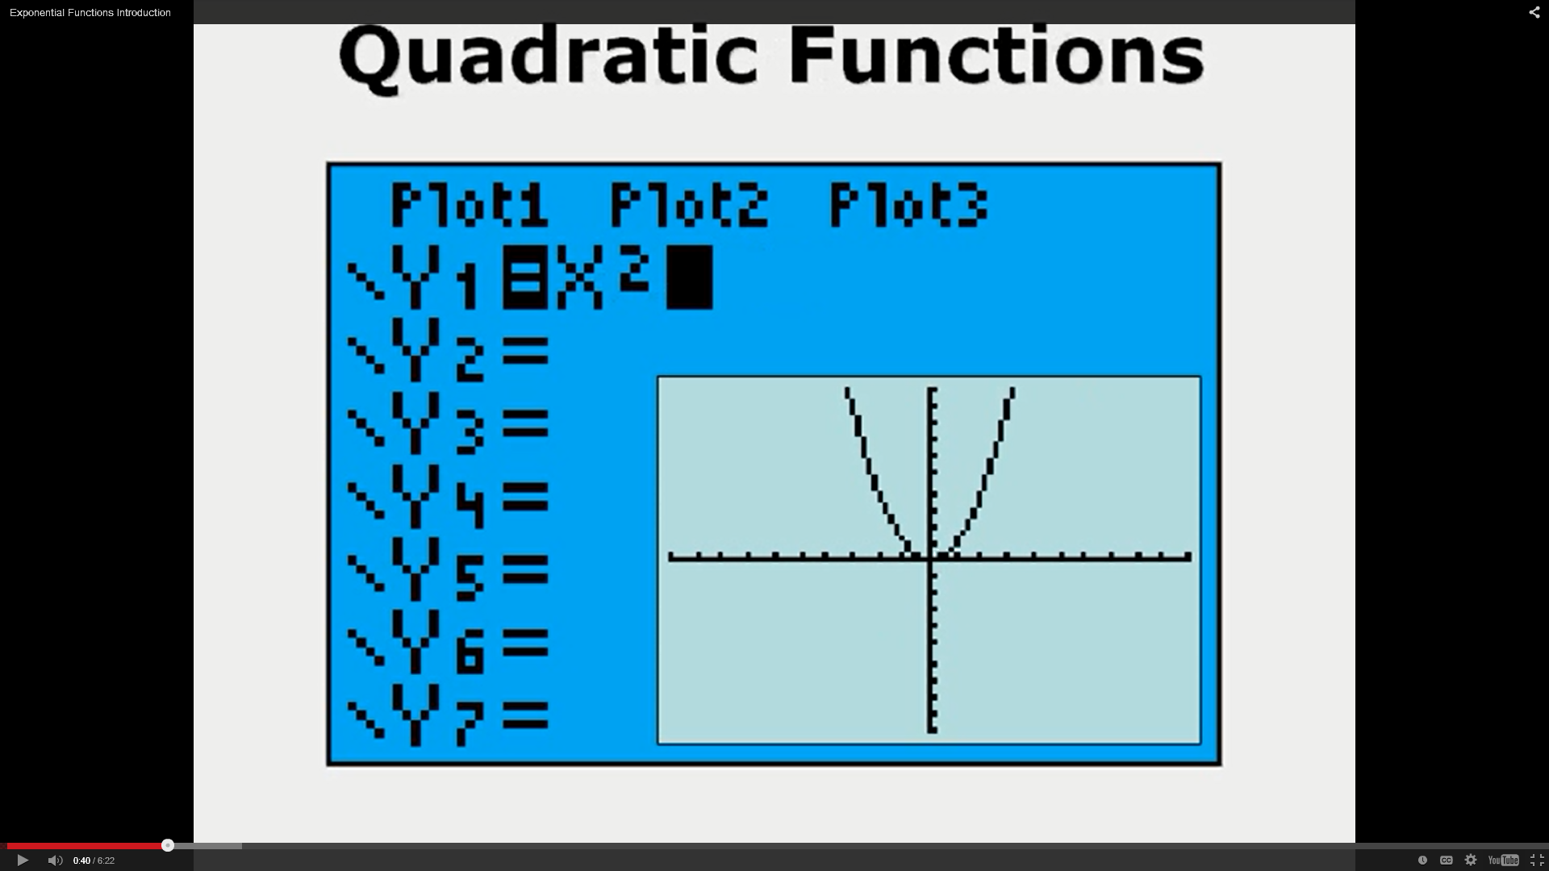
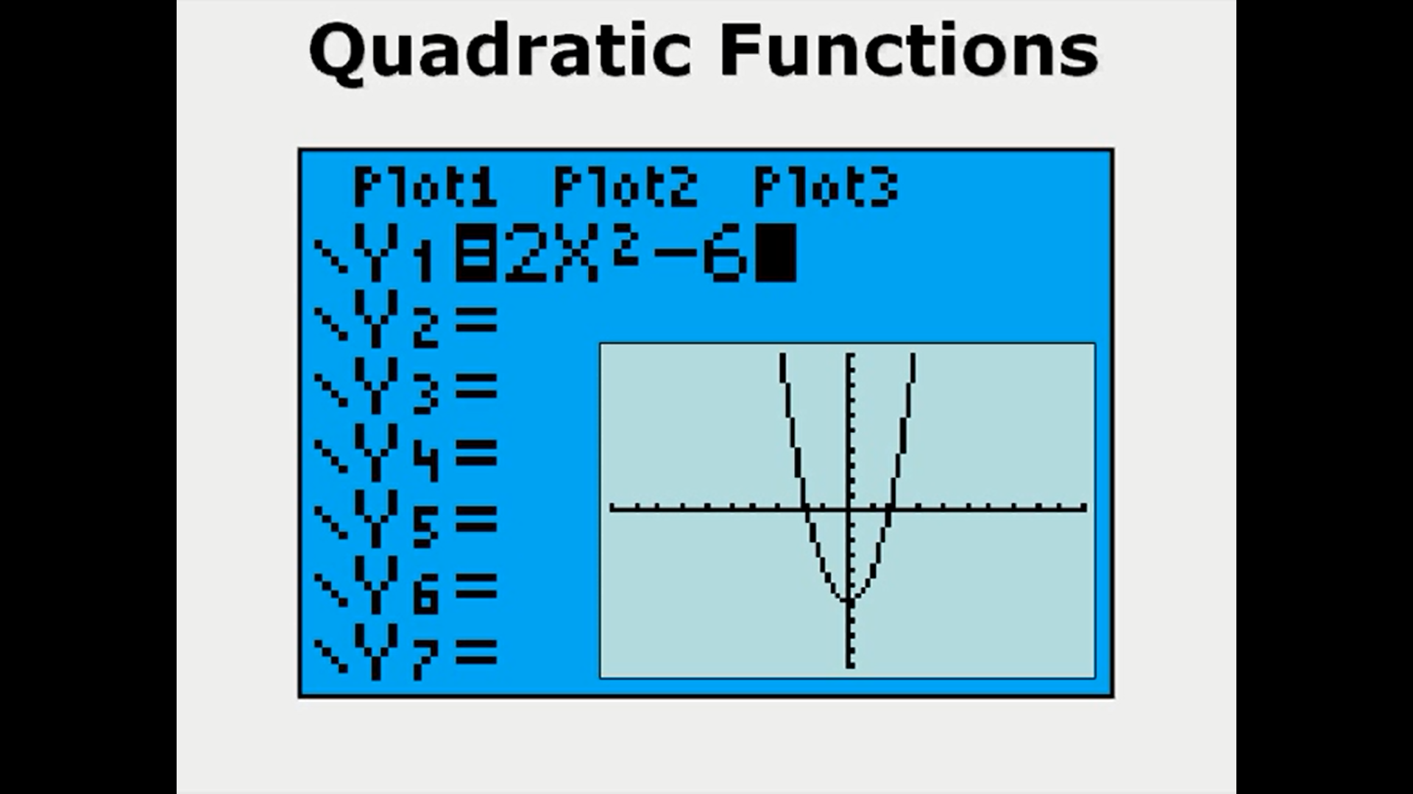
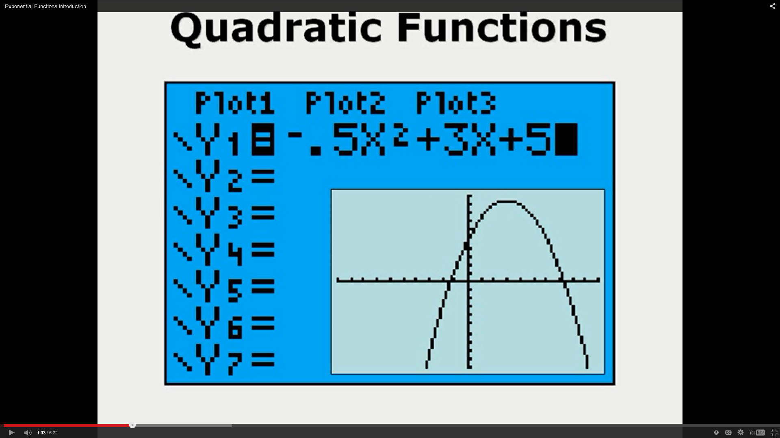
Definition – part 1
Comparing some functions
Linear/Affine
Quadratic
Exponential

Slide 4
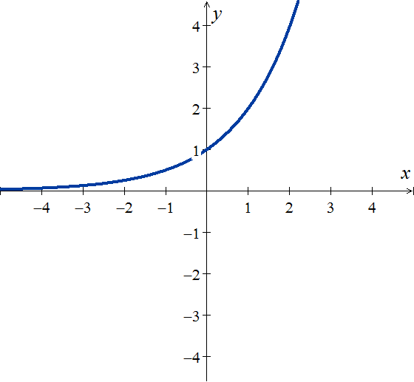
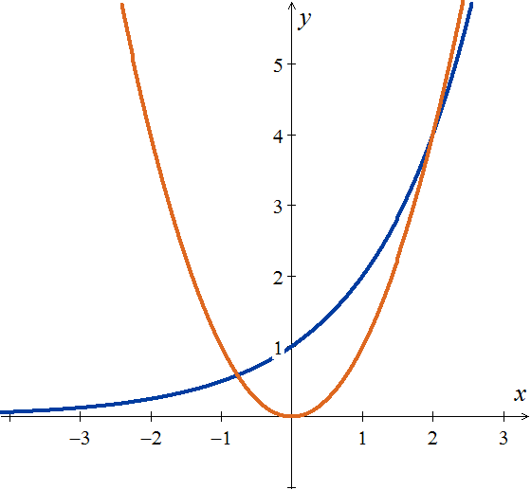
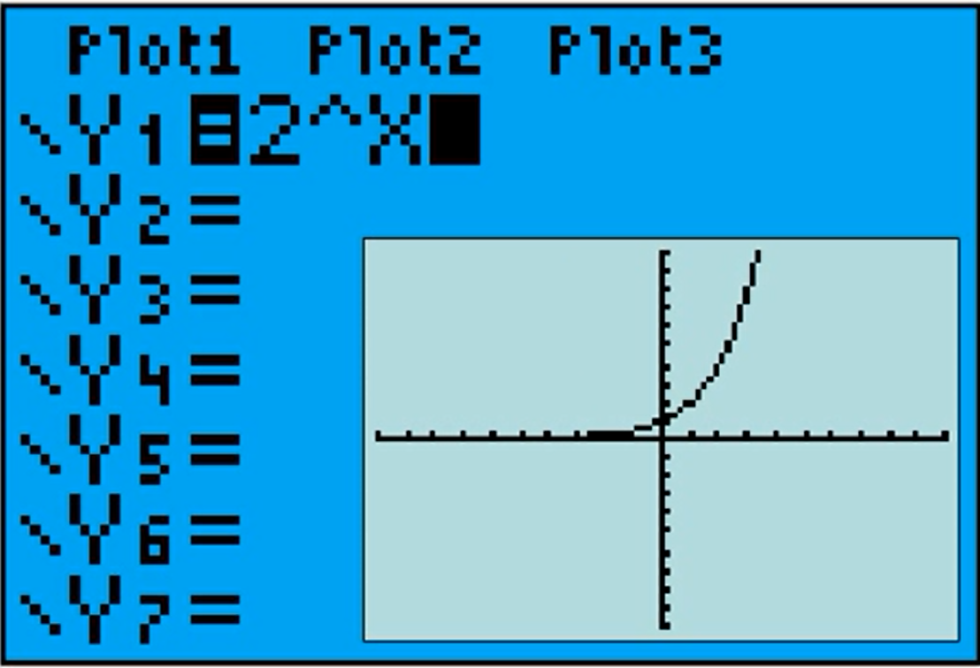
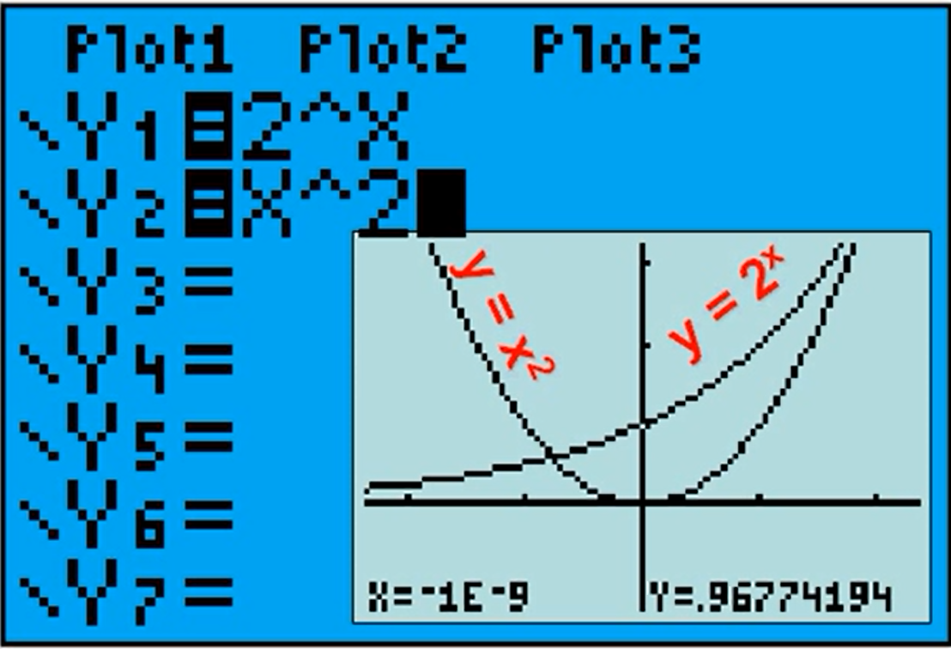
Definition – part 1
Comparing some functions
Linear/Affine
Quadratic
Exponential

Slide 5
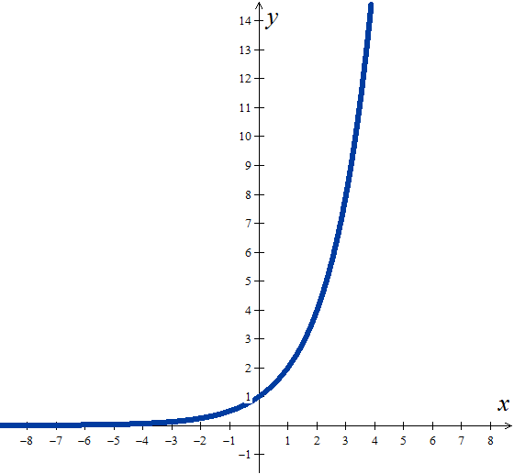
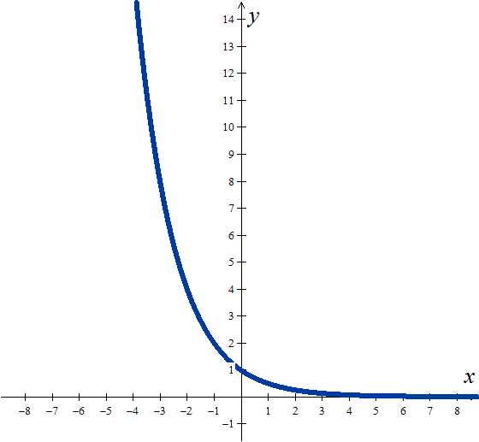

Definition – part 2
Types of Exponential Functions
Exponential Growth
Exponential Decay/Decline
Reflected images

Slide 6

General Examples
Comparing "Types of Growth"
1st degree functions
A function of the 1st degree (linear or affine) has the same rate of change over its entire domain.
2nd degree functions
EXAMPLE
x | y
- 1 | -1
0 | 1
1 | 3
2 | 5
3 | 7
1
2
1
2
Constant
Change rate
1
2
1
2

Slide 7
More General Examples
Comparing "Types of Growth"
1st degree functions
Quadratic functions have a rate of change that steadily grows (or decreases).
2nd degree functions
EXAMPLE
x | y
0 | 1
1 | 2
2 | 5
3 | 10
4 | 17
1
1
Change rate changes (grows or decreases) constantly
2
1
3
2nd
differences
2
1
5
2
1
7

Slide 8
Mathematics examples
Comparing "Types of Growth"
An exponential function has a rate of change that grows (or decreases) by the same multiple or percentage of each unit of variation of the object ( independente variable).
1st degree functions
2nd degree functions
Exponential Functions
EXAMPLE
x | y
-1 | 0,5
0 | 1
1 | 2
2 | 4
3 | 8
Rate of change increases by a factor of 2 for each unit of the independent v.
1
.5
x 2
1
1
x 2
1
2
x 2
1
4

Slide 9
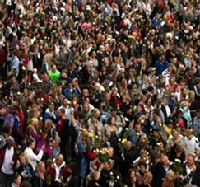
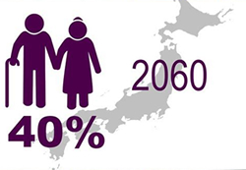
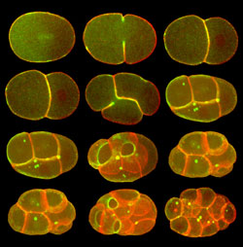
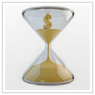

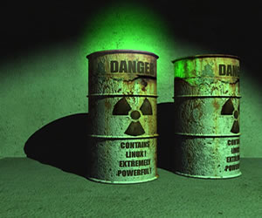
Mathematics examples
Applications and Examples
Increasing Exponential
Decreasing Exponential
Population Growth
Cell division/growth
Capitalization Systems
…
Population Decline
Depreciation of Assets
Radioactive Decrease
…

Slide 10
Mathematics examples
Applications and Examples
Increasing Exponential
Decreasing Exponential
Population Growth
Cell division/growth
Capitalization Systems
…
Population Decline
Depreciation of Assets
Radioactive Decrease
…
In 2010 the population of "HAPPY" city was estimated at 38,000 people, with an annual growth rate of about 2.1%.

Slide 11
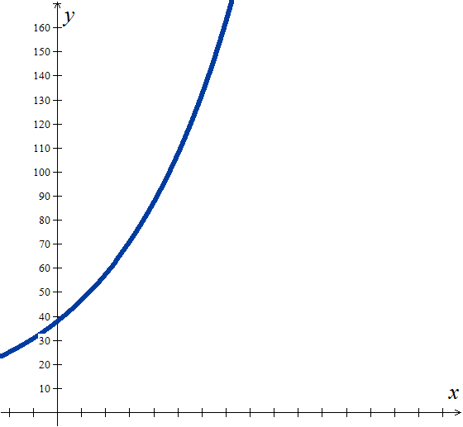
Mathematics examples
Applications and Examples
Increasing Exponential
Decreasing Exponential
Population Growth
Cell division/growth
Capitalization Systems
…
Population Decline
Depreciation of Assets
Radioactive Decrease
…
In 2010 the population of "HAPPY" city was estimated at 38,000 people, with an annual growth rate of about 2.1%.
GROWTH FACTOR
2011
2010

Slide 12
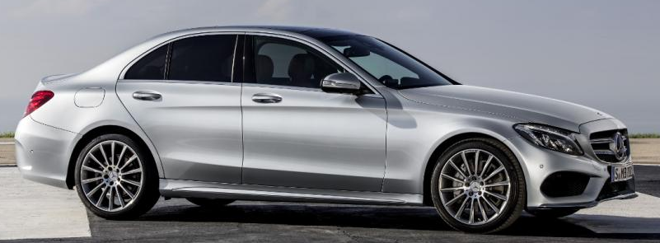
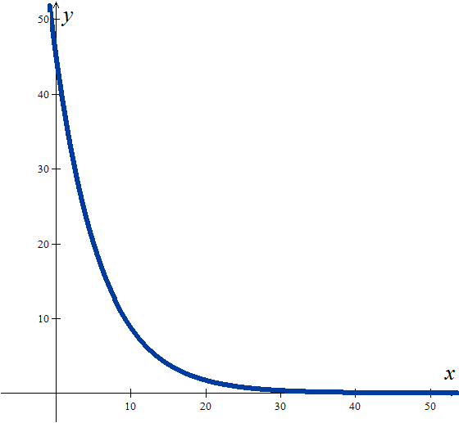
Mathematics examples
Applications and Examples
Decreasing Exponential
Population Decline
Depreciation of Assets
Radioactive Decrease
…
A new Mercedes C220 BlueTec, costs €45,500. It is known that this vehicle depreciates by about 15% per year.
DEPRECIATION FACTOR
1ST YEAR

Slide 13

Hope it helped you!
Try more pratice …

