Slide 1

  Exponential Function
  Natural Exponential

Slide 2




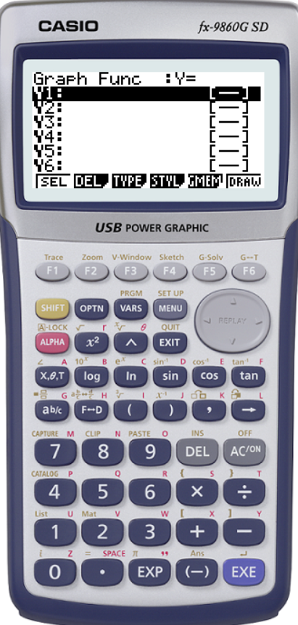


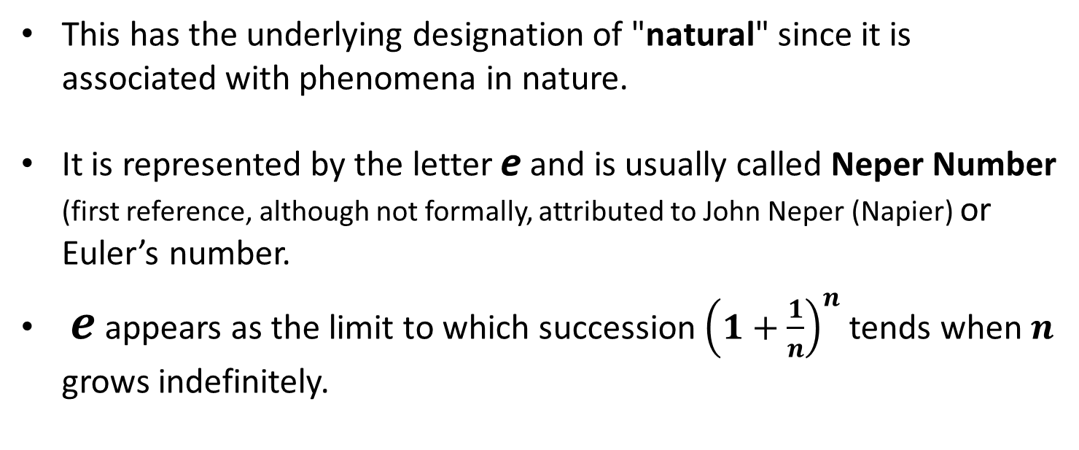


Definition – part 1
A "special" irrational number: $e$
This has the underlying designation of "natural" since it is associated with phenomena in nature.
It is represented by the letter e and is usually called Neper Number (first reference, although not formally, attributed to John Neper (Napier) or Euler’s number.
$e$ appears as the limit to which succession ${\left(1+\frac{1}{n}\right)}^{n}$ tends when $n$ grows indefinitely.
X | Y
1 | 2
2 | 2,25
… | …
100 | 2,704813829
… | …
1000 | 2,716923932
… | …
$$e$$
$$e$$
$$≈2,71828182459…$$

Slide 3
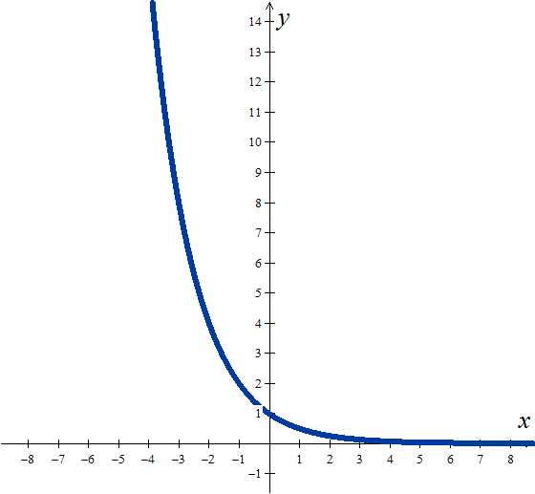
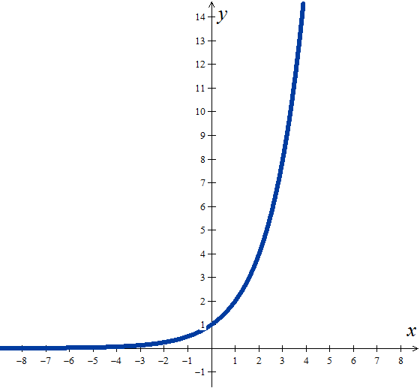
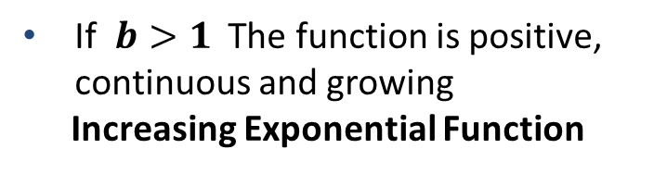
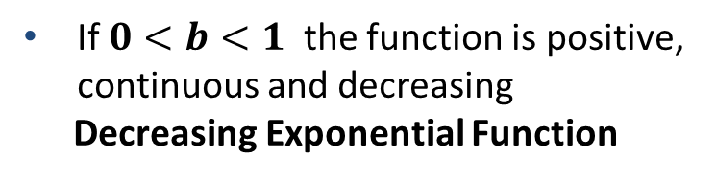

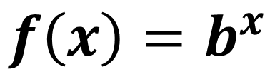

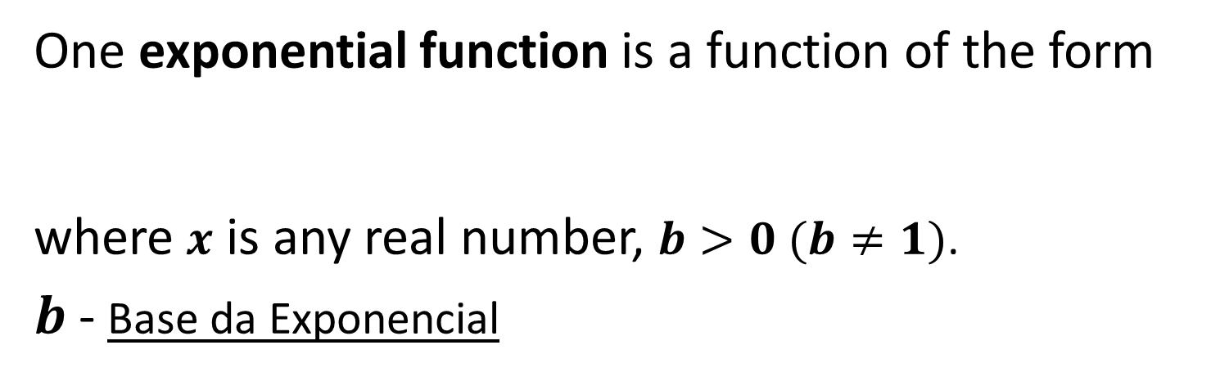
Definition – part 2
Natural Exponential Function
One exponential function is a function of the form
where $x$ is any real number, $b>0 (b≠1)$.
$b$- Base da Exponencial
$$f\left(x\right)=b^{x}$$
If $0<b<1$ the function is positive, continuous and decreasing
Decreasing Exponential Function
If $b>1$ The function is positive, continuous and growing
Increasing Exponential Function
$$0<b<1$$
$$b>1$$

Slide 4

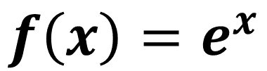
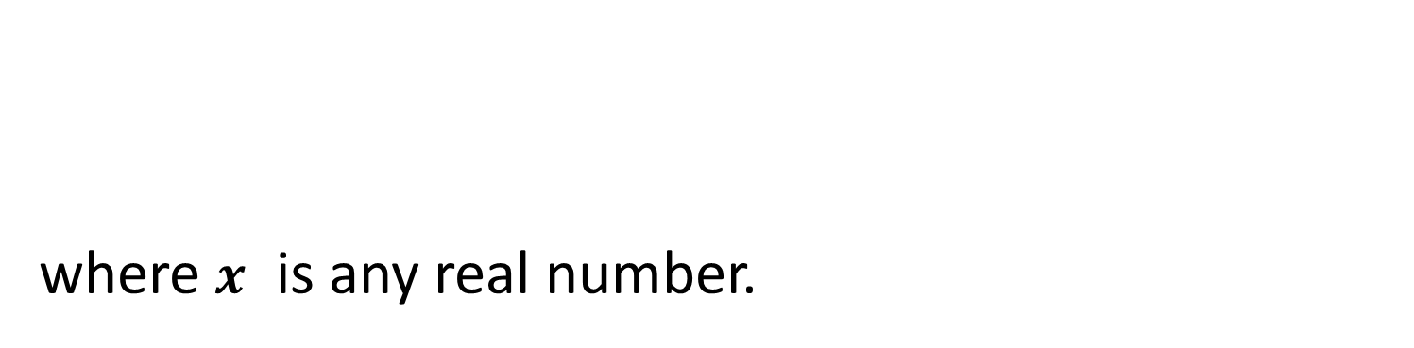
General Examples
Natural Exponential Function
Uma função exponencial é uma função da forma
where $x$ is any real number.
The Natural Exponential Function is the function
$$f\left(x\right)=e^{x}$$
As $e>1$
the function is positive, continuous and growing.
If $0<b<1$ the function is positive, continuous and decreasing
Decreasing Exponential Function
If $b>1$ The function is positive, continuous and growing
Increasing Exponential Function
$$0<b<1$$
$$b>1$$

Slide 5
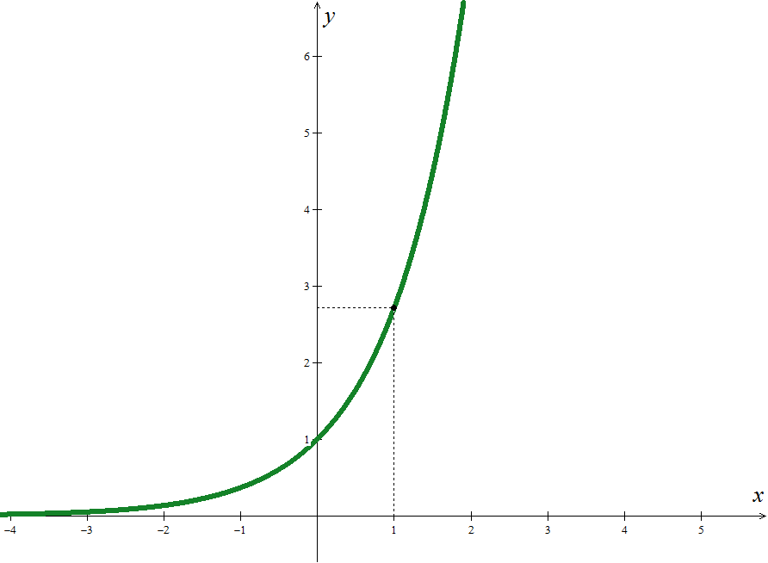

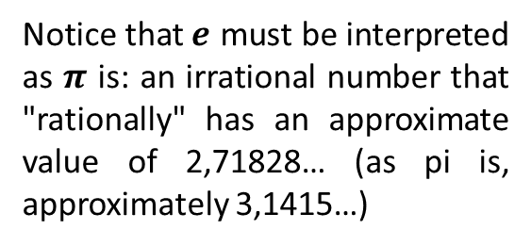



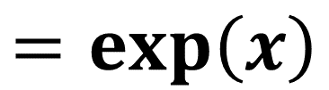

More General Examples
Natural Exponential Function
Uma função exponencial é uma função da forma
where $x$ is any real number.
The Natural Exponential Function is the function
$$f\left(x\right)=e^{x}$$
$$=exp\left(x\right)$$
As $e>1$
the function is positive, continuous and growing.
Notice that$e$ must be interpreted as $π$ is: an irrational number that "rationally" has an approximate value of 2,71828… (as pi is, approximately 3,1415…)
$$e$$

Slide 6
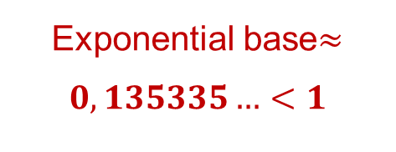
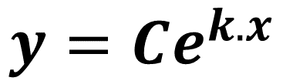
Mathematics examples
Another exponential model
$$y=Ce^{k.x}$$
General Exponential Model
$C$ - Initial value (value of$y$ when $x=0$)
$k$ - Growth/Decay Constant
For positive starting values($C>0$) we have:
$k>0$ - Growing exponential
$k<0$ - Decreasing exponential
Exponential base$≈0,135335…<1$
Example

Slide 7
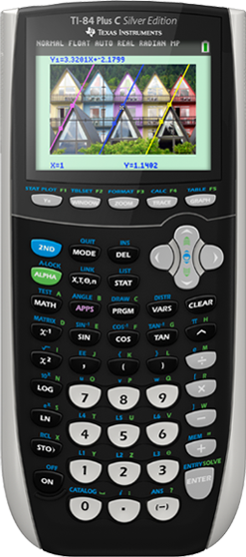







Mathematics examples
Calculators and
Neper’s / Euler’s
Number

Slide 8
Mathematics examples
EXAMPLES (Operative Properties)
Determine x which verifies each of the following conditions:
1.
2.
3.
Proposed Solution:
Replacing:
we get:
Returning to the initial variable:
We get the solutions:

Slide 9

Hope it helped you!
Try to pratice more…

