Slide 1

  Exponential Function
  Generalities and Properties
  b < 1

Slide 2

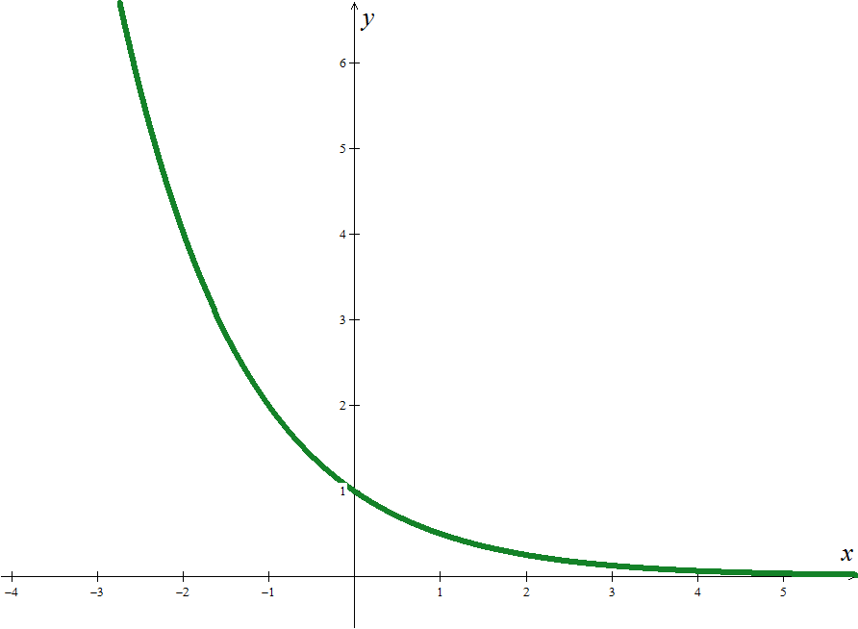
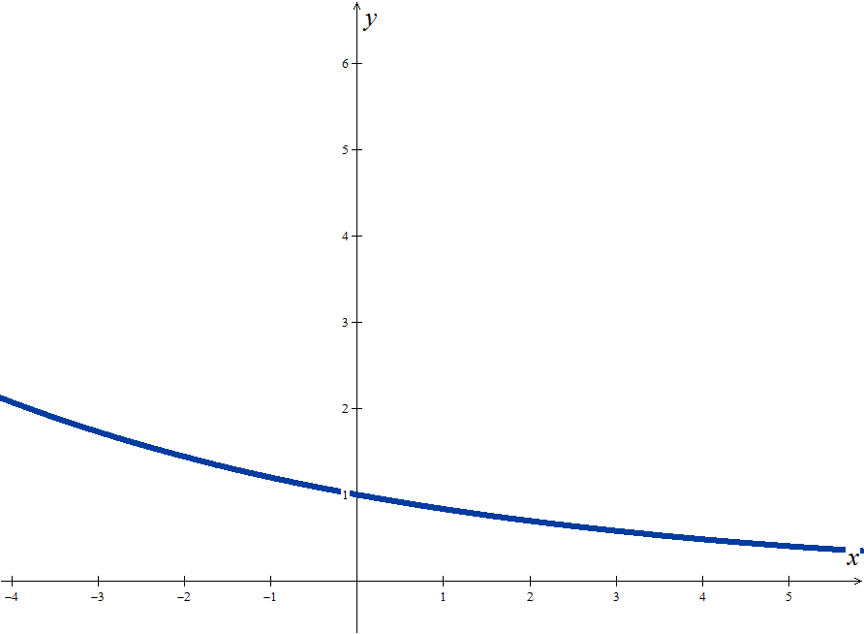
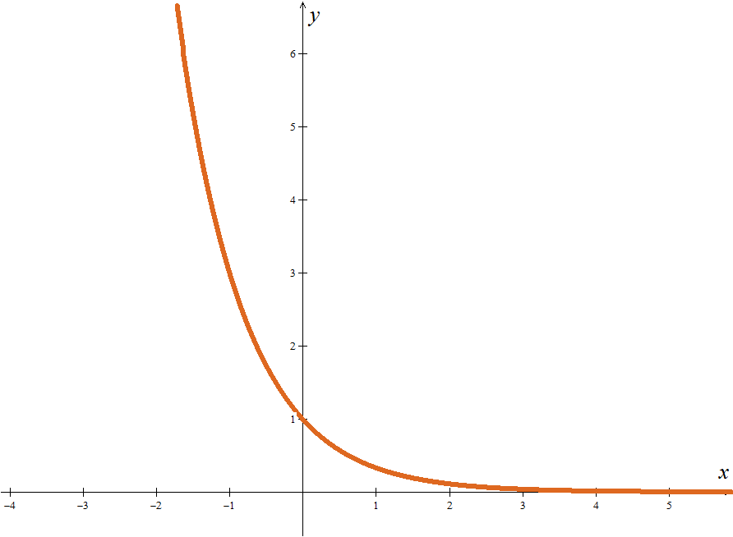
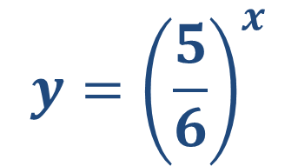


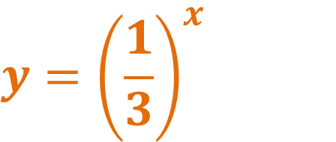
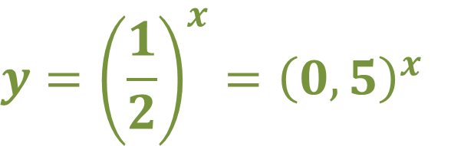
Mathematics examples
Exponential function - base less than one
$$f:IR→IR$$
$$x{ b}^{x}$$
$$b<1$$
EXAMPLES
$$y={\left(\frac{5}{6}\right)}^{x}$$
$$y={\left(\frac{1}{2}\right)}^{x}={\left(0,5\right)}^{x}$$
$$y={\left(\frac{1}{3}\right)}^{x}$$

Slide 3
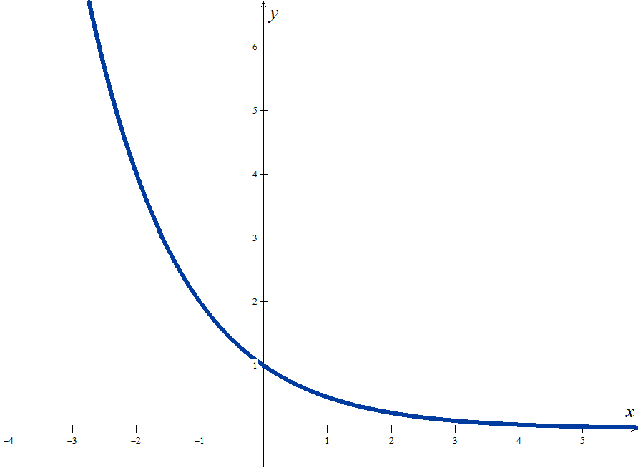








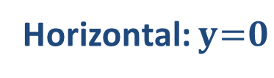



Definition – part 1
Exponential function - base less than one
Domain
$${D=IR}^{}$$
$$f:IR→IR$$
$$x{ b}^{x}$$
$$b<1$$
Codomain
$${D′=IR}^{ +}$$
Sign
Positive in ${IR}^{}$
Zeros
There is none
$$\lim_{x→−∞}{b^{x}=+∞}$$
y-intercept
$${y_{0}=1}^{ }$$
Injectivity
Yes, in$IR$
Monotony
Decreasing, in $IR$
Extrema
There is none
$${y=b}^{x}$$
Continuity
Continuous in $IR$
(0,1)
Asymptotes
Horizontal: $y = 0$
$$\lim_{x→+∞}{b^{x}=0}$$

Slide 4

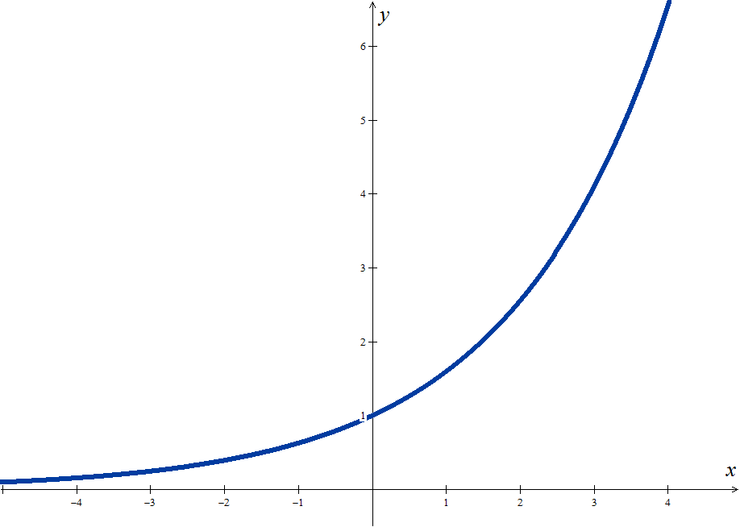
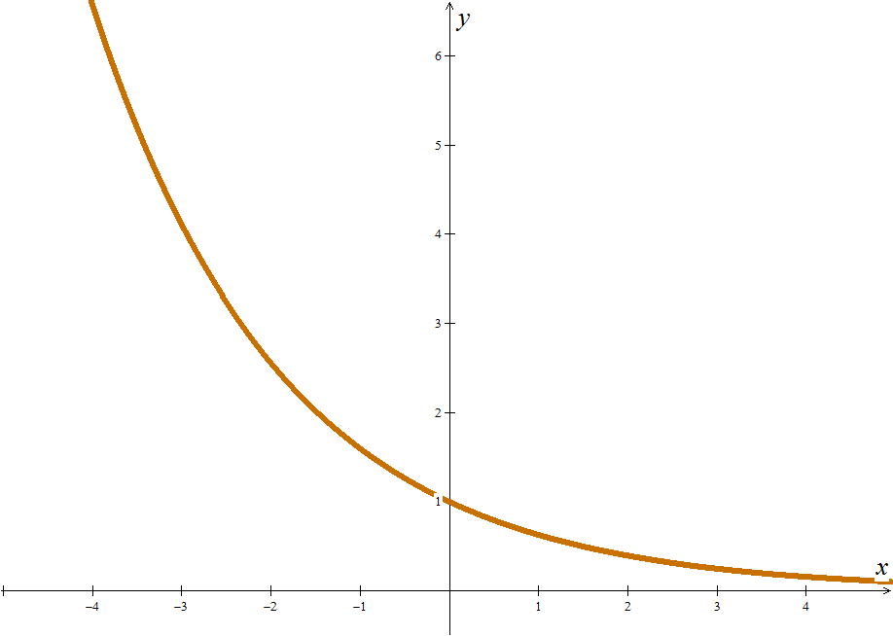




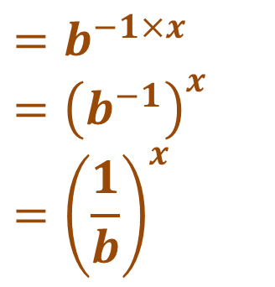

Definition – part 2
Comparing Exponential Functions
$$f:IR→IR$$
$$x{ b}^{x}$$
$$g:IR→IR$$
$$x{ b}^{−x}$$
$$b>1$$
$$b^{−x}$$
$$=b^{−1×x}$$
$$={\left(b^{−1}\right)}^{x}$$
$$={\left(\frac{1}{b}\right)}^{x}$$
$${y=b}^{x}$$
$${y=b}^{−x}$$

Slide 5
General Examples
EXAMPLES (Bases and Properties)
1. Determine the value of the constant a, real, knowing that the coordinate point (1,3) belongs to the graph of the function defined by:
Proposed Solution:
It is given that:
So, replacing in the function expression:
we get the following equation:

Slide 6

More General Examples
EXAMPLES (Inequalities)
2. Determine for which values of x the following conditions apply:
2.1
2.2
Proposed Solution:
Changes the sign of the inequality
Auxiliary Calculations:
Changes the sign of the inequality
-3
3

Slide 7

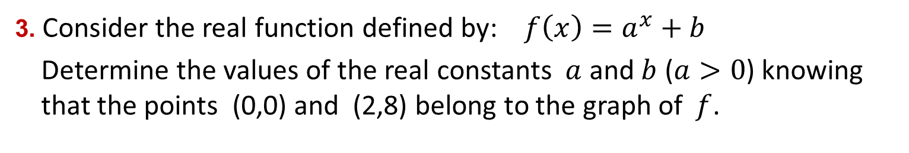
Mathematics examples
EXAMPLES (Bases and Properties)
3. Consider the real function defined by: $f\left(x\right)=a^{x}+b$
Determine the values of the real constants $a$ and $b$ ($a>0$) knowing that the points (0,0) and (2,8) belong to the graph of$f$.
Proposed Solution:
It is given that:
So, replacing in the function expression:
we get the system of equations:
$$⇒f\left(x\right)=3^{x}−1$$

Slide 8

Hope we have helped!
Practice a little…

