Slide 1

  Exponential Function
  General Properties
  b > 1

Slide 2

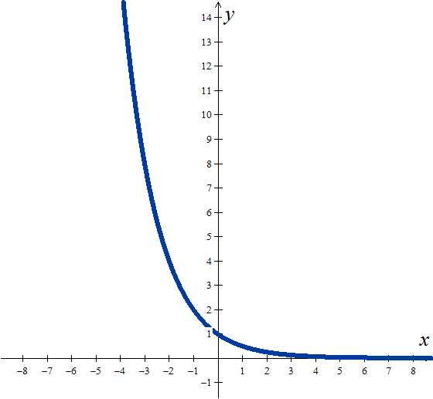
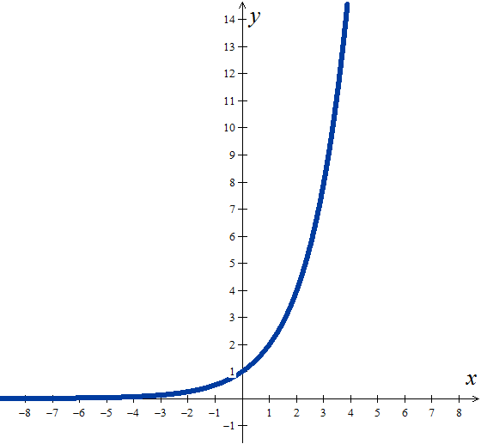
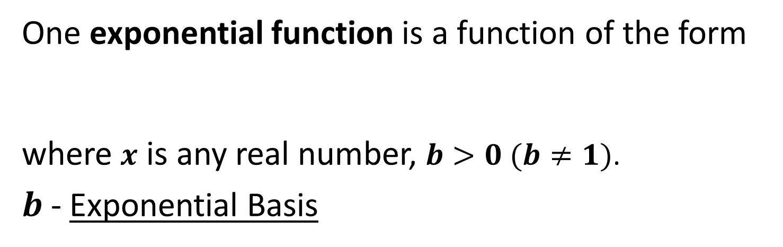
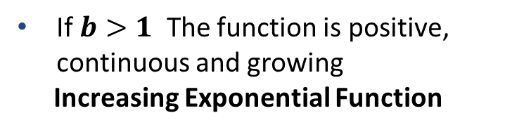
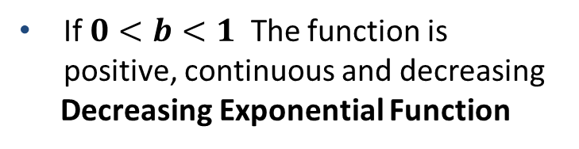

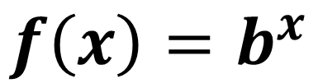

Mathematics examples
DEFINITION
One exponential function is a function of the form
where $x$ is any real number, $b>0 (b≠1)$.
$b$- Exponential Basis
$$f\left(x\right)=b^{x}$$
If $0<b<1$ The function is positive, continuous and decreasing
Decreasing Exponential Function
If $b>1$ The function is positive, continuous and growing
Increasing Exponential Function
$$0<b<1$$
$$b>1$$

Slide 3
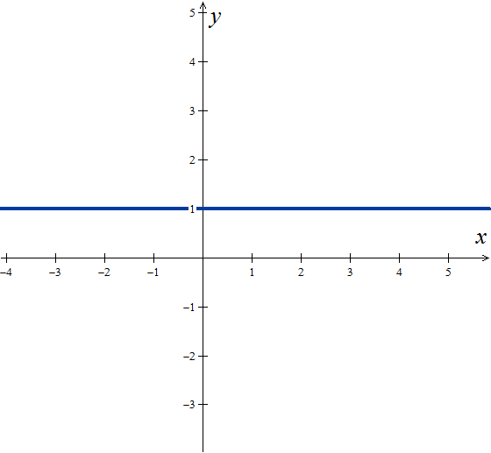

Definition – part 1
DEFINITION
One exponential function is a function of the form
where $x$ is any real number, $b>0 (b≠1)$.
$b$- Exponential Basis
$$f\left(x\right)=b^{x}$$
I$f b=1$ the function is not exponential
$→$ Constant Function

Slide 4
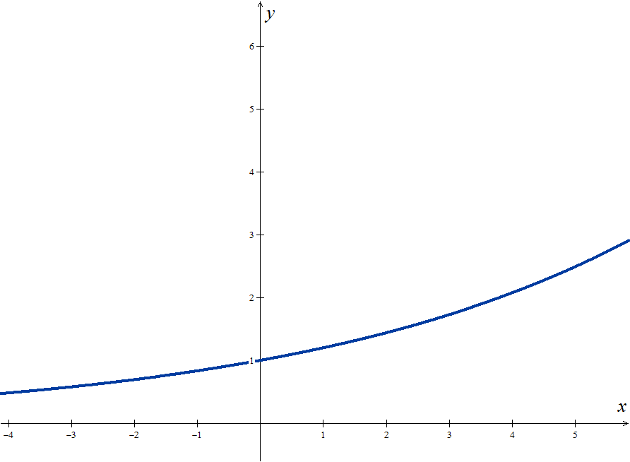
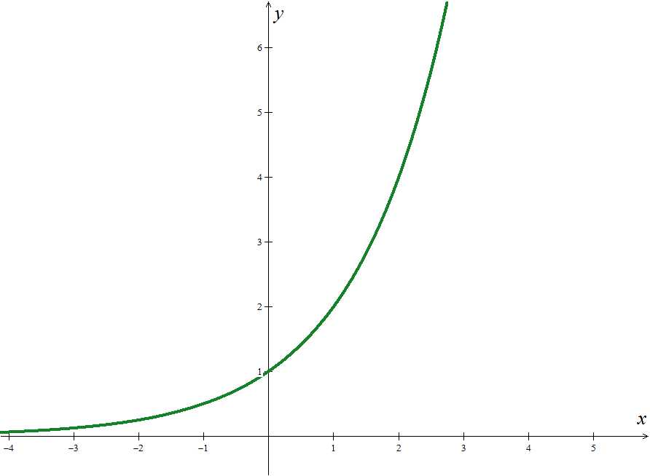
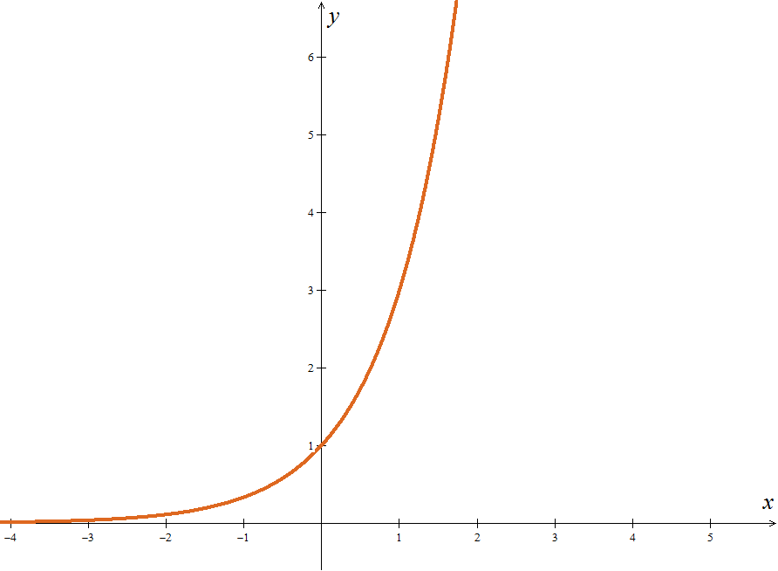


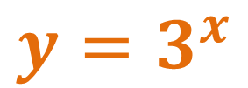
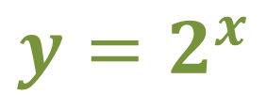
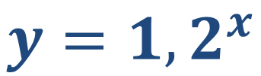
Definition – part 2
Base exponential function greater than one
$$f:IR→IR$$
$$x{ b}^{x}$$
$$b>1$$
EXAMPLES
$${y=3}^{x}$$
$${y=2}^{x}$$
$${y=1,2}^{x}$$

Slide 5
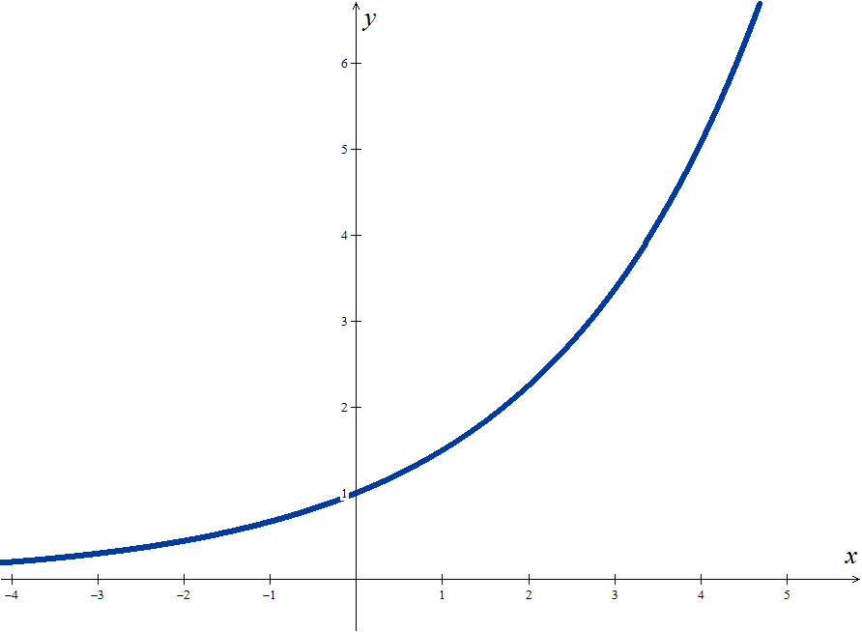










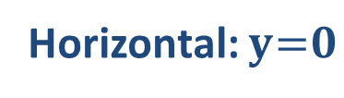
General Examples
Base exponential function greater than one
Domain
$${D=IR}^{}$$
$$f:IR→IR$$
$$x{ b}^{x}$$
$$b>1$$
Codomain
$${D′=IR}^{ +}$$
Sign
Positive in ${IR}^{}$
Zeros
There is none
$$\lim_{x→+∞}{b^{x}=+∞}$$
Y-intersect
$${y_{0}=1}^{ }$$
Injectivity
Yes, in $IR$
$${y=b}^{x}$$
Monotony
Increasing, in $IR$
Extrema
There is none
Continuity
Continuous in $IR$
(0,1)
Asymptotes
Horizontal: $y = 0$
$$\lim_{x→−∞}{b^{x}=0}$$

Slide 6
More General Examples
EXAMPLES (Operating Properties)
1. Calculate the value of x that verifies each of the following conditions:
1.1
1.2
1.3
Proposed solution :
To solve this last equation we will make a change of variable:
and we get:
and applying the Solving Formula comes:
Going back to the initial variable, we can write:
Since the 1st condition is impossible to be reduced to the 2nd:

Slide 7

Mathematics examples
EXAMPLES (Inequalities)
2. Determine for which values of x the following conditions apply:
2.1
2.2
Proposed solution:
Auxiliary Calculations:

Slide 8

Hope we have helped!
Practice a little…

