Slide 1

  Logarithmic Function
  General Information

Slide 2

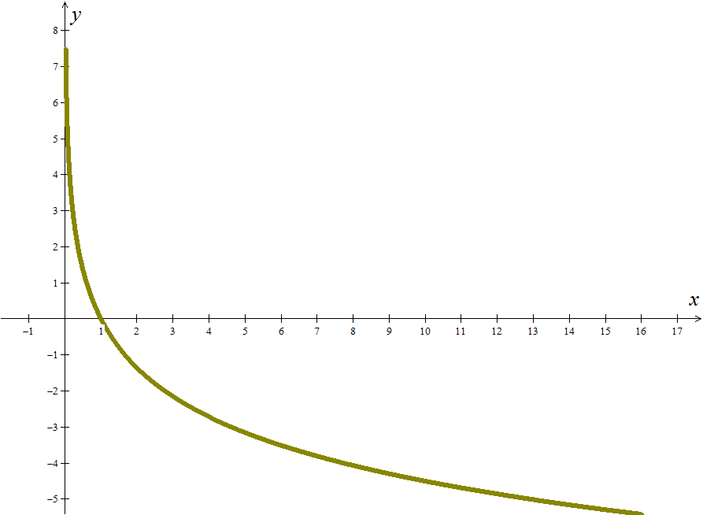
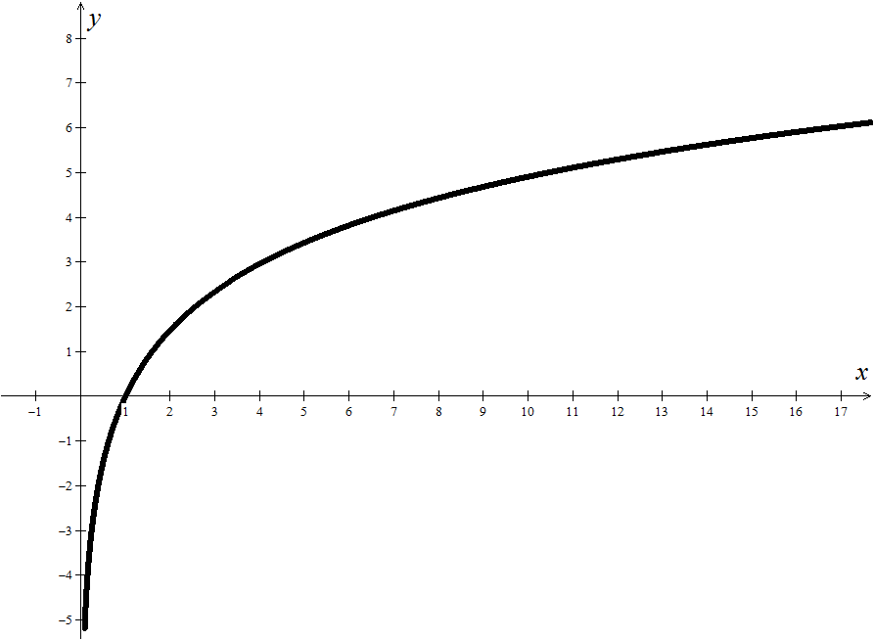
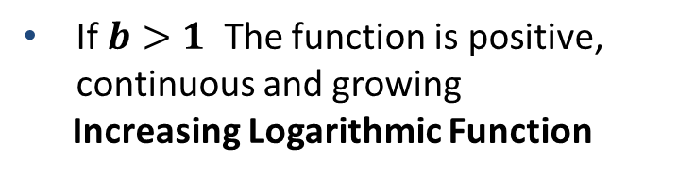
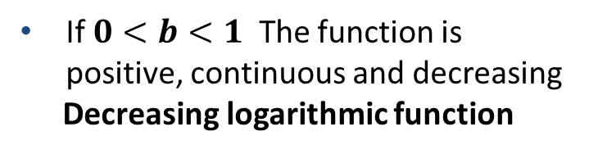
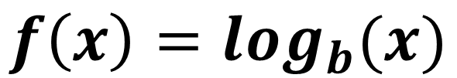
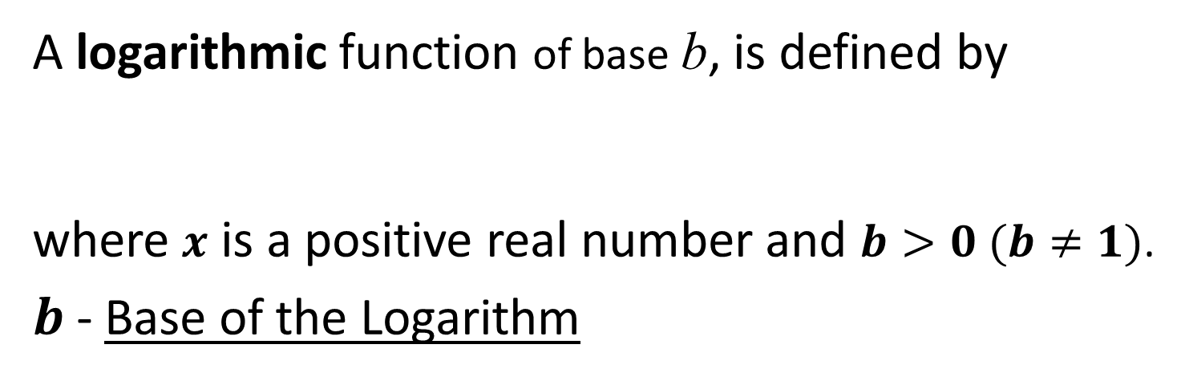


Mathematics examples
DEFINITION
A logarithmic function of base b, is defined by
where $x$ is a positive real number and $b>0 (b≠1)$.
$b$- Base of the Logarithm
$$f\left(x\right)=\log_{b}(x)$$
If $0<b<1$ The function is positive, continuous and decreasing
Decreasing logarithmic function
If $b>1$ The function is positive, continuous and growing
Increasing Logarithmic Function
$$0<b<1$$
$$b>1$$

Slide 3
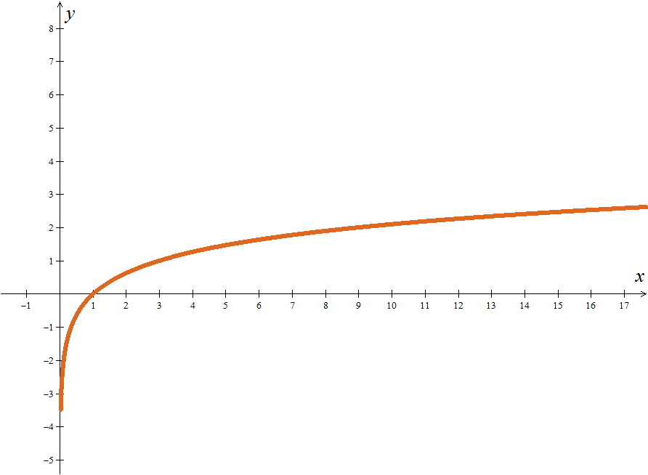
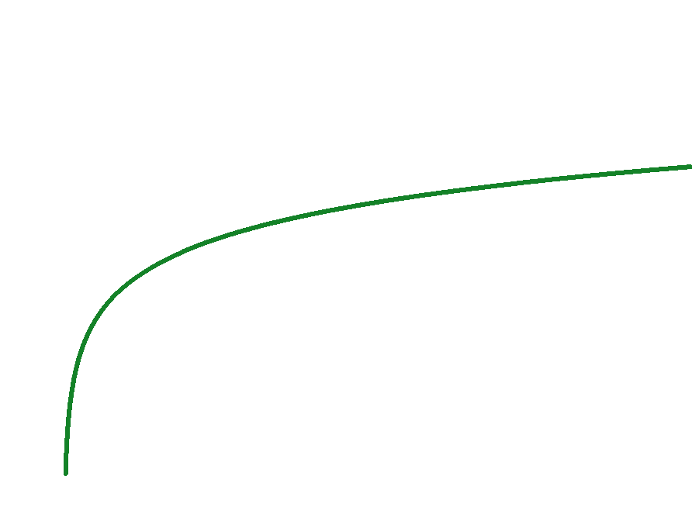

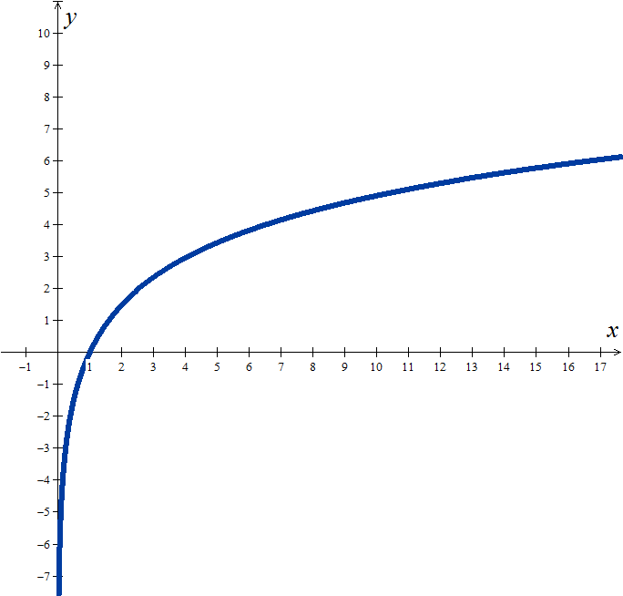

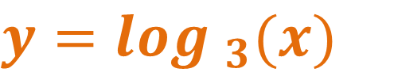
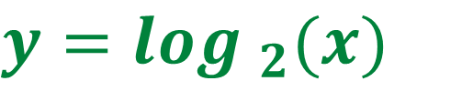
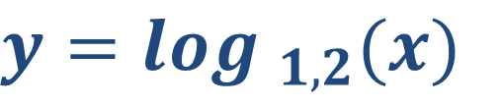

Mathematics examples
Logarithmic function with base greater than one
$$f:{IR}^{+}→IR$$
$$x {}^{}\log_{b}(x)$$
$$b>1$$
EXAMPLES
$$y=\log_{3}(x)$$
$$y=\log_{2}(x)$$
$$y=\log_{1,2}(x)$$

Slide 4
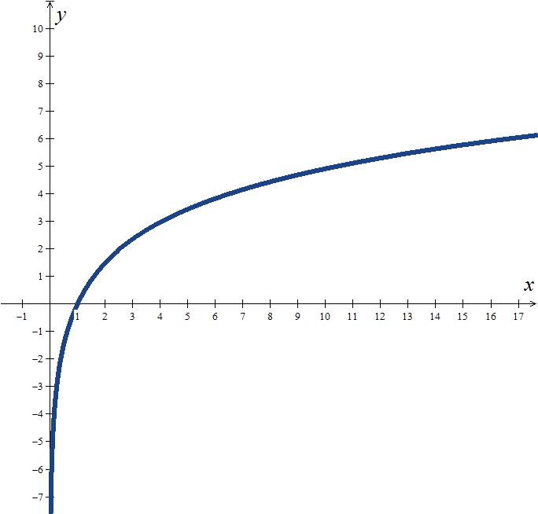



Mathematics examples
Logarithmic function with base greater than one
Domain
$${D=IR}^{+}$$
$$f:{IR}^{+}→IR$$
$$x {}^{}\log_{b}(x)$$
$$b>1$$
Codomain
$${D′=IR}^{ }$$
Sign
Zeros
Injectivity
Monotony
Extreme
Continuity
$$y=\log_{b}(x)$$
Asymptotes

Slide 5

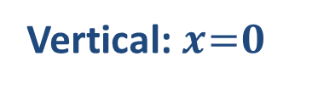
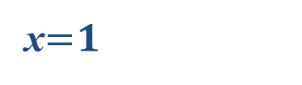








Mathematics examples
Logarithmic function with base greater than one
Domain
$${D=IR}^{+}$$
$$f:{IR}^{+}→IR$$
$$x {}^{}\log_{b}(x)$$
$$b>1$$
Codomain
$${D′=IR}^{ }$$
Sign
Positive in ]1, +$∞[$
Negative in ]0, 1$[$
$$\lim_{x→+∞}{\log_{b}\left(x\right)=+∞}$$
Zeros
x$= 1$
Injectivity
Yes, in ${IR}^{+}$
Monotony
Increasing, in ${IR}^{+}$
Extreme
There is none
(1,0)
Continuity
Continuous in${IR}^{+}$
$$y=\log_{b}(x)$$
Asymptotes
Vertical: $x= 0$
$$\lim_{x→0^{+}}{\log_{b}\left(x\right)=−∞}$$

Slide 6
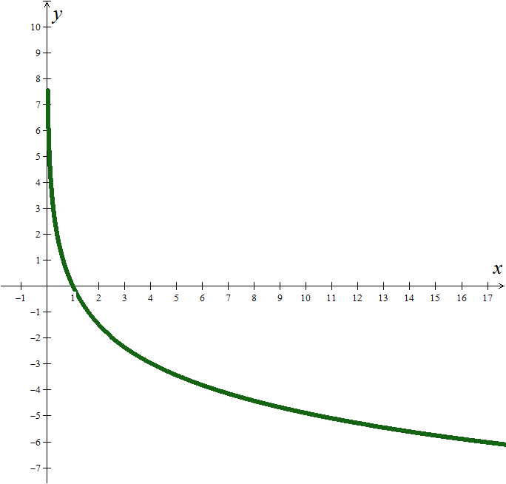





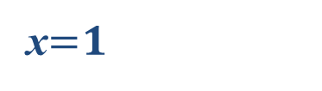








Mathematics examples
Logarithmic function with base greater than one
less
Domain
$${D=IR}^{+}$$
$$f:{IR}^{+}→IR$$
$$x {}^{}\log_{b}(x)$$
$$b<1$$
Codomain
$${D′=IR}^{ }$$
Sign
Positive in ]1, +$∞[$
Negative
Negative in ]0, 1$[$
Positive
$$\lim_{x→+∞}{\log_{b}\left(x\right)=+∞}$$
$$\lim_{x→+∞}{\log_{b}\left(x\right)=−∞}$$
Zeros
x$= 1$
Injectivity
Yes, in ${IR}^{+}$
Monotony
Decreasing
Increasing, in ${IR}^{+}$
Extreme
There is none
(1,0)
Continuity
Continuous in ${IR}^{+}$
$$y=\log_{b}(x)$$
Asymptotes
Vertical: $x= 0$
$$\lim_{x→0^{+}}{\log_{b}\left(x\right)=+∞}$$
$$\lim_{x→0^{+}}{\log_{b}\left(x\right)=−∞}$$

Slide 7
Mathematics examples
EXAMPLES
Determine the value of x that verifies each of the following conditions:
1.
Proposed Solution:

Slide 8
Mathematics examples
EXAMPLES
Determine the value of x that verifies each of the following conditions:
2.
Proposed Solution :
Base less than 1
Decreasing function
SIGNAL EXCHANGE!

Slide 9
Mathematics examples
EXAMPLES
Determine the value of x that verifies each of the following conditions:
3.
Proposed Solution :
Base less than 1
Decreasing function
SIGNAL EXCHANGE!

Slide 10

Hope we have helped!
Practice a little…

