Slide 1

Fundamental Counting Principle or Product Rule

Slide 2

Fundamental Counting Principle or Product Rule
Suppose that a result is composed of a "sequence" of k outcomes where each of these can occur, respectively, in .
different ways.
Then the given result can occur in
different ways.

Slide 3
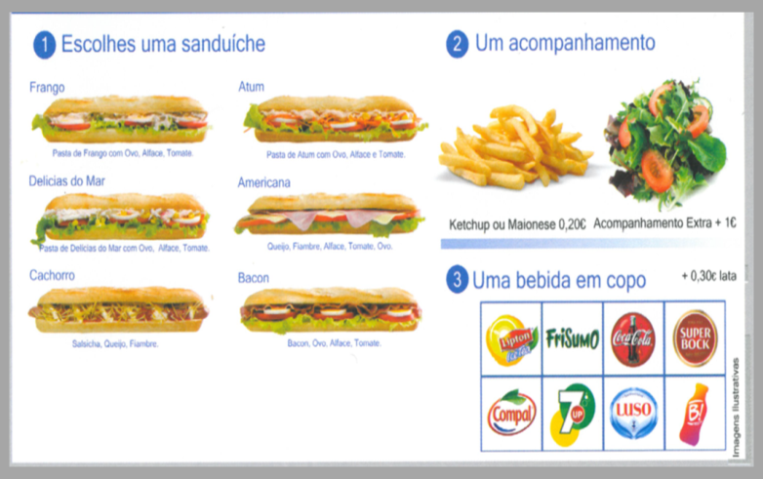

EXAMPLE (Fundamental Counting Principle)
1. According to the image, a “day menu” can be composed of three of the options presented.
How many menus consisting of a sandwich, a side dish and a drink can we organize?
1
Pick a sandwich
2
Choose a side dish
Chicken
Tuna
Seafood
Ham and cheese
3
One drink (glass)
Hot Dog
Bacon
Proposed Solution:
Sandwich
Side dishes
Drink (glass)
Applying the fundamental principle of counting we have:
distinct menus
6 Possibilities
2 Possibilities
8 Possibilities

Slide 4

em)
2. With the digits from 1 to 9, how many 4-digit even numbers can you form?
Proposed Solution:
For the number to be four digits and even, the last digit can be 2, 4, 6 or 8.
_ _ _ 2 _ _ _ 4 _ _ _ 6 _ _ _ 8
that is, __ __ __ even
Applying the fundamental counting principle:
EXAMPLE (Fundamental Counting Principle)
9
9
9
4

Slide 5

EXAMPLE (Fundamental Counting Principle)
E contagem)
3. In a bar at a college, six flavors of ice cream are for sale (strawberry, chocolate, vanilla, cream, lemon and pineapple). Three friends, Ana, Filipa and Catarina, decide to eat an ice cream, with a flavor, each. Ana chooses cream or lemon. Filipa doesn't choose chocolate. How many different ways can ice cream be chosen?
Proposed Solution:
Ana 2 alternatives
Filipa 5 alternatives
Catarina 6 alternatives
Applying the fundamental counting principle :
different ways to choose ice cream.

Slide 6

REMARK
Rule of thumb in counting problems
When you have:
and corresponds to a multiplication (x)
or corresponds to an addition (+)

Slide 7

E
4. With the digits from 1 to 9, how many even numbers less than 1,000 can be formed?
Proposed solution:
__ or __ __ or __ __ __
In total, there are 4 + 9 × 4 + 9 × 9 × 4 = 364 numbers under the desired conditions.
EXAMPLE (Fundamental Counting Principle)
Even
Even
Even
4
9 x
4
9 x
9 x
4

Slide 8
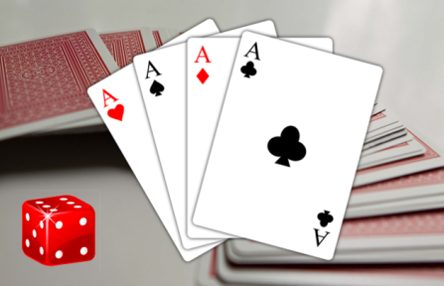
EXAMPLE (Fundamental Counting Principle in Probability)
E
5. A game consists of drawing a card at random from a deck of 52 cards and rolling a dice. A prize is awarded if an ace and odd face roll. What is the probability of a prize?
Proposed solution:
The number of possible cases is given by the pairs
(card, Dice face)
Using the fundamental counting principle, we have 52 × 6 options.
Let us consider the event A "coming out ace and odd face".
This event can be carried out in 4 × 3 different ways.
Since all pairs have the same probability, we can use Laplace's rule and calculate the requested probability:

