Slide 1

Permutations/Arrangements
with Repetition

Slide 2
Permutations with repetition
Given a set with n distinct elements, it's called Permutations/Arrangements with Repetition of n elements taken p to p the total number of sequences with p elements such that:
• In each sequence there are p elements repeated or not;
• Two sequences are different if they differ in some element or in the order in which they are placed.
It is represented by:

Slide 3

EXAMPLE (Permutations with repetition)
1. With the numerals, , , , , and , how many three-digit numbers can you write?
Proposed solution:
In the case of a set of 6 elements, with which we want to form sequences of 3 elements, equal or different, we have, using the expression given:
It is possible to write 216 numbers.
Note: Using the fundamental counting principle:
3
4
5
7
8
9
__ __ __
x
6
6
6
x

Slide 4

EXAMPLE (Permutations with repetition)
2. How many four-digit numbers are multiples of 5?
Proposed solution:
__ __ __ __
Thus, there are
four-digit numbers that are multiples of 5.
For the first digit there are 9 possibilities
(it can't be zero)
For the second and third digits, the number of two-digit sequences (equal or different) is given by
For the units’ digit there are two possibilities (0 or 5)

Slide 5


EXAMPLE (Permutations with repetition)
3. In a given country, car license plates are made up of a two-digit group between two groups of two letters (consider the alphabet with 23 letters). Knowing that both the numbers and the letters can be the same or different, how many car plates can you form?
Proposed solution:
Number of sequences of 4 letters
Number of pairs of digits
Total

Slide 6
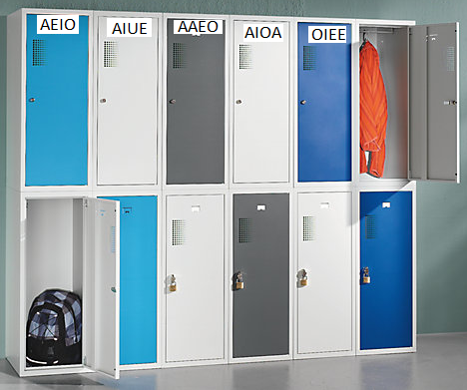

EXAMPLE (Permutations with repetition)
4. In a school with 750 students, there are individual lockers identified by a code consisting of a sequence of four vowels. The number of existing lockers is equal to the maximum number of codes that can be formed.
It is intended to know if there are enough
lockers that to all students, knowing that there are no repeated codes.
Proposed solution:
Total number of codes that are possible form with 4 vowels
__ __ __ __
Thus, there are not enough lockers for the 750 students!

