Slide 1

Permutations without repetition

Slide 2
Permutations without repetition
Given a set with n distinct elements, it is called permutations or arrangements without repetition or simple arrangements, from n elements, p to p, to the total number of sequences of p different elements, chosen among the n elements, with
and is represented, by:
Remark – In Probability problems, counting techniques are often used, and combinatorial analysis facilitates this task. There are several notations to represent this permutations as:

Slide 3
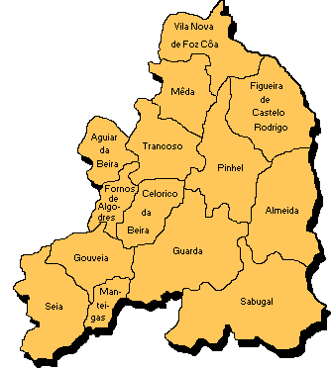
EXAMPLE (Permutations without repetition)
1. The Portuguese Minister of Education will visit six of the fifteen schools with secondary education in the district of Guarda. How many ways can you organize the visit?
Proposed solution (1):
The total number of ways to organize the visit can be obtained directly through , which reads “Permutations without repetition of 15 elements, 6 to 6”
Applying the formula
There are, therefore, 3,603,600 different ways to visit 6 of these 15 schools.
It should be noted that these possibilities are distinguished both by the schools chosen to visit and by the order in which the visit will be carried out.

Slide 4
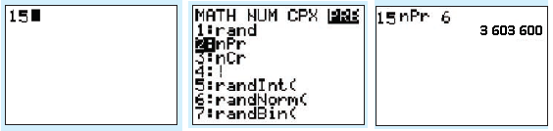
Using a calculator…
We can easily get the value you want:
CASIO
OPTN →Prob → nPr
TEXAS
MATH → PRB → 2:nPr
So, using a TEXAS calculator, after turning on the machine, type the number 15 followed by the sequence
MATH → PRB → 2:nPr → ENTER→6 → ENTER.
The result is 3 603 600, that is,

Slide 5
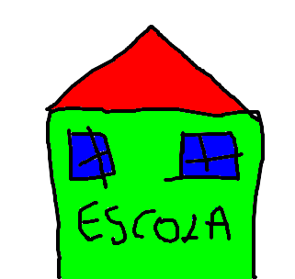
EXAMPLE (Permutations without repetition)
1. The Portuguese Minister of Education will visit six of the fifteen schools with secondary education in the district of Guarda. How many ways can you organize the visit?
Proposed solution (2):
This question could have been settled without recourse to the permutations without repetition as follows:
1
2
3
4
5
6
e
15
x
14
x
13
x
12
x
11
x
10
The same result is obtained, in a less direct way: 3,603,600 different ways to visit 6 of these 15 schools.

Slide 6

EXAMPLE (Permutations without repetition)
2. How many natural numbers, written with all different digits, are there between the numbers 2,000 and 5,000?
Proposed solution :
Therefore, there are
natural numbers, written with different digits, between the numbers 2,000 and 5,000.
For the first digit there are 3 possibilities
(two, three or four)
Number of ways to choose the sequence of the three digits (hundreds, tens and ones) from the 9 that are available

Slide 7
EXAMPLE (Permutations without and with repetition in probability)
3. With the digits 5, 6, 7, 8 and 9, all possible four-digit numbers are formed. Suppose you chose one of these numbers at random, what is the probability that it will not have repeated digits?
Proposed solution:
The Possible cases are permutations with repetition of 5, 4 to 4:
The Favorable cases are permutations without repetition of 5, 4 to 4:
Thus, the probability is:

