Slide 1

Permutations

Slide 2
Permutations
Given a set with n different elements, it's called n element permutation to the whole way of ordering them, that is, to all the sequence that can be obtained with these n elements.
It is represented by:
1
2
3
2
1
3
3
1
2
1
3
2
2
3
1
3
2
1

Slide 3




EXAMPLE (Permutations)
1. How many different ways can you arrange 3 Mathematics books, 2 Chemistry books and 2 Biology books:
a) Without any special order?
b) Putting together the books of each subject?
Proposed Solution:
a) In total, we have 7 books.
Therefore, it is possible to place the books in different ways.
b) As we want the books of each subject to be together, we have:
2 Biology books
2 Chemistry books
3 Mathematics books
3 Subjects
Therefore, we have 144 different ways to place these books.

Slide 4
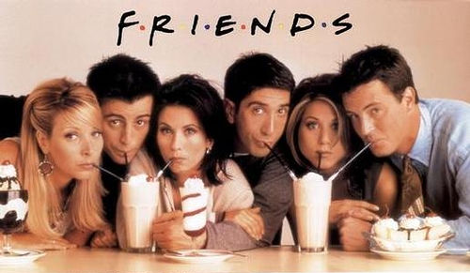
Example (Permutations in probability)
2. The 6 friends from Friends series will take a picture.
How likely is Ross to be at Joey’s side?
Proposed Solution:
The number of possible cases is:
Let's see what the number of favorable cases is:
The following scheme suggests the various ways for Ross and Joey to take the places, staying together, with Ross on the left and Joey on the right.
Since Ross and Joey can switch positions, we have .
Once Ross and Joey are placed, the other 4 friends can occupy any place. Thus, the number of favorable cases is:
Thus, the probability is:
Phobe Joey Monica Ross Rachel Chandler
Ross | Joey
 | Ross | Joey
 |  | Ross | Joey
 |  |  | Ross | Joey
 |  |  |  | Ross | Joey

Slide 5
Permutation of Multisets
Permutations when some elements are identical
The number of different permutations of n objects, of which n₁ are of a kind, n₂ of a second type, ... , and n_{K} of a k-th type, and where , can be computed using the following expression:
Remark – The fact that there are objects of the same type means that any exchange of the relative position of two of them leads to the same organization of the objects, thus not counting as a "new" permutation, which happens when all the objects to be exchanged are distinct.

Slide 6


EXAMPLE (Permutation of Multisets)
1. In how many different ways can three Nintendo Switch 2, four Playstations 6 and five Xbox series X be distributed to twelve children?
Proposed Solution :
If the consoles were all different, we'd have 12! different permutations, i.e. 479,001,600 ways of distributing consoles.
However, we have 3 consoles of one type, 5 of another type and 4 of another.
By exchanging the position of consoles of the same type with each other, we get the same permutation.
So, the number of different ways to distribute these 12 consoles among the 12 children is:

Slide 7


EXAMPLE (Permutation of Multisets)
2. With all the letters of the word (MATACTIVA) how many different words, with or without meaning, can be formed?
Proposed Solution:
If the letters were all different, we would have 9! (362 880) different permutations.
Since, we have 3 letters of one type (A) and 2 of another type (T), then we can form
words with the letters of the word MATACTIVA.

