Slide 1

Combinations

Slide 2
Combinations
Given a set with n distinct elements, one may call combination of the elements of this set, to any of its subsets.
We represente by the number of subsets that is possible to form with p elements chosen from among the n given elements.
The number of combinations of n elements, p to p, is given by:
it can be read as, simply, combinations of n, p to p.

Slide 3
Combinations
Given a set with n distinct elements, one may call combination of the elements of this set, to any of its subsets.
We represente by the number of subsets that is possible to form with p elements chosen from among the n given elements.
The number of combinations of n elements, p to p, is given by:
it can be read as, simply, combinations of n, p to p.
Remark - Since in combinations the arguments are subsets, the order of the elements doesn't change groupings.

Slide 4

EXAMPLE (Combinations)
1. Among the 24 teams registered in a motor racing race, 4 will be chosen, at random, to present the event at a press conference. How many different choices can the organization of the race make?
Proposed solution:
When choosing the teams, the order does not matter, since choosing the ABCD team set is the same as choosing the CADB or DABC team…
Thus, to solve this question, it will be enough to calculate the value of:
Therefore, 10,626 different choices from 4 teams can be made from among the 24 registered in the competition.

Slide 5
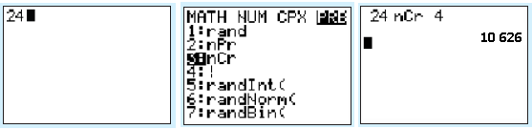

Using a calculator…
CASIO
Menu RUN n → OPTN F6 (>) → F3 (PROB) → F3 (nCr) → p → EXE
TEXAS
n → MATH → PRB → 3:nCr → ENTER→ p → ENTER
So, in the case of the previous example, using a TEXAS calculator, enter the number 24 followed by the sequence:
MATH → PRB → 3:nCr → ENTER→ 4 → ENTER
The result obtained is 10 626.
n
C
…it is easy to obtain the value of
p

Slide 6
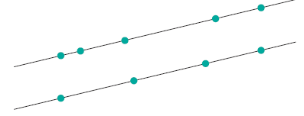
EXEMPLO (Combinações)
2. Consider nine points in a plan: four over one straight line s and five on a straight line s, strictly parallel to s.
How many distinct triangles can be drawn having, as it were, vertices of three of these nine points?
Note: As [ABC], [BCA], [CAB]... represent the "same" triangle, the order in which the three points are chosen does not matter.
Proposed solution (1):
We can consider all the ways to choose 3 points from the 9 and then subtract the number of cases in which the 3 points do not define a triangle, which correspond to situations in which the 3 points chosen are collinear, that is, they are all on the same line:
Proposed solution (2):
To make sure we don't choose 3 collinear points, we select 2 points on one of the lines and 1 point on the other:
r
s

Slide 7




EXAMPLE (Combinations in probability)
3. Going back to example 1, suppose that one of the 24 teams registered in the event in question is Circle Sport (Spring Cup Series –NASCAR). Knowing that a group of three teams will be chosen, at random, among the 24, to carry outdoor cameras provided by the organization, what is the probability of Circle Sport being part of that group?
Proposed solution:
The number of possible cases is (number of ways to choose three teams, from the 24 registered).
The number of favorable cases is (for Circle Sport to be part of the group that will carry the organization's cameras, it is only necessary to choose two more teams, but only from 23, that is, the number of favorable cases is the number of different ways to choose two teams, out of 23).
Thus, the probability is:

