Slide 1
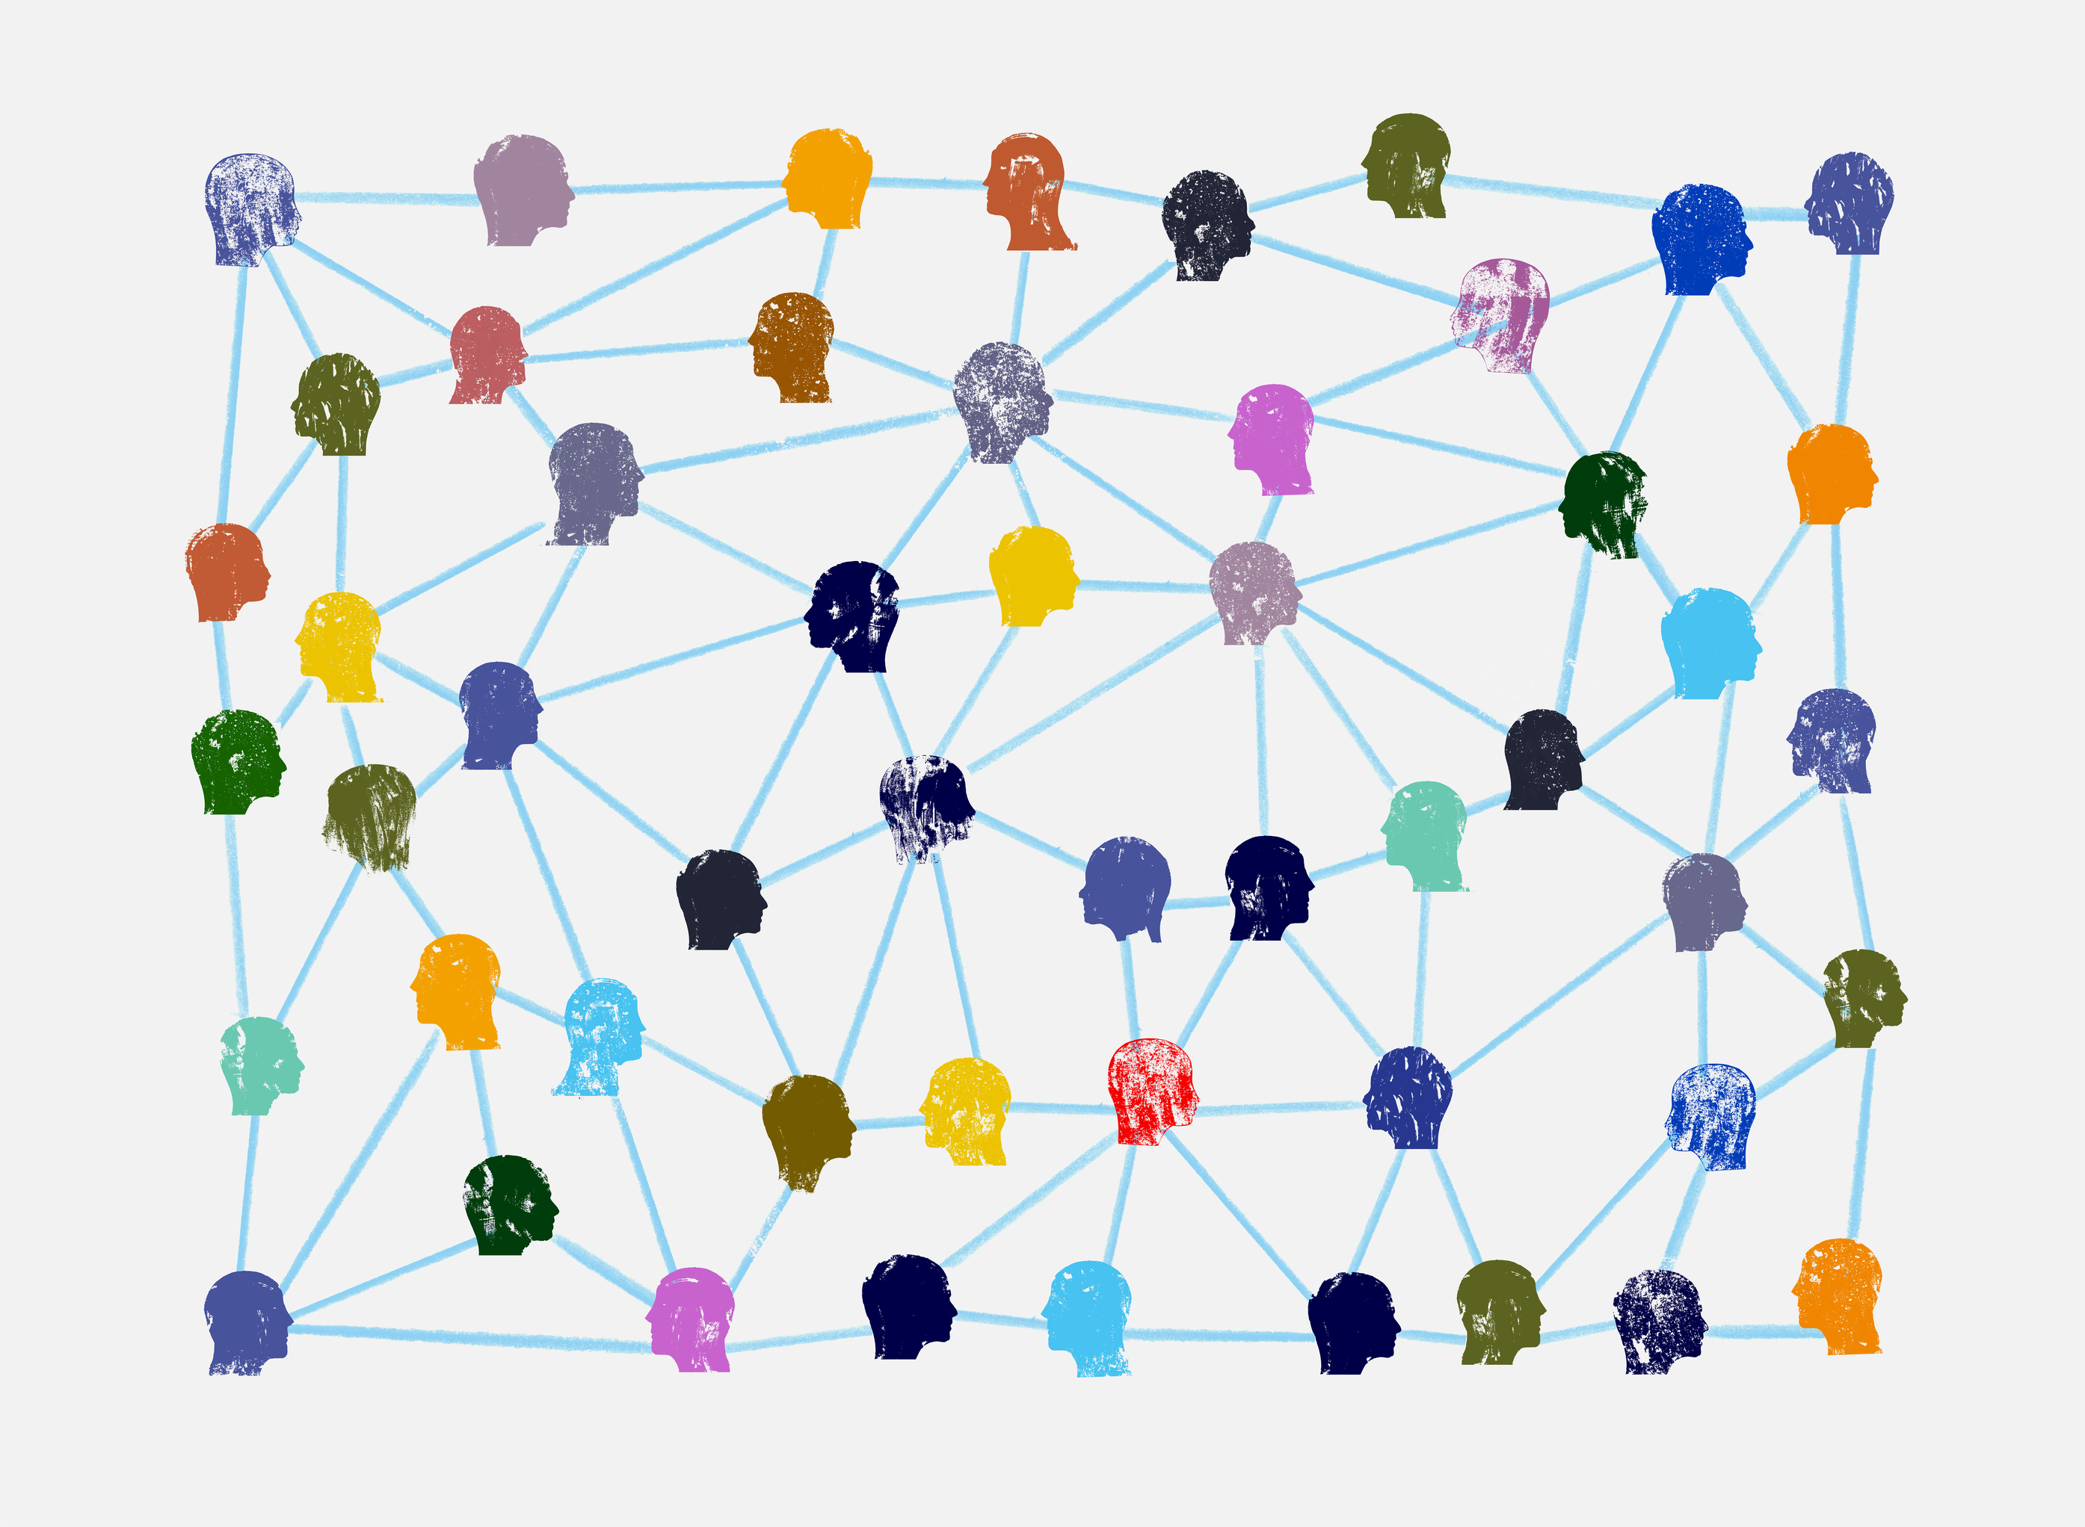
Hall’s
(marriage) theorem
[graph theory approach]

Slide 2
Suppose we are given:
Two finite nonempty sets A (first set) and B (second set);
A nonempty set of pairs of the kind (x,y), where x ∈ A (first
−or initial− element) and y ∈ B (second −or end− element).
We want to ask the question:
is it possible to select some of these given pairs (x,y) in such a way that the following two conditions hold at the same time?
⊳ each element of A is the initial element of exactly one of given pairs;
⊳ no two selected pairs share an end element.
➡
This is asked as: Is it possible to find a complete matching of A
into B (also known as an A-perfect matching) ?

Slide 3
Graphically, we can see this as a bipartite graph (where elements of A, B are depicted as points, and a given pair (x,y) is shown as a line joining x and y):
Bipartite Graph
neither two elements in A nor two
elements in B are joined by means
of a line
A
B
⇔
x₁
y₁
x₂
y₂
y₃
x₃
y₄
x₄
y₅

Slide 4
Graphically, we can see this as a bipartite graph (where elements of A, B are depicted as points, and a given pair (x,y) is shown as a line joining x and y):
Bipartite Graph
neither two elements in A nor two
elements in B are joined by means
of a line
A
B
⇔
x₁
y₁
x₂
y₂
y₃
x₃
A complete matching of A into B
(there are others):
y₄
x₄
y₅
{ (x₁,y₄), (x₂,y₁), (x₃,y₅), (x₄,y₃) }

Slide 5
Some useful notation:
For every nonempty subset S⊆A, let n_{A}(S), n_{B}(S) be defined as:
n_{A}(S) = number of elements of S;
n_{B}(S) = number of elements of B that are linked with some
element of S.
The solution:
Hall’s theorem (graph theory approach)
There exists a complete matching of A into B if and only if
n_{B}(S) ≥ n_{A}(S)
holds for all nonempty S⊆A.

Slide 6
Example 1
A={x₁,x₂,x₃}, B={y₁,y₂,y₃,y₄}, set of lines joining A and
B given in the figure:
A
x₁
y₁
B
x₂
y₂
y₃
x₃
y₄
To start with, how many nonempty subsets S ⊆ A do we have? [choose option…]
7 (2 of them with 2 elements)
8 (3 of them with 2 elements)
7 (3 of them with 2 elements)

Slide 7
EXCELLENT!
back to example

Slide 8
Sorry, that is
not correct
back to example

Slide 9

Example 1
A={x₁,x₂,x₃}, B={y₁,y₂,y₃,y₄}, set of lines joining A and
B given in the figure:
A
x₁
y₁
B
x₂
y₂
y₃
x₃
Note: if A has N elements, there are as many nonempty subsets S ⊆ A as 2^{N}-1
y₄
For each of the 7 nonempty subsets S of A, let us check whether n_{B}(S) ≥ n_{A}(S) or not
(call S_{B} to the set of elements of B that are linked with some element of S):
Subsets with 1 element: S={ x₁ }, n_{A}(S)=1 S_{B}={ y₁, y₂, y₄ }, n_{B}(S)=3 ≥ 1=n_{A}(S)
S={ x₂ }, n_{A}(S)=1 S_{B}={ y₃ }, n_{B}(S)=1 ≥ 1=n_{A}(S)
S={ x₃ }, n_{A}(S)=1 S_{B}={ y₁, y₂ }, n_{B}(S)=2 ≥ 1=n_{A}(S)

Slide 10
Example 1
A={x₁,x₂,x₃}, B={y₁,y₂,y₃,y₄}, set of lines joining A and
B given in the figure:
A
x₁
y₁
B
x₂
y₂
y₃
x₃
y₄
For each of the 7 nonempty subsets S of A, let us check whether n_{B}(S) ≥ n_{A}(S) or not
(call S_{B} to the set of elements of B that are linked with some element of S):
Subsets with 2 elements:

Slide 11
Example 1
A={x₁,x₂,x₃}, B={y₁,y₂,y₃,y₄}, set of lines joining A and
B given in the figure:
A
x₁
y₁
B
x₂
y₂
y₃
x₃
y₄
For each of the 7 nonempty subsets S of A, let us check whether n_{B}(S) ≥ n_{A}(S) or not
(call S_{B} to the set of elements of B that are linked with some element of S):
Subsets with 2 elements: S={x₁, x₂}, n_{A}(S)=2 S_{B}={ y₁, y₂, y₃, y₄ }, n_{B}(S)=4 ≥ 2=n_{A}(S)
S={x₁, x₃}, n_{A}(S)=2 S_{B}={ y₁, y₂, y₄ }, n_{B}(S)=3 ≥ 2=n_{A}(S)
S={x₂, x₃}, n_{A}(S)=2 S_{B}={ y₁, y₂, y₃ }, n_{B}(S)=3 ≥ 2=n_{A}(S)

Slide 12
Example 1
A={x₁,x₂,x₃}, B={y₁,y₂,y₃,y₄}, set of lines joining A and
B given in the figure:
A
x₁
y₁
B
x₂
y₂
y₃
x₃
y₄
For each of the 7 nonempty subsets S of A, let us check whether n_{B}(S) ≥ n_{A}(S) or not
(call S_{B} to the set of elements of B that are linked with some element of S):
Subset with 3 elements: S={x₁, x₂, x₃}, n_{A}(S)=3 S_{B}={y₁, y₂, y₃, y₄}, n_{B}(S)=4 ≥ 3=n_{A}(S)

Slide 13
Example 1
A={x₁,x₂,x₃}, B={y₁,y₂,y₃,y₄}, set of lines joining A and
B given in the figure:
A
x₁
y₁
B
x₂
y₂
y₃
x₃
y₄
For each of the 7 nonempty subsets S of A, let us check whether n_{B}(S) ≥ n_{A}(S) or not
(call S_{B} to the set of elements of B that are linked with some element of S):
Subset with 3 elements: S={x₁, x₂, x₃}, n_{A}(S)=3 S_{B}={y₁, y₂, y₃, y₄}, n_{B}(S)=4 ≥ 3=n_{A}(S)
Hence, there exists a complete matching of A into B; for example:
{ x₁y₁, x₂y₃, x₃y₂ }

Slide 14
Example 2
A={x₁,x₂,x₃,x₄}, B={y₁,y₂,y₃,y₄}, set of lines joining A and B given in the figure:
A
x₁
y₁
B
x₂
y₂
x₃
y₃
x₄
y₄

Slide 15
Example 2
A={x₁,x₂,x₃,x₄}, B={y₁,y₂,y₃,y₄}, set of lines joining A and B given in the figure:
A
x₁
y₁
B
x₂
y₂
x₃
y₃
x₄
y₄
For the 2⁴-1=15 nonempty subsets S of A, please check whether n_{B}(S) ≥ n_{A}(S) or not:
For all subsets with 1 element:
n_{B}(S) ≥ n_{A}(S)
TRUE
n_{B}(S) ≥ n_{A}(S)
FALSE

Slide 16
GREAT!
back to example

Slide 17
I am afraid it is the other way around
back to example

Slide 18
Example 2
A={x₁,x₂,x₃,x₄}, B={y₁,y₂,y₃,y₄}, set of lines joining A and B given in the figure:
A
x₁
y₁
B
x₂
y₂
x₃
y₃
x₄
y₄
Note that (again: S_{B}=set of elements of B that are linked with some element of S):
For all subsets with 1 element: S={ x₁ }, n_{A}(S)=1 S_{B}={ y₁, y₂ }, n_{B}(S)=2 ≥ 1=n_{A}(S)
S={ x₂ }, n_{A}(S)=1 S_{B}={ y₂, y₃, y₄ }, n_{B}(S)=3 ≥ 1=n_{A}(S)
S={ x₃ }, n_{A}(S)=1 S_{B}={ y₁ }, n_{B}(S)=1 ≥ 1=n_{A}(S)
S={ x₄ }, n_{A}(S)=1 S_{B}={ y₁, y₂ }, n_{B}(S)=2 ≥ 1=n_{A}(S)

Slide 19
Example 2
A={x₁,x₂,x₃,x₄}, B={y₁,y₂,y₃,y₄}, set of lines joining A and B given in the figure:
A
x₁
y₁
B
x₂
y₂
x₃
y₃
x₄
y₄
Please continue checking whether n_{B}(S) ≥ n_{A}(S) or not:
For all subsets with 2 elements:
n_{B}(S) ≥ n_{A}(S)
TRUE
n_{B}(S) ≥ n_{A}(S)
FALSE

Slide 20
WONDERFUL!
back to example

Slide 21
One can guess:
some detail is missing
back to example

Slide 22
Example 2
A={x₁,x₂,x₃,x₄}, B={y₁,y₂,y₃,y₄}, set of lines joining A and B given in the figure:
A
x₁
y₁
B
x₂
y₂
x₃
y₃
x₄
y₄
Note that, for all subsets with 2 elements (n_{A}(S)=2) :
S={ x₁, x₂ } S_{B}={ y₁, y₂, y₃, y₄ }, n_{B}(S)=4 ≥ n_{A}(S)
S={ x₁, x₃ } S_{B}={ y₁, y₂ }, n_{B}(S)=2 ≥ n_{A}(S)
S={ x₁, x₄ } S_{B}={ y₁, y₂ }, n_{B}(S)=2 ≥ n_{A}(S)
S={ x₂, x₃ } S_{B}={ y₁, y₂, y₃, y₄ }, n_{B}(S)=4 ≥ n_{A}(S)
S={ x₂, x₄ } S_{B}={ y₁, y₂, y₃, y₄ }, n_{B}(S)=4 ≥ n_{A}(S)
S={ x₃, x₄ } S_{B}={ y₁, y₂ }, n_{B}(S)=2 ≥ n_{A}(S)

Slide 23
Example 2
A={x₁,x₂,x₃,x₄}, B={y₁,y₂,y₃,y₄}, set of lines joining A and B given in the figure:
A
x₁
y₁
B
x₂
y₂
x₃
y₃
x₄
y₄
Please continue checking whether n_{B}(S) ≥ n_{A}(S) or not:
For all subsets with 3 elements:
n_{B}(S) ≥ n_{A}(S)
TRUE
n_{B}(S) ≥ n_{A}(S)
FALSE

Slide 24
WOW, YOU
GOT IT!
back to example

Slide 25
Have you tried
with subset
S={ x₁, x₃, x₄ } ⊆ A ?
back to example

Slide 26

Example 2
A={x₁,x₂,x₃,x₄}, B={y₁,y₂,y₃,y₄}, set of lines joining A and B given in the figure:
A
x₁
y₁
B
x₂
y₂
x₃
y₃
x₄
y₄
Indeed, for all subsets with 3 elements (n_{A}(S)=3) :
S={ x₁, x₂, x₃ } S_{B}={ y₁, y₂, y₃, y₄ }, n_{B}(S)=4 ≥ n_{A}(S)
S={ x₁, x₂, x₄ } S_{B}={ y₁, y₂, y₃, y₄ }, n_{B}(S)=4 ≥ n_{A}(S)
S={ x₁, x₃, x₄ } S_{B}={ y₁, y₂}, n_{B}(S)=2 < n_{A}(S)
S={ x₂, x₃, x₄ } S_{B}={ y₁, y₂, y₃, y₄ }, n_{B}(S)=4 ≥ n_{A}(S)
there does not exist a complete matching of A into B
[the other sets S ( ) shown for completion]

