Slide 1
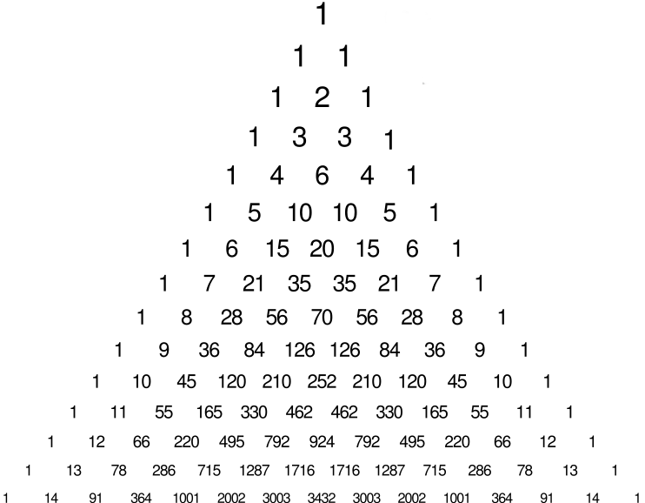
Combinatorial numbers

Slide 2
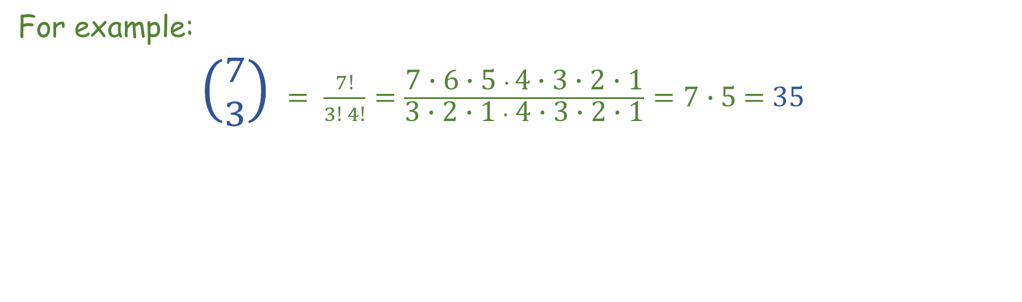
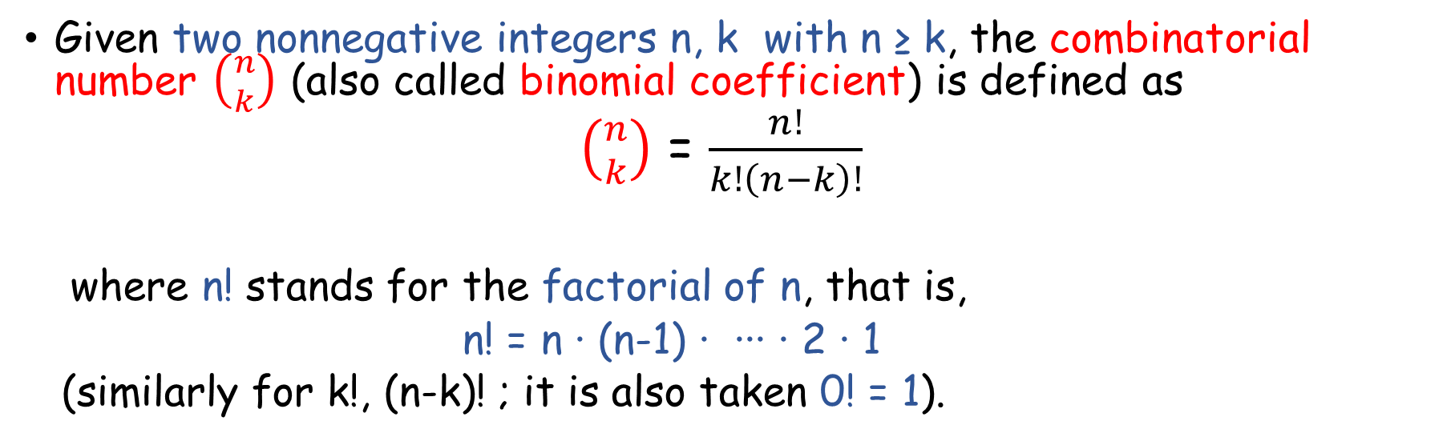
Definition
Given two nonnegative integers n, k with n ≥ k, the combinatorial number $\left({n \atop k}\right)$ (also called binomial coefficient) is defined as
$\left({n \atop k}\right)$ = $\frac{n!}{k!\left(n−k\right)!}$
where n! stands for the factorial of n, that is,
n! = n ∙ (n-1) ∙ ∙∙∙ ∙ 2 ∙ 1
(similarly for k!, (n-k)! ; it is also taken 0! = 1).
For example:
$\left({7 \atop 3}\right)$ $= \frac{7!}{3! 4!}=\frac{\text{7}\text{ ∙ }\text{6}\text{ ∙}\text{ 5 }∙ \text{4}\text{ ∙} \text{3 }\text{∙ 2 ∙ 1}}{\text{3 }\text{∙ 2 ∙ 1} ∙ \text{4}\text{ ∙}\text{ 3 }\text{∙ 2 ∙ 1}}=7∙$ 5 = 35

Slide 3
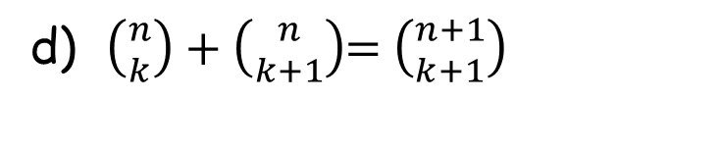
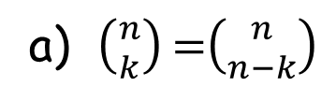
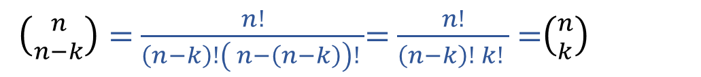

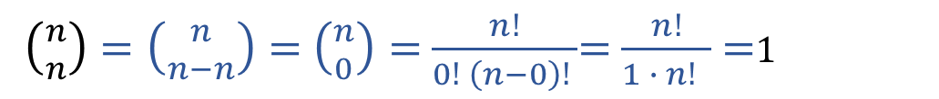

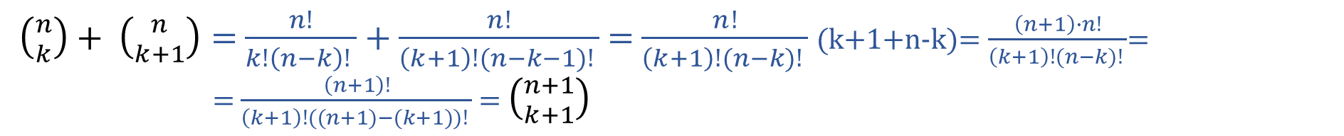
Four basic properties
For all given two nonnegative integers n, k with n ≥ k, the following four
properties hold:
b) $\left({n \atop 0}\right)$ =$\left({n \atop n}\right)$=1
$\left({n \atop n−k}\right)=$ $\frac{n!}{\left(n−k\right)!\left( n−\left(n−k\right)\right)! }$= $\frac{n!}{\left(n−k\right)! k! }$ =$\left({n \atop k}\right)$
a) $\left({n \atop k}\right)$=$\left({n \atop n−k}\right)$
a)
c) $\left({n \atop 1}\right)$=$\left({n \atop n−1}\right)=n$
$\left({n \atop n}\right)=\left({n \atop n−n}\right)=$ $\left({n \atop 0}\right)=$ $\frac{n!}{0! \left(n−0\right)! }$= $\frac{n!}{1 ∙ n! }$ =1
a)
$\left({n \atop n−1}\right)=\left({n \atop n−(n−1)}\right)=$ $\left({n \atop 1}\right)=$ $\frac{n!}{1! \left(n−1\right)! }$= $\frac{n ∙(n−1)!}{(n−1)! }$ = $n$
d) $\left({n \atop k}\right)+\left({n \atop k+1}\right)$= $\left({n+1 \atop k+1}\right)$
$\left({n \atop k}\right)+ \left({n \atop k+1}\right)=$ $\frac{n!}{k!\left(n−k\right)! }$ + $\frac{n!}{\left(k+1\right)!(n−k−1)! }$ = $\frac{n!}{\left(k+1\right)!(n−k)! }$ (k+1+n-k)= $\frac{\left(n+1\right)∙n!}{\left(k+1\right)!(n−k)! }$=
= $\frac{\left(n+1\right)!}{\left(k+1\right)!((n+1)−(k+1))! }$ = $\left({n+1 \atop k+1}\right)$

Slide 4
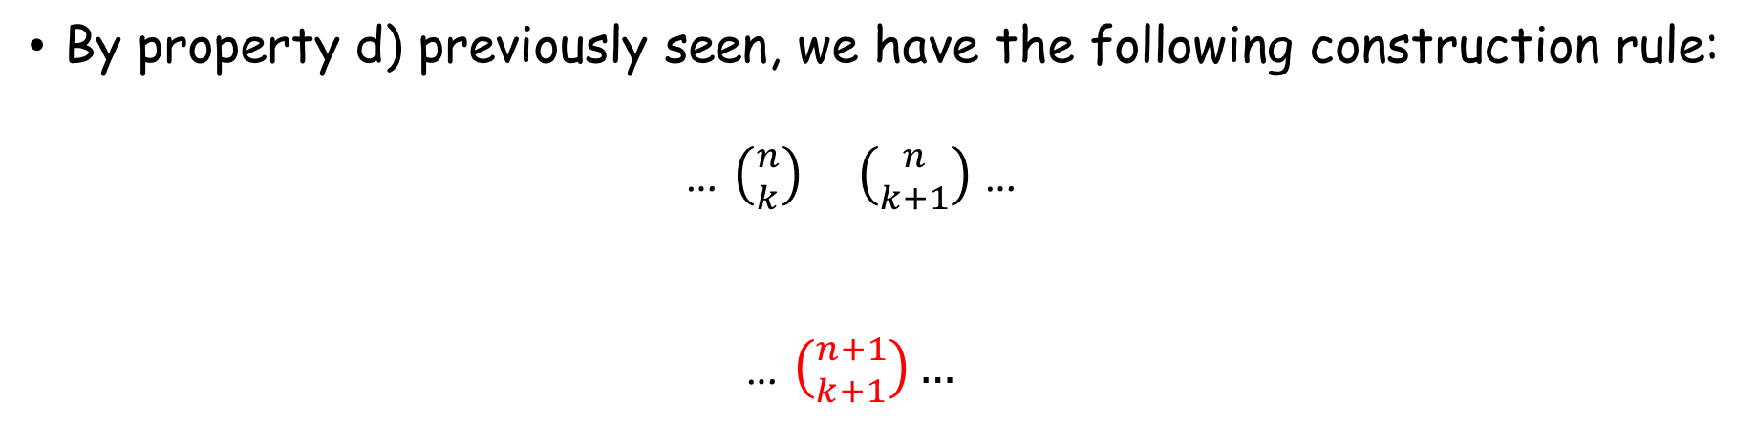
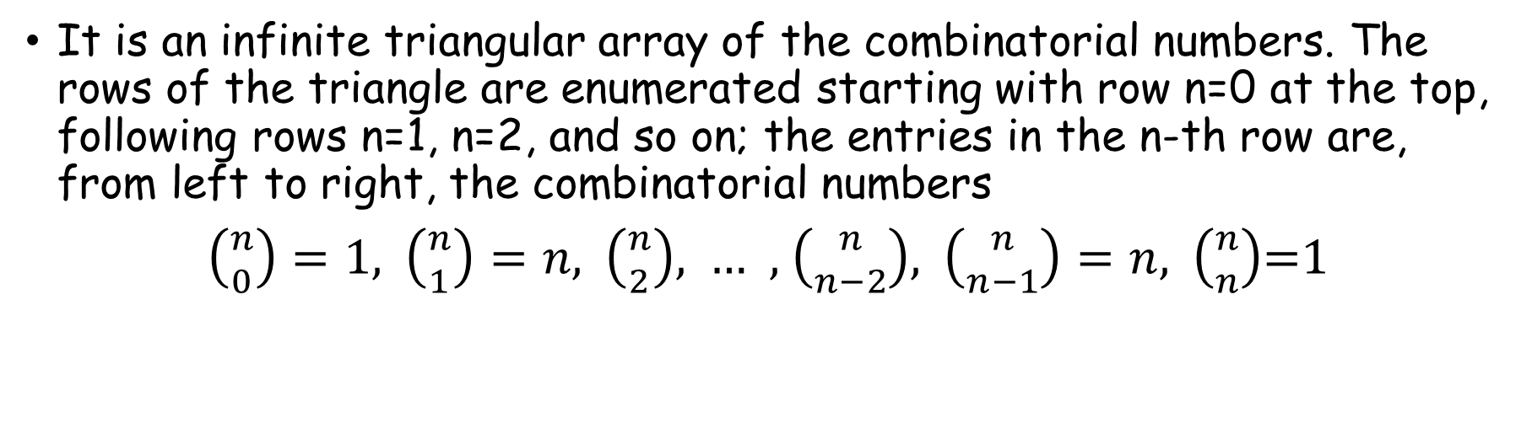
Pascal’s triangle
It is an infinite triangular array of the combinatorial numbers. The rows of the triangle are enumerated starting with row n=0 at the top, following rows n=1, n=2, and so on; the entries in the n-th row are, from left to right, the combinatorial numbers
$\left({n \atop 0}\right)=1,$ $\left({n \atop 1}\right)=n$, $\left({n \atop 2}\right)$, … , $\left({n \atop n−2}\right)$, $\left({n \atop n−1}\right)=n,$ $\left({n \atop n}\right)$=1
By property d) previously seen, we have the following construction rule:
… $\left({n \atop k}\right) \left({n \atop k+1}\right)$ …
… $\left({n+1 \atop k+1}\right)…$
row n
✚
row n+1

Slide 5
Let’s construct the first rows of Pascal’s triangle:
Combinatorial numbers in the row
(left to right)
Row
Pascal’s triangle
$0 \left({0 \atop 0}\right)$ $1$
$1 \left({1 \atop 0}\right),\left({1 \atop 1}\right) 1 1$
✚
$2 \left({2 \atop 0}\right),\left({2 \atop 1}\right),\left({2 \atop 2}\right) 1 2 1$

Slide 6
Let’s construct the first rows of Pascal’s triangle:
Combinatorial numbers in the row
(left to right)
Row
Pascal’s triangle
$0 \left({0 \atop 0}\right)$ $1$
$1 \left({1 \atop 0}\right),\left({1 \atop 1}\right) 1 1$
$2 \left({2 \atop 0}\right),\left({2 \atop 1}\right),\left({2 \atop 2}\right) 1 2 1$
✚
$3 \left({3 \atop 0}\right),\left({3 \atop 1}\right),\left({3 \atop 2}\right),\left({3 \atop 3}\right) 1 3 3 1$

Slide 7
Let’s construct the first rows of Pascal’s triangle:
Combinatorial numbers in the row
(left to right)
Row
Pascal’s triangle
$0 \left({0 \atop 0}\right)$ $1$
$1 \left({1 \atop 0}\right),\left({1 \atop 1}\right) 1 1$
$2 \left({2 \atop 0}\right),\left({2 \atop 1}\right),\left({2 \atop 2}\right) 1 2 1$
✚
$3 \left({3 \atop 0}\right),\left({3 \atop 1}\right),\left({3 \atop 2}\right),\left({3 \atop 3}\right) 1 3 3 1$

Slide 8
Let’s construct the first rows of Pascal’s triangle:
Combinatorial numbers in the row
(left to right)
Row
Pascal’s triangle
$0 \left({0 \atop 0}\right)$ $1$
$1 \left({1 \atop 0}\right),\left({1 \atop 1}\right) 1 1$
$2 \left({2 \atop 0}\right),\left({2 \atop 1}\right),\left({2 \atop 2}\right) 1 2 1$
$3 \left({3 \atop 0}\right),\left({3 \atop 1}\right),\left({3 \atop 2}\right),\left({3 \atop 3}\right) 1 3 3 1$
✚
$4 \left({4 \atop 0}\right),\left({4 \atop 1}\right),\left({4 \atop 2}\right),\left({4 \atop 3}\right),\left({4 \atop 4}\right) 1 4 6 4 1$

Slide 9
Let’s construct the first rows of Pascal’s triangle:
Combinatorial numbers in the row
(left to right)
Row
Pascal’s triangle
$0 \left({0 \atop 0}\right)$ $1$
$1 \left({1 \atop 0}\right),\left({1 \atop 1}\right) 1 1$
$2 \left({2 \atop 0}\right),\left({2 \atop 1}\right),\left({2 \atop 2}\right) 1 2 1$
$3 \left({3 \atop 0}\right),\left({3 \atop 1}\right),\left({3 \atop 2}\right),\left({3 \atop 3}\right) 1 3 3 1$
✚
$4 \left({4 \atop 0}\right),\left({4 \atop 1}\right),\left({4 \atop 2}\right),\left({4 \atop 3}\right),\left({4 \atop 4}\right) 1 4 6 4 1$

Slide 10
Let us construct the first rows of Pascal’s triangle:
Combinatorial numbers in the row
(left to right)
Row
Pascal’s triangle
$0 \left({0 \atop 0}\right)$ $1$
$1 \left({1 \atop 0}\right),\left({1 \atop 1}\right) 1 1$
$2 \left({2 \atop 0}\right),\left({2 \atop 1}\right),\left({2 \atop 2}\right) 1 2 1$
$3 \left({3 \atop 0}\right),\left({3 \atop 1}\right),\left({3 \atop 2}\right),\left({3 \atop 3}\right) 1 3 3 1$
✚
$4 \left({4 \atop 0}\right),\left({4 \atop 1}\right),\left({4 \atop 2}\right),\left({4 \atop 3}\right),\left({4 \atop 4}\right) 1 4 6 4 1$
$… … …$
Up to row n=14 Pascal’s triangle looks like follows:

Slide 11


Slide 12
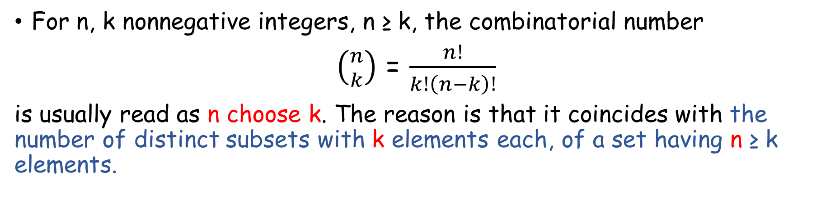
Combinatorial interpretation
For n, k nonnegative integers, n ≥ k, the combinatorial number
$\left({n \atop k}\right)$ = $\frac{n!}{k!\left(n−k\right)!}$
is usually read as n choose k. The reason is that it coincides with the number of distinct subsets with k elements each, of a set having n ≥ k elements.
Note that two such subsets with k elements (two k-subsets, as is usually said) are distinct when they have at least one noncommon element, ordering of elements here is not taken into account.
For example, 3-subsets of A={1,2,3,4,5,6} are S₁={1,2,3}, S₂={2,4,6}, and S₃={3,1,2}, for which: S₁ ≠ S₂, S₂ ≠ S₃, but S₁ = S₃.

Slide 13
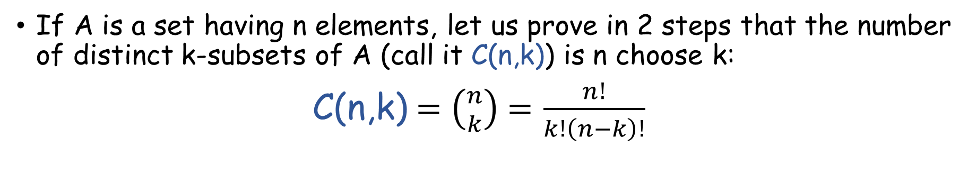
If A is a set having n elements, let us prove in 2 steps that the number of distinct k-subsets of A (call it C(n,k)) is n choose k:
C(n,k)$=\left({n \atop k}\right)$ $=$ $\frac{n!}{k!\left(n−k\right)!}$
①
First, note that the number of distinct ways we can order the elements of A (the number of distinct permutations of A) is n!, because:
- we have n possibilities for the 1st element;
- we then have n-1 possibilities for the 2nd element (≠ from 1st);
…
- we have 1 possibility for the last element (≠ from the n-1 chosen
before). Hence,
n ∙ (n-1) ∙ (n-2) ∙ ∙∙∙ ∙ 1 = n! possibilities

Slide 14
For example, the permutations of A={a,b,c} are the following 3! = 6
ordered sets P₁, P₂, …, P₆:
1st element 2nd element 3rd element Set P_{i}
b
c
P₁=(a,b,c)
a
A={a,b,c}
c
b
P₂=(a,c,b)
a
c
P₃=(b,a,c)
b
c
a
P₄=(b,c,a)
a
b
P₅=(c,a,b)
c
b
a
P₆=(c,b,a)

Slide 15
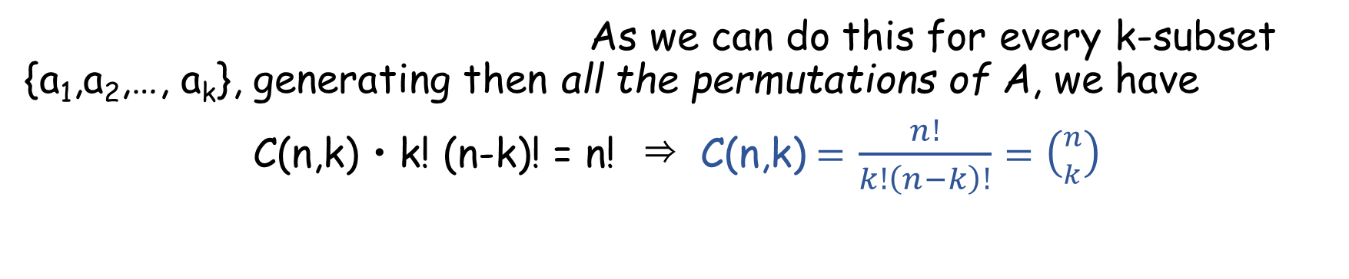
②
Consider next a k-subset of A, say {a₁,a₂,…, a_{k}}, and also the (n-k)-subset of A formed with the remaining elements of A, call it {a_{k+1},a_{k+2},…, a_{n}}. And form the ordered set
s = (a₁,a₂,…, a_{k}, a_{k+1},a_{k+2},…, a_{n}),
which is a permutation of A.
If we reorder its first k entries (there are k! possibilities) we obtain different permutations of A;
and, for each of them, if we reorder its last n-k entries (there are (n-k)! possibilities) we obtain new different permutations of A. In other words, from the ordered set s we can obtain as many as
k! (n-k)!
different permutations of A.
As we can do this for every k-subset {a₁,a₂,…, a_{k}}, generating then all the permutations of A, we have
C(n,k) • k! (n-k)! = n! ⇒ C(n,k)$=$ $\frac{n!}{k!\left(n−k\right)!}=\left({n \atop k}\right)$

Slide 16
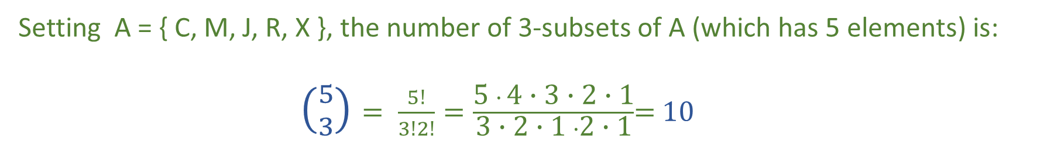
Example
Carles (C), Montse (M), Jordi (J), Rosa (R), and Xavier (X) are 5 researchers in Mathematics, they all belong to the same university. They want to attend an international conference in their field, but financial constraints only permit attending to 3 of them. How many possibilities exist for selecting such a group of 3 ?
Setting A = { C, M, J, R, X }, the number of 3-subsets of A (which has 5 elements) is:
$\left({5 \atop 3}\right)$ $= \frac{5!}{3!2!}=\frac{\text{5 }∙ \text{4}\text{ ∙} \text{3 }\text{∙ 2 ∙ 1}}{\text{3 }\text{∙ 2 ∙ 1} ∙\text{2 ∙ 1}}$= 10
In fact, the 10 such 3-subsets of A are:
S₁ = { C, M, J }, S₂ = { C, M, R }, S₃ = { C, M, X }, S₄ = { C, J, R }, S₅ = { C, J, X },
S₆ = { C, R, X }, S₇ = { M, J, R }, S₈ = { M, J, X }, S₉ = { M, R, X }, S₁₀ = { J, R, X }.

