Slide 1

Binomial theorem

Slide 2
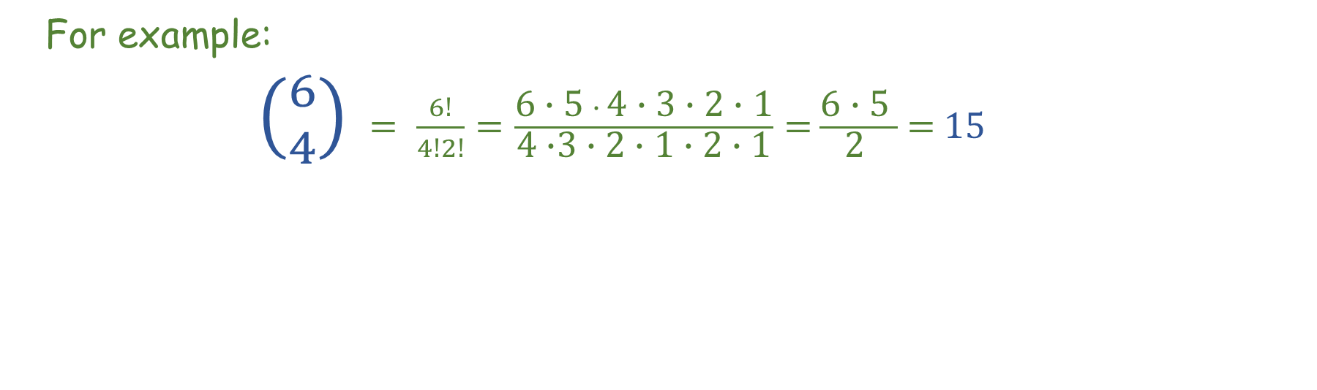
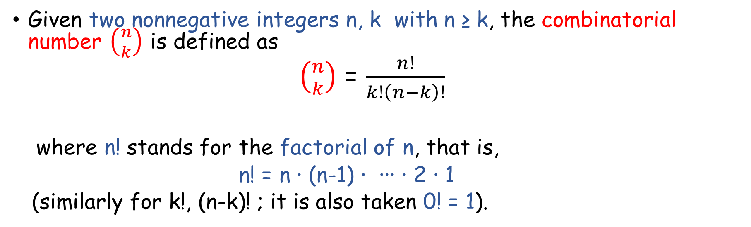
Recall:
Given two nonnegative integers n, k with n ≥ k, the combinatorial number $\left({n \atop k}\right)$ is defined as
$\left({n \atop k}\right)$ = $\frac{n!}{k!\left(n−k\right)!}$
where n! stands for the factorial of n, that is,
n! = n ∙ (n-1) ∙ ∙∙∙ ∙ 2 ∙ 1
(similarly for k!, (n-k)! ; it is also taken 0! = 1).
For example:
$\left({6 \atop 4}\right)$ $= \frac{6!}{4!2!}=\frac{\text{6}\text{ ∙}\text{ 5 }∙ \text{4}\text{ ∙} \text{3 }\text{∙ 2 ∙ 1}}{\text{4 }\text{∙}\text{3 }\text{∙ 2 ∙ 1} \text{∙} \text{2 ∙ 1}}=$ $\frac{\text{6}\text{ ∙}\text{ 5 }}{\text{2 }}$ = 15

Slide 3
Among others, two important facts should be recalled:
1) $\left({n \atop k}\right)$=$\left({n \atop n−k}\right)$ holds for all integer k = 0, 1, …, n.
2) $\left({n \atop k}\right)$= number of distinct subsets with k elements each (they are said
to be k-subsets) of a set having n elements (k = 0, 1, …, n), n ≥ k .
Two distinct such k-subsets have at least one noncommon element.

Slide 4
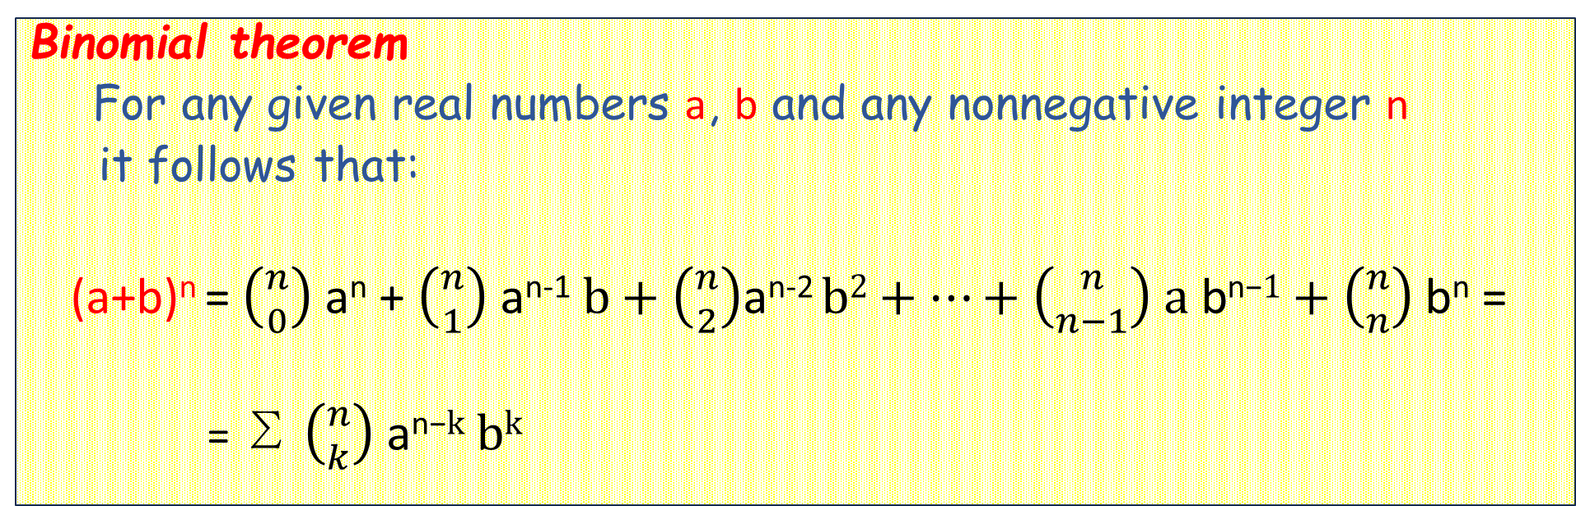
The Binomial Theorem
Binomial theorem
For any given real numbers a, b and any nonnegative integer n
it follows that:
(a+b)^{n} = $\left({n \atop 0}\right)$ a^{n} + $\left({n \atop 1}\right)$ a^{n-1}$b+\left({n \atop 2}\right)\text{a}\text{n}\text{−2} b2+…+\left({n \atop n−1}\right) \text{a} \text{b}\text{n}\text{−}1+\left({n \atop n}\right)$ $\text{b}\text{n}$ =
= ∑ $\left({n \atop k}\right) \text{a}\text{n}\text{−}k bk$
n
k=0
⊳ This theorem is also valid when a, b are complex numbers, and even in
other situations, as when a, b are square matrices such that a ∙ b = b ∙ a.
⊳ Due to this theorem, combinatorial numbers $\left({n \atop k}\right)$ are also called binomial
coefficients.

Slide 5
Example
Which of the following expressions accounts for
(a+b)⁴ (a, b being two given real numbers) ?
Please choose:
a⁴ + 4ab³ + 4a³b + b⁴
a⁴ + 4ab³ + 4a²b² + 4a³b + b⁴
b⁴ + 4ab³ + 6a²b² + 4a³b + a⁴
None of the others

Slide 6
WELL DONE!
back to example

Slide 7
Sorry, check
your answer
try again, please

Slide 8
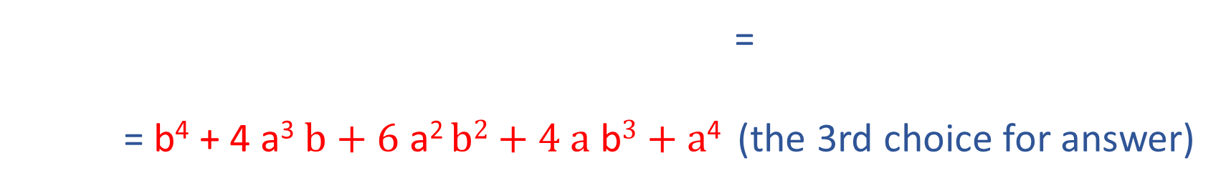
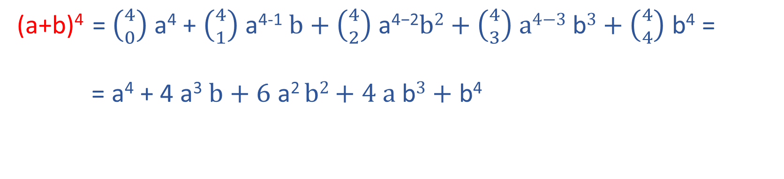
Certainly,
(a+b)⁴ = $\left({4 \atop 0}\right)$ a⁴ + $\left({4 \atop 1}\right)$ a⁴⁻¹$b+\left({4 \atop 2}\right) \text{a}\text{4−2}b2+\left({4 \atop 3}\right) \text{a}\text{4−3} \text{b}3+\left({4 \atop 4}\right)$ $\text{b}\text{4}$ =
= a⁴ + 4 a³$b+\text{6} \text{a}\text{2} b2+\text{4 }\text{a} \text{b}3+\text{b}\text{4}$
sum is commutative (addends a⁴, b⁴)
=
= b⁴ + 4 a³$b+\text{6} \text{a}\text{2} b2+\text{4 }\text{a} \text{b}3+\text{a}\text{4}$ (the 3rd choice for answer)

Slide 9
Binomial theorem: the proof
The theorem clearly holds when either n=0 or n=1, hence suppose n ≥ 2.
Let us first compute (a+b)^{n} for cases n=2, n=3, in a useful way:

Slide 10
Binomial theorem: the proof
The theorem clearly holds when either n=0 or n=1, hence suppose n ≥ 2.
Let us first compute (a+b)^{n} for cases n=2, n=3, in a useful way:
(a+b)² = (a+b) (a+b) =

Slide 11
Binomial theorem: the proof
The theorem clearly holds when either n=0 or n=1, hence suppose n ≥ 2.
Let us first compute (a+b)^{n} for cases n=2, n=3, in a useful way:
(a+b)² = (a+b) (a+b) = a² +

Slide 12
Binomial theorem: the proof
The theorem clearly holds when either n=0 or n=1, hence suppose n ≥ 2.
Let us first compute (a+b)^{n} for cases n=2, n=3, in a useful way:
(a+b)² = (a+b) (a+b) = a² + ab +

Slide 13
Binomial theorem: the proof
The theorem clearly holds when either n=0 or n=1, hence suppose n ≥ 2.
Let us first compute (a+b)^{n} for cases n=2, n=3, in a useful way:
(a+b)² = (a+b) (a+b) = a² + ab + ba +

Slide 14
Binomial theorem: the proof
The theorem clearly holds when either n=0 or n=1, hence suppose n ≥ 2.
Let us first compute (a+b)^{n} for cases n=2, n=3, in a useful way:
(a+b)² = (a+b) (a+b) = a² + ab + ba + b² =

Slide 15
Binomial theorem: the proof
The theorem clearly holds when either n=0 or n=1, hence suppose n ≥ 2.
Let us first compute (a+b)^{n} for cases n=2, n=3, in a useful way:
2^{n} = 2² addends, each of type
a^{n-k} b^{k} for some k, 0 ≤ k ≤ n=2;
k = number of factors in
(a+b) (a+b) where b is chosen
(a+b)² = (a+b) (a+b) = a² + ab + ba + b² =
= a² + ab + ab + b²

Slide 16
Binomial theorem: the proof
The theorem clearly holds when either n=0 or n=1, hence suppose n ≥ 2.
Let us first compute (a+b)^{n} for cases n=2, n=3, in a useful way:
2^{n} = 2² addends, each of type
a^{n-k} b^{k} for some k, 0 ≤ k ≤ n=2;
k = number of factors in
(a+b) (a+b) where b is chosen
(a+b)² = (a+b) (a+b) = a² + ab + ba + b² =
= a² + ab + ab + b²
(a+b)³ = (a+b) (a+b) (a+b)=
= a³ + a²b + aba + ab² +
+ ba² + bab + b²a + b³ =
= a³ + a²b + a²b + ab² +
+ a²b + ab² + ab² + b³
2^{n} = 2³ addends, each of type
a^{n-k} b^{k} for some k, 0 ≤ k ≤ n=3;
k = number of factors in
(a+b) (a+b) (a+b) where b is
chosen
(similarly)

Slide 17
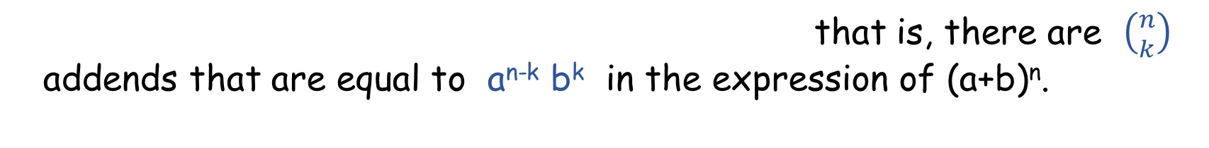
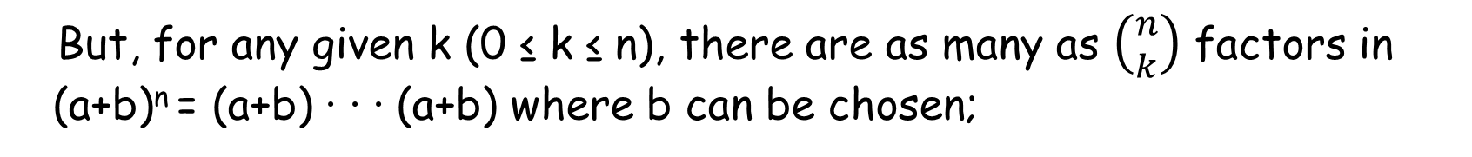

Then, for all n it is clear that we can write (a+b)^{n} in this way with twice
the addends of (a+b)^{n-1}, that is, with:
2^{n} addends, each of type
a^{n-k} b^{k} for some k, 0 ≤ k ≤ n;
k = number of factors in
(a+b) (a+b) ∙∙∙ (a+b) where b
is chosen
But, for any given k (0 ≤ k ≤ n), there are as many as $\left({n \atop k}\right)$factors in
(a+b)^{n} = (a+b) ∙ ∙ ∙ (a+b) where b can be chosen;
that is, there are $\left({n \atop k}\right)$
addends that are equal to a^{n-k} b^{k} in the expression of (a+b)^{n}.
Hence,
finally:
($\text{a}$ + b)^{n} = ∑ $\left({n \atop k}\right) \text{a}\text{n}\text{−}k \text{b}k$
n
k=0

Slide 18
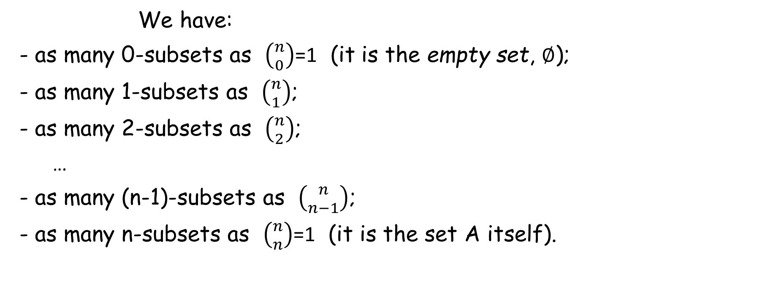
An application: the number of subsets of a finite set
Given a nonempty finite set A with n elements, how many subsets of A are there?
We have:
- as many 0-subsets as $\left({n \atop 0}\right)$=1 (it is the empty set, ∅);
- as many 1-subsets as $\left({n \atop 1}\right)$;
- as many 2-subsets as $\left({n \atop 2}\right)$;
…
- as many (n-1)-subsets as $\left({n \atop n−1}\right)$;
- as many n-subsets as $\left({n \atop n}\right)$=1 (it is the set A itself).
Summing up all these contributions:

Slide 19
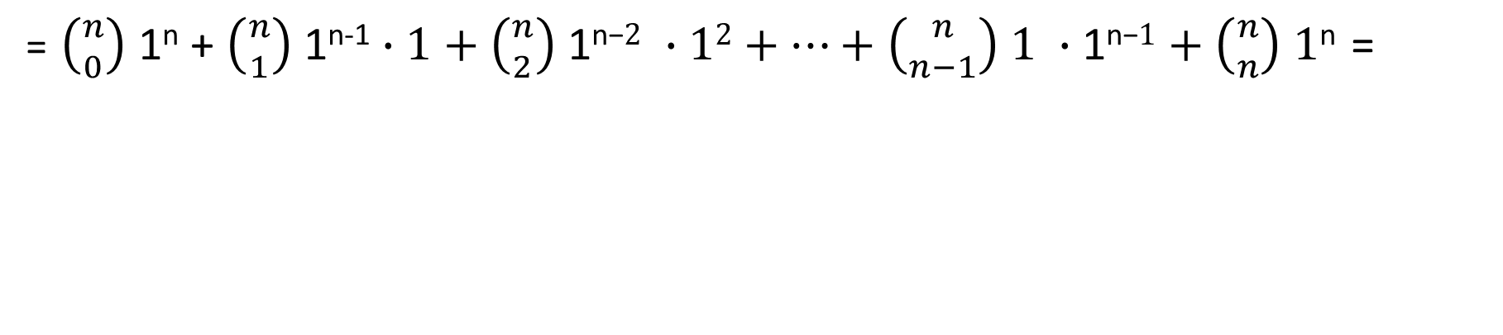
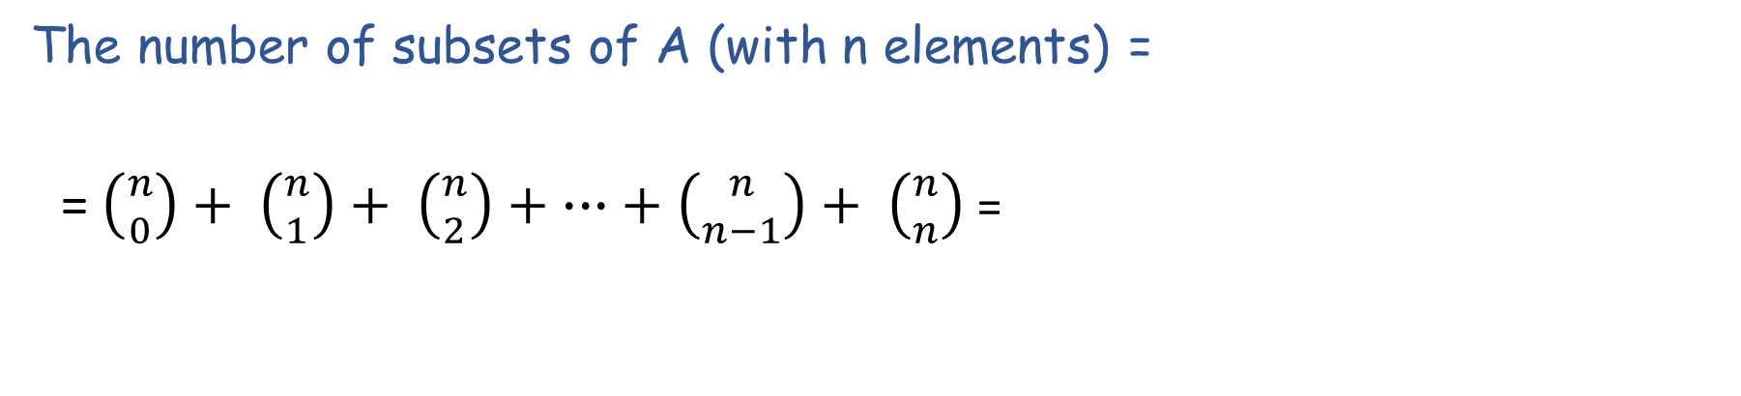
The number of subsets of A (with n elements) =
= $\left({n \atop 0}\right)+ \left({n \atop 1}\right)+ \left({n \atop 2}\right)+ ∙∙∙+ \left({n \atop n−1}\right)+ \left({n \atop n}\right)$ =
= $\left({n \atop 0}\right)$ 1^{n} + $\left({n \atop 1}\right)$ 1^{n-1}$∙1+\left({n \atop 2}\right) \text{1}\text{n}\text{−}2 ∙12+…+\left({n \atop n−1}\right)\text{ 1 }∙\text{1}\text{n}\text{−}1+\left({n \atop n}\right)$ $\text{1}\text{n}$ =
= 2^{n}
= (1+1)^{n}
⇒ A set with n elements has 2^{n} subsets
binomial
theorem

Slide 20
Example
Let us show that the finite nonempty set
A = { 1, 2, 3, 4 }
has as many as 2⁴ = 16 subsets.
Subsets of A :
[with 0 elements] S₁ = ∅
[with 1 element] S₂ = {1}, S₃ = {2}, S₄ = {3}, S₅ = {4}
[with 2 elements] S₆ = {1, 2}, S₇ = {1, 3}, S₈ = {1, 4}, S₉ = {2, 3}, S₁₀ = {2, 4}, S₁₁ = {3, 4}
[with 3 elements] S₁₂ = {1, 2, 3}, S₁₃ = {1, 2, 4}, S₁₄ = {1, 3, 4}, S₁₅ = {2, 3, 4}
[with 4 elements] S₁₆ = {1, 2, 3, 4} = A

