Slide 1
Problems in real-life contexts
Real-World Math Problems
SNOWPLOW PROBLEM

Slide 2
Snowplow problem

Slide 3
Snowplow problem
It starts snowing in the morning and continues steadily throughout the day. A snowplow that removes snow at a constant rate starts plowing at noon. It plows 2 miles in the first hour, and 1 mile in the second. What time did it start snowing?

Slide 4
Snowplow problem
It starts snowing in the morning and continues steadily throughout the day. A snowplow that removes snow at a constant rate starts plowing at noon. It plows 2 miles in the first hour, and 1 mile in the second. What time did it start snowing?
The first version of the snowplow problem was invented by Ralph Palmer Agnew (1900-1986), a mathematician at Cornell University, New York.

Slide 5
Mathematical writing

Slide 6
Mathematical writing

Slide 7



Mathematical writing
Let t be the time measured in hours after noon.
Let x(t) be the distance the snowplow has travelled.
Let h(t) be the height of the snow at time t.
Let k be the constant rate at which snow falls (in any convenient unit).
Let α be the constant rate of snow removal (in any convenient unit).
Let b be the (unknown) number of hours before noon that it started snowing.
The change in height of the snow is given by… [choose option]:
$\frac{dh}{dt}$(t)=k
$\frac{dh}{dt}$(t)=𝛼
$\frac{dh}{dt}$(t)=x(t)

Slide 8

Perfect! Congrats!
return to “mathematical writing”

Slide 9
Sorry, check your answer
try again

Slide 10
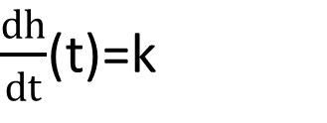
Mathematical writing
Let t be the time measured in hours after noon.
Let x(t) be the distance the snowplow has travelled.
Let h(t) be the height of the snow at time t.
Let k be the constant rate at which snow falls (in any convenient unit).
Let α be the constant rate of snow removal (in any convenient unit).
Let b be the (unknown) number of hours before noon that it started snowing.
The change in height of the snow is given by the rate the snow falls,
$\frac{dh}{dt}$(t)=k

Slide 11
Solve the problem

Slide 12
Solve the problem

Slide 13

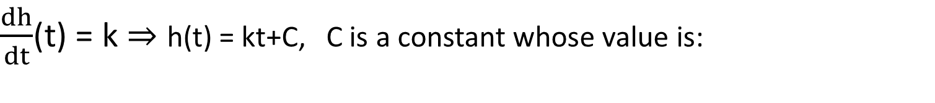


Solve the problem
$\frac{dh}{dt}$(t) = k ⇒ h(t) = kt+C, C is a constant whose value is:
$C=−kb,$
$because$h(b)=0
$C=kb,$
$because$h(-b)=0
$C=0,$
$because$h(0)=0

Slide 14

Great!
Pixabay
return to “solve the problem”

Slide 15
You should take a second look
try again

Slide 16

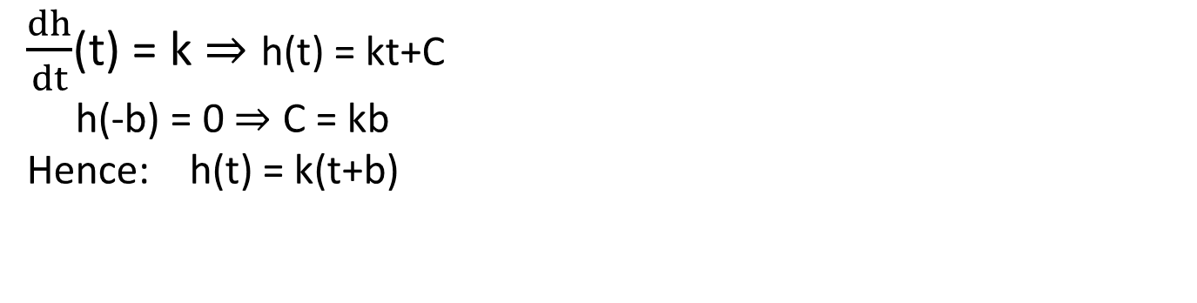


Solve the problem
$\frac{dh}{dt}$(t) = k ⇒ h(t) = kt+C
h(-b) = 0 ⇒ C = kb
Hence: h(t) = k(t+b)
The rate α is proportional to the cross-section of the snow being plowed and the speed of the truck. Let’s assume the width of the road is a constant ω. Then:
$α=ω h\left(t\right) \frac{dx}{dt}$ (t)
$α=ω\frac{dh}{dt}$ (t) x(t)
$ω=α h\left(t\right) \frac{dx}{dt}$ (t)

Slide 17

Brilliant!
Pixabay
return to “solve the problem”

Slide 18
Maybe next time
try again

Slide 19
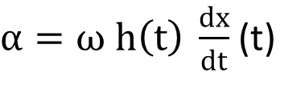
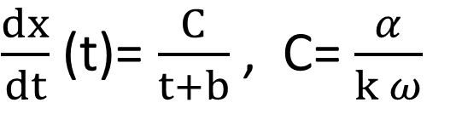
Solve the problem
$\frac{dh}{dt}$(t) = k ⇒ h(t) = kt+C
h(-b) = 0 ⇒ C = kb
Hence: h(t) = k(t+b)
The rate α is proportional to the cross-section of the snow being plowed and the speed of the truck. Let’s assume the width of the road is a constant ω. Then
$α=ω h\left(t\right) \frac{dx}{dt}$ (t)
Rearranging, we find that
$\frac{dx}{dt}$ (t)= $\frac{C}{t+b}$ , C= $\frac{α}{k ω}$
Which is a separable differential equation.

Slide 20
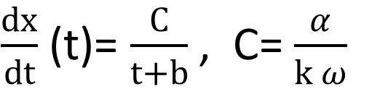
Solve the problem
$\frac{dx}{dt}$ (t)= $\frac{C}{t+b}$ , C= $\frac{α}{k ω}$
Integrating both sides yields
x(t) = C ln(|t + b|) + D
Plugging in the condition x(0) = 0 gives the constant of integration
D = −C ln(b)
Plugging in the other two conditions x(1) = 1(mile) and x(2) = 2, then lets us solve for b:
b = 0.618h (=37 min approximately)
So the snow began about 37 minutes before noon. That is, at about 11:23 am.

Slide 21


Wolframalpha simulation
https://www.wolframalpha.com/

Slide 22

Wolframalpha simulation
Step-by-step solution

