Slide 1
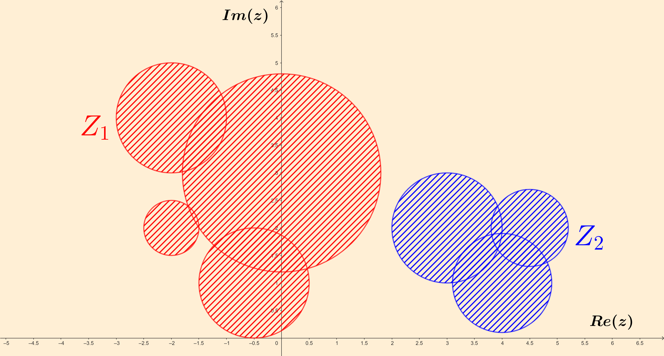
Gershgorin circle
theorem
Gershgorin circle
theorem

Slide 2
To start with [notation]
M_{C}(n x n) : set of square matrices on n rows and n columns, with
entries belonging to the set of complex numbers (C)
1 0 0 0
0 1 0 0
∙∙∙ ∙∙∙ ∙∙∙ ∙∙∙
0 0 0 1
I_{n} = ∈ M_{C}(n x n) : identity matrix (ones in main diagonal,
zeroes outside).
M_{C}(n x 1) : set of column matrices on n rows and 1 column, entries in C
0
0
∙∙∙
0
[0]_{n x 1} = ∈ M_{C}(n x 1) : zero matrix (full of zeroes).

Slide 3
To start with [useful to recall]
Given A ∈ M_{C}(n x n) and λ ∈ C, λ is said to be an eigenvalue of A if there
exists some column matrix X ∈ M_{C}(n x 1), X ≠ [0]_{n x 1}, such that
A X = λ X
( recall that M_{R}(n x n) is included in M_{C}(n x n), where M_{R}(n x n) is the set of square matrices on n rows and n columns with entries belonging to the set of real numbers (R) ).
A^{T} ∈ M_{C}(n x n) (the transpose of A ∈ M_{C}(n x n)) and A have the same set of eigenvalues.
λ ∈ C is an eigenvalue of A ∈ M_{C}(n x n) if and only if
det_{n}(A - λ I_{n}) = 0 (det_{n} = determinant)

Slide 4
det_{n}(A - x I_{n}) is a polynomial of degree n in x (called the characteristic
polynomial of A, denoted p_{A}(x)), that can be written as
p_{A}(x) = det_{n}(A - x I_{n}) = (-1)^{n} (x-λ₁)^{m}1 ∙ (x-λ₂)^{m}2 ∙ … ∙ (x-λ_{s})^{m}s ,
where λ_{i} ≠ λ_{j} when i ≠ j, and each m_{i} is a positive integer called the
multiplicity of λ_{i} ; and m₁ + m₂ + … + m_{s} = n holds.
Hence, {λ₁, λ₂, …, λ_{s}} is the set of all pairwise distinct eigenvalues of A,
each corresponding multiplicity m_{i} indicating how many times eigenvalue λ_{i}
appears repeated as a solution of p_{A}(x) = 0.

Slide 5
For example, for matrix A = we have:
-4 6 1
1 0 -1
-6 7 3
p_{A}(x) = det₃(A - x I₃) = = -x³-x²+5x-3 = -(x-1)² (x+3),
-4-x 6 1
1 -x -1
-6 7 3-x
last expression coming from the fact that -x³-x²+5x-3 = 0 yields the
following solutions: x=1, x=1, x=-3.
Hence, all distinct eigenvalues λ_{i} (and
corresponding multiplicities m_{i}) of A are:
λ₁ = 1 , m₁ = 2
λ₂ = -3, m₂ = 1 (note: m₁ + m₂ = 3 as stated)

Slide 6
To start with [useful to note]
• Knowing the set of eigenvalues of a matrix is one of the most useful tools
in a variety of problems approached by (applied) Mathematics:
- differential equations
- vibration analysis
- control theory
- quantum mechanics
- electric circuits; … and a large etc.
• Calculation of eigenvalues of a matrix can be non-trivial and quite costly
in general. With a very simple function of the matrix elements, Gershgorin
circle theorem allows some amount of localization of those eigenvalues,
which in turn has some important practical consequences.

Slide 7
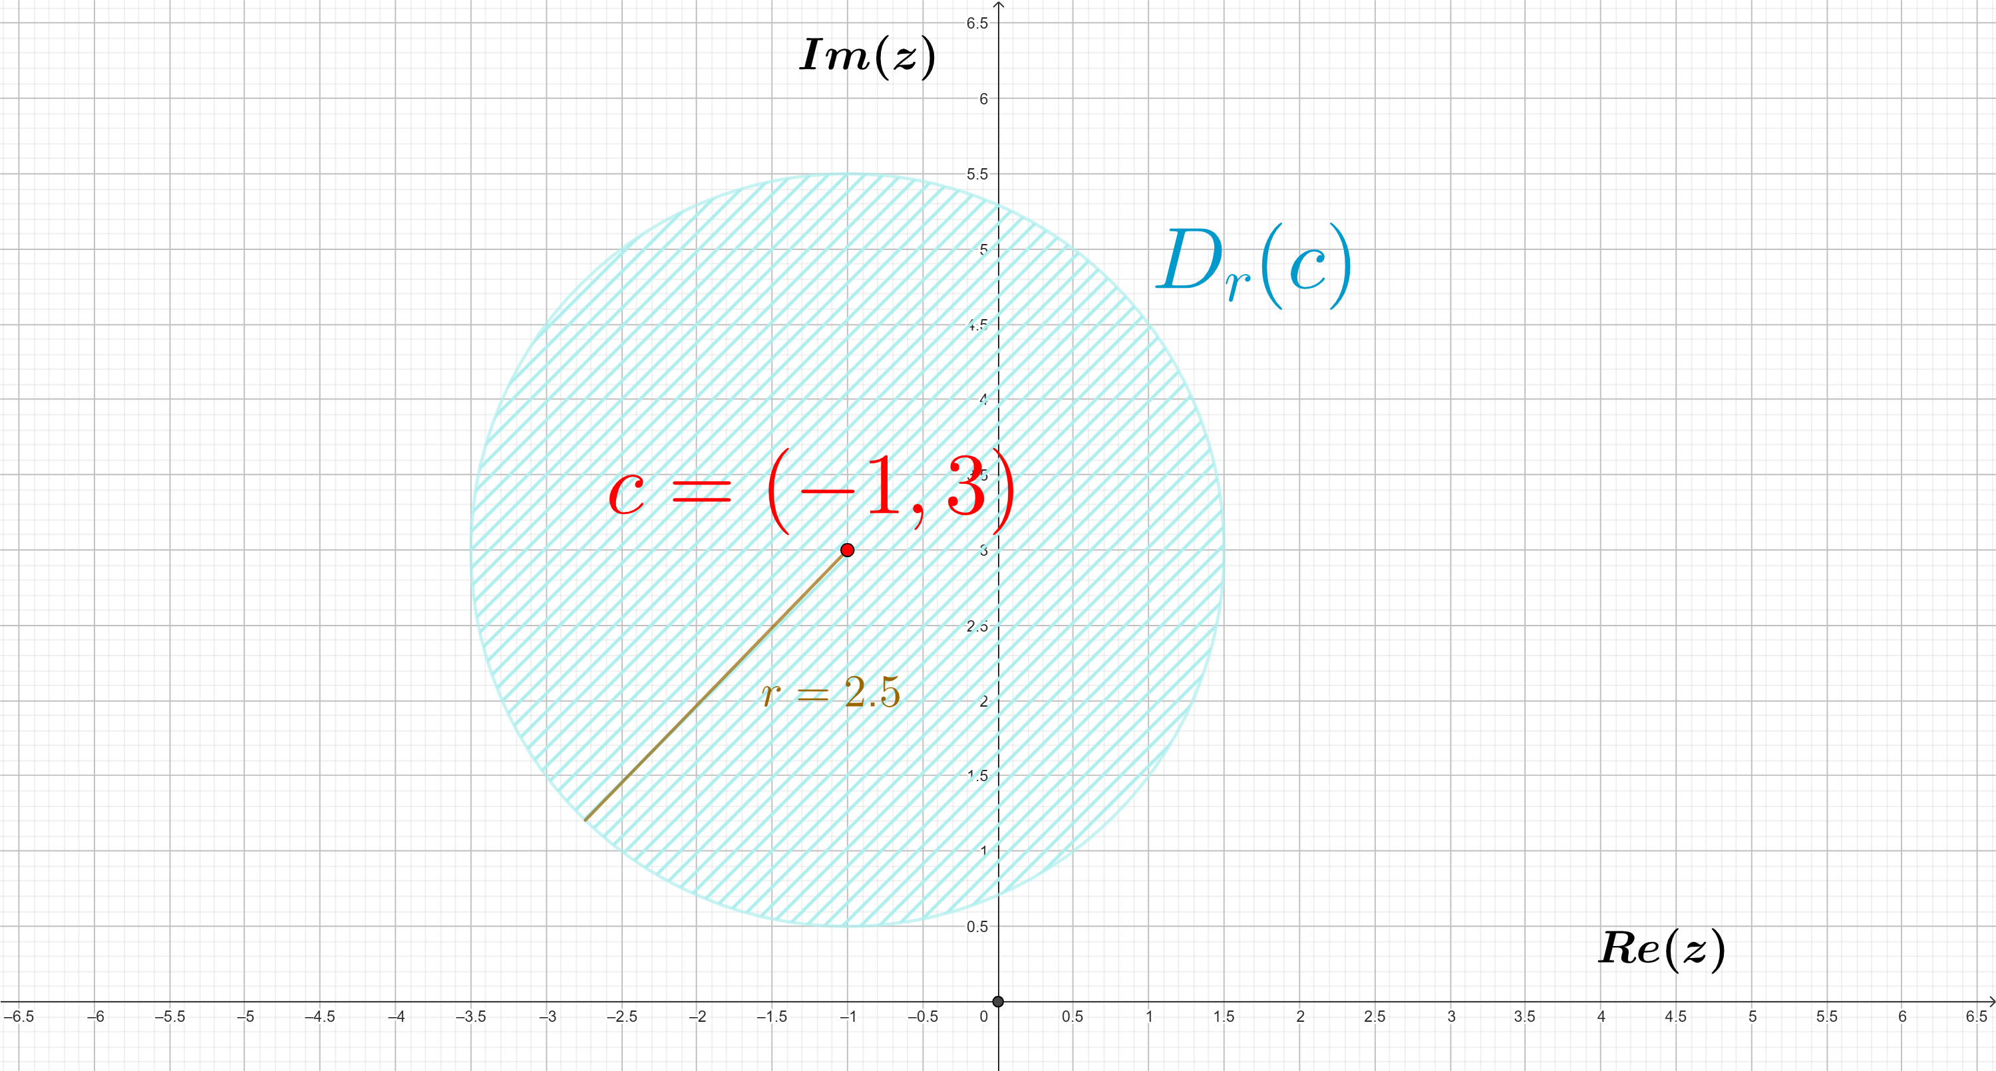
Preparing for the theorem [two definitions]
Given c ∈ C and r ∈ R, r > 0, the disk with center c and radius r is the set
of complex numbers at distance at most r from c; that is,
D_{r}(c) = { z ∈ C : |z-c| ≤ r }
Geometrically is a circle with center c and radius r; in the following
example for c=(-1,3)=-1+3i, r=2.5, D_{r}(c) is the area in blue color:

Slide 8

Given a set of n disks { D_{r1}(c₁), D_{r2}(c₂), … , D_{rn}(c_{n}) }, we will write
D_{r1}(c₁) ∪ D_{r2}(c₂) ∪ ∙∙∙ ∪ D_{rn}(c_{n}) = Z₁ ∪ Z₂ ∪ ∙∙∙ ∪ Z_{s} ,
nonempty sets Z₁, Z₂, ... , Z_{s} satisfying the following three conditions:
a) Z_{i} is the union of some of the given disks, for all i = 1, 2,…, s;
b) Z_{i} ∩ Z_{j} = ∅ for all i , j = 1, 2,…, s, i ≠ j;
c) any two given points of Z_{i} can be connected by means of a
continuous curve that is completely included in Z_{i}, for all i = 1, 2,…, s.
We will call sets Z₁, Z₂, ... , Z_{s} components of the given set of disks
{ D_{r1}(c₁), D_{r2}(c₂), … , D_{rn}(c_{n}) }; components are unique except for relabeling
(the name components has been borrowed from graph theory, as they
correspond to the components of the graph that has centers c₁, …, c_{n}
as vertices, two vertices c_{i}, c_{j} being adjacent if D_{ri}(c_{i}) ∩ D_{rj}(c_{j}) ≠ ∅).

Slide 9
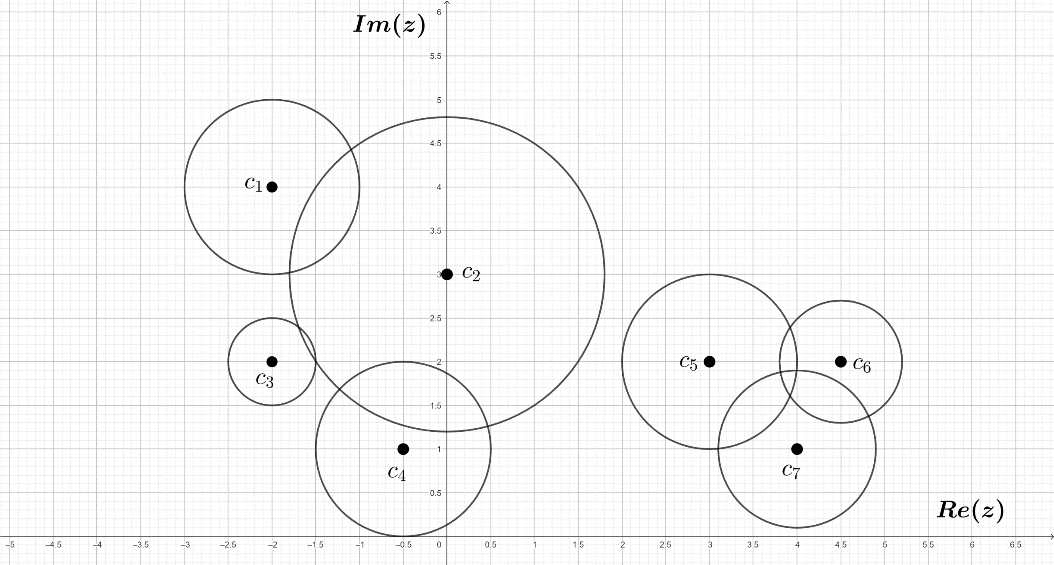
For example, for the following 7 disks

Slide 10
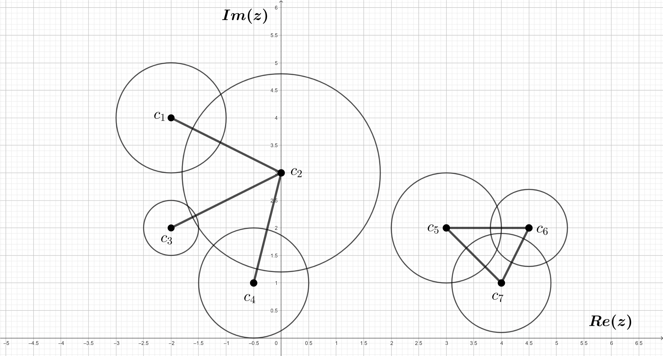
For example, for the following 7 disks we have

Slide 11
For example, for the following 7 disks we have
Z₁
Z₂
Hence, the union of the 7 given disks can be writen as the union of components Z₁, Z₂

Slide 12
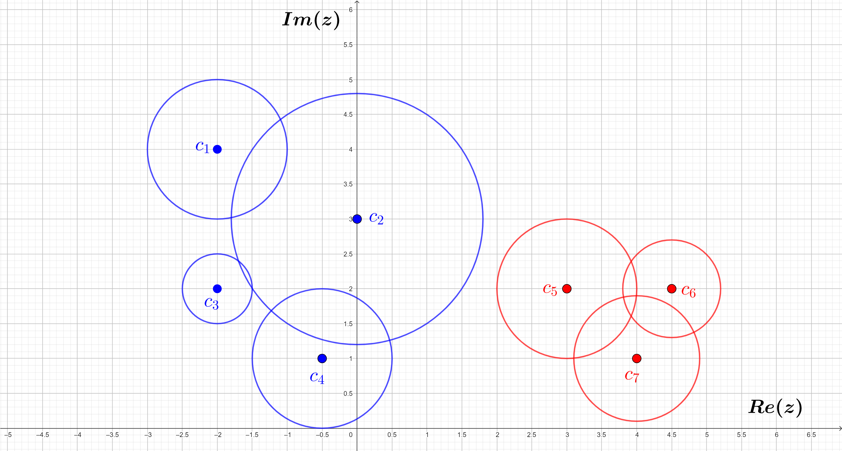
For example, for the following 7 disks we have
Z₁
Z₂
Z₁
Z₂
Hence, the union of the 7 given disks can be writen as the union of components Z₁, Z₂

Slide 13
The Theorem
Gershgorin circle theorem. All the eigenvalues of a square matrix
A = ∈ M_{C}(n x n)
lie in the union of the disks D_{R1}(A₁₁), D_{R2}(A₂₂), … , D_{Rn}(A_{nn}) (from now on,
Gershgorin circles or disks), where each R_{i} is the sum of the modulus of
the nondiagonal elements in row i, for i = 1, 2, …, n : R_{i} = ∑ |A_{ij}|.
A₁₁ A₁₂ ∙∙∙ A_{1n}
A₂₁ A₂₂ ∙∙∙ A_{2n}
∙∙∙ ∙∙∙ ∙∙∙ ∙∙∙
A_{n1} A_{n2} ∙∙∙ A_{nn}
j ≠i
Moreover, if Z₁, Z₂, ... , Z_{s} are the components of the set of Gershgorin
circles, then in each Z_{i} we can find a number of distinct eigenvalues of A
that runs between 1 and the number of Gershgorin circles contained in Z_{i}.

Slide 14
Notice that:
⊳ Gershgorin circle D_{Ri}(A_{ii}) is centered at the diagonal element A_{ii} of the
matrix (row i), R_{i} being calculated from the other elements in row i.
⊳ As A^{T} and A have the same eigenvalues and the rows of A^{T} are the columns of A, Gershgorin circle theorem can be applied to locate the eigenvalues of A by using as new Gershgorin circles the sets
D_{R’1}(A₁₁), D_{R’2}(A₂₂), … , D_{R’n}(A_{nn}) ,
each D_{R’i}(A_{ii}) centered at the diagonal element A_{ii} of the matrix (in column i), R’_{i} being obtained from the other elements in column i:
R’_{i} = ∑ |A_{ki}|.
k ≠i

Slide 15
For example, for matrix A = we have:
5 1 1
1 1 0
2 0 -1

Slide 16
For example, for matrix A = we have:
5 1 1
1 1 0
2 0 -1
Gershgorin circles (rows of A):
A₁₁ = 5, R₁ = |1|+|1| = 2

Slide 17
For example, for matrix A = we have:
5 1 1
1 1 0
2 0 -1
Gershgorin circles (rows of A):
A₁₁ = 5, R₁ = |1|+|1| = 2 D₂(5)

Slide 18
For example, for matrix A = we have:
5 1 1
1 1 0
2 0 -1
Gershgorin circles (rows of A):
A₁₁ = 5, R₁ = |1|+|1| = 2 D₂(5)
A₂₂ = 1, R₂ = |1|+|0| = 1

Slide 19
For example, for matrix A = we have:
5 1 1
1 1 0
2 0 -1
Gershgorin circles (rows of A):
A₁₁ = 5, R₁ = |1|+|1| = 2 D₂(5)
A₂₂ = 1, R₂ = |1|+|0| = 1 D₁(1)

Slide 20
For example, for matrix A = we have:
5 1 1
1 1 0
2 0 -1
Gershgorin circles (rows of A):
A₁₁ = 5, R₁ = |1|+|1| = 2 D₂(5)
A₂₂ = 1, R₂ = |1|+|0| = 1 D₁(1)
A₃₃ = -1, R₃ = |2|+|0| = 2

Slide 21
For example, for matrix A = we have:
5 1 1
1 1 0
2 0 -1
Gershgorin circles (rows of A):
A₁₁ = 5, R₁ = |1|+|1| = 2 D₂(5)
A₂₂ = 1, R₂ = |1|+|0| = 1 D₁(1)
A₃₃ = -1, R₃ = |2|+|0| = 2 D₂(-1)

Slide 22
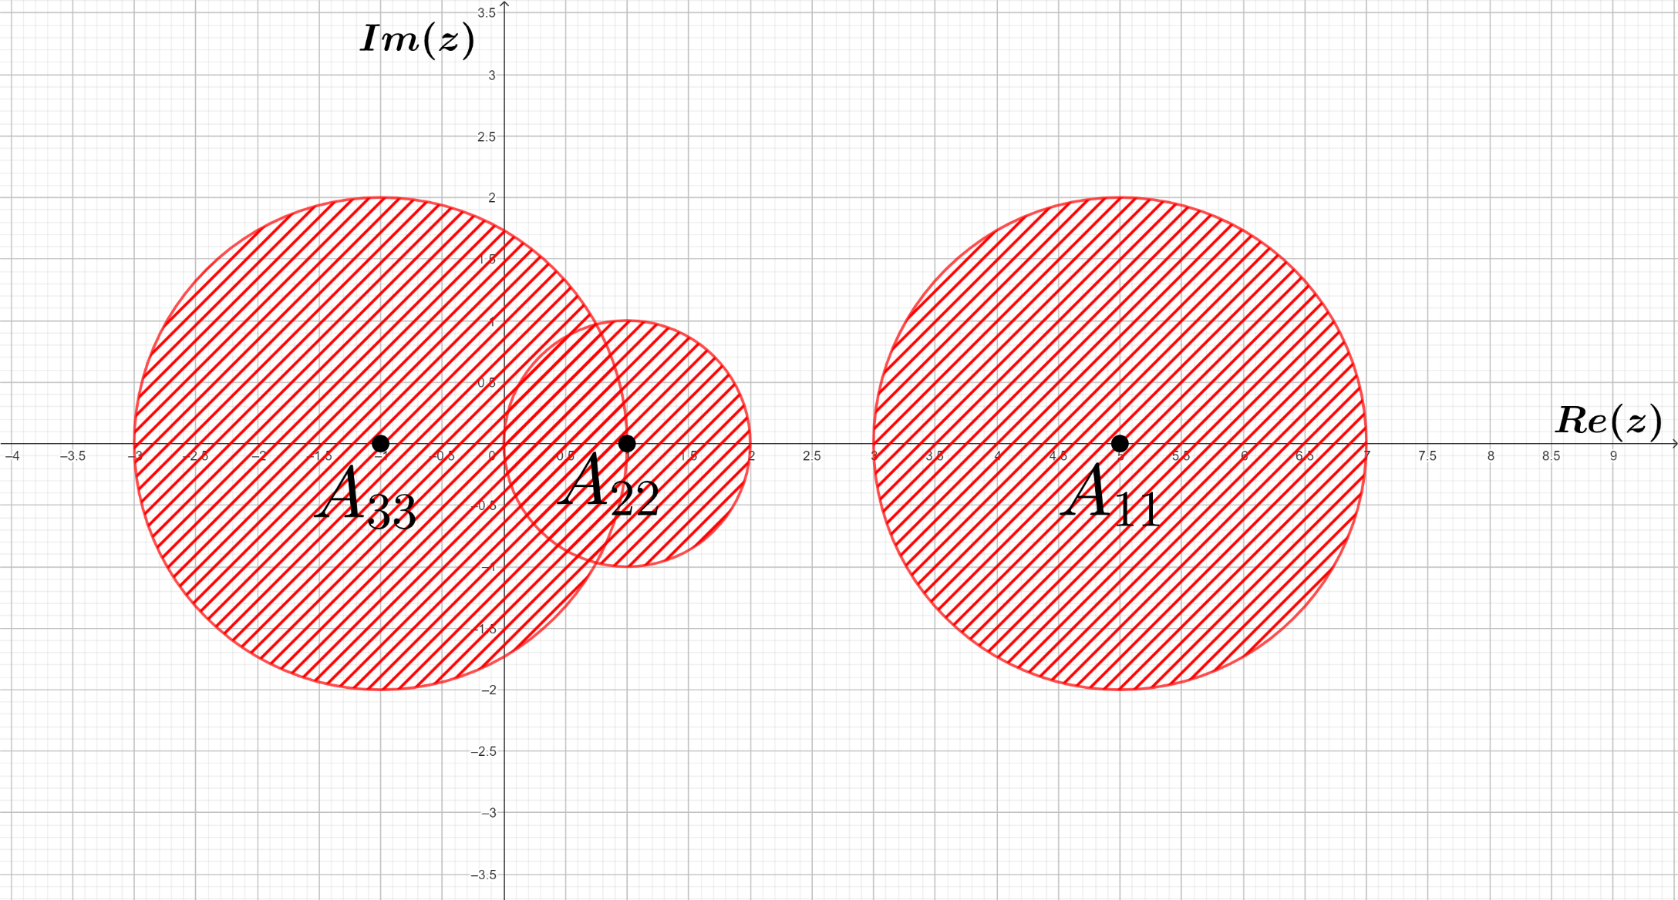
For example, for matrix A = we have:
5 1 1
1 1 0
2 0 -1
Gershgorin circles (rows of A):
A₁₁ = 5, R₁ = |1|+|1| = 2 D₂(5)
A₂₂ = 1, R₂ = |1|+|0| = 1 D₁(1)
A₃₃ = -1, R₃ = |2|+|0| = 2 D₂(-1)

Slide 23
For example, for matrix A = we have:
5 1 1
1 1 0
2 0 -1
Gershgorin circles (columns of A):
A₁₁ = 5, R’₁ = |1|+|2| = 3 D₃(5)
A₂₂ = 1, R’₂ = |1|+|0| = 1 D₁(1)
A₃₃ = -1, R’₃ = |1|+|0| = 1 D₁(-1)

Slide 24
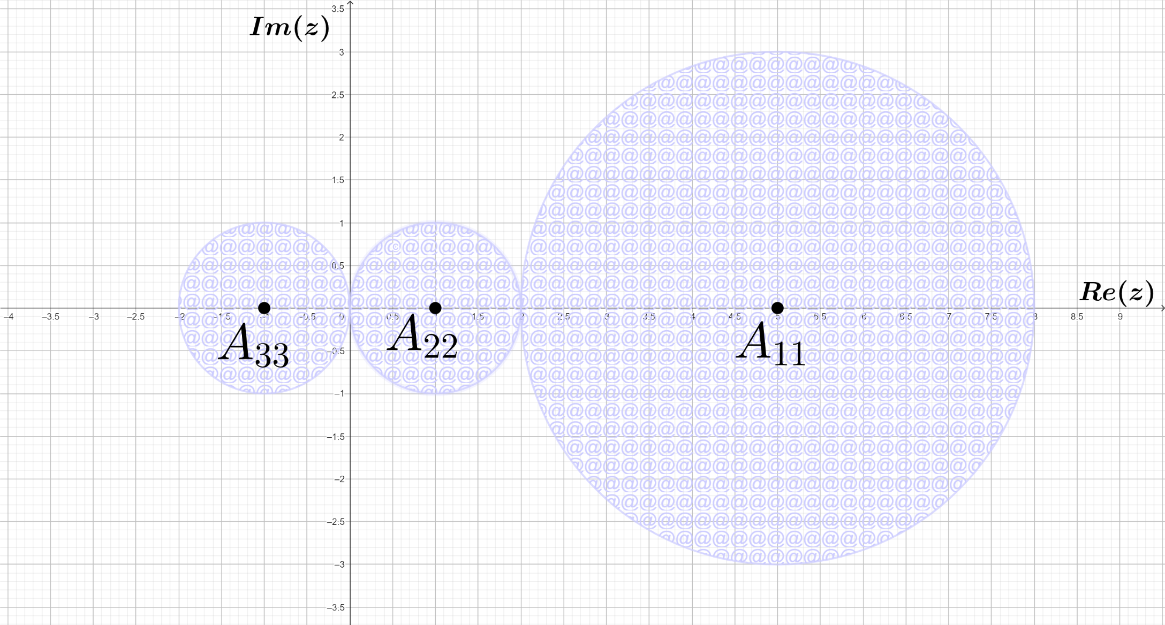
For example, for matrix A = we have:
5 1 1
1 1 0
2 0 -1
Gershgorin circles (columns of A):
A₁₁ = 5, R’₁ = |1|+|2| = 3 D₃(5)
A₂₂ = 1, R’₂ = |1|+|0| = 1 D₁(1)
A₃₃ = -1, R’₃ = |1|+|0| = 1 D₁(-1)

Slide 25
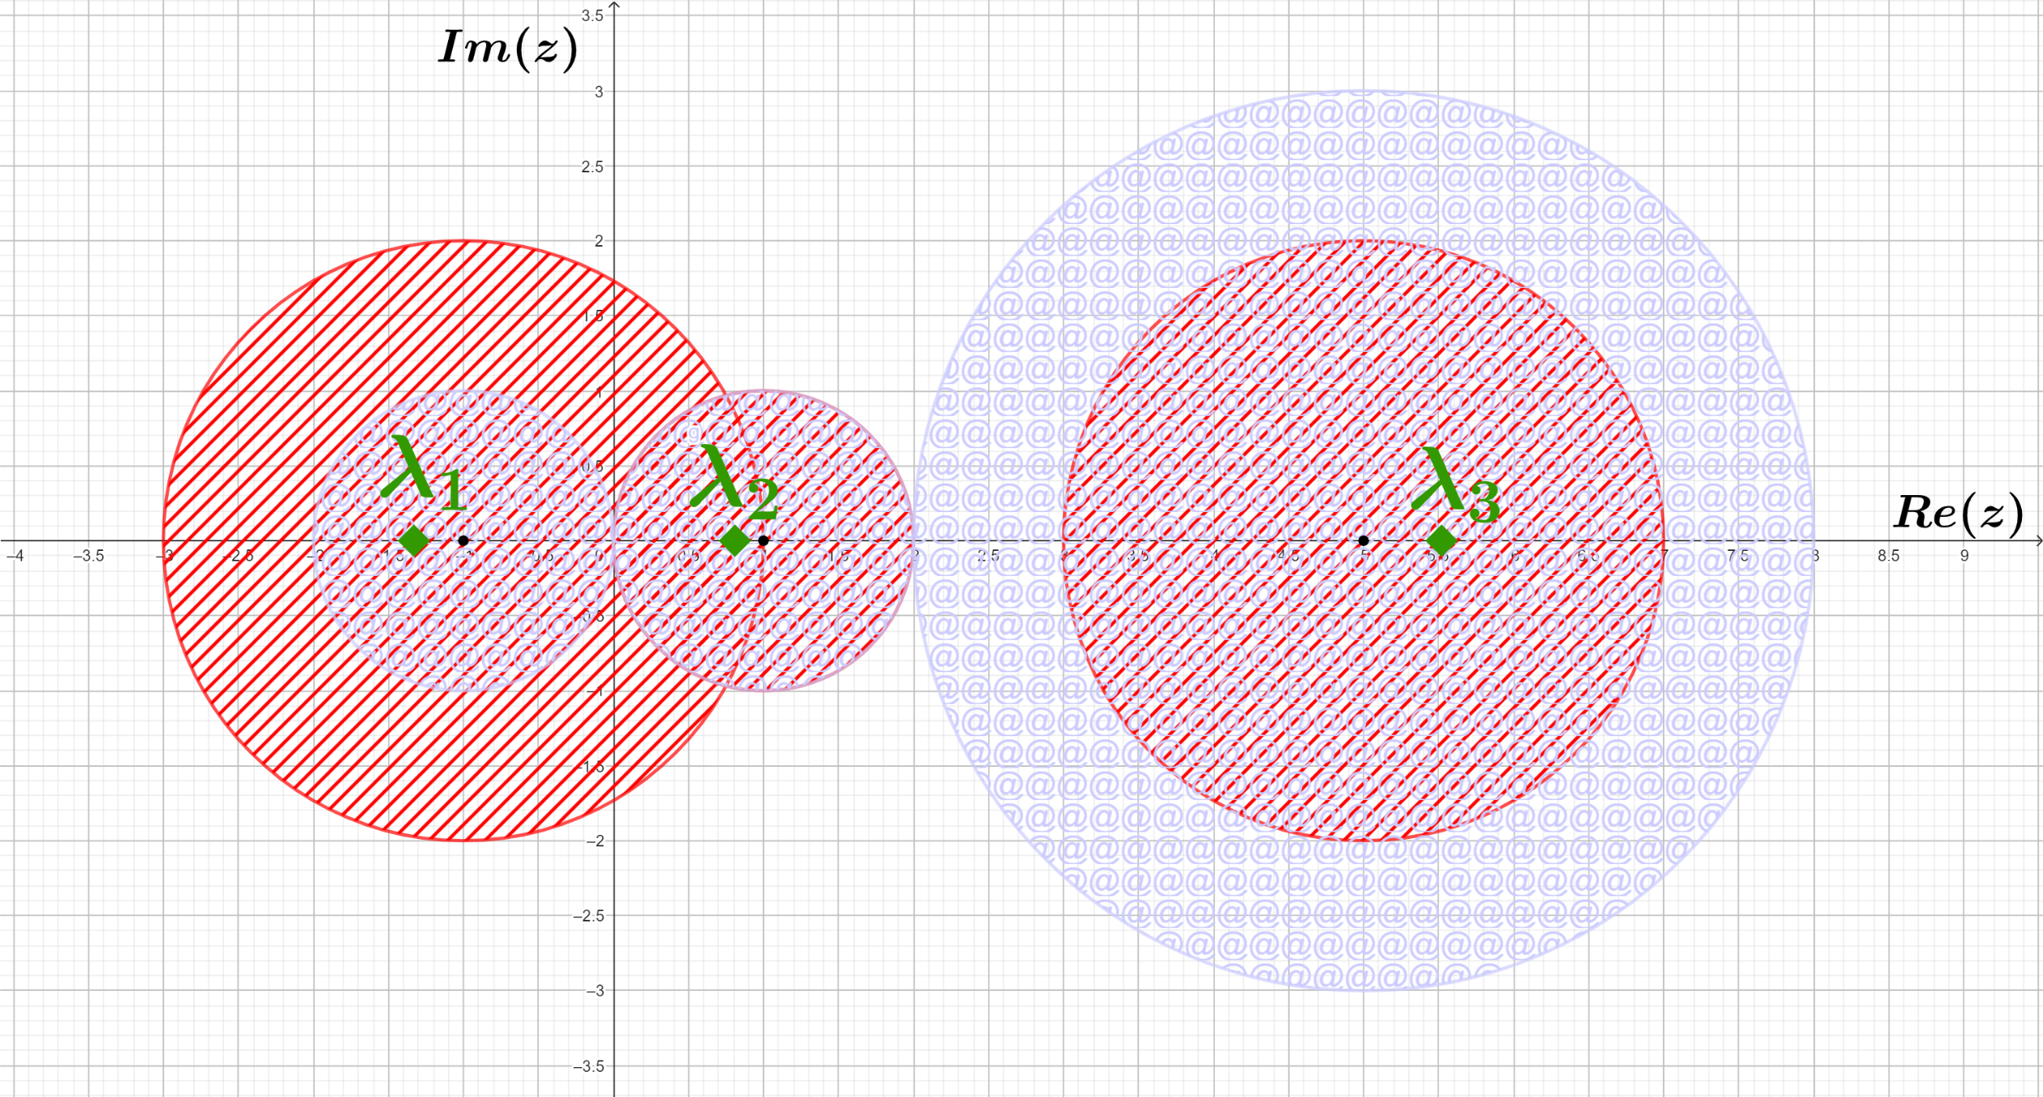
For example, for matrix A = we have:
5 1 1
1 1 0
2 0 -1
( gathering together just to check: as the eigenvalues of A turn out to be
λ₁ ≃ -1.33, λ₂ ≃ 0.81, λ₃ ≃ 5.52 )

Slide 26
For matrix A = ∈ M_{C}(3 x 3) we
want to apply Gershgorin circle theorem to locate
its eigenvalues.
6+i i 0
0 i 1-i
0 1 (1+7i)/2
Example
Concerning the rows of A, please choose:
D_{i}(6+i) is a Gershgorin circle of A
D₂(1) is a Gershgorin circle of A
D₁(i) is a Gershgorin circle of A
D_{√2}(i) is a Gershgorin circle of A

Slide 27
WELL DONE!
back to example

Slide 28
Sorry, check
your answer
try again, please

Slide 29
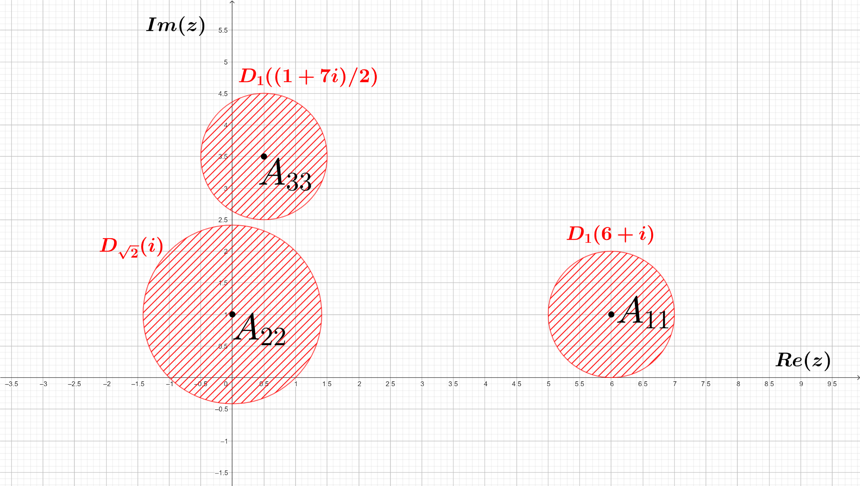
Certainly, from the rows of A = we obtain the
following
6+i i 0
0 i 1-i
0 1 (1+7i)/2
Gershgorin circles:
A₁₁ = 6+i, R₁ = |i|+|0| = 1 + 0 = 1 D₁(6+i)
A₂₂ = i, R₂ = |0|+|1-i| = 0 + √2 = √2 D_{√2}(i)
A₃₃ = (1+7i)/2, R₃ = |0|+|1| = 0 + 1 = 1 D₁((1+7i)/2)

Slide 30
Continuing with A = ∈ M_{C}(3 x 3), and concerning now
6+i i 0
0 i 1-i
0 1 (1+7i)/2
the components of the set of Gershgorin circles obtained from the columns of A, please choose:
There is only 1 component
There are 2 different components, none of them consists of a single point
There are 3 different components
There are 2 different components, one of them consists of a single point

Slide 31
GREAT!
back to example

Slide 32
Mmm, I am
not that sure…
try again, please

Slide 33
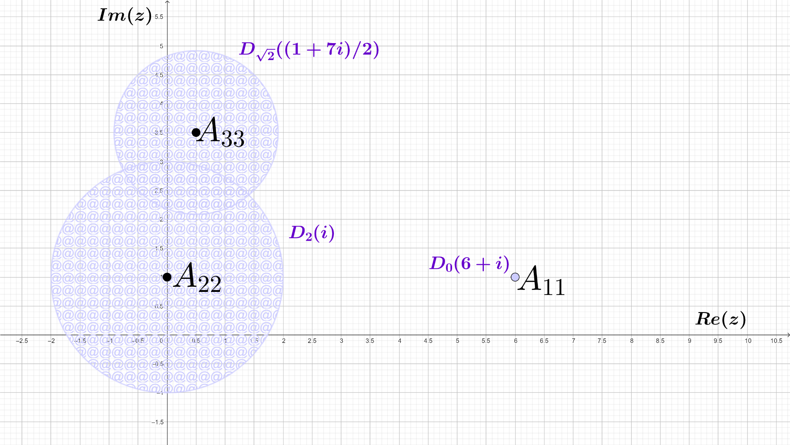
6+i i 0
0 i 1-i
0 1 (1+7i)/2
Indeed, from the columns of A = we obtain the
following
Gershgorin circles:
A₁₁ = 6+i, R’₁ = |0|+|0| = 0 + 0 = 0 D₀(6+i)
A₂₂ = i, R’₂ = |i|+|1| = 1 + 1 = 2 D₂(i)
A₃₃ = (1+7i)/2, R’₃ = |0|+|1-i| = 0 + √2 = √2 D_{√2}((1+7i)/2)
= Z₁ (component)
= Z₂ (component)
Z₂
Z₁

Slide 34
6+i i 0
0 i 1-i
0 1 (1+7i)/2
Still for matrix A = ∈ M_{C}(3 x 3) (for which it can be
seen that has 3 distinct eigenvalues), again considering the components of
the set of Gershgorin circles obtained from the columns of A, Z₁=D₀(6+i) and Z₂=D₂(i) ∪ D_{√2}((1+7i)/2), please choose:
There is 1 eigenvalue in Z₁ and
1 eigenvalue in Z₂
There is no eigenvalue in Z₁ and 2 distinct eigenvalues in Z₂
There is 1 eigenvalue in Z₁ and 2 distinct eigenvalues in Z₂
There is no eigenvalue in Z₁ and 3 distinct eigenvalues in Z₂

Slide 35
WONDERFUL!
back to example

Slide 36
That is not a
good choice…
try again, please

Slide 37
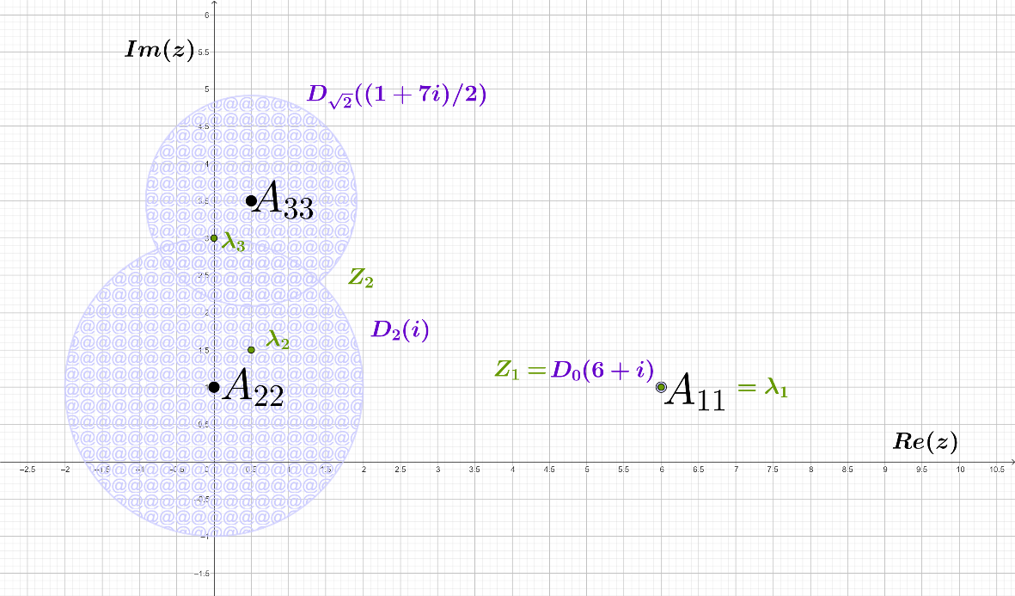
It is not difficult to see that the eigenvalues of A are:
λ₁ = 6+i, λ₂ = (1+3i)/2, λ₃ = 3i,
one of them coincides with Z₁, the other two being in Z₂ :

Slide 38
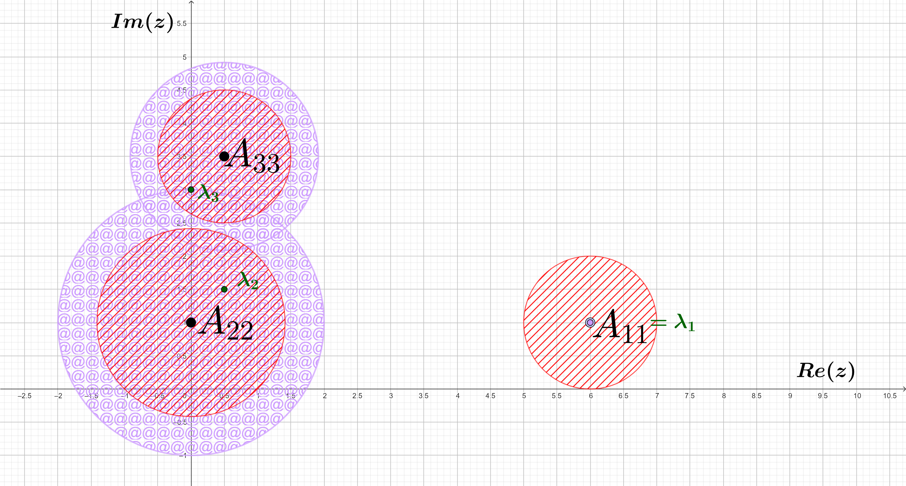
Even further, observe at the same time the location of the eigenvalues
λ₁ = 6+i, λ₂ = (1+3i)/2, λ₃ = 3i,
with respect to both the components of the set of row-Gershgorin circles (in red colour) and the components of the set of column-Gershgorin circles (in purple colour):

