Slide 1
Strictly
diagonally dominant
(SDD)
matrices
Strictly
diagonally dominant
(SDD)
matrices
*
*
*
*

Slide 2
The objectives
• To introduce the concept of strictly diagonally dominant (SDD) matrix.
• To show and prove two important properties of strictly diagonally
dominant matrices (one of these properties involves only Hermitian
matrices).
To this end, some useful notation, concepts and related results are
initially presented.
Some of these related results are also proved, for
the sake of completeness.

Slide 3
To start with [notation]
M_{C}(n x n) : set of square matrices on n rows and n columns, with
entries belonging to the set of complex numbers (C).
M_{R}(n x n) : set of square matrices on n rows and n columns, with
entries belonging to the set of real numbers (R).
Clearly M_{R}(n x n) ⊂ M_{C}(n x n) (real matrices are also complex matrices).

Slide 4
To start with [notation]
• Given A ∈ M_{C}(n x n), the transpose of A is A^{T} ∈ M_{C}(n x n) with entries
(A^{T})_{ij}=A_{ji}, for all i, j=1, 2,…, n,
first index indicating rows, second for columns; hence each (horizontal)
row of A^{T} is the corresponding (vertical) column of A.

Slide 5
To start with [notation]
• Given A ∈ M_{C}(n x n), the conjugate (or Hermitian) transpose of A is
matrix A* ∈ M_{C}(n x n) with matrix elements
(A*)_{ij}=A_{ji}, for all i, j=1, 2,…, n
(A* is obtained applying complex conjugation to each entry of A^{T}).
For example, for matrix A = we have:
A^{T} = , A* =
-4+i 1-2i
3i 5
-4+i 3i
1-2i 5
-4-i -3i
1+2i 5

Slide 6
To start with [notation]
• Clearly, the concepts of transpose and of conjugate transpose also
hold for nonsquare matrices.
And it is simple to see that, for any two matrices A, B for which the
product AB exists and for any number a ∈ C, it follows that:
⊳ (AB)^{T} = B^{T} A^{T} , (a A)^{T} = a A^{T}
⊳ (AB)* = B* A* , (a A)* = a A*.

Slide 7
To start with [notation]
•A ∈ M_{C}(n x n) is said to be symmetric whenever A^{T} = A
(we are usually interested in symmetric real matrices).
•A ∈ M_{C}(n x n) is said to be Hermitian (or self-adjoint) whenever A* = A.
① Each diagonal element A_{ii} is a real number.
Note for an Hermitian matrix A ∈ M_{C}(n x n) :
Indeed, for all
i = 1, 2, …, n we have
(A*)_{ii} = A_{ii} ⇒ (A^{T})_{ii} = A_{ii} ⇒ A_{ii} = A_{ii} ⇒ A_{ii} ∈ R
② If A ∈ M_{R}(n x n), then A^{T} = A.

Slide 8
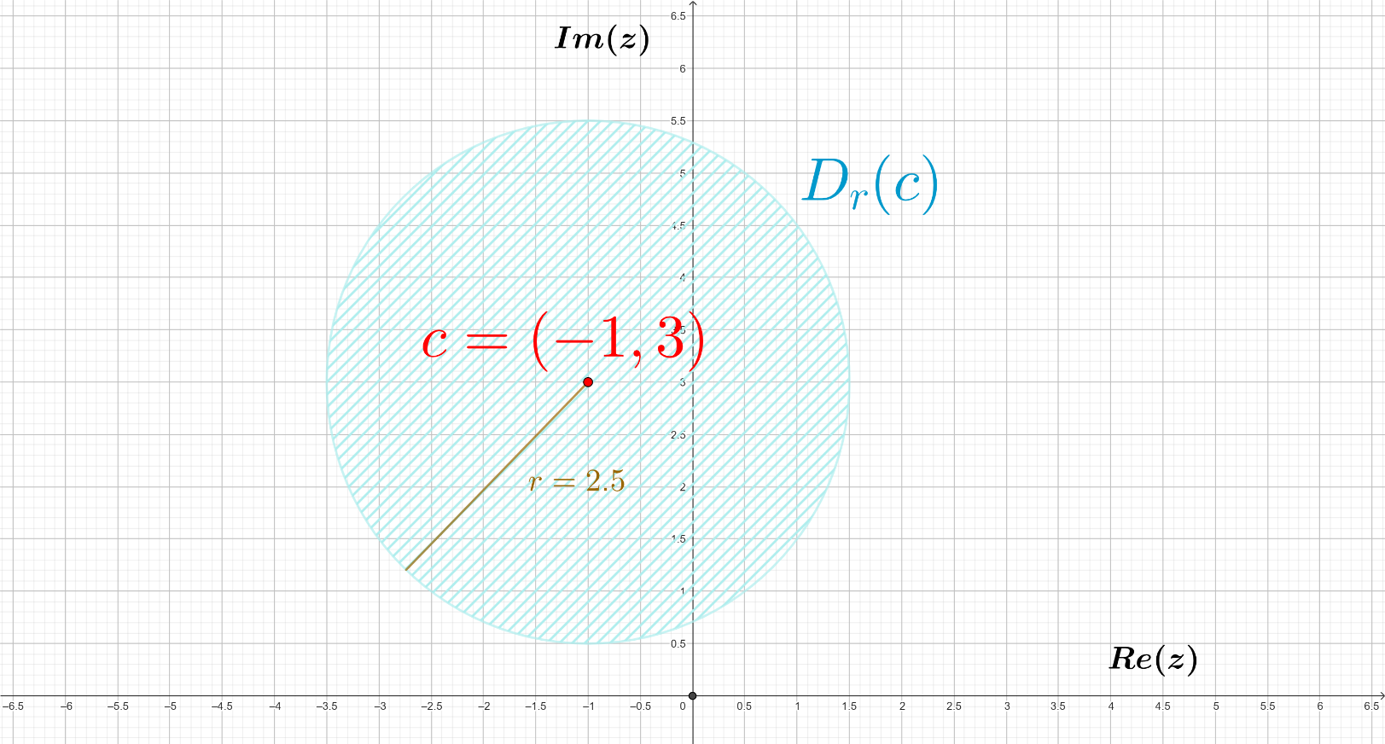
To start with [notation]
Given c ∈ C and r ∈ R, r > 0, the disk with center c and radius r is the set
of complex numbers at distance at most r from c; that is,
D_{r}(c) = { z ∈ C : |z-c| ≤ r }
Geometrically is a circle with center c and radius r; in the following
example for c=(-1,3)=-1+3i, r=2.5, D_{r}(c) is the area in blue color:

Slide 9
To start with [useful to recall]
Given A ∈ M_{C}(n x n) and λ ∈ C, λ is said to be an eigenvalue of A if there
exists some column matrix X ∈ M_{C}(n x 1), X ≠ [0]_{n x 1} (X has some nonzero
entry) such that
A X = λ X
λ ∈ C is an eigenvalue of A ∈ M_{C}(n x n) if and only if
det_{n}(A - λ I_{n}) = 0 (det_{n} = determinant)
And it is not difficult to see that
A ∈ M_{C}(n x n) has at least 1 eigenvalue,
and at most n distinct eigenvalues.

Slide 10
To start with [useful to recall]
Note that all eigenvalues of an Hermitian matrix A ∈ M_{C}(n x n) are real.
Certainly, if λ ∈ C is such an eigenvalue, we have
A X = λ X (then, X* A = X* A* = (AX)* = λ X*)
for some column matrix X ∈ M_{C}(n x 1), X ≠ [0]_{n x 1} (observe that X* X > 0,
real).
Next, we calculate X* A X in two different forms:
X* A X = X* (A X) = X* λ X = λ (X* X)
X* A X = (X*A) X = λ X* X = λ (X* X)
⇒ 0 = (λ – λ) (X* X) ⇒ 0 = λ – λ
⇒
λ = λ
⇒
λ ∈ R

Slide 11
To start with [useful to recall]
• Gershgorin circle theorem. All the eigenvalues of a square matrix
A = ∈ M_{C}(n x n)
lie in the union of the disks D_{R1}(A₁₁), D_{R2}(A₂₂), … , D_{Rn}(A_{nn}) (from now on,
Gershgorin circles or disks), where each R_{i} is the sum of the moduli of
the nondiagonal elements in row i, for i = 1, 2, …, n : R_{i} = ∑ |A_{ij}|.
A₁₁ A₁₂ ∙∙∙ A_{1n}
A₂₁ A₂₂ ∙∙∙ A_{2n}
∙∙∙ ∙∙∙ ∙∙∙ ∙∙∙
A_{n1} A_{n2} ∙∙∙ A_{nn}
j ≠i

Slide 12
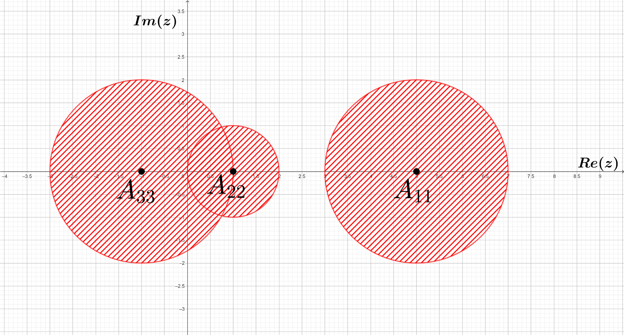
For example, for matrix A = we have:
5 1 1
1 1 0
2 0 -1
Gershgorin circles (looking at the rows of A):
A₁₁ = 5, R₁ = |1|+|1| = 2 D₂(5)
A₂₂ = 1, R₂ = |1|+|0| = 1 D₁(1)
A₃₃ = -1, R₃ = |2|+|0| = 2 D₂(-1)

Slide 13
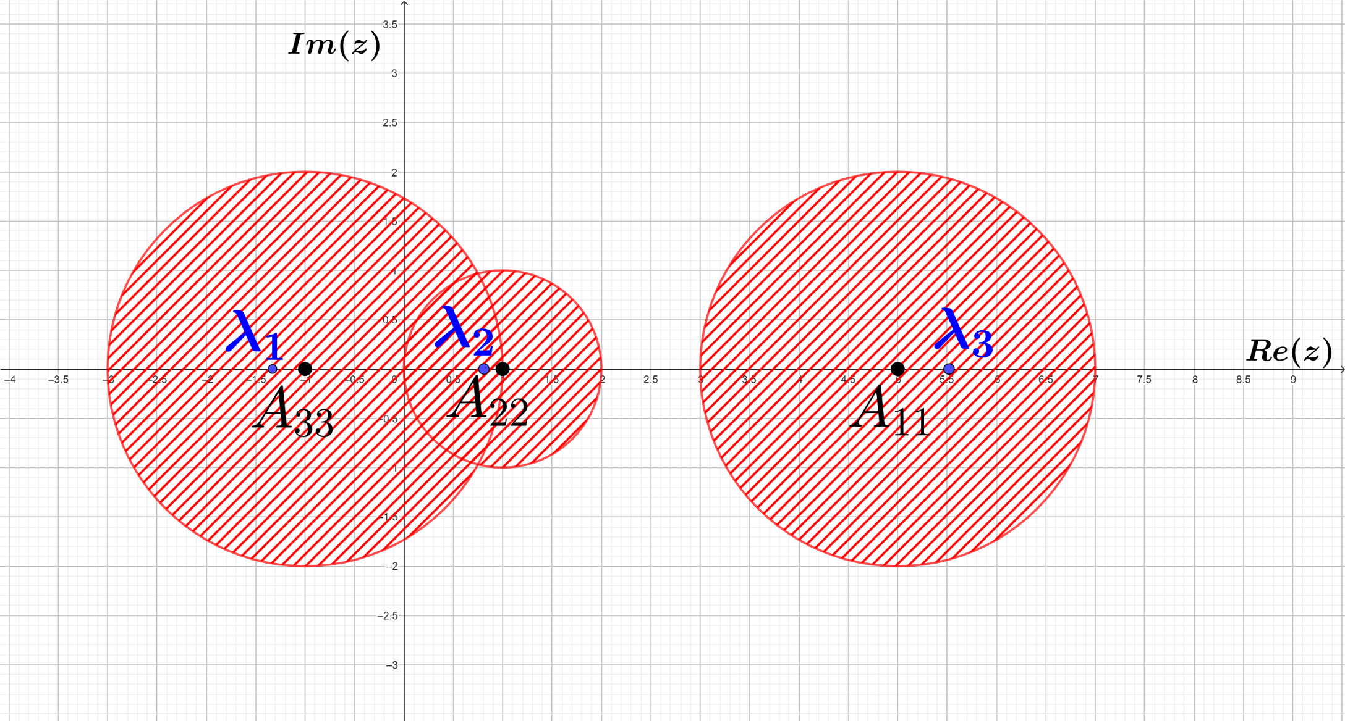
For example, for matrix A = we have:
5 1 1
1 1 0
2 0 -1
Gershgorin circles (looking at the rows of A):
A₁₁ = 5, R₁ = |1|+|1| = 2 D₂(5)
A₂₂ = 1, R₂ = |1|+|0| = 1 D₁(1)
A₃₃ = -1, R₃ = |2|+|0| = 2 D₂(-1)
( the eigenvalues
turn out to be
λ₁ ≃ -1.33,
λ₂ ≃ 0.81,
λ₃ ≃ 5.52 )

Slide 14
To start with [useful to recall]
A ∈ M_{C}(n x n) is said to be regular (or invertible, or nonsingular)
if there exists a matrix A⁻¹ ∈ M_{C}(n x n) such that
A A⁻¹ = I_{n}
where I_{n} ∈ M_{C}(n x n) is the identity matrix, with ones in the main
diagonal and zeroes outside.
And it is easy to see that
A is regular if and only if det_{n}(A) ≠0.

Slide 15
Strictly diagonally dominant (SDD) matrix: definition
• A square matrix
A = ∈ M_{C}(n x n)
is said to be strictly diagonally dominant (SDD) if the condition
|A_{ii}| > ∑ |A_{ij}|
holds for every row index i = 1, 2, …, n.
A₁₁ A₁₂ ∙∙∙ A_{1n}
A₂₁ A₂₂ ∙∙∙ A_{2n}
∙∙∙ ∙∙∙ ∙∙∙ ∙∙∙
A_{n1} A_{n2} ∙∙∙ A_{nn}
j ≠i

Slide 16
For example, matrix A = is SDD, because looking at rows:
3+4i 1 -i
0 -4 2
1+i -1 6i
∑ |A_{1j}|= |1|+|-i| = 2 < 5 = |A₁₁|
∑ |A_{2j}|= |0|+|2| = 2 < 4 = |A₂₂|
∑ |A_{3j}|= |1+i|+|-1| = 2^{1/2} +1 < 6 = |A₃₃|
j ≠1
j ≠2
j ≠3
But matrix B = is not SDD; indeed, for the 2nd row:
-5i 1 i
3 3-4i 2i
-1 0 2
∑ |B_{2j}|= |3|+|2i| = 5 = |B₂₂|
not SDD
j ≠2

Slide 17
SDD matrices: first result
Theorem. A strictly diagonally dominant matrix A ∈ M_{C}(n x n)
is always regular.
Proof. Call A_{ij} to the matrix element in row i-column j, as usual. And
take R_{i} = ∑ |A_{ij}| for every row index i = 1, 2, …, n.
j ≠i
As A is SDD, we have that |A_{ii}| > R_{i} holds for every row
index i = 1, 2, …, n; that is, |A_{ii} - 0| > R_{i} for all i.
In other words 0 ∈ D_{Ri}(A_{ii}) (= Gershgorin disk) for all i, hence by Gershgorin circle theorem it follows that λ = 0 is not an eigenvalue of A, so det_{n}(A – 0 ∙ I_{n}) ≠ 0.
Then:
det_{n}(A) = det_{n}(A – 0 ∙ I_{n}) ≠ 0 A is regular

Slide 18
Observation. A matrix A ∈ M_{C}(n x n) that is not SDD may have
a transpose A^{T} that is SDD, in which case we would be
able to ensure that A is regular.
Note that A^{T} being SDD is equivalent to saying that
the condition for SDD is fulfilled by the columns of A.
For example, matrix A = is not SDD; for row 1:
|2| = 2 = |2i|
2 2i
i 4
not SDD.
But A^{T} = is SDD; indeed:
|2| = 2 > 1 = |i|; |4| = 4 > 2 = |2i|
2 i
2i 4
SDD
A is regular
( note: det₂(A) = 10 ≠ 0 )

Slide 19
Consider matrix
Example-Test
-8 1 2 -2
1 4 0 -1
-1 2 7 1
5 0 -2 -6
Q = ∈ M_{R}(4 x 4) ⊂ M_{C}(4 x 4)
Please choose the option that best suites:
Q is not SDD,
Q^{T} is not SDD,
and det₄(Q)=1469
Q is SDD,
Q^{T} is not SDD,
and det₄(Q)=1429
Q is not SDD,
Q^{T} is SDD,
and det₄(Q)=1499
Q is SDD,
Q^{T} is SDD,
and det₄(Q)=1449
Q is not SDD,
Q^{T} is not SDD,
and det₄(Q)=0
None of the others

Slide 20
WELL DONE!
back to example

Slide 21
Sorry, check
your answer
try again, please

Slide 22
Matrix Q = is not SDD; indeed, for the 4th row:
-8 1 2 -2
1 4 0 -1
-1 2 7 1
5 0 -2 -6
∑ |Q_{4j}| = |5|+|0|+|-2| = 7 > 6 = |-6| = |Q₄₄|
not SDD.
j≠4
But Q^{T} is SDD; certainly, looking at the columns of Q:
∑ |Q_{i1}| = |1|+|-1|+|5| = 7 < 8 = |-8| = |Q₁₁|; ∑ |Q_{i2}| = |1|+|2|+|0| = 3 < 4 = |4| = |Q₂₂|;
∑ |Q_{i3}| = |2|+|0|+|-2| = 4 < 7 = |7| = |Q₃₃|; ∑ |Q_{i4}| = |-2|+|-1|+|1| = 4 < 6 = |-6| = |Q₄₄|.
i≠1
i≠2
And it is not difficult to see that det₄(Q)=1499 (≠0; we already knew Q is regular
as Q^{T} is SDD ).
i≠3
i≠4

Slide 23
SDD matrices: preparing for the second result
• A square Hermitian matrix A ∈ M_{C}(n x n) is said to be:
⊳ Positive definite if for every column matrix X ∈ M_{C}(n x 1), X ≠ [0]_{n x 1},
it follows that
X* A X > 0
⊳ Negative definite if for every column matrix X ∈ M_{C}(n x 1), X ≠ [0]_{n x 1},
it follows that
X* A X < 0

Slide 24
For example, for Hermitian matrices A = , B = , C = :
-3 0
0 -1
1 2
2 5
1 1+i
1-i 2
a
b
[0]_{2 x 1}
⊳ A is negative definite as, for all X = ≠ :
X* A X = = -3 a a – b b = -3|a|² - |b|² < 0
-3 0
0 -1
a
b
a b
a
b
[0]_{2 x 1}
⊳ B is positive definite as, for all X = ≠ :
X* B X = = (a+2b) (a+2b) + b b = |a+2b|² + |b|² > 0
1 2
2 5
a
b
a b
⊳ C is neither positive definite nor negative definite as:
= = 0
1 1+i
1-i 2
-1-i
1
1 1+i
1-i 2
-1-i
1
-1-i 1
-1+i 1

Slide 25
• Note for an Hermitian matrix A ∈ M_{C}(n x n) :
[1] If A is positive definite, then A_{ii} > 0 for each diagonal element A_{ii}.
This fact is direct from A_{ii} = X* A X > 0 when X is a column matrix
full of zeroes, except an entry equal to 1 in row i.
[2] Not so straightforwardly proved, it can also be seen that:
A is positive definite if and only if all the eigenvalues of A are > 0
(recall that it has been proved that eigenvalues of A are real).

Slide 26
• … still for an Hermitian matrix A ∈ M_{C}(n x n) :
[3] A is negative definite if and only if (-A) is positive definite.
This fact follows from X* A X = - [X* (-A) X] for every column
matrix X.
[4] From previous items [1], [2] and [3], it can be deduced that:
⊳ If A is negative definite, then A_{ii} < 0 for each diagonal element A_{ii}.
⊳ A is negative definite if and only if all the eigenvalues of A are < 0.

Slide 27

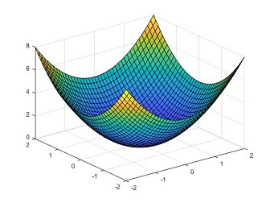
• … And it is worth knowing that:
[5] The concepts of positive / negative definite are useful in several
applications. One of them is the study of local extrema in functions
of the kind f : R^{n} R, where candidates to be extrema points are
analysed by means of a symmetric (Hermitian) matrix, called the
hessian matrix, for which it has to be determined whether it is or
not positive definite or negative definite.
As an example, this drawing depicts a function f : R² R with a
local minimum (that where the surface gets its smallest –lowest-
value), a point where its hessian matrix is positive definite.

Slide 28
SDD matrices: second result
Theorem. Let A ∈ M_{C}(n x n) be an Hermitian matrix. If all
diagonal elements are > 0 and A is SDD, then A is
positive definite.
Proof. Call A_{ij} to the matrix element in row i-column j, as usual. And
take R_{i} = ∑ |A_{ij}| for every row index i = 1, 2, …, n.
j ≠i
As A is SDD, we have for every row index i = 1, 2, … , n that
|A_{ii}| > R_{i} holds, that is, A_{ii} > R_{i} because A_{ii} > 0; hence, every real number contained in D_{Ri}(A_{ii}) (= Gershgorin disk) is positive.
Then, by the Gershgorin circle theorem it follows all the eigenvalues of A are positive, yielding that A is positive definite.

Slide 29
SDD matrices: … second result
• And next result is almost direct, written this time for negative definite
matrices:
Theorem. Let A ∈ M_{C}(n x n) be an Hermitian matrix. If all
diagonal elements are < 0 and A is SDD, then A is
negative definite.
Proof. Follows from the theorem for positive definite matrices,
recalling that A is negative definite whenever (-A) is
positive definite.

Slide 30
Consider the Hermitian matrix
Example-Test
H_{x} = ∈ M_{R}(3 x 3) ⊂ M_{C}(3 x 3)
for values x = -2, x = -1, x = 1 and x = 2.
6-x -1 2
-1 3x 1
2 1 -2-6x
Please choose the option that best suites:
When x = -2,
H₋₂ is not SDD
but it is negative definite
When x = -1,
H₋₁ is SDD
and it is positive definite
When x = 1,
H₁ is SDD
but it is not negative definite
When x = 2,
H₂ is not SDD
and it is not positive definite

Slide 31
WONDERFUL!
back to example

Slide 32
That is not a
good choice…
try again, please

Slide 33
All four matrices H_{x} are SDD, which is easily checked by means of the following table:
Diagonal entries
Sum of moduli of nondiagonal entries | x = -2 | x = -1 | x = 1 | x = 2
H_{x} =
6-x -1 2
-1 3x 1
2 1 -2-6x
Row 1 | |-1| + |2| = 3 | 8 | 7 | 5 | 4
Row 2 | |-1| + |1| = 2 | -6 | -3 | 3 | 6
Row 3 | |2| + |1| = 3 | 10 | 4 | -8 | -14
Despite of this, the table also shows that for all considered value of x, matrix H_{x} has
both positive and negative diagonal elements, hence H_{x} neither can be positive
definitive nor negative definite.
Then, the correct answer is:
When x = 1, H₁ is SDD
but it is not negative definite

