Slide 1
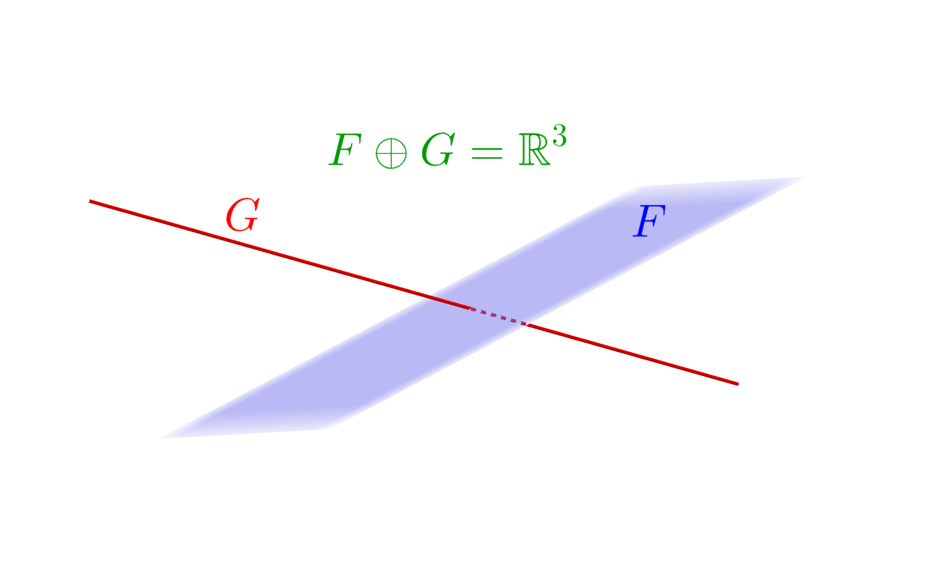
Supplementary of a subspace of a finite dimensional linear space: matrix approach

Slide 2
Initial data
A subspace F of a finite dimensional linear space E_{n} (n = dimension
of E_{n}, n > 0) over the scalar field K (K=R, real numbers; or K=C,
complex numbers). The subspace F is defined by means of a finite
set of generators (generator vectors):
F = < w₁, w₂, …, w_{r} >
The objective
To use matrices for easily calculating a supplementary (subspace) of F (or: a supplement of F in E_{n}); that is, for obtaining a subspace G for which the following 2 conditions hold at the same time:
1) F ∩ G = {zero vector}; 2) F + G = E_{n}

Slide 3
… the objective
Observation. If F = {zero vector}, it can be proved that there exists a unique supplementary of F: G = E_{n}.
Analogously, if F = E_{n}, then there exists a unique supplementary of subspace F: G = {zero vector}.
Thus, the most interesting case is when both F ≠ {zero vector} and F ≠ E_{n}; that is, dim(F) = p with 0 < p < n. We assume heretofore
that this is the case we are given.

Slide 4
General procedure
First obtain a basis of F, that is, the largest possible number of linearly independent vectors among all vectors of F. Suppose that one selects the following p vectors of F (they could be or not among the initially given generators):
{f₁, f₂, …, f_{p}} = basis of F (0 < p < n)
Append n-p new vectors (recall: n = dimension of linear space
E_{n}) g_{p+1}, g_{p+2}, …, g_{n} ∈ E_{n} in such a way that
{f₁, f₂, …, f_{p ,} g_{p+1}, g_{p+2}, …, g_{n}} are linearly independent
c) Define a supplementary subspace of F (call it G) as:
G = < g_{p+1}, g_{p+2}, …, g_{n} >
(and {g_{p+1}, g_{p+2}, …, g_{n}} is a basis of G).

Slide 5
… general procedure (proof):
» Each vector x of F ∩ G can be written as a linear combination of the generators of F (as x belongs to F) and also of the generators of G (because x also belongs to G):
x = a₁ f₁ + a₂ f₂ + … + a_{p}f_{p} = b_{p+1} g_{p+1} + b_{p+2} g_{p+2} + … + b_{n}g_{n} [§]
for some scalars (numbers) a_{i}, b_{j} ∈K.
By subtracting the second expression for x from its first one:
a₁ f₁ + a₂ f₂ + … + a_{p}f_{p} - b_{p+1} g_{p+1} - b_{p+2} g_{p+2} - … - b_{n}g_{n} = 0 (zero vector),
hence one gets a₁=a₂= … =a_{p}=b_{p+1}=b_{p+2} =…=b_{n}=0 because vectors
{f₁, f₂, …, f_{p ,} g_{p+1}, g_{p+2}, …, g_{n}} are linearly independent.
Now, by substi-
tuting in [§], it follows that x = 0 (zero vector), and as a consequence,
F ∩ G = {zero vector} holds.

Slide 6
… general procedure (proof):
» And by means of Grassmann’s theorem for dimensions:
dim(F + G) = dim(F) + dim(G) – dim(F ∩ G) = p+(n-p)-0 = n = dim(E_{n}),
hence F + G and E_{n} have the same dimension. Then, as F + G ⊆ E_{n} ,
one finally obtains that F + G = E_{n}.
» Its is usually written in this case F ⊕ G = E_{n}, where the symbol ⊕
indicates direct sum, a term used to refer to the sum F + G when
F ∩ G = {zero vector}, as is the case we are working with.

Slide 7
Observations on the procedure (agility/computation time)
▪It would be interesting to have a quick and efficient way of
obtaining {f₁, f₂, …, f_{p}} (a basis of F).
▪The n-p appended vectors g_{p+1}, g_{p+2}, …, g_{n} ∈ E_{n} are usually proposed
“by eye”, checking afterwards if
{f₁, f₂, …, f_{p ,} g_{p+1}, g_{p+2}, …, g_{n}} are linearly independent
(in case they are not, the proposal is not appropriate and a new one is
needed; this may imply an excessively long computation time).
▪Is there any way to speed up this procedure?
to use matrices (Gauss elimination)

Slide 8
The method in 4 steps:
For example (in R⁴):
F = < (3,2,0,1), (1,-1,2,1), (1,4,-4,-1) >
➊ Take a basis V of E_{n}, write
the components in V of the
r generators of F, and
define a matrix A (r rows,
n columns) as:
(as if we took
V=canonical
basis of R⁴)
(they could also be written in
columns; here we only consider
rows)
Generators of F
in basis V (rows)
A =
3 2 0 1
1 -1 2 1
1 4 -4 -1
A =

Slide 9
… example…
The method in 4 steps:
3 2 0 1
1 -1 2 1
1 4 -4 -1
A =
➋ Apply successive elementary
row operations on A until
obtaining a matrix R in row
echelon form (r.e.f.)
r₁ r₂
r₂-3r₁
A
r₃-r₁
r₃-r₂
1 -1 2 1
0 5 -6 -2
0 0 0 0
= R
(r.e.f.)

Slide 10
… example…
The method in 4 steps:
3 2 0 1
1 -1 2 1
1 4 -4 -1
A =
➌ Delete from R all zero rows
(if any) and insert as many
rows as necessary to obtain
a square matrix in row echelon
form with no zero row. Call H
to this new matrix in r.e.f.
(there is an infinite number of
possibilities for such H, when
some row has to be inserted).
1 -1 2 1
0 5 -6 -2
1 -1 2 1
0 5 -6 -2
0 0 0 0
0 0 1 0
0 0 0 1
R =
= H
(square, in r.e.f., with no zero row)

Slide 11
… example…
The method in 4 steps:
3 2 0 1
1 -1 2 1
1 4 -4 -1
A =
➍ The rows inserted to define
H (taken as vectors in basis V,
the reference basis of the
linear space E_{n}) generate a sub-
space G, which is supplementary
of F; this set of generators of
G is also a basis of G.
1 -1 2 1
0 5 -6 -2
H=
0 0 1 0
0 0 0 1
G=< (0,0,1,0), (0,0,0,1) >
inserted

Slide 12
Need for a new example?
In R₄[x] (polynomials of degree ≤ 4 with real coefficients):
F = < 2-2x-2x²+2x³+7x⁴, 1+2x+3x³+3x⁴, 2+x-x²+5x³+8x⁴ >
We want to calculate a subspace G,supplementary of F.
We follow the 4 steps of the method:
Taking V = {1,x, x², x³, x⁴}, canonical basis of R₄[x] :
F = < (2,-2,-2,2,7)_{V}, (1,2,0,3,3)_{V}, (2,1,-1,5,8)_{V} > .
➊ (matrix A)
So:
2 -2 -2 2 7
1 2 0 3 3
2 1 -1 5 8
A =

Slide 13
F = < (2,-2,-2,2,7)_{V}, (1,2,0,3,3)_{V}, (2,1,-1,5,8)_{V} >
➋ (elementary row operations to get matrix R, in r.e.f.)
2 -2 -2 2 7
1 2 0 3 3
2 1 -1 5 8
A =
r₁ r₂
r₂-2r₁
r₃-2r₁
r₂ r₃
1 2 0 3 3
0 3 1 1 -2
0 0 0 -2 -3
-r₂
r₃+2r₂
= R (r.e.f.)

Slide 14
F = < (2,-2,-2,2,7)_{V}, (1,2,0,3,3)_{V}, (2,1,-1,5,8)_{V} >
➌ (delete from R all zero rows, and insert rows to obtain
a square matrix H in r.e.f. with no zero rows)
0 0 1 0 0
0 0 0 0 1
1 2 0 3 3
0 3 1 1 -2
0 0 0 -2 -3
1 2 0 3 3
0 3 1 1 -2
0 0 0 -2 -3
1 2 0 3 3
0 3 1 1 -2
0 0 0 -2 -3
insert
nothing to delete
R=
=H

Slide 15
F = < (2,-2,-2,2,7)_{V}, (1,2,0,3,3)_{V}, (2,1,-1,5,8)_{V} >
➍ (define a supplementary subspace from the inserted
rows in H)
1 2 0 3 3
0 3 1 1 -2
0 0 0 -2 -3
0 0 1 0 0
0 0 0 0 1
G = < (0,0,1,0,0)_{V}, (0,0,0,0,1)_{V} > =
= < x², x⁴ > : supplementary of F
{ x², x⁴ } : basis of G (dim(G)=2)
inserted rows
H =

Slide 16
… another possible solution (another supplementary of F) …
➍ (define another supplementary from other inserted rows)
(after deleting from R zero rows)
1 2 0 3 3
0 3 1 1 -2
0 0 0 -2 -3
new
inserted
rows
0 0 1 3 -5
0 0 0 0 1
L = < (0,0,1,3,-5)_{V}, (0,0,0,0,1)_{V} > =
= < x²+3x³-5x⁴, x⁴ > : supplementary of F
{ x²+3x³-5x⁴, x⁴ } : basis of L (dim(L)=2)

Slide 17
The last example
In M_{C}(2x2) (complex matrices on 2 rows and 2 columns):
F = < , , , >
We want to obtain a subspace G, supplementary of F.
1 i
-i 2
1+i 0
-1 1
1+2i -1
0 1+2i
-i i
1-i 1
We follow the 4 steps of the method:
Taking V = canonical basis of M_{C}(2 x 2):
F = < (1,i,-i,2)_{V}, (1+i,0,-1,1)_{V}, (1+2i,-1,0,1+2i)_{V}, (-i,i,1-i,1)_{V} >
➊ (matrix A)
1 i -i 2
1+i 0 -1 1
1+2i -1 0 1+2i
-i i 1-i 1
Then:
A =

Slide 18
( La base canónica de M_{C}(2 x 2) es:
( The canonical basis of M_{C}(2 x 2) is:
V = { , , , } ,
1 0
0 0
0 1
0 0
0 0
1 0
0 0
0 1
hence a matrix Q = ∈ M_{C}(2 x 2) can be written as:
Q = (x,y,z,t)_{V} )
x y
z t

Slide 19
F = < (1,i,-i,2)_{V}, (1+i,0,-1,1)_{V}, (1+2i,-1,0,1+2i)_{V}, (-i,i,1-i,1)_{V} >
➋ (elementary row operations to get matrix R, in r.e.f.)
1 i -i 2
1+i 0 -1 1
1+2i -1 0 1+2i
-i i 1-i 1
r₃-r₂
r₂-r₃
r₂-r₁
r₃-i r₁
r₄+i r₁
A =
1 i -i 2
0 1-i -2+i -1-2i
0 0 0 0
0 0 0 0
r₄+2r₂
= R (r.e.f.)

Slide 20
F = < (1,i,-i,2)_{V}, (1+i,0,-1,1)_{V}, (1+2i,-1,0,1+2i)_{V}, (-i,i,1-i,1)_{V} >
➌ (delete from R the zero rows, and insert rows to obtain
a square matrix H in r.e.f. with no zero rows)
1 i -i 2
0 1-i -2+i -1-2i
0 0 0 0
0 0 0 0
1 i -i 2
0 1-i -2+i -1-2i
0 0 1 0
0 0 0 1
delete
insert
1 i -i 2
0 1-i -2+i -1-2i
R=
=H

Slide 21
F = < (1,i,-i,2)_{V}, (1+i,0,-1,1)_{V}, (1+2i,-1,0,1+2i)_{V}, (-i,i,1-i,1)_{V} >
➍ (define a supplementary subspace from the inserted
rows in H)
G = < (0,0,1,0)_{V}, (0,0,0,1)_{V} > =
= < , > : supplementary
of F
{ (0,0,1,0)_{V}, (0,0,0,1)_{V} } : basis of G
(dim(G)=2)
1 i -i 2
0 1-i -2+i -1-2i
0 0 1 0
0 0 0 1
inserted
rows
0 0
1 0
0 0
0 1
H =

Slide 22


SOME HELPFUL RELATED TOPICS
• Revision of the some of following topics is suggested:
– Subspace of a finite dimensional linear space; basis and
dimension of such a subspace
– Sum and intersection of subspaces; supplementary subspaces
– Elementary row operations
– Matrices in row echelon form (r.e.f.)
– Gaussian elimination (or row reduction)

