Slide 1
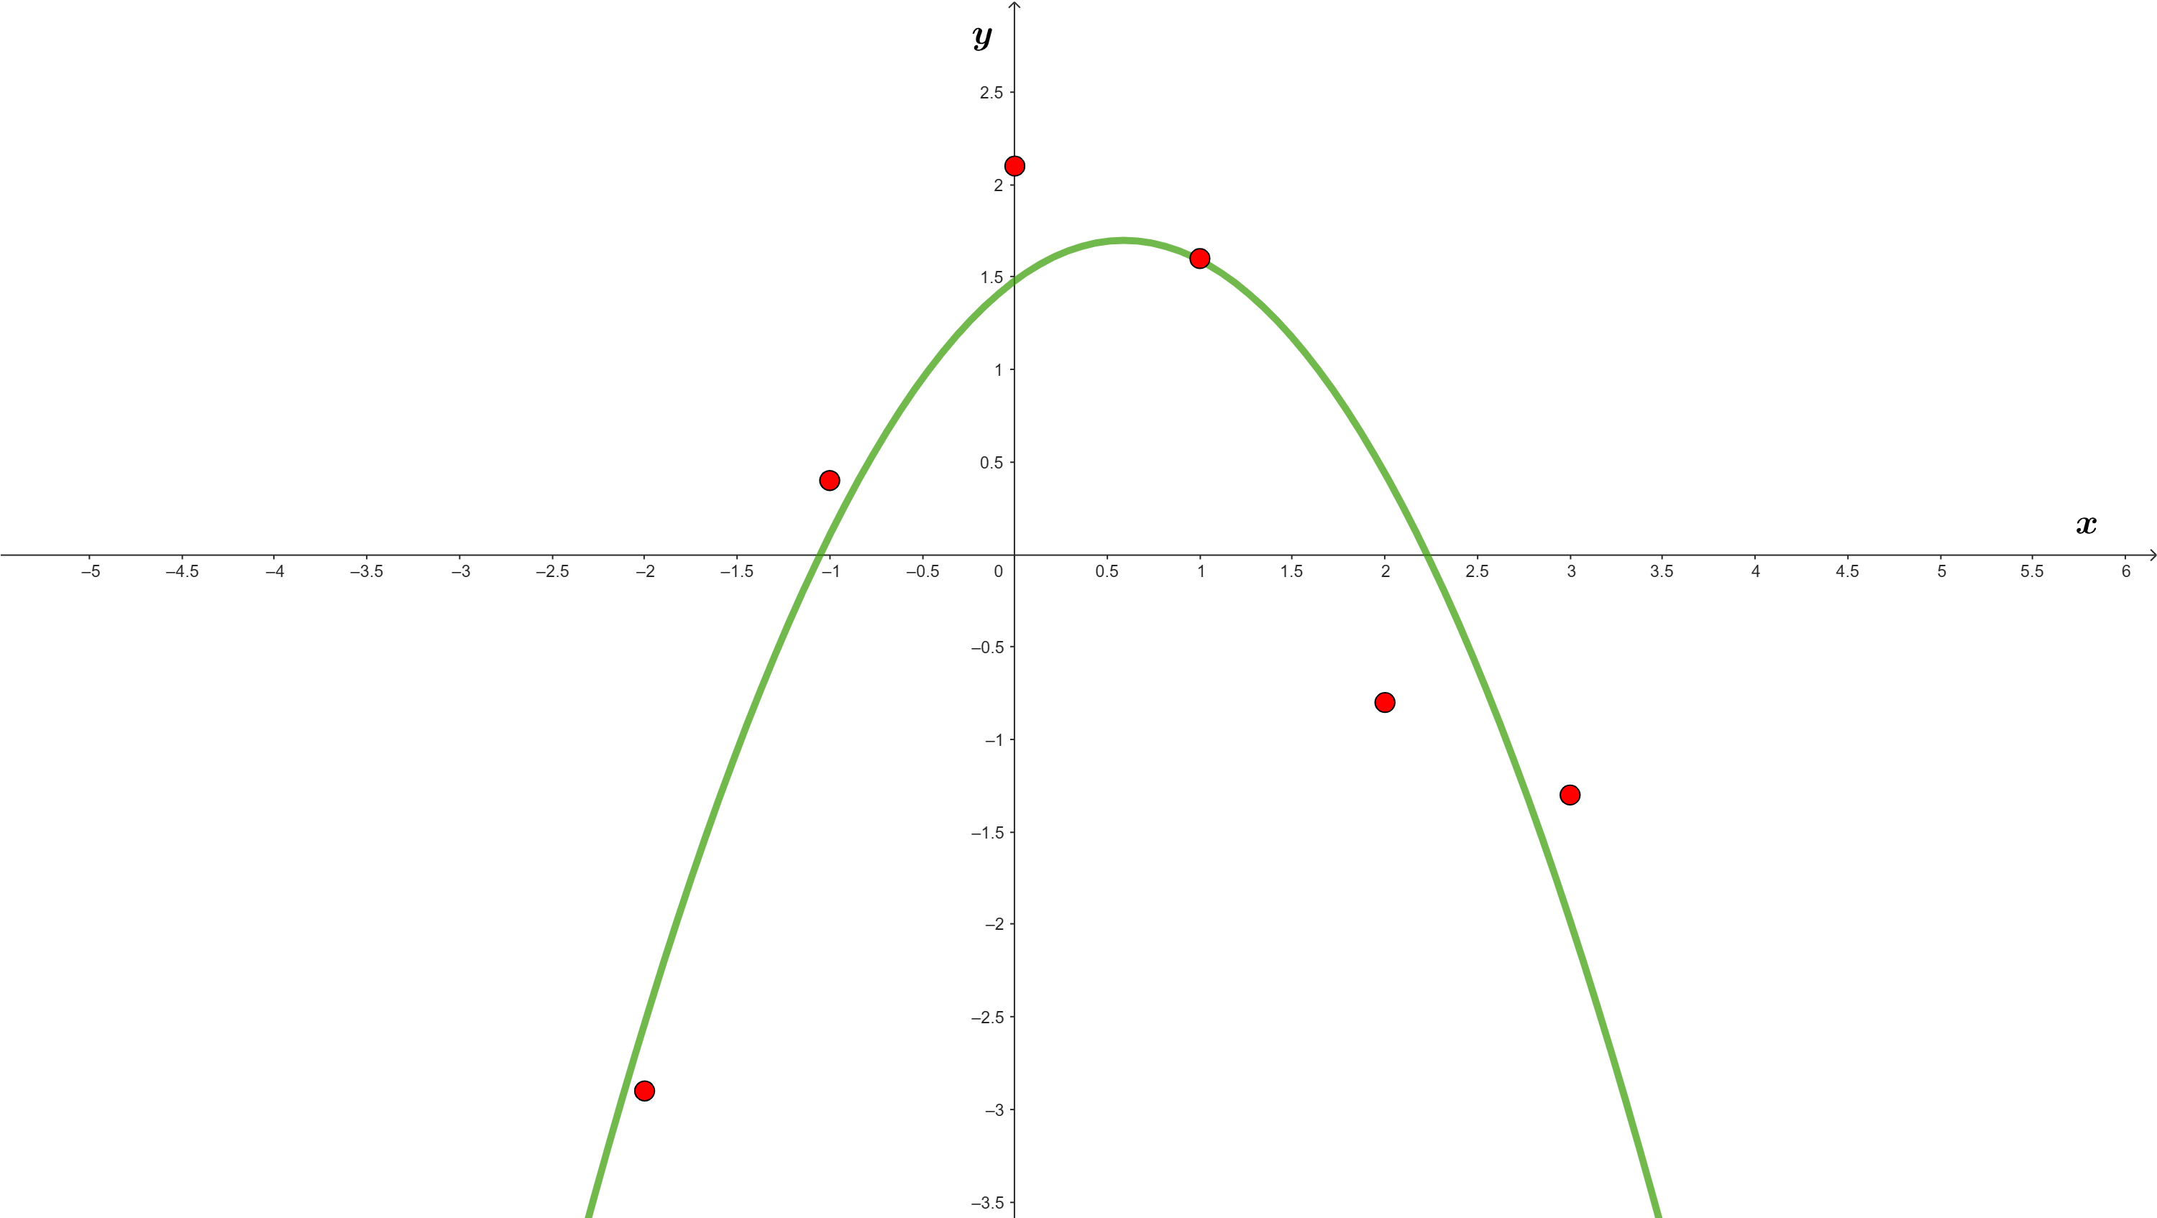
LEAST SQUARES
APPROXIMATION
(OR ADJUSTMENT)

Slide 2
Initial data
• A set of n points in the plane:
{ (x₁ , y₁) , (x₂ , y₂) , … , (x_{n} , y_{n}) }
• A set of p < n functions f₁(x), f₂(x), … , f_{p}(x) from which we
define
y(x) = a₁ f₁(x) + a₂ f₂(x) + ∙∙∙ + a_{p} f_{p}(x),
where a₁, a₂, … , a_{p} ∈ R.

Slide 3
The objective
• To find those values of a₁, a₂, … , a_{p} ∈ R that best fit the
given points to the function y = a₁ f₁(x) + a₂ f₂(x) + ∙∙∙ + a_{p} f_{p}(x);
that is, those values of a₁, a₂, … , a_{p} ∈ R such that the difference
(in absolute value) |y_{i}- y(x_{i})| is the smallest possible for the
whole set of the n given points.
• This objective is usually pursued by looking for the minimum
possible value for the sum
(y₁- y(x₁))² + (y₂- y(x₂))² + ∙∙∙∙ + (y_{n}- y(x_{n}))² ( ”least squares”),
sum that often is written as
E(a₁, a₂, … , a_{p}) = Σ (y_{i}- y(x_{i}))² (“E” by ”error”)
n
i=1

Slide 4
For example, the straight line y = a + bx that best fit the 3 points
{ (x₁,y₁) = (0,2) , (x₂,y₂) = (1,4) , (x₃,y₃) = (2,8) }
is that for which a = 5/3, b=3, that is,
y = (5/3) + 3x,
for which the error is (since y(0)=5/3, y(1)=14/3, y(2)=23/3):
E(a=5/3,b=3) = (2-5/3)² + (4-14/3)² + (8-23/3)² = 2/3
If we had taken another straight line (even one passing through 2 of the
3 points), the error wouldn’t have been smaller. For instance, for the line
y = 2 + 3x it follows that:
E(a=2,b=3) = (2-2)² + (4-5)² + (8-8)² = 1 > 2/3
Graphically:

Slide 5
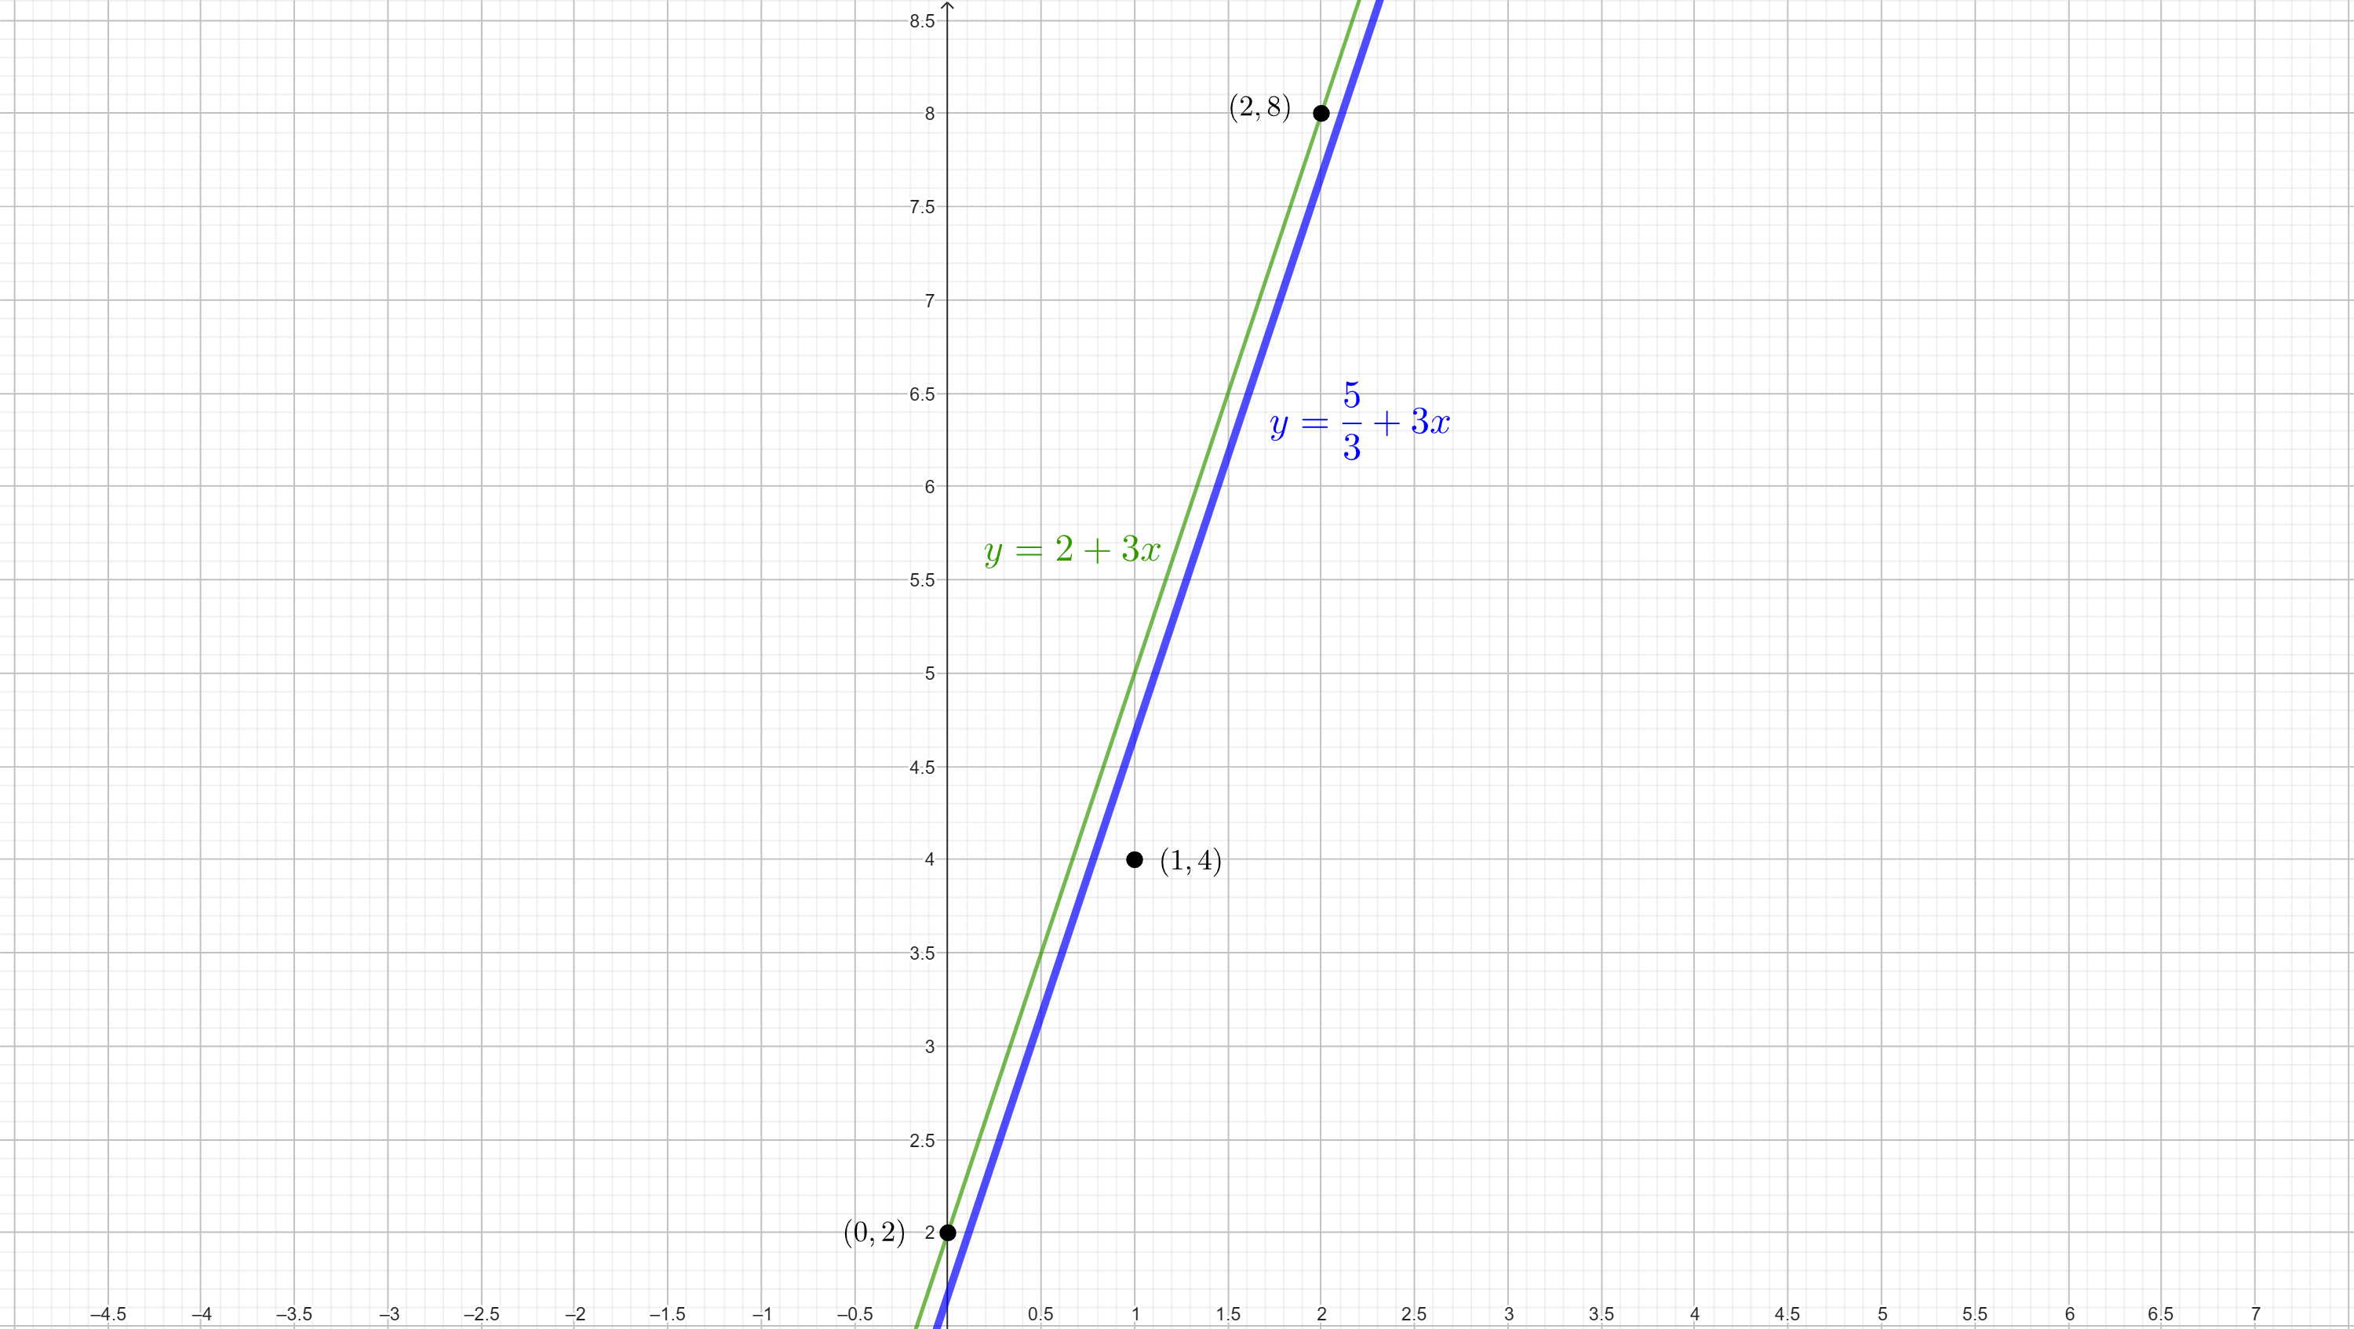

Slide 6
• Observation. The function to which one wants to fit the given points
can be more general than that shown ( y(x) = a₁ f₁(x) + ∙∙∙ + a_{p} f_{p}(x) ),
the parameters to be determined (a₁, … , a_{p} ∈ R) can appear in a
number of other “nonlinear” ways; for example,
y(x) = a₁ ln(a₂x²) + sin(a₃x) + a₄ .
Even though the procedure to determine in these cases the best
a₁, … , a_{p} ∈ R is identical to which we will explain, the system of
equations that allows to find those values of a₁, … , a_{p} ∈ R is not always
analytically solvable (it may be with the help of software and/or in
an approximate way), just opposite to what happens for a function as
y(x) = a₁ f₁(x) + ∙∙∙ + a_{p} f_{p}(x), to which we focus exclusively.

Slide 7
The procedure
• To find out the minimum value of the error function
E = E(a₁, a₂, … , a_{p}) = Σ (y_{i}- y(x_{i}))² = Σ (y_{i}- a₁ f₁(x_{i}) - ∙∙∙ - a_{p} f_{p}(x_{i}))²
we know that all its partial derivatives with respect to a₁, … , a_{p}
must be zero: = 0, … , = 0 (easily: it is not a maximum).
n
n
i=1
i=1
∂E
∂E
∂a₁
∂a_{p}
For all j = 1, 2, …, p, one gets
0 = = Σ ( 2 ∙ (y_{i}- a₁ f₁(x_{i}) - ∙∙∙ - a_{p} f_{p}(x_{i})) ∙ (-f_{j}(x_{i})) )
∂E
n
∂a_{j}
i=1
n
n
n
n
- Σ y_{i} f_{j}(x_{i}) + a₁ Σ f_{j}(x_{i}) f₁(x_{i}) + ∙∙∙ + a_{j} Σ f_{j}(x_{i}) f_{j}(x_{i}) + ∙∙∙ + a_{p} Σ f_{j}(x_{i}) f_{p}(x_{i})=0.
i=1
i=1
i=1
i=1

Slide 8
… the procedure
Giving raise to a system of linear equations (in the unknowns
a₁, a₂, … , a_{p} ∈ R) that we can write as:
Σf₁(x_{i}) f₁(x_{i}) Σf₁(x_{i}) f₂(x_{i}) ∙∙∙ Σf₁(x_{i}) f_{p}(x_{i}) a₁ Σf₁(x_{i}) y_{i}
Σf₂(x_{i}) f₁(x_{i}) Σf₂(x_{i}) f₂(x_{i}) ∙∙∙ Σf₂(x_{i}) f_{p}(x_{i}) a₂ Σf₂(x_{i}) y_{i} ,
… … …
Σf_{p}(x_{i}) f₁(x_{i}) Σf_{p}(x_{i}) f₂(x_{i}) ∙∙∙ Σf_{p}(x_{i}) f_{p}(x_{i}) a_{p} Σf_{p}(x_{i}) y_{i}
system that always has some solution.
n
n
n
n
i=1
i=1
i=1
i=1
n
n
n
n
=
i=1
i=1
i=1
i=1
n
n
n
n
i=1
i=1
i=1
i=1

Slide 9
… the procedure
It is usual to define some auxiliary matrices to express this system in a more compact form, useful for its resolution:
C_{F} ∈ M_{R}(n x p) : each column j is given by f_{j}(x₁), f_{j}(x₂), … , f_{j}(x_{n}) ;
C_{y} ∈ M_{R}(n x 1) : column matrix with entries y₁, y₂, … , y_{n} ;
C_{a} ∈ M_{R}(p x 1) : column matrix with entries a₁, a₂, … , a_{p} .
Now, the system can be written as:
(C_{F})^{T} C_{F} C_{a} = (C_{F})^{T} C_{y} (from where one can get C_{a})
Which, when C_{F} has rank p (the most common), allows to deduce:
a₁
C_{a} = ( (C_{F})^{T} C_{F} )⁻¹ (C_{F})^{T} C_{y} , that is, … = ( (C_{F})^{T} C_{F} )⁻¹ (C_{F})^{T} C_{y}
a_{p}

Slide 10
Let us find the function
y(x) = a₁ + a₂ cos(x)
that best fits the following 6 points set:
{ (-2, -2.9), (-1, 0.4), (0, 2.1), (1, 1.6), (2, -0.8), (3, -1.3) }
Example 1
Taking f₁(x) = 1, f₂(x) = cos(x) ( y(x) = a₁f₁(x)+a₂f₂(x) ) we have the matrices
1 cos(-2)
1 cos(-1)
1 cos(0)
1 cos(1)
1 cos(2)
1 cos(3)
1 -0.416
1 0.540
1 1
1 0.540
1 -0.416
1 -0.989
-2.9
0.4
2.1
1.6
-0.8
-1.3
C_{F} = = ,
C_{y} = ,
from which:

Slide 11
(C_{F}) ^{T} C_{F} = =
1 -0.416
1 0.540
1 1
1 0.540
1 -0.416
1 -0.989
1 1 1 1 1 1
-0.416 0.540 1 0.540 -0.416 -0.989
6 0.258
0.258 2.910
a₁ -0.239
= ( (C_{F}) ^{T} C_{F} )⁻¹ (C_{F})^{T} C_{y} =
a₂ 2.085
Then:
( (C_{F}) ^{T} C_{F} )⁻¹ =
0.167 -0.014
-0.014 0.344
y(x) = -0.239 + 2.085 cos(x)
E(a₁=-0.239,a₂=2.085) = 5.126, error

Slide 12
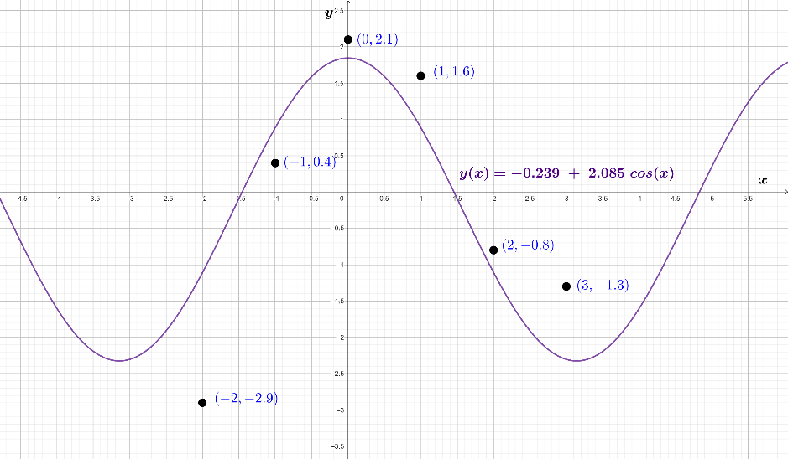

Slide 13
Particular case: polynomial approximation
• This occurs when the function y(x) = a₁ f₁(x) + a₂ f₂(x) + ∙∙∙ + a_{p}f_{p}(x)
is a polynomial, that is, it is defined by means of
f₁(x) = 1, f₂(x) = x, f₃(x) = x² , … , f_{p}(x) = x^{p-1}.
• In this case, the matrix C_{F} ∈ M_{R}(n x p) has rank p when the
n given points have their x-coordinates pairwise distinct, that is,
x_{i} ≠ x_{j} whenever i ≠j, for all i, j = 1, 2, …, n;
and then the following formula can be used to get the best values for
a₁, a₂, … , a_{p} ∈ R :
a₁
… = ( (C_{F})^{T} C_{F} )⁻¹ (C_{F})^{T} C_{y}
a_{p}

Slide 14
… particular case: polynomial approximation
• One refers to:
- when p=2 ( y(x) = a₁ + a₂ x ): linear approximation
(also linear regression);
- when p=3 ( y(x) = a₁ + a₂ x + a₃ x² ): quadratic approximation;
- when p=4 ( y(x) = a₁ + a₂ x + a₃ x² + a₄ x³ ): cubic approximation.
In the following example the show the quadratic approximation of
the same 6 points set used in the Example 1 (it is worth comparing
the error with the error obtained in Example 1).

Slide 15
Let us find the quadratic function
y = a + bx + cx²
that best fit the following set of 6 points:
{ (-2, -2.9), (-1, 0.4), (0, 2.1), (1, 1.6), (2, -0.8), (3, -1.3) }
Example 2
Taking f₁(x)=1, f₂(x)=x, f₃(x)=x² ( y(x)=af₁(x)+bf₂(x)+cf₃(x) ) we have the matrices
1 -2 4
1 -1 1
1 0 0
1 1 1
1 2 4
1 3 9
-2.9
0.4
2.1
1.6
-0.8
-1.3
C_{F} = ,
C_{y} = ,
from which:

Slide 16
(C_{F}) ^{T} C_{F} = =
1 -2 4
1 -1 1
1 0 0
1 1 1
1 2 4
1 3 9
1 1 1 1 1 1
-2 -1 0 1 2 3
4 1 0 1 4 9
6 3 19
3 19 27
19 27 115
a
b = ( (C_{F}) ^{T} C_{F} )⁻¹ (C_{F})^{T} C_{y} =
c
Hence:
( (C_{F}) ^{T} C_{F} )⁻¹ =
13/35 3/70 -1/14
3/70 47/560 -3/112
-1/14 -3/112 3/112
y(x) = 1.479 + 0.743 x - 0.632 x²
1.479
0.743
-0.632
=
E(a=1.479,b=0.743,c=-0.632) = 2.599, error

Slide 17
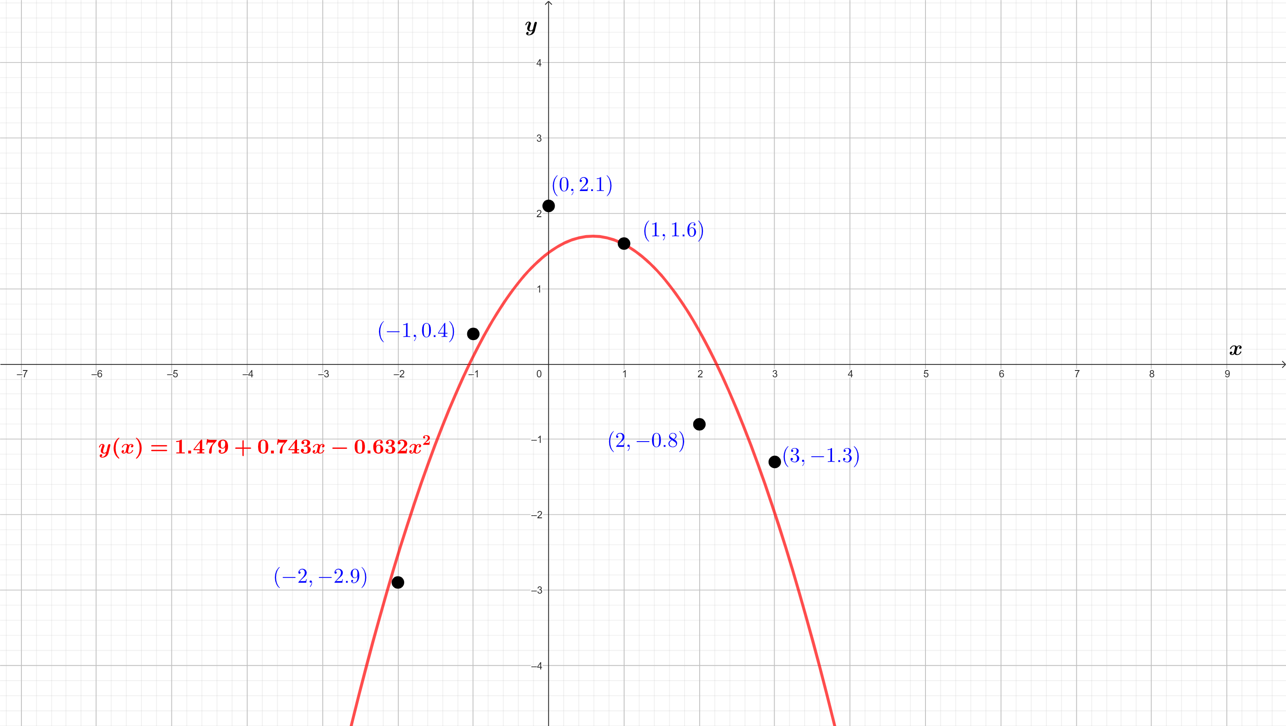
Comparison of results from
both Example 1 and Example 2
is shown in the following graph…

Slide 18
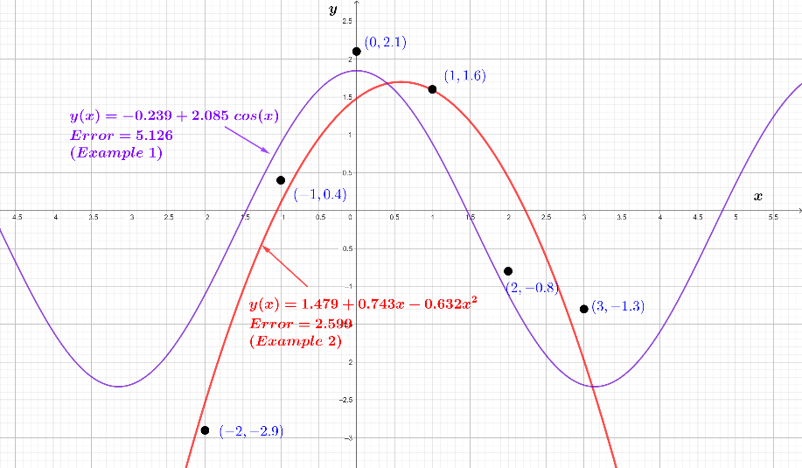

Slide 19
… particular case: polynomial approximation
• For the case p=2 ( y(x) = a₁ + a₂ x, regression line ) we can further:
- give an alternative (usual) formula for the best values
of a₁, a₂ ∈ R;
- give a parameter (different from the error) that assesses how
accurate the adjustment of the regression line is.

Slide 20
… particular case: regression line
( y(x) = a₁ + a₂ x )
- First of all, one can easily see that matrix C_{F} is equal to
1 x₁
1 x₂
…
1 x_{n}
n
n ∑ x_{i}
∑ x_{i} ∑ (x_{i})²
i=1
, then (C_{F})^{T} C_{F} =
, and also
C_{F} =
n
n
i=1
i=1
n
∑ x_{i}
∑ x_{i} y_{i}
(C_{F})^{T} C_{y} =
i=1
n
i=1
Hence, after some simple calculations, we get:

Slide 21

… particular case: regression line
( y(x) = a₁ + a₂ x )
a₁ 1
= ( (C_{F})^{T} C_{F} )⁻¹ (C_{F})^{T} C_{y} =
a₂ n ∑ (x_{i})² - ( ∑ x_{i} )²
n
n
n
n
∑ (x_{i})² ∑ y_{i} - ∑ x_{i} ∑ x_{i} y_{i}
- ∑ x_{i} ∑ y_{i} + n ∑ x_{i} y_{i}
i=1
i=1
i=1
i=1
n
n
n
n
n
i=1
i=1
i=1
i=1
i=1
That is:
∑ (x_{i})² ∑ y_{i} - ∑ x_{i} ∑ x_{i} y_{i}
a₁ = ,
n ∑ (x_{i})² - ( ∑ x_{i} )²
n
n
n
n
n ∑ x_{i} y_{i} - ∑ x_{i} ∑ y_{i}
a₂ =
n ∑ (x_{i})² - ( ∑ x_{i} )²
n
n
i=1
i=1
i=1
i=1
i=1
i=1
i=1
n
n
n
n
i=1
i=1
i=1
i=1

Slide 22
… particular case: regression line
( y(x) = a₁ + a₂ x )
- Second, to assess the goodness of an adjustment by a regression line, note
that we could also have adjusted the given points (x_{i}, y_{i}) by a line of the kind
x = b₁ + b₂ y (b₁ , b₂ ∈ R)
Replacing in this second expression “y” with “a₁ + a₂ x” :
x = b₁ + b₂(a₁+a₂x)
x = (b₁+b₂a₁) + (b₂a₂)x
0 = (b₁+b₂a₁) + (b₂a₂-1)x,
from where, in order to be accomplished by distinct values of “x”, it must
be b₂ a₂ – 1 = 0, that is, a₂ b₂ =1.
This equality (a₂ b₂ = 1) does not hold actually, as the given points are not
(in principle) on a line. But how close this equality is to be true gives us an
idea of the goodness of the initial linear regression.

Slide 23
… particular case: regression line
( y(x) = a₁ + a₂ x )
The usual way to proceed is to calculate (a₂ b₂)^{1/2} and see how close it
is to ± 1.
We know the expression for a₂ ; for b₂ it would follow in the
same way, just swapping the roles of x_{i} and y_{i} (for each i). Then:
n ∑ x_{i} y_{i} - ∑ x_{i} ∑ y_{i} n ∑ x_{i} y_{i} - ∑ x_{i} ∑ y_{i} ^{1/2}
r_{xy} = (a₂ b₂)^{1/2} = ∙ =
n ∑ (x_{i})² - ( ∑ x_{i} )² n ∑ (y_{i})² - ( ∑ y_{i} )²
n
n
n
n
n
n
i=1
i=1
i=1
i=1
i=1
i=1
n
n
n
n
i=1
i=1
i=1
i=1
correlation
coefficient,
or Pearson
coefficient
n ∑ x_{i} y_{i} - ∑ x_{i} ∑ y_{i}
=
n ∑ (x_{i})² - ( ∑ x_{i} )² ∙ n ∑ (y_{i})² - ( ∑ y_{i} )²
i=1
i=1
i=1
1/2
1/2
(-1 ≤ r_{xy} ≤ 1)
i=1
i=1
i=1
i=1

Slide 24
Let us find the (regression) line
y = a + bx
that best fits the following set of 12 points (x_{i},y_{i}):
{ (-5, 13.9), (-4, 12.2), (-3, 10.3), (-2, 7.8), (-1, 6.1), (0, 3.7),
(1, 1.9), (2, -0.2), (3, -1.8), (4, -4.1), (5, -5.8), (6, -7.7) },
giving the values of both the error (E) and of Pearson
coefficient (r_{xy}).
Example 3
Let us first organize the given data in a table:
Info. (i) | 1 | 2 | 3 | 4 | 5 | 6 | 7 | 8 | 9 | 10 | 11 | 12
x_{i} | -5 | -4 | -3 | -2 | -1 | 0 | 1 | 2 | 3 | 4 | 5 | 6
y_{i} | 13.9 | 12.2 | 10.3 | 7.8 | 6.1 | 3.7 | 1.9 | -0.2 | -1.8 | -4.1 | -5.8 | -7.7

Slide 25
Let us now calculate some distinct quantities that appear in the expressions of
a (=a₁), b=(a₂) ∈ R, r_{xy}, E :
Dato (i) | 1 | 2 | 3 | 4 | 5 | 6 | 7 | 8 | 9 | 10 | 11 | 12
x_{i} | -5 | -4 | -3 | -2 | -1 | 0 | 1 | 2 | 3 | 4 | 5 | 6
y_{i} | 13.9 | 12.2 | 10.3 | 7.8 | 6.1 | 3.7 | 1.9 | -0.2 | -1.8 | -4.1 | -5.8 | -7.7
12
∑ x_{i} = 6
i=1
12
∑ y_{i} = 36.3
i=1
12
(x_{i})² | 25 | 16 | 9 | 4 | 1 | 0 | 1 | 4 | 9 | 16 | 25 | 36
(y_{i})² | 193.21 | 148.84 | 106.09 | 60.84 | 37.21 | 13.69 | 3.61 | 0.04 | 3.24 | 16.81 | 33.64 | 59.29
x_{i}y_{i} | -69.5 | -48.8 | -30.9 | -15.6 | -6.1 | 0 | 1.9 | -0.4 | -5.4 | -16.4 | -29 | -46.2
∑ (x_{i})² = 146
i=1
12
∑ (y_{i})² =676.51
12
i=1
∑ x_{i} y_{i} =-266.4
i=1
Then:

Slide 26
∑ (x_{i})² ∑ y_{i} - ∑ x_{i} ∑ x_{i} y_{i} 146 ∙ 36.3 – 6 ∙ (-266.4)
a = a₁ = = = 4.019
12 ∑ (x_{i})² - ( ∑ x_{i} )² 12 ∙ 146 – 6²
12
12
12
12
i=1
i=1
i=1
i=1
12
12
12 ∑ x_{i} y_{i} - ∑ x_{i} ∑ y_{i} 12 ∙ (-266.4) – 6 ∙ 36.3
b = a₂ = = = - 1.989
12 ∑ (x_{i})² - ( ∑ x_{i} )² 12 ∙ 146 – 6²
i=1
i=1
12
12
12
i=1
i=1
i=1
12
12
i=1
i=1
Hence, the regression line is:
y(x) = 4.019 - 1.989 x

Slide 27
And Pearson coefficient is equal to:
12 ∑ x_{i} y_{i} - ∑ x_{i} ∑ y_{i}
r_{xy} = =
12 ∑ (x_{i})² - ( ∑ x_{i} )² ∙ 12 ∑ (y_{i})² - ( ∑ y_{i} )²
12
12
12
i=1
i=1
i=1
12
12
1/2
12
12
1/2
i=1
i=1
i=1
i=1
12 ∙ (-266.4) – 6 ∙ 36.3
= = -0.9996
12 ∙ 146 – 6² ∙ 12 ∙ 676.51 – 36.3²
1/2
1/2
,
indicating that the linear approximation (or adjustment) is pretty good, since this
coefficient is very close to -1 (see the following graph):

Slide 28
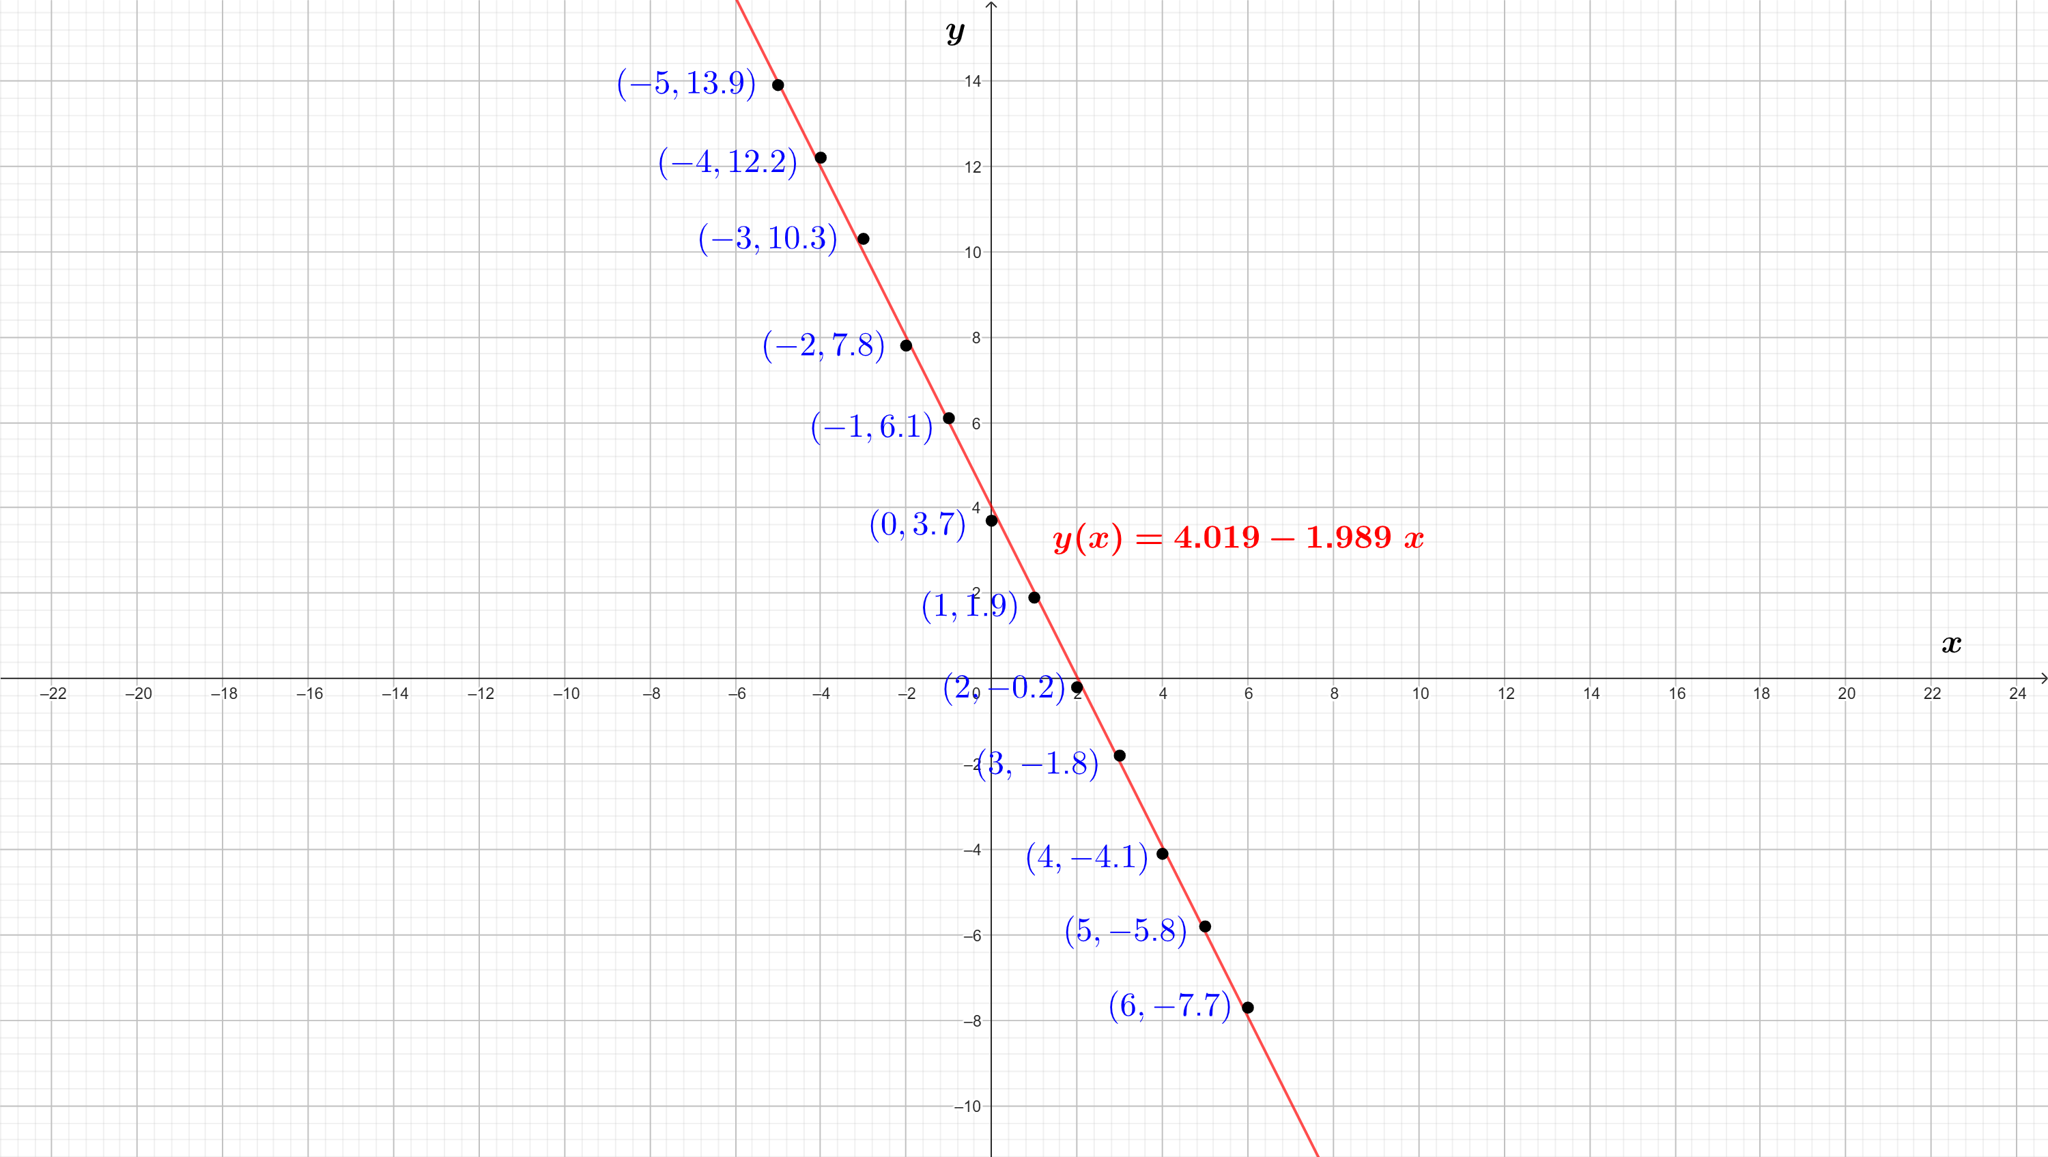

Slide 29
E = ∑ (y_{i} – (a + b x_{i})) ² = ∑ (y_{i} – (4.019 – 1.989 x_{i})) ² = 0.488
With respect to the error:
12
12
i=1
i=1
• Observation. In principle, the error depends strongly on the number of
given points (the larger the number of points, the greater the error since
it contains more positive addends); this has not been the case in the 3
presented examples, where the error has been much greater for the 6
points sets (Examples 1 and 2) than for the 12 points set (Example 3).
To somehow prevent from this dependence (and be able to compare errors)
one usually calculates the ratio E/n, called mean squared error.
Then:
E/6 (Example 1) = 0.854, E/6 (Example 2) = 0.433, E/12 (Example 3) = 0.041.

Slide 30
Particular case: exponential approximation
• There are some approximating functions that are not of the kind
y(x) = a₁ f₁(x) + a₂ f₂(x) + ∙∙∙ + a_{p} f_{p}(x)
but that can “become” this type after certain transformation of
data.
One such example is the exponential approximation, where one wants to
adjust data to a function of the kind
y(x) = A e^{Bx} ,
A , B ∈ R being the parameters to be determined to fit best possible
the n given points set { (x₁ , y₁) , (x₂ , y₂) , … , (x_{n} , y_{n}) }. We will first assume
that y_{i} > 0 for all i = 1, 2, …, n.

Slide 31
… particular case: exponential approximation
If we calculate the natural logarithm of both parts of the equality
y = A e^{Bx} we get
ln(y) = ln(A) + Bx
ln(y) = ln(A e^{Bx})
ln(y) = a + bx, with
ln(A) = a (A=eª), B=b.
Then, taking as data the n points
{ (x₁ , ln(y₁)) , (x₂ , ln(y₂)), … , (x_{n} , ln(y_{n})) }
we can find their regression line to determine a, b and, from these
values, deduce the best A , B ∈ R as A = eª, B = b.

Slide 32
… particular case: exponential approximation
- In case it was y_{i} < 0 for all i = 1, 2, …, n, we should proceed
similarly, finding the regression line ln(-y) = a + bx (that is, from the
data { (x₁ , ln(-y₁)) , (x₂ , ln(-y₂)), … , (x_{n} , ln(-y_{n})) }) and, from these values
a, b, deduce the best A , B ∈ R as
A = - eª, B = b for the adjustment y(x) = A e^{Bx}.
- And in case there were y_{i}’s of opposite signe, we should take first
some value C ∈ R, C > 0, such that y_{i} + C > 0 for all i = 1,…, n. And
find the regression line ln(y + C) = a + bx (that is, from the data
{ (x₁ , ln(y₁+C)) , (x₂ , ln(y₂+C)), … , (x_{n} , ln(y_{n}+C)) }), to deduce the
best A , B ∈ R (for that value of C) as
A = eª, B = b for the adjustment y(x) = A e^{Bx} - C.

Slide 33
Let us find the values of A, B ∈ R that best fit the
10 points set
{ (0, 2.1), (0.3, 1.911), (0.39, 1.75), (0.54, 1.915), (0.63, 1.716),
(0.78, 1.422), (0.96, 1.047), (1.14, 0.635), (1.32, 0.196), (1.41, 0.22) },
to an exponential function of the kind
y(x) = A e^{Bx} .
Example 4
Note that the second coordinates of the points are all positive.
Let us now gather together these data in a table:
Info. (i) | 1 | 2 | 3 | 4 | 5 | 6 | 7 | 8 | 9 | 10
x_{i} | 0 | 0.3 | 0.39 | 0.54 | 0.63 | 0.78 | 0.96 | 1.14 | 1.32 | 1.41
y_{i} | 2.1 | 1.911 | 1.75 | 1.915 | 1.716 | 1.422 | 1.047 | 0.635 | 0.196 | 0.22

Slide 34
We now calculate the regression line for the set of pairs (x_{i}, ln(y_{i})), so we first
expand last table in order to include the value of ln(y_{i}) for each i:
Info. (i) | 1 | 2 | 3 | 4 | 5 | 6 | 7 | 8 | 9 | 10
x_{i} | 0 | 0.3 | 0.39 | 0.54 | 0.63 | 0.78 | 0.96 | 1.14 | 1.32 | 1.41
y_{i} | 2.1 | 1.911 | 1.75 | 1.915 | 1.716 | 1.422 | 1.047 | 0.635 | 0.196 | 0.22
ln(y_{i}) | 0.741 | 0.647 | 0.559 | 0.649 | 0.54 | 0.352 | 0.045 | -0.454 | -1.629 | -1.514
After some simple calculations we get:
10
10
10
10
10
∑ x_{i} = 7.470,
∑ ln(y_{i}) = -0.061 ,
∑ (x_{i})² = 7.490 ,
∑ (ln(y_{i}))² = 7.277 ,
∑ x_{i} ln(y_{i}) = -3.381 ,
i=1
i=1
i=1
i=1
i=1
hence:

Slide 35
∑ (x_{i})² ∑ ln(y_{i}) - ∑ x_{i} ∑ x_{i} ln(y_{i})
a = = 1.298 A = e^{1.298} = 3.662
10 ∑ (x_{i})² - ( ∑ x_{i} )²
10
10
10
10
i=1
i=1
i=1
i=1
10
10
10 ∑ x_{i} ln(y_{i}) - ∑ x_{i} ∑ ln(y_{i})
b = = -1.746 B = -1.746
10 ∑ (x_{i})² - ( ∑ x_{i} )²
i=1
i=1
10
10
10
i=1
i=1
i=1
10
10
i=1
i=1
Then, the best exponential function of the kind A e^{Bx} is:
y(x) = 3.662 e^{-1.746 x}

Slide 36
And Pearson coefficient is equal to:
10 ∑ x_{i} ln(y_{i}) - ∑ x_{i} ∑ ln(y_{i} )
r_{xy} = = -0.895 ,
10 ∑ (x_{i})² - ( ∑ x_{i} )² ∙ 10 ∑ (ln(y_{i}))² - ( ∑ ln(y_{i}) )²
10
10
10
i=1
i=1
i=1
10
10
1/2
10
10
1/2
i=1
i=1
i=1
i=1
that maybe is not close enough to ±1 so as to consider that the performed
exponential adjustment is very good (see next graph).
E = ∑ (y_{i} – (A e^{Bx}i))² = ∑ (y_{i} – (3.662 e^{-1.746 x}i)) ² = 3.424 , E/10 = 0.342
Actually, the error (and the mean squared one) are equal to:
10
10
i=1
i=1

Slide 37
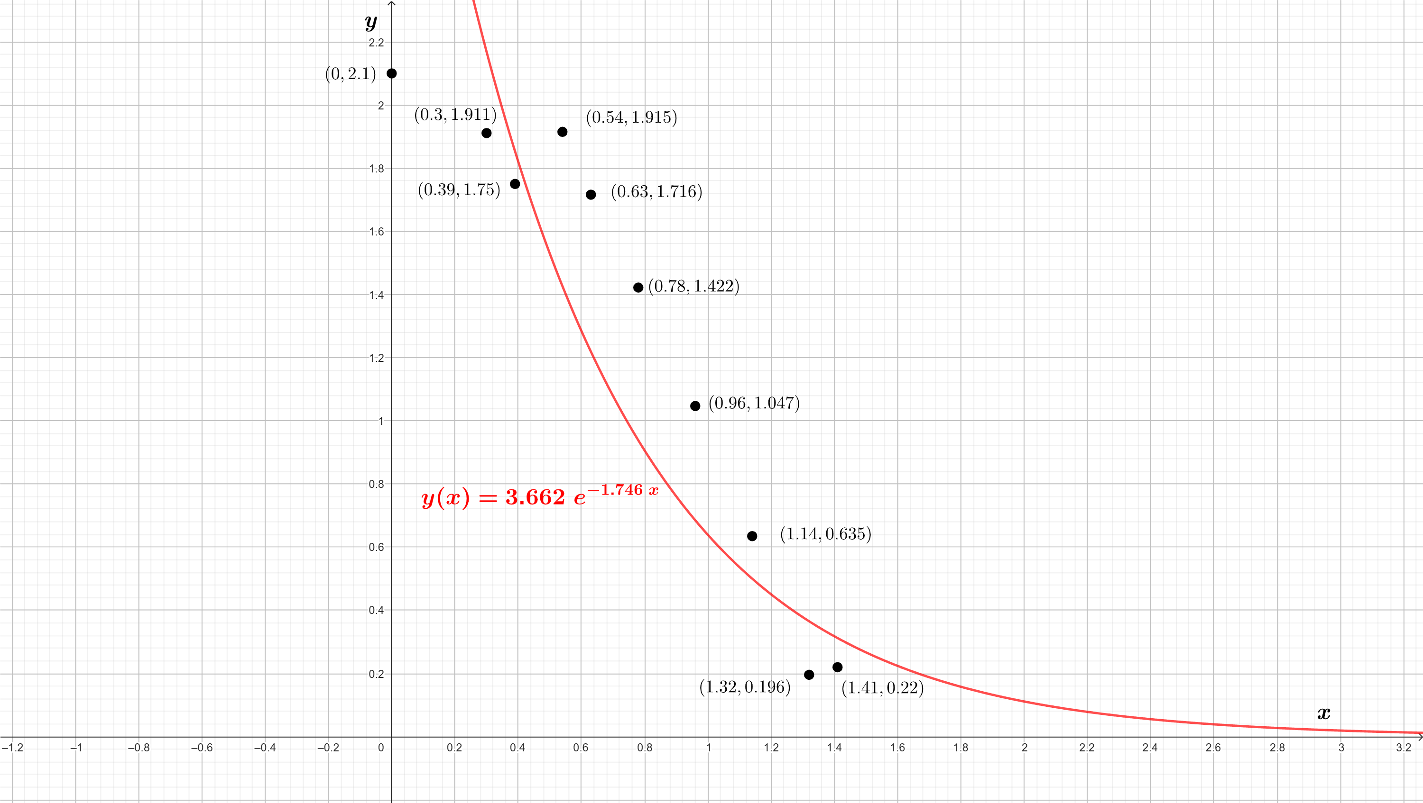

Slide 38
Other particular cases
• Apart from the exponential approximation (or adjustment), there
exist other usual examples of approximating functions not of type
y(x) = a₁ f₁(x) + a₂ f₂(x) + ∙∙∙ + a_{p} f_{p}(x)
but that can be “converted” to this type after transforming
the data in a suitable form; for instance, the potential
approximation, where one wants to adjust data to a function as
y(x) = A x^{B} ,
A , B ∈ R being the parameters to be determined.
No such example will be treated here, it is left as an exercise
for anyone who could be interested.

Slide 39
Test yourself?
Yes
No

Slide 40
Question 1
Given a set with 2 points in the plane, {(x₁,y₁), (x₂,y₂)},
with x₁ ≠ x₂ , the regression line must be the line that
minimizes the error. And, obviously, this happens when
the error is equal to zero, that is, the line contains the
2 given points. Could you prove it?
Watch the solution
Next question

Slide 41
Let y(x) = a₁ + a₂ x be the regresión line, for which:
((x₁)²+(x₂)²) (y₁+y₂) - (x₁+x₂) (x₁y₁+x₂y₂) (x₁-x₂) (x₁y₂-x₂y₁) x₁y₂-x₂y₁
a₁ = = =
2((x₁)²+(x₂)²) - (x₁+x₂) ² (x₁-x₂) ² x₁-x₂
2(x₁y₁+x₂y₂) - (x₁+x₂) (y₁+y₂) (x₁-x₂) (y₁-y₂) y₁-y₂
a₂ = = =
2((x₁)²+(x₂)²) - (x₁+x₂) ² (x₁-x₂) ² x₁-x₂
Then, calculating y(x) for x₁ and for x₂ (must yield y₁, y₂, respectively):
x₁y₂-x₂y₁ (y₁-y₂)x₁ (x₁-x₂)y₁
y(x₁)= + = = y₁ ;
x₁-x₂ x₁-x₂ x₁-x₂
x₁y₂-x₂y₁ (y₁-y₂)x₂ (x₁-x₂)y₂
y(x₂)= + = = y₂
x₁-x₂ x₁-x₂ x₁-x₂

Slide 42
Question 2
Given the following set of 8 points in the plane:
{ (0,2.1), (0.2,2.5), (0.8,3.5), (1.5,4.35),
(3,6.4), (4.1,8.55), (5.9,10.65), (6.2,11.8) },
we want to adjust it by using 3 distinct functions:
1) y(x) = a₁ + b₁ x ;
2) y(x) = a₂ x + b₂ x² ;
3) y(x) = a₃ e^{b}3^{x} .
Calling E₁, E₂, E₃ to the respective errors for the best
values of the parameters in each cas, please choose
the correct option:
E₁ < E₃ < E₂
E₃ < E₂ < E₁
E₁ < E₂ < E₃
None of the others is correct

Slide 43
Please,
check your
answer
try again

Slide 44
EXCELLENT!
( a₁ = 2.152, b₁ = 1.503, E₁ = 0.398;
a₂ = 2.898, b₂ = -0.175, E₂ = 11.063;
a₃ = 2.585, b₃ = 0.258, E₃ = 5.177 )

Slide 45
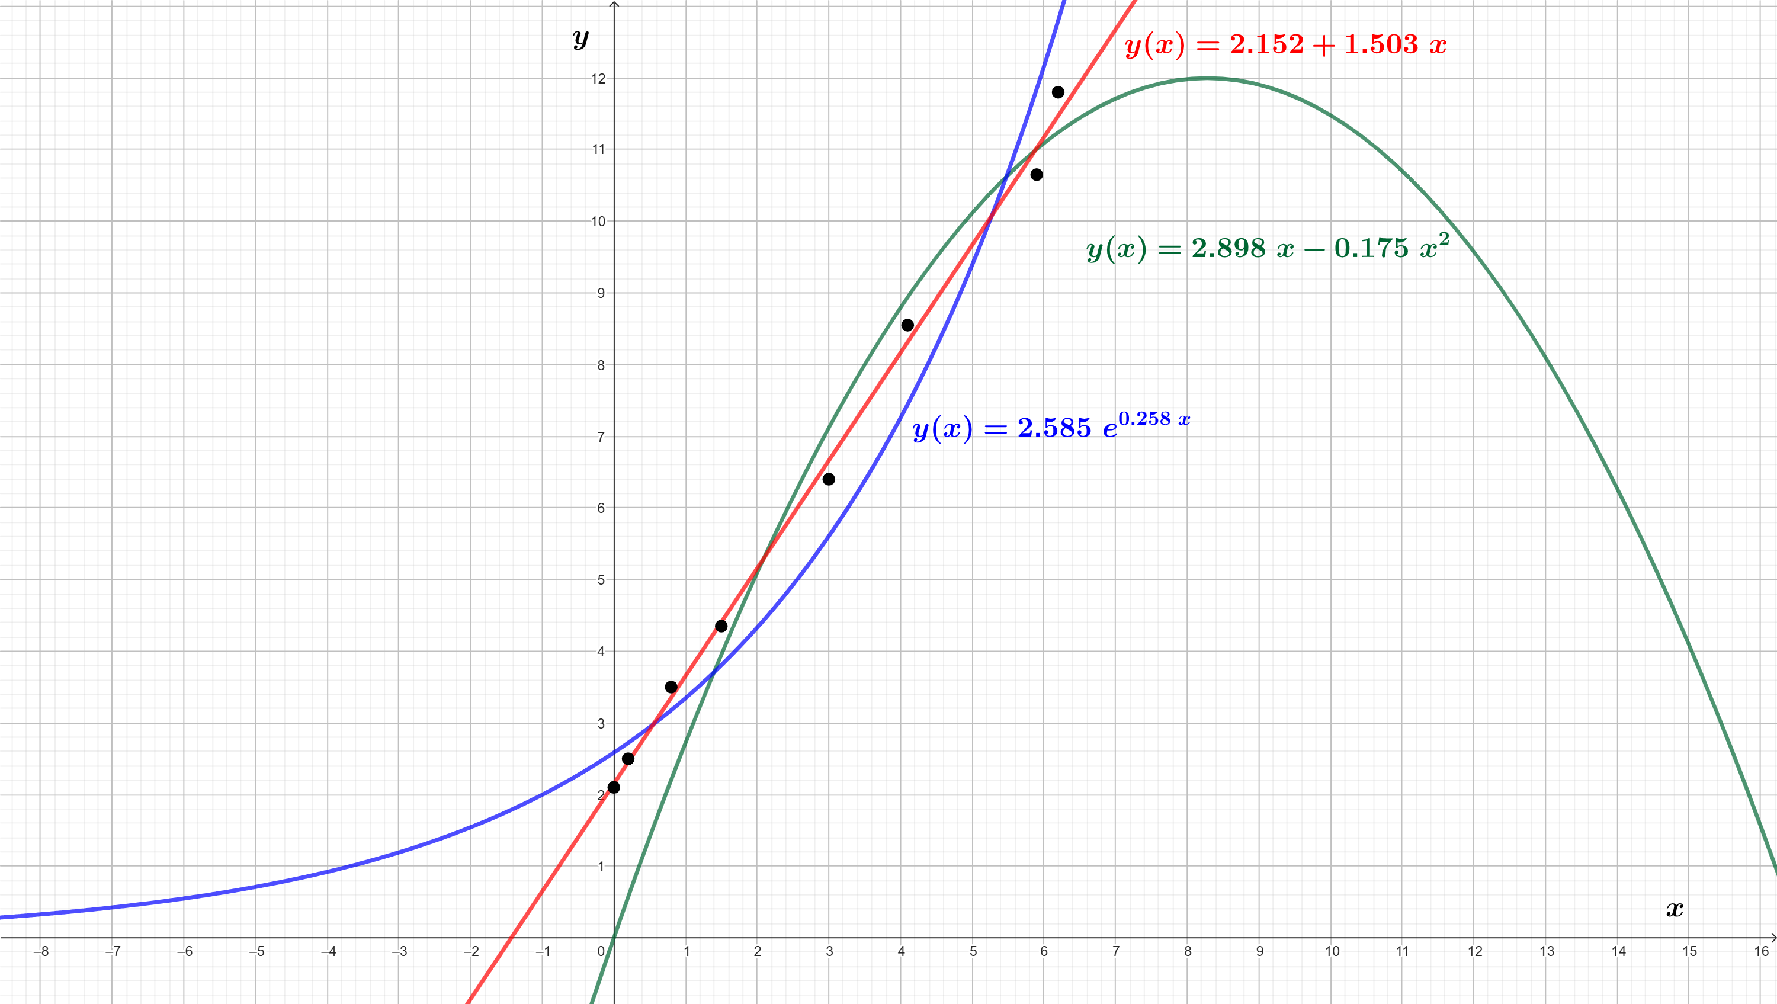

Slide 46

SOME USEFUL RELATED
TOPICS
• Revision of some of the following topics is suggested:
– Orthogonal projection of a vector onto a subespace
– Best approximation of a vector by elements of a subespace
– Extrema of a multivariate function; gradient
– Conjugate gradient method
– Correlation between two statistical variables
– Interpolation

