Slide 1
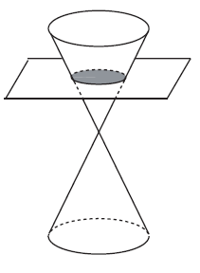

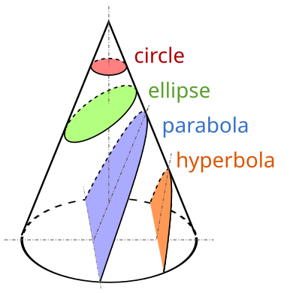
Circle
A conic section, conic or a quadratic curve is a curve obtained from a cone's surface intersecting a plane. The three types of conic section are the hyperbola, the parabola, and the ellipse; the circle is a special case of the ellipse, though it was sometimes considered a fourth type.

Slide 2
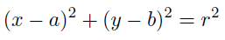

Circle
A circle is a shape where distance from the center to the edge of the circle is always the same.
A circle is a two-dimensional geometric shape where all points on the shape are equidistant from the center. The circumference of a circle, on the other hand, is the distance around the outer edge of the circle. In other words, the circumference is the length of the closed curve that defines the circle.
The equation of a circle of center $\left(a,b\right)$ and radius $r$ is:

Slide 3
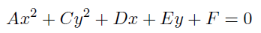
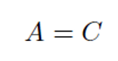
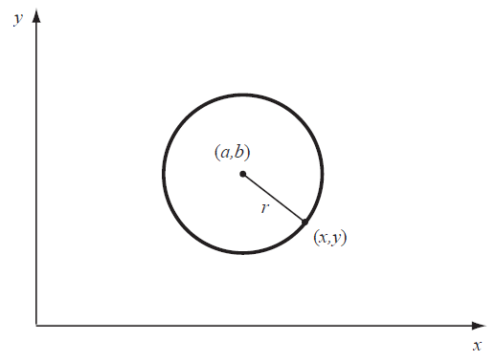
Circle

Slide 4

Circle

Slide 5
Circle
We look for the squares,

Slide 6


Circle
We look for the squares,
We continue operating,

Slide 7
Circle
We look for the squares,
We continue operating,
We have

Slide 8
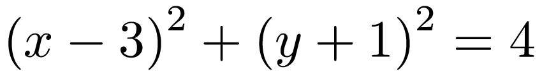
Circle
We look for the squares,
We continue operating,
We have

Slide 9
Circle
We look for the squares,
We continue operating,
We have

Slide 10
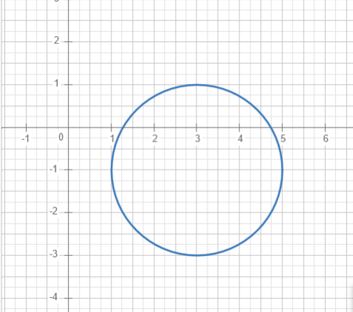
Circle
Buscamos los cuadrados,
Seguimos operando,

