Slide 1
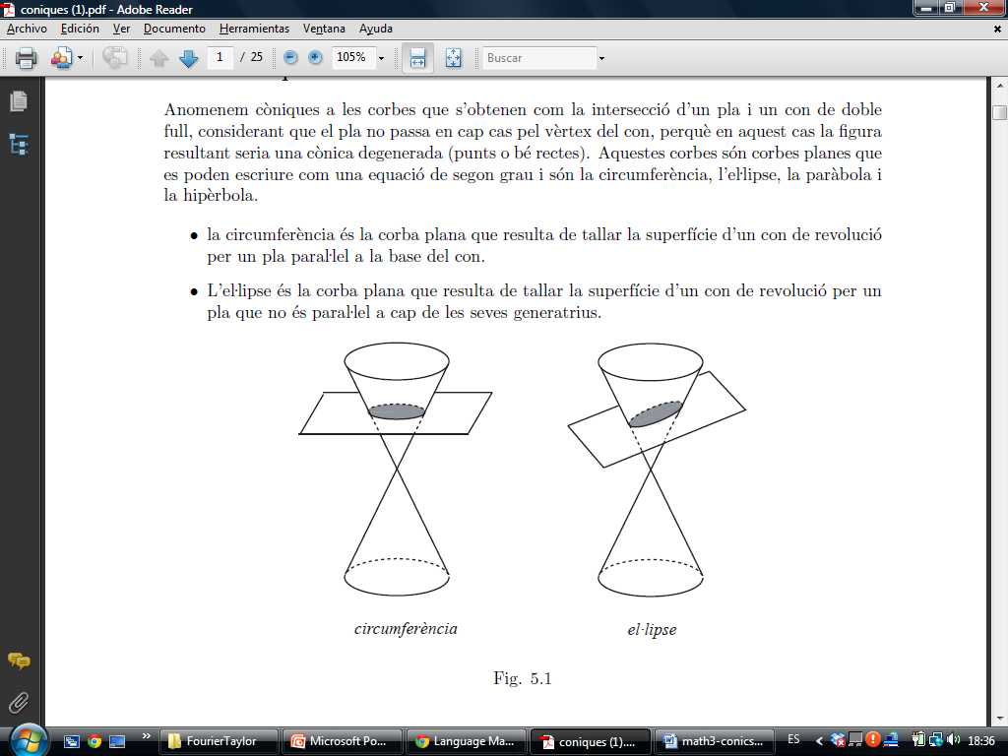

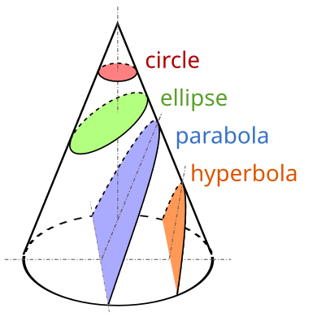
Ellipse
A conic section, conic or a quadratic curve is a curve obtained from a cone's surface intersecting a plane. The three types of conic section are the hyperbola, the parabola, and the ellipse; the circle is a special case of the ellipse, though it was sometimes considered a fourth type.

Slide 2
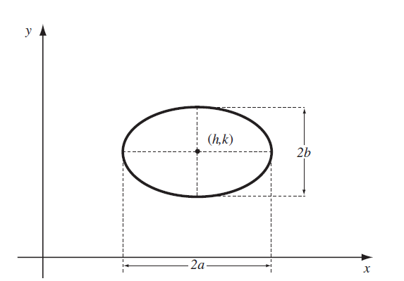
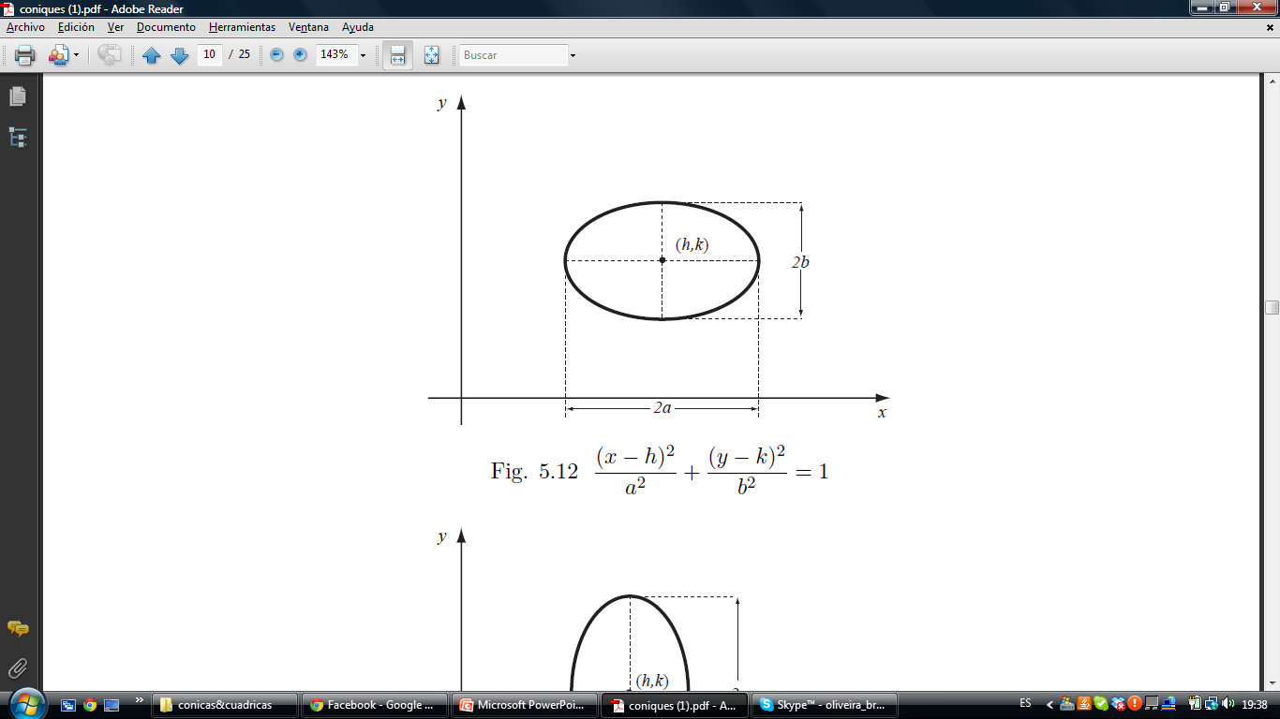
Ellipse
In mathematics, an ellipse is a plane curve surrounding two focal points, such that for all points on the curve, the sum of the two distances to the focal points is a constant. It generalizes a circle, which is the special type of ellipse in which the two focal points are the same.

Slide 3
Ellipse

Slide 4
Ellipse
We look for the squares,

Slide 5
Ellipse
We look for the squares,
We continue operating,

Slide 6

Ellipse
We look for the squares,
We continue operating,
and we obtain

Slide 7
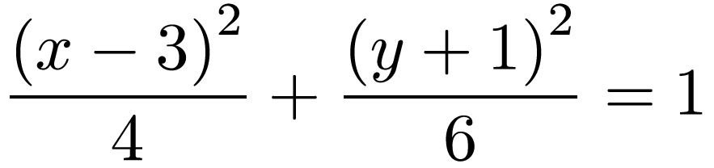
Ellipse
We look for the squares,
We continue operating,
and we obtain

Slide 8
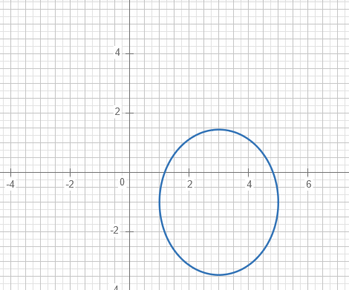
Ellipse
Buscamos los cuadrados,
Seguimos operando,

