Slide 1
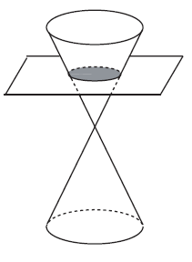
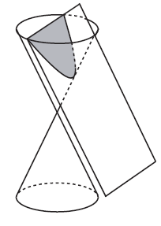

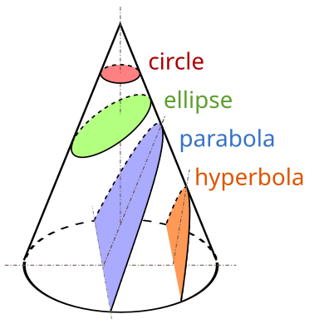
Parabola
A conic section, conic or a quadratic curve is a curve obtained from a cone's surface intersecting a plane. The three types of conic section are the hyperbola, the parabola, and the ellipse; the circle is a special case of the ellipse, though it was sometimes considered a fourth type.

Slide 2
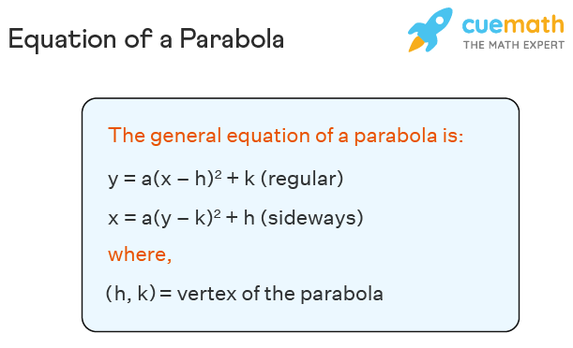
Parabola
A parabola is a curve in which every point on the curve is equidistant from a point called a focus and a straight line called a directrix.

Slide 3
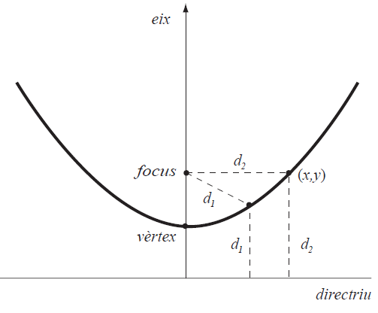
Parabola

Slide 4
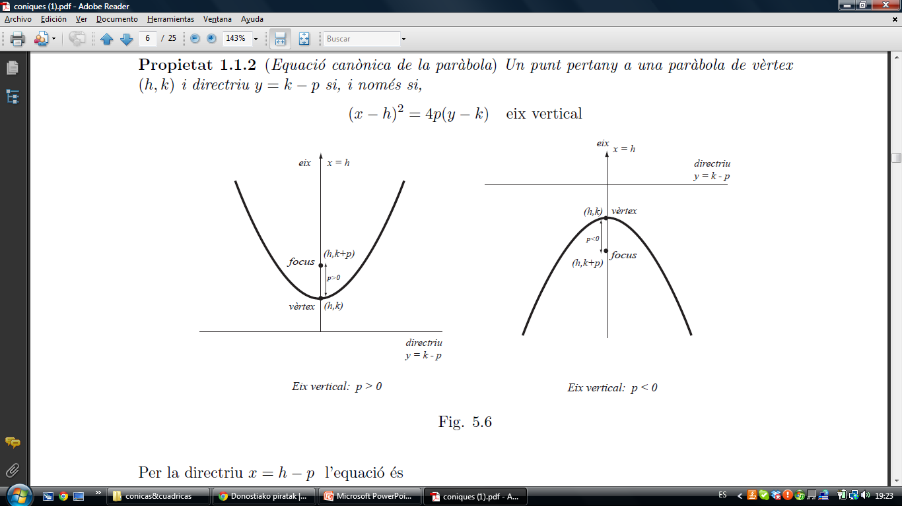
Parabola

Slide 5
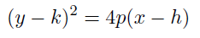
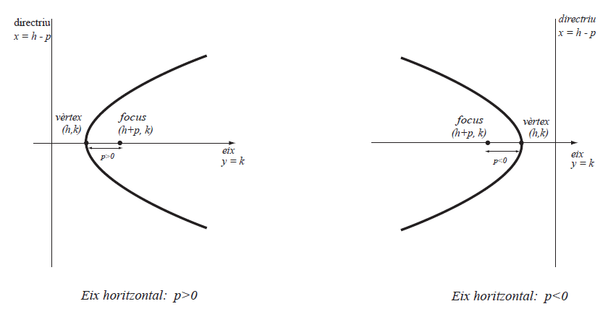
Parabola

Slide 6
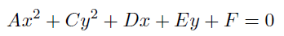
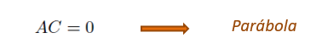
Parabola
Identification
Parabola

Slide 7

Parabola

Slide 8

Parabola
We look for the squares,

Slide 9
Parabola
We look for the squares,
We continue operating,

Slide 10

Parabola
We look for the squares,
We continue operating,

Slide 11
Parabola
We look for the squares,
We continue operating,
and we obtain

Slide 12
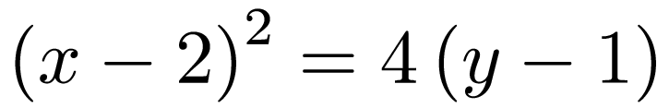
Parabola
We look for the squares,
We continue operating,
and we obtain

Slide 13
Parabola
We look for the squares,
We continue operating,
and we obtain

Slide 14
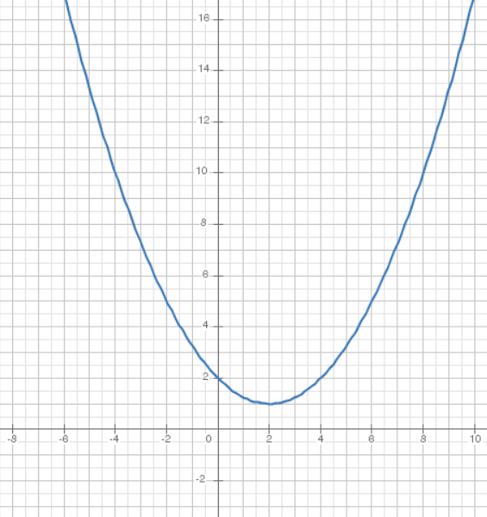
Parabola
Buscamos los cuadrados,
Seguimos operando,
Obtenemos

