Slide 1
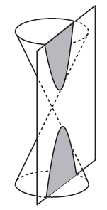

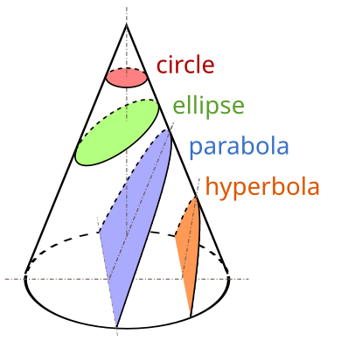
Hyperbola
A conic section, conic or a quadratic curve is a curve obtained from a cone's surface intersecting a plane. The three types of conic section are the hyperbola, the parabola, and the ellipse; the circle is a special case of the ellipse, though it was sometimes considered a fourth type.

Slide 2
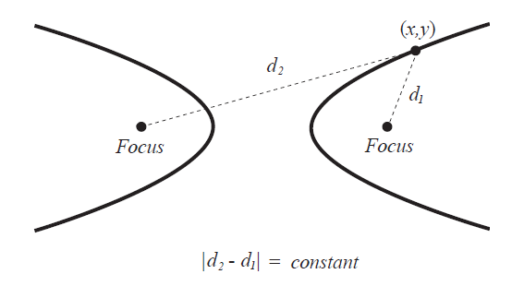
Hyperbola
A hyperbola is the set of all points (x,y) in a plane such that the difference of the distances between (x,y) and the foci is a positive constant.

Slide 3
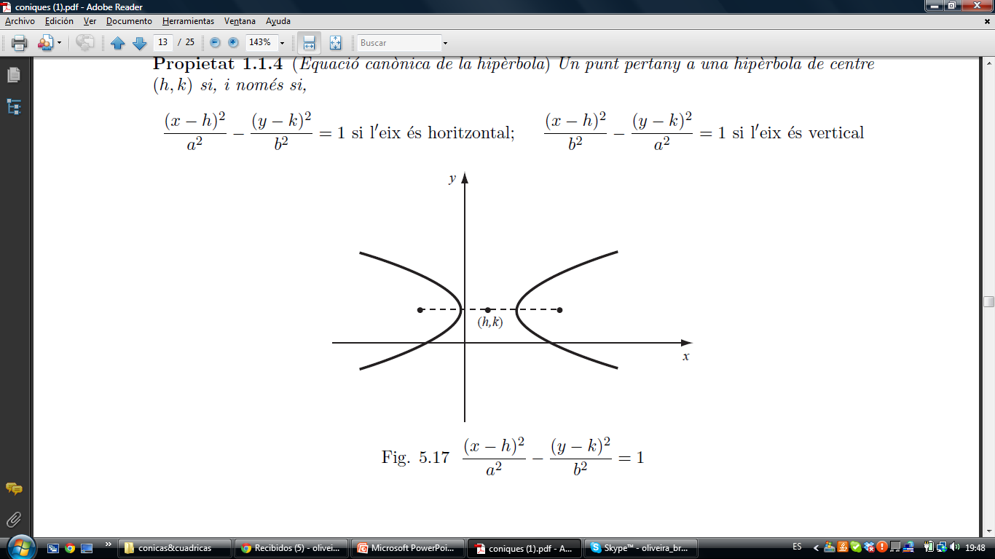
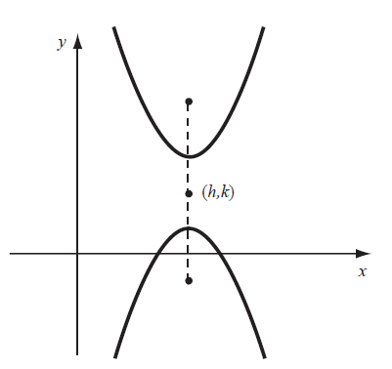
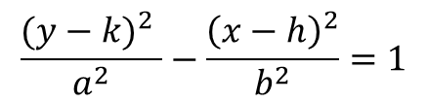
Hyperbola
$$\frac{{(y−k)}^{2} }{a^{2}}−\frac{{\left(x−h\right)}^{2}}{b^{2}}=1$$
The foci are at a distance $c$from the center and $c^{2}=a^{2}+b^{2}$

Slide 4
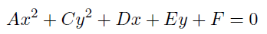
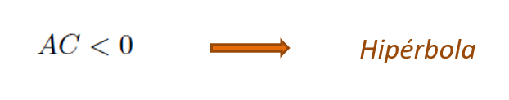
Hyperbola
Identification
Hyperbola

Slide 5
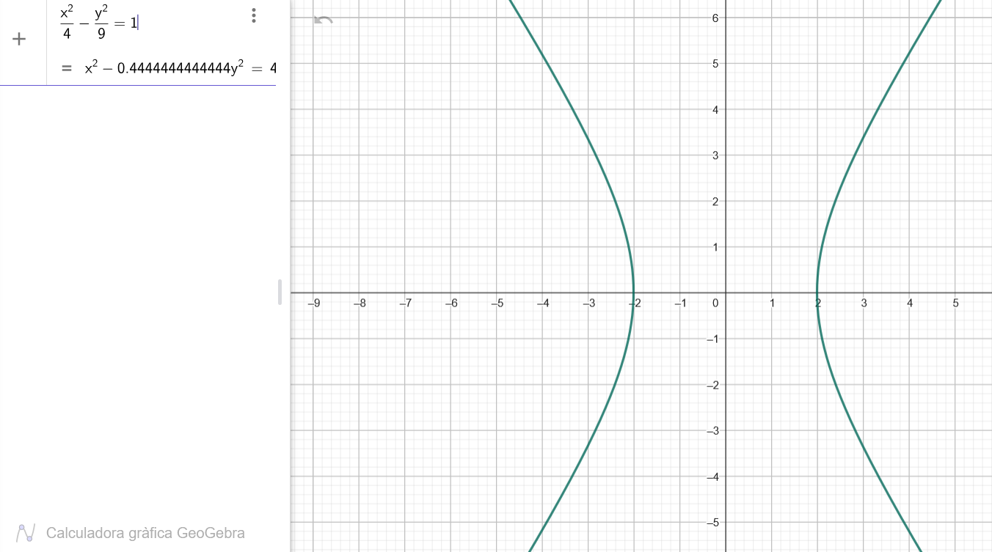
Hyperbola
Example

