Slide 1
Mosaics
Matemàtiques per al disseny
J. Guàrdia
Universitat Politècnica de Catalunya – Barcelona Tech

Slide 2
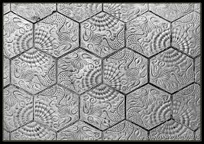
BASIC NOTIONS
A mosaic is a covering of the plane obtained by applying isometries to a tile.
Tiles must not overlap or leave gaps.

Slide 3
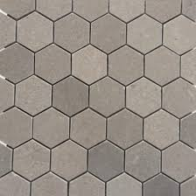
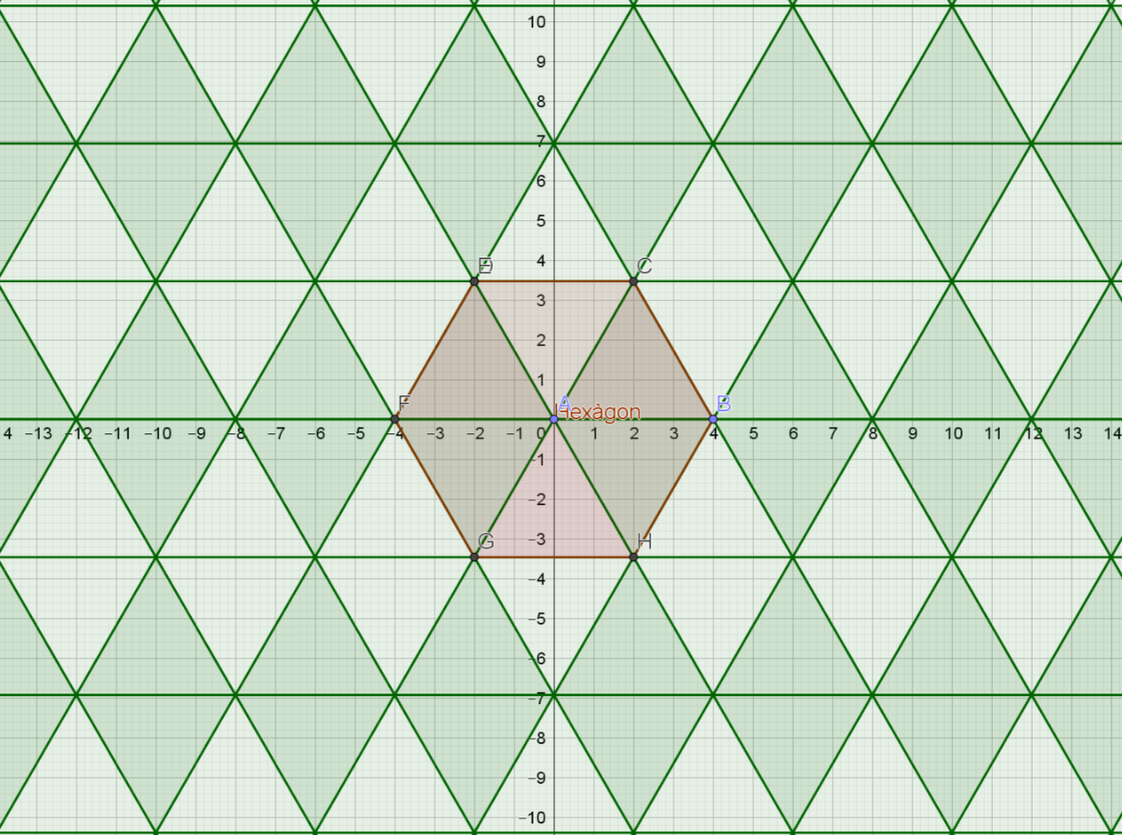
BASIC NOTIONS (II)
The tiles that form a mosaic can be either simple or constructed from a basic motif to which certain isometries are applied
The basic motif is the smallest part that can generate the whole mosaic.
Simple tiles
Composite tiles

Slide 4
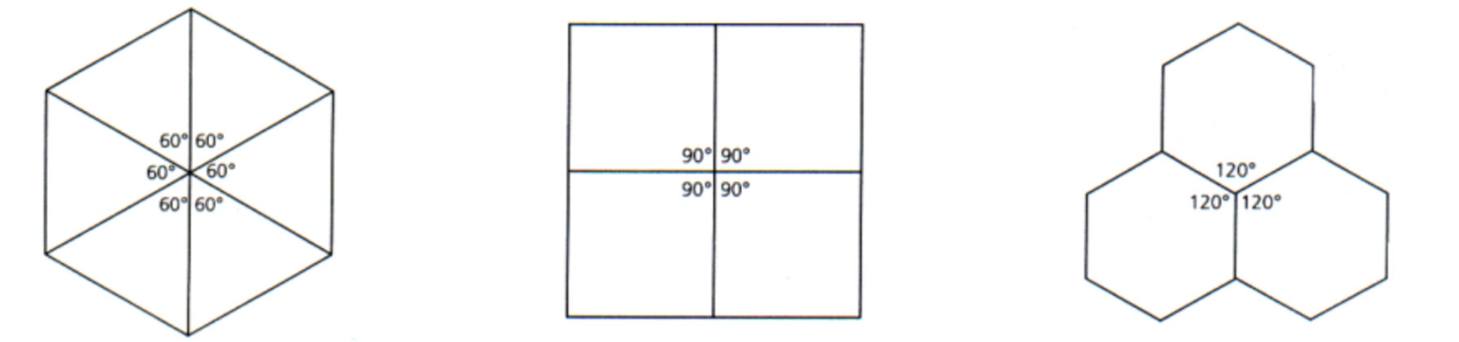
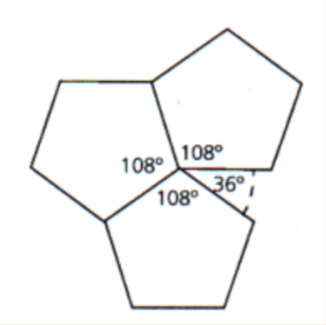
REGULAR MosaiCS
The basic motif is a regular polygon.
The same number of polygons meet at each vertex.
This implies that triangles, squares, and hexagons can be used.

Slide 5
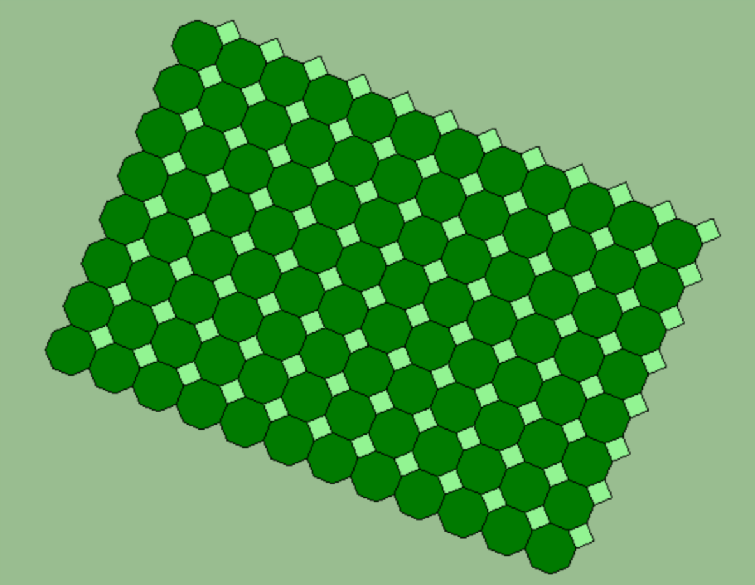
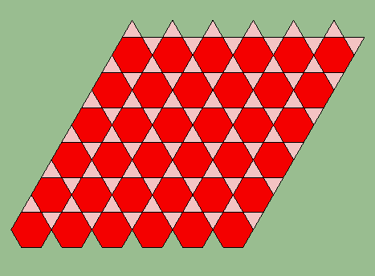
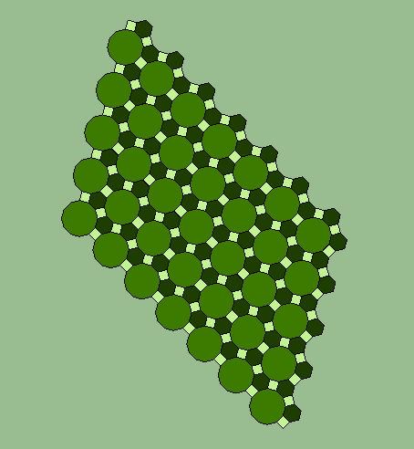
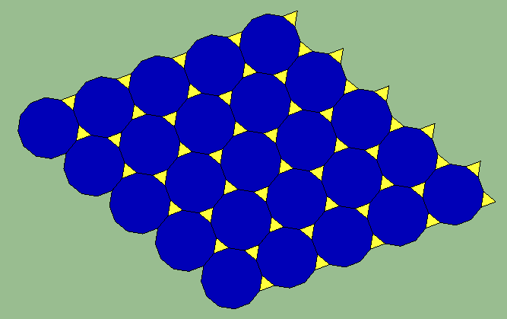
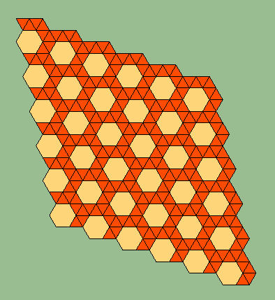
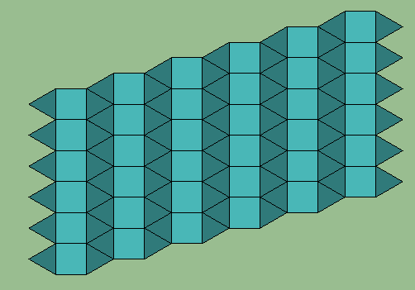
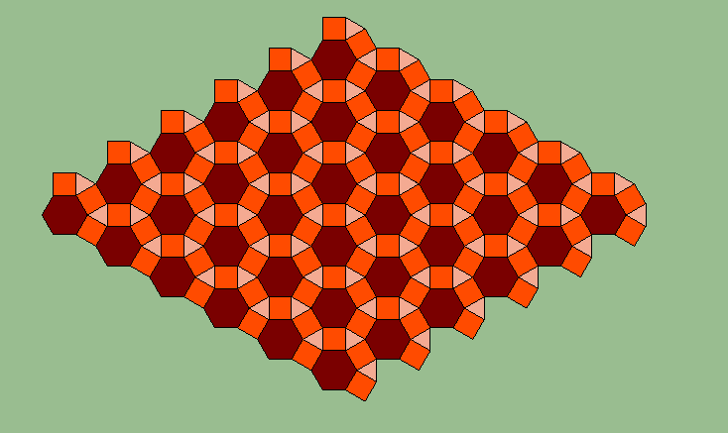
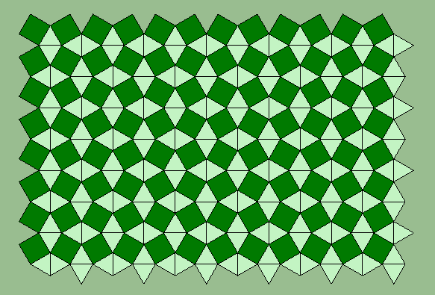
semiregular UNIFORME Mosaics
Regular polygons of different types are combined.
The inner angles at each vertex must sum to 360º.
4, 8, 8
3, 6, 3, 6
3,12, 12
4, 6, 12
3, 3, 3, 3, 6
3, 3 ,4, 3, 4
3, 3, 3, 4, 4
4, 3, 4, 6

Slide 6
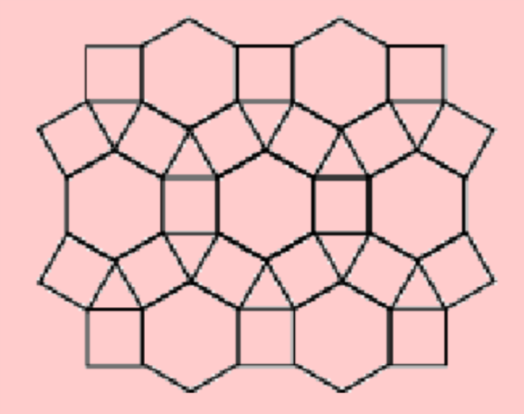
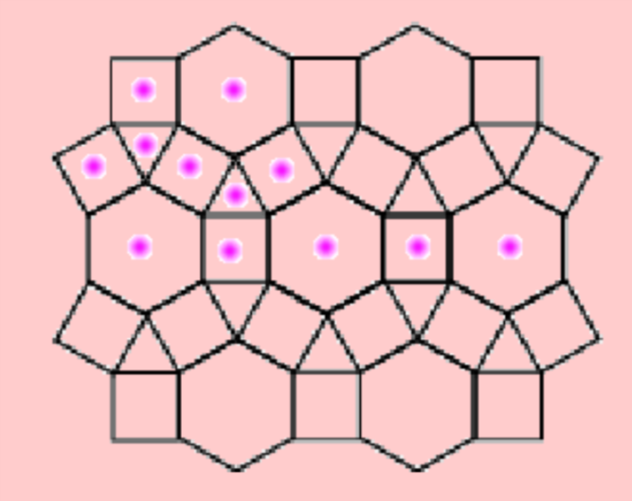
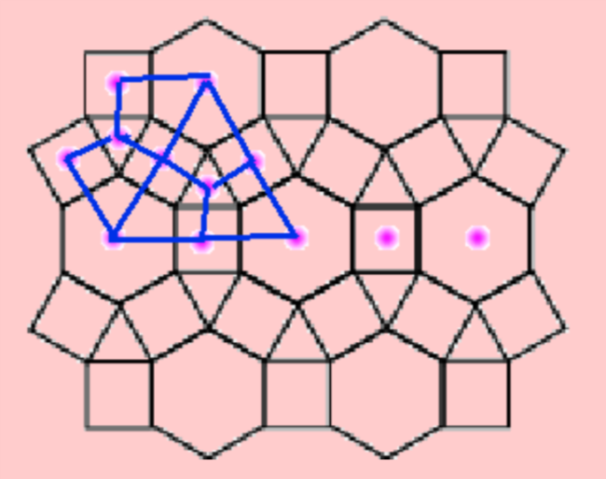
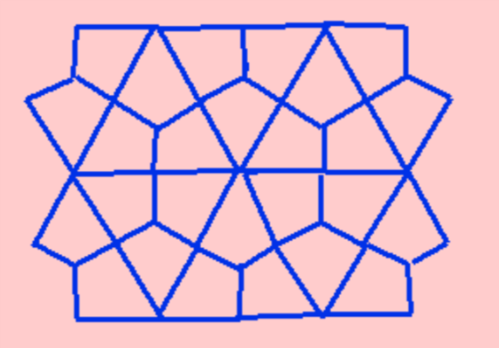
dual Mosaics
From a given mosaic, we can form a new one by joining the centers of the polygons composing it
Regular mosaics
Regular mosaics
Semiregular mosaics
Periodic non-uniform mosaics (composed by non-regular polígons=

Slide 7
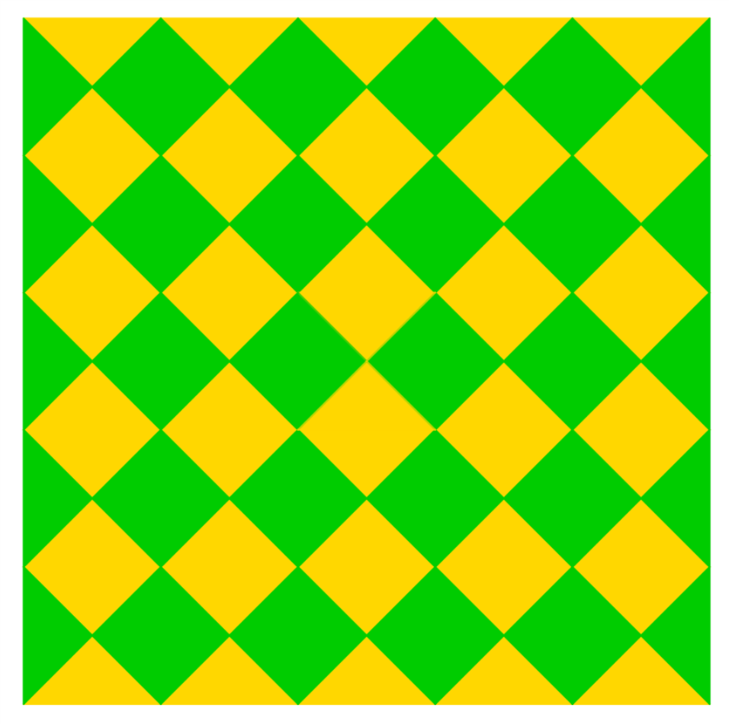


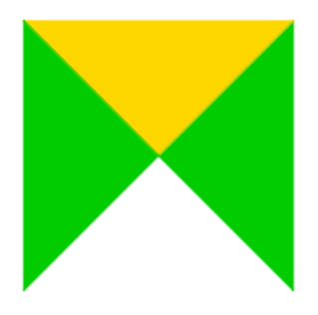
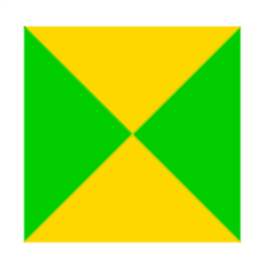
PERIODIC Mosaics
From the basic motif, we create a fundamental cell and translate it in two directions.
The symmetry group of the mosaic is formed by its isometries.
There are 17 “distinct” symmetry groups, originating the 17 possible types of periodic mosaics

Slide 8
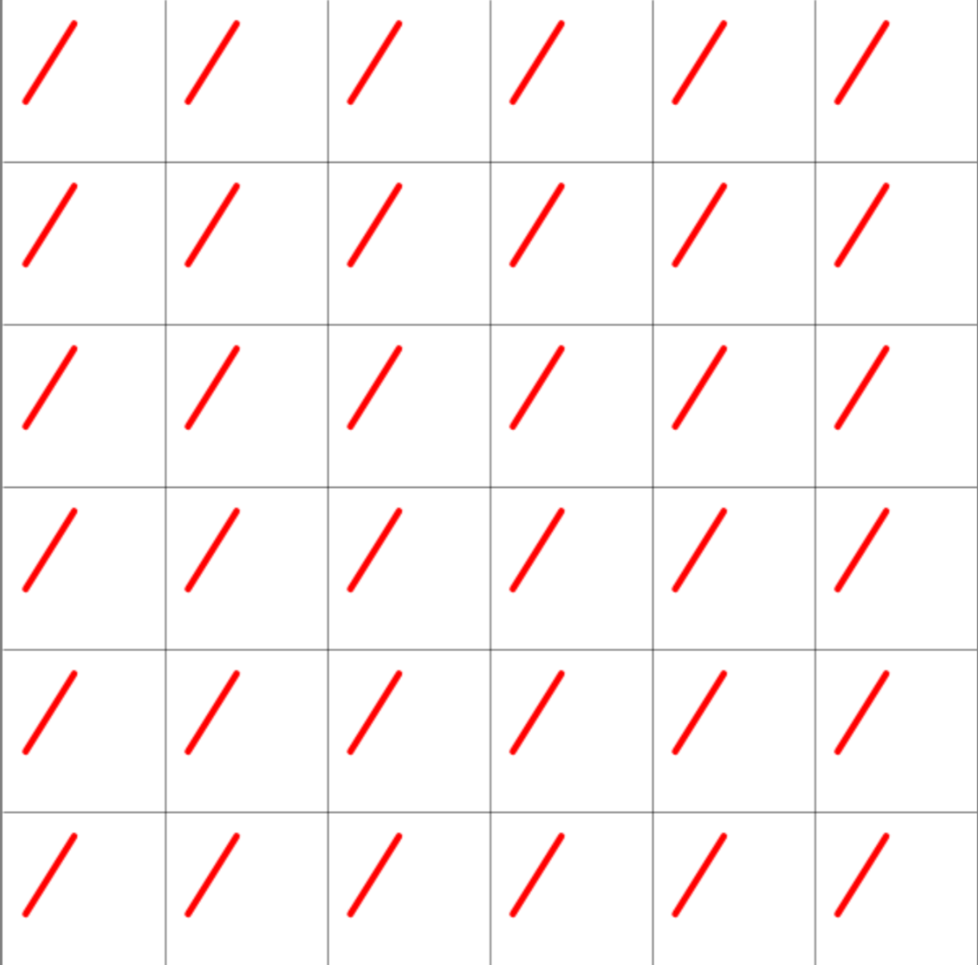
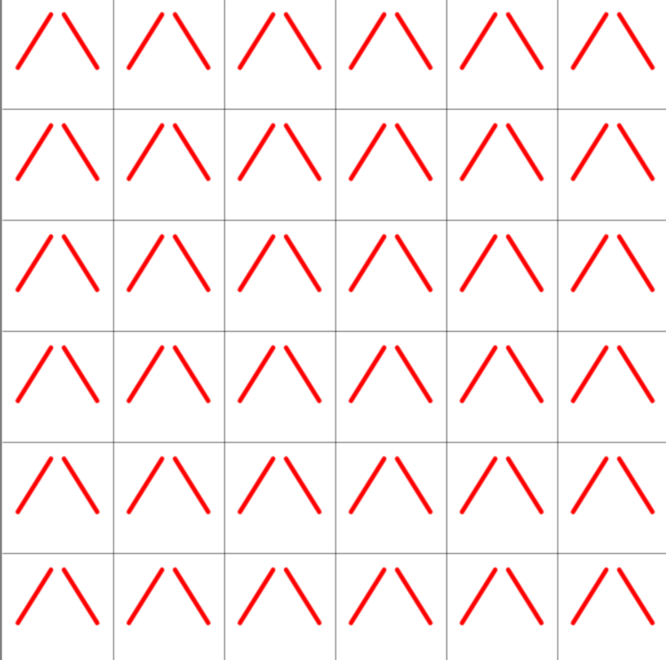
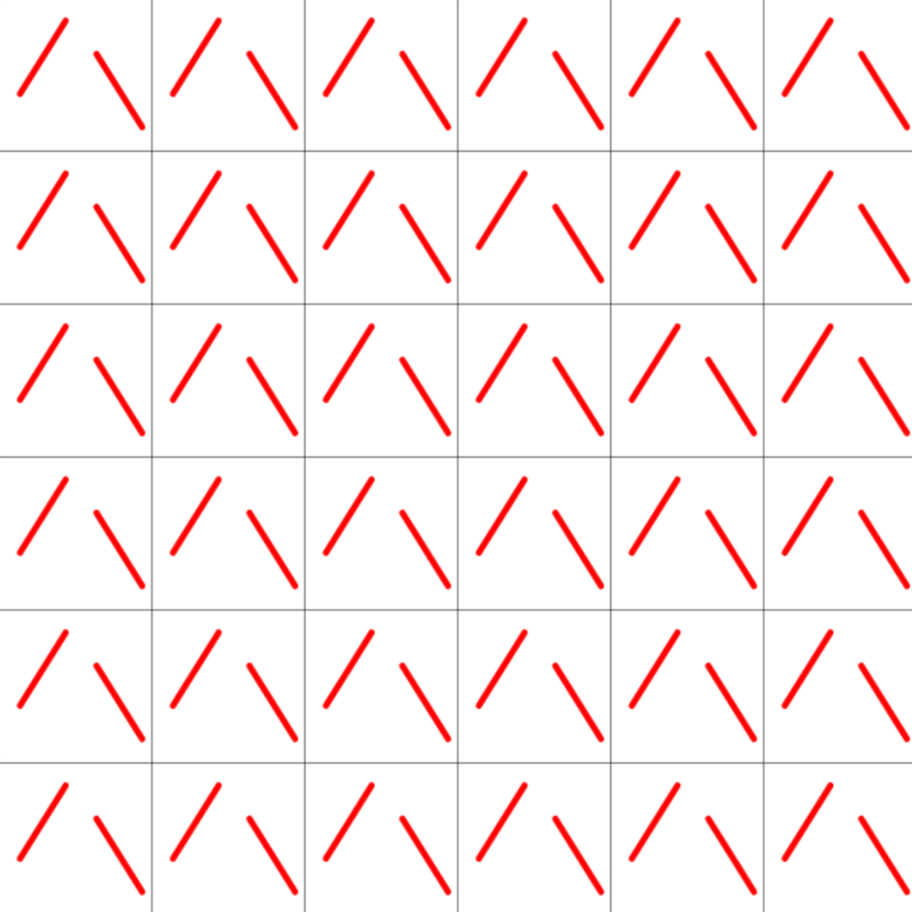
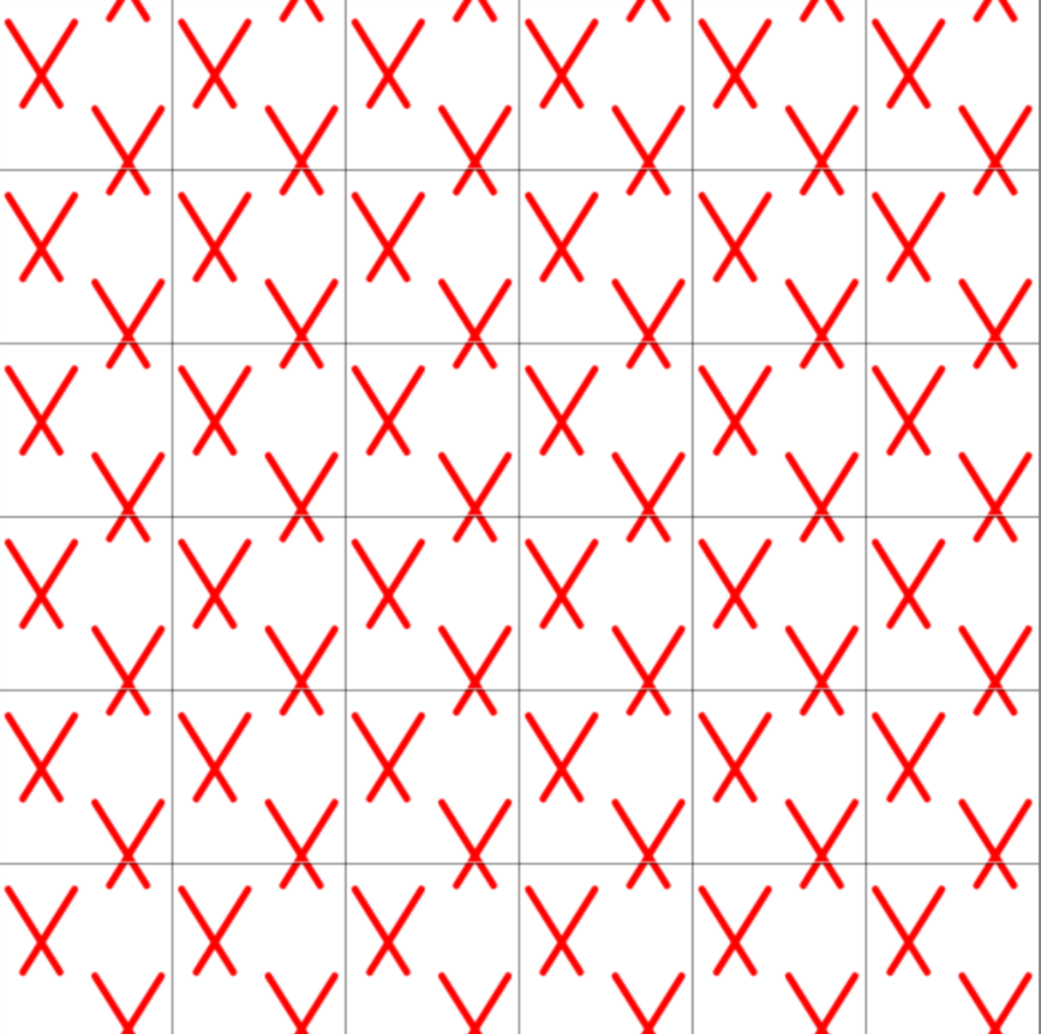
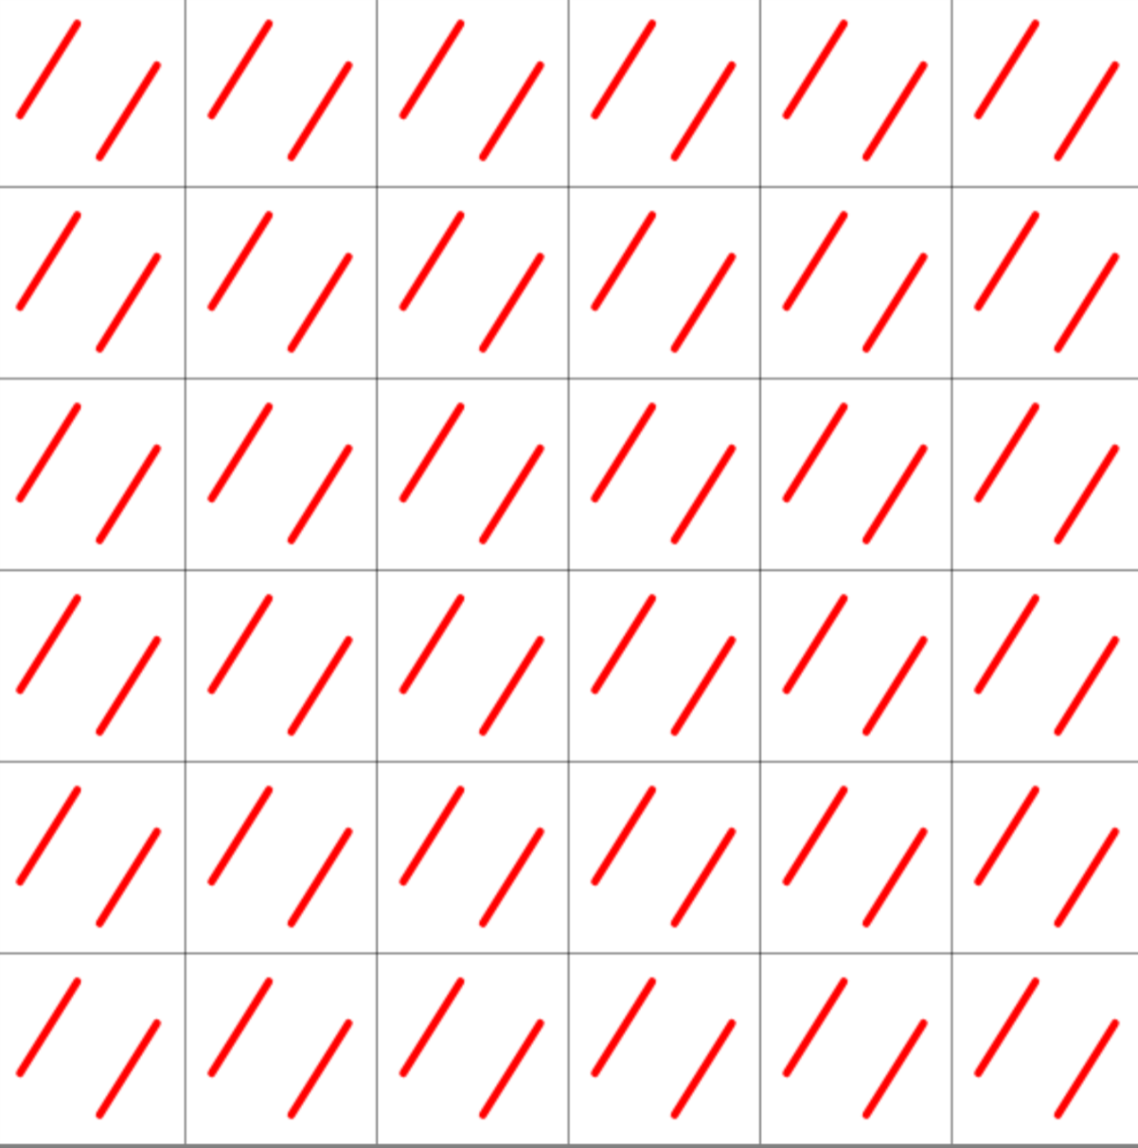
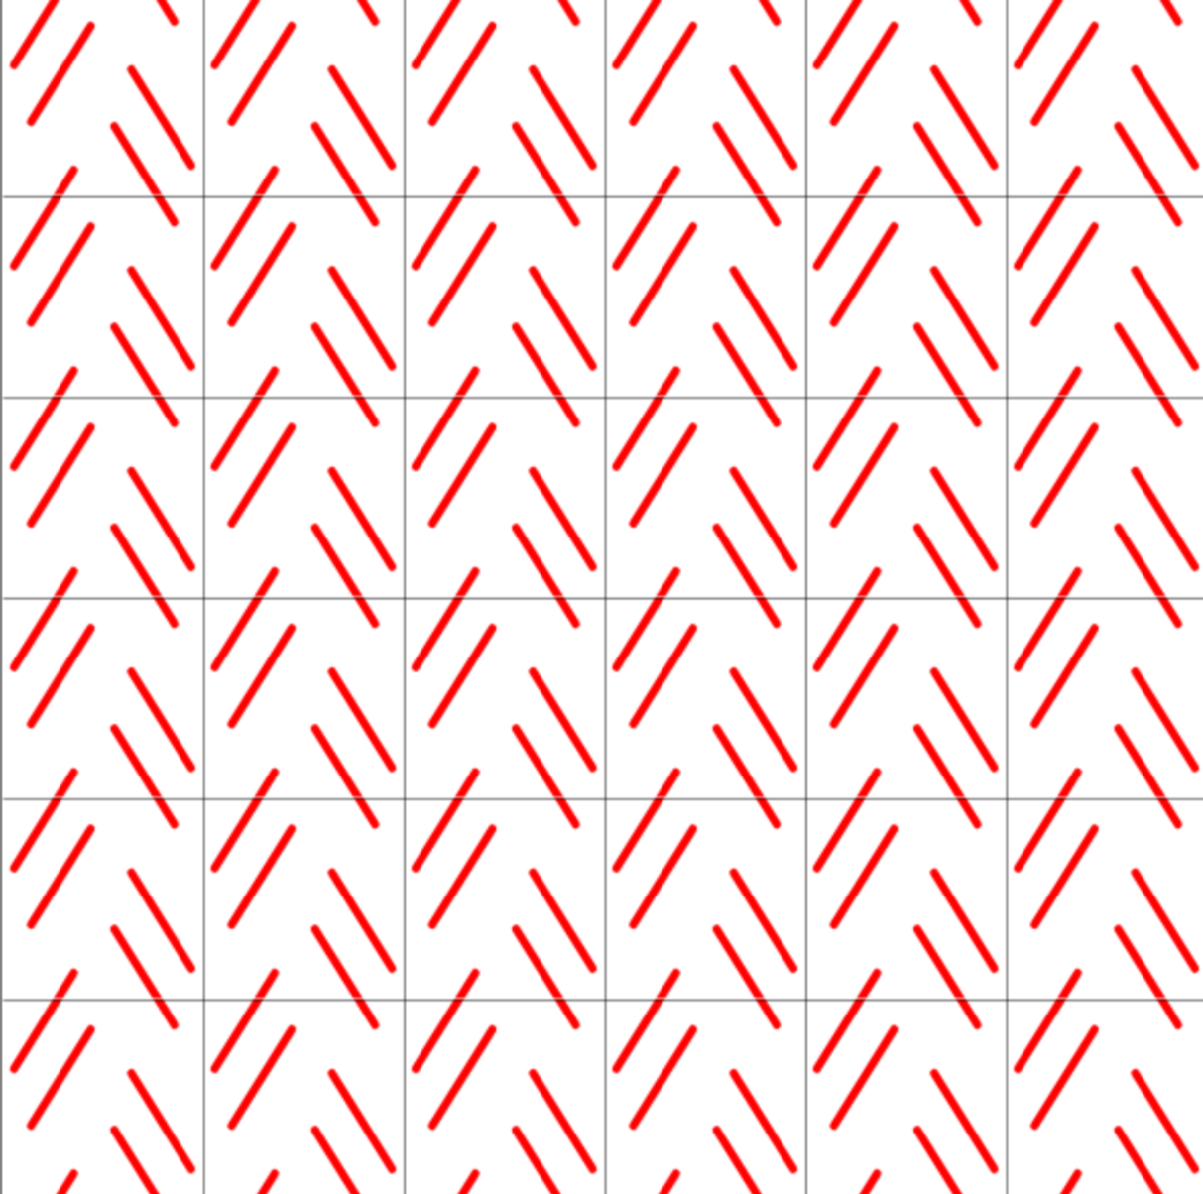
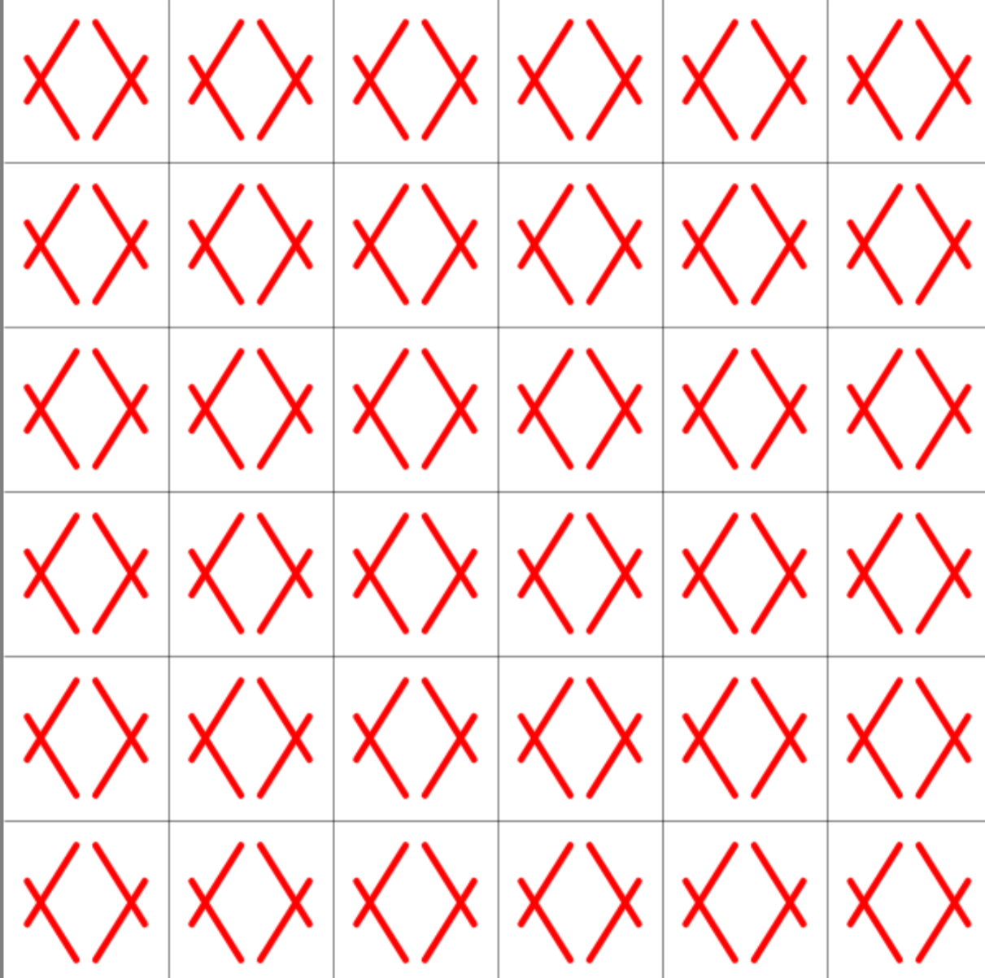
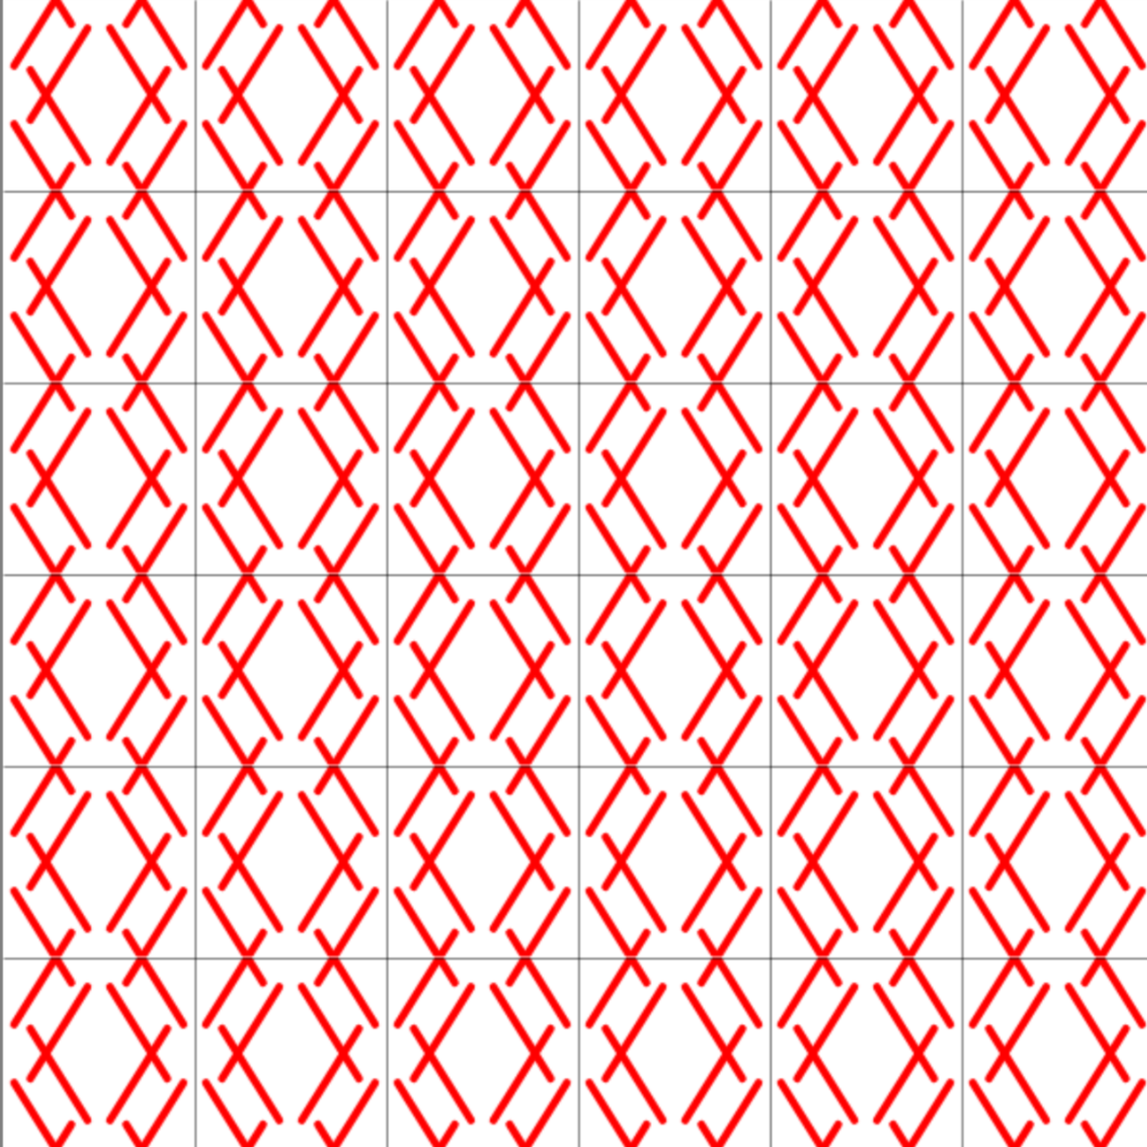
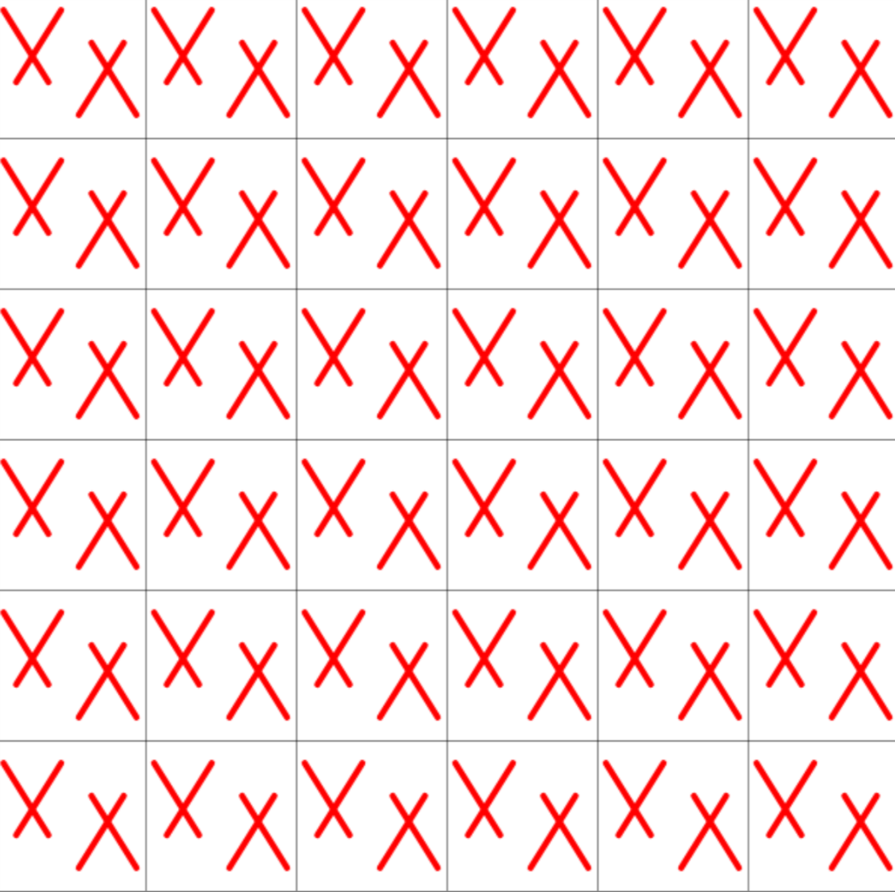
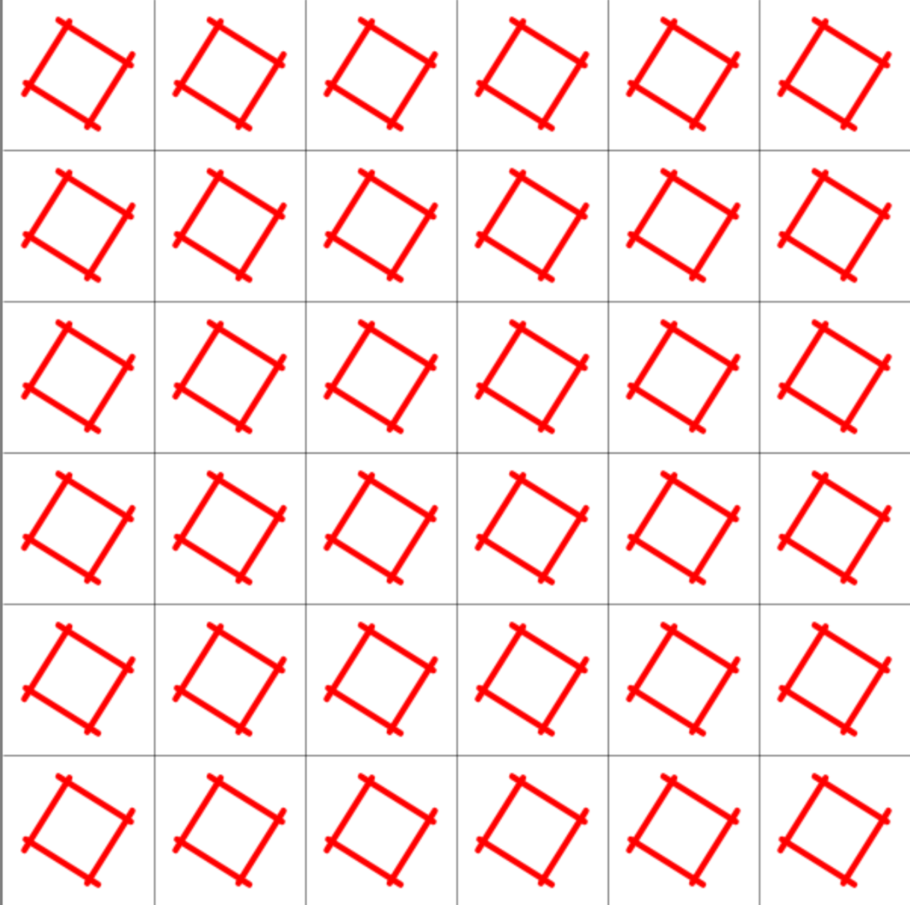
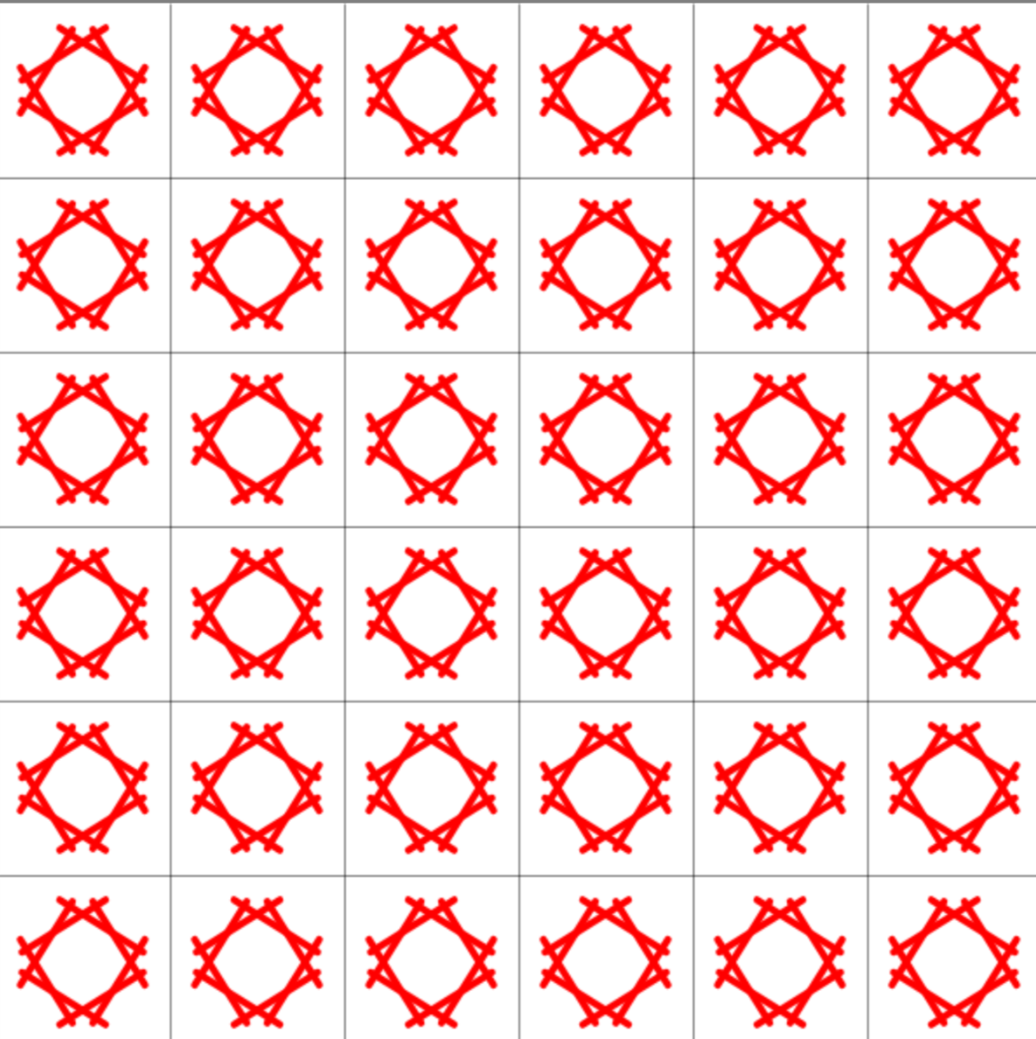
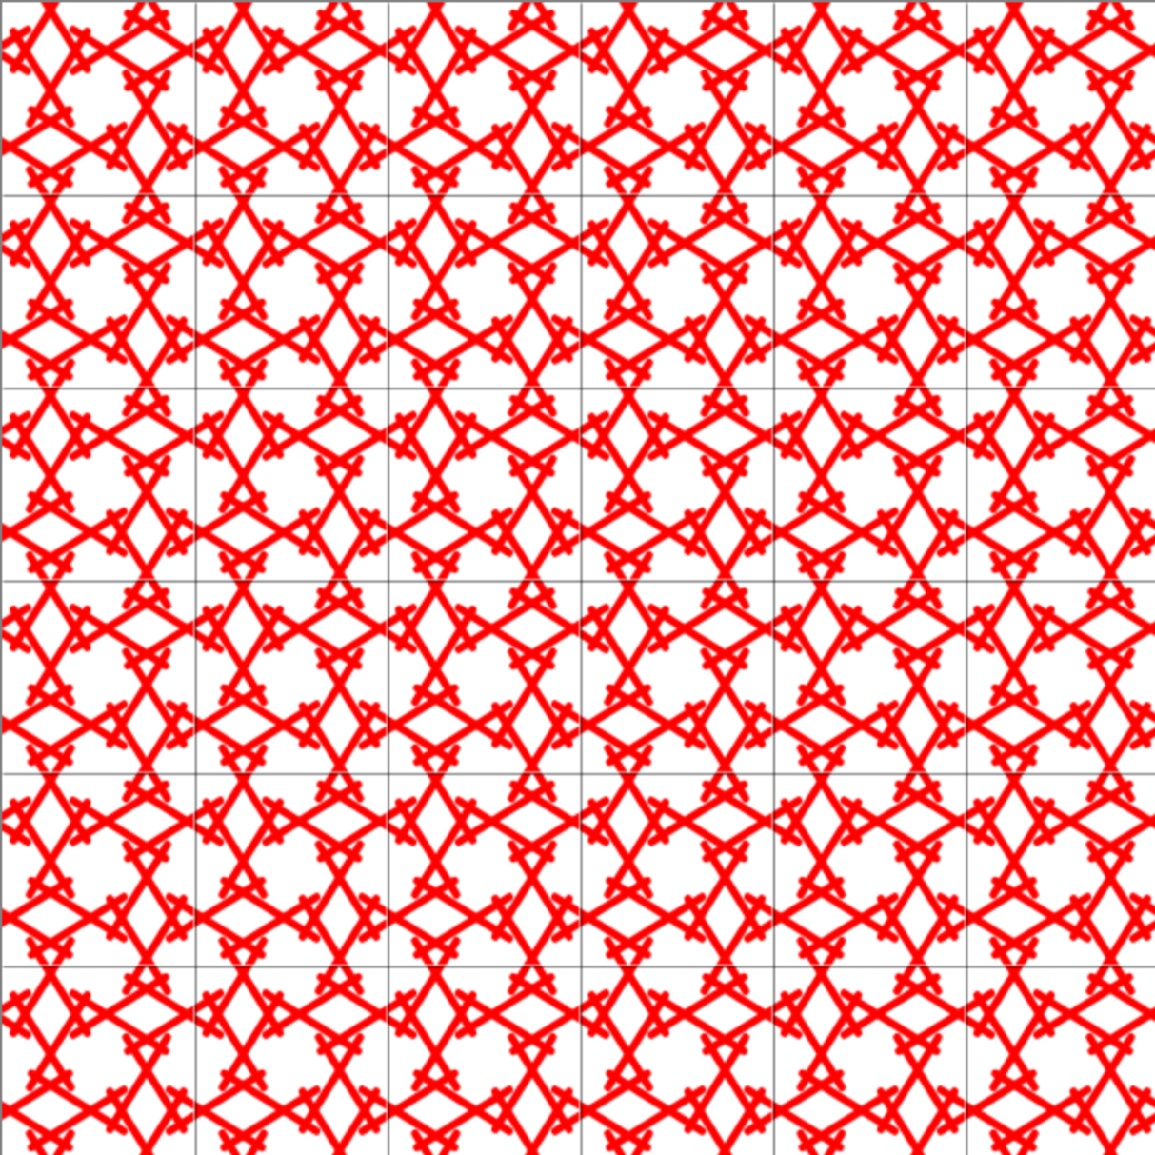
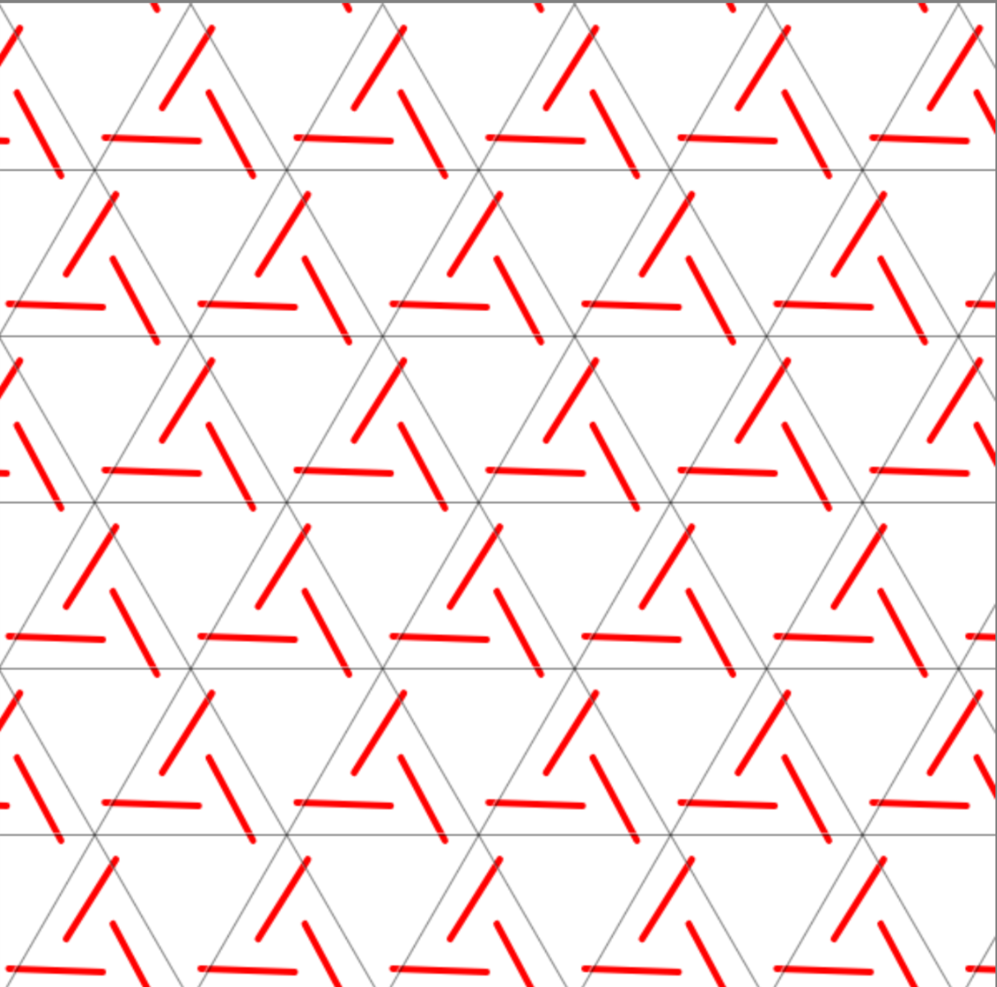
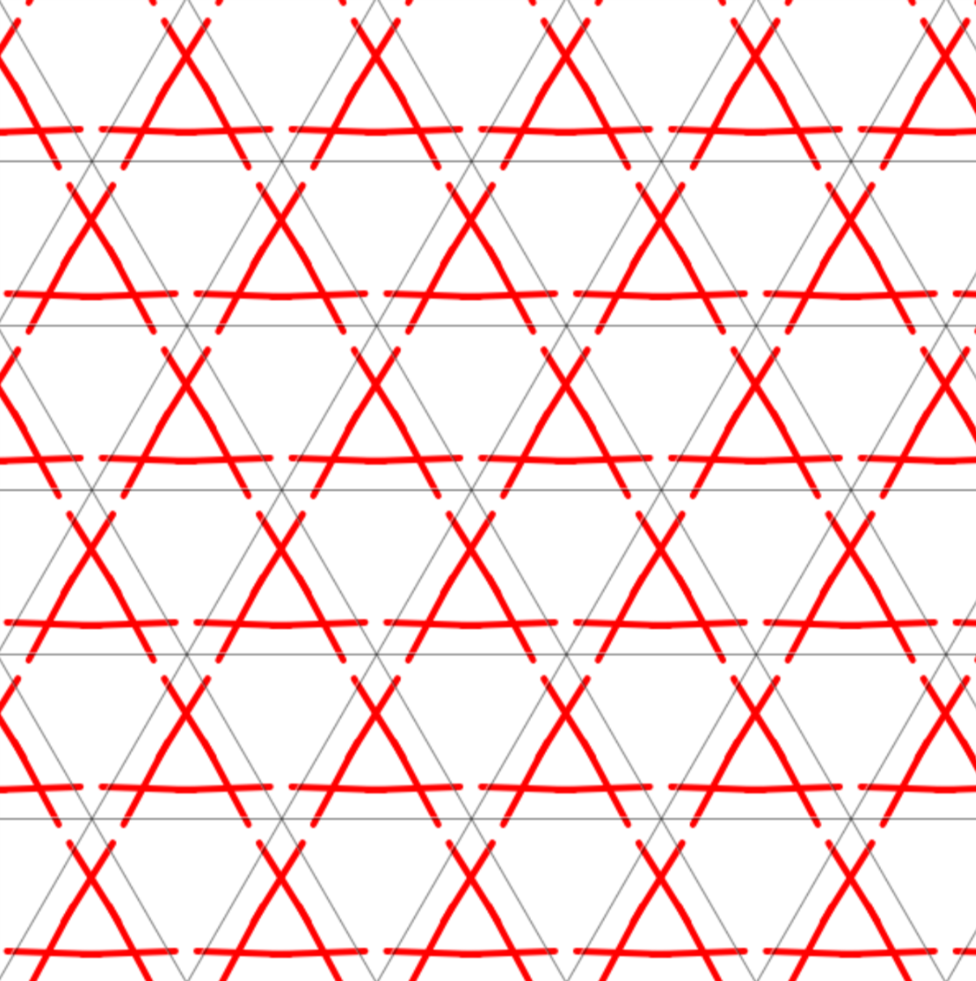
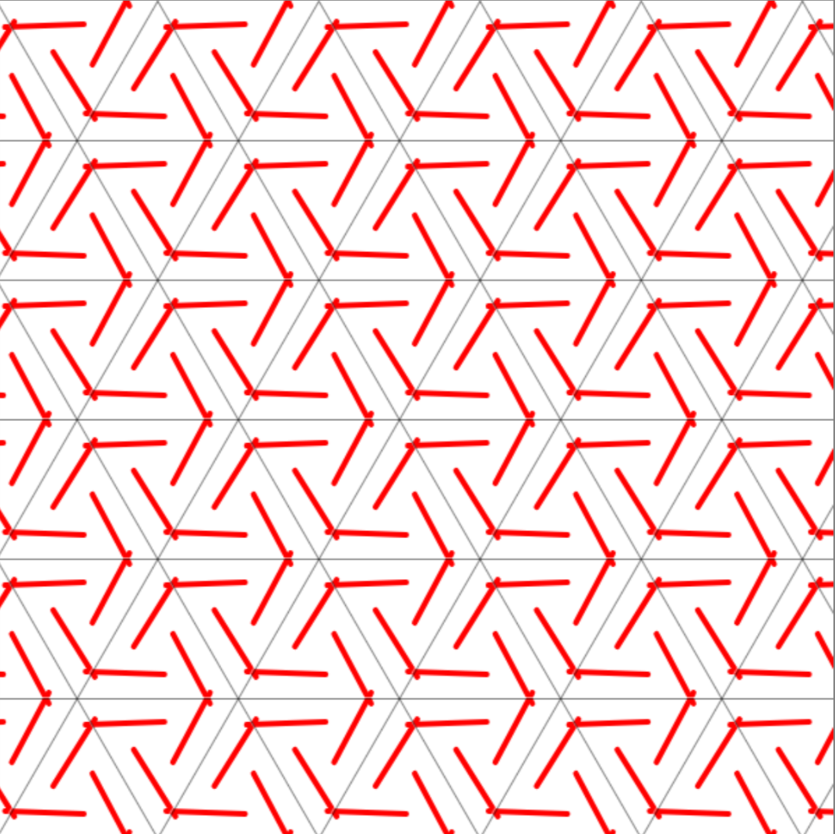
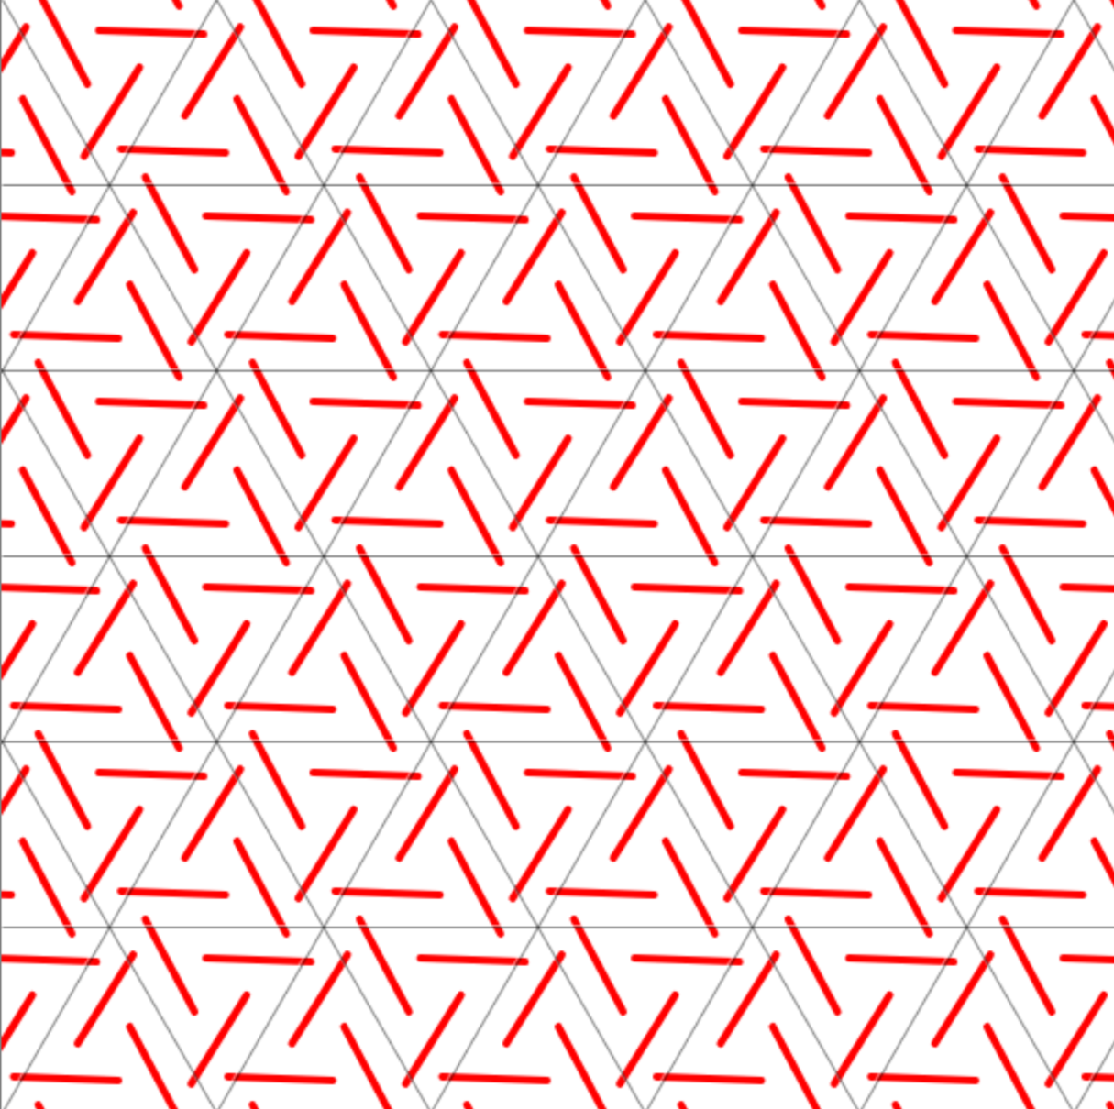
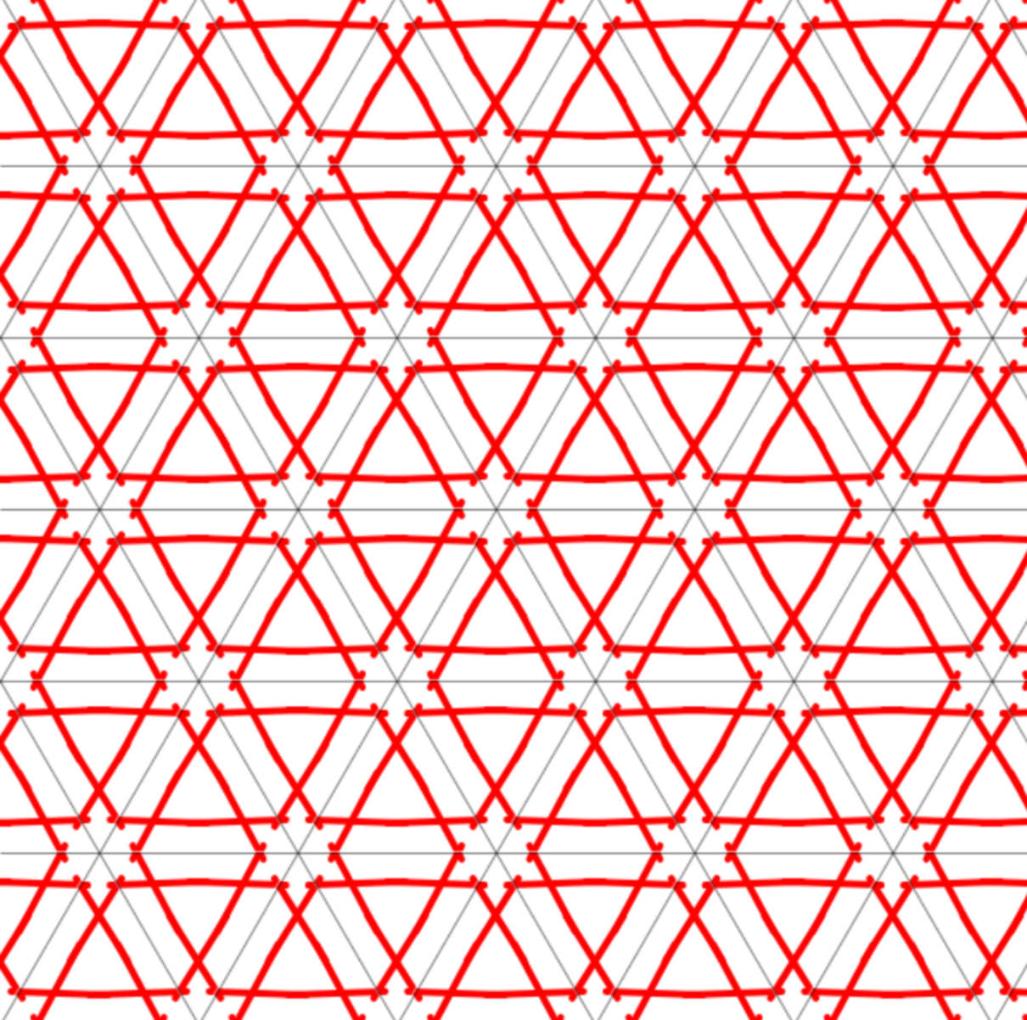
periOdic Mosaics : THE 17 SYMMETRY grOups
p1
pm
pg
cm
p2
pgg
pmm
cmm
pmg
p4
p4m
p4g
p3
p3m1
p31m
p6
p6m
Explore them at: http://math.hws.edu/eck/jsdemo/wallpaper.html

Slide 9
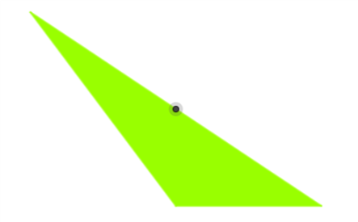
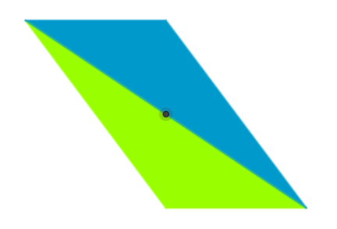
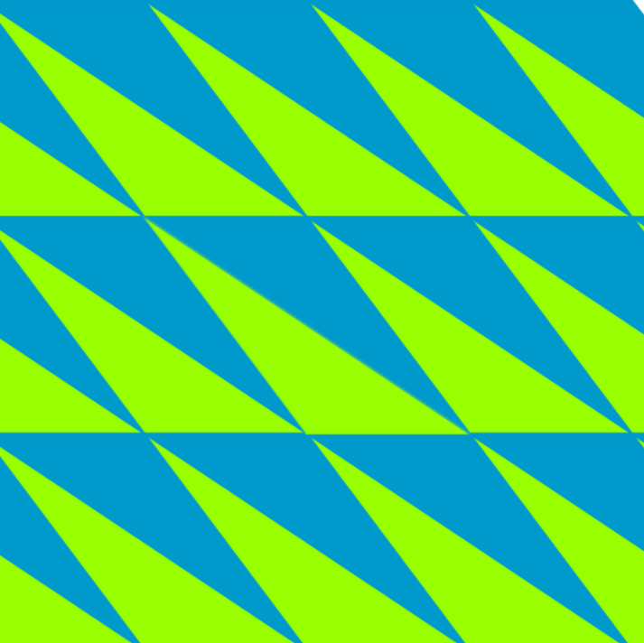
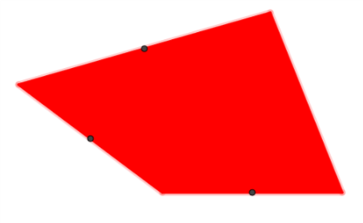
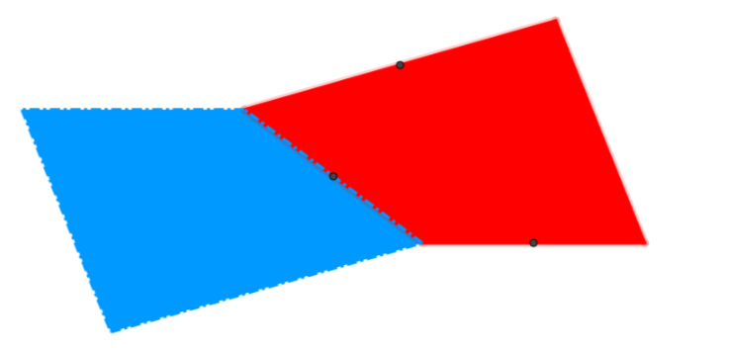
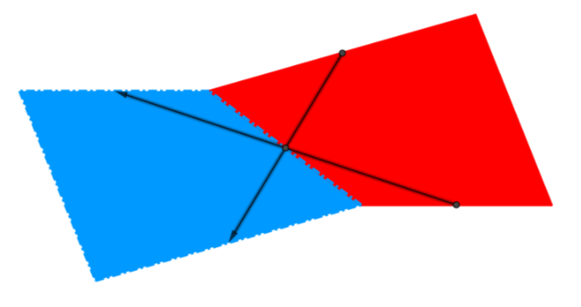
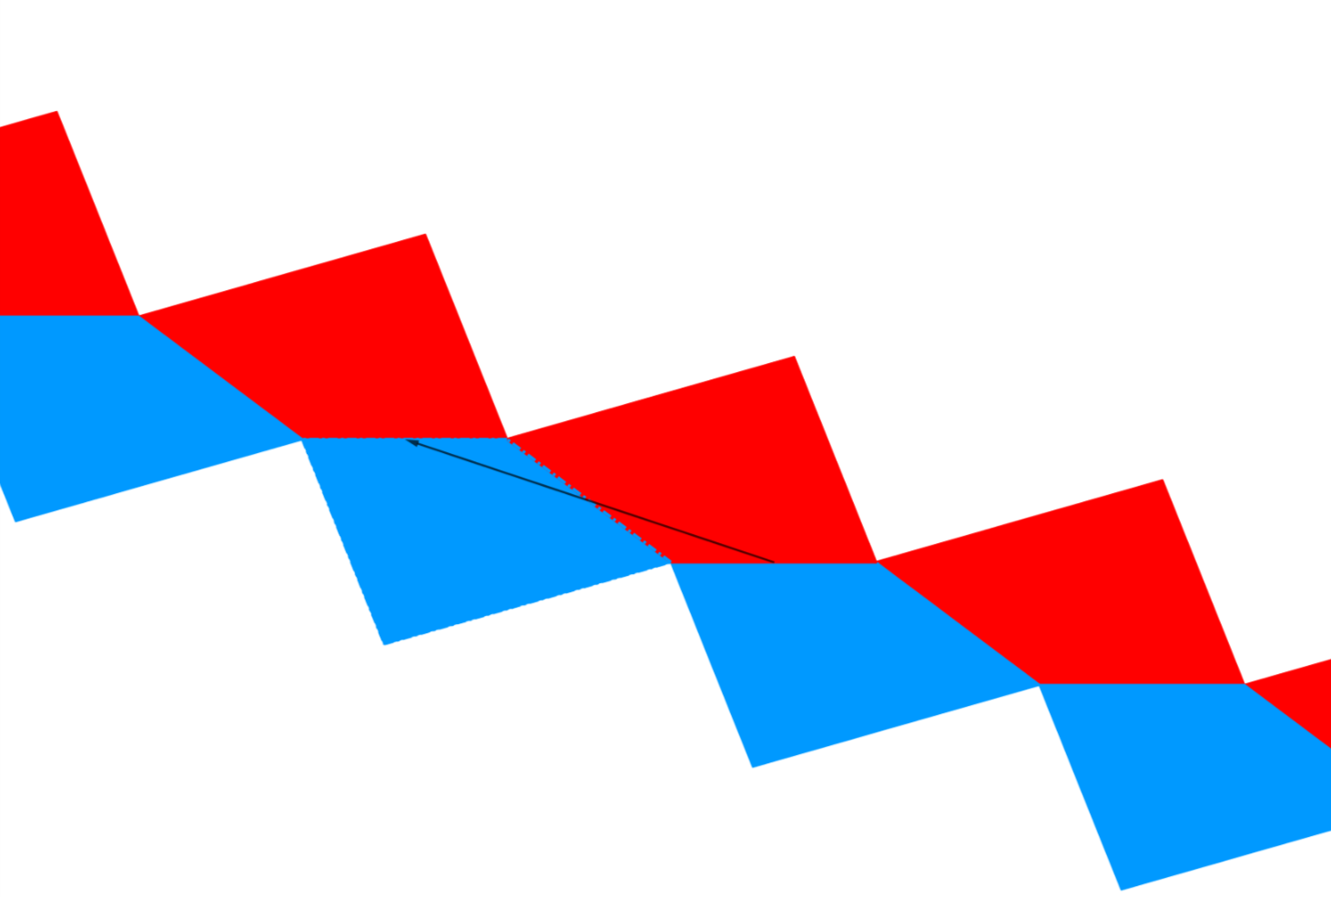
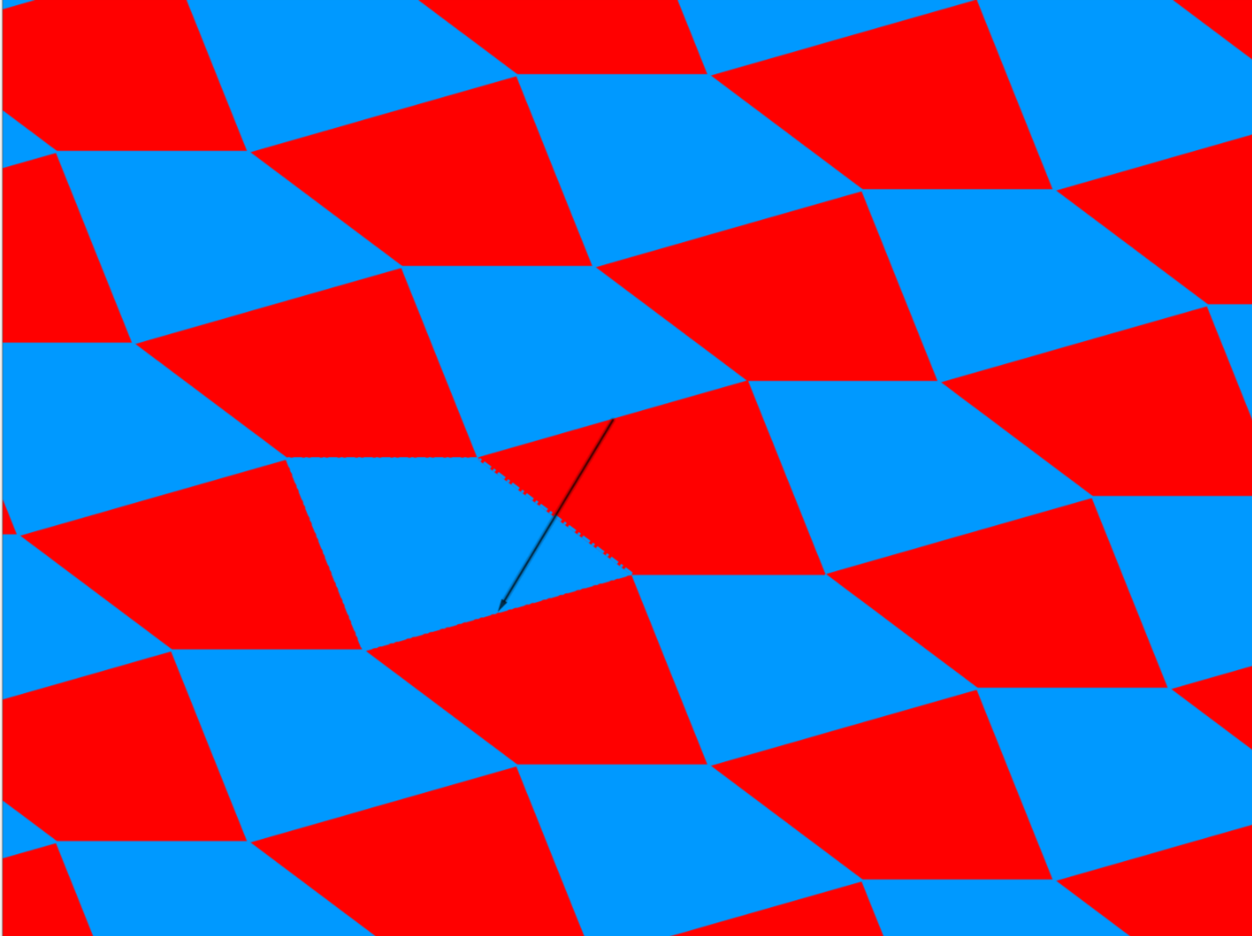
NON-UNIFORM Mosaics
Can be formed using any triangle, any quadrilateral, and some pentagons and hexagons.
Not possible with polygons with more than 6 sides

Slide 10
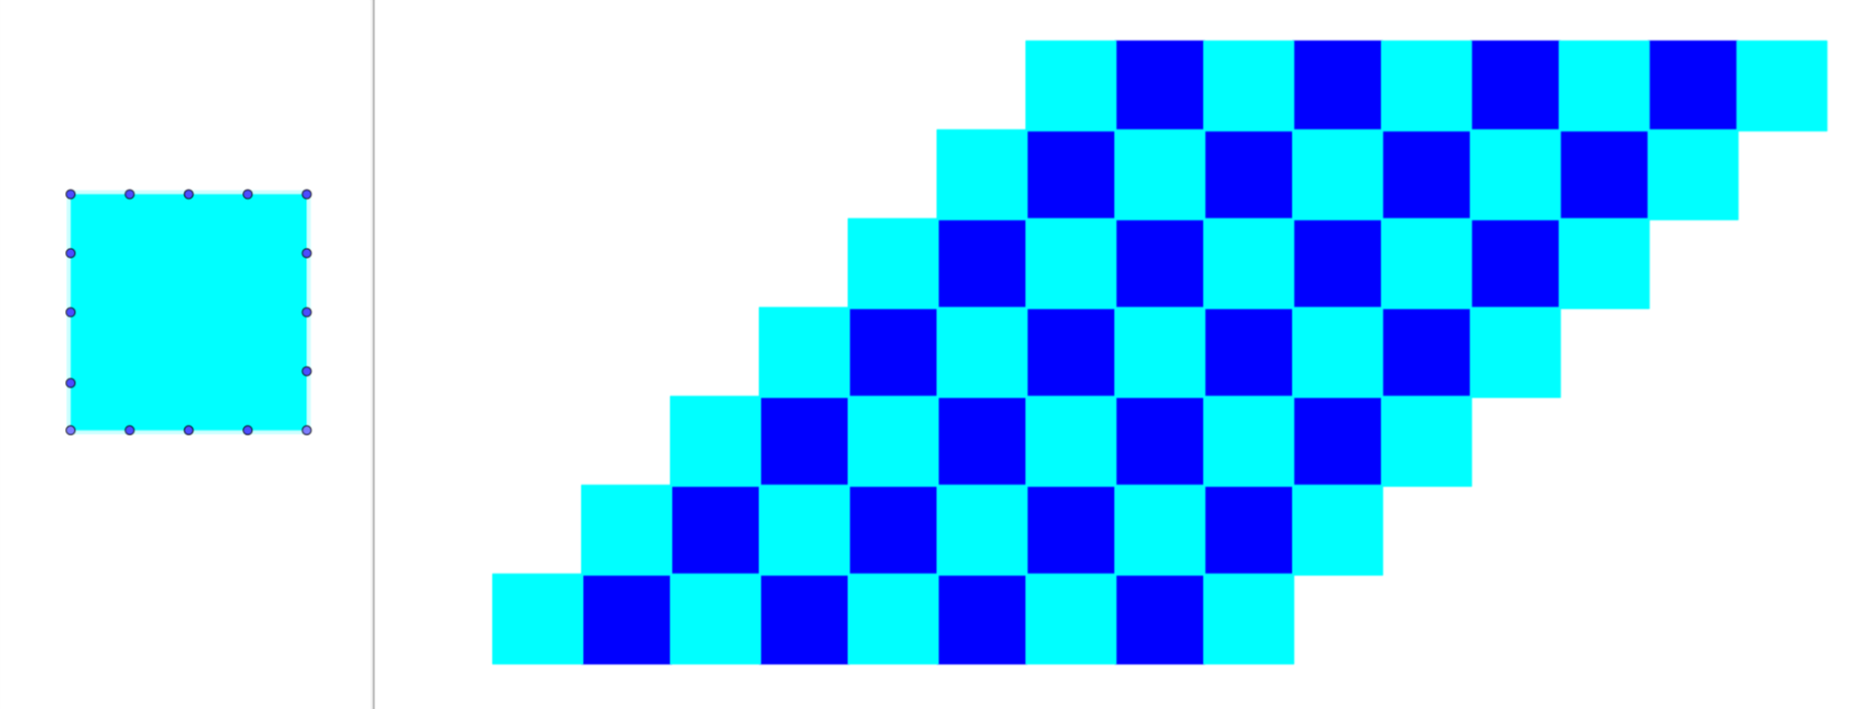
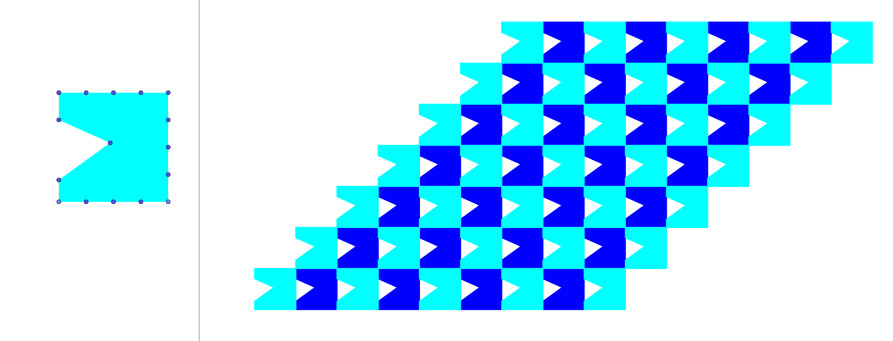
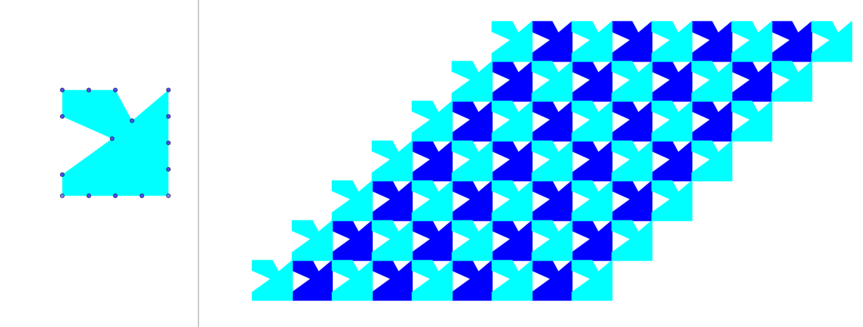
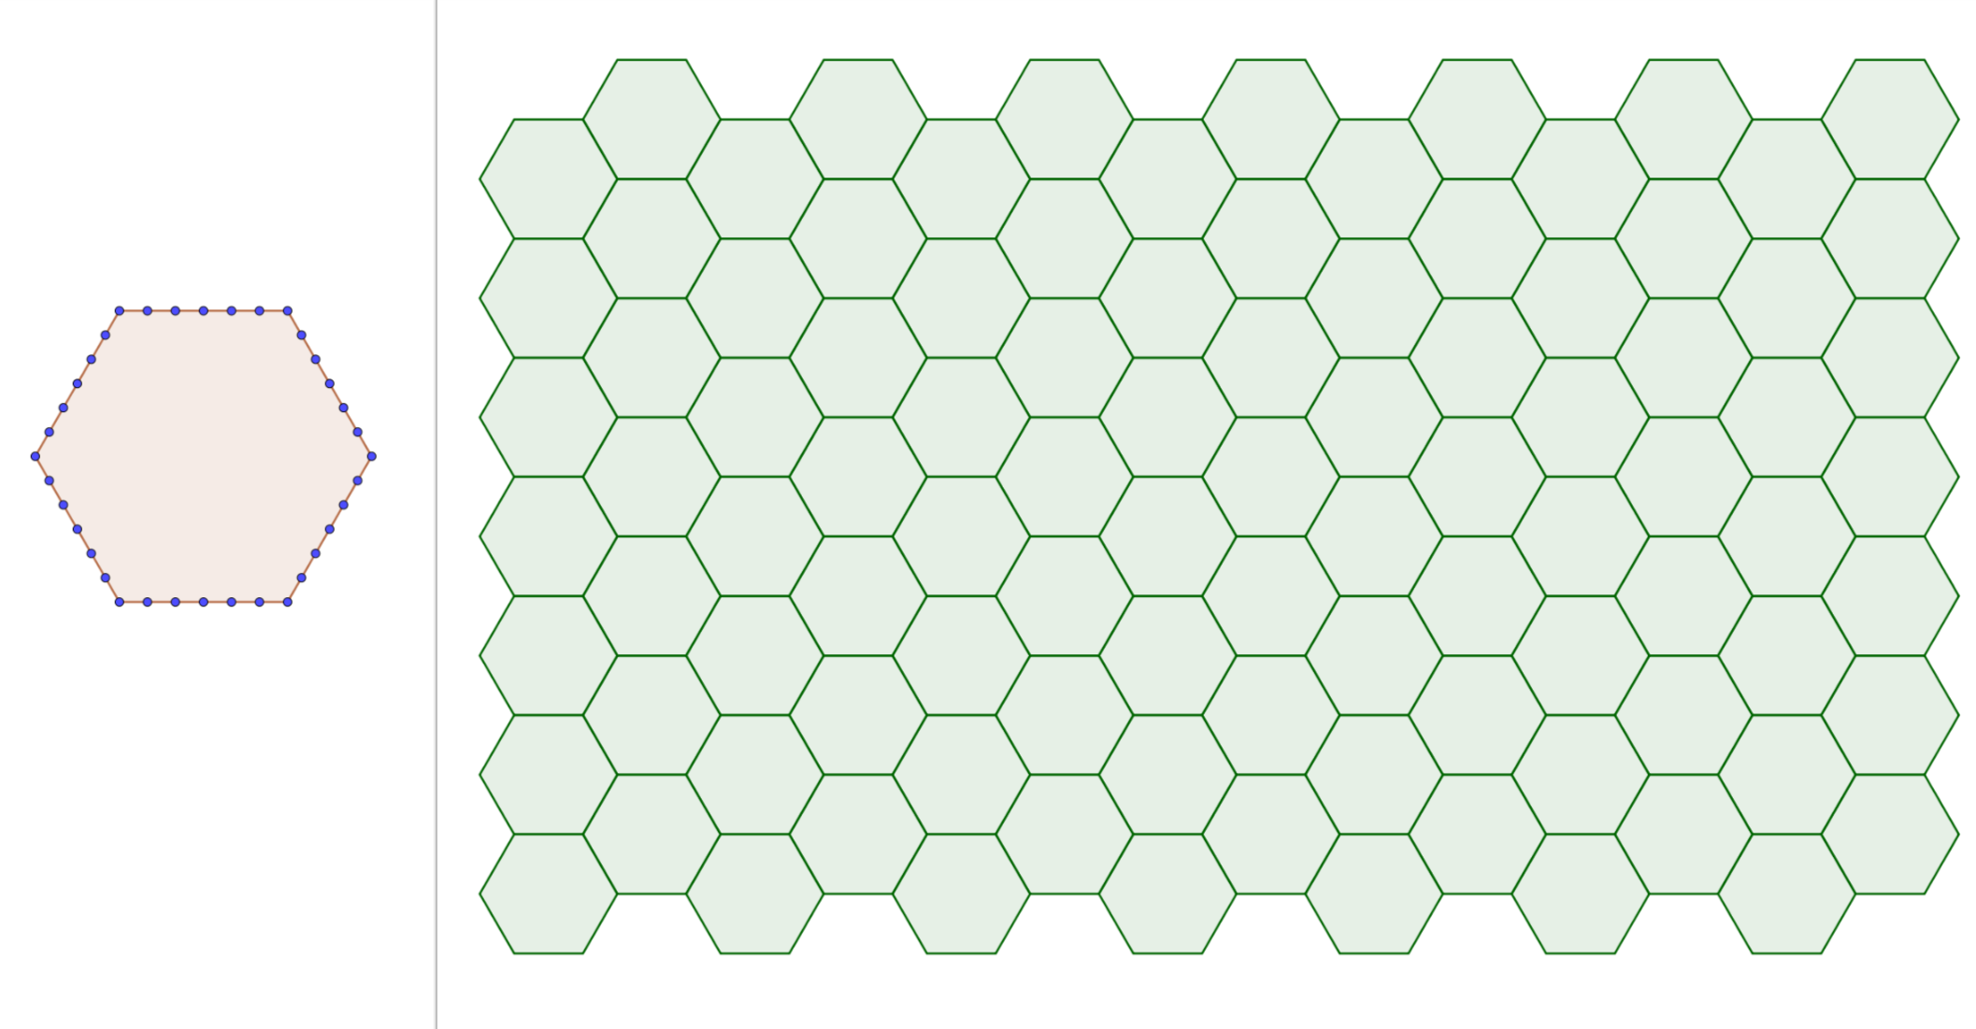
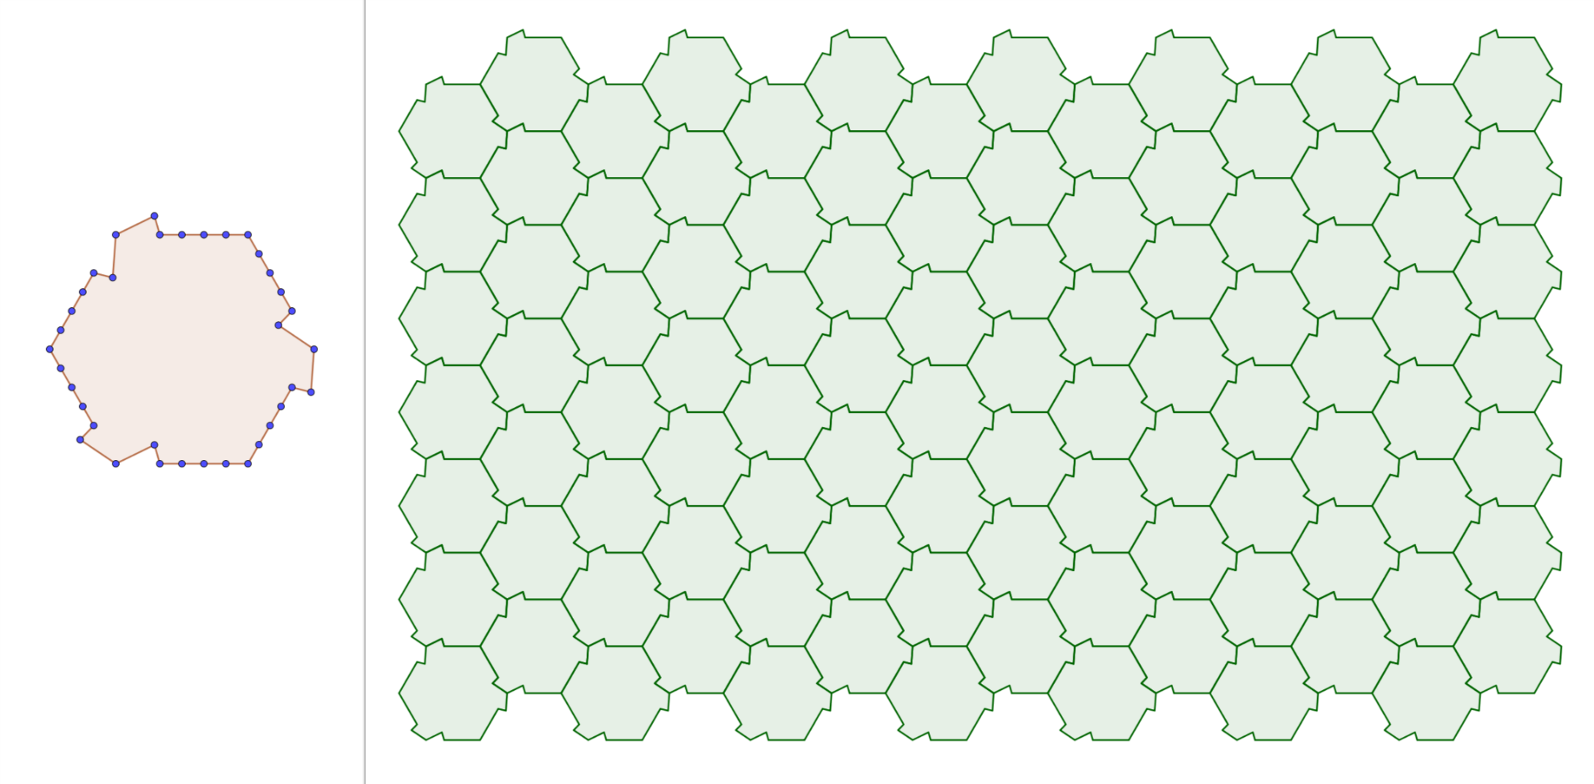



Mosaics BY DEFORMATION
Mosaics can also be created by deforming regular structures.

Slide 11
USEFUL LINKS
Mosaicos y celosías geométricos: www.acorral.es
Moviments, simetries, mosaics i rosasses: https://www.geogebra.org/m/XNP5QfzH
Tilings and tesselations: http://www.scienceu.com/geometry/articles/tiling/
Wallpaper symmetry: http://math.hws.edu/eck/jsdemo/wallpaper.html
Math and the art of M.C. Escher: http://mathstat.slu.edu/escher/index.php/Math_and_the_Art_of_M._C._Escher

