Slide 1
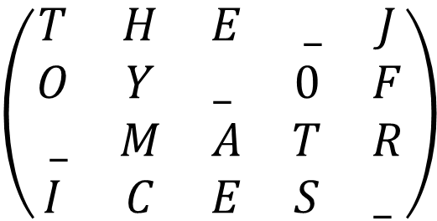
PERMUTATION MATRICES
$$\left(\begin{matrix}T & H & E & _ & J \\ O & Y & _ & 0 & F \\ _ & M & A & T & R \\ I & C & E & S & _ \end{matrix}\right)$$
Playing with matrices, matrix products, determinants, permutations, factorials, encrypting and decrypting messages

Slide 2

MATRICES WITH A FEW ONES
Matrices formed only by zeros except for a 1 in each row and each column have curious properties
$$\left(\begin{matrix}0 & 1 & 0 & 0 \\ 1 & 0 & 0 & 0 \\ 0 & 0 & 0 & 1 \\ 0 & 0 & 1 & 0\end{matrix}\right)$$

Slide 3
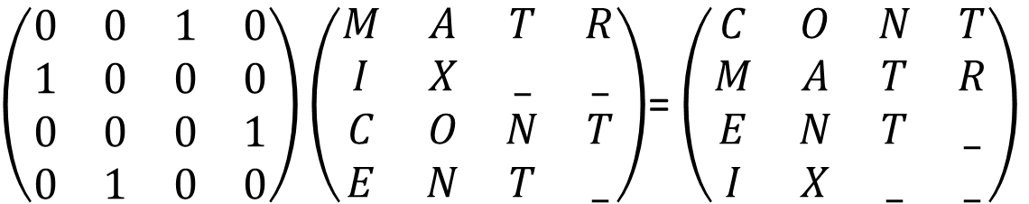
MATRICES WITH A FEW ONES:
ACTION ON THE LEFT
Let’s observe the result of multiplying on the left by a matrix of this type
$\left(\begin{matrix}0 & 0 & 1 & 0 \\ 1 & 0 & 0 & 0 \\ 0 & 0 & 0 & 1 \\ 0 & 1 & 0 & 0\end{matrix}\right)\left(\begin{matrix}M & A & T & R \\ I & X & _ & _ \\ C & O & N & T \\ E & N & T & _\end{matrix}\right)$= $\left(\begin{matrix}C & O & N & T \\ M & A & T & R \\ E & N & T & _ \\ I & X & _ & _\end{matrix}\right)$
What effect did it have on the matrix it multiplies?
ANSWER

Slide 4
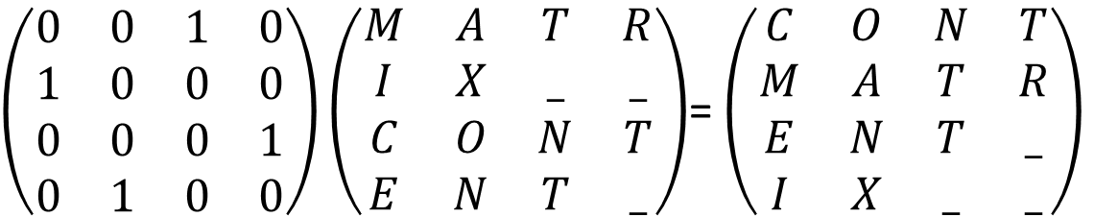
QUESTION
$\left(\begin{matrix}0 & 0 & 1 & 0 \\ 1 & 0 & 0 & 0 \\ 0 & 0 & 0 & 1 \\ 0 & 1 & 0 & 0\end{matrix}\right)\left(\begin{matrix}M & A & T & R \\ I & X & _ & _ \\ C & O & N & T \\ E & N & T & _\end{matrix}\right)$= $\left(\begin{matrix}C & O & N & T \\ M & A & T & R \\ E & N & T & _ \\ I & X & _ & _\end{matrix}\right)$
What effect did it have on the matrix it multiplies?
(a)
It has permuted the rows of the matrix.
It has permuted the columns of the matrix.
It has transposed the matrix
None of the others
(b)
(c)
(d)

Slide 5
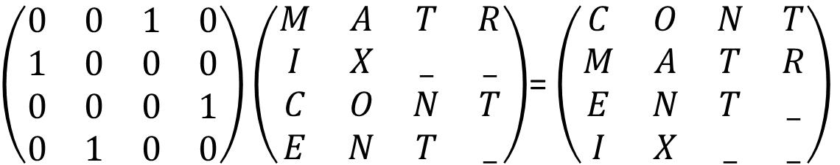
QUESTION
$\left(\begin{matrix}0 & 0 & 1 & 0 \\ 1 & 0 & 0 & 0 \\ 0 & 0 & 0 & 1 \\ 0 & 1 & 0 & 0\end{matrix}\right)\left(\begin{matrix}M & A & T & R \\ I & X & _ & _ \\ C & O & N & T \\ E & N & T & _\end{matrix}\right)$= $\left(\begin{matrix}C & O & N & T \\ M & A & T & R \\ E & N & T & _ \\ I & X & _ & _\end{matrix}\right)$
NOOOO!!! Look closely at the result and answer again
COME BACK

Slide 6
WELL DONE!!!!

Slide 7
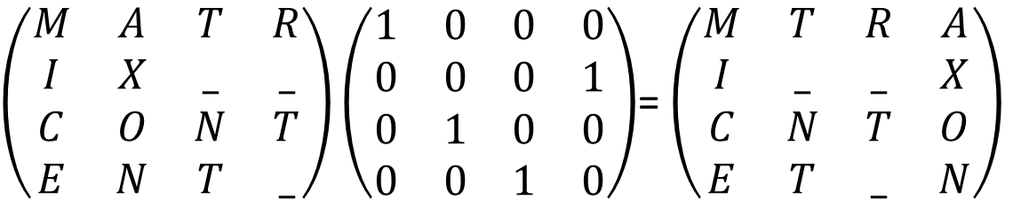
AND THE ACTION ON THE RIGHT?
Let’s observe the result of multiplying on the right by a matrix of this type
$\left(\begin{matrix}M & A & T & R \\ I & X & _ & _ \\ C & O & N & T \\ E & N & T & _\end{matrix}\right)\left(\begin{matrix}1 & 0 & 0 & 0 \\ 0 & 0 & 0 & 1 \\ 0 & 1 & 0 & 0 \\ 0 & 0 & 1 & 0\end{matrix}\right)$= $\left(\begin{matrix}M & T & R & A \\ I & _ & _ & X \\ C & N & T & O \\ E & T & _ & N\end{matrix}\right)$
What effect did it have on the matrix it multiplies?
ANSWER

Slide 8
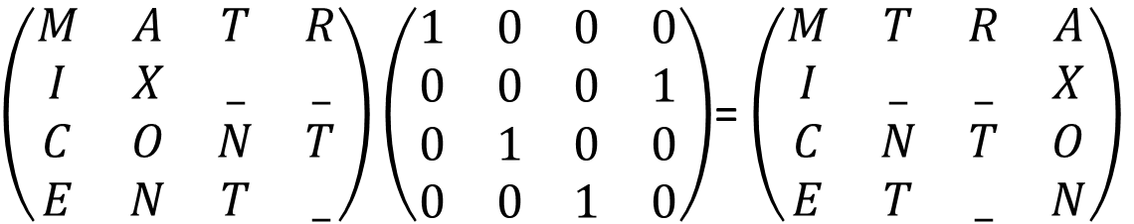
QUESTION
$\left(\begin{matrix}M & A & T & R \\ I & X & _ & _ \\ C & O & N & T \\ E & N & T & _\end{matrix}\right)\left(\begin{matrix}1 & 0 & 0 & 0 \\ 0 & 0 & 0 & 1 \\ 0 & 1 & 0 & 0 \\ 0 & 0 & 1 & 0\end{matrix}\right)$= $\left(\begin{matrix}M & T & R & A \\ I & _ & _ & X \\ C & N & T & O \\ E & T & _ & N\end{matrix}\right)$
What effect did it have on the matrix it multiplies?
(a)
It has permuted the rows of the matrix.
It has permuted the columns of the matrix.
It has transposed the matrix
None of the others
(b)
(c)
(d)

Slide 9
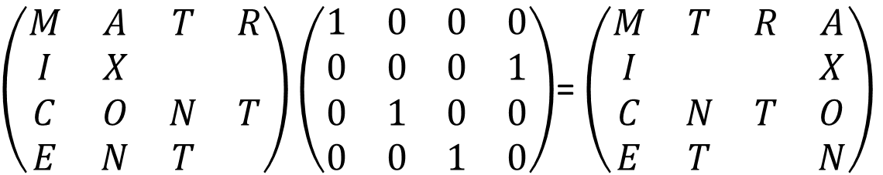
QUESTION
$\left(\begin{matrix}M & A & T & R \\ I & X & & \\ C & O & N & T \\ E & N & T & \end{matrix}\right)\left(\begin{matrix}1 & 0 & 0 & 0 \\ 0 & 0 & 0 & 1 \\ 0 & 1 & 0 & 0 \\ 0 & 0 & 1 & 0\end{matrix}\right)$= $\left(\begin{matrix}M & T & R & A \\ I & & & X \\ C & N & T & O \\ E & T & & N\end{matrix}\right)$
NOOOO!!! Look closely at the result and answer again
COME BACK

Slide 10
WELL DONE!!!!

Slide 11
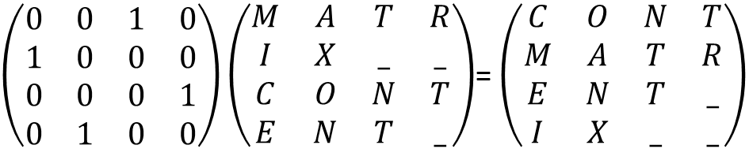
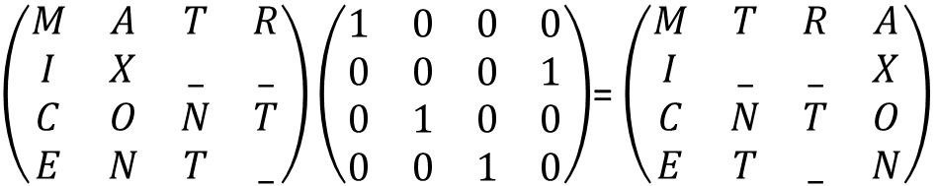
LET'S SUM UP WHAT WE'VE DISCOVERED
Result of multiplying on the left: it permutes the rows.
Result of multiplying on the right: it permutes the columns.
$\left(\begin{matrix}0 & 0 & 1 & 0 \\ 1 & 0 & 0 & 0 \\ 0 & 0 & 0 & 1 \\ 0 & 1 & 0 & 0\end{matrix}\right)\left(\begin{matrix}M & A & T & R \\ I & X & _ & _ \\ C & O & N & T \\ E & N & T & _\end{matrix}\right)$= $\left(\begin{matrix}C & O & N & T \\ M & A & T & R \\ E & N & T & _ \\ I & X & _ & _\end{matrix}\right)$
$\left(\begin{matrix}M & A & T & R \\ I & X & _ & _ \\ C & O & N & T \\ E & N & T & _\end{matrix}\right)\left(\begin{matrix}1 & 0 & 0 & 0 \\ 0 & 0 & 0 & 1 \\ 0 & 1 & 0 & 0 \\ 0 & 0 & 1 & 0\end{matrix}\right)$= $\left(\begin{matrix}M & T & R & A \\ I & _ & _ & X \\ C & N & T & O \\ E & T & _ & N\end{matrix}\right)$

Slide 12
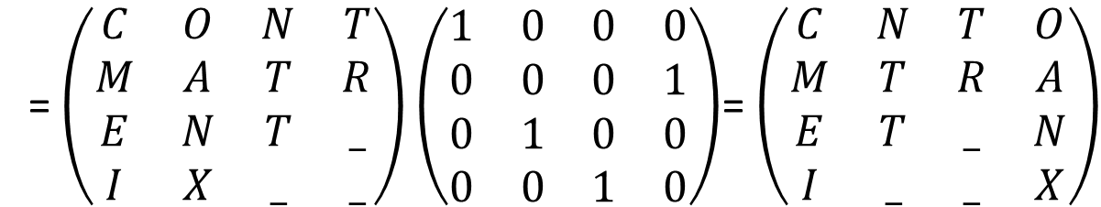
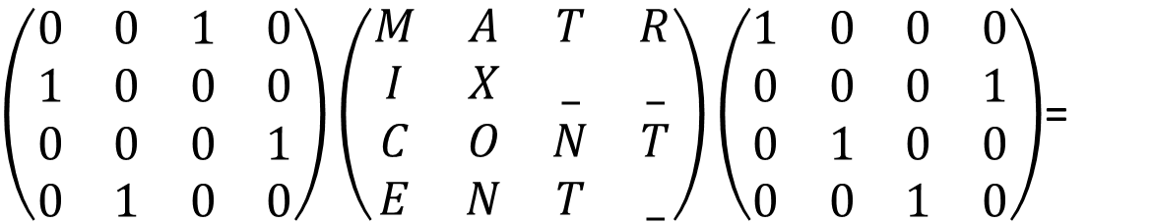
AND WHAT RESULT DO WE GET IF WE MULTIPLY ON BOTH SIDES?
$\left(\begin{matrix}0 & 0 & 1 & 0 \\ 1 & 0 & 0 & 0 \\ 0 & 0 & 0 & 1 \\ 0 & 1 & 0 & 0\end{matrix}\right)\left(\begin{matrix}M & A & T & R \\ I & X & _ & _ \\ C & O & N & T \\ E & N & T & _\end{matrix}\right)\left(\begin{matrix}1 & 0 & 0 & 0 \\ 0 & 0 & 0 & 1 \\ 0 & 1 & 0 & 0 \\ 0 & 0 & 1 & 0\end{matrix}\right)$=
= $\left(\begin{matrix}C & O & N & T \\ M & A & T & R \\ E & N & T & _ \\ I & X & _ & _\end{matrix}\right)$ $\left(\begin{matrix}1 & 0 & 0 & 0 \\ 0 & 0 & 0 & 1 \\ 0 & 1 & 0 & 0 \\ 0 & 0 & 1 & 0\end{matrix}\right)$= $\left(\begin{matrix}C & N & T & O \\ M & T & R & A \\ E & T & _ & N \\ I & _ & _ & X\end{matrix}\right)$

Slide 13
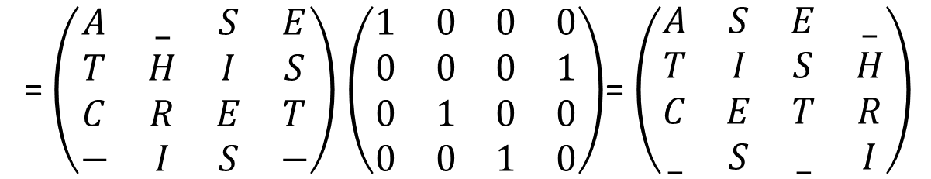
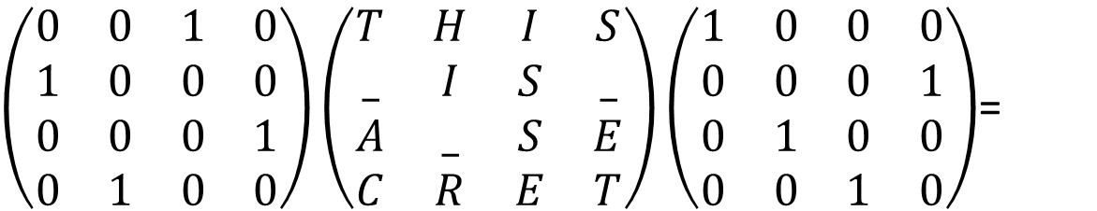
LET'S USE THESE MULTIPLICATIONS TO ENCRYPT MESSAGES
To encrypt the message $m=THIS_IS_A_SECRET$ we do:
$\left(\begin{matrix}0 & 0 & 1 & 0 \\ 1 & 0 & 0 & 0 \\ 0 & 0 & 0 & 1 \\ 0 & 1 & 0 & 0\end{matrix}\right)\left(\begin{matrix}T & H & I & S \\ _ & I & S & _ \\ A & _ & S & E \\ C & R & E & T\end{matrix}\right)\left(\begin{matrix}1 & 0 & 0 & 0 \\ 0 & 0 & 0 & 1 \\ 0 & 1 & 0 & 0 \\ 0 & 0 & 1 & 0\end{matrix}\right)$=
= $\left(\begin{matrix}A & _ & S & E \\ T & H & I & S \\ C & R & E & T \\ − & I & S & −\end{matrix}\right)$ $\left(\begin{matrix}1 & 0 & 0 & 0 \\ 0 & 0 & 0 & 1 \\ 0 & 1 & 0 & 0 \\ 0 & 0 & 1 & 0\end{matrix}\right)$= $\left(\begin{matrix}A & S & E & _ \\ T & I & S & H \\ C & E & T & R \\ _ & S & _ & I\end{matrix}\right)$
And the encrypted message is $c=ASE_TISHCETR_S_I$

Slide 14
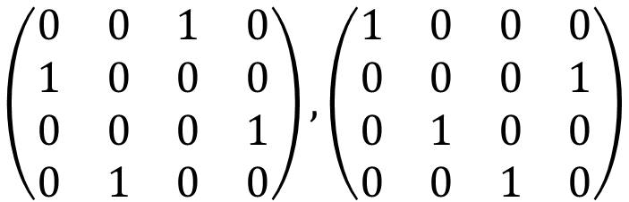

LET'S USE THESE MULTIPLICATIONS TO ENCRYPT MESSAGES
Therefore, from the two matrices,
(which are called the private key) we obtain that the encryption of the message $m=THIS_IS_A_SECRET$ is
$c=ASE_TISHCETR_S_I$
$$\left(\begin{matrix}0 & 0 & 1 & 0 \\ 1 & 0 & 0 & 0 \\ 0 & 0 & 0 & 1 \\ 0 & 1 & 0 & 0\end{matrix}\right),\left(\begin{matrix}1 & 0 & 0 & 0 \\ 0 & 0 & 0 & 1 \\ 0 & 1 & 0 & 0 \\ 0 & 0 & 1 & 0\end{matrix}\right)$$

Slide 15
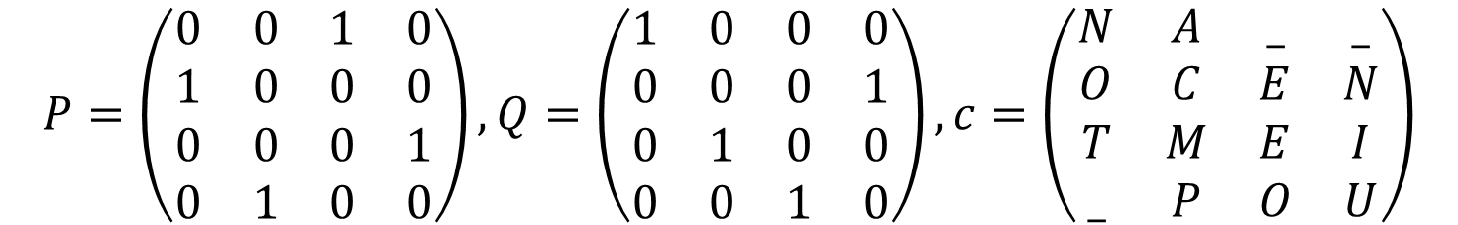
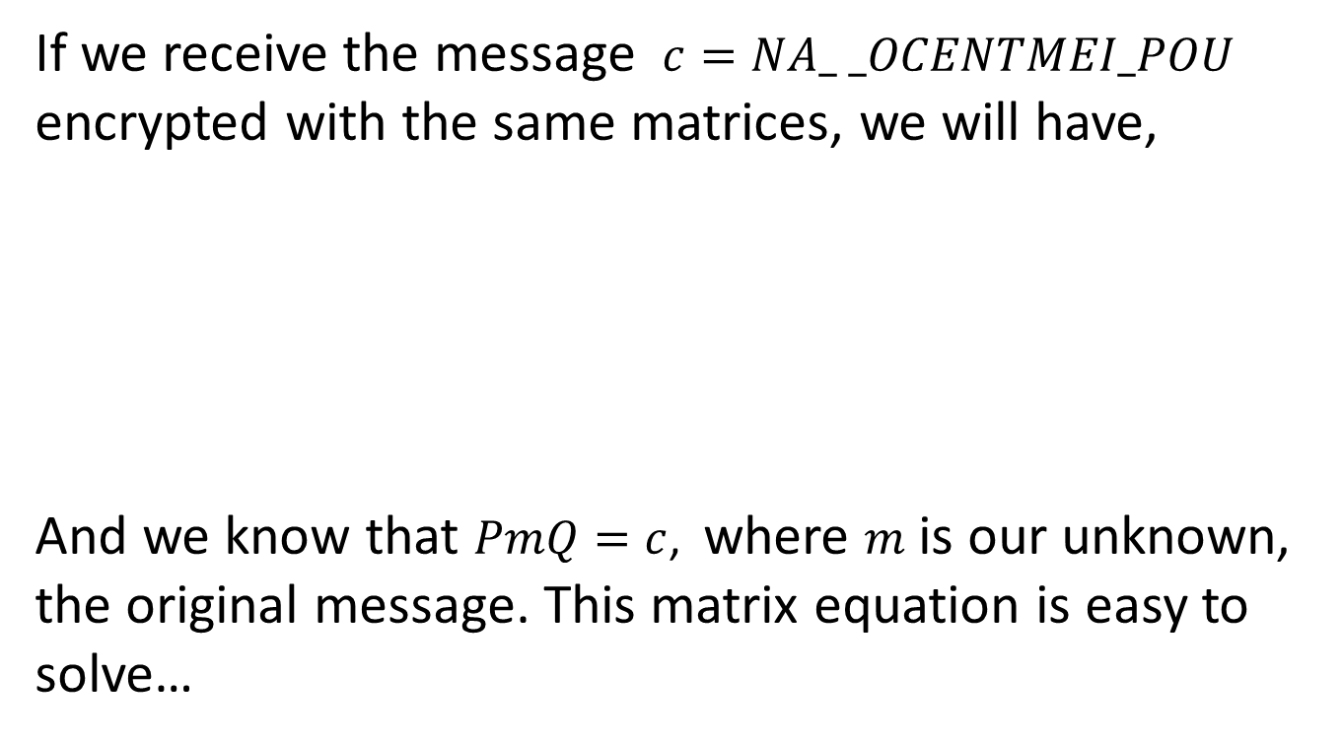
AND HOW DO WE DECRYPT A MESSAGE?
If we receive the message $c=NA_ _OCENTMEI_POU$
encrypted with the same matrices, we will have,
And we know that $PmQ=c$, where 𝑚 is our unknown, the original message. This matrix equation is easy to solve…
$$P=\left(\begin{matrix}0 & 0 & 1 & 0 \\ 1 & 0 & 0 & 0 \\ 0 & 0 & 0 & 1 \\ 0 & 1 & 0 & 0\end{matrix}\right),Q=\left(\begin{matrix}1 & 0 & 0 & 0 \\ 0 & 0 & 0 & 1 \\ 0 & 1 & 0 & 0 \\ 0 & 0 & 1 & 0\end{matrix}\right),c=\left(\begin{matrix}N & A & _ & _ \\ O & C & E & N \\ T & M & E & I \\ _ & P & O & U\end{matrix}\right)$$

Slide 16
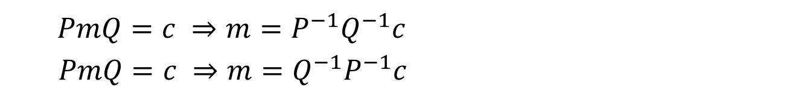
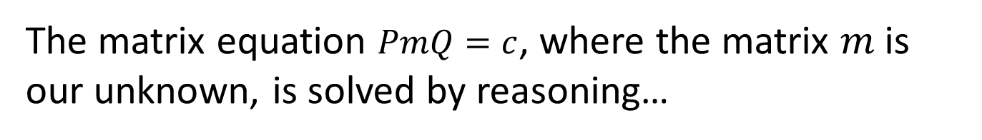
QUESTION
The matrix equation $PmQ=c$, where the matrix 𝑚 is our unknown, is solved by reasoning…
(a)
$PmQ=c ⇒m=P^{−1}Q^{−1}c$
$PmQ=c ⇒m=Q^{−1}P^{−1}c$
(b)
(c)
$PmQ=c ⇒mQ=cP^{−1}$ $⇒m=Q^{−1}cP^{−1}$
(d)
$PmQ=c ⇒mQ=P^{−1}c$ $⇒m=P^{−1}cQ^{−1}$

Slide 17
QUESTION
NOOOO!!! You have to think carefully whether to multiply on the right or on the left by the inverse of the matrix (on both sides of the equation)
COME BACK

Slide 18
WELL DONE!!!!

Slide 19
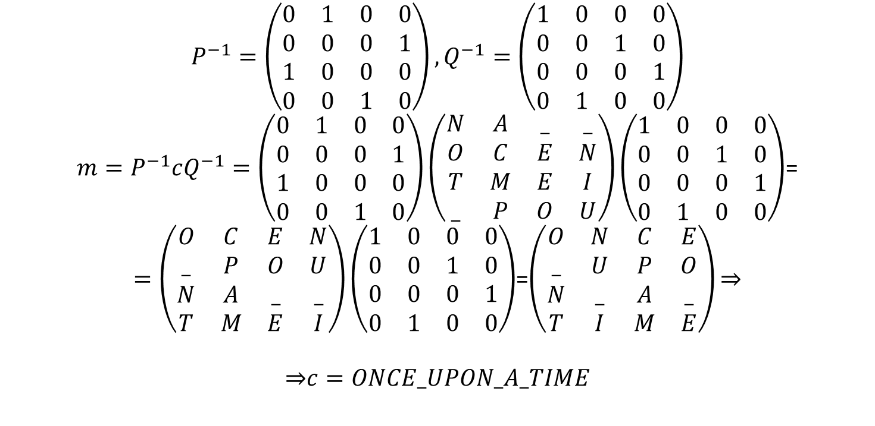

AND HOW DO WE DECRYPT A MESSAGE?
Now we need to calculate two inverse matrices to use the result $m=P^{−1}cQ^{−1}$ and we obtain:
$$P^{−1}=\left(\begin{matrix}0 & 1 & 0 & 0 \\ 0 & 0 & 0 & 1 \\ 1 & 0 & 0 & 0 \\ 0 & 0 & 1 & 0\end{matrix}\right),Q^{−1}=\left(\begin{matrix}1 & 0 & 0 & 0 \\ 0 & 0 & 1 & 0 \\ 0 & 0 & 0 & 1 \\ 0 & 1 & 0 & 0\end{matrix}\right)$$
$m=P^{−1}cQ^{−1}=\left(\begin{matrix}0 & 1 & 0 & 0 \\ 0 & 0 & 0 & 1 \\ 1 & 0 & 0 & 0 \\ 0 & 0 & 1 & 0\end{matrix}\right)\left(\begin{matrix}N & A & _ & _ \\ O & C & E & N \\ T & M & E & I \\ _ & P & O & U\end{matrix}\right)\left(\begin{matrix}1 & 0 & 0 & 0 \\ 0 & 0 & 1 & 0 \\ 0 & 0 & 0 & 1 \\ 0 & 1 & 0 & 0\end{matrix}\right)$=
$=\left(\begin{matrix}O & C & E & N \\ _ & P & O & U \\ N & A & _ & _ \\ T & M & E & I\end{matrix}\right)\left(\begin{matrix}1 & 0 & 0 & 0 \\ 0 & 0 & 1 & 0 \\ 0 & 0 & 0 & 1 \\ 0 & 1 & 0 & 0\end{matrix}\right)$=$\left(\begin{matrix}O & N & C & E \\ _ & U & P & O \\ N & _ & A & _ \\ T & I & M & E\end{matrix}\right)\text{⇒}$
$$\text{⇒}c=ONCE_UPON_A_TIME$$

Slide 20
FUN, RIGHT?

Slide 21
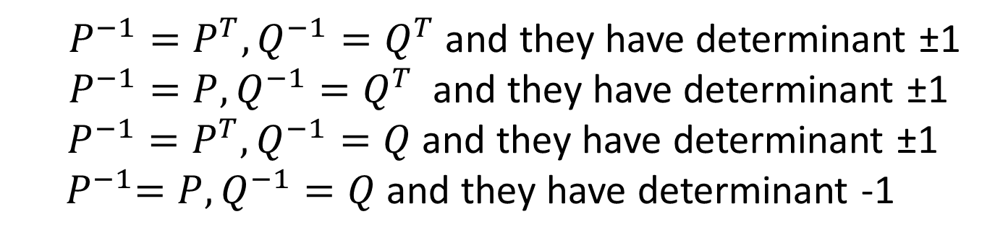
IN THE CALCULATIONS WE'VE MADE,
IT IS OBSERVED THAT…
(a)
$P^{−1}=P^{T}, Q^{−1}=Q^{T}$ and they have determinant ±1
$P^{−1}=P, Q^{−1}=Q^{T}$ and they have determinant ±1
$P^{−1}=P^{T}, Q^{−1}=Q$and they have determinant ±1
${ P}^{−1}=P, Q^{−1}=Q$ and they have determinant -1
(b)
(c)
(d)

Slide 22
IN THE CALCULATIONS WE'VE MADE, IT IS OBSERVED THAT...
NOOOO!!! Check the calculations!!
COME BACK

Slide 23
WELL DONE!!!!

Slide 24
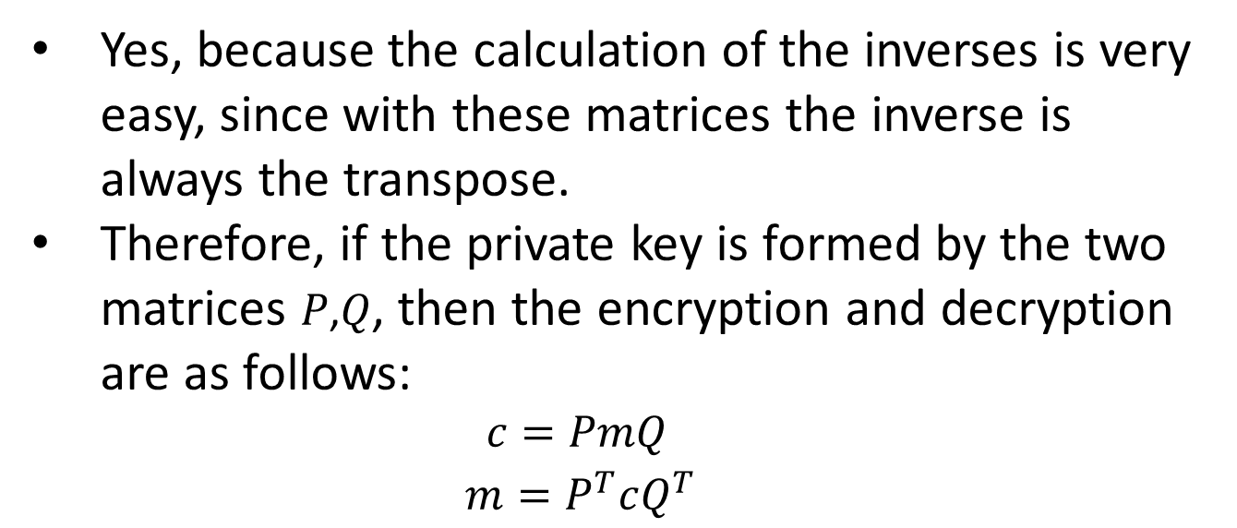
DOES THIS SIMPLIFY THE CALCULATIONS?
Yes, because the calculation of the inverses is very easy, since with these matrices the inverse is always the transpose.
Therefore, if the private key is formed by the two matrices 𝑃,𝑄, then the encryption and decryption are as follows:
$c=PmQ$
$m=P^{T}cQ^{T}$

Slide 25
IS THIS ENCRYPTION METHOD SECURE?
In the previous decryption, without knowing the private key (the two matrices), it would not be easy at all to obtain the plaintext message.
For the matrix on the right, we have 4! = 24 possible matrices, and the same for the one on the left.
Therefore, we would have to test 24·24 = 576 possible private keys.
The number of matrix products we would need to perform until finding an intelligible word would be very high.
Obviously, by increasing the matrix dimension, the security increases significantly.

Slide 26
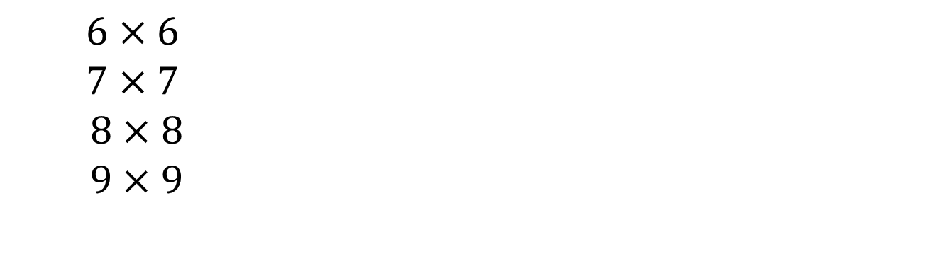
LET'S SEE IF YOU CAN ANSWER THE FOLLOWING QUESTIONS...
What should be the dimension of the matrices that form the private key so that there are more than 1.5 billion possible keys in total?
(a)
$6×6$
$7×7$
$8×8$
$9×9$
(b)
(c)
(d)

Slide 27
NOOOOOO!!!!
Check the calculations!!
TORNA

Slide 28
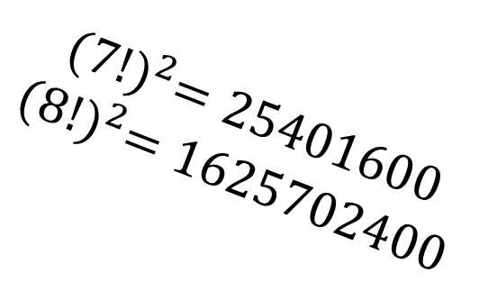
WELL DONE!!!!
$${(7!)}^{2}=25401600$$
$${(8!)}^{2}=1625702400$$

Slide 29

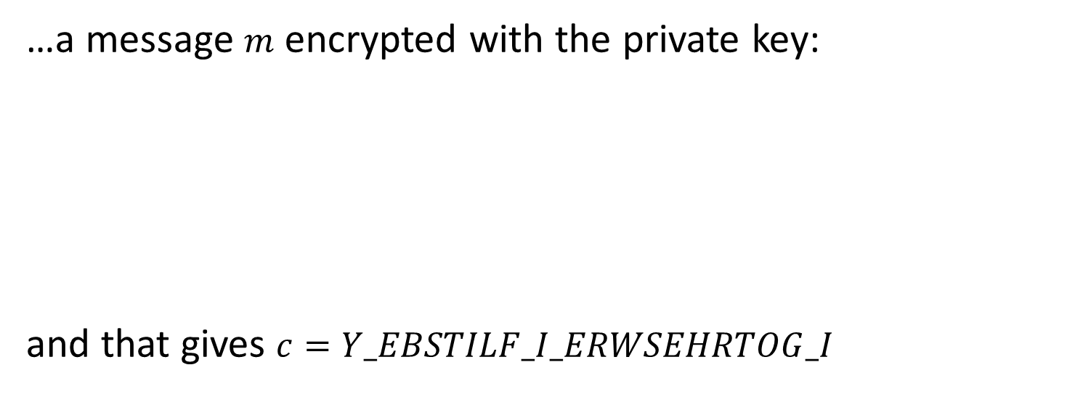
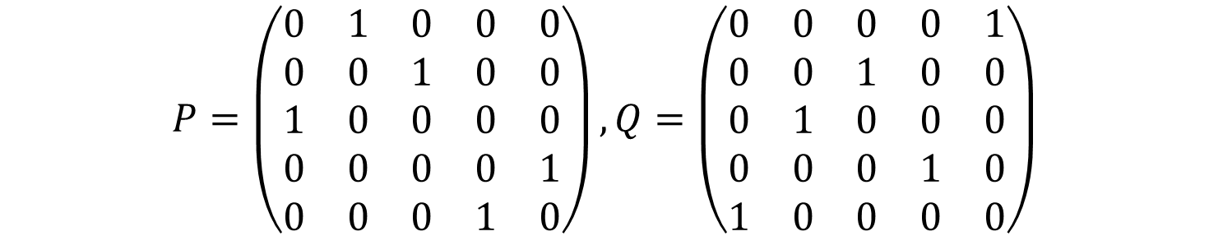
LET'S SEE IF YOU CAN ANSWER THE FOLLOWING QUESTIONS...
…a message $m$ encrypted with the private key:
and that gives $c=Y_EBSTILF_I_ERWSEHRTOG_I$
$$P=\left(\begin{matrix}0 & 1 & 0 & 0 & 0 \\ 0 & 0 & 1 & 0 & 0 \\ 1 & 0 & 0 & 0 & 0 \\ 0 & 0 & 0 & 0 & 1 \\ 0 & 0 & 0 & 1 & 0\end{matrix}\right),Q=\left(\begin{matrix}0 & 0 & 0 & 0 & 1 \\ 0 & 0 & 1 & 0 & 0 \\ 0 & 1 & 0 & 0 & 0 \\ 0 & 0 & 0 & 1 & 0 \\ 1 & 0 & 0 & 0 & 0\end{matrix}\right)$$
(a)
$m=WE_RISE_BY_LIFTING_OTHERS$
$$m=\text{BIG}\text{_}\text{WOLF}\text{_}\text{RISES}\text{_}\text{YET}\text{_}\text{HIGHER}$$
(b)
$$m\text{=}\text{WHERE}\text{_}\text{BIG}\text{_}\text{HEARTS}\text{_}\text{LIFT}\text{_}\text{YO}\text{_}\text{RISE}$$
(c)
(d)
None of the others

Slide 30
NOOOOO!!!!
Check the calculations!!
TORNA

Slide 31
WELL DONE!!!!

Slide 32
HOPE YOU'VE ENJOYED IT!!!!
THE JOY OF PLAYFUL MATRICES

