Slide 1
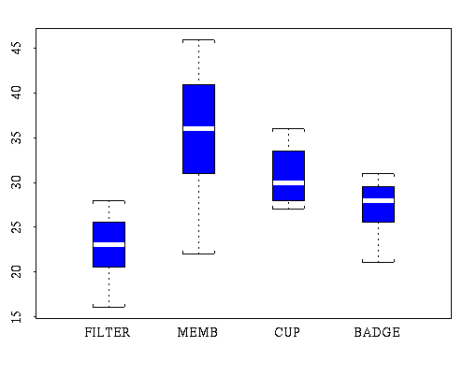
APPLIED STATISTICS
Exploratory Data Analysis

Slide 2
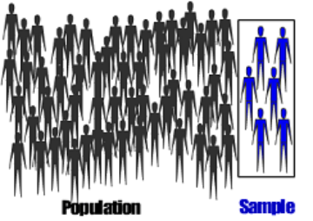
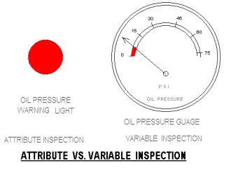
Population and Variables
Population: set of elements subject to study
  Finite and infinite populations
Sample: subset of the population
  Random sample and sample size
Variable: property of the elements of the population
  Qualitative variable
  Quantitative variable (discrete and continuous)
Observation: value that the variable takes on in an element of the population

Slide 3
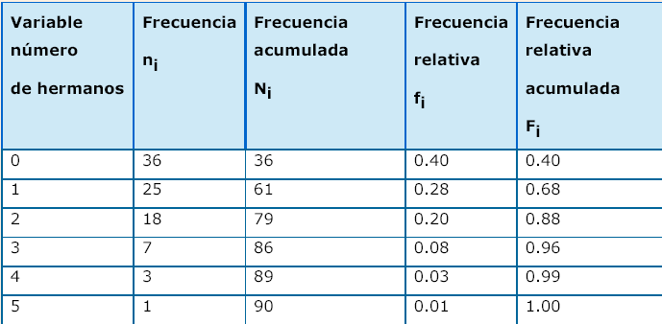
One-dimensional distributions
Absolute frequency (n_{i}): number of times a given value x_{i} occurs in the n observations of the variable X
Frequency distribution: {(x_{i} , n_{i}) / i = 1, 2,..., k}, i.e.: set formed by the different values of the variable, x_{i} , and the frequency associated with each value, n_{i}
Relative frequency, f_{i} : f_{i} = n_{i} / n
Cumulative frequencies, N_{i} and F_{i}
Example 5
Sum = 90
Sum = 1
(Continued)

Slide 4
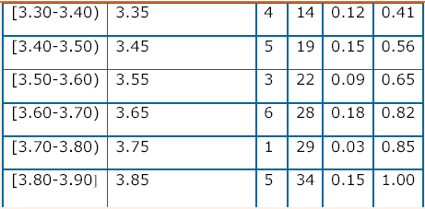
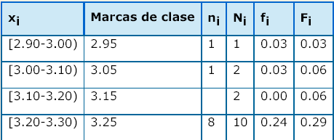
One-dimensional distributions
If there are many observations or the variable is continuous, the data can be grouped into class intervals.
Frequency of a class
Class mark: central value of each class interval
Frequency distribution
Example 6
Sum = 34
Sum = 1

Slide 5
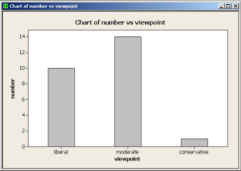
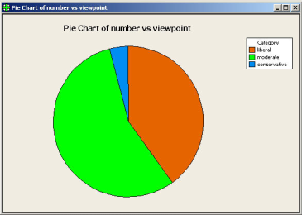
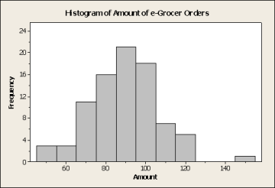
Graphic representations
← bar chart
Pie chart →
← Frequency histograms

Slide 6
Descriptors of a set of observations
Given a sample of n observations, x₁ , x₂ , ..., x_{n ,} how are the data distributed? (use of centrality and dispersion descriptors )
Statistics for a sample:
Parameters of a population:
(Continued)

Slide 7
Descriptors of a set of observations
Measures of central tendency:
  Mean :
  Mode
  Median (median):
Position measurements:
  Quartiles :
  Quantiles :
Very sensitive to outliers!
After sorting the data
(Continued)

Slide 8
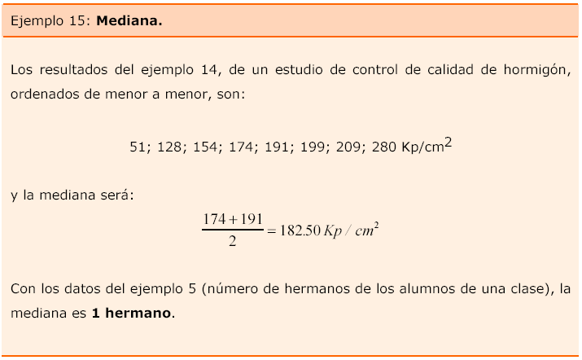
Descriptors of a set of observations
8 (even) sorted data
(Continued)

Slide 9
Descriptors of a set of observations
Let's look at the following table:
The first column contains the values of the variable
In the second column the absolute frequency of each of the variables
The last row is the sum of each of the columns.
x _{and} | n _{i} | No​ | x _{i} ·n _{i}
1 | 1 | 1 | 1
4 | 24 | 25 | 96
5 | 30 | 55 | 150
6 | 20 | 75 | 120
7 | 24 | 99 | 168
10 | 1 | 100 | 10
 | 100 |  | 545
Measures of central tendency:
  Mean: 545/100 = 5.45
  Mode: 5
  Median: (5+5)/2 = 5 = Q2
n
(Continued)
Notes:
9

Slide 10
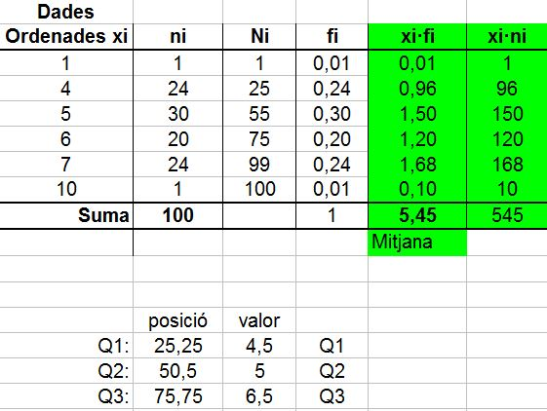
Descriptors of a set of observations
Here we have the table created with Excel.
Position measurements:
  Quartiles:
= (4+5)/2 = 4.5
= (6+7)/2 = 6. 5
(Continued)
Notes:
10

Slide 11
Descriptors of a set of observations
Dispersion measures:
  Range or amplitude:
  Interquartile range (IQR):
  Mean deviation:
  Variance:
  Corrected variance (Minitab):
  Standard deviation (StDev):
(Continued)

Slide 12
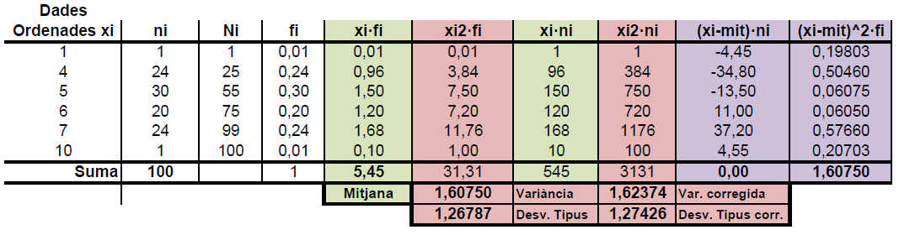
Descriptors of a set of observations
Dispersion measures:
  Range or amplitude: 10 – 1 = 9
  Interquartile range (IQR): 6.5 – 4.5 = 2
  Variance : 3131/100 – 5.45 ² = 1.6075
  Standard deviation : √1.6075 = 1.26787
(Continued)
Notes:
12

Slide 13
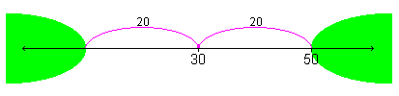
Descriptors of a set of observations
Chebyshev's inequality: "it is very rare to find data that are "many deviations" from the mean; much less frequent the further we move away from this mean"
(Continued)

Slide 14
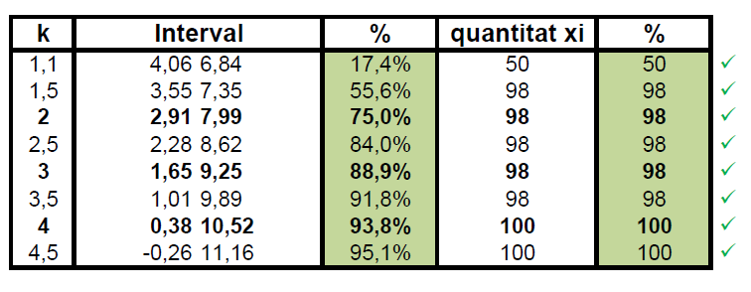
Descriptors of a set of observations
Chebyshev's inequality
With the data in the example we can verify for different values of k that the percentage of data contained in each interval is, at least, that guaranteed by the inequality.

Slide 15
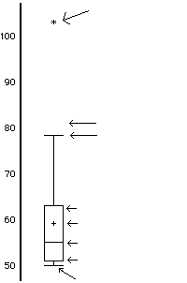
Boxplots (box diagrams)
Boxplot: allows you to characterize the distribution (symmetry, dispersion, etc.) and detect atypical data (outliers)
Construction of a Boxplot:
  Find: Q1, Q2, Q3 and IQR = Q3 – Q1
  Calculate: LI = Q1 – 1.5*IQR and
  LS = Q3 + 1.5*IQR
  Mark data outside the interval [LI, LS] as outliers
  Draw a line (whisker) from each end of the central rectangle to the furthest non-outlier data point
Outlier (atypical)
LS
Maximum not atypical
Q3
Mean
Median (Q2)
Q1
Minimum not atypical
LI
(Continued)

Slide 16
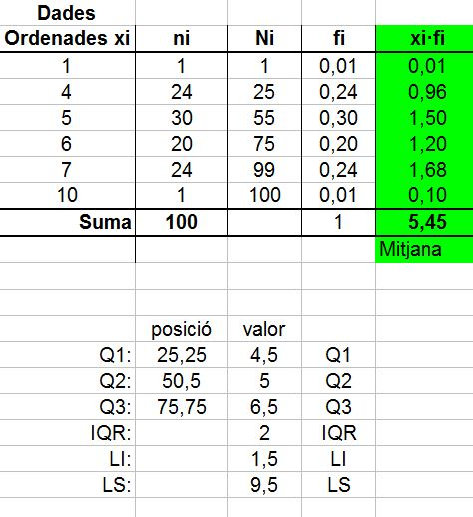
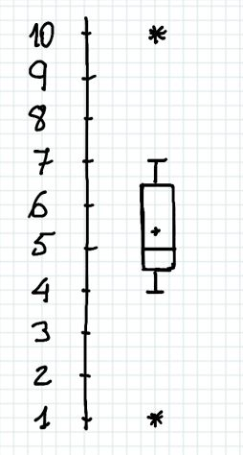
Boxplots (box diagrams)
Notes:
16

