Slide 1
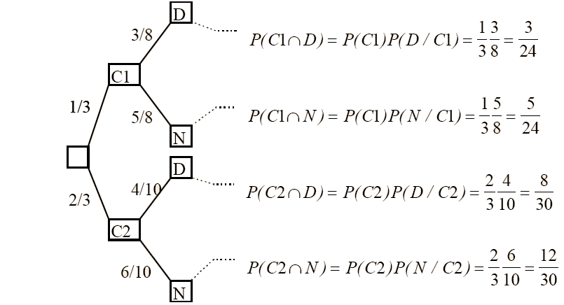
APPLIED STATISTICS
Probability

Slide 2
Probability Axiomatics
Random experiment (unpredictable outcome) vs. deterministic experiment (predictable outcome)
The sample space, Ω, is the set of all possible outcomes that can be obtained by performing a random experiment. Each of these outcomes is an elementary event (a, b, c, ...)
An event (A, B, C, ...) is any subset of Ω. The set of events, E = Parts (Ω) includes Ω (sure event) and Ø (impossible event)
Example (rolling a die):
Ω = {1, 2, 3, 4, 5, 6}
E = { Ω , Ø, {1}, {2}, …, {1,2}, {1,3}, …, {1,2,3}, …, {1,2,3,4}, … }
(Continued)

Slide 3
Probability Axiomatics
If A and B are two events, then:
A U B is the event that occurs when A or B (union)
A ∩ B is the event that occurs when A and B (intersection)
Ā is the event that occurs when A does not occur (complementary)
A and B are incompatible ⬄ A ∩ B = Ø
Example (rolling a die): A = {even}, B = {3, 6}, C = {odd} → A and C incompatible, A and B compatible, ...
Ω
To
A∩B
B
(Continued)

Slide 4
Probability Axiomatics
A probability, P, is an application P : E → lR such that:
Observation:
Properties:
Probability ←→ Area
Ω
To
B
(Continued)

Slide 5
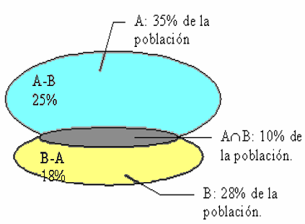
Probability Axiomatics
Example 5:
35% A, 28% B, 10% A and B
P(A or B)?
P(AUB) = P(A) +P(B) - P(A ∩ B) = 0.35 + 0.28 – 0.10 = 0.53
P(A but not B)?
P(A - B) = 0.35 – 0.10 = 0.25
P(only one)?
P(only A or only B) = 0.25 + 0.18 = 0.43
P(none)?
P(none) = 1 – P(AUB) = 0.47

Slide 6
Conditional Probability and Bayes’ Theorem
Conditional probability of A knowing that B has been given:
Example 6:
M1 60% pieces, M2 40% pieces, P(D/M1) = 0.03, P(D/M2) = 0.02
P(D)?
P(D) = P( M1∩D ) + P(M2 ∩D) =
= 0.018 + 0.008 = 0.026
P(M1/D)?
P(M1/D) = P(M1 ∩ D) / P(D) = 0.018 / 0.026 = 0.69
0.03
D
P(M1 ∩D) = 0.6*0.03
0.6
M1
¬D
0.02
D
P(M2 ∩D) = 0.4*0.02
0.4
M2
¬D
(Continued)

Slide 7
Conditional Probability and Bayes’ Theorem
A and B are independent ⬄ P(A∩B) = P(A)*P(B)
A and B are independent ⬄ P(A/B) = P(A) and P(B/A) = P(B)
Attention!: independent ≠ incompatible
Bayes' Theorem :
Example 7 (continued from 6):
P(M1/D)?
P(M1/D) = P(D/M1)*P(M1) / P(D) = 0.03*0.6 / 0.026 = 0.69
It allows us to obtain
a conditional probability
from the opposite conditional
probability

Slide 8
Tree Diagrams
Series of sequential experiments, each with two (or more) possible outcomes
Example 9: roll dice; if die < 3 → C1, otherwise → C2; C1: 8 pieces (3 defect.), C2: 10 pieces (4 defect.); P(defect.)?
P(D) = 3/24 + 8/30 = 47/120 = 0.4

