Slide 1
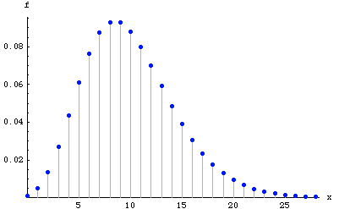
APPLIED STATISTICS
Discrete Random Variables

Slide 2
Random Variables
A random variable (r.v.) is any application X: Ω → lR which assigns a real number to each elementary event
If X(Ω) is countable, then X is said to be discrete. If X(Ω) is uncountable we say that X is continuous
Example discrete r.v. (tossing 3 coins):
  X = “number of faces”
  Ω = {ccc, cc+, c+c, +cc, c++, +c+, ++c, +++}
  X(Ω) = {0, 1, 2, 3}
Example Continuous r.v. (throwing a dart at a target):
  X = “distance of the dart to the center of the target”
  X(Ω) = [0, L) (L = radius of target)
(Continued)

Slide 3
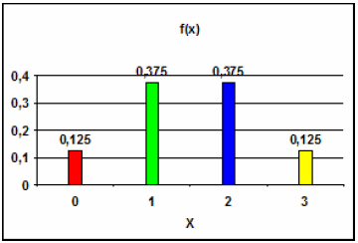
Random Variables
The probability function (pdf) associated with a discrete variable, X, is the map f: X(Ω) → [0, 1] such that f(x_{i}) = P(X = x_{i})
Example (tossing 3 coins):
  X = “number of faces”
  Ω = {ccc, cc+, c+c, +cc, c++, +c+, ++c, +++}
  X( Ω ) = {0, 1, 2, 3}
  f(0) = P(X = 0) = 1/8
  f(1) = P(X = 1) = 3/8
  f(2) = P(X = 2) = 3/8
  f(3) = P(X = 3) = 1/8
Remark: the sum of all the values that pdf takes must be 1, i.e.: Σ f(x _{i} ) = 1
(Continued)

Slide 4
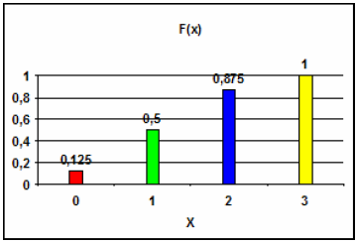
Random Variables
The distribution function (cdf) associated with a discrete r.v., X, is the map F: X(Ω) → [0, 1] such that F(x_{i}) = P(X <= x_{i})
Example (tossing 3 coins):
  X = “number of faces”
  Ω = {ccc, cc+, c+c, +cc, c++, +c+, ++c, +++}
  X( Ω ) = {0, 1, 2, 3}
  F(0) = P(X <= 0) = 1/8
  F(1) = P(X <= 1) = 1/8 + 3/8 = 1/2
  F(2) = P(X <= 2) = 1/8 + 3/8 + 3/8 = 7/8
  F(3) = P(X <= 3) = 1
Remark: cdf is monotone increasing (from 0 to 1) and steppy

Slide 5
Features of a Discrete r.v.
Expectation of a X r.v.:
Variance of a X r.v.:
Standard deviation of a X r.v.:
Example (tossing 3 coins):
  X = “number of faces”; X( Ω ) = {0, 1, 2, 3}
  f(0) = f(3) = 1/8 f(1) = f(2) = 3/8
  E[X] = Σ (x _{i} · f(x _{i} )) = 0·1/8 + 1·3/8 + 2·3/8 + 3·1/8 = 3/2 = 1.5
  E[X² ] = Σ (x _{i} ² · f(x _{i} )) = 0² ·1/8 + 1² · 3/8 + 2² · 3/8 + 3² ·1/8 = 3
  Var[X] = 3 - 1.5 ² = 0.75 → σ = 0.866
Remark: the smaller σ is, the more concentrated around E[X] the values x_{i} are
(Continued)

Slide 6
Features of a Discrete r.v.
Chebyshev’s Theorem: “it is very unlikely to find data that is very far from the expectation; less likely the further we move away from this expectation”
Only cases where k>1 provide useful information

Slide 7
Binomial distribution
Bernoulli experiment: random experiment with 2 possible outcomes, success or failure (1/0, white/black, on/off...), with constant probability of success p. If X is the number: X ~ B(p)
n independent Bernoulli experiments are performed and X is the number of successes in the n tests → X we will say that it follows a Binomial distribution, i.e.: X ~ B(n, p)
If X ~ B(n, p) and k = number of successes in the n trials, then:
If X ~ B(n, p) →
(Continued)

Slide 8
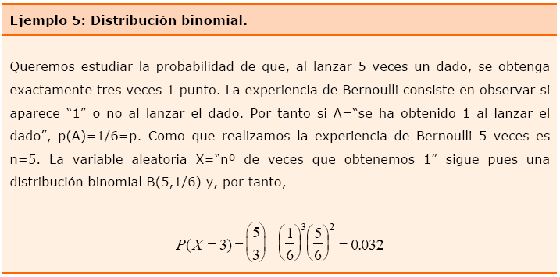
Binomial distribution
(Continued)

Slide 9
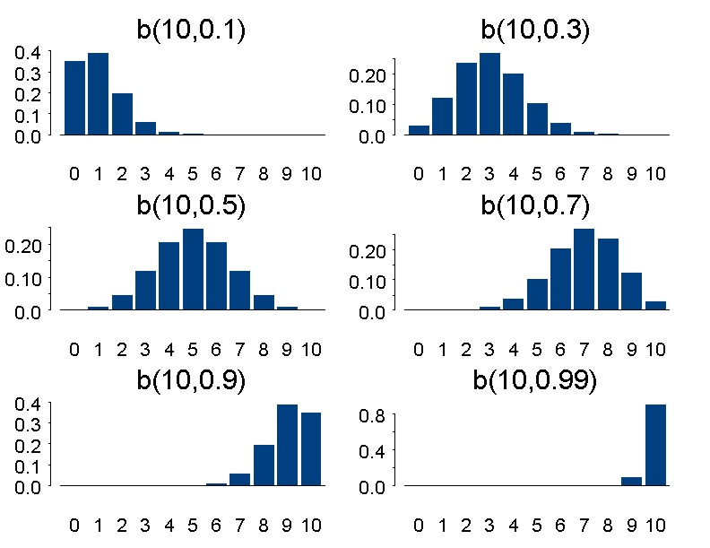
Binomial distribution

Slide 10
Poisson distribution
Poisson experiment: random experiment consisting of recording the observation of a punctual and independent event in a continuous interval of time or space (e.g.: arrival of a car at a toll booth, arrival of a request to a web server, occurrence of a failure in a structure, ...)
In a Poisson experiment, if we call X = “number of occurrences in a given interval”, this follows a Poisson distribution with parameter λ , where λ is the average of observations per unit of time, i.e.: X ~ Poisson(λ) (e.g.: number of cars arriving over 3 hours, number of customers arriving over a morning, ...)
If X ~ Poisson( λ ) and k is a natural number, then:
(Continued)

Slide 11
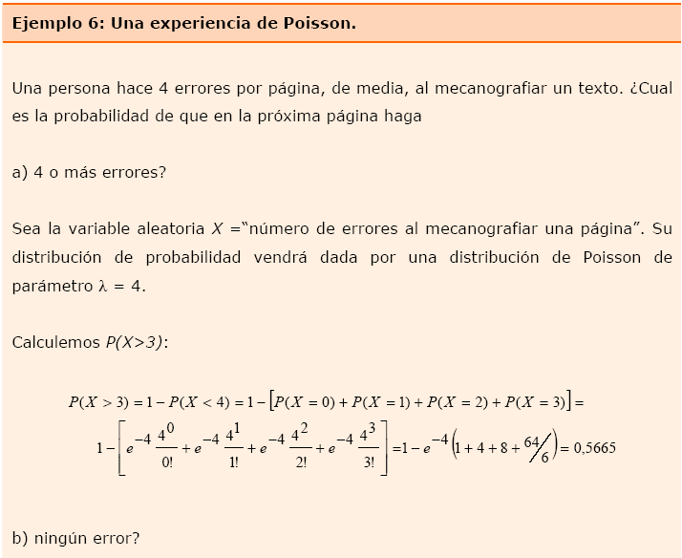
Poisson distribution
(Continued)

Slide 12
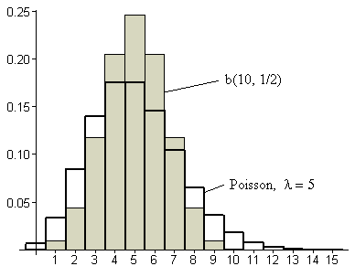
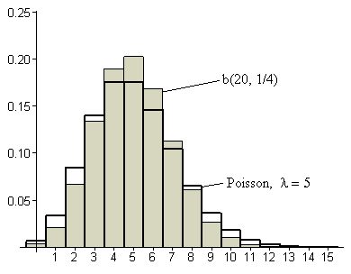
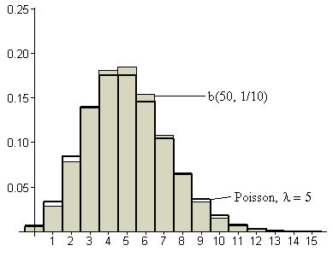
Poisson distribution
Approximation of a Binomial r.v. by a Poisson r.v.:
If n → ∞ and p → 0, then: B(n, p) ≈ Poisson(n·p)
n → ∞
p → 0

