Slide 1
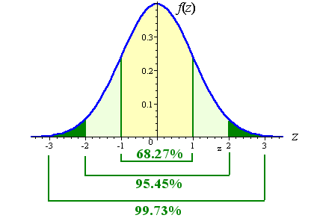
APPLIED STATISTICS
Continuous Random Variables

Slide 2
Probability Distribution
Note: if X is a continuous r.v. → P(X = x) = 0
The probability density function (pdf) associated with a continuous r.v., X, is the map f: lR → lR such that:
  Note: If X is continuous → P(a < X < b) = P(a <= X <= b)
The distribution function (cdf) associated with a continuous variable, X, is the map F: lR → [0, 1] such that F(x) = P(X <= x)
pdf f(x)
Probability = Area
cdf F(x)

Slide 3
Continuous characteristics
Expectation of a X r.v. :
Variance of a X r.v.:
Standard deviation of a X r.v.:
Properties:
  E[aX + b] = a E[X] + b
  Var[aX + b] = a ² Var[X]
Remark: the smaller σ is, the more concentrated around E[X] the observations of X are
Chebyshev’s Theorem:

Slide 4
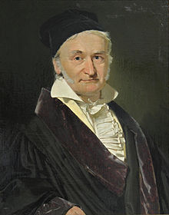
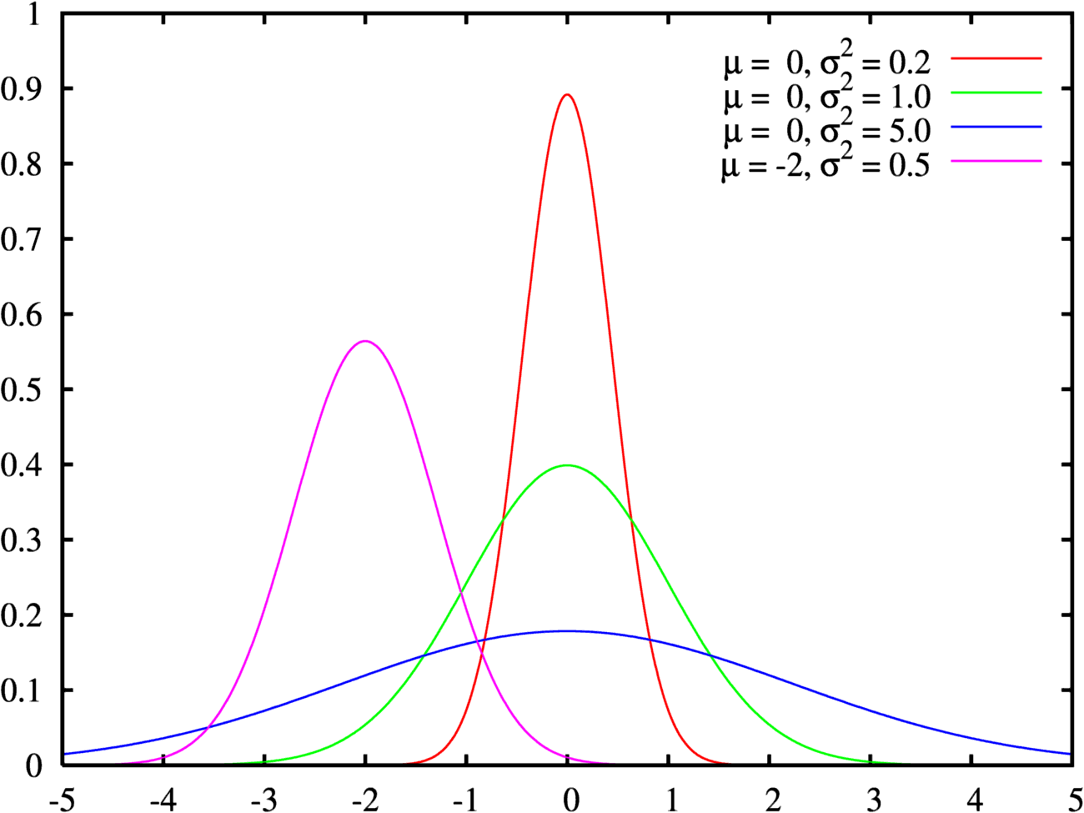
Normal Distribution
The Normal distribution is due to
Carl Friedrich Gauss (1777-1855)
A r.v. X follows a Normal distribution with expectation μ and standard deviation σ, N(μ, σ), if its pdf is:
N(μ, σ) is symmetric, centered
at μ and with inflections at μ ± σ
X~N(0,1): Standardized Normal Distribution
(Continued)

Slide 5

Normal Distribution
Rule 68-95-99
In a N(μ, σ) approx. 68% of the distribution is at μ ± σ, 95% at μ ±2σ and 99% at μ ±3σ
  Typification process:
  If X ~ N( μ , σ ) → Z = (X - μ ) / σ ~ N(0, 1)
(Continued)

Slide 6
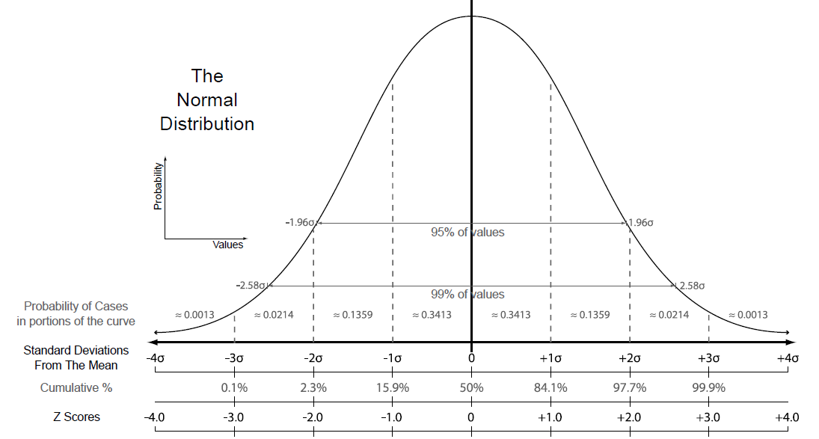
Normal Distribution
μ
μ
μ
μ
μ
μ
μ
μ
μ

Slide 7
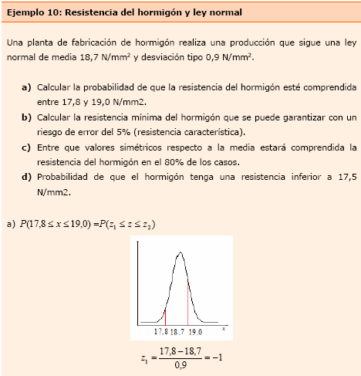
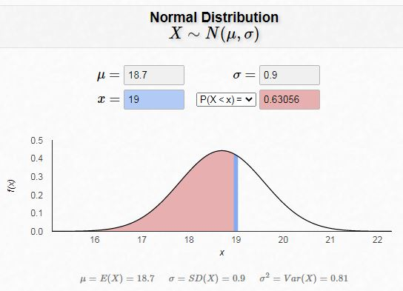
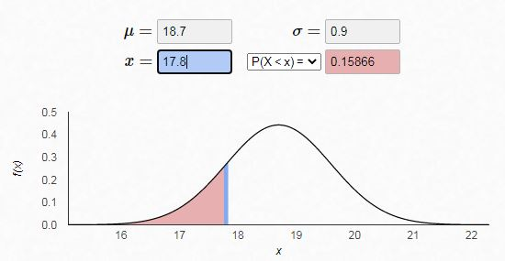
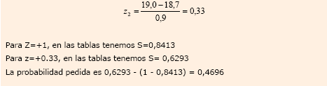
Normal Distribution
Example: Concrete strength and Normal law
A concrete manufacturing plant produces concrete with resistance values that follow a Normal law with an average of 18.7 N/mm² and a standard deviation of 0.9 N/mm²
Probability that the resistance is
between 17.8 and 19.0 N/mm²
X ~ N(18.7, 0.9)
P(17.8 < X <19.0) =
= 0.63056 – 0.15866 = 0.4719
Using the app:
https://homepage.divms.uiowa.edu/
~mbognar/applets/normal.html
(Continued)

Slide 8
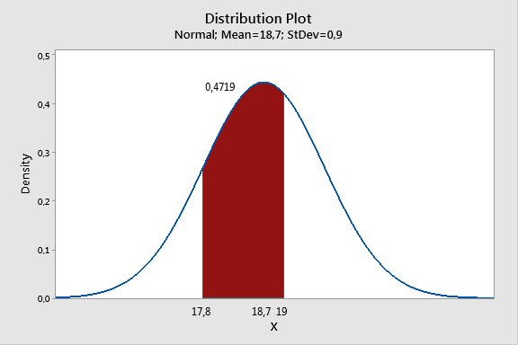
Normal Distribution
Example: Concrete strength and Normal law
Or equivalently with Minitab:
Graph / Probability Distribution Plot / View Probability
(Continued)

Slide 9
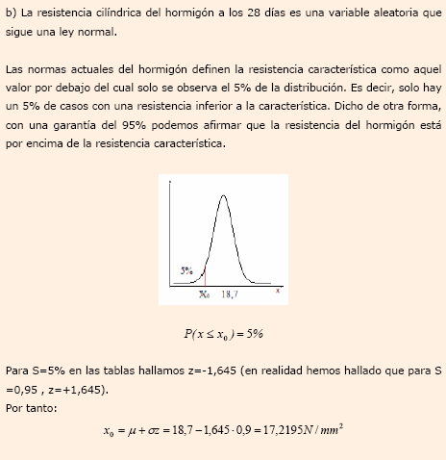
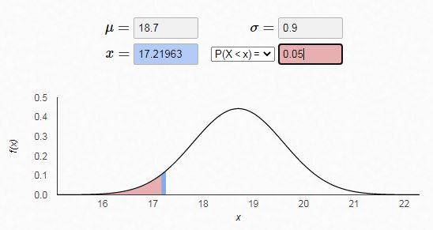
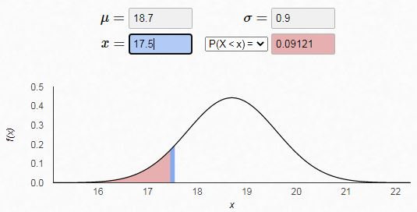
Normal Distribution
Example: Concrete strength and Normal law
b) Minimum concrete strength that can be guaranteed with a risk of error
of 5% (characteristic resistance) .
X ~ N(18.7, 0.9)
P(X ≤ x₀) = 0.05
then x₀ = 17.22 N/mm²
c) Probability that the concrete has a
resistance less than 17.5 N/mm²
P(X < 17.5) = 0.09121
(Continued)
Notes:
9

Slide 10
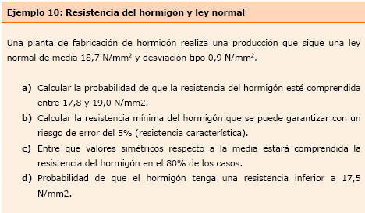
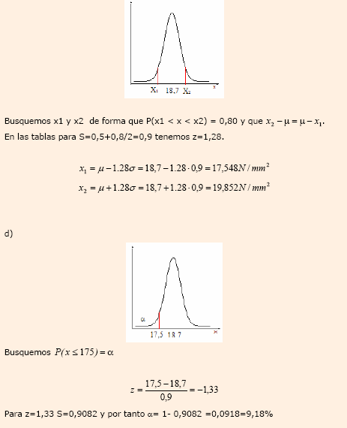
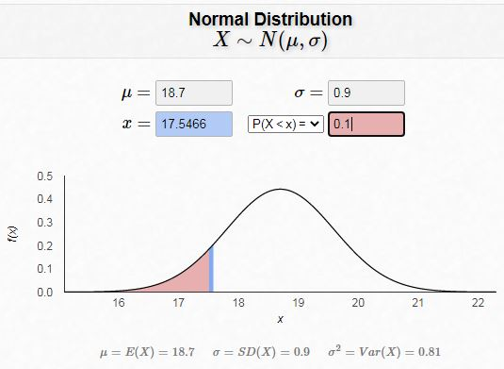
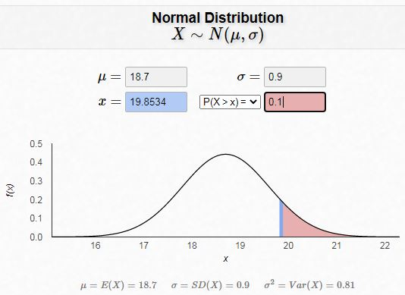
Normal Distribution
Example: Concrete strength and Normal law
d) Between which symmetrical values with respect to the average will the concrete resistance be included in 80% of cases?
X ~ N(18.7, 0.9) Must satisfy: P(x₀ ≤ X ≤ x₁) = 0.8
then: x₀ = 17.55 x₁ = 19.85
(Continued)

Slide 11
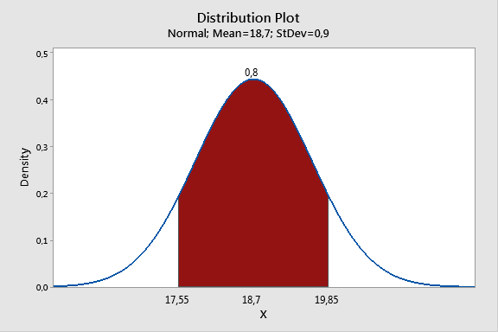
Normal Distribution
Example: Concrete strength and Normal law
Or equivalently with Minitab:
Graph / Probability Distribution Plot / View Probability

Slide 12
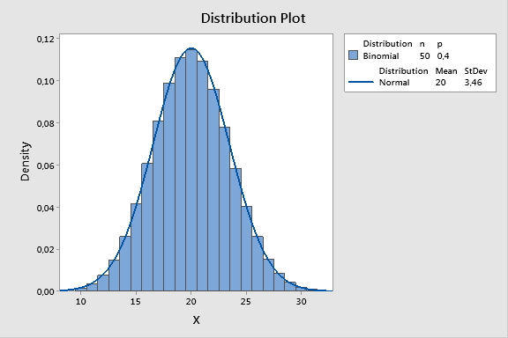
Binomial r.v. Approximated by Normal r.v.
Approximation of a Binomial r.v. by a Normal r.v.:
If n → ∞ then: B(n, p) ≈ N( n·p, √(n·p·(1-p)) )
Note: the approximation is better when:
(a) the larger n is,
(b) the closer p is to 0.5
Midpoint correction: If X ~ B(n, p) with large n, then:
P(a <= X_{bin} <= b) ≈ P(a-0.5 < X_{nor} < b+0.5)
(Continued)

Slide 13
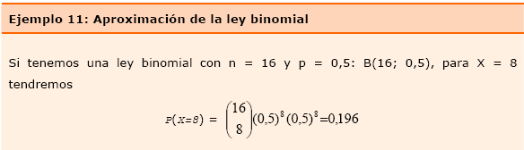
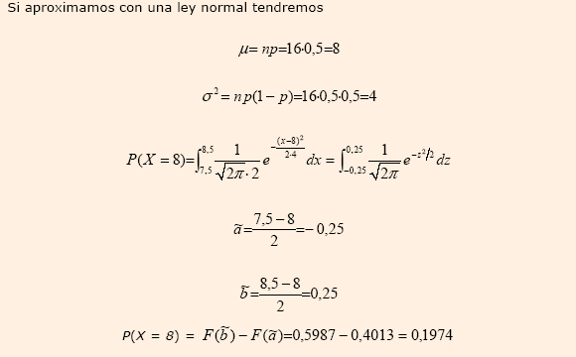
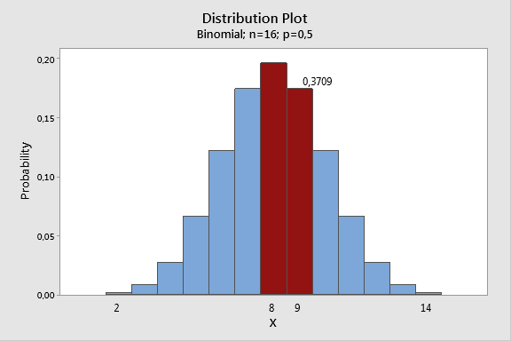
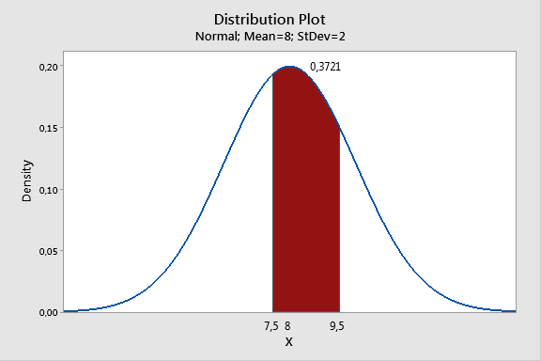
Binomial r.v. Approximated by Normal r.v.
Example: Approximation of the Binomial Law
If X follows a Binomial law B(16, 0.5) it can be approximated by Y ~ N(8, 2)
P(8 ≤ X ≤ 9) = 0.196381 + 0.174561 P(7.5 < Y < 9.5) = 0.773373 - 0.401294
= 0.370942 = 0.372079

Slide 14
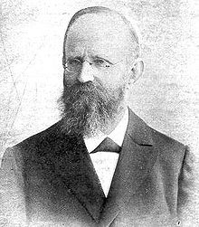
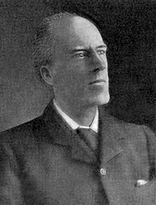
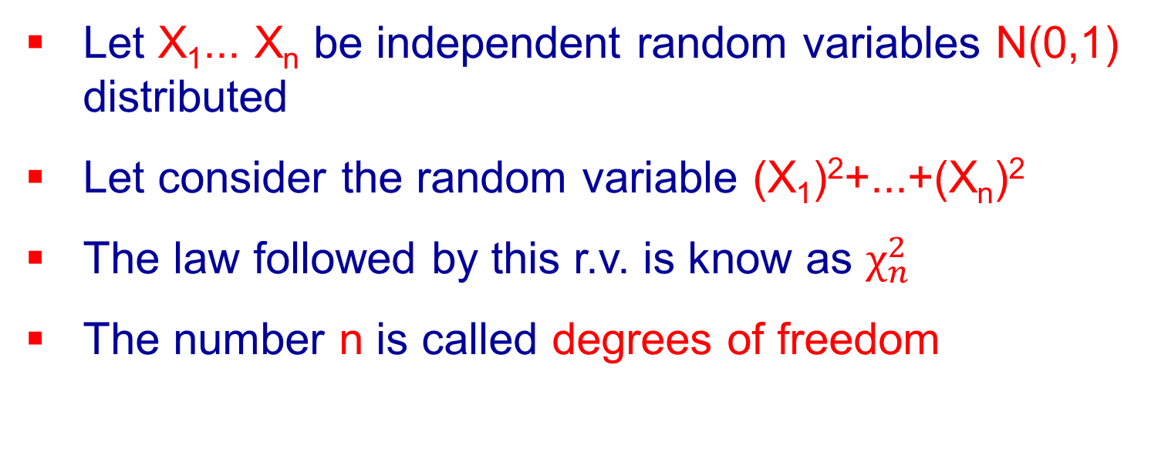
Chi-square Distribution
1876, Friedrich Robert Helmert
(1843-1917)
1900, Karl Pearson (1857-1936)
Let X₁... X_{n} be independent random variables N(0,1) distributed
Let consider the random variable (X₁)²+...+(X_{n})²
The law followed by this r.v. is know as $χ_{n}^{2}$
The number n is called degrees of freedom
(Continued)

Slide 15
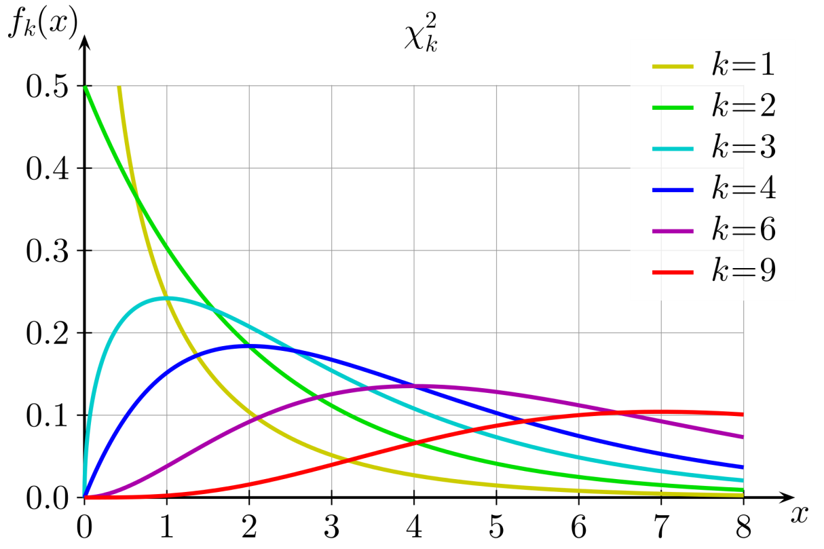

Chi-square Distribution
$χ^{2}$ is a family of distributions
Properties:
  Are not symmetric. $P\left(χ_{n}^{2}<0\right)=0$
  Each Chi-square is defined by its n = degrees of freedom
  $E\left(χ_{n}^{2}\right)=n Var\left(χ_{n}^{2}\right)=2n$
(Continued)

Slide 16
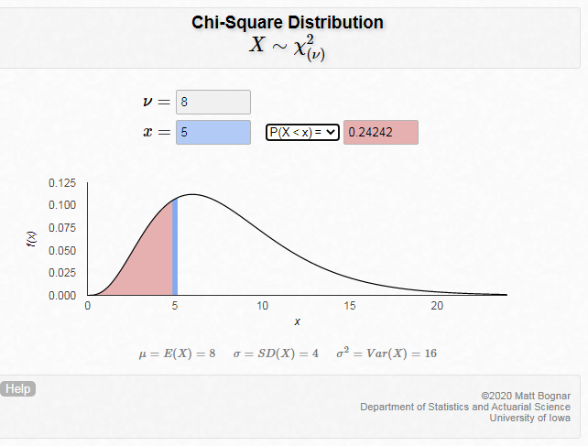
Chi-square Distribution
Example: Let X be a random variable that follows a Chi-square law with 8 degrees of freedom. We calculate: P(X < 5) = 0.24242
https://homepage.divms.uiowa.edu/~mbognar/applets/chisq.html
Notes:
16

Slide 17
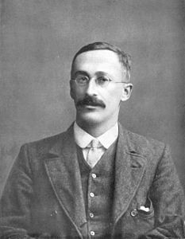
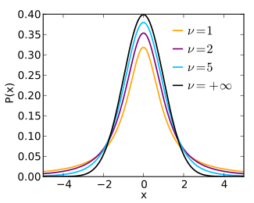
Student’s t Distribution
        The t-Student, are a family of distributions, proposed by William Sealey Gosset (1876-1937)
Properties:
  Each t-Student, t_{n}, is defined by the
  parameter n = degrees of freedom
  They are symmetrical with respect
  to its average, 0 and
  Approximation by a Normal:
  if n → ∞ then t _{n} ≈ N(0, 1)
(https://www.geogebra.org/m/xp7A3A53)
(Continued)

Slide 18
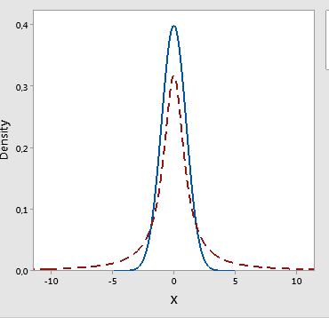
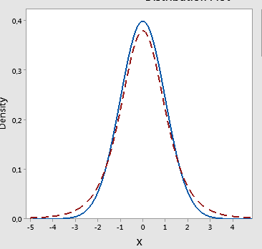
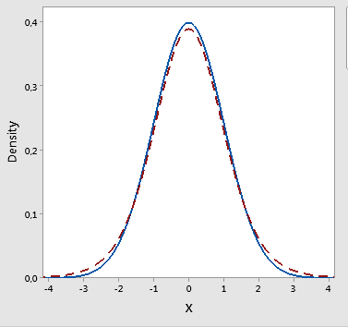
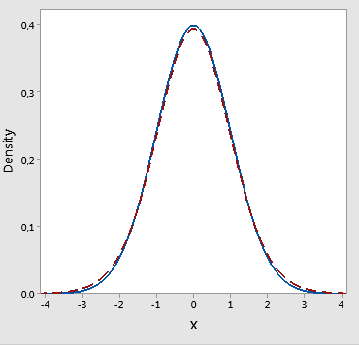
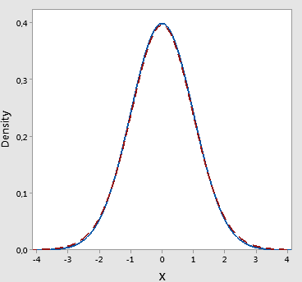
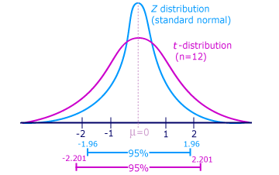
Student’s t Distribution
The t-Student and the Normal(0,1) distribution
n=1
n=5
n=10
n=20
n=30
(Continued)

Slide 19
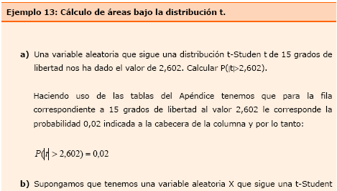
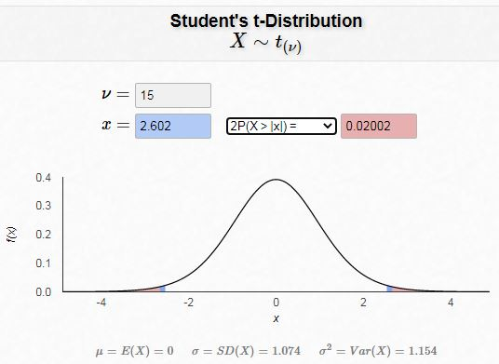
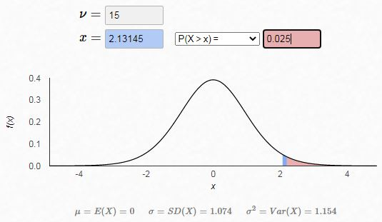
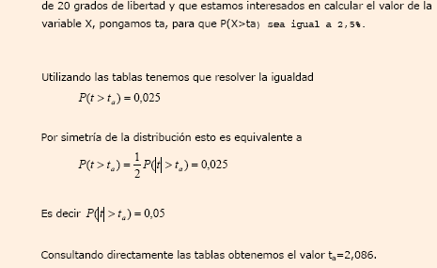
Student’s t Distribution
Examples : a) A random variable t that follows a t-Student distribution with 15 degrees of freedom has given us the value of 2.602.
We calculate P(|t| > 2.602) = 0.02002
b) We look for a value t_{α} such that
P(t > t_{α} ) = 0.025
Then t_{α} = 2.13145
https://homepage.divms.uiowa.edu/~mbognar/applets/t.html
(Continued)

Slide 20
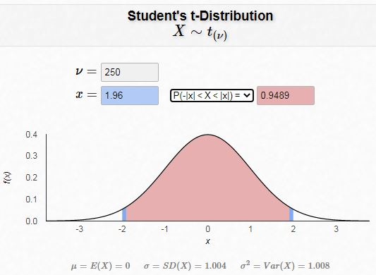
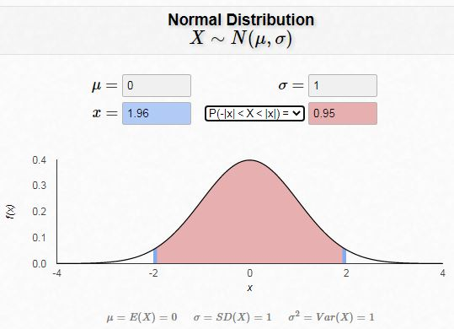
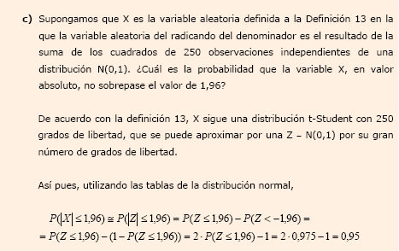
Student’s t Distribution
Example: Normal law approximation
Suppose that X is a random variable that follows a t-Student with 250 degrees of freedom. Calculate P(|X| < 1.96)
0.9489 0.95
Notes:
20

